Slide 1
PPSurf Combining Patches and Point Convolutions for Detailed Surface Reconstruction
Philipp Erler, Lizeth Fuentes-Perez, Pedro Hermosilla, Paul Guerrero, Renato Pajarola and Michael Wimmer
Institute of Visual Computing & Human-Centered Technology
Research Unit of Computer Graphics
TU Wien, Austria
Notes:
https://eg2024.cyens.org.cy/speakers-information/
20 +10 min
Thanks to Liz who helped so much. She is also here today
Also thanks to Elias and Daniel for their support

Slide 2
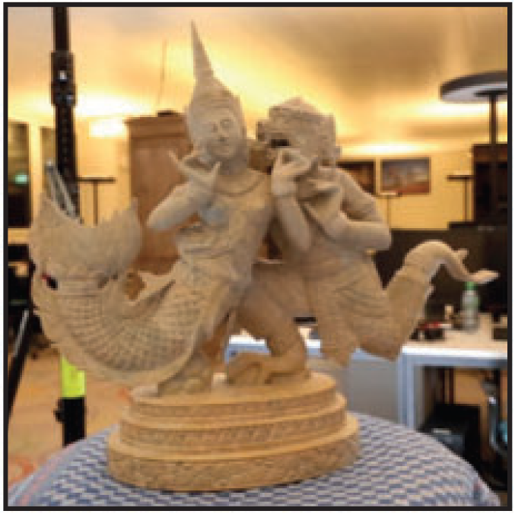
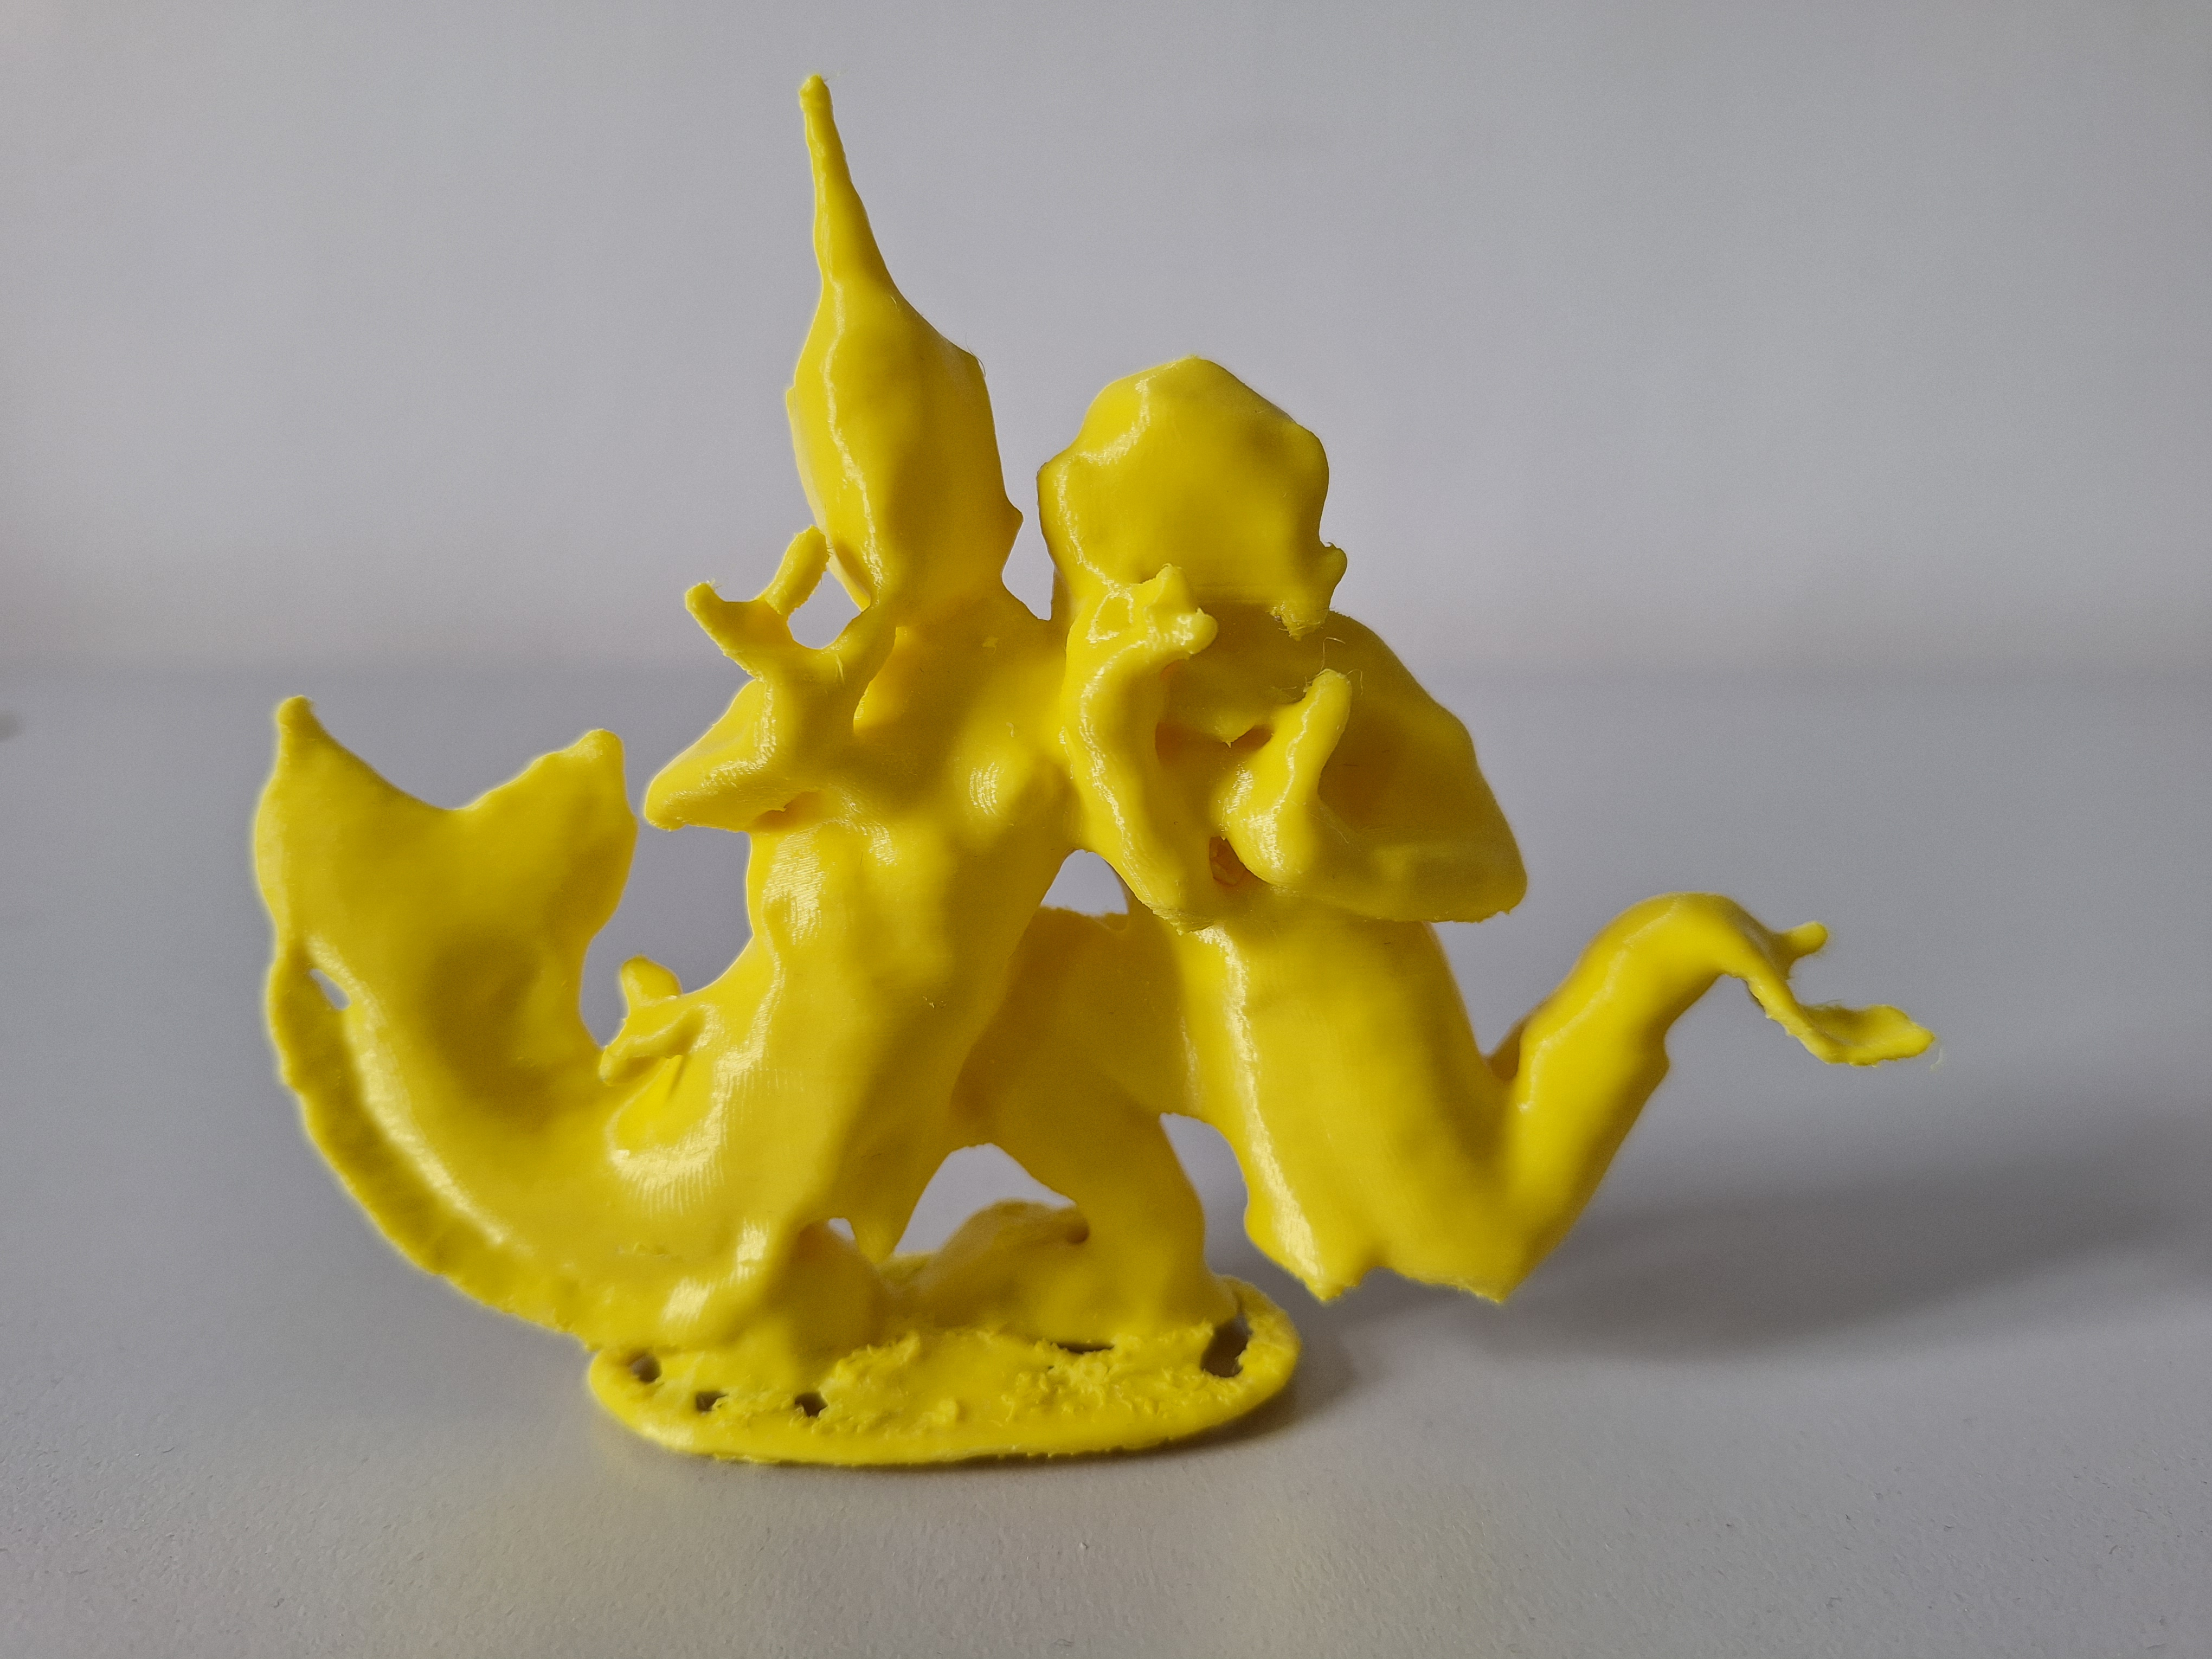
Motivation
Photos
Unoriented Point Cloud
Mesh
Photogrammetry
3D Print
Reconstruction
Reconstruction
Export
Yücer, Kaan, et al. "Efficient 3D object segmentation from densely sampled light fields with applications to 3D reconstruction." ACM Transactions on Graphics (TOG) 35.3 (2016): 1-15.
Notes:
Assuming we have a lot of photos of an object
We can use photogrammetry like COLMAP to create a point cloud
Then, we use a reconstruction method like our new work to turn it into a surface mesh
Afterwards, we can do many downstream tasks like 3D printing
Here, we focus on reconstruction methods that take an unoriented, noisy point cloud with missing areas as input and produce a mesh
This mesh should be as clean as possible, ideally 2-manifold and watertight

Slide 3
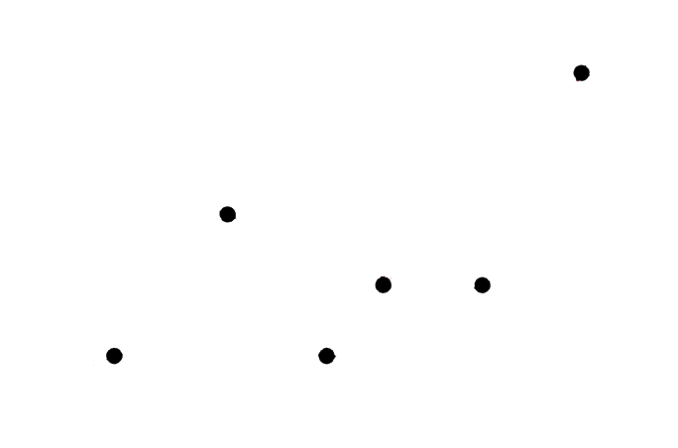
Surface Reconstruction
Sulzer, Raphael et al. “A Survey and Benchmark of Automatic Surface Reconstruction from Point Clouds.” ArXiv abs/2301.13656 (2023): n. pag.
Notes:
What’s surface reconstruction?
Point cloud in
Mesh out

Slide 4
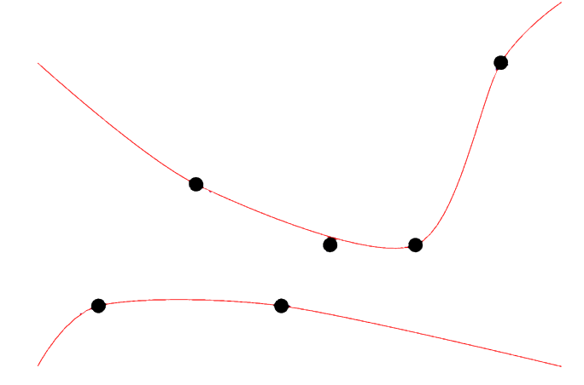
Surface Reconstruction
Sulzer, Raphael et al. “A Survey and Benchmark of Automatic Surface Reconstruction from Point Clouds.” ArXiv abs/2301.13656 (2023): n. pag.
Notes:
Reconstruction could be this…

Slide 5
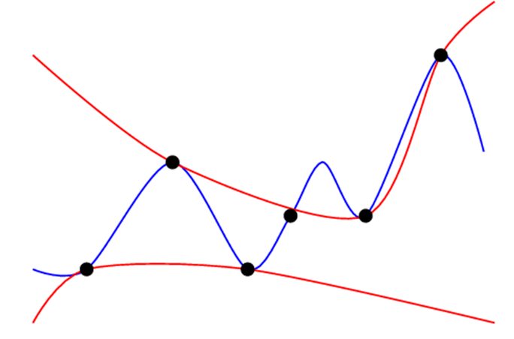
Surface Reconstruction
Sulzer, Raphael et al. “A Survey and Benchmark of Automatic Surface Reconstruction from Point Clouds.” ArXiv abs/2301.13656 (2023): n. pag.
Notes:
Or this…
Ill-posed problem: one point cloud can correspond to many surfaces
We try to find the most plausible and most accurate reconstruction of the original surface

Slide 6
Reconstruction Difficulties
Notes:
Reconstruction methods will get noisy and incomplete point clouds as inputs
We need to deal with that or our results will be unusable

Slide 7
Method Categories
Non-data-driven Methods
Notes:
We found two categories of reconstruction methods: non-data-driven and data-driven
Non-data driven are e.g. the well-known Poisson Reconstruction. They usually fit some 3d representation (surface or volume) to the given input point cloud.
Data driven ones are similar but they were trained on many other point clouds, so they know e.g. noise statistics

Slide 8
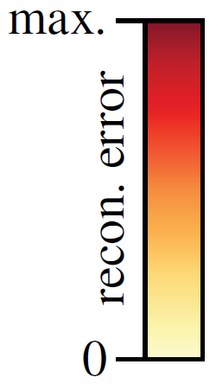
Non-Data Driven Methods
Neural-IMLS
SAP (unlearned)
PGR
WANG Z., WANG P., WANG P., DONG Q., GAO J., CHEN S., XIN S., TU C., WANG W.: Neural-imls: Self-supervised implicit moving least-squares network for surface reconstruction. IEEE Transactions on Visualization and Computer Graphics (2023), 1–16. doi: 10.1109/TVCG.2023.3284233.
Peng S., Jiang C. M., Liao Y., Niemeyer M., Pollefeys M., Geiger A.: Shape as points: A differentiable poisson solver. In Advances in Neural Information Processing Systems (NeurIPS) (2021).
LIN S., XIAO D., SHI Z., WANG B.: Surface reconstruction from point clouds without normals by parametrizing the gauss formula. ACM Trans. Graph. 42, 2 (oct 2022). URL: https://doi.org/10.1145/3554730, doi:10.1145/3554730.
Notes:
Here are some results with recent non-data driven methods
Red encodes the deviation from the ground truth surface
Neural IMLS messes up the topology and oversmooths, overfitting method
SAP (unlearned) and PGR can’t handle the noise

Slide 9
Method Categories
Non-data-driven Methods
Data-driven Methods
learned
Notes:
We found two categories of reconstruction methods: non-data-driven and data-driven
Non-data driven are e.g. the well-known Poisson Reconstruction. They usually fit some 3d representation (surface or volume) to the given input point cloud.
Data driven ones are similar but they were trained on many other point clouds, so they know e.g. noise statistics

Slide 10
Data Driven Methods
Points2Surf
SAP (learned)
POCO
ERLER P., GUERRERO P., OHRHALLINGER S., MITRA N. J., WIMMER M.: Points2Surf: Learning implicit surfaces from point clouds. In European Conference on Computer Vision (ECCV) (2020).
Peng S., Jiang C. M., Liao Y., Niemeyer M., Pollefeys M., Geiger A.: Shape as points: A differentiable poisson solver. In Advances in Neural Information Processing Systems (NeurIPS) (2021).
BOULCH A., MARLET R.: Poco: Point convolution for surface reconstruction. In Proceedings of the IEEE/CVF Conference on Computer Vision and Pattern Recognition (CVPR) (June 2022), pp. 6302–6314.
Notes:
Here are results with recent data-driven methods
Points2Surf, our previous work, creates a somewhat noisy surface
SAP (learned) oversmooths a lot
POCO is already quite accurate

Slide 11
Predicting Implicit Surfaces
Park, Jeong Joon, et al. "Deepsdf: Learning continuous signed distance functions for shape representation." Proceedings of the IEEE/CVF conference on computer vision and pattern recognition. 2019.
Notes:
DeepSDF introduced a now common approach for learned reconstruction methods
We predict a signed distance field with a neural network
Then, we run marching cubes to get a mesh
Critical for this is to get the inside and outside right, which is a global property
Would be much easier if had point normal. There are more efficient methods for that. We deal with the difficult case here.

Slide 12
Occupancy Probability
TSDF: [-1, +1]
Occupancy: [0, 1]
Occupancy Probability (POCO):
In: [0, 1]
Out: [0, 1]
Occ_prob = (Out – In)
Park, Jeong Joon, et al. "Deepsdf: Learning continuous signed distance functions for shape representation." Proceedings of the IEEE/CVF conference on computer vision and pattern recognition. 2019.
Notes:
SDF: distance to original surface, can run marching cubes on a certain threshold, usually 0
TSDF: often truncated to +-1, we care only about the zero-level set for marching cubes, needs only to be accurate near the surface
Occ prob: 2 classes predicted by the NN. measure for insecurity included and more expressive than in SDF
Note: Indicator function: 0…1

Slide 13
Global and Local Information
Only Local
Only Global
Local + Global
Notes:
If we only have local information without any context, it’s hard to get a consistent inside-outside prediction
Only global information is much better but might miss some details

Slide 14
Global and Local Information
GT
Only Global
Local + Global
Notes:
And in more detail
See the rim here and the holes
See the wheel’s outside

Slide 15
Points2Surf
Global Branch
PTS
Global Features
MLP
Signed Distance
Local Branch
PTS
Local Features
Erler P., Guerrero P., Ohrhallinger S., Mitra N. J., Wimmer M.: Points2Surf: Learning implicit surfaces from point clouds. In European Conference on Computer Vision (ECCV) (2020).
Notes:
merge global with local features was the idea of our previous work
We predict the SDF value for a query point (red)
We take a local (yellow) and a global (purple) subsample
Each subsample goes through a PointNet which produce feature vectors
We combine the feature vectors and get the SDF prediction
We do this for many query points to fill a grid so we can run marching cubes
Also: we introduced a dataset with a realistic simulated scanner -> scan shadows and noise

Slide 16
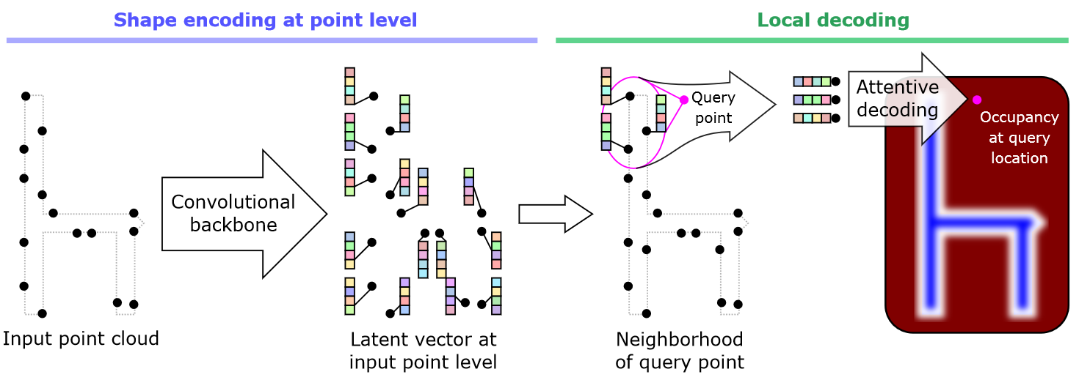
POCO
Boulch A., Marlet R.: POCO: Point convolution for surface reconstruction. In Proceedings of the IEEE/CVF Conference on Computer Vision and Pattern Recognition (CVPR) (June 2022), pp. 6302–6314.
Notes:
POCO improved over P2S a lot with their very strong FKAConvNet for global encoding
Heavy lifting, strong encoding of a global sub-sample on the left side
Light-weight interpolation of global features on the right side
Together, it’s very accurate and quite fast
Critical is here that the input is only a subset of the whole pointcloud
POCO’s test-time augmentation averages global features over many random subsamples but some inaccuracies remain

Slide 17
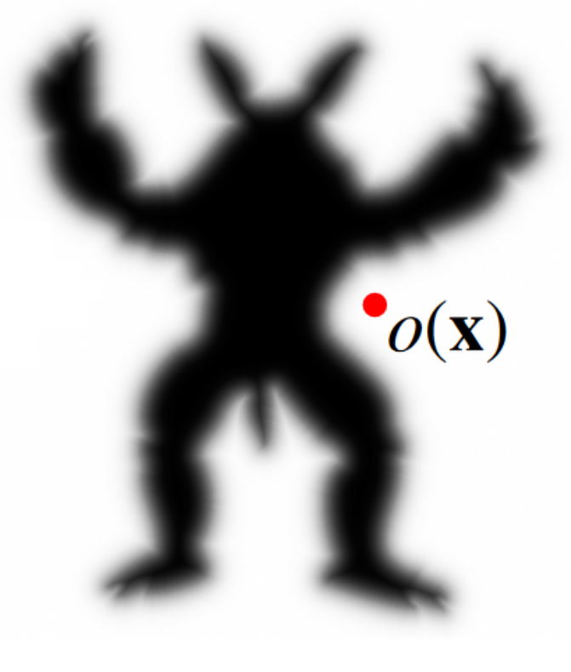
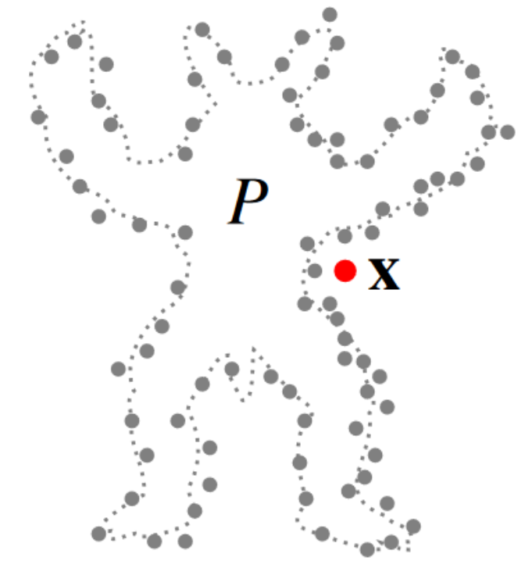
Idea
Global POCO
Merge Features
Local POCO
Notes:
Merging ideas from POCO and Points2Surf should improve things
But POCO for the local branch was waaay to slow, even a smaller version with only a few hierarchy levels

Slide 18
Idea
Global POCO
Merge Features
Local PointNet
Notes:
So we went back to the roots
Using the good old PointNet was good enough for local information and fast enough
Modified pointnet with attention

Slide 19
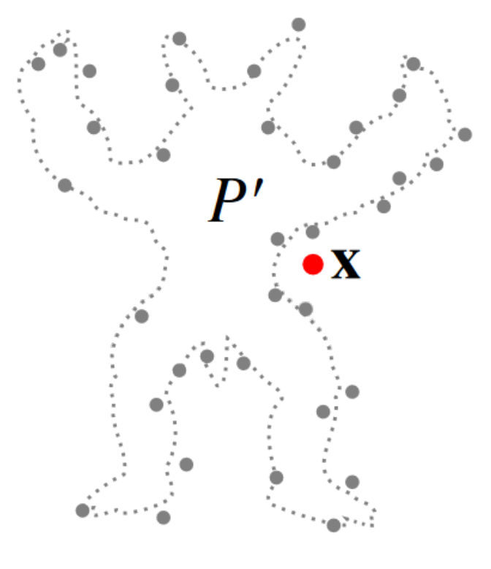
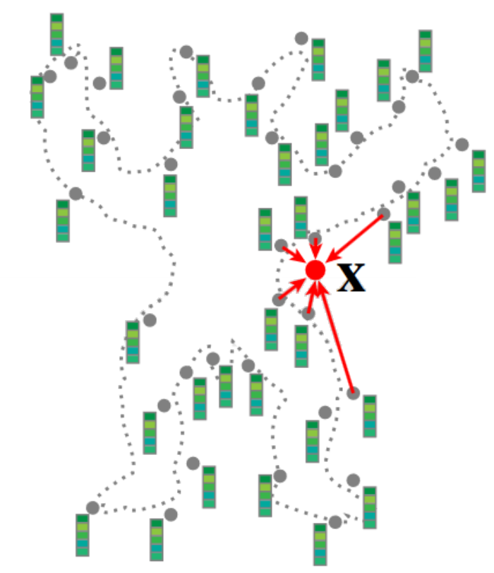
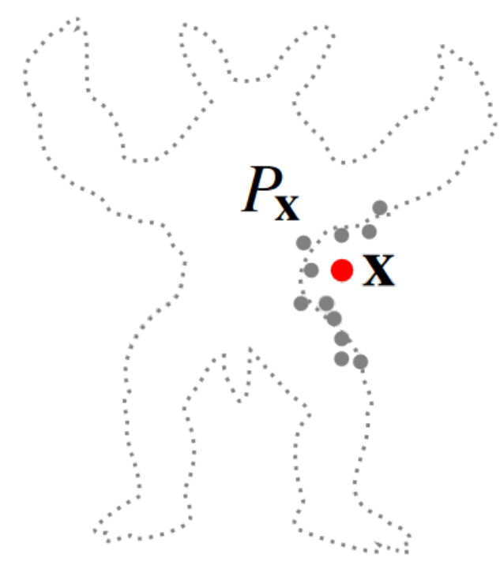
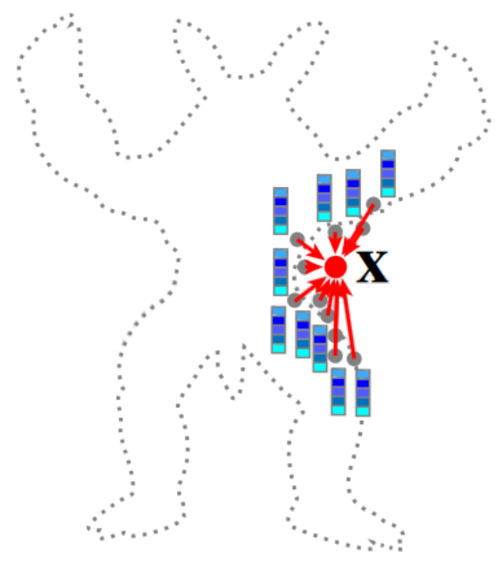
PPSurf Architecture
Uniform Subsample
Global Features
POCO
MLP
Nearest Neighbors
Local Features
PointNet
Notes:
Say multi-layer perceptron
Element-wise sum of feature vectors
Explain interpolation -> attention (weight per element)

Slide 20
PPSurf: Local Branch
Points
MLP
Per-Point Features
Sym Op
Features
Self-Attention
Notes:
Let’s have a closer look at the local branch
We have 50 nearest neighbors as input points
we get features for each point from a multi-layer perceptron
Then, we apply a symmetric operation to get a single feature vector
Previously, this symmetric operation was a sum or max
We apply POCO’s Multi-Head self-attention as a symmetric operation

Slide 21
Data Driven Methods
POCO
PPSurf (ours)
Ground Truth
BOULCH A., MARLET R.: Poco: Point convolution for surface reconstruction. In Proceedings of the IEEE/CVF Conference on Computer Vision and Pattern Recognition (CVPR) (June 2022), pp. 6302–6314.
Erler, Philipp, et al. "PPSurf: Combining Patches and Point Convolutions for Detailed Surface Reconstruction." Computer Graphics Forum. Vol. 43. No. 1. 2024.
Notes:
But our new method is even better
Magic flight

Slide 22
Data Driven Methods
POCO
PPSurf
Ground Truth
BOULCH A., MARLET R.: Poco: Point convolution for surface reconstruction. In Proceedings of the IEEE/CVF Conference on Computer Vision and Pattern Recognition (CVPR) (June 2022), pp. 6302–6314.
Erler, Philipp, et al. "PPSurf: Combining Patches and Point Convolutions for Detailed Surface Reconstruction." Computer Graphics Forum. Vol. 43. No. 1. 2024.
Notes:
1st row: This hole and the connection are smaller
2nd row: PPSurf is more accurate at the fine structures here

Slide 23
Qualitative Comparison
Notes:
Non-data-driven are not very robust against noise but some are very good for clean point clouds
P2S is quite noisy, SAP learned oversmoothes
POCO and PPSurf are very similar
PPSurf has more advantage with strong noise, fine structures and dense point clouds
Please see the big table in our paper, especially Chamfer distance
Non-data driven can’t deal well with noise
P2S outdated, noisy reconstruction, limited PointNet for global encoding
SAP extremely fast but smoothed over, very small model
POCO best before, nice 2-stage architecture for compromise of speed and accuracy
PPSurf like POCO but with access to raw point cloud -> a bit slower but better at edges

Slide 24
Quantitative Comparison
Notes:
Here are the most important numbers from our comparison table
Chamfer distance, mean over all testsets
Neural IMLS is close, but it was concurrent work and the others didn’t provide results on the extra noisy testsets
Head-to-head race between POCO and PPSurf with a slight advantage for PPSurf

Slide 25
Time and Memory
13.5
>46
Notes:
Most methods take 1-2 minutes per shape, learned SAP is blazing fast with less than a second, P2S is very slow due to redundancy of input points
PGR went out of memory on some shapes because its memory has quadratic complexity with point cloud size
SAP is quite efficient, P2S not so much
PPSurf needs a bit more memory than POCO for the additional local branch
PPSurf needs only 200 MB and 20 sec/shape more than POCO

Slide 26
Ablation Study
Notes:
Extensive ablation study
Left: comparison of branches -> local-only doesn’t work, both branches is a bit better than only global
Middle: 10 NN for the local branch is not enough, no noteworthy advantage beyond 50 NN
Right: attention as a symmetric operation for the local PointNet is clearly better than max. max seems to break even the good global features

Slide 27
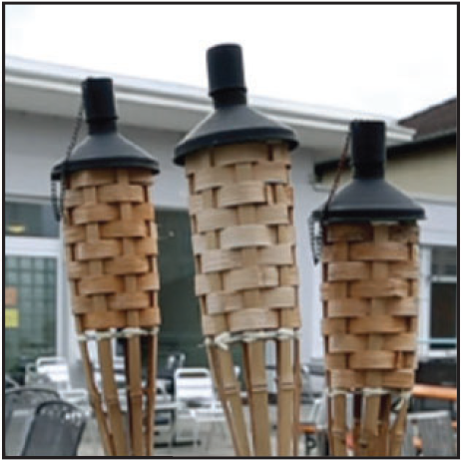
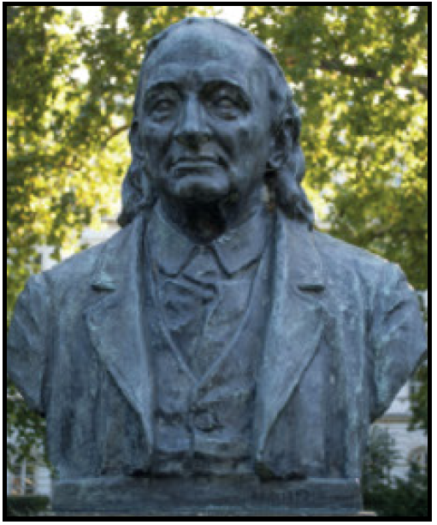
Real-World Examples
Notes:
More circling around

Slide 28
Limitations
Notes:
TODO: add point cloud
edges of clean point clouds are smoothed, probably because of bias towards noisy point clouds in dataset
Data-driven not optimal for clean point clouds

Slide 29
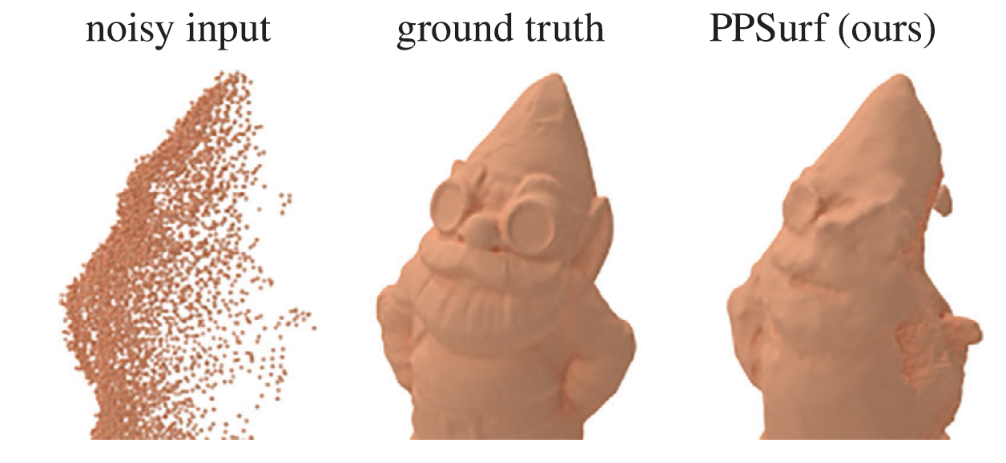
Limitations
Notes:
no meaningful hole filling for larger holes

Slide 30
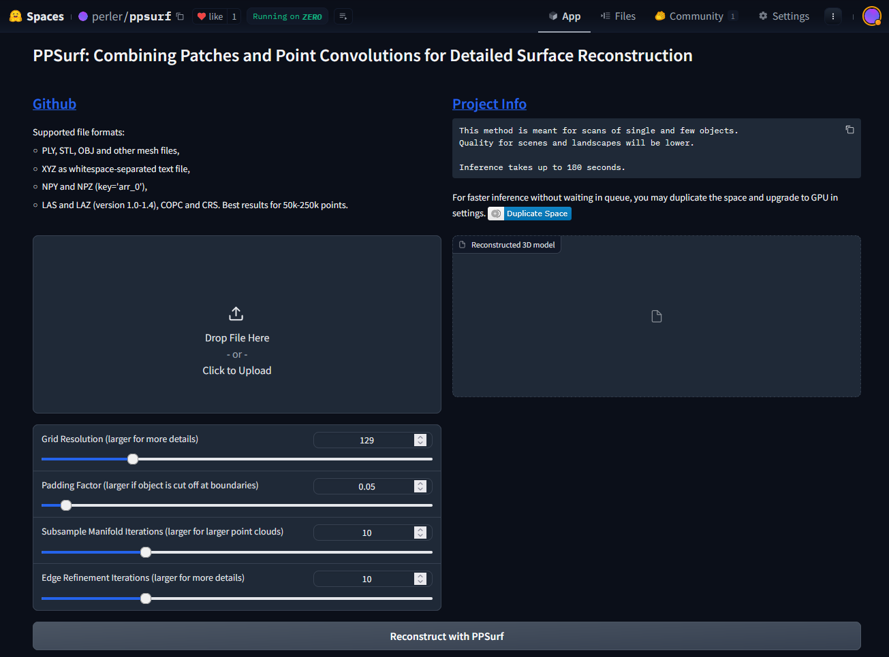
PPSurf Live System
https://huggingface.co/spaces/perler/ppsurf
Notes:
You can test it right now on huggingface
Thanks to them for providing a free GPU from their pool!

Slide 31
Points2Surf
Erler P., Guerrero P., Ohrhallinger S., Mitra N. J., Wimmer M.: Points2Surf: Learning implicit surfaces from point clouds. In European Conference on Computer Vision (ECCV) (2020).
Notes:
New life

Slide 32
PPSurf: Architecture
encoding
interpolation
Notes:
So what did we do in PPSurf? Here is our architecture…
We keep the idea of Points2Surf with its global and local branches in the network
We use POCO for strong global encoding and PointNet for fast local encoding
Both branches output a feature vector, which we sum and put into an MLP
MLP predicts occupancy probabilities which we turn into a mesh like in POCO
Let’s have a closer look at the local branch

Slide 33
Noise Robustness
No noise
Mid noise
Max noise
Notes:
One of the biggest strengths of data driven methods is noise robustness
Here results with our method
Reasonable results even with crazy amounts of noise
Use uncolored here? Add “GT” text?

Slide 34
Title

