Slide 1
Optimising 3D Mesh Unfoldings with Additional Gluetags using Simulated Annealing
Thorsten Korpitsch
Institute of Visual Computing&Human-Centered Technology
TU Wien, Austria

Slide 2
Overview
Background
Motivation
Related Work
Goal
Gluetags
Challenges
Outlook
Methodology
Unfolding
Optimisation
Results
Limitations
Conclusion & Future Work

Slide 3
Overview
Background
Motivation
Related Work
Goal
Gluetags
Challenges
Outlook
Methodology
Unfolding
Optimisation
Results
Limitations
Conclusion & Future Work

Slide 4
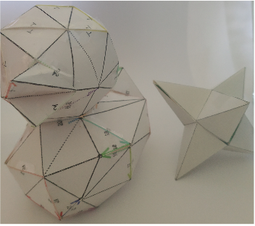
Background
Creation of Papercraft Models
Notes:
main purpose of 3d mesh unfolding is to create sheets that can be used to create papercraft models

Slide 5
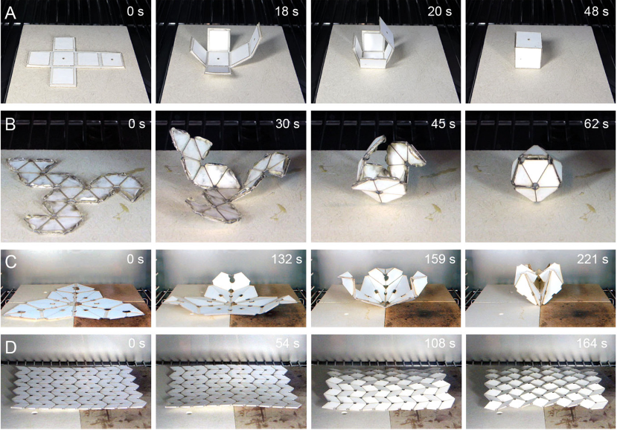
Background
Creation of Papercraft Models
Self-folding Materials
and more
Tolley et al. 2014 [1]
Notes:
self folding materials as seen in the picture are much like papercraft models, but to generate the printing patch a unfolding technique needs to be employed

Slide 6
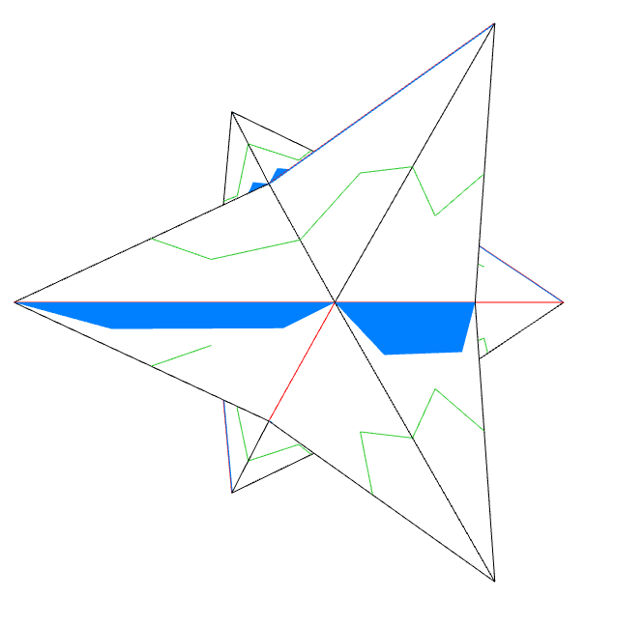
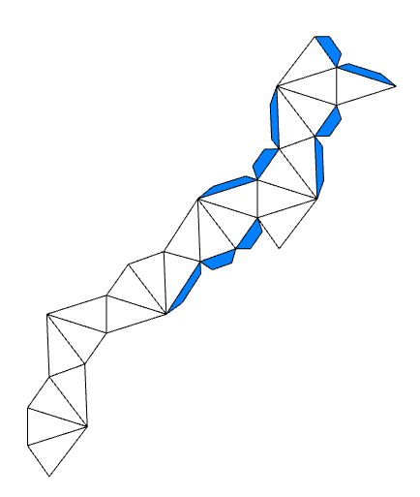
What is 3D-Mesh Unfolding?
24 Faces
Notes:
we have a 3d model, consisting of vertices and their relationship to each other, forming triangles (without loss of generality)
that is unfolded with the purpose of being able to reconstruct it again
3d printer might be able to print this example easier, but it’s expensive and with unfolding we can print it on a sheet of paper and glue it back together
3d mesh unfolding does not only work on triangulated meshes but all kinds of meshes and also meshes with a genus higher than 0

Slide 7
Motivation
Unfolding
single piece of paper
no overlaps
practical amount of time
Application
satellites
toys, art
creating machine parts

Slide 8
Motivation
Unfolding
single piece of paper
no overlaps
practical amount of time
Application
satellites
toys, art
creating machine parts

Slide 9
Motivation
Unfolding
single piece of paper
no overlaps
practical amount of time
Application
satellites
toys, art
creating machine parts

Slide 10
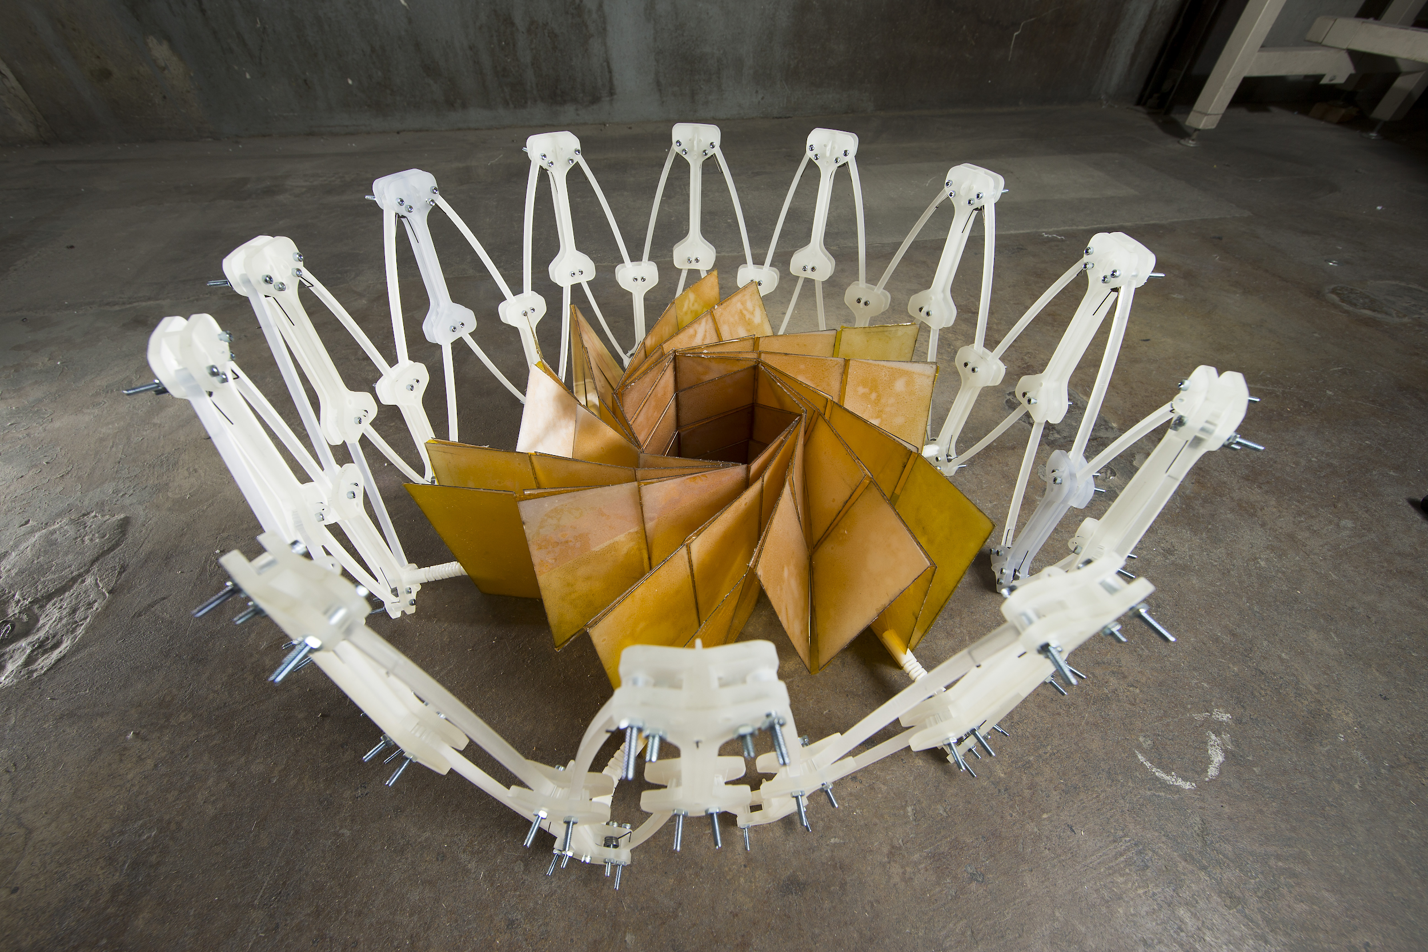
Motivation
Unfolding
single piece of paper
no overlaps
practical amount of time
Application
satellites
toys, art
creating machine parts
NASA 2014 [2]
Notes:
sattelites use different folding techniques from one sheet

Slide 11
Motivation
Unfolding
single piece of paper
no overlaps
practical amount of time
Application
satellites
toys, art
creating machine parts

Slide 12
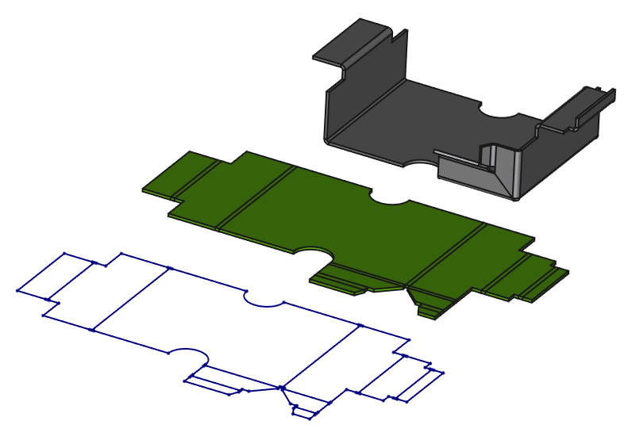
Motivation
Unfolding
single piece of paper
no overlaps
practical amount of time
Application
satellites
toys, art
creating machine parts
Freecadweb [3]

Slide 13
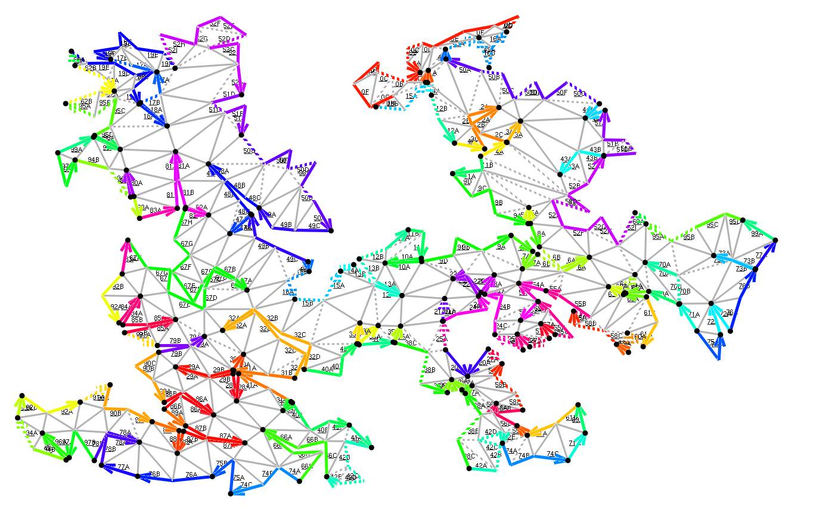
Related Work
Sophisticated Algorithms
Indicators for Reconstruction
Post-processed Gluetags
Changing the Mesh to find unfoldings
Takahashi et al. 2011 [4]
Notes:
what is already happening for the topic of 3d mesh unfolding: sophisticaded algorithms (heuristic based onse and greedy ones) for example genetic based algorithms
indicators for reconstruction that indicate in which order the faces should be glued together

Slide 14
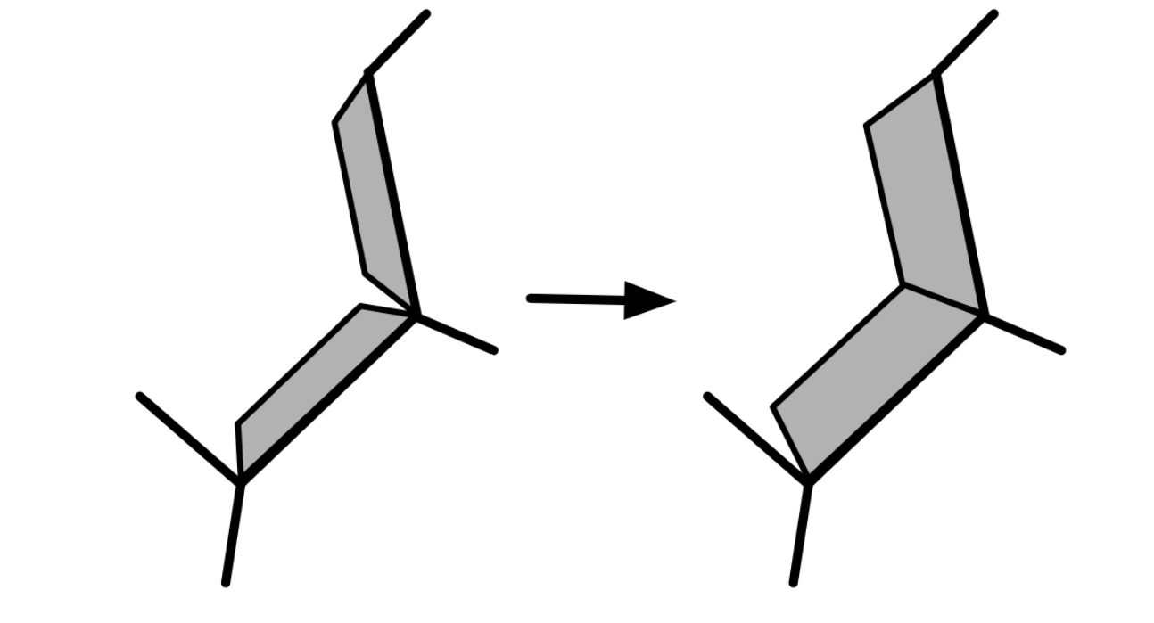
Related Work
Sophisticated Algorithms
Indicators for Reconstruction
Post-processed Gluetags
Changing the Mesh to find unfoldings
Straub and Prautzsch 2011 [5]
Notes:
straub and prautzsch proposed using a minimum perimeter spanning tree
they calculated the gluetag during the unfolding
and proposed post-process optimization of the gluetag to make the best use of space
improvement to this work is calculating the gluetags beforehand will reduce calculation overhead as they stay the same
picture: gluetag gets optimised after an unfolding is found

Slide 15
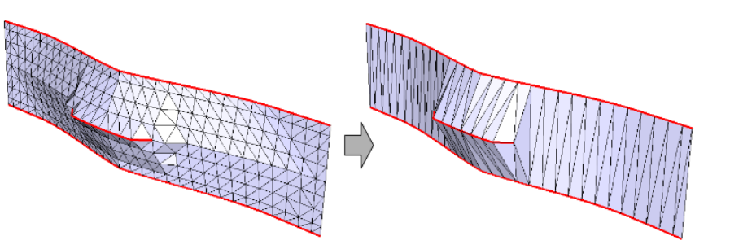
Related Work
Sophisticated Algorithms
Indicators for Reconstruction
Post-processed Gluetags
Changing the Mesh to find unfoldings
Mitani and Suzuki 2004 [6]
Notes:
mitani and suzuki proposed simplification for the mesh and introducing new cuts to approximate unfoldings
in the picture left the original mesh, red marked “important features”, left = mesh simplified, feature kept introducing a new cut and spanning new triangles

Slide 16
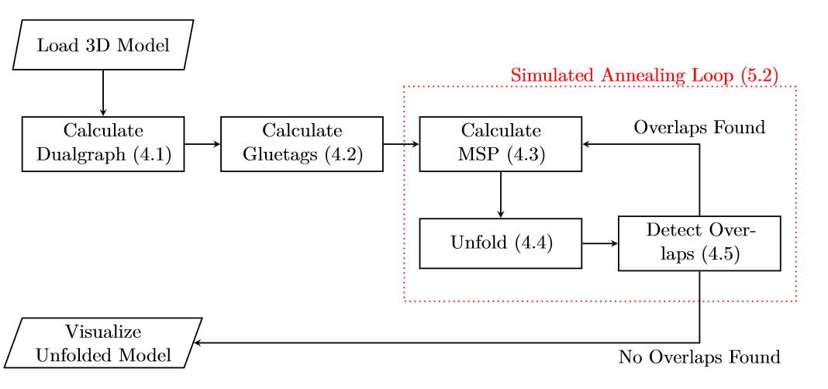
Goal
Notes:
goal of this thesis is to add gluetags
these should help users with reconstructing, as they give users space to apply glue to
also the gluetags should not be added afterwards in a post processing process but be calculated and unfolded like the mesh itself

Slide 17
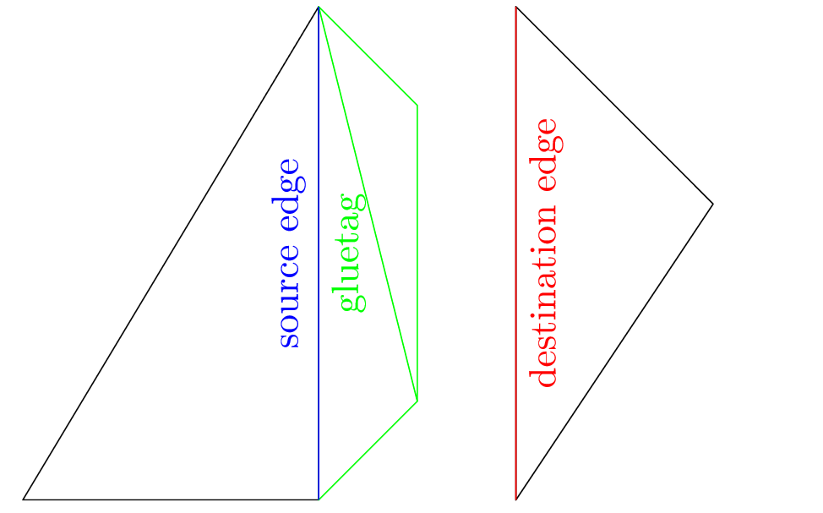
Gluetags
Trapezoid Shape
Pre-calculated
Improve Reconstruction Experience

Slide 18
Challenges
NP-hard
Size and amount of Gluetags
Time Limit
Resolve overlaps
Do not distort the model
Notes:
its not an easy task, as the gluetags take up space
if they are too small, they won’t help with reconstruction
if they are too big maybe no unfolding can be found as they take up even more space
therefore the search space gets bigger and the solution space smaller
as it should work also on bigger meshes bruteforce is not feasible

Slide 19
Outlook

Slide 20
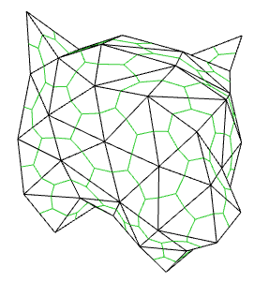
Methodology
Calculate the dual graph
Calculate the gluetags
Calculate a minimum spanning tree
Unfold mesh-triangles
Calculate the overlap area ΔE_{T}
Determine “useable” gluetags
Unfold gluetags
Calculate the overlap area ΔE_{G}
Notes:
we calculate the dualgraph as the dual edges (green lines) represent the face connections of the model (edges between the faces)
these edges between the faces can either be bent or cut to make an unfolding possible
the dual graph can be generated by iterating over all triangles of the mesh and then iterating through the half edges (edges seen as directed ones) -> identifying their neighbours

Slide 21
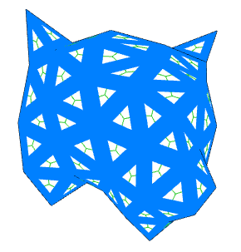
Methodology
Calculate the dual graph
Calculate the gluetags
Calculate a minimum spanning tree
Unfold mesh-triangles
Calculate the overlap area ΔE_{T}
Determine “useable” gluetags
Unfold gluetags
Calculate the overlap area ΔE_{G}
Notes:
so to only calculate the gluetags once, we calculate a gluetag for each edge and for each side of the edge

Slide 22
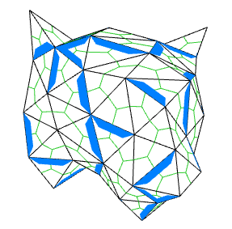
Methodology
Calculate the dual graph
Calculate the gluetags
Calculate a minimum spanning tree
Unfold mesh-triangles
Calculate the overlap area ΔE_{T}
Determine “useable” gluetags
Unfold gluetags
Calculate the overlap area ΔE_{G}
Notes:
to show how the gluetags look like, in the tested approach they had trapezoid shape using ⅕ of the height of the targeted triangle and the top of the trapezoid is ¾ of the base, which is the length of the edge they are attached to

Slide 23
Methodology
Calculate the dual graph
Calculate the gluetags
Calculate a minimum spanning tree
Unfold mesh-triangles
Calculate the overlap area ΔE_{T}
Determine “useable” gluetags
Unfold gluetags
Calculate the overlap area ΔE_{G}
Notes:
next is calculating a minimum spanning tree, which will give us the order in which the triangles will be unfolded

Slide 24
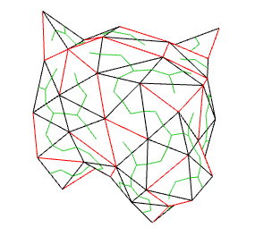
Methodology
Calculate the dual graph
Calculate the gluetags
Calculate a minimum spanning tree
Unfold mesh-triangles
Calculate the overlap area ΔE_{T}
Determine “useable” gluetags
Unfold gluetags
Calculate the overlap area ΔE_{G}
Notes:
the minimum spanning tree can be seen as a list of edges that are connected together (the green line crosses those edges) the other lines (red) are not connected and can therefore be cut
to be able to calculate a minimum spanning tree of the dual graph we need to assign weights to the edges which is important later
this spanning tree gives us therefore a list of edges to be cut and a list of edges to be bent

Slide 25
Methodology
Calculate the dual graph
Calculate the gluetags
Calculate a minimum spanning tree
Unfold mesh-triangles
Calculate the overlap area ΔE_{T}
Determine “useable” gluetags
Unfold gluetags
Calculate the overlap area ΔE_{G}
Notes:
next step is unfolding the triangles of the mesh easier with an example -> next slide

Slide 26
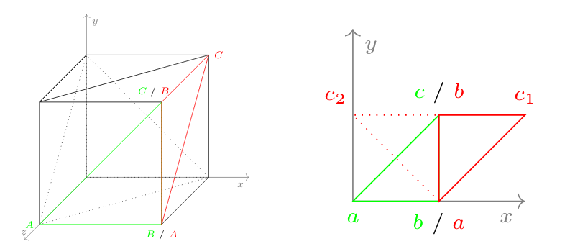
Unfold Mesh-Triangles
Notes:
in this example we unfold a box, or the first two triangles of the box
green is the first triangle capital ABC, a can be placed to 0,0 and b to 0,lenAB -> c has two positions above or below the line ab -> we can chose above as it does not matter in which direction we unfold
second triangle has already two points given due to the shared edge with the first one, point c has again two possibilities
we chose the side of ab where the previous point a of the triangle is not placed, so we “unfold” and not selfoverlap while unfolding

Slide 27
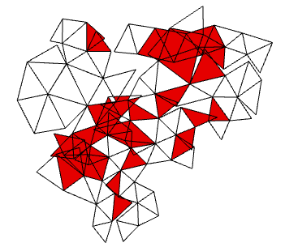
Methodology
Calculate the dual graph
Calculate the gluetags
Calculate a minimum spanning tree
Unfold mesh-triangles
Calculate the overlap area ΔE_{T}
Determine “useable” gluetags
Unfold gluetags
Calculate the overlap area ΔE_{G}
Notes:
we check the unfolded patch for overlaps, to determine if it is without overlaps, for this we calculate the area of overlapping triangles (only once, if one triangle overlaps multiple others it is only calculated once)
-> sutherland hodgman, one triangle is the clip polygon, the other one the cliped one -> resulting pointlist is our “overlap polygon” we can use the shoelace formula to calculate the area

Slide 28
Methodology
Calculate the dual graph
Calculate the gluetags
Calculate a minimum spanning tree
Unfold mesh-triangles
Calculate the overlap area ΔE_{T}
Determine “useable” gluetags
Unfold gluetags
Calculate the overlap area ΔE_{G}
Notes:
we don’t want to take all gluetags, not even all that are attached to a cut edge as we try to minimise it (why glue more than necessary)
therefore we calculate all necessary gluetags by iterating through all cut edges and picking gluetags if
targeted or source face is not yet glued with a gluetag yet
the edge the gluetag is applied to has one more neighbour that is not glued yet (no “open wounds possible”, reconstruction is stable)

Slide 29
Methodology
Calculate the dual graph
Calculate the gluetags
Calculate a minimum spanning tree
Unfold mesh-triangles
Calculate the overlap area ΔE_{T}
Determine “useable” gluetags
Unfold gluetags
Calculate the overlap area ΔE_{G}
Treated like mesh-triangles
Notes:
gluetags are suggested to be a trapezoid shape as seen before, therefore consisting of two triangles, which means they can be treated like the rest of the mesh

Slide 30
Optimisation
Calculate the dual graph
Calculate the gluetags
Calculate a minimum spanning tree
Unfold mesh-triangles
Calculate the overlap area ΔE_{T}
Determine “useable” gluetags
Unfold gluetags
Calculate the overlap area ΔE_{G}
Simulated Annealing loop
until ΔE_{T}+ ΔE_{G} = 0
Notes:
as probably doing these steps only once will not yield a result simulated annealing is used to optimise the search for a solution
but we need additional steps -> next slide

Slide 31
Optimisation
Calculate the dual graph
Calculate the gluetags
Initialize edge-weight of dual edges P
Change weight of a random edge P’
Calculate a minimum spanning tree
Unfold mesh-triangles
Calculate the overlap area ΔE_{T}
Determine “useable” gluetags
Unfold gluetags
Calculate the overlap area ΔE_{G}
Simulated Annealing loop
until ΔE_{T}+ ΔE_{G} = 0;
if ΔE_{P’}< ΔE_{P} P = P’
Notes:
to make simulated annealing work, two more steps are necessary,
edge weight necessary to calculate a minimum spanning tree, can be randomized weight
in each iteration the weight of a random edge is changed

Slide 32
Optimisation
Calculate the dual graph
Calculate the gluetags
Initialize edge-weight of dual edges P
Change weight of a random edge P’
Calculate a minimum spanning tree
Unfold mesh-triangles
Calculate the overlap area ΔE_{T}
Determine “useable” gluetags
Unfold gluetags
Calculate the overlap area ΔE_{G}
Restart the loop if ΔE_{T} > 0
Simulated Annealing loop
until ΔE_{T}+ ΔE_{G} = 0;
if ΔE_{P’}< ΔE_{P} P = P’
Notes:
to make simulated annealing work, two more steps are necessary,
edge weight necessary to calculate a minimum spanning tree, can be randomized weight
in each iteration the weight of a random edge is changed

Slide 33
Results
Meshes <200 faces are solved fast
Cut Edges
MSP
Gluetags
24 Faces
Notes:
works well for faces < 200 and reasonable for faces < 400
reconstruction impractical without additional indicators

Slide 34
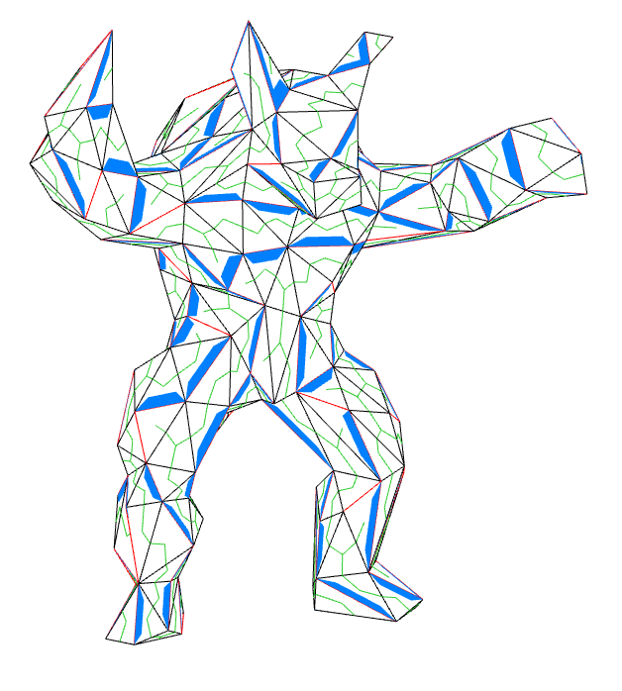
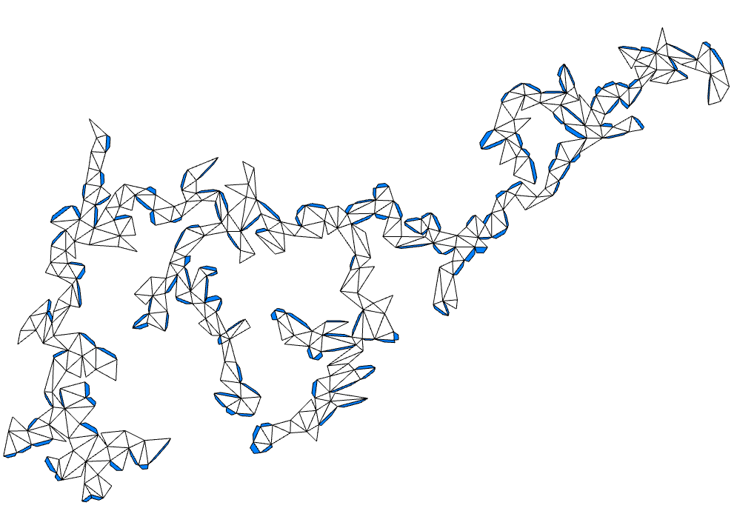
Results
Meshes <400 faces are solved in a reasonable time
Cut Edges
MSP
Gluetags
386 Faces
Notes:
works well for faces < 200 and reasonable for faces < 400
reconstruction impractical without additional indicators

Slide 35
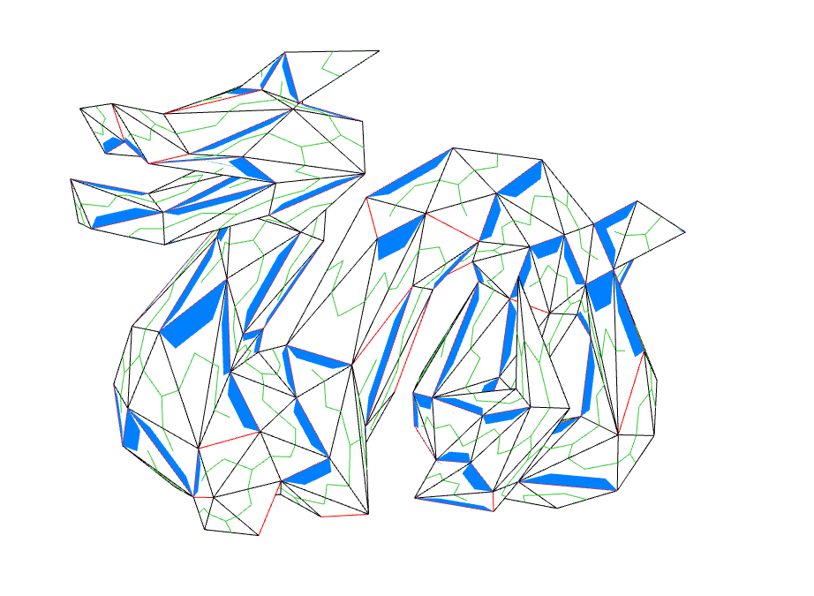
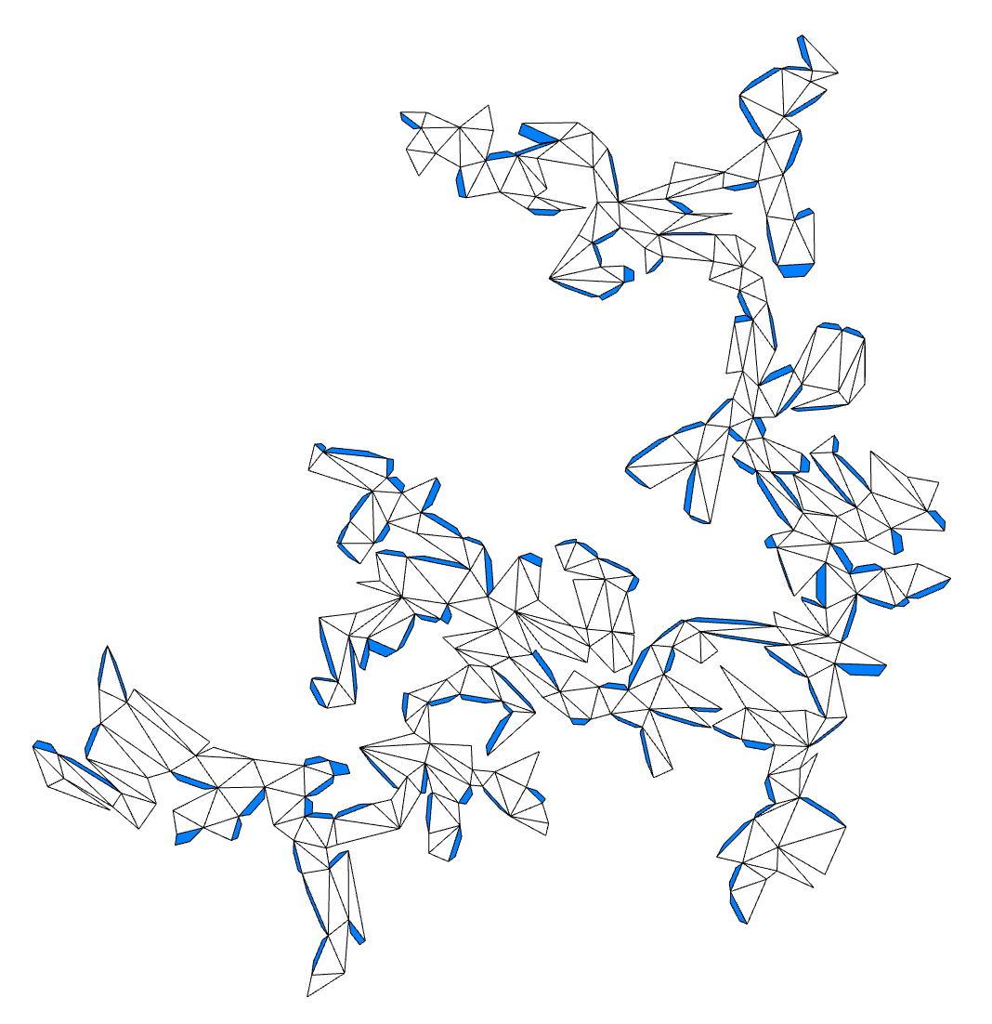
Results
Meshes <400 faces are solved in a reasonable time
Cut Edges
MSP
Gluetags
344 Faces
Notes:
works well for faces < 200 and reasonable for faces < 400
reconstruction impractical without additional indicators

Slide 36
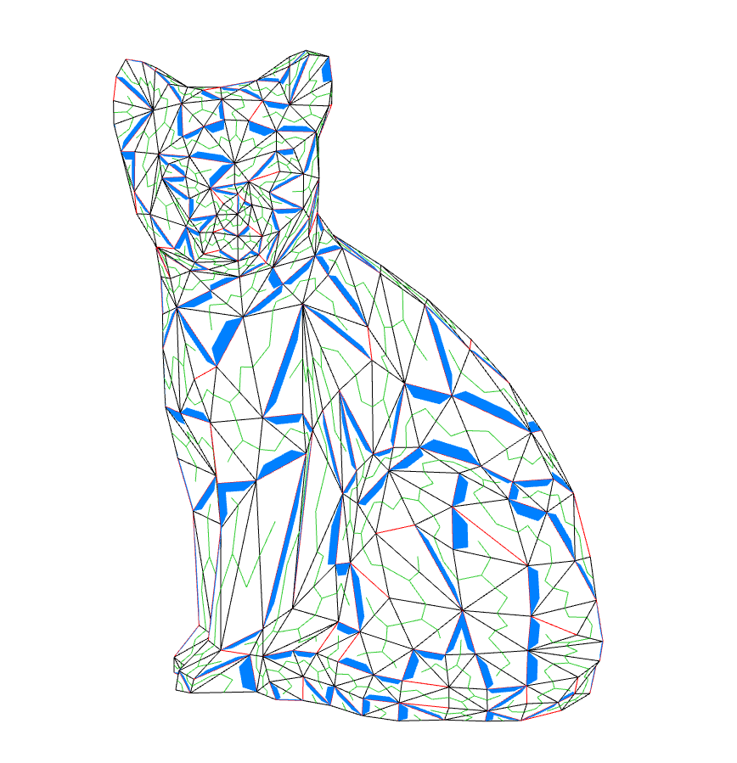
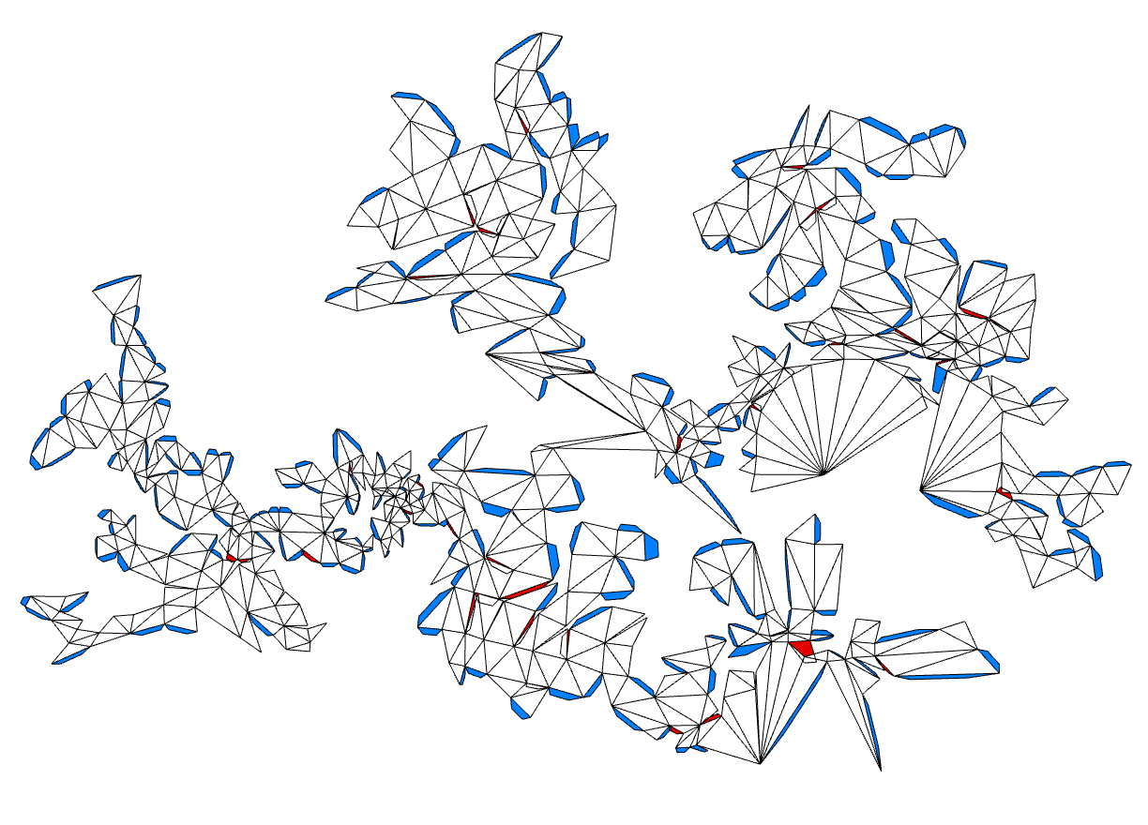
Limitations - Mesh Size
Large Meshes >400 are problematic
702 Faces
Notes:
time is a limiting factor, only so many iterations can be done in a reasonable timeframe
large meshes > 400 are very unreliable, don’t always solve within 100000 iterations (benchmark number)
problematic areas -> next slide

Slide 37
Limitations - Problematic Areas
Notes:
next slide

Slide 38
Limitations - Problematic Areas
Notes:
explain problematic areas exemplary (almost circular, cutable but gluetags won’t fit, gluetag very small if face is very small)

Slide 39
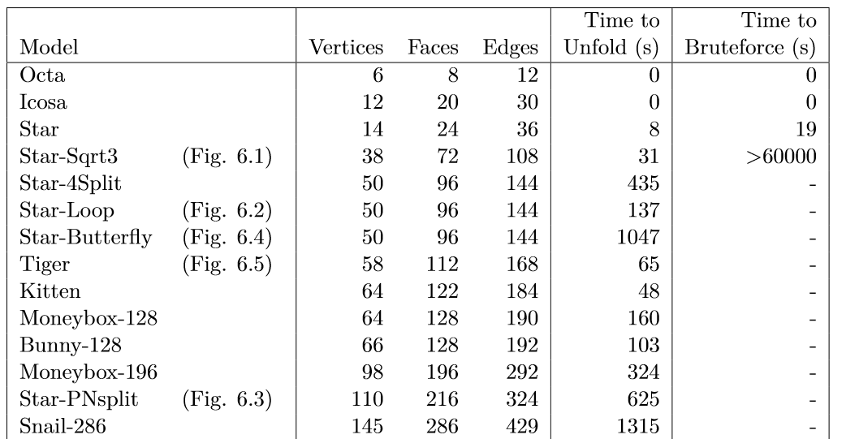
Limitations - Performance I

Slide 40
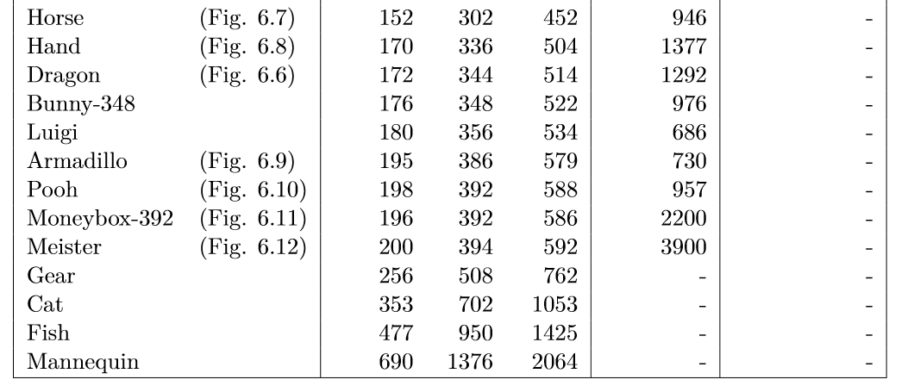
Limitations - Performance II

Slide 41
Conclusion & Future Work
Conclusion
Solutions are found within a reasonable time
Mesh size is a limiting factor
Reconstruction works for small meshes
Mesh shape also influences the performance
Future Work
Improve performance
Add additional indicators
Additional post processing of Gluetags
Prove of minimal amount of Gluetags
Notes:
solutions for small meshes using this spanning tree approach are found very fast, but also works well for bigger meshes around 200 faces
mesh size is still a limiting factor, > 400 it gets really problematic to find a solution
reconstruction works for smaller meshes BUT is impractical without additional indicators
mesh shape can also influence the performance

Slide 42
Conclusion & Future Work
Conclusion
Solutions are found within a reasonable time
Mesh size is a limiting factor
Reconstruction works for small meshes
Mesh shape also influences the performance
Future Work
Improve performance
Add additional indicators
Additional post processing of Gluetags
Prove of minimal amount of Gluetags
Notes:
performance improvements to work better for larger meshes -> computation time down, more iterations possible
indicators -> color gluetags and match on the side they should be on
post process gluetags to maximise use of space

Slide 43
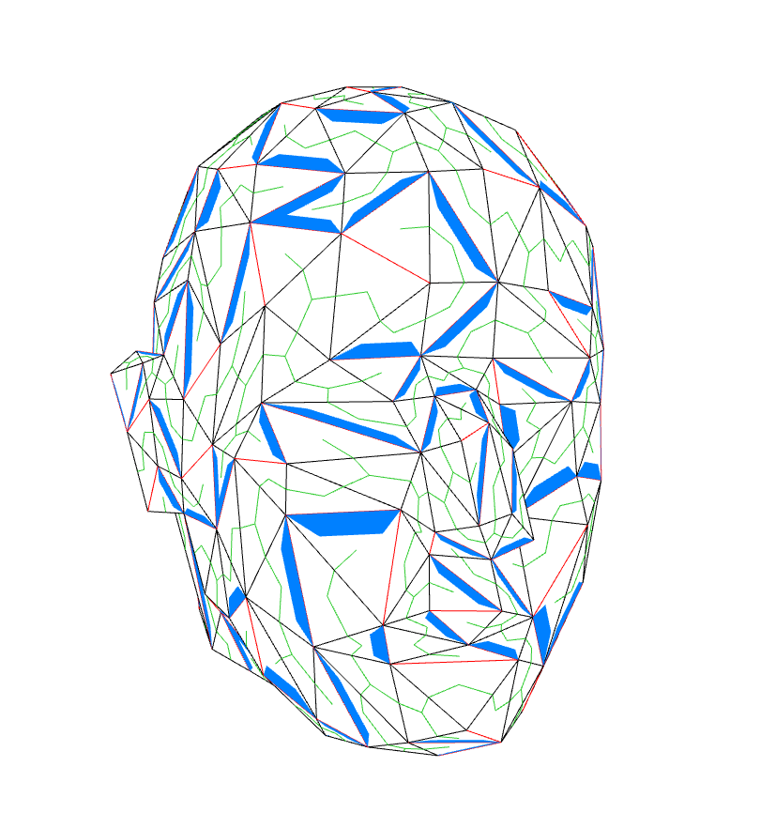
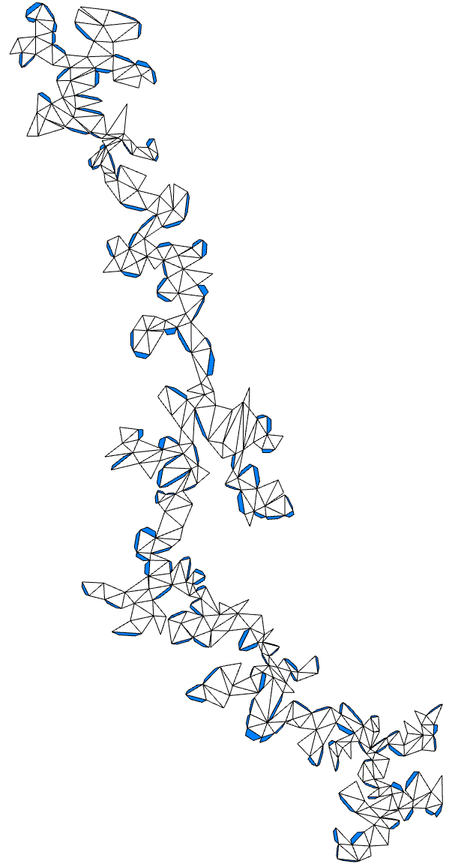
Thank You for your Attention!
Meister Gröller [7]
Meister Gröller (400 Polygons)
Notes:
thank you for your attention are there any questions

Slide 44
Bibliography
[1] Tolley, M.T., Felton, S.M., Miyashita, S., Aukes, D., Rus, D. and Wood, R.J., 2014. Self-folding origami: shape memory composites activated by uniform heating. Smart Materials and Structures, 23(9), p.094006
[2] NASA, 2014, accessed on 03.09.2019, https://www.nasa.gov/jpl/news/origami-style-solar-power-20140814
[3] Freecadweb, accessed on 03.09.2019, https://www.freecadweb.org/wiki/SheetMetal_Workbench
[5] Straub, Raphael, and Hartmut Prautzsch. Creating optimized cut-out sheets for paper models from meshes. KIT, Fakultät für Informatik, 2011
[4] Takahashi, S., Wu, H.Y., Saw, S.H., Lin, C.C. and Yen, H.C., 2011, September. Optimized topological surgery for unfolding 3d meshes. In Computer Graphics Forum (Vol. 30, No. 7, pp. 2077-2086). Oxford, UK: Blackwell Publishing Ltd
[6] Mitani, Jun, and Hiromasa Suzuki. "Making papercraft toys from meshes using strip-based approximate unfolding." ACM transactions on graphics (TOG). Vol. 23. No. 3. ACM, 2004
[7] Meister Gröller, accessed on 03.09.2019, https://www.cg.tuwien.ac.at/staff/EduardGroeller.html
Notes:
some sources

