Slide 8
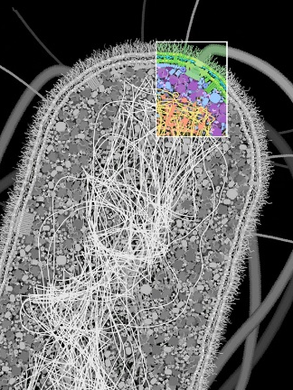
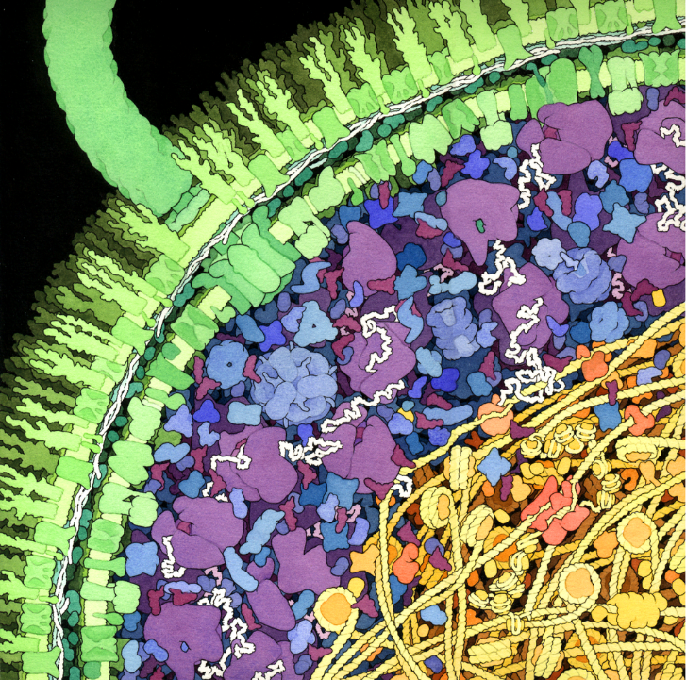
illustrations from The Machinery of Life by David S. Goodsell

Slide 9
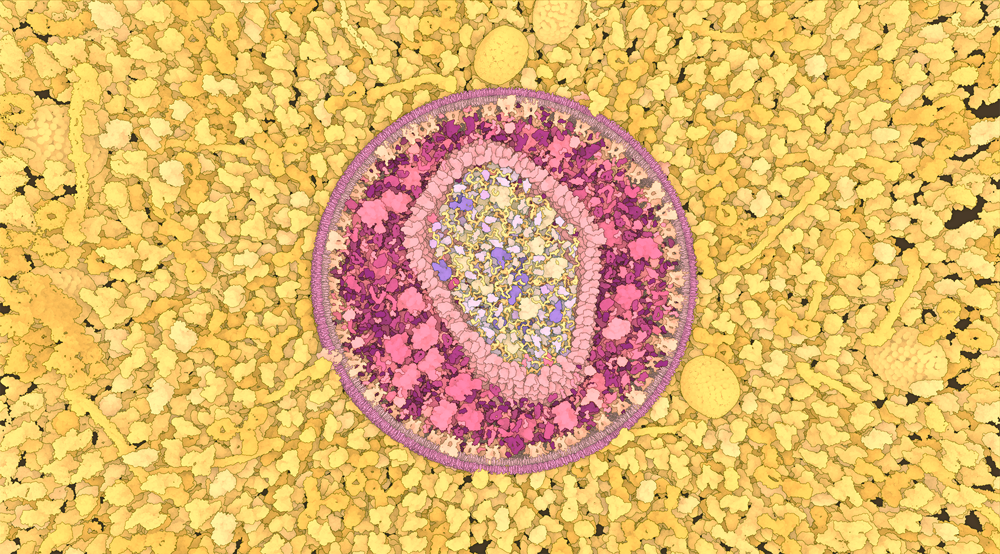

Slide 13
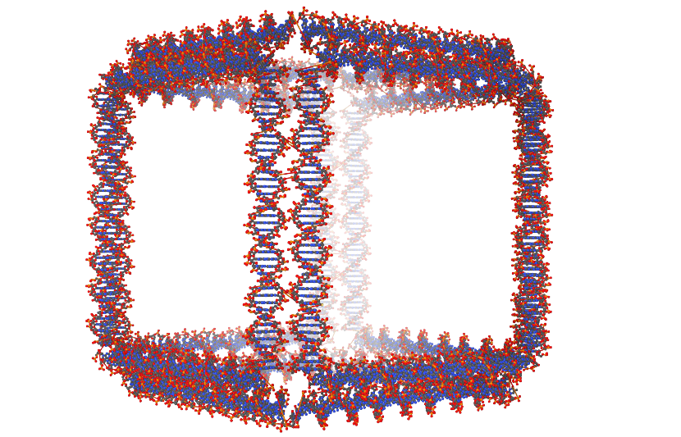
image by Miao et al.

Slide 14
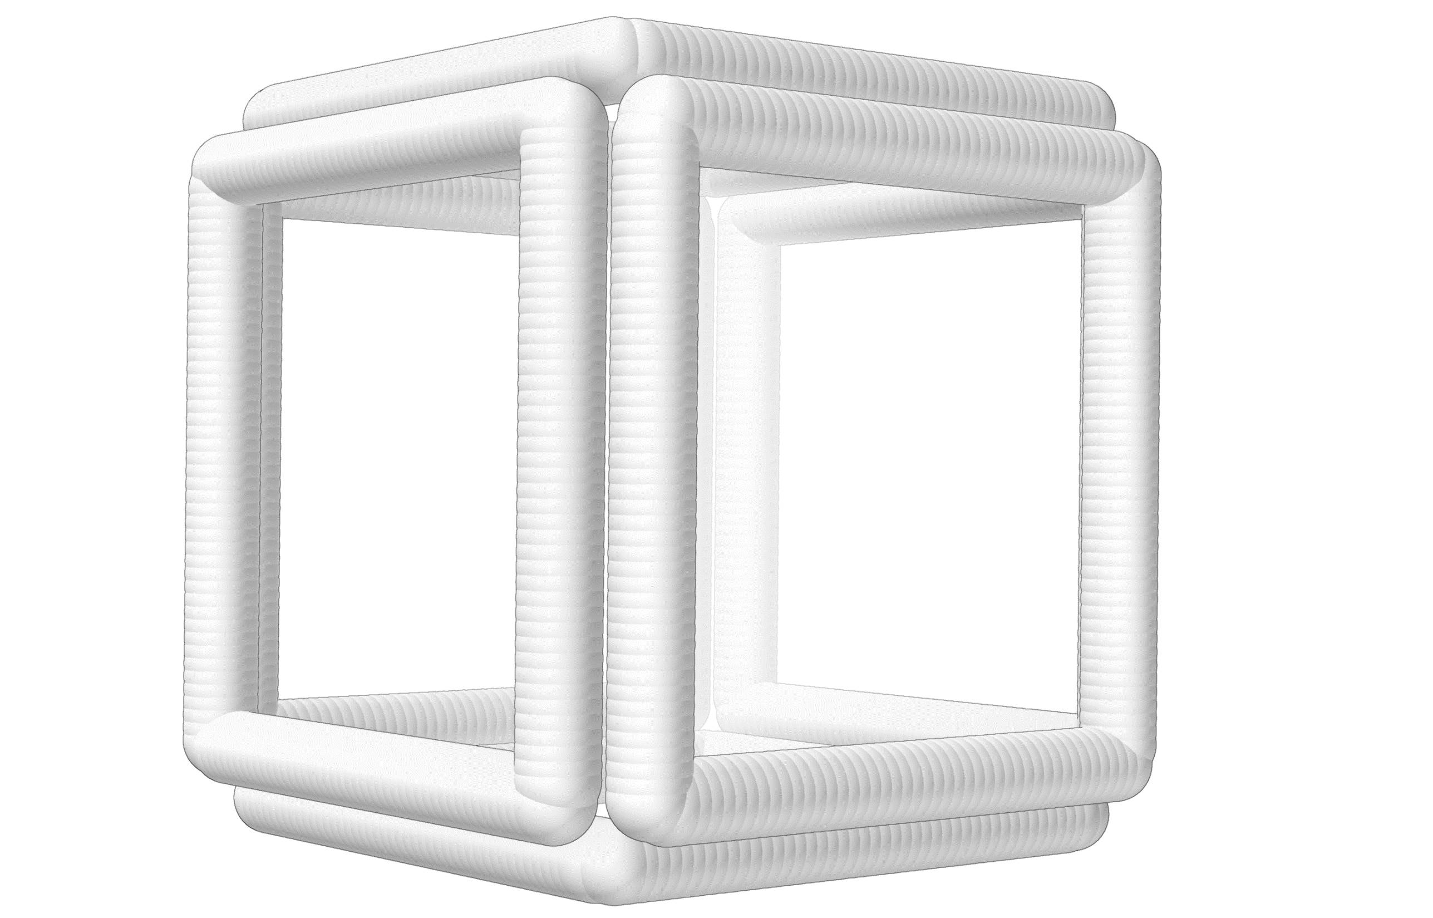
image by Miao et al.

Slide 15
image by Miao et al.

