Slide 1
Visualization Multi-Pipeline for Communicating Biology
Peter Mindek, David Kouřil, Johannes Sorger,
Daniel Toloudis, Blair Lyons, Graham Johnson,
M. Eduard Gröller, Ivan Viola
Institute of Computer Graphics and Algorithms, TU Wien, Austria

Slide 2
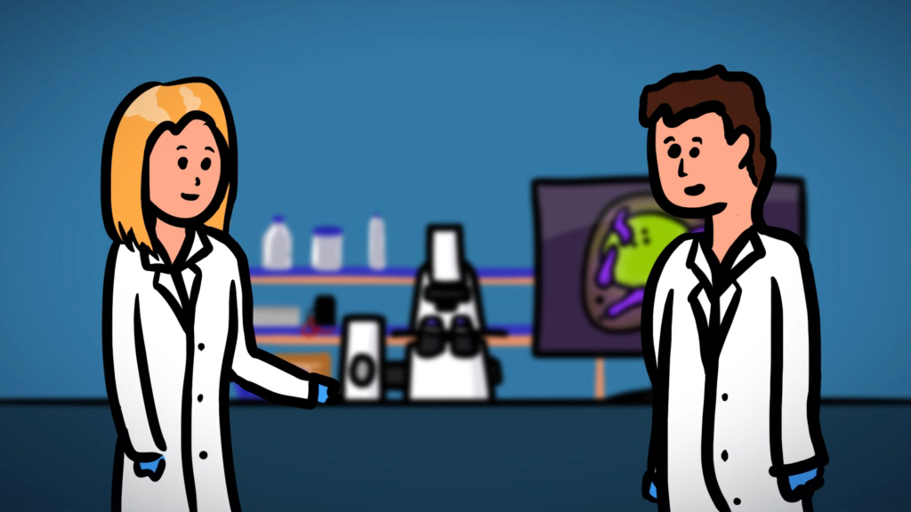

Slide 3
Communicating Biology

Slide 4
Communicating Biology

Slide 5
Communicating Biology

Slide 6
Communicating Biology

Slide 7
Communicating Biology

Slide 8
Communicating Biology

Slide 9
Out Approach

Slide 10
Out Approach

Slide 11
Out Approach

Slide 12
Out Approach

Slide 13
Marion

Slide 14
Marion

Slide 15
Marion

Slide 16
Marion

Slide 17
System Architecture

Slide 18
System Architecture
Notes:
Visualization layer allows rapid prototyping

Slide 19
System Architecture

Slide 20
System Architecture

Slide 21
System Architecture

Slide 22
System Architecture

Slide 23
System Architecture
Notes:
Application layer allows deployment to various platforms and media

Slide 24
System Architecture

Slide 25
System Architecture

Slide 26
Visualization Multi-Pipeline

Slide 27
Visualization Multi-Pipeline

Slide 28
Visualization Multi-Pipeline

Slide 29
Visualization Multi-Pipeline

Slide 30
Visualization Multi-Pipeline

Slide 31
Visualization Multi-Pipeline

Slide 32
Visualization Multi-Pipeline
Notes:
Scenes combine the modules to allow storytelling

Slide 33
Marion in Action: Communicating Cell Biology

Slide 34
Marion in Action: Communicating Cell Biology

Slide 35
Marion in Action: Communicating Cell Biology

Slide 36
Marion in Action: Communicating Cell Biology

Slide 37
Data Processing

Slide 38
Data Processing

Slide 39
Data Processing

Slide 40
Data Processing

Slide 41
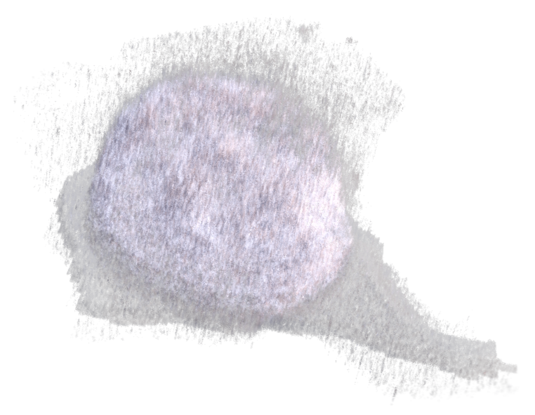
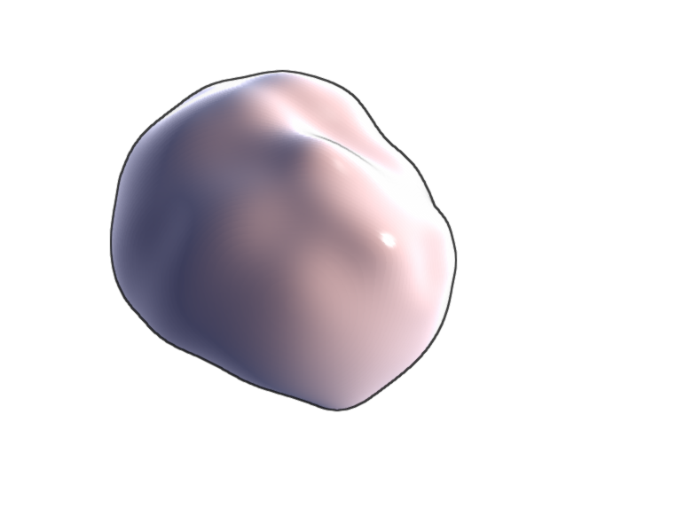

Rendering – Large Structures

Slide 42
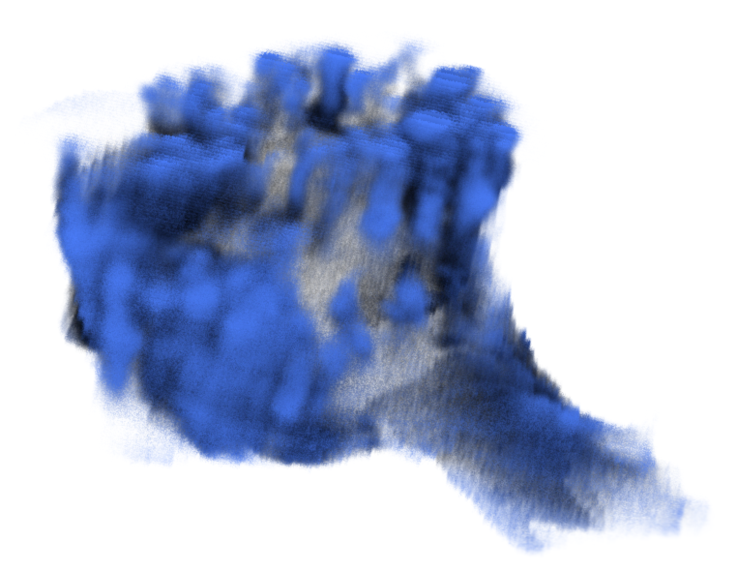
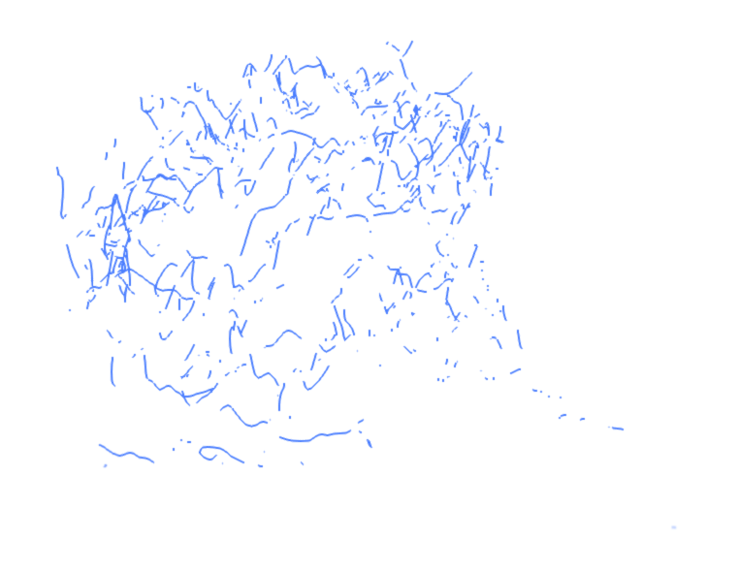
Rendering – Small Structures
directional occlusion shading
backbones rendering

Slide 43
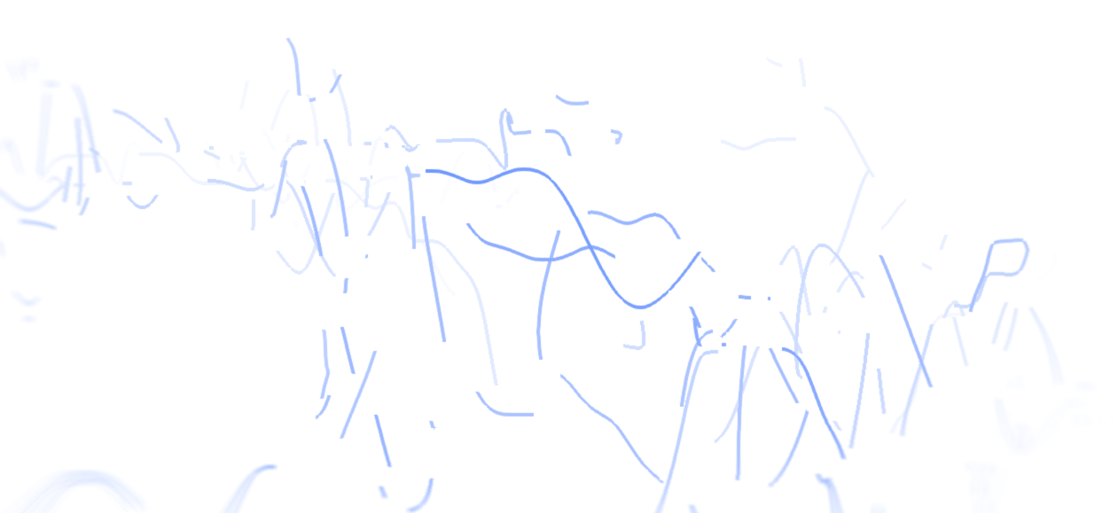
Rendering – Small Structures – Backbones

Slide 44
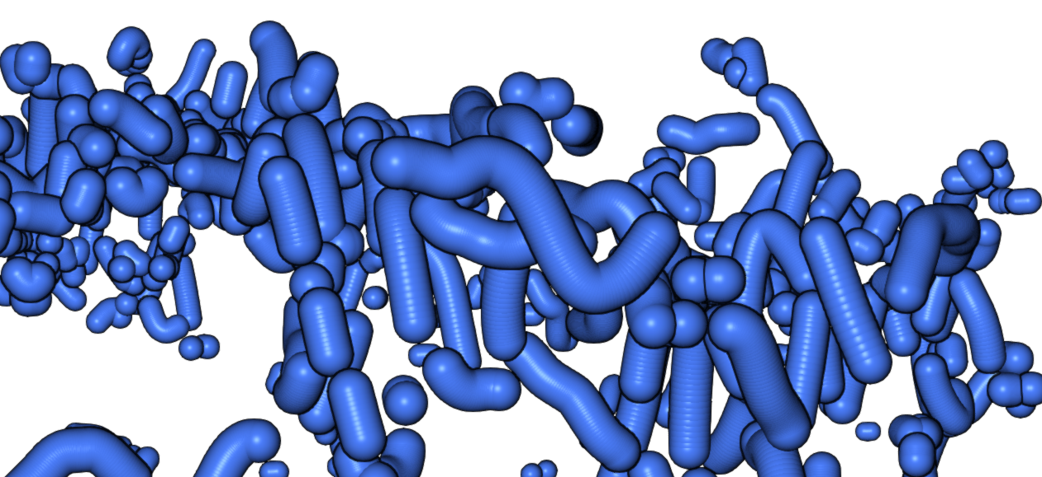
Rendering – Small Structures – Impostor Spheres

Slide 45
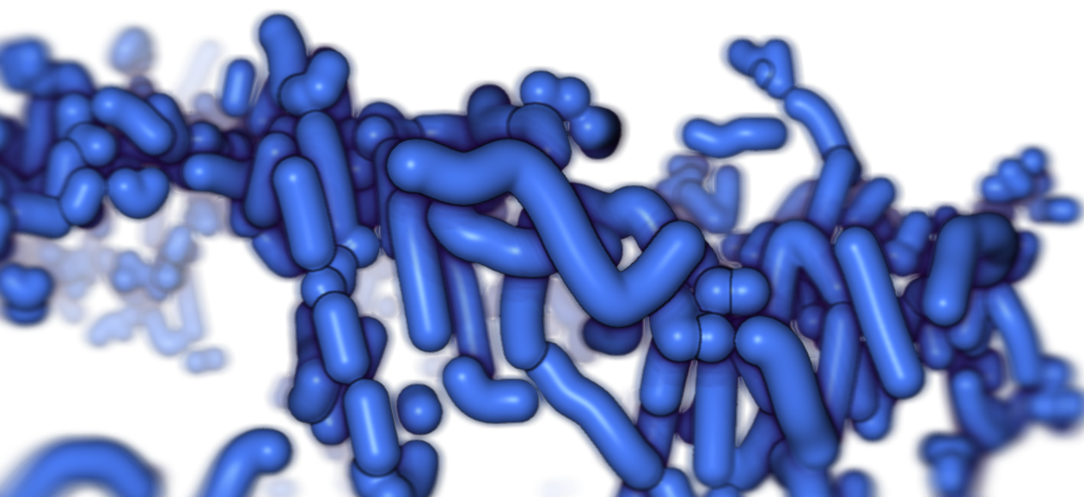
Rendering – Small Structures – Screen-Space Metaballs

Slide 46
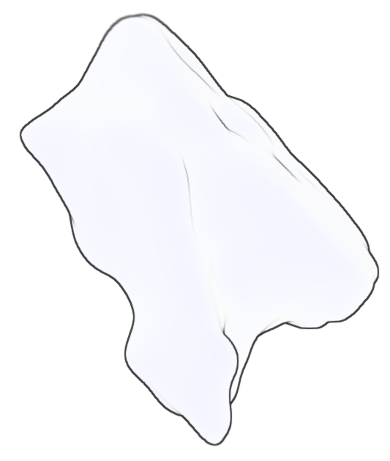
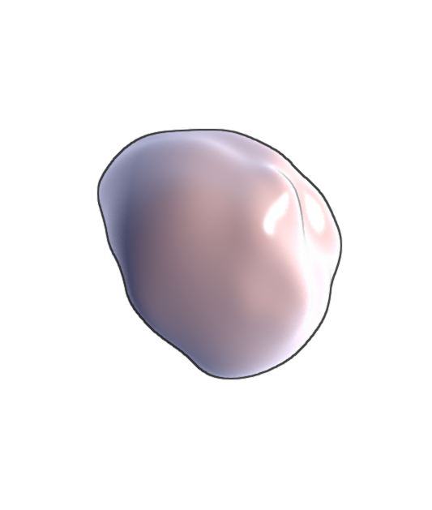
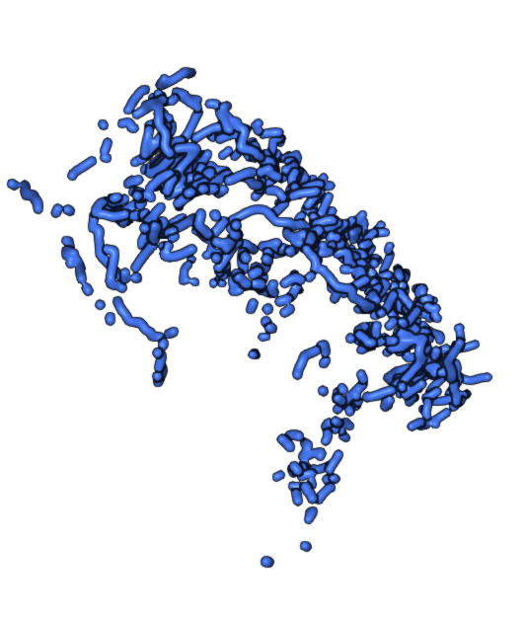
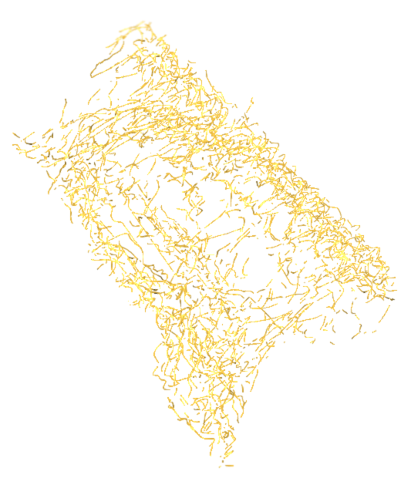
Rendering

Slide 47
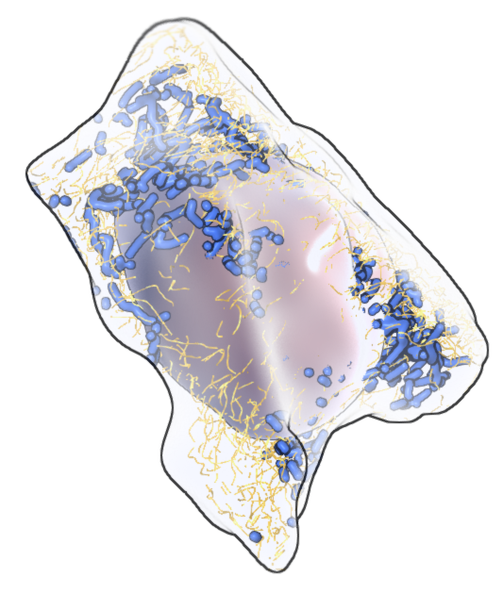
Compositing

Slide 48
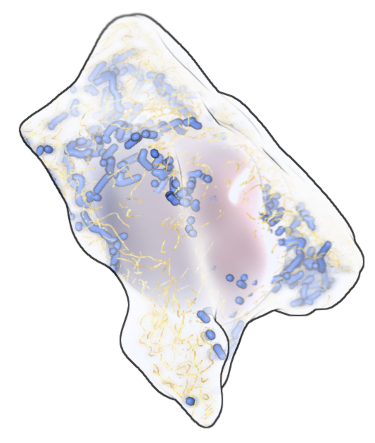
Compositing

Slide 49
Deployment
remote rendering server
desktop application

Slide 50
Conclusions

Slide 51
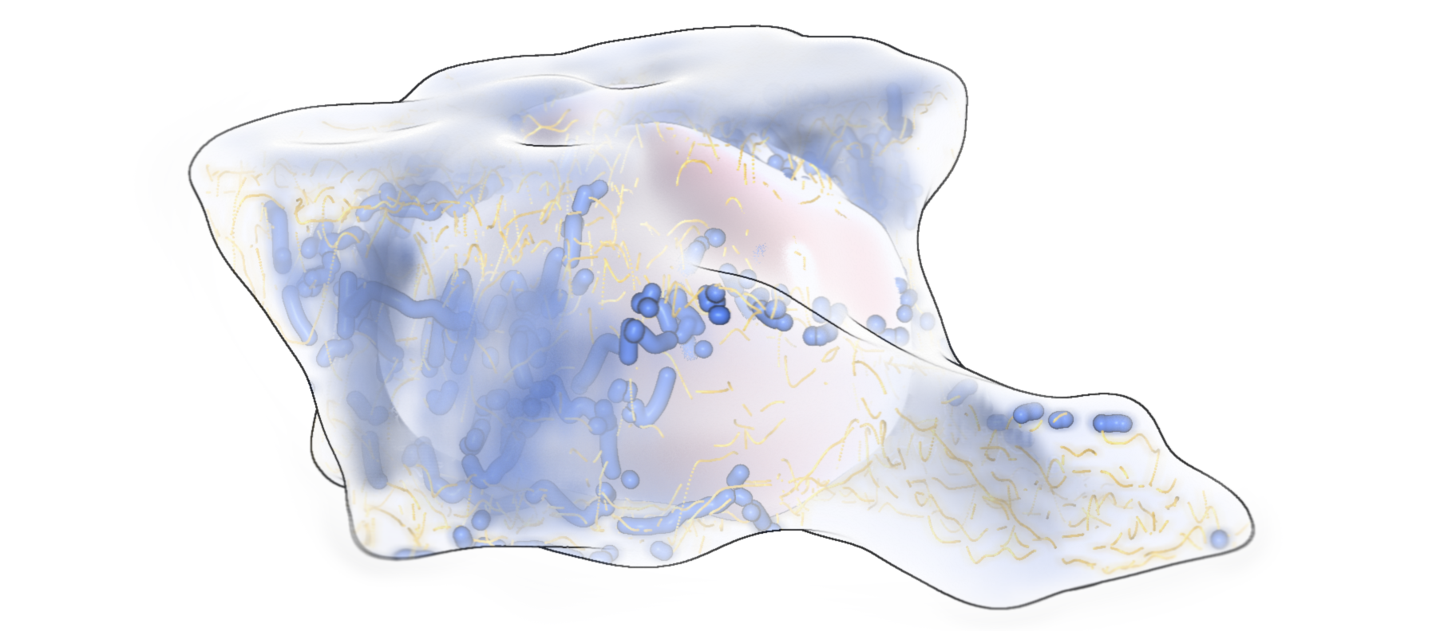
Thank you for your attention!
mindek@cg.tuwien.ac.at
www.cg.tuwien.ac.at/research/vis/BioVis.html

Slide 52
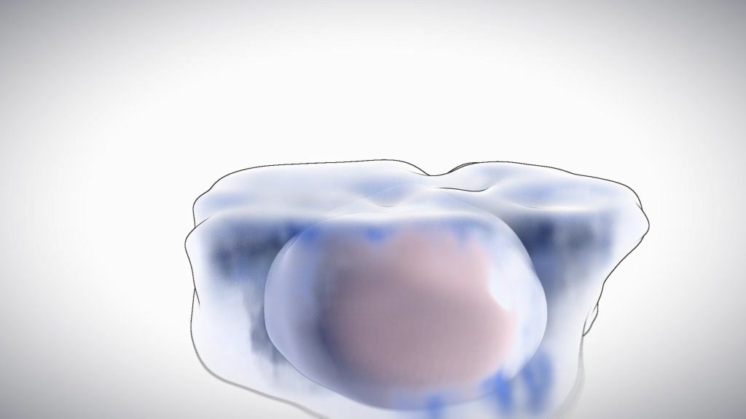

Slide 53
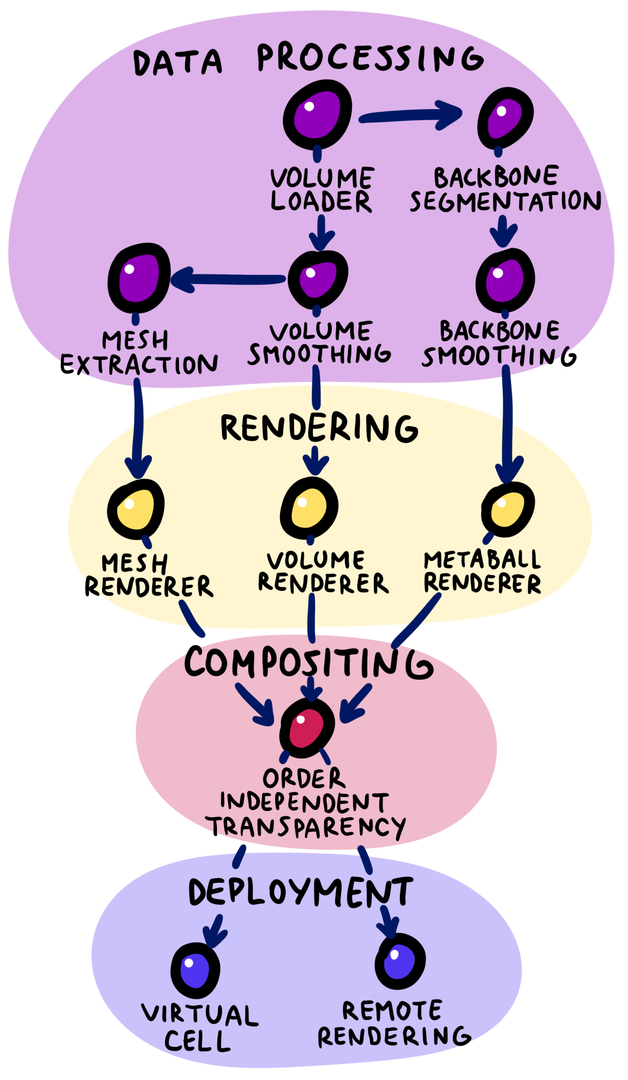
Marion in Action: Communicating Cell Biology

