Slide 1
Guided Interactive Volume Editing in Medicine
Alexey Karimov
Institute of Computer Graphics and Algorithms
Technische Universität Wien, Vienna, Austria
Notes:
Good afternoon, ladies and gentlemen. My name is Alexey Karimov. Today I would like to present you my dissertation Guided Interactive Volume Editing in Medicine.

Slide 2
Segmentation Editing
Segmentation Editing
Notes:
The topic of our thesis is editing segmentation masks of volumetric objects. Such editing is required if the segmentation mask contains classification errors. At this slide, we illustrate two types of these errors. First, the mask contains some parts that do not belong to the object. These parts has to be removed. Also, there could be object parts that are not included into the segmentation mask. The user has to add them.

Slide 3
Segmentation Editing in Medicine
Medical Imaging
Radiologist
Measurements
CT
Automatic Segmentation Tools
Segmentation Editing Tools
Analytic Tools
Diagnosis
Abnormalities
Differences in scan protocols
Variations between patients
Inhomogeneities in tissues
Noise in the data
MRI
Treatment Planning
US
Notes:
The objects that we aim for in our thesis are various organs of the human body. The data is provided by various acquisition techniques, such as Computed Tomography, Magnetic Resonance Imaging and Ultrasound imaging. The usual workflow of the radiologist is following. First, the initial segmentation mask is created with automatic segmentation tools. Its quality is often suboptimal for diagnostics purposes due to presence of abnormalities, unavoidable differences in scanning protocols, variations between patients, inhomogeneities in tissue characteristics, and noise in the data. Before the radiologist can use analytic tools that offer various measurements, support diagnosis and treatment planning, he has to edit the segmentation mask to correct misclassifications.

Slide 4
Segmentation Editing | Approaches
Guided Volume Editing
Volume Editing
Interactive Segmentation
Graph Cut
Random Walker
Live Wire
Active Contour
Stat. Shape Model
Notes:
First class of existing approaches to the segmentation editing is represented by interactive segmentation techniques. These techniques, based on graph cuts, random walkers, live wires, active contours and statistical shape models, allow the user to interactively segment the object. These methods generally do not allow to edit the existing mask, but instead create it from scratch. The guidance here is rather limited. For graph cut and random walker methods the underlying uncertainty of the segmentation is quantified and communicated to the user. With live wires, the plane that contains the most unstable contour is found. With active contour methods and statistical shape models the user is not guided towards uncertain or unstable regions of the segmentation mask to the best of our knowledge.

Slide 5
Segmentation Editing | Approaches
Guided Volume Editing
Volume Editing
Deformable 3D Mesh
Sketches + Surface Reconstruction
Specialized Editing Tools
Skeleton-based Volume Editing
Interactive Segmentation
Graph Cut
Random Walker
Live Wire
Active Contour
Stat. Shape Model
Notes:
Volume editing techniques allow the user to edit arbitrary segmentation mask in order to reach the desired output. Some approaches represent the mask as a mesh that can be adjusted by the user by displacing vertices and applying deformation forces. With sketches the user can mark the defective regions and specify the necessary editing operations. The segmentation mask is then interpolated to fit the sketches. For specific objects, such as bones, cartilages, heart ventricles specialized editing tools exist. These tools are oriented towards common defects that occur during segmenting such objects. With the skeleton-based volume editing that we introduce the user can specify parts of the mask for the subsequent editing by manipulating on the skeleton. With a few pre-defined correction operations, the user fixes the selected defects. These volume editing approaches provide no guidance of the user towards the segmentation defects or their fixes.

Slide 6
Segmentation Editing | Approaches
Guided Volume Editing
Statistics-Driven Localization of Dissimilarities in Data
Guided Volume Editing based on Histogram Dissimilarity
Volume Editing
Deformable 3D Mesh
Sketches + Surface Reconstruction
Specialized Editing Tools
Skeleton-based Volume Editing
Interactive Segmentation
Graph Cut
Random Walker
Live Wire
Active Contour
Stat. Shape Model
Notes:
We enhance our skeleton-based volume editing with a guidance of the user. With the guided volume editing based on histogram dissimilarity we are able to detect certain types of segmentation defects. We present them to the user who decides which suggested defects to fix. With the statistics-driven localization of dissimilarities in data we statistically compare the suggested defects with the reference parts of the object. This way, we can identify regions that most likely contain the defects.

Slide 7
Segmentation Editing | Research Questions
Q1 | How to select the defects prior to the correction?
Q2 | How to correct the selected defects?
Q3 | How to detect certain types of defects?
Q4 | How to present detected defects to the user?
Q5 | How to design the interactive editing process?
Notes:
In the thesis we identified the following research questions: How to select the defects prior to the correction? How to correct the selected defects? How to detect certain types of defects? How to present detected defects to the user? How to design the interactive editing process? Each segmentation editing technique has to deal with the questions one, two and five. Only advanced techniques tackle the questions three and four.

Slide 8
Skeleton
Medial Axis Transformation: for each point $p∈\text{Mask}$ it finds closest boundary points $B\left(p\right)$
Skeleton $S=\left\{p∈\text{Mask} | \#B\left(p\right)>1\right\}$
$$\text{Point}∈\text{Mask}$$
$$\text{Point}∉\text{Mask}$$
$$\text{Boundary} \text{Point}$$
$$\text{Skeleton} \text{Point}$$
Notes:
In order to support interactive selection of parts of the segmentation mask (Q1) and automatically detect segmentation defects (Q3), we use topological representation of the segmentation mask. Precisely, we use a skeleton. The skeleton can be defined using the medial axis transformation. After the transformation, for each point p of the mask we know the closest boundary points. The skeleton consists of the points that have more than one closest boundary point.

Slide 9
Structural Features
$F\left(Q\right)=\left\{p∈\text{Mask} | \min_{q∈Q}{D\left(p,q\right)=\min_{s∈S}{D\left(p,s\right)}}\right\}$ where $Q⊂S$
$$Q_{1}$$
$$Q_{2}$$
$$Q_{3}$$
$$Q_{4}$$
$$F\left(Q_{4}\right)$$
$$\text{Point}∈\text{Mask}$$
$$\text{Skeleton} \text{Point}$$
$$\text{Feature} \text{Boundary}$$
$$F\left(Q_{1}\right)$$
$$F\left(Q_{2}\right)$$
$$F\left(Q_{3}\right)$$
$$Q_{5}$$
$$F\left(Q_{5}\right)$$
Notes:
Having the skeleton we can define the structural features. A structural feature of a set of skeleton points $Q$ is defined as a set of points that have the closest skeleton point in $Q$. The structural features allow us to find correspondence between the skeleton and mask points. This correspondence we will use while analyzing data values inside the segmentation mask.

Slide 10
Our Classification of Segmentation Defects
$$\text{Voxel}∈\text{Mask}$$
$$\text{Voxel}∉\text{Mask}$$
$$\text{Voxel}∈\text{Mask}$$
$$\text{Voxel}∉\text{Object}$$
$$\text{Voxel}∉\text{Mask}$$
$$\text{Voxel}∈\text{Object}$$
Layer Defect $L$
Part Defect $P$
Over-Estimation Defect $O$
Under-Estimation Defect $U$
Notes:
Before we describe our volume editing techniques, we introduce our classification of segmentation defects. The misclassification of voxels can happen in two ways: First, non-object voxels can be assigned to the segmentation mask, creating over-estimation defects. Second, the under-estimation happens if some object voxels are not included into the segmentation mask. Segmentation defects can also be different with respect to the skeleton. The layer defects do not contain voxels of the skeleton being far away from the medial lines of the segmentation mask. Such defects only affect the surface layers of the segmentation mask. Part defects, contrary, contain voxels of the skeleton. These defects concern entire volumetric parts of the segmentation mask. As a result, we distinguish 4 classes of defects: OL, OP, UL, UP.

Slide 11
Defects Classification | Phantom Objects
Notes:
Let us consider two phantom objects.

Slide 12
Defects Classification | Phantom Objects
Notes:
Suppose we have the following segmentation masks.

Slide 13
Defects Classification | Phantom Objects
$$O_{P}$$
$$U_{P}$$
$$U_{L}$$
$$O_{L}$$
Notes:
Then, according to our defect classification, we have the following defects: OP, UP, UL, OL.

Slide 14
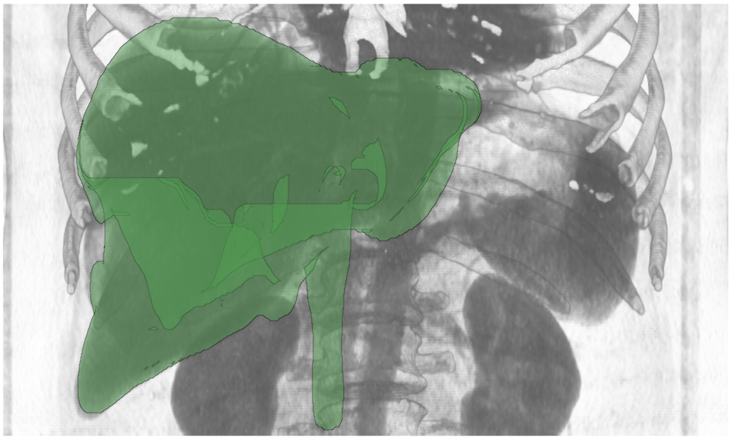
Defects Classification | Liver
$$O_{P}$$
Data Source: [1]
Notes:
Obviously, such classification works not only for phantom datasets. Here we have medical data of abdominal region. The object of interest is the liver. The contrast enhancement agent is injected into the blood in order to make the liver distinct from other organs. However, the contrast agent travels with the blood outside the liver. As a result, there is a severe over-estimation part defect here.

Slide 15
Defects Classification | Liver
$$U_{P}$$
Data Source: [1]
Notes:
After the user edits this defect, there is a under-estimation part defect that requires the user’s attention. This defect is caused by a tumor.

Slide 16
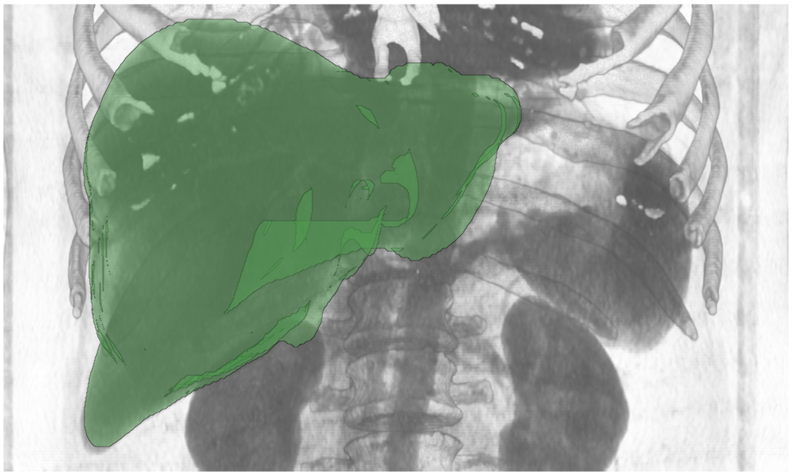
Defects Classification | Liver
Data Source: [1]
Notes:
After editing, the segmentation mask of the liver is having sufficient quality for further usage. The radiologist can measure the liver volume, locate the tumor and preplan tumor resection operation.

Slide 17
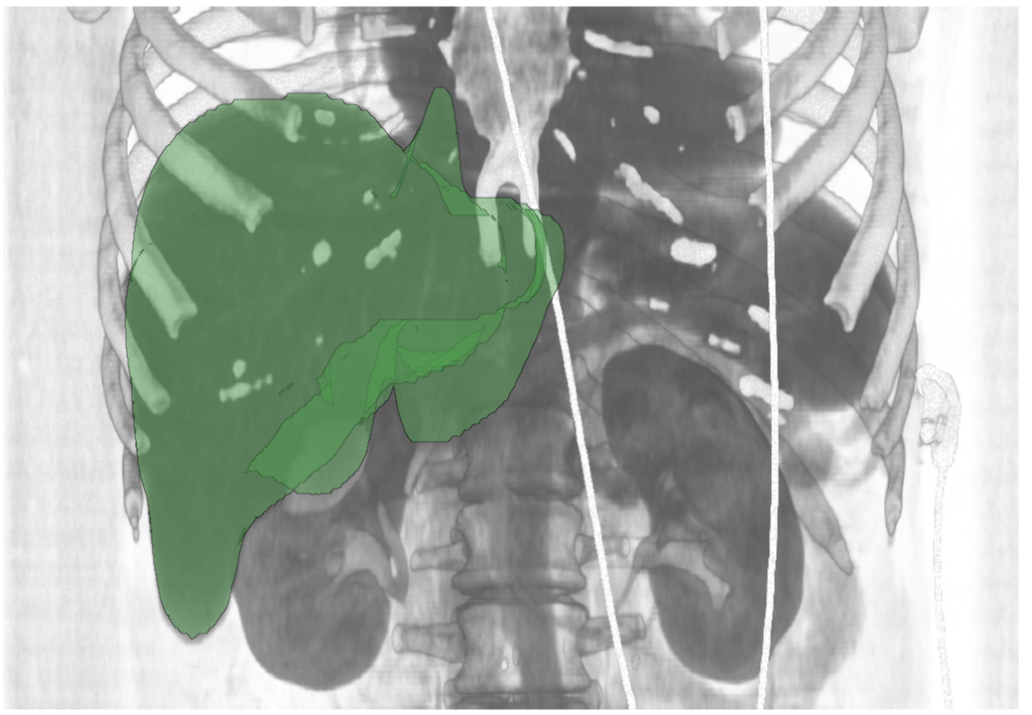
Defects Classification | Liver
$$O_{L}$$
Data Source: [1]
Notes:
In another liver dataset we have layer defects. First, there is an over-estimation layer defect that goes towards the heart. It is caused by weak difference in density between liver and heart tissues.

Slide 18
Defects Classification | Liver
$$U_{L}$$
Data Source: [1]
Notes:
After fixing the over-estimation defect, we can focus on a under-estimation layer defect. Some part of the liver parenchyma is not captured by the segmentation algorithm.

Slide 19
Defects Classification | Liver
Data Source: [1]
Notes:
Now this defect is also fixed. The radiologist can verify if the liver contains any abnormal tissues such as fat deposits.

Slide 20
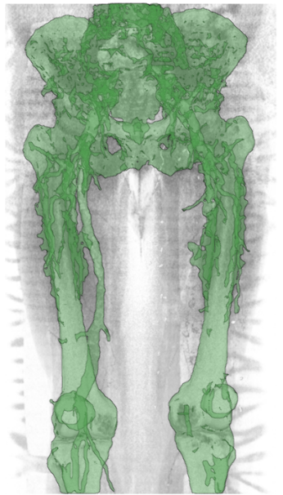
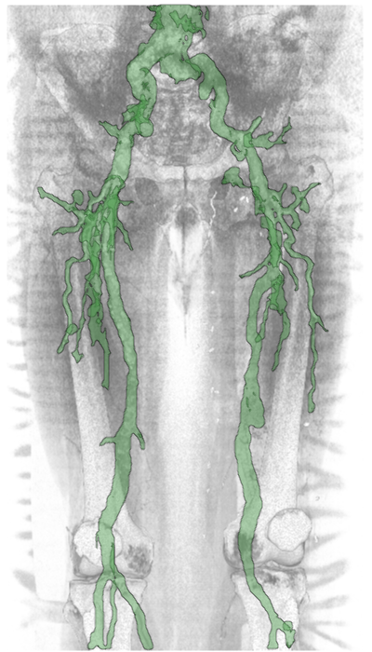
Defects Classification | Vessels
Initial Segmentation Mask
Desired Segmentation Mask
Data Source: [2]
Notes:
Let us now consider the case of vessels in the human lower extremities. Before the scanning, the contrast enhancement agent is injected into the blood in order to make vessels visible. However, the agent makes the density of vessels to be comparable to the density of trabecular bones that are also present in this region. Combined with several contact points between vessels and bones, this leads to a quite bad initial segmentation mask, compared to the desired segmentation mask. The radiologist has to remove bones as they would hide vessels on MIP and reformation images.

Slide 21
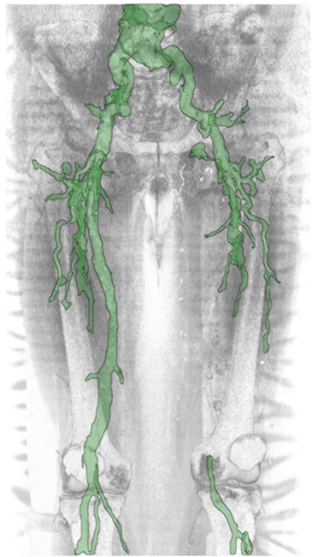
Defects Classification | Vessels
$$O_{P}$$
$$U_{P}$$
Data Source: [2]
Notes:
First of all, the major over-estimated parts are corrected. Then the user notices the missing vessel branch that is a under-estimation part defect according to our classification.

Slide 22
Defects Classification | Vessels
$$O_{L}$$
$$U_{L}$$
Data Source: [2]
Notes:
The user makes some minor adjustments to the segmentation mask by fixing layer defects. Over-estimation layer defect is located at the bifurcation point of the aorta. Some vessels are incorrectly thin, thus the user corrects the under-estimation layer defects.

Slide 23
Defects Classification | Vessels
Data Source: [2]
Notes:
Now the vessel segmentation has sufficient quality for rendering reformation images. With our defect classification we cover most of the segmentation issues that occur at these quite dissimilar medical objects.

Slide 24
Overview of the Contributions
Guided Volume Editing
Statistics-Driven Localization of Dissimilarities in Data (SDL)
Guided Volume Editing based on Histogram Dissimilarity (GVE)
Volume Editing
Skeleton-based Volume Editing (SVE)
Notes:
Having introduced our defect classification we now proceed with the volume editing techniques we developed.

Slide 25
Overview of the Contributions
Guided Volume Editing
Statistics-Driven Localization of Dissimilarities in Data (SDL)
Guided Volume Editing based on Histogram Dissimilarity (GVE)
Volume Editing
Skeleton-based Volume Editing (SVE)
Notes:
We start with the skeleton-based volume editing.

Slide 26
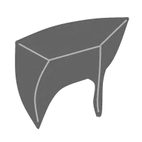
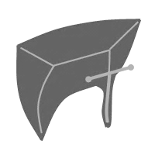
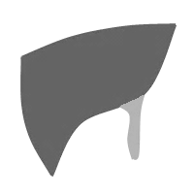
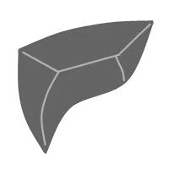
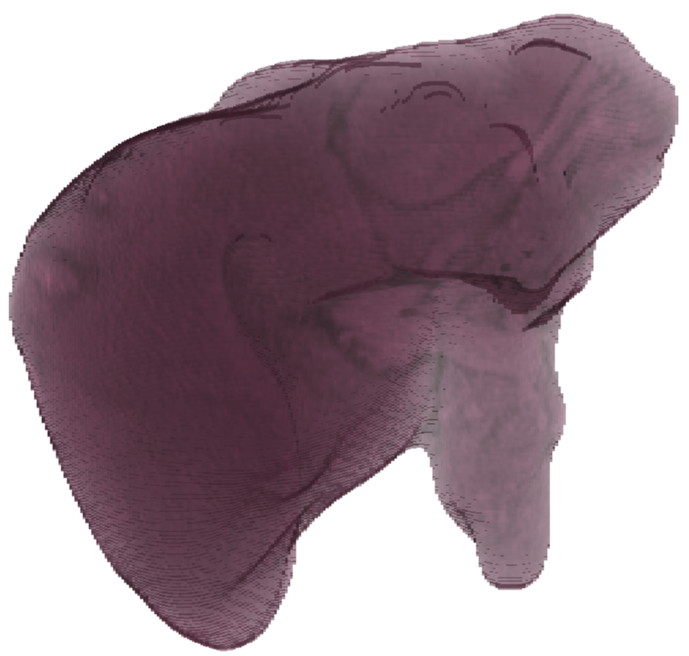
SVE | Workflow
Input: segmentation mask with problems
Data Source: [1]
Notes:
The workflow of the user with our technique is following: first, as input data the segmentation mask with problems is provided.

Slide 27
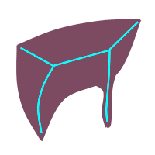
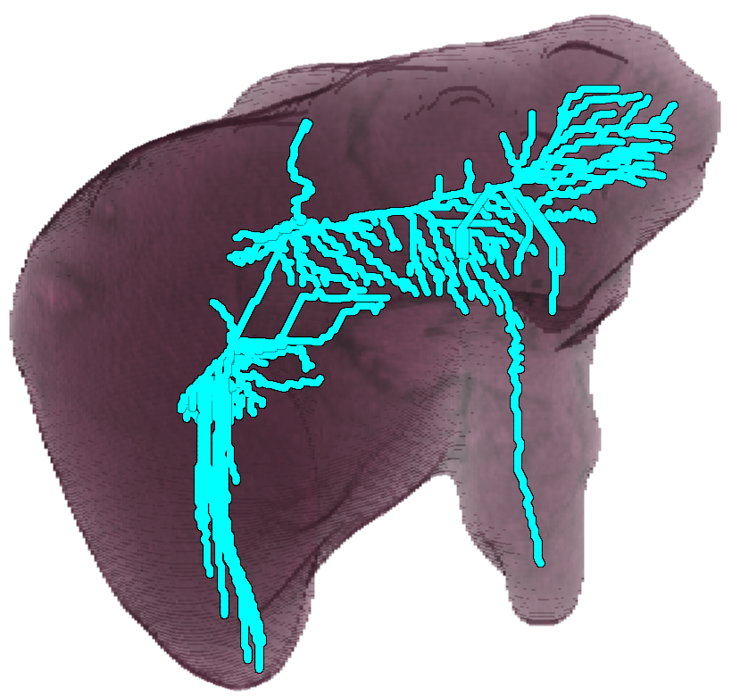
SVE | Workflow
Skeletonization
Skeleton
Data Source: [1]
Notes:
Then, the skeleton of the segmentation mask is constructed.

Slide 28
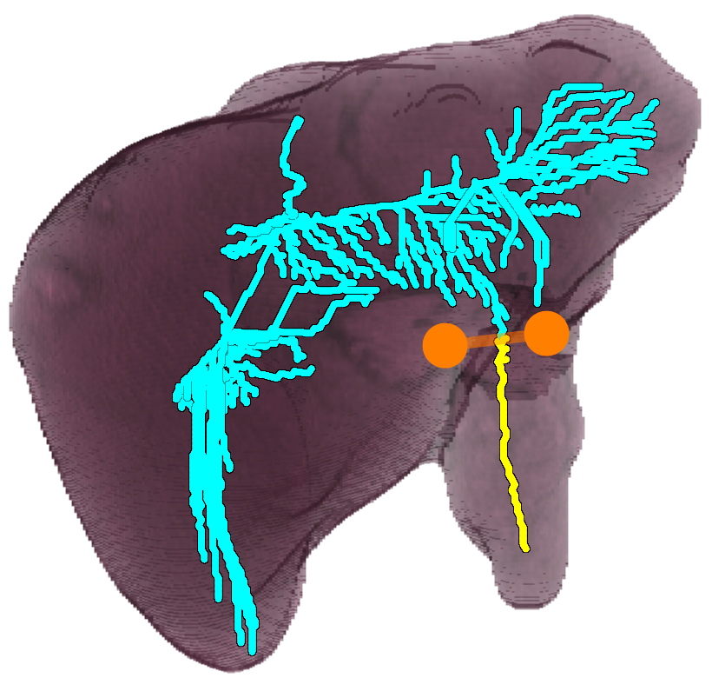
SVE | Workflow
User selection on the skeleton
Selection tool
Selected part of the skeleton
Data Source: [1]
Notes:
During user interaction phase, the user via the selection tools operates on the skeleton. As a result, some part of the skeleton is selected

Slide 29
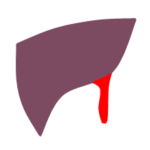
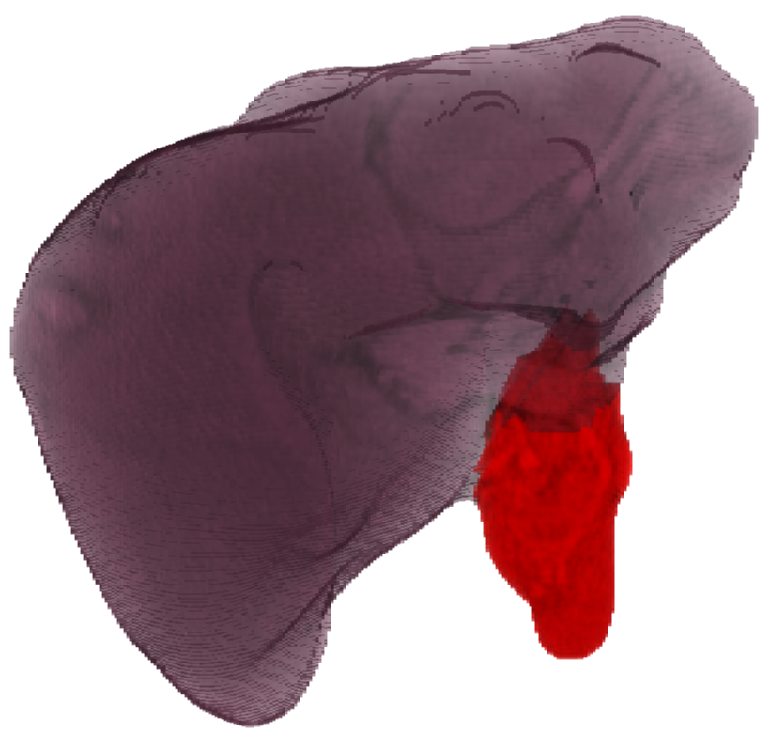
SVE | Workflow
Preview of correction operation
Selected part of the mask
Data Source: [1]
Notes:
Red part of the mask corresponds to the selected part of the skeleton. This part of the mask is being corrected with a certain operation, like remove or add.

Slide 30
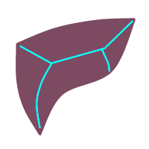
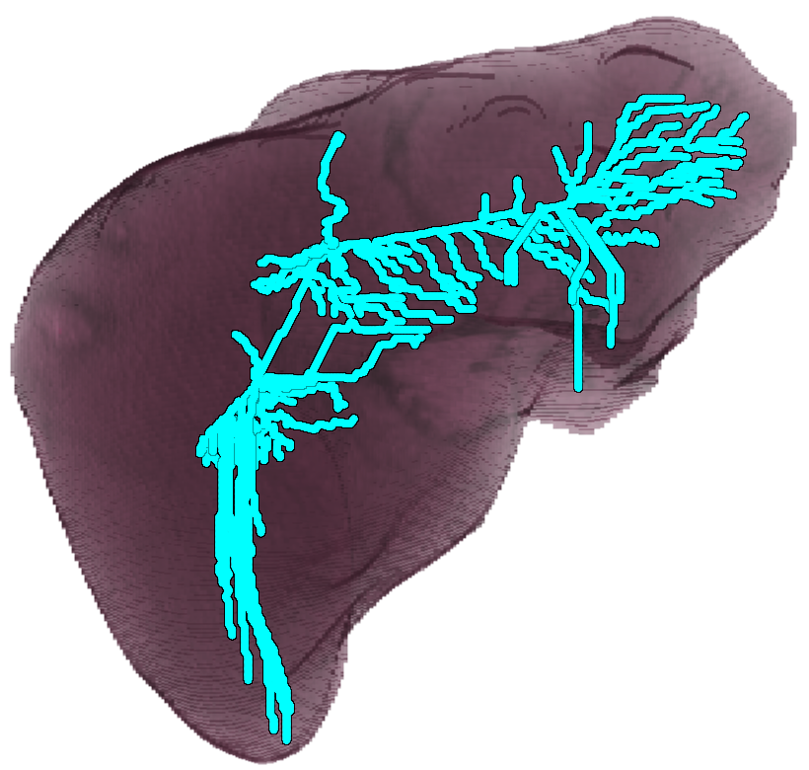
SVE | Workflow
Output: corrected segmentation mask
Data Source: [1]
Notes:
Finally, the user receives corrected segmentation mask.

Slide 31
From Skeleton to Segmentation Mask
Background voxel
Object voxel
Notes:
For illustration purposes, we consider the following phantom dataset. It consists of the background and object voxels.

Slide 32
From Skeleton to Segmentation Mask
Voxel $∉$ Mask
Voxel $∈$ Mask
Skeleton voxel
Notes:
The segmentation mask of the object is depicted in this slide. Also, we show here the skeleton voxels.

Slide 33
From Skeleton to Segmentation Mask
Selection tool
Selected skeleton voxel
Notes:
Imagine, that the user selects this part of the skeleton by using the selection tool.

Slide 34
From Skeleton to Segmentation Mask
?
Notes:
In order to perform the segmentation editing, we need to define which voxels correspond to each selected skeleton voxel. There could be several such definitions. Our definition is based on two novel concepts: skeleton distance field and influence zones. The skeleton distance field measures the distance from each voxel to the closest skeleton voxel while taking into account topological properties of the segmentation mask. The influence zones can be thought of as non-overlapping sections of the segmentation mask, orthogonal to the skeleton.

Slide 35
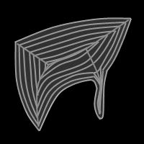
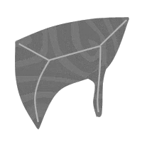
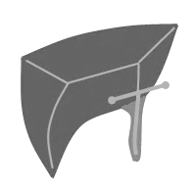
SVE | Pipeline
Skeletonization
Skeleton Distance Field
Influence Zones
Interaction + Correction
Notes:
Now we will provide details on how we define the correspondence between the skeleton and voxels as well as organize the interaction.

Slide 36
SVE | Pipeline
Skeletonization
Skeleton Distance Field
Influence Zones
Interaction + Correction
36
Notes:
First, we start with the skeletonization as the skeleton distance field depends on it.

Slide 37
Thinning-based Skeletonization
Iteration-based
Removes voxels on the boundary of the segmentation mask
Notes:
We utilize thinning-based skeletonization. It operates in the following manner.

Slide 38
Thinning-based Skeletonization
Iteration-based
Removes voxels on the boundary of the segmentation mask
Removed voxel
Notes:
At each iteration voxels at the boundary of the segmentation mask are removed. If removal of a voxel changes the topological properties of the segmentation mask, then the voxel stays.

Slide 39
Thinning-based Skeletonization
Iteration-based
Removes voxels on the boundary of the segmentation mask
Leaves only skeleton voxels
Notes:
Iterations are repeated until no more voxels can be removed. Voxels left are the skeleton voxels.

Slide 40
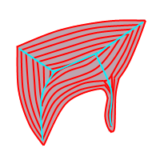
SVE | Pipeline
Skeletonization
Skeleton Distance Field
Influence Zones
Interaction + Correction
Notes:
Then, we proceed with skeleton distance field computation.

Slide 41
Skeleton Distance Field
Constructed during the skeletonization
Orders voxels with respect to the skeleton
Notes:
It is constructed during the skeletonization.

Slide 42
Skeleton Distance Field
Constructed during the skeletonization
Orders voxels with respect to the skeleton
1
1
1
1
1
1
1
1
1
1
1
1
1
1
1
1
1
1
1
1
1
1
1
1
1
1
1
1
1
1
1
1
1
1
1
1
1
Notes:
We assign to each removed voxel the number of iteration when it was removed.

Slide 43
Skeleton Distance Field
Constructed during the skeletonization
Orders voxels with respect to the skeleton
1
2
2
1
1
2
2
1
1
2
2
1
1
2
2
2
2
1
1
2
2
2
1
1
2
1
1
1
2
1
1
1
1
1
1
1
1
1
1
1
1
1
1
1
1
1
1
1
1
1
1
1

Slide 44
Skeleton Distance Field
Constructed during the skeletonization
Orders voxels with respect to the skeleton
$D_{S}\left(v\right)={It}^{\text{max}}−It\left(v\right)$
2
1
0
1
2
2
1
0
1
2
2
1
0
1
2
2
1
1
0
1
1
2
2
1
0
1
0
1
2
2
1
0
2
2
2
0
1
2
2
0
2
2
0
2
2
0
2
2
0
2
2
0
2
2
0
2
2
0
2
2
0
2
2
0
2
2
0
2
2
2
Notes:
Then, the skeleton distance of a voxel equals to the maximal number of iterations minus the number of iteration when the voxel was removed. As skeleton voxels are never removed, we assign to them zero distances.

Slide 45
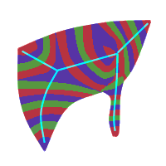
SVE | Pipeline
Skeletonization
Skeleton Distance Field
Influence Zones
Interaction + Correction
Notes:
Using the skeleton distance field we may determine influence zones

Slide 46
Influence Zones
Shortest path $D_{p→q}$ from skeleton voxel $p$ to voxel $q∈\text{Mask}$
2
1
0
1
2
2
1
0
1
2
2
1
0
1
2
2
1
1
0
1
1
2
2
1
0
1
0
1
2
2
1
0
2
2
2
0
1
2
2
0
2
2
0
2
2
0
2
2
0
2
$$IZ\left(p\right)=\left\{q | D_{p→q}=\min_{r∈S}{D_{r→q}}\right\}$$
2
0
2
2
0
2
2
0
2
2
0
2
2
0
2
2
0
2
2
2
Notes:
These zones are local parts of the segmentation mask that are connected to individual skeleton voxels. The influence zones are based on the skeleton distance field. They rely on the shortest path D from skeleton voxel p to voxel q in the segmentation mask. Formally, the influence zone of a skeleton voxel p is a set of voxels q, such that the path from p to q is the shortest compared to all other skeleton voxels.

Slide 47
Influence Zones | 1st Rule
Voxel $∈$ Mask
Skeleton voxel
2
1
0
q
p
1
0
2
0
2
Connection in an influence zone
Notes:
We start with the skeleton voxels. If a voxel q has a neighboring skeleton voxel p, then it is assigned to the influence zone of p. The arrows connect voxels within influence zones.

Slide 48
Influence Zones | 1st Rule
2
1
0
1
2
2
1
0
1
2
2
1
0
1
2
2
1
1
0
1
1
2
2
1
0
1
0
1
2
2
1
0
2
2
2
0
1
2
2
0
2
2
0
2
2
0
2
2
0
2
2
0
2
2
0
2
2
0
2
2
0
2
2
0
2
2
0
2
2
2
Notes:
Intermediate state of the influence zones construction is shown here.

Slide 49
Influence Zones | 2nd Rule
Voxel $∈$ Mask
Voxel $∈$ Mask
$$D_{S}\left(r\right)<D_{s}\left(q\right)$$
2
1
1
q
r
2
1
0
1
0
2
Notes:
However, not all voxels have neighboring skeleton voxels. Then we continue constructing the influence zones as follows. If a voxel q has a neighboring voxel r such that skeleton distance of r is less than skeleton distance of q, then q is assigned to the influence zone of r.

Slide 50
Influence Zones | 2nd Rule
2
1
0
1
2
2
1
0
1
2
2
1
0
1
2
2
1
1
0
1
1
2
2
1
0
1
0
1
2
2
1
0
2
2
2
0
1
2
2
0
2
2
0
2
2
0
2
2
0
2
2
0
2
2
0
2
2
0
2
2
0
2
2
0
2
2
0
2
2
2
Notes:
With this new rule, we continue the influence zones construction.

Slide 51
Influence Zones | 2nd Rule
2
1
0
1
2
2
1
0
1
2
2
1
0
1
2
2
1
1
0
1
1
2
2
1
0
1
0
1
2
2
1
0
2
2
2
0
1
2
2
0
2
2
0
2
2
0
2
2
0
2
2
0
2
2
0
2
2
0
2
2
0
2
2
0
2
2
0
2
2
2

Slide 52
Influence Zones | Result
Notes:
The influence zones are finally constructed. If we now color-code each influence zone, we get the following image.

Slide 53
Influence Zones | Ambiguities Handling
Handle ambiguity by Euclidean distance between $p$ and $q$
Handle ambiguity by populations of $IZ\left(p\right)$ and $IZ\left(r\right)$
Example of ambiguities handling
2
1
0
1
2
p
2
1
0
1
2
q
r
2
1
0
1
2
r
q
q
p
p
s
0
1
1
0
q
p
0
1
1
0
r
0
1
1
0
Links that are not used in Influence Zones construction
Choose the link to the Influence Zone with the smallest population
Notes:
There are the cases when we need to handle ambiguities in assignment of the influence zones. The first rule to handle the ambiguities is to use the Euclidean distance between the target voxel q and the source voxels p, r, and s. If there are several source voxels, we select from them one with the smallest Euclidean distance. If however, this is not enough to rule out the ambiguities, we apply the second rule. We assign the target voxel q to the influence zone with the smallest population. These two rules handle the ambiguities as shown in the example column.

Slide 54
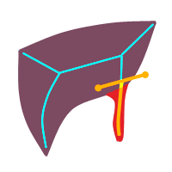
SVE | Pipeline
Skeletonization
Skeleton Distance Field
Influence Zones
Interaction + Correction
Notes:
With influence zones the selection on the skeleton can be propagated towards voxels in the segmentation mask.

Slide 55
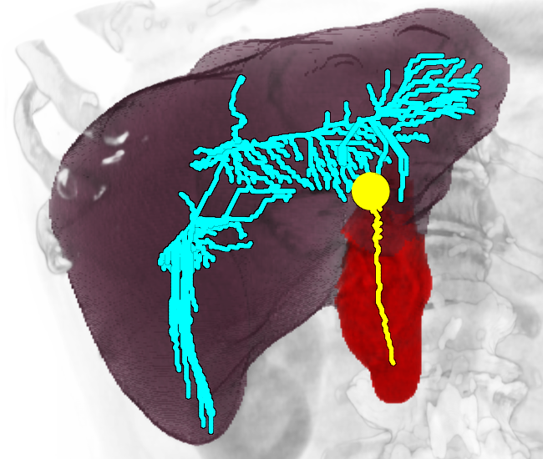
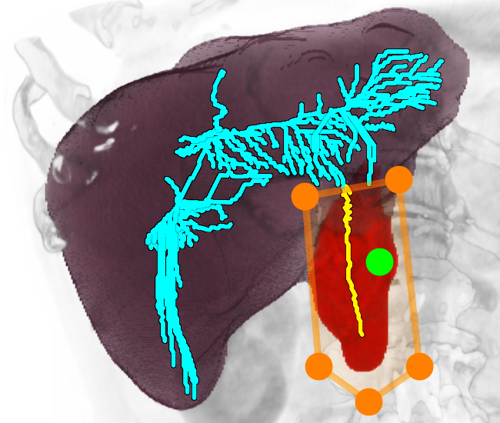
Selection Tools
User
Needle
Scalpel
Lasso
Data Source: [1]
Notes:
The user have the following selection tools: Needle, Scalpel, Lasso.

Slide 56
Selection Tools | Scalpel
Notes:
Here we demonstrate the scalpel selection tool that selects part of the skeleton in the example dataset.

Slide 57
Selection Tools | Scalpel
Notes:
We propagate the selection to voxels of the segmentation mask via the influence zones. The red part of the segmentation mask is selected here.

Slide 58
Selection Tools | Scalpel
Notes:
The user chooses the “remove part” operation. Results of the editing are displayed on the right side.

Slide 59
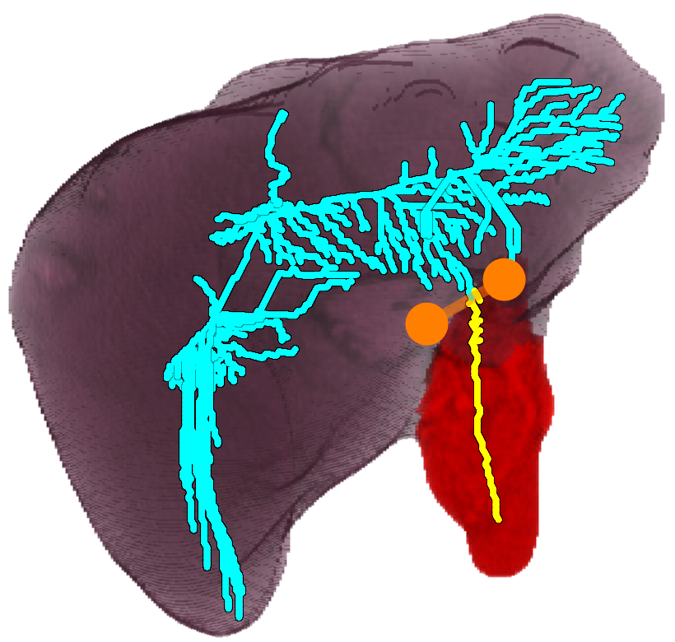
Selection Tools | Scalpel
Data Source: [1]
Notes:
In this medical dataset the user would like to correct the over-estimation defect. He selects the part of the segmentation mask with the scalpel selection tool. The user chooses the “remove part” operation. The removed part is highlighted in red.

Slide 60
Selection Tools | Scalpel
Data Source: [1]
Notes:
After applying the correction, the over-estimated region is fixed. The user interaction was just 2 mouse clicks for the specification of the defect.

Slide 61
SVE | Results
20 CTA datasets [1, 3]
Average correction time: 105 sec.
Quality is measured by the Jaccard coefficient $J$ of the segmentation mask and the ground truth:
The lowest quality improved from $0.76$ to $0.90$
The average quality increased from $0.86$ to $0.93$
“Sufficiently precise to correct major segmentation defects” [Domain Expert #2]
Notes:
We collected feedback of users on our technique. We used 20 Computed Tomography Angiography datasets of liver in abdominal region. The average correction time was one hundred five seconds. We measured the quality of the segmentation masks before and after the correction by the Jaccard Coefficient. The lowest quality improved from zero point seventy six to zero point ninety. The average quality increased from zero point eighty six to zero point ninety three. One domain expert commented that our technique is sufficiently precise to correct major segmentation defects.

Slide 62
SVE | Summary
Provides support for the simplified defect selection by the user
Offers selection tools and operations for rapid correction of major segmentation defects
The selection is based on the structural information derived from the skeleton
Notes:
To summarize, the skeleton-based volume editing provides support for the simplified defect selection by the user and offers selection tools and operations for rapid correction of major segmentation defects.
The selection is based on the structural information derived from the skeleton.

Slide 63
Overview of the Contributions
Guided Volume Editing
Statistics-Driven Localization of Dissimilarities in Data (SDL)
Guided Volume Editing based on Histogram Dissimilarity (GVE)
Volume Editing
Skeleton-based Volume Editing (SVE)
Notes:
Now we move to our next technique that offers guidance to the user.

Slide 64
GVE | Motivation
The user has to select the defect prior to its editing
Manual search task
Error-prone
Complicated interaction in 3D
Guide the user towards the defects after automatically detecting them
Data Source: [1]
Notes:
Without guidance, the user has to select the defect prior to its editing. It is a manual search task that is error-prone as it involves complicated interaction in 3D. Our idea is to guide the user towards the defects after we detected them.

Slide 65
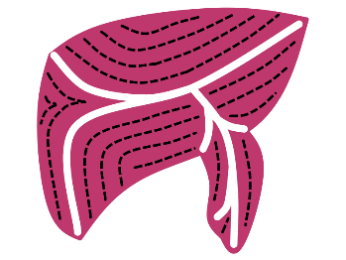
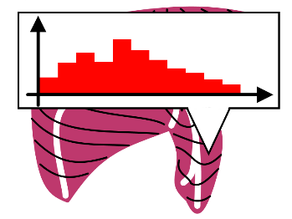
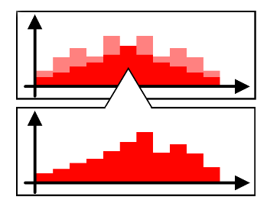
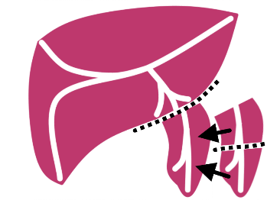
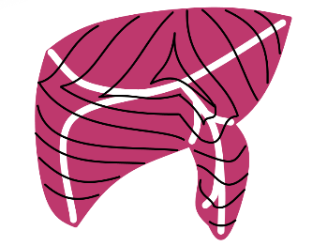
GVE | Overview
Input
Skeleton-based Volume Editing
Guided Volume Editing
Input
segmentation
mask
Regions of
data values collection
Data values collection into histograms
Histogram dissimilarity
analysis
Correction
scenarios generation
Notes:
Our assumption is that the object and the over-estimation defects have different data value distributions. We start with the definition of regions, where we collect data values. Then we discuss how exactly we store the collected data. Next, we introduce our dissimilarity measure. Finally, with the help of derived dissimilarities, we construct the correction scenarios that target the defects. As for under-estimation defects, we will refer to them later.

Slide 66
Phantom Dataset #1
Background
$$𝒩_{1}\left(μ_{1}=50,σ_{1}=20\right)$$
Object
$$𝒩_{2}\left(μ_{2}=150,σ_{2}=20\right)$$
Notes:
Let us consider the first phantom object. Here we have two classes of voxels – background and object. They have different distributions of scalar values.

Slide 67
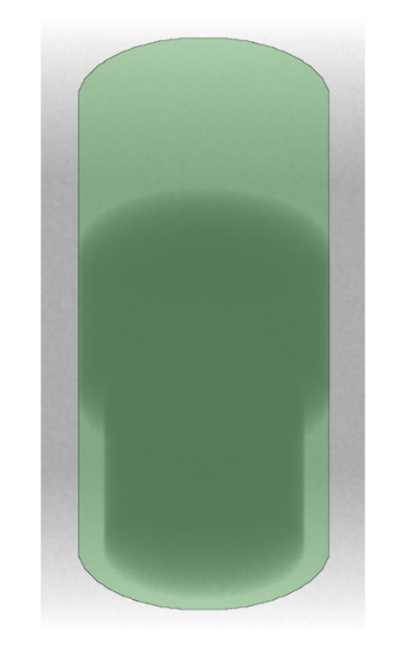
Phantom Dataset #1
$O_{P}$ defect
Segmentation mask
$O_{L}$ defect
Notes:
The segmentation mask definitely contains over-estimation defects.

Slide 68
Skeletonization
Skeleton voxel
Notes:
We represent the segmentation mask by the means of the skeleton.

Slide 69
Skeleton Distance Field
Notes:
During the skeletonization process, we also construct a skeleton distance field. The iso-surfaces of a skeleton distance field are shown here with colored bands.

Slide 70
Influence Zones
Notes:
Then we construct the influence zones. They are shown here with colored bands.

Slide 71
Part Defects | Detection
Notes:
Now we calculate a dissimilarity value delta-one at each skeleton voxel, in order to detect part defects.

Slide 72
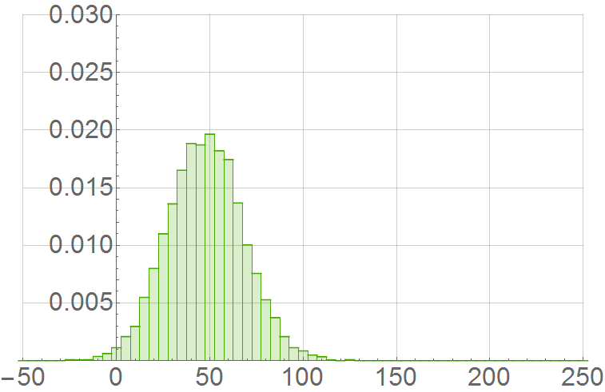
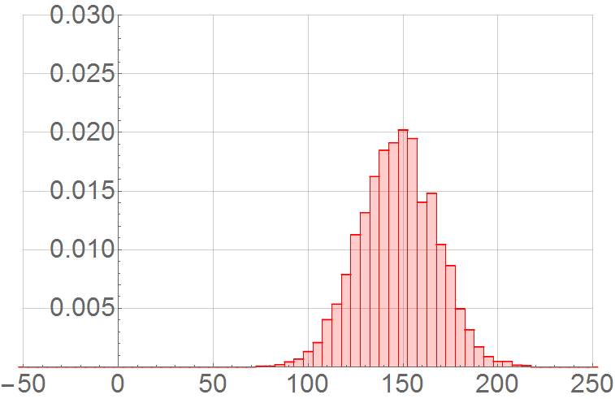
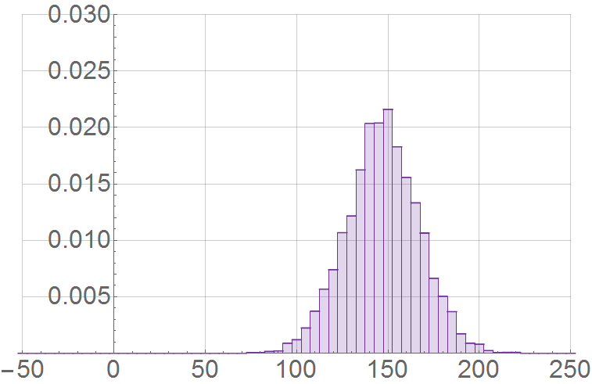
Part Defects | Data Collection
Notes:
To illustrate the process, let us consider this skeleton voxel. The dissimilarity value comes from comparison of histograms. Each histogram accumulates data values inside certain influence zone. For this particular skeleton voxel, we compare the histograms of the following three adjacent influence zones.

Slide 73
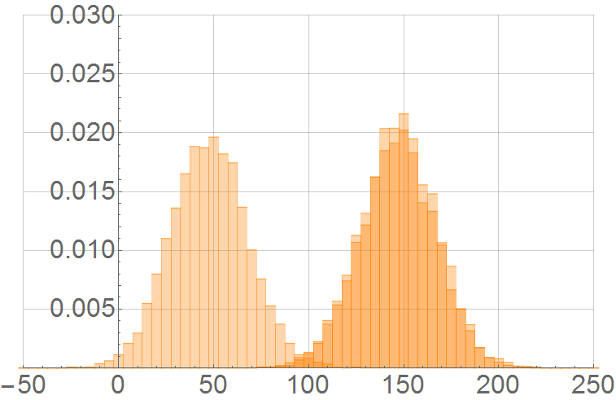
Part Defects | Dissimilarity Analysis
Notes:
Now we introduce a dissimilarity measure between the histograms.

Slide 74
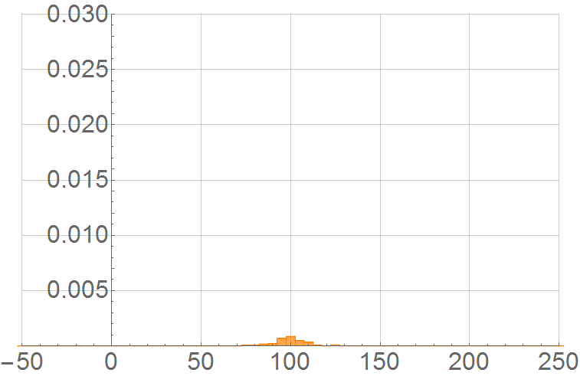
Part Defects | Dissimilarity Analysis
$$A_{∩}=0.0144$$
Notes:
We intersect all the histograms. Then we calculate area of intersection. This area represents the common part that the histograms share with each other.

Slide 75
Part Defects | Dissimilarity Analysis
$$A_{∩}=0.0144$$
$$δ_{1}=1−A_{∩}=0.9856$$
Notes:
To create a dissimilarity measure we subtract the area of intersection from one. Our dissimilarity measure is normalized. In case of no differences between the histograms it yields zero. As the differences appear, the dissimilarity value increases. Non-overlapping histograms have a maximal dissimilarity value of one. For this particular voxel, the dissimilarity value is rather high, which indicates presence of a part defect.

Slide 76
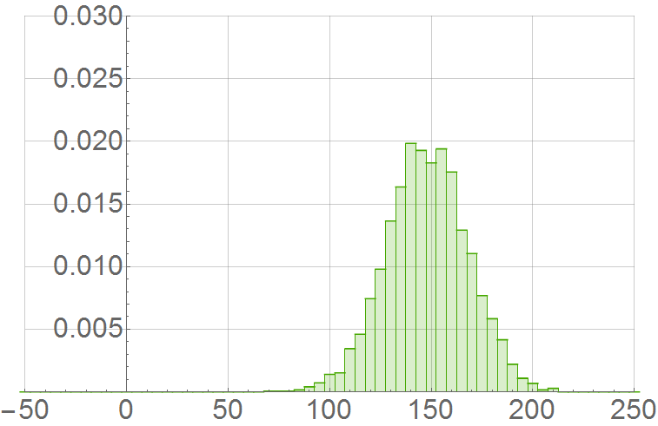
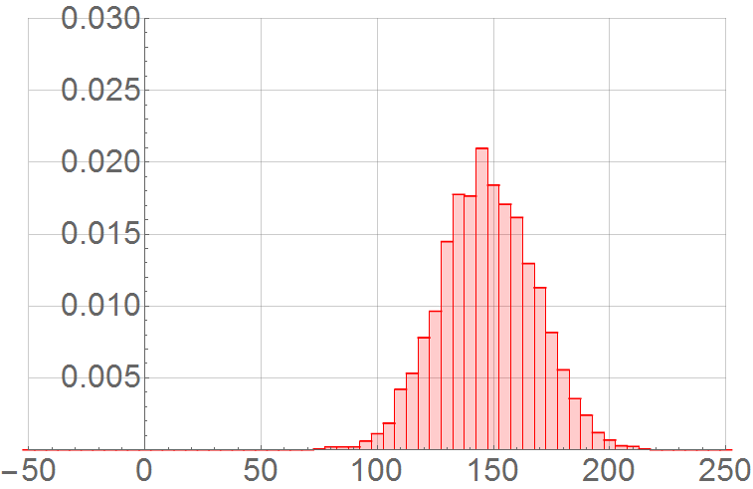
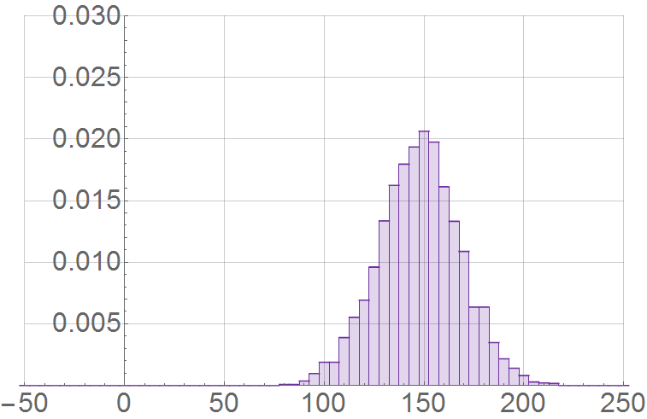
Part Defects | Data Collection
Notes:
Let us now try the region that is segmented properly.

Slide 77
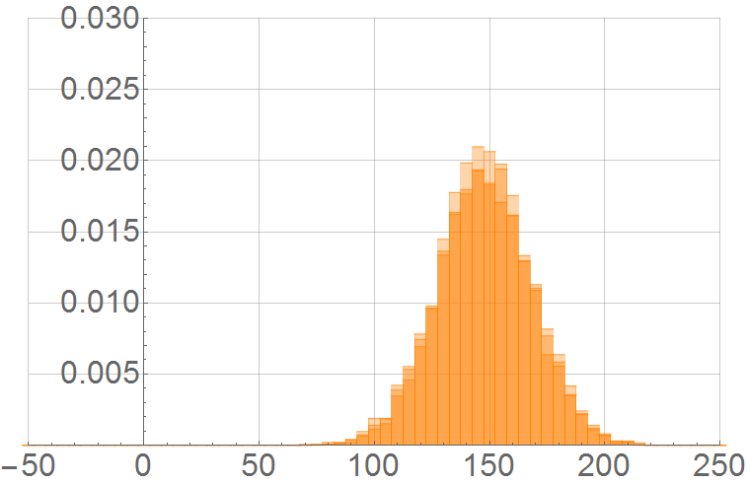
Part Defects | Dissimilarity Analysis
Notes:
The histograms look quite the same, however, there is some fluctuation of data values.

Slide 78
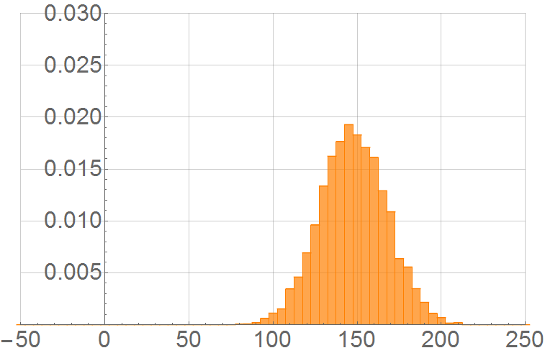
Part Defects | Dissimilarity Analysis
$$A_{∩}=0.948$$
$$δ_{1}=1−A_{∩}=0.052$$
Notes:
Our measure shows rather small dissimilarity. With such low value we are sure that this region is homogeneous enough.

Slide 79
Dissimilarity $δ_{1}$
$$δ_{1}$$
$$1$$
$$0$$
Skeleton
Skeleton
$$δ_{1}$$
$$0$$
$$1$$
Notes:
Let us now analyze the dissimilarity values at the skeleton voxels. By our assumption, defects and the object are separated from each other by ridges of the dissimilarity.

Slide 80
Watershed Transformation over $δ_{1}$
$$δ_{1}$$
$$R_{1}$$
$$R_{2}$$
$$B_{1}$$
$$B_{2}$$
$$B_{3}$$
$$1$$
$$0$$
Skeleton
Skeleton
$$δ_{1}$$
$$0$$
$$1$$
Notes:
To find these ridges we use the watershed transformation over the dissimilarity delta-1 defined on the skeleton. Here we have two ridges R1 and R2 that separate three basins B1, B2, and B3. Each basin represents a part of the segmentation mask that is either a defect or belongs to the object.

Slide 81
Hierarchical Watershed Transformation over $δ_{1}$
$$δ_{1}$$
$$R_{1}$$
$$B_{1}$$
$$B_{2}$$
$$1$$
Level for merging the basins
$$0$$
Skeleton
Skeleton
$$δ_{1}$$
$$0$$
$$1$$
Notes:
We proceed with the hierarchical watershed transformation that merges basins with small differences together. As a result, we get a hierarchy of the basins. Each level of hierarchy represents the entire segmentation mask with a certain level of detail. Each basin represents a correction region that the user can fix.

Slide 82
Hierarchical Watershed Transformation over $δ_{1}$
$$δ_{1}$$
$$B_{1}$$
Level for merging the basins
$$1$$
$$0$$
Skeleton
Skeleton
$$δ_{1}$$
$$0$$
$$1$$
Notes:
By adjusting the level of detail the user can get coarse or fine suggestions on where the defects are located.

Slide 83
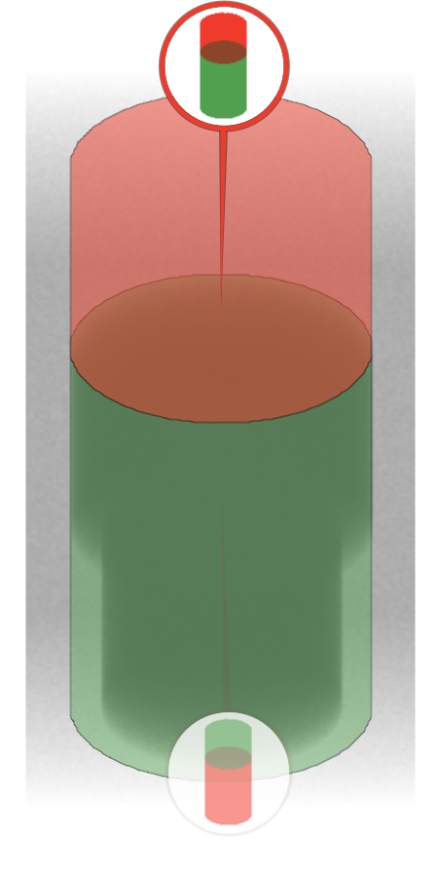
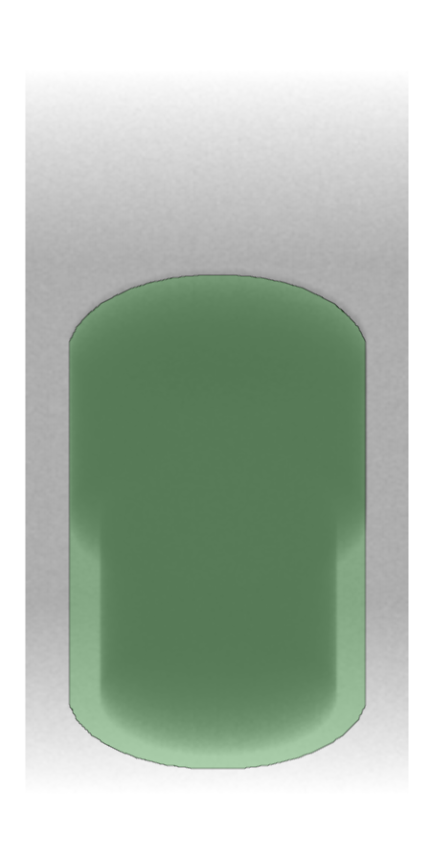
Part Defects | Correction
Notes:
Here we demonstrate how the user corrects the part defect in our example. He chooses certain level of detail, where two correction regions are presented. Then he selects one, and our technique fixes the defect by removing entire red region from the segmentation mask.

Slide 84
Layer Defects | Detection
Notes:
Now let us consider layer defects. In order to detect them, we calculate a dissimilarity value delta-two at each skeleton voxel.

Slide 85
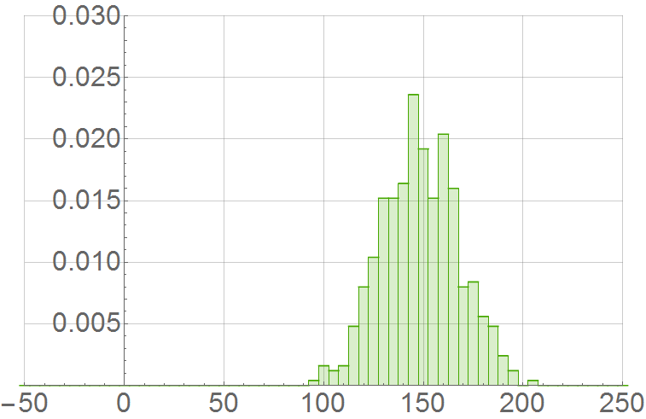
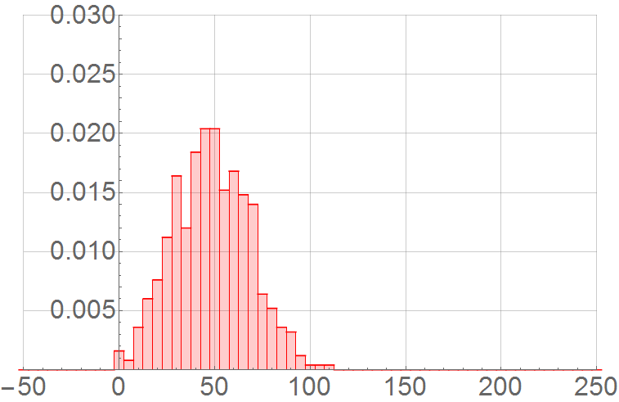
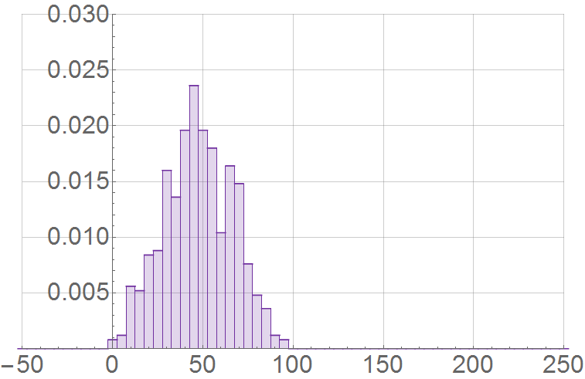
Layer Defects | Data Collection
Notes:
To illustrate the process, let us consider this skeleton voxel. We analyze its influence zone. In it we collect data values at each skeleton distance iso-surface into a separate histogram.

Slide 86
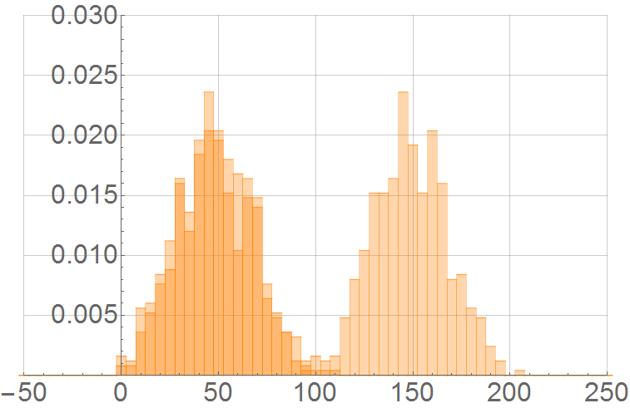
Layer Defects | Dissimilarity Analysis
Notes:
The histogram dissimilarity measure remains the same. First, we find intersection of all histograms, except those that are too close to the skeleton…

Slide 87
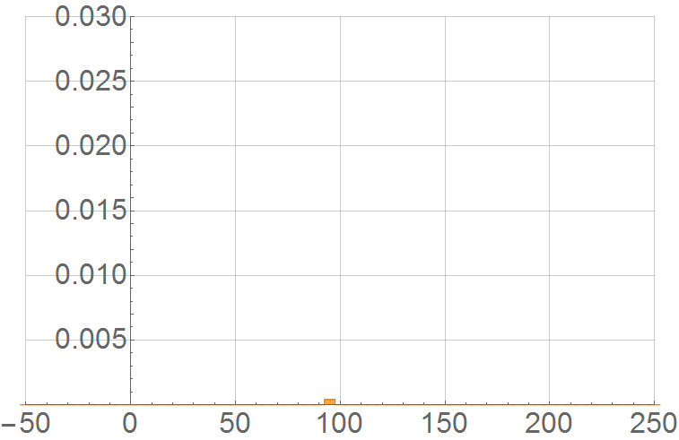
Layer Defects | Dissimilarity Analysis
$$A_{∩}=0.002$$
$$δ_{2}=1−A_{∩}=0.998$$
Notes:
… and then we subtract the area of intersection from one. At the position of the layer defect, our dissimilarity measure yields rather high value.

Slide 88
Layer Defects | Data Collection
Notes:
Now we check the dissimilarity measure at the region that does not contain any layer defect.

Slide 89
Layer Defects | Dissimilarity Analysis
Notes:
The histograms show some fluctuation…

Slide 90
Layer Defects | Dissimilarity Analysis
$$A_{∩}=0.804$$
$$δ_{2}=1−A_{∩}=0.196$$
Notes:
… , however, the intersection area is still large. The dissimilarity values delta-2 are usually higher than the dissimilarity values delta-1, as the histograms contain fewer values. Still, the defects can be distinguished. Having computed the dissimilarity delta-2, we use the hierarchical watershed transformation over it to obtain correction regions that potentially contain layer defects.

Slide 91
Layer Defects | Correction
Notes:
Here we demonstrate how the user corrects the layer defect. The user finds necessary correction regions easily. The correction operation for the layer defect is to peel surface at the red region away from the segmentation mask.

Slide 92
Under-Estimation Defects | Complement
Not $O$ Defects
Convex hull
Dilation of the hull
Exclusion of the segm. mask
$U$Defects in Cavities
$U_{L}$ Defects
Notes:
Under-estimation defects are considered to be over-estimation defects of the background. However, analyzing entire background is computationally expensive. Instead, we just take a part of it, called a complement. We define the complement as follows. First, we construct the convex hull of the segmentation mask. This would allow the user to fix defects in cavities. Then we dilate it. As a result, layer defects would be fixable. Finally, we remove all voxels from the segmentation mask as we do not correct over-estimation defects. This makes our volume editing technique consistent for all four kinds of the defects.

Slide 93
Under-Estimation Defects | Correction
Notes:
Here we demonstrate how the user corrects the under-estimation defects in our second phantom object. The only difference is that now the correction operations remove or peel the voxels from the blue part of the background and add them to the segmentation mask.

Slide 94
Glyphs for Correction Scenarios
 | Layer Defect $L$ | Part Defect $P$
Over-estimation Defect $O$
Under-estimation Defect $U$
Notes:
Each correction scenario is represented by a glyph. Shape of the glyph distinguishes correction of part and layer defects. Color of the glyph distinguishes between over-estimation and under-estimation correction. A miniature image is shown inside the glyph and serves as a preview of the correction. It allows the user to quickly find necessary correction scenario.

Slide 95
GVE | Vessel Segmentation Editing
Data Source: [4]
Notes:
In order to present the user interaction with our technique, we perform segmentation editing of vessels. This dataset captures knee region of the human lower extremities. The contrast agent is added to the blood in order to enhance visibility of vessels.

Slide 96
GVE | Vessel Segmentation Editing
Initial Segmentation Mask
Desired Segmentation Mask
Data Source: [4]
Notes:
In the knee region we have trabecular bones that are resembling the appearance of contrast-enhanced vessels. Also, here the vessels and bones touch. Therefore, an automatic segmentation results in severe over-estimation defects that contain the bones. The segmentation mask of the vessels should not contain the bones, as they hide the vessels in rendered images.

Slide 97
GVE | Vessel Segmentation Editing
Data Source: [4]
Notes:
The user starts with investigating two major components, each of which contains vessels and bones. He starts with correcting segmentation of the right vessel.

Slide 98
GVE | Vessel Segmentation Editing
Data Source: [4]
Notes:
By selecting the corresponding glyph, the user receives suggestion to remove the entire structure highlighted in red. However, this suggestion is sub-optimal, as it would remove the vessels as well. Therefore, the user adjusts the level of detail to get finer suggestions.

Slide 99
GVE | Vessel Segmentation Editing
Data Source: [4]
Notes:
At this level of detail, the structure on the right is split into 3 regions: two regions contain the bones, and one region contains the vessels. The user selects the region that contains most of the bones.

Slide 100
GVE | Vessel Segmentation Editing
Data Source: [4]
Notes:
Before the user applies the selected scenario, he has a possibility to validate the correction in the slice view. The red part is then removed.

Slide 101
GVE | Vessel Segmentation Editing
Data Source: [4]
Notes:
After removing the major bone structures from the right vessel, the user focuses on the left part of the segmentation mask.

Slide 102
GVE | Vessel Segmentation Editing
Data Source: [4]
Notes:
After adjusting the level of detail, he finds the correction that separates the vessel from rest of the bones.

Slide 103
GVE | Vessel Segmentation Editing
Data Source: [4]
Notes:
Now both vessels are split from the remaining bone fragments. The user chooses the correction operations that remove these bone fragments.

Slide 104
GVE | Vessel Segmentation Editing
Data Source: [4]
Notes:
This is rather straight-forward task, as each connected component is represented with its own glyph at the coarsest level of detail.

Slide 105
GVE | Vessel Segmentation Editing
Data Source: [4]

Slide 106
GVE | Vessel Segmentation Editing
Data Source: [4]

Slide 107
GVE | Vessel Segmentation Editing
Data Source: [4]

Slide 108
GVE | Vessel Segmentation Editing
Data Source: [4]

Slide 109
GVE | Vessel Segmentation Editing
Data Source: [4]

Slide 110
GVE | Vessel Segmentation Editing
Data Source: [4]

Slide 111
GVE | Vessel Segmentation Editing
Data Source: [4]

Slide 112
GVE | Vessel Segmentation Editing
Data Source: [4]
Notes:
In the end, the user achieves the required quality of the segmentation mask. This mask can be further used for creating vessel reformation images that communicate size of vessel lumen and potential vessel stenosis.

Slide 113
GVE | Evaluation
Sufficient information for making decision
Possibility to adjust the level of detail of corrections
Miniatures provide good preview of changes
Guidance of the user during the correction
Useful suggestions for defects correction
Fine-tuning and verification instead of manual search for the defects and their fixes
Overview of the correction suggestions
Data Source: [1, 3]
Notes:
During the evaluation, the domain experts pointed out that: they had sufficient information for making decisions while correcting the defects, they liked the possibility to adjust the level of detail of corrections, the miniatures provide good preview of changes, the users appreciated the guidance during the correction, they considered the suggestions for defect correction useful, and, finally, they spent more time for the fine-tuning and verification of changes instead of manually searching for the defects and their fixes. Only one aspect of the technique is suboptimal according to our domain experts. It is an overview of the correction suggestions with the glyphs.

Slide 114
GVE | Comparative Evaluation
Interaction: GVE, PB
Time: GVE, SVE
Ease of use: GELS (voxel-level editing in slices)
Tolerance: GVE
Satisfaction: GVE, PB, TV, GELS
GVE – our guided volume editing technique
SVE – our skeleton-based volume editing technique
PB, TV, GELS – clinical state-of-the-art techniques for interactive segmentation: Phillips Brilliance, Toshiba Vitrea, and General Electric Light Speed
Data Source: [1, 3]
Notes:
We compared our technique GVE with our previous method SVE and three clinical state-of-the-art techniques for interactive segmentation. Our technique got the best score in the following categories: interaction efforts, interaction time, tolerance to the imprecise user-input, satisfaction with the end result. The only category our technique was not considered the best was ease of use. The slice-based voxel-level editing in the technique GELS was the easiest.

Slide 115
GVE | Comparative Evaluation
Technique | GVE | SVE | PB | TV | GELS
Average quality before | $$0.83$$ |  | $$N/A$$
Average interaction time | $40$ sec. | $60$ sec. | $100$ sec. | $150$ sec. | $780$ sec.
Average quality after | $$0.92$$ | $$0.92$$ | $$0.91$$ | $$0.88$$ | $$0.94$$
Data Source: [1, 3]
Notes:
We also derived quantitative information about the compared techniques. With our technique GVE, the users spent the shortest time doing corrections. The result is comparable to manually tuned corrections in our previous technique SVE. With techniques PB and TV the users spent more time, reaching, however, fewer quality. Only the slice-based voxel-level editing with GELS reached better quality than our techniques, but it took tremendous amount of efforts.

Slide 116
GVE | Summary
Dissimilarity information allows detection of segmentation defects
Type of the defect suggests necessary operations for its correction
Hierarchy of correction scenarios enables fine tuning of the editing operations
Notes:
We summarize the guided volume editing technique with the following statements: dissimilarity information allows detection of segmentation defects, type of the defect suggests necessary operations for its correction, hierarchy of correction scenarios enables fine tuning of the editing operations.

Slide 117
Overview of the Contributions
Guided Volume Editing
Statistics-Driven Localization of Dissimilarities in Data (SDL)
Guided Volume Editing based on Histogram Dissimilarity (GVE)
Volume Editing
Skeleton-based Volume Editing (SVE)
Notes:
Now we proceed with the last method: Statistics-Driven Localization of Dissimilarities in Data.

Slide 118
SDL | Motivation
Guided Volume Editing technique has mediocre overview capabilities
Notes:
This work is motivated by the following observations.
First, the guided volume editing technique has mediocre overview capabilities as was pointed out during the evaluation.

Slide 119
SDL | Motivation
Guided Volume Editing technique has mediocre overview capabilities
They may not be sufficient for segmenting complex structures, e.g., vessels of the human body
Data Source: [2]
Notes:
These capabilities may not be sufficient for segmenting complex structures, for example, vessels of the human body.

Slide 120
SDL | Motivation
Guided Volume Editing technique has mediocre overview capabilities
They may not be sufficient for segmenting complex structures, e.g., vessels of the human body
The technique has no reference data to distinguish the object from the defect
Notes:
The guided volume editing technique has no reference data to distinguish between the object and the defect. Instead, it detects inhomogeneities via the dissimilarity measure. In this example, the user can remove either upper or lower part that are split by region with severe inhomogeneity. The lower part, in fact, contains the object. The upper part does not. The user has to decide which part to remove.

Slide 121
Statistics-Driven Localization of Dissimilarities
Statistics-Driven Localization of Dissimilarities
Visual Guidance during Interactive Data Exploration
Statistical Evaluation of Dissimilarities in Data
Notes:
Our third segmentation editing technique is based on statistical handling of the data values. It has the following main contributions: statistical evaluation of dissimilarities in data and visual guidance during interactive data exploration. Due to the time constraints, we focus on the visual guidance contribution.

Slide 122
SDL | Vessel Segmentation Editing
Volume Data
Initial Segmentation Mask
Corrected Segmentation Mask
Data Source: [2]
Notes:
Let us now consider an entire vessel tree of the human lower extremities. Such kind of objects is more complex to segment than single organ. Also, it is a global structure in the body compared to vessels in knee region. Due to several contact points between bones and vessels and usage of the contrast enhancement agent, the initial segmentation mask has severe over-estimation defects. These defects should be corrected prior to rendering vessel reformation images.

Slide 123
SDL | Vessel Segmentation Editing
Data Source: [2]
Notes:
We follow our assumption that the over-estimation defects and the object have different data value distributions. To enable the statistical analysis of the dissimilarities, in our technique the user specifies several markers inside the object of interest. In this case, all four markers are specified inside the vessel structures. Then we compute dissimilarities in data values between various regions of the volume and the markers. The vessels get blue tones that indicate low dissimilarity estimate to the markers. The bones, contrary, exhibit significant differences and, thus, are colored with red tones.

Slide 124
SDL | Vessel Segmentation Editing
Data Source: [2]
Notes:
After having statistically evaluated the dissimilarities, we introduce the user to the following view. The radial tree displays the hierarchy of the correction scenarios from our previous method. We enhance the tree with the color-coded statistical information. Red tones denote the correction regions with severe dissimilarities to several markers the user placed. Blue tones indicate low dissimilarity regions. We sort the tree nodes by increasing dissimilarity counterclockwise.

Slide 125
SDL | Vessel Segmentation Editing
Data Source: [2]
Notes:
In this particular example, the user is interested in finding regions with high dissimilarity, as they most likely do not contain the vessels. We aid the user in this task by identifying the most dissimilar regions at each level of detail and connecting them with the path in the radial tree. By following this path, the user explores only relevant correction scenarios adjusting the level of detail on-the-fly. In this slide, the user quickly finds along the path the correction scenario that removes most of the bones shown in red.

Slide 126
SDL | Vessel Segmentation Editing
Data Source: [2]
Notes:
After applying the found correction scenario, the user continues the correction. Now, in the radial tree he finds the correction scenario that removes vertebrae highlighted in red.

Slide 127
SDL | Vessel Segmentation Editing
Data Source: [2]
Notes:
With the third correction, the user removes the tibia and fibula.

Slide 128
SDL | Vessel Segmentation Editing
Data Source: [2]
Notes:
Rarely, while following the path the user arrives at the region that is suboptimal in terms of the correction. Such region is, in fact, correctly segmented. In this particular case, the path suggests the aorta region with calcification. This is the reason why the region is recognized as different from other vessels. The user can select alternative path by clicking at a different node of the radial tree. The path that passes through the selected node is then displayed allowing further exploration. Here, the user would like to remove the remaining vertebrae.

Slide 129
SDL | Vessel Segmentation Editing
Data Source: [2]
Notes:
With the fifth editing operation, the user removes the tibia and fibula.

Slide 130
SDL | Vessel Segmentation Editing
Data Source: [2]
Notes:
After removing connected components without markers, the user achieves the desired segmentation mask.

Slide 131
SDL | Vessel Segmentation Editing
Data Source: [2]
Notes:
The user can compare the current state of the segmentation against the original state. The overall improvement of quality related to decrease of the corresponding dissimilarity values is conveyed to the user with more blue tones.

Slide 132
SDL | Vessel Segmentation Editing
Result from our editing technique
Result from manual editing by domain experts
Notes:
For comparison reasons we provide the segmentation of the same dataset performed in a different framework by a domain expert. Major vessel structures are present in both segmentation masks. Finer vessel structures, though, are missing in both masks, because with the current workflow the domain experts are not interested in them.

Slide 133
SDL | Evaluation
Improved overview
Exploration with the radial tree and paths in it
Straightforward specification of markers
Effective color-coding of dissimilarity
Increased confidence due to statistical information on the defects
Specification of markers in tiny vessels
Data Source: [2]
Notes:
During the evaluation our domain experts confirmed that the radial tree and the paths in it improve the overview of the correction suggestions, the exploration paths are guiding the user towards the necessary correction scenarios, the specification of markers is straightforward, the color coding of dissimilarity is effective. They felt more confident having statistical information on the defects. The experts expressed a little concern about specifying the markers in tiny vessels.

Slide 134
SDL | Comparative Evaluation
Interaction: SDL
Time: SDL
Ease of use: SDL
Tolerance: SDL
Satisfaction: SDL, AVP
Information: SDL
SDL – our statistics-driven localization of dissimilarities in data
GVE – our skeleton-based volume editing technique
AVP – method employed in the AngioVis framework
$t_{\text{avg}}\left(SDL\right)=350$ sec. $t_{\text{avg}}\left(\text{GVE}\right)>1200$ sec. $t_{\text{avg}}\left(\text{AVP}\right)=380$ sec.
Data Source: [2]
Notes:
We compared our technique SDL with the original volume-editing technique GVE and the method employed in the clinical AngioVis framework AVP. Unfortunately, the experts were unable to finish their tasks in acceptable time frame with GVE due to its poor overview capabilities. Our technique SDL got best scores in the following categories: interaction efforts, interaction time, ease of use, tolerance to imprecise user-input, and information for decision making. With both techniques SDL and AVP the experts were satisfied with the results. The average correction time was slightly shorter with our technique SDL.

Slide 135
SDL | Summary
Statistical quantification of the dissimilarities discriminates segmentation defects and the object
The data exploration protocol enabled by the radial tree and the paths in it
Streamlined segmentation editing with a guidance towards the defects and estimation of the segmentation quality
Notes:
We summarize the statistics-driven localization of dissimilarities in data with the following statements:
Statistical quantification of the dissimilarities discriminates segmentation defects and the object,
We offer the data exploration protocol enabled by the radial tree and the paths in it,
Our technique provides streamlined segmentation editing with active guidance towards the defects and estimation of the segmentation quality.

Slide 136
Conclusion
 | Skeleton-based Volume Editing (SVE) | Guided Volume Editing based on Histogram Dissimilarity (GVE) | Statistics-Driven Localization of Dissimilarities in Data (SDL)
Q1 | Direct interaction on the skeleton | Automatically suggested corrections | Automatically suggested corrections that match the reference statistically
Q2 | User-specified operations | Suggested correction operations | Suggested correction operations
Q3 | N/A | Histogram dissimilarity metric | Statistical significance of dissimilarity in data values
Q4 | N/A | Glyphs | Radial tree and paths in it
Q5 | Manual selection of the defect and its correction operation | Find necessary correction among large number of the suggestions | Find necessary correction following the paths in the tree
How to select the defects prior to the correction?
Notes:
Summarizing our contributions to the guided volume editing, we provide the following answers to the research questions we identified. How to select the defects prior to the correction? Our SVE technique allows the user to select part of the segmentation mask by directly interacting on the skeleton. In order to guide the user, we automatically suggest where to correct defects in the GVE technique. The suggestions are matched to the reference statistically in our SDL method, further supporting the user while he selects the defects.

Slide 137
Conclusion
 | Skeleton-based Volume Editing (SVE) | Guided Volume Editing based on Histogram Dissimilarity (GVE) | Statistics-Driven Localization of Dissimilarities in Data (SDL)
Q1 | Direct interaction on the skeleton | Automatically suggested corrections | Automatically suggested corrections that match the reference statistically
Q2 | User-specified operations | Suggested correction operations | Suggested correction operations
Q3 | N/A | Histogram dissimilarity metric | Statistical significance of dissimilarity in data values
Q4 | N/A | Glyphs | Radial tree and paths in it
Q5 | Manual selection of the defect and its correction operation | Find necessary correction among large number of the suggestions | Find necessary correction following the paths in the tree
How to correct the selected defect?
Notes:
How to correct the selected defect? Originally, the user had to choose which correction operation to apply in the SVE technique. By discriminating different types of defects, we automatically select the necessary correction operations in the GVE technique. The same mechanism is used in the SDL method.

Slide 138
Conclusion
 | Skeleton-based Volume Editing (SVE) | Guided Volume Editing based on Histogram Dissimilarity (GVE) | Statistics-Driven Localization of Dissimilarities in Data (SDL)
Q1 | Direct interaction on the skeleton | Automatically suggested corrections | Automatically suggested corrections that match the reference statistically
Q2 | User-specified operations | Suggested correction operations | Suggested correction operations
Q3 | N/A | Histogram dissimilarity metric | Statistical significance of dissimilarity in data values
Q4 | N/A | Glyphs | Radial tree and paths in it
Q5 | Manual selection of the defect and its correction operation | Find necessary correction among large number of the suggestions | Find necessary correction following the paths in the tree
How to detect certain types of defects?
Notes:
How to detect certain types of defects? Our GVE technique detects four types of defects by analyzing histogram dissimilarities. As a result, we split the segmentation mask into parts that belong to the object, to the background, or to defects. With the SDL method, we can discriminate between these three cases, focusing the user on regions with defects.

Slide 139
Conclusion
 | Skeleton-based Volume Editing (SVE) | Guided Volume Editing based on Histogram Dissimilarity (GVE) | Statistics-Driven Localization of Dissimilarities in Data (SDL)
Q1 | Direct interaction on the skeleton | Automatically suggested corrections | Automatically suggested corrections that match the reference statistically
Q2 | User-specified operations | Suggested correction operations | Suggested correction operations
Q3 | N/A | Histogram dissimilarity metric | Statistical significance of dissimilarity in data values
Q4 | N/A | Glyphs | Radial tree and paths in it
Q5 | Manual selection of the defect and its correction operation | Find necessary correction among large number of the suggestions | Find necessary correction following the paths in the tree
How to present detected defects to the user?
Notes:
How to present detected defects to the user? In the GVE technique, we present potential defects using the glyphs. To further improve the visualization in the SDL method, we display the hierarchy of the suggestions with the radial tree. We color code the statistical information in it. The most relevant regions that potentially contain the defects are linked together by the exploration paths.

Slide 140
Conclusion
 | Skeleton-based Volume Editing (SVE) | Guided Volume Editing based on Histogram Dissimilarity (GVE) | Statistics-Driven Localization of Dissimilarities in Data (SDL)
Q1 | Direct interaction on the skeleton | Automatically suggested corrections | Automatically suggested corrections that match the reference statistically
Q2 | User-specified operations | Suggested correction operations | Suggested correction operations
Q3 | N/A | Histogram dissimilarity metric | Statistical significance of dissimilarity in data values
Q4 | N/A | Glyphs | Radial tree and paths in it
Q5 | Manual selection of the defect and its correction operation | Find necessary correction among large number of the suggestions | Find necessary correction following the paths in the tree
How to design the interactive editing process?
Notes:
How to design the interactive editing process? In the SVE technique, the user manually selects the defect and its correction operation. In the GVE technique, the user’s task is to find necessary correction among large number of the suggestions. This way we guide the user at each individual correction step. With the SDL method, the user only checks the suggestions along the exploration path. In rare cases, he needs alternative paths, available in the radial tree. We also guide the user throughout the entire editing process by estimating the segmentation quality after each correction step.

Slide 141
Data Sources
[1] SLiver 2007 Contest: T. Heimann, B. van Ginneken, M. Styner
[2] General Hospital of Vienna, Austria
[3] Republican Clinical Hospital of G. G. Kuvatov, Ufa, Russia
[4] Kaiser-Franz-Josef Hospital of Vienna, Austria
Notes:
During making our thesis we utilized the following data sources.

Slide 142
The End
Thank you for your attention!
Skeleton-based Volume Editing
Guided Volume Editing based on Histogram Dissimilarity
Statistics-Driven Localization of Dissimilarities in Data
Data Source: [1, 2, 4]
Notes:
Thank you for your attention.

Slide 143
Segmentation Editing | Existing Approaches
Interactive segmentation
Volume editing
Graph cut
Random walker
Live wire
Statistical shape model
Deformable 3D mesh
Active contour
Specialized interactive editing tools
Sketches + Surface reconstruction
Beichel et al. [1], Boykov et al. [2, 3], Egger et al. [4], Liu et al. [5], Kohli and Torr [6], Tarlow and Adams [7]
Funka and Grady [8], El-Zehiry et al. [9], Praßni et al. [10]
Mortensen and Barrett [11], Hastreiter and Ertl [12], Falcão and Udupa [13], Hamarneh et al. [14], Poon et al. [15], Top et al. [16]
Bornik et al. [25], Proksch et al. [26], Timinger et al. [27], Jackowski et al. [28]
Li et al. [17], Wang and Ma [18], Yushkevich et al. [19]
Beichel et al. [20], Mirzaalian et al. [21], Neumann and Lorenz [22], Seim et al. [23], Zhang et al. [24]
Heckel et al. [29], Heimann et al. [30]
Kang et al. [31], Silva et al. [32]
Notes:
In this slide, we give references to the related work.

Slide 144
Interactive Segmentation | Graph Cuts
User input: seed points, sketches
Guidance: underlying uncertainty is quantified [6, 7]
Voxel with low intensity
Voxel with high intensity
Background seed point (terminal)
Object seed point (terminal)
Graph edge
Graph cut through an edge
Notes:
With the graph cuts, the user specifies seed points or sketches that are either belong to the object or the background. The graph is constructed with vertices located at the individual voxels and edges linking the neighboring voxels. Some graph edges are cut separating the object and the background. The graph cut is optimized in terms of costs of the cut edges.
Underlying uncertainty related to the chosen graph cut is quantified.

Slide 145
Interactive Segmentation | Random Walk
User input: seed points [8], sketches [9, 10]
Guidance: underlying uncertainty is quantified, regions are ranked by their uncertainty [10]
Voxel with low intensity
Voxel with high intensity
Background seed point (terminal)
Object seed point (terminal)
Connection with high probability
Connection with low probability
Notes:
Random walkers also use as an input seed-points or sketches. The connections between neighboring voxels are assigned certain probabilities given relative characteristics of the voxels. The random walk from each voxel is performed. Each voxel is classified by type of the seed point it reaches with higher probability. Underlying uncertainty of the segmentation is quantified. Some authors suggest to rank regions by their uncertainty. This way the user refines most uncertain regions first.

Slide 146
Interactive Segmentation | Live Wire
User input: seed points (nodes)
Guidance: slice with the most unstable contour is found [16]
Voxel with low intensity
Voxel with high intensity
Start node
Goal node
Edge of checked route to a goal node
Resulting contour
Notes:
Live wire is a curve or surface that passes through user-specified points called nodes. The exact contour is determined by dynamical programming that check all routes from start nodes to goal nodes. The optimal route with respect to image data characteristics is found. Some authors suggest to show the user the slice of data that contains the most unstable contour. The user’s interaction should refine such contour.

Slide 147
Interactive Segmentation | Active Contour
User input: coarse contour of the object
Guidance: no guidance of the user to the best of our knowledge
Voxel with low intensity
Voxel with high intensity
Coarse contour
Corrected contour
Notes:
Active contours start with a coarse contours of the object either drawn by the user or found by some heuristic. The final contour is then generated after several optimization iterations. The user can affect the result by changing the coarse contour locally.

Slide 148
Interactive Segmentation | Stat. Shape Model
User input: landmark points
Guidance: no guidance of the user to the best of our knowledge
Voxel with low intensity
Voxel with high intensity
Automatically fit contour from the statistical shape model
User-specified landmark point
Corrected contour
Notes:
With the statistical shape models the user can specify some landmark points. Then pre-computed shape model is then fitted to the data and the landmark points.

Slide 149
Segmentation Editing | Deformable 3D Mesh
User input: pairs of points that define the deformation
Guidance: no guidance of the user to the best of our knowledge
Voxel in the initial segm. mask
Voxel in the initial segm. mask
Initial point for the deformation
End point for the deformation
Initial surface mesh
Corrected surface mesh after the deformation
Notes:
Using deformable 3D meshes, the user can easily correct the major segmentation defects by displacing vertices of the mesh and deforming the surface. However, the user may need to specify the complete transformation, meaning both initial and end points.

Slide 150
Segmentation Editing | Sketches
User input: sketches (or scribbles)
Guidance: no guidance of the user to the best of our knowledge
Voxel with low intensity
Voxel with high intensity
Initial surface of the segm. mask
Sketch input
Corrected surface of the segm. mask
Notes:
With sketch interfaces, the user can mark the segmentation defects and roughly specify how to correct them. By representing the segmentation mask with certain basis functions, these algorithms incorporate the sketch data and reconstruct the corrected segmentation mask.

Slide 151
Segmentation Editing | Specialized Tools
Cover various interaction tools specialized for particular types of segmentation defects
Do not fit for general volume editing task due to this specialization
Technique by Kang et al. [31] offers:
Hole filling tool for fixing holes and cavities in bone segmentation masks
Point bridging tool for correcting trochanter major segmentation mask
Surface dragging tool for editing bones surfaces
Notes:
The specialized segmentation editing tools are designed for particular types of segmentation defects. They do not fit for general volume editing task. As an example, the technique by Kang et al. offers hole filling, point bridging, and surface dragging tools. These tools may be suboptimal when applied to different organs than originally designed.

Slide 152
Bibliography
[1] Beichel, R., Bauer, C., Bornik, A., Sorantin, E., & Bischof, H. (2007). Liver Segmentation in CT data: A Segmentation Refinement Approach. In Proceedings of MICCAI Workshop on 3D Segmentation in The Clinic (pp. 235–245).
[2] Boykov, Y., & Funka-Lea, G. (2006). Graph Cuts and Efficient N-D Image Segmentation. International Journal of Computer Vision, 70(2), 109–131. http://doi.org/10.1007/s11263-006-7934-5
[3] Boykov, Y., & Veksler, O. (2006). Graph Cuts in Vision and Graphics : Theories and Applications. In Handbook of Mathematical Models in Computer Vision (pp. 1–19).
[4] Egger, J., Colen, R. R., Freisleben, B., & Nimsky, C. (2012). Manual Refinement System for Graph-Based Segmentation Results in the Medical Domain. Journal of Medical Systems, 36(5), 2829–2839. http://doi.org/10.1007/s10916-011-9761-7
[5] Liu, L., Raber, D., & Nopachai, D. (2008). Interactive separation of segmented bones in CT volumes using graph cut. Lecture Notes in Computer Science, 5241, 296–304. http://doi.org/10.1007/978-3-540-85988-8_36
[6] Kohli, P., & Torr, P. H. S. (2008). Measuring uncertainty in graph cut solutions. Computer Vision and Image Understanding, 112(1), 30–38. http://doi.org/10.1016/j.cviu.2008.07.002
[7] Tarlow, D., & Adams, R. P. (2012). Revisiting uncertainty in graph cut solutions. Proceedings of the IEEE Computer Society Conference on Computer Vision and Pattern Recognition, 2440–2447. http://doi.org/10.1109/CVPR.2012.6247958
[8] Grady, L., & Funka-Lea, G. (2006). An Energy Minimization Approach to the Data Driven Editing of Presegmented Images / Volumes. Lecture Notes in Computer Science, 4191, 888–895. http://doi.org/10.1007/11866763_109

Slide 153
Bibliography
[9] El-Zehiry, N., Jolly, M. P., & Sofka, M. (2013). A splice-guided data driven interactive editing. In Proceedings of IEEE International Symposium on Biomedical Imaging (pp. 6–9). http://doi.org/10.1109/ISBI.2013.6556670
[10] Praßni, J.-S., Ropinski, T., & Hinrichs, K. (2010). Uncertainty-aware guided volume segmentation. IEEE Transactions on Visualization and Computer Graphics, 16(6), 1358–65. http://doi.org/10.1109/TVCG.2010.208
[11] Mortensen, E. N., & Barrett, W. A. (1995). Intelligent Scissors for Image Composition. In SIGGRAPH ’95 Proceedings of the 22nd annual conference on Computer graphics and interactive techniques (pp. 191–198). http://doi.org/10.1145/218380.218442
[12] Hastreiter, P., & Ertl, T. (1998). Fast and Interactive 3D Segmentation of Medical Volume Data. Computer Graphics International, 78–85.
[13] Falcão, A. X., & Udupa, J. K. (2000). A 3D generalization of user-steered live-wire segmentation. Medical Image Analysis, 4, 389–402. http://doi.org/10.1016/S1361-8415(00)00023-2
[14] Hamarneh, G., Yang, J., McIntosh, C., & Langille, M. (2005). 3D live-wire-based semi-automatic segmentation of medical images. In SPIE (Vol. 5747, pp. 1597–1603). http://doi.org/10.1117/12.596148
[15] Poon, M., Hamarneh, G., & Abugharbieh, R. (2008). Efficient interactive 3D Livewire segmentation of complex objects with arbitrary topology. Computerized Medical Imaging and Graphics, 32(8), 639–650. http://doi.org/10.1016/j.compmedimag.2008.07.004
[16] Top, A., Hamarneh, G., & Abugharbieh, R. (2011). Spotlight: Automated confidence-based user guidance for increasing efficiency in interactive 3D image segmentation. Lecture Notes in Computer Science, 6533, 204–213. http://doi.org/10.1007/978-3-642-18421-5_20

Slide 154
Bibliography
[17] Li, H., Yezzi, A., & Cohen, L. D. (2006). 3D Brain Segmentation Using Dual-Front Active Contours with Optional User Interaction. International Journal of Biomedical Imaging, 2006, 1–20. http://doi.org/10.1155/IJBI/2006/53186
[18] Wang, K., & Ma, C. (2016). A robust statistics driven volume-scalable active contour for segmenting anatomical structures in volumetric medical images with complex conditions. Biomedical Engineering Online, 15(1), 39. http://doi.org/10.1186/s12938-016-0153-6
[19] Yushkevich, P. A., Piven, J., Hazlett, H. C., Smith, R. G., Ho, S., Gee, J. C., & Gerig, G. (2006). User-guided 3D active contour segmentation of anatomical structures: Significantly improved efficiency and reliability. NeuroImage, 31(3), 1116–1128. http://doi.org/10.1016/j.neuroimage.2006.01.015
[20] Beichel, R., Mitchell, S., Sorantin, E., Leberl, F., Goshtasby, A., & Sonka, M. (2001). Shape- and Appearance-based Segmentation of Volumetric Medical Images. In International Conference on Image Processing (pp. 589–592). IEEE. http://doi.org/10.1109/ICIP.2001.958561
[21] Mirzaalian, H., Wels, M., Heimann, T., Kelm, B. M., & Suehling, M. (2013). Fast and robust 3D vertebra segmentation using statistical shape models. In Proceedings of 35th Annual International Conference of the IEEE Engineering in Medicine and Biology Society (pp. 3379–3382). http://doi.org/10.1109/EMBC.2013.6610266
[22] Neumann, A., & Lorenz, C. (1998). Statistical shape model based segmentation of medical images. Computerized Medical Imaging and Graphics, 22(2), 133–143. http://doi.org/10.1016/S0895-6111(98)00015-9

Slide 155
Bibliography
[23] Seim, H., Kainmüeller, D., & Heller, M. (2008). Automatic Segmentation of the Pelvic Bones from CT Data Based on a Statistical Shape Model. In Proceedings of Eurographics Workshop on Visual Computing for Biomedicine (pp. 93–100). http://doi.org/10.2312/VCBM/VCBM08/093-100
[24] Zhang, X., Tian, J., Deng, K., Wu, Y., & Li, X. (2010). Automatic liver segmentation using a statistical shape model with optimal surface detection. IEEE Transactions on Biomedical Engineering, 57(10), 2622–2626. http://doi.org/10.1109/TBME.2010.2056369
[25] Bornik, A., Beichel, R., & Schmalstieg, D. (2006). Interactive Editing of Segmented Volumetric Datasets in a Hybrid 2D/3D Virtual Environment. In ACM Symposium on Virtual Reality Software and Technology (pp. 197–206). http://doi.org/10.1145/1180495.1180536
[26] Proksch, D., Dornheim, J., & Preim, B. (2010). Interaktive Korrektur von 3D-Segmentierungen. In Bildverarbeitung für die Medizin (pp. 420–424).
[27] Timinger, H., Pekar, V., von Berg, J., Dietmayer, K., & Kaus, M. (2003). Integration of Interactive Corrections to Model-Based Segmentation Algorithms. In Bildverarbeitung für die Medizin (pp. 171–175).
[28] Jackowski, M., Satter, M., & Goshtasby, A. (2003). Approximating Digital 3D Shapes by Rational Gaussian Surfaces. IEEE Transactions on Visualization and Computer Graphics, 9(1), 56–69. http://doi.org/10.1109/TVCG.2003.1175097
[29] Heckel, F., Moltz, J., Tietjen, C., & Hahn, H. K. (2013). Sketch-Based Editing Tools for Tumour Segmentation in 3D Medical Images. Computer Graphics Forum, 32(8), 144–157. Retrieved from http://onlinelibrary.wiley.com/doi/10.1111/cgf.12193/full

Slide 156
Bibliography
[30] Heimann, T., Thorn, M., Kunert, T., & Meinzer, H.-P. (2004). New Methods for Leak Detection and Contour Correction in Seeded Region Growing Segmentation. In The International Archives of the Photogrammetry, Remote Sensing and Spatial Information Sciences (Vol. 34, pp. 317–322). Retrieved from http://isprsserv.ifp.uni-stuttgart.de/proceedings/XXXV/congress/comm5/papers/572.pdf
[31] Kang, Y., Engelke, K., & Kalender, W. A. (2004). Interactive 3D editing tools for image segmentation. Medical Image Analysis, 8(1), 35–46. http://doi.org/10.1016/j.media.2003.07.002
[32] Silva, S., Santos, B. S., Madeira, J., & Silva, A. (2010). A 3D tool for left ventricle segmentation editing. Lecture Notes in Computer Science, 6112, 79–88. http://doi.org/10.1007/978-3-642-13775-4_9

Slide 157
SDL | Liver Segmentation Editing
Initial Segmentation Mask
Corrected Segmentation Mask
Data Source: [1]
Notes:
The statistics-driven localization of dissimilarities is also applicable in the case of under-estimation defects. Here we have a liver that contains a tumor. The tumor is not captured by the segmentation algorithm, as it lies at the boundary of the liver.

Slide 158
SDL | Liver Segmentation Editing
Data Source: [1]
Notes:
After the user specifies the markers inside the liver and the tumor, we compare different parts of the complement with the markers. Now we aim at showing the user the regions that do not exhibit significant dissimilarities towards the marker. The user first gets the following suggestion shown in blue. It is, however, sub-optimal. This blue region should rather be corrected with the layer operation.

Slide 159
SDL | Liver Segmentation Editing
Data Source: [1]
Notes:
Then the user investigates the alternative route and finds another suggestion. The underlying region exhibits even smaller differences towards the markers than the first checked one. This suggestion corrects the under-estimated tumor region.

Slide 160
SDL | Liver Segmentation Editing
Data Source: [1]
Notes:
To validate the suggestion, the user inspects the changes in the slice view. The blue region would be now added to the segmentation mask.

Slide 161
SDL | Liver Segmentation Editing
Data Source: [1]
Notes:
The user finishes the correction as the tumor is now properly segmented. Further analysis of tissue density distribution would indicate that the liver contains abnormal region. Its’ size could be automatically measured for diagnostic purposes.

Slide 162
Segmentation Failure due to Pathology
Computed Tomography Angiography of Abdominal Region.
Diagnosis: Non-Alcoholic Fatty Liver Disease
Data Source: [3]
Notes:
This image is an example of typical segmentation failure. The diagnosis is non-alcoholic fatty liver disease. It is characterized by build-up of the fat deposits in the liver. As a result, the radiological density of the liver decreases to the degree that it is hard to delineate the liver and the myocardium. A segmentation algorithm in this case fails by including heart tissues into the segmentation mask.

Slide 163
Corrected Segmentation Mask
Over-estimation towards the heart is corrected
Data Source: [3]
Notes:
The radiologist corrects the segmentation mask by removing the heart tissues, as shown in this image.

Slide 164
Guided Volume Editing | Evaluation
Best grade – 5, worst grade – 1
System Usability Score – 78 points
Data Source: [1, 3]
Notes:
We asked three domain experts about different aspects of our technique.
The evaluation was performed with 5-grades Likert scale.

Slide 165
Comparative Evaluation
T1 – our guided volume editing technique
T2 – our skeleton-based volume editing technique
T3, T4, T5 – clinical state-of-the-art techniques for interactive segmentation
Data Source: [1, 3]
Notes:
We compared our technique T1 with our previous method T2 and three clinical state-of-the-art techniques for interactive segmentation. In terms of interaction efforts, our technique and T3 got the best score. As for the time, the experts rated our technique T1 to be slightly faster than T3 and T4. As for the ease of use, the slice-based voxel-level editing in T5 is rated the easiest. However, our technique T1 is rated second. As for the tolerance to imprecise input, our technique is treated as quite tolerant, partly because it automatically provides suggestions that the user can choose and apply. As for the satisfaction, every technique which allows voxel-level editing is rated as highly satisfactory. The only exception here is our previous technique T2.

Slide 166
Comparative Evaluation
Technique | T1 | T2 | T3 | T4 | T5
Average quality before | $$0.83$$ |  | $$N/A$$
Average interaction time | $40$ sec. | $60$ sec. | $100$ sec. | $150$ sec. | $780$ sec.
Average quality after | $$0.92$$ | $$0.92$$ | $$0.91$$ | $$0.88$$ | $$0.94$$
Data Source: [1, 3]
Notes:
We also derived quantitative information about the compared techniques. With our technique T1, the users spent the shortest time doing corrections. The result is comparable to manually tuned corrections in our previous technique T2. With techniques T3 and T4 the users spent more time, reaching, however, fewer quality. Only the slice-based voxel-level editing with T5 reached better quality than our techniques, but it took tremendous amount of efforts.

Slide 167
Statistics-Driven Localization | Evaluation
Data Source: [2]
Notes:
We collected feedback from two our domain experts.
Both experts work with the medical image processing tools.
The evaluation was performed with 5-grades Likert scale.

Slide 168
Comparative Evaluation
T1 – our statistics-driven localization of dissimilarities in data
T2 – our skeleton-based volume editing technique (was unusable due to poor overview)
T3 – AngioVis framework
$t_{\text{avg}}\left(T_{1}\right)=350$ sec. $t_{\text{avg}}\left(T_{2}\right)>1200$ sec. $t_{\text{avg}}\left(T_{3}\right)=380$ sec.
Data Source: [2]
Notes:
We compared our technique T1 with our previous method T2 and a clinical AngioVis framework.
Unfortunately, the experts were enable to finish their tasks with T2 due to its poor overview capabilities.
In terms of interaction efforts, our technique T1 got the best score.
As for the time, the experts rated our technique T1 to be faster than T3.
Average interaction time for one dataset was 350 and 380 seconds for T1 and T3 respectively.
As for the ease of use, our technique T1 was still rated to be slightly easier to operate.
As for the tolerance to imprecise input, both T1 and T3 are treated as tolerant.
With both techniques, the experts achieved completely satisfactory results.
Both techniques provided sufficient amount of information to perform the correction.
In total, our technique got better score than the AngioVis framework.

Slide 169
Statistics-Driven Localization of Dissimilarities
Input Data
Notes:
Our third segmentation editing technique is based on statistical handling of the data values.
The statistics-driven localization of dissimilarities in data we develop is a general technique.
As an input our techniques requires a scalar data of any dimensionality.

Slide 170
Statistics-Driven Localization of Dissimilarities
User
Input Data
Markers
Notes:
The user specifies a set of markers – regions of the input data that serve as references.
The markers in medical volume data are usually spheres.
The user specifies their positions and radii using a slice view.

Slide 171
Statistics-Driven Localization of Dissimilarities
User
Input Data
Application-Specific Data
Markers
Atomic Regions
Composite Regions
Notes:
Using application specific data we define atomic and composite regions.
The atomic regions cover entire input data and do not overlap with each other.
The atomic regions should be small enough to contain data values from exactly one feature of the data.
Also, the data values collected inside the atomic regions should be enough to perform statistical analysis.
In case of medical volume data, we use the influence zones as the atomic regions.
The composite regions are arbitrary regions of the data composed of the atomic regions.
In order to simplify the data exploration, we prefer the composite regions to form a hierarchy.
In case of medical volume data, the composite regions are mapped to the correction regions from the guided volume editing technique.
This way we now can statistically compare the suggested corrections with the reference and provide only the relevant corrections to the user.

Slide 172
Statistics-Driven Localization of Dissimilarities
User
Input Data
Application-Specific Data
Markers
Atomic Regions
Composite Regions
Distribution Recovery: Empirical Distribution Function
Notes:
But before we can do any statistical test, we need to describe the data value distributions.
We use empirical distribution functions for this purpose.
Such representation is model-free, in other words, we do not need to specify a distribution model that can be violated in the presence of the segmentation defects.

Slide 173
Statistics-Driven Localization of Dissimilarities
User
Input Data
Application-Specific Data
Markers
Atomic Regions
Composite Regions
Distribution Recovery: Empirical Distribution Function
Dissimilarity Testing (P-Values of Atomic Regions): Kolmogorov-Smirnov Test
Notes:
We utilize the Kolmogorov-Smirnov test in order to statistically compare a distribution from a marker with a distribution from atomic region.
As a result, we get a p-value, that can be used to test statistical hypothesis whether the two distributions are the same.
To get the result, the p-value is compared against the significance level – pre-defined value, usually set to 0.05.
We perform the test for each pair of marker and atomic region.

Slide 174
Statistics-Driven Localization of Dissimilarities
User
Input Data
Application-Specific Data
Markers
Atomic Regions
Composite Regions
Distribution Recovery: Empirical Distribution Function
Dissimilarity Testing (P-Values of Atomic Regions): Kolmogorov-Smirnov Test
P-Values of Composite Regions: Stouffer’s Z-score Method
Notes:
To compute the p-value for a composite region, we employ the Stouffer’s Z-score method.
This method aggregates several independent p-values into a p-value for the compound hypothesis.
The user gets the test result by comparing the p-value with the same significance level.

Slide 175
Statistics-Driven Localization of Dissimilarities
User
Input Data
Application-Specific Data
Markers
Atomic Regions
Composite Regions
Distribution Recovery: Empirical Distribution Function
Dissimilarity Testing (P-Values of Atomic Regions): Kolmogorov-Smirnov Test
P-Values of Composite Regions: Stouffer’s Z-score Method
Dissimilarity P-values and Significances
Notes:
In the end, our methods provides dissimilarity p-values and significances for various composite regions in the data.
The user can use this data in order to choose the composite regions for the further analysis.
In our case, the chosen composite region represents the correction to apply.

Slide 176
Statistics-Driven Localization of Dissimilarities
User
Input Data
Application-Specific Data
Markers
Atomic Regions
Composite Regions
Distribution Recovery: Empirical Distribution Function
Dissimilarity Testing (P-Values of Atomic Regions): Kolmogorov-Smirnov Test
P-Values of Composite Regions: Stouffer’s Z-score Method
Dissimilarity P-values and Significances
Global Statistics on P-values
Notes:
In order to support the user in case the input data changes, we provide global statistics on p-values.
Such changes arise from applying corrections to the segmentation mask.
This way, the user can find out whether he or she improves the segmentation mask quality.

Slide 177
Statistics-Driven Localization of Dissimilarities
User
Input Data
Application-Specific Data
Markers
Atomic Regions
Composite Regions
Distribution Recovery: Empirical Distribution Function
Dissimilarity Testing (P-Values of Atomic Regions): Kolmogorov-Smirnov Test
P-Values of Composite Regions: Stouffer’s Z-score Method
Dissimilarity P-values and Significances
Global Statistics on P-values
Data-Exploration using Dissimilarity Significances
Notes:
Finally, we streamline the exploration of the data by sorting the composite regions according to their p-values and displaying them in a radial tree hierarchy.
The paths in the radial tree allow the user to concentrate on regions with the least or the most significant differences to the markers.

Slide 178
Kolmogorov-Smirnov Two-Sample Test
Data
$$\sim 𝒩\left(μ=70,σ=32\right)$$
$$\text{ROI}$$
$$\sim 𝒩\left(μ=140,σ=32\right)$$
Notes:
In order to illustrate our approach, let us consider the case of the phantom dataset.
We start with the object that exhibit a normal data value distribution with the mean of 140 and standard deviation of 32.
The background is distributed normally with the mean of 70 and standard deviation of 32.

Slide 179
Kolmogorov-Smirnov Two-Sample Test
Data
$$\sim 𝒩\left(μ=70,σ=32\right)$$
$$\text{ROI}$$
Atomic Regions
$$ℛ_{1}$$
$$ℛ_{2}$$
$$ℛ_{3}$$
$$\sim 𝒩\left(μ=140,σ=32\right)$$
Notes:
The atomic regions are the influence zones.
Here we display three atomic regions R1, R2, and R3.

Slide 180
Kolmogorov-Smirnov Two-Sample Test
Data
$$\sim 𝒩\left(μ=70,σ=32\right)$$
$$\text{ROI}$$
Atomic Regions
Markers
$$ℛ_{1}$$
$$ℳ_{1}$$
$$ℛ_{2}$$
$$ℛ_{3}$$
$$\sim 𝒩\left(μ=140,σ=32\right)$$
Notes:
The user defines one marker M1 in the middle of the object.

Slide 181
Kolmogorov-Smirnov Two-Sample Test
Data
$$\sim 𝒩\left(μ=70,σ=32\right)$$
$$\text{ROI}$$
Atomic Regions
Markers
$$ℛ_{1}$$
$$ℳ_{1}$$
$$ℛ_{2}$$
$$ℛ_{3}$$
$$\sim 𝒩\left(μ=140,σ=32\right)$$
Empirical Distribution Functions
$${\hat{F}}_{ℳ_{1}}\left(t\right)$$
$${\hat{F}}_{ℛ_{1}}\left(t\right)$$
$${\hat{F}}_{ℛ_{2}}\left(t\right)$$
$${\hat{F}}_{ℛ_{3}}\left(t\right)$$
Notes:
We collect the data values in the atomic regions and the markers into the empirical distribution functions.
The empirical distribution function is a cumulative distribution function of outcomes of a random variable.
In our case, the random variable is the data value in the corresponding region.

Slide 182
Kolmogorov-Smirnov Two-Sample Test
Data
$$\sim 𝒩\left(μ=70,σ=32\right)$$
$$\text{ROI}$$
Atomic Regions
Markers
$$ℛ_{1}$$
$$ℳ_{1}$$
$$ℛ_{2}$$
$$ℛ_{3}$$
$$\sim 𝒩\left(μ=140,σ=32\right)$$
Empirical Distribution Functions
$${\hat{F}}_{ℳ_{1}}\left(t\right)$$
$${\hat{F}}_{ℛ_{1}}\left(t\right)$$
$${\hat{F}}_{ℛ_{2}}\left(t\right)$$
$${\hat{F}}_{ℛ_{3}}\left(t\right)$$
Kolmogorov-Smirnov Two-Sample Test $\text{pv}=\operatorname{Pr}\left(D_{n}≥d|H_{0}\right)$
$$d_{ℳ_{1},ℛ_{1}}=0.73 \\ {\text{pv}}_{ℳ_{1},ℛ_{1}}<{10}^{−3}$$
$$d_{ℳ_{1},ℛ_{2}}=0.04$$
$${\text{pv}}_{ℳ_{1},ℛ_{2}}=0.38$$
$$d_{ℳ_{1},ℛ_{3}}=0.26$$
$${\text{pv}}_{ℳ_{1},ℛ_{3}}<{10}^{−3}$$
Notes:
With the Kolmogorov-Smirnov test, we now statistically test dissimilarities between R1 and M1, R2 and M1, R3 and M1.
The p-values are following: less than 10 in power -3, 0.38, and less than 10 in power -3.
This means that we can reject the null hypothesis for the atomic regions R1 and R3.
They exhibit different data value distributions than the marker M1.
For the region R2 we cannot reject the null hypothesis as there is no evidence that the distributions are different.

Slide 183
Stouffer’s Z-score Method
Atomic Regions
Notes:
Having computed p-values for each atomic region we now continue with the Stouffer’s Z-score method.
It allows us to combine several p-values from atomic regions into a p-value for a composite region that contains these atomic regions.

Slide 184
Stouffer’s Z-score Method
Atomic Regions
Composite Regions
$$𝒞_{1}$$
$$𝒞_{2}$$
$$𝒞_{3}$$
$$…$$
Notes:
Let us consider now three composite regions C1, C2, and C3.
These regions contain upper, middle and lower part of the dataset.
They span several atomic regions.
The corresponding p-values are shown in the histograms.
Please note that the regions C1 and C3 mostly contain very low p-values that are less than 0.05.
The region C2 contains p-values that are higher than the significance level.

Slide 185
Stouffer’s Z-score Method
Atomic Regions
Composite Regions
Stouffer’s Z-score method
$$𝒞_{1}$$
Compute $Z_{S}$ from p-values
$Z_{𝒞_{1}}=−18$, $Z_{𝒞_{2}}=2$,
$Z_{𝒞_{3}}=−19$, $…$
$$\text{pv}=\operatorname{Pr}\left(𝒩\left(0,1\right)≤Z_{s}\right)$$
$$𝒞_{2}$$
$$Z_{s}$$
${\text{pv}}_{𝒞_{1}}<{10}^{−70}$ (significant)
${\text{pv}}_{𝒞_{2}}=0.98$ (non-significant)
${\text{pv}}_{𝒞_{3}}<{10}^{−70}$ (significant)
$…$
$$𝒞_{3}$$
$$…$$
Notes:
With the Stouffer’s Z-score method we transform each combined p-value into a z-score, compute normalized sum of the z-scores, and get p-value for observing the normalized total z-score.
For our three composite regions we get the following p-values: less than 10 in power -70, 0.98 and less than 10 in power -70.
This means that we can reject the null hypothesis for the composite regions C1 and C3.
They exhibit different data value distributions than the marker M1.
For the region C2 we cannot reject the null hypothesis as there is no evidence that the distributions are different.
Therefore, we need to apply corrections to the regions C1 and C3.

Slide 186
Radial Tree Layout
$$𝒞_{2}$$
$$𝒞_{5}$$
$$𝒞_{5}$$
$$𝒞_{3}$$
$$𝒞_{1}$$
$$𝒞_{1}$$
$$𝒞_{4}$$
$$𝒞_{3}$$
$$𝒞_{2}$$
$$𝒞_{4}$$
Notes:
For the phantom dataset, the guided volume editing produces the following hierarchy of the correction regions.
For each correction region we now compute a p-value that tells the user if the differences are significant in the corresponding region.
We display the hierarchy with the radial tree layout conveying the p-values with the color coding.
Low p-values indicate significant differences and are shown with red tones.
High p-values are displayed with blue tones.
The path connects the regions that exhibit the most significant differences throughout different levels of detail.

