Slide 1
Resolution-Independent Superpixels Based on Convex Constrained Meshes Without Small Angles
Jeremy Forsythe^{1,2}, Vitaliy Kurlin³ and Andrew Fitzgibbon⁴
¹ Institute of Computer Graphics and Algorithms
Vienna University of Technology
² Department of Mathematical Sciences
Durham University
³ Computer Science Department
University of Liverpool
⁴ Microsoft Research, Cambridge
Notes:
The high resolution of today’s digital images represents a gross excess of information. We can also think of this as an over-segmentation where each image is represented by thousands, or even millions, of small square pixels.
SD – 400k pixels, HD – 2m , 4k – 8m

Slide 2
Convex Constrained Mesh (CCM)
Image – 262,144 pixels
1024 ‘pixels’
Notes:
Object detection or recognition, used in making photos ‘pop-up’ to become 3D

Slide 3
Convex Constrained Mesh (CCM)
Image – 262,144 pixels
CCM – 416 faces
Notes:
Object detection or recognition, used in making photos ‘pop-up’ to become 3D

Slide 4
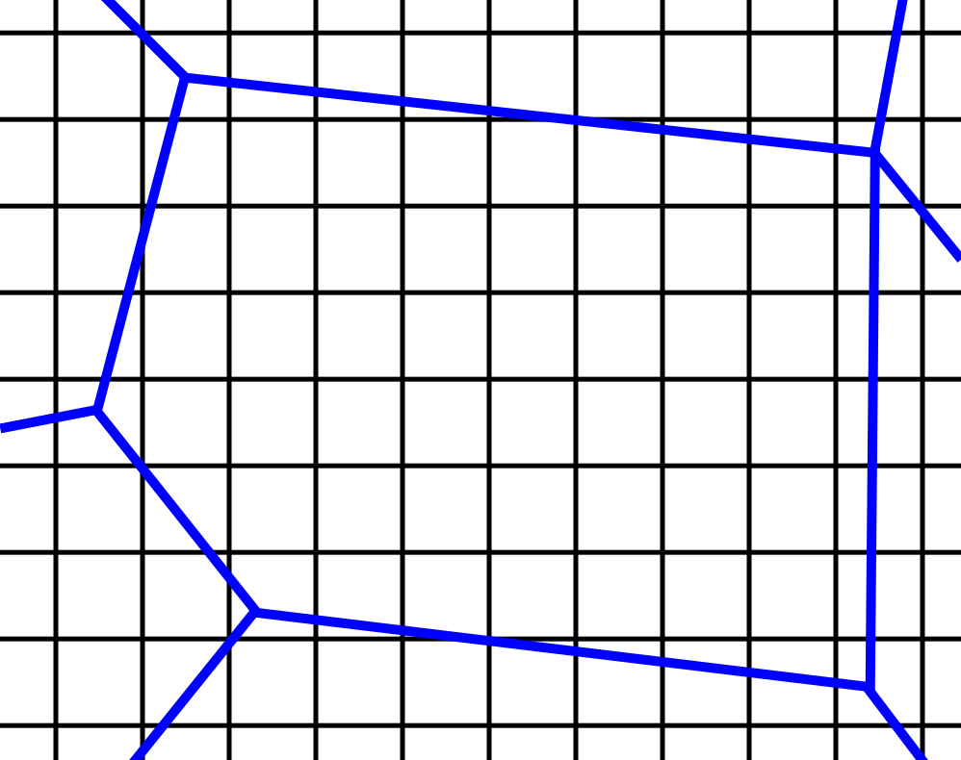
Convex Constrained Mesh (CCM)
Resolution-independent Superpixels
Convex polygonal mesh
Without small angles
CCM – 416 faces
Notes:
Better accuracy than the only previous method
Modeling spatially continuous world

Slide 5
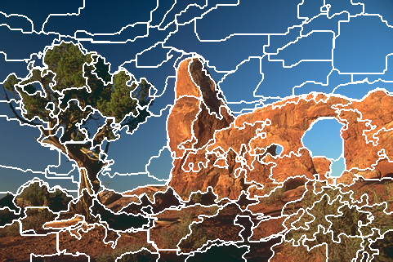
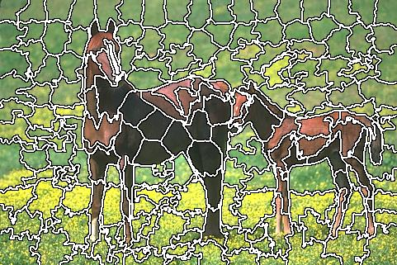
State-of-the-art
SEEDS Superpixels [den Bergh et al., 2013]
SLIC Superpixels [Achanta et al., 2010]
Coarse-to-fine approach
K-means
Notes:
SEEDS (Superpixels Extracted via Energy-Driven Sampling) – energy-driven coarse to fine optimization,
SLIC – (simple linear iterative clustering) – uses k-means

Slide 6
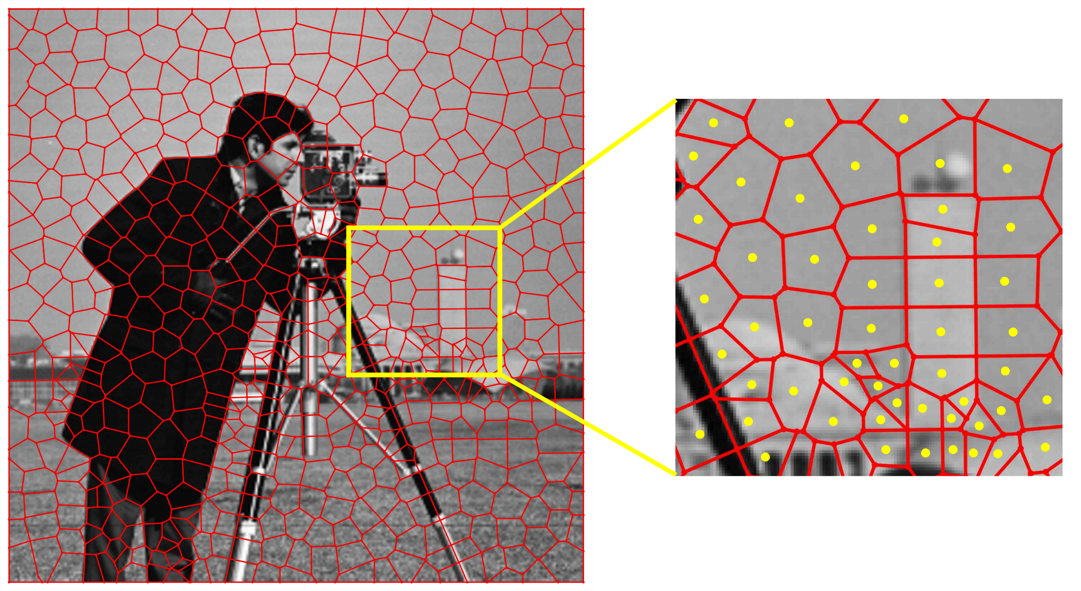
Voronoi Superpixels
Voronoi Superpixels [Duan, Lafarge, 2015]

Slide 7
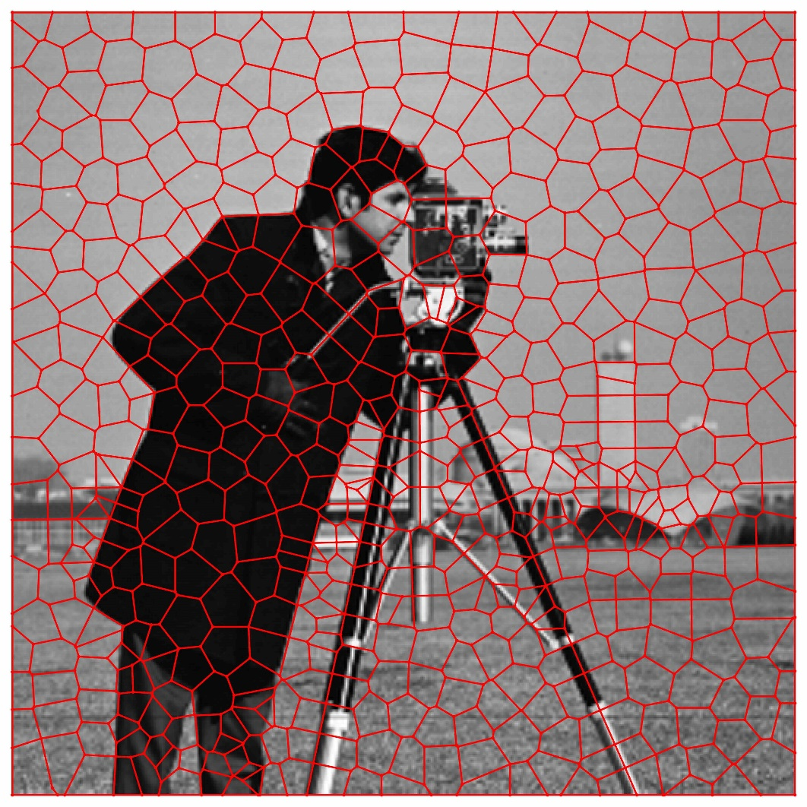
Voronoi Superpixels
Voronoi Superpixels [Duan, Lafarge, 2015]

Slide 8
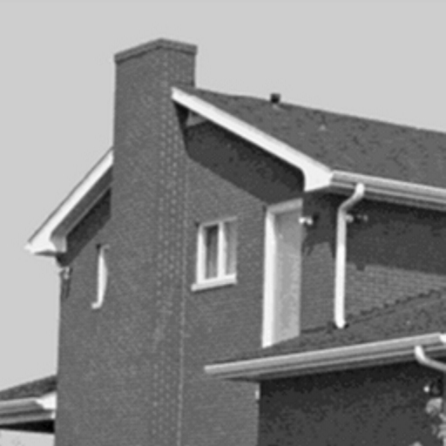
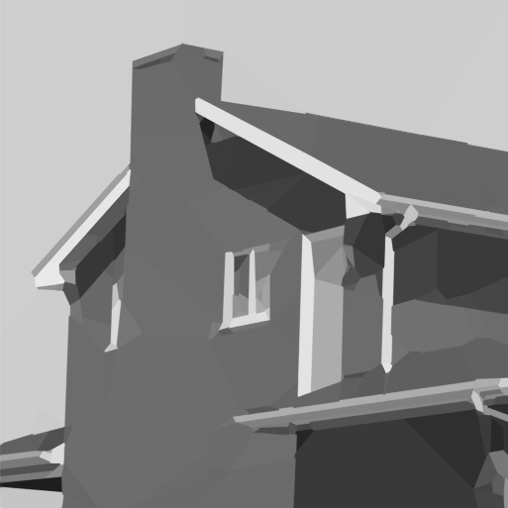
Convex Constrained Mesh (CCM)
Reconstruction Problem
Input
Output

Slide 9
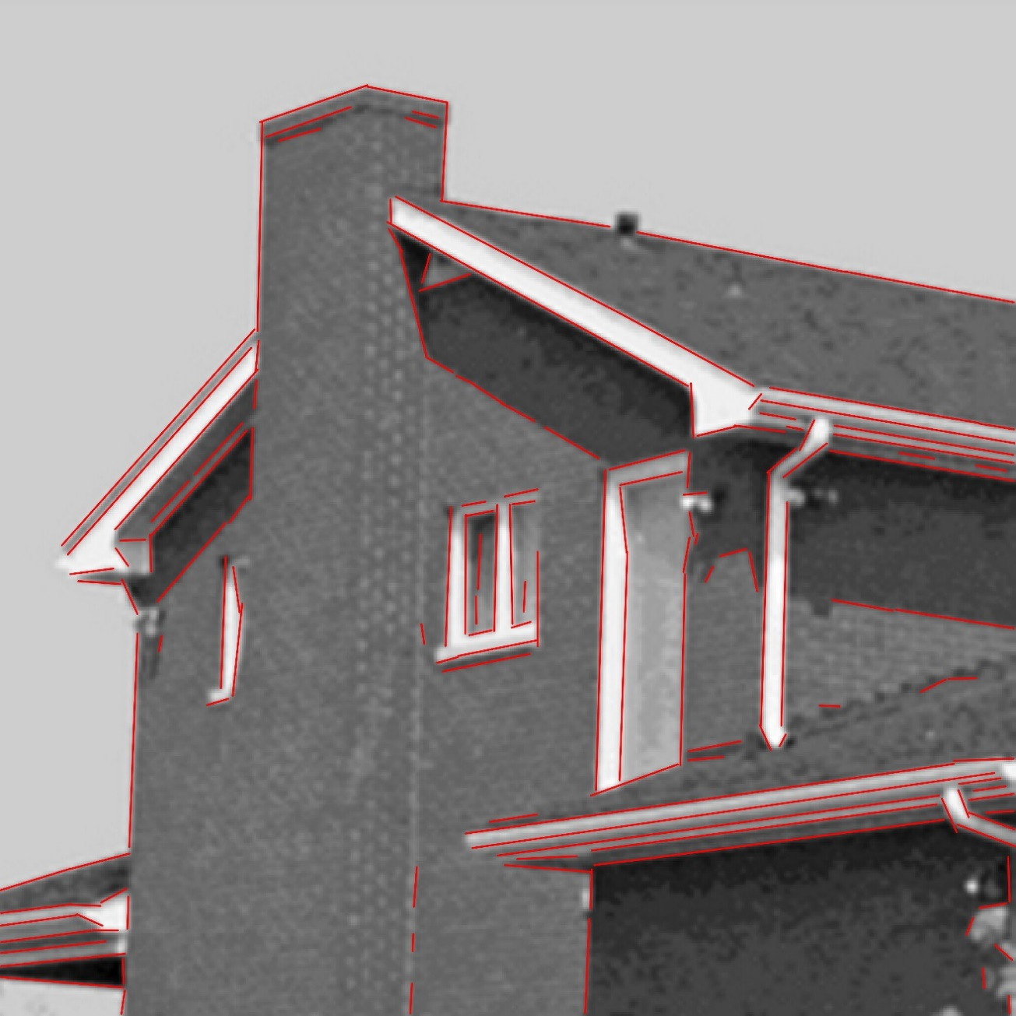
Algorithm
Line Segment Detector (LSD)
[von Gioi et al., 2012]
Triangulation
Merge triangles into convex polygons
Compute the reconstructed image

Slide 10
Algorithm
Line Segment Detector (LSD)
LSD Refinement
Triangulation
Merge triangles into convex polygons
Compute the reconstructed image

Slide 11
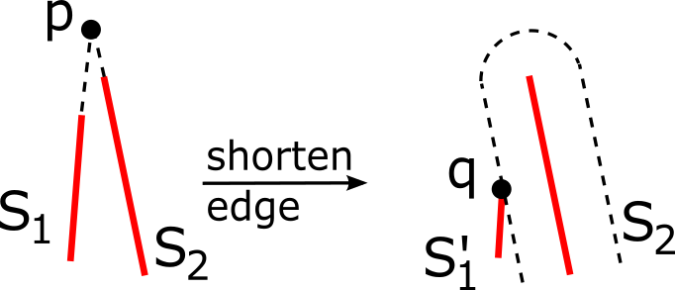
Algorithm
Line Segment Detector (LSD)
LSD Refinement
Triangulation
Merge triangles into convex polygons
Compute the reconstructed image
Build graph G

Slide 12
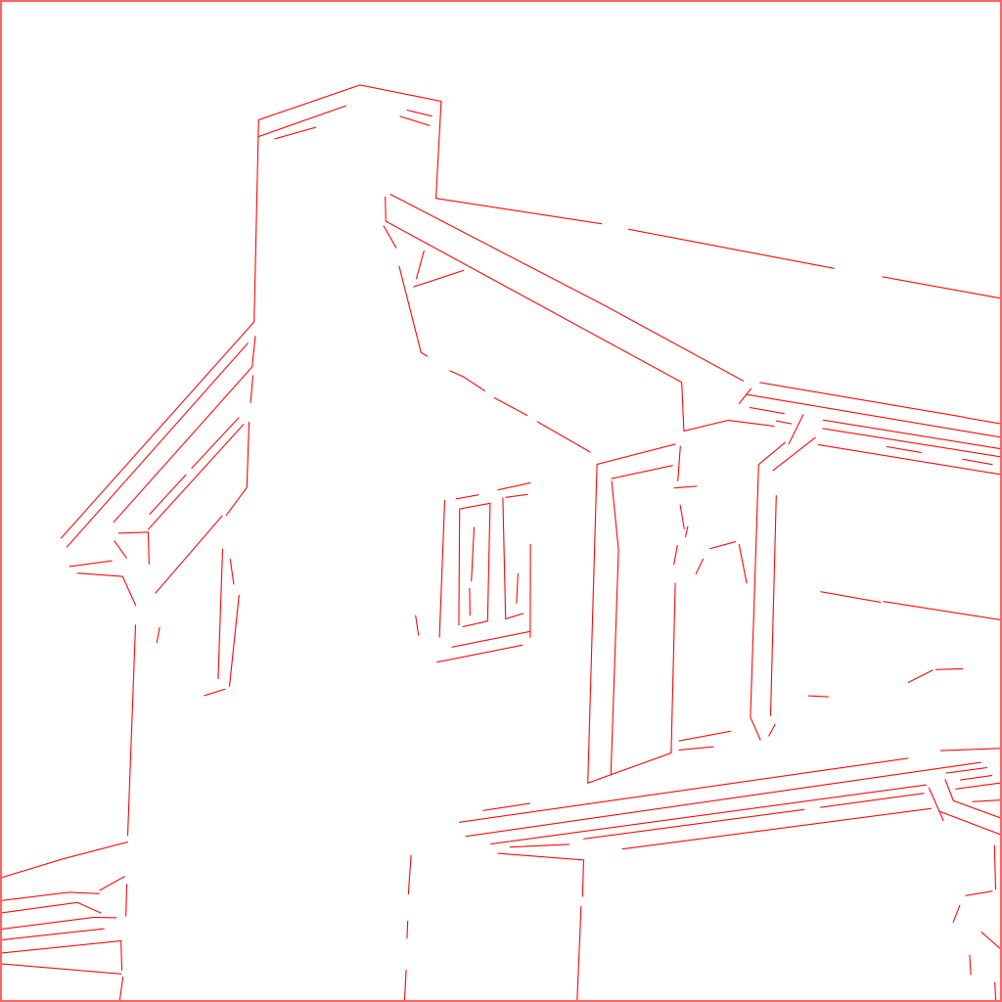
Algorithm
Line Segment Detector (LSD)
LSD Refinement
Triangulation
Merge triangles into convex polygons
Compute the reconstructed image

Slide 13
Algorithm
Line Segment Detector (LSD)
LSD Refinement
Triangulation
Merge triangles into convex polygons
Compute the reconstructed image
Triangle software [Shewchuk, 2002]
Angles <= Min_angle
Delaunay based triangulation
Graph G -> Triangle mesh

Slide 14
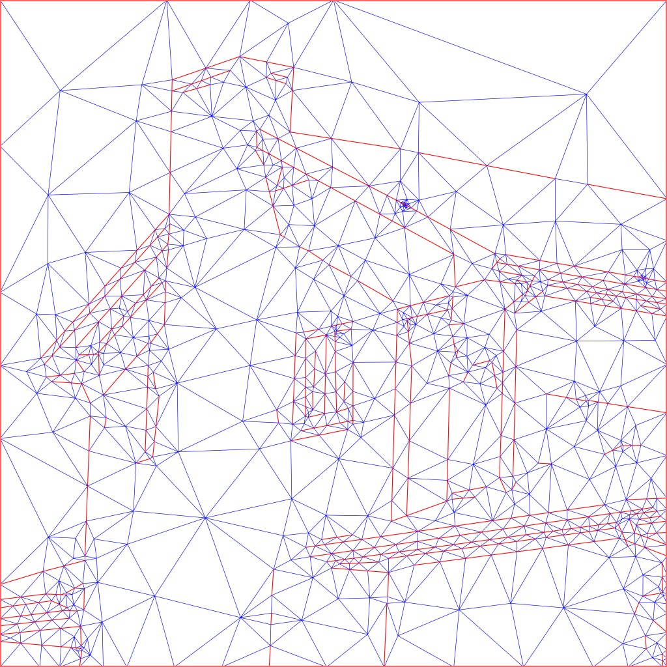
Algorithm
Line Segment Detector (LSD)
LSD Refinement
Triangulation
Merge triangles into convex polygons
Compute the reconstructed image
Notes:
1645 triangles

Slide 15
Algorithm
Line Segment Detector (LSD)
LSD Refinement
Triangulation
Merge triangles into convex polygons
Compute the reconstructed image
Remove edges
Move vertices

Slide 16
Algorithm
Line Segment Detector (LSD)
LSD Refinement
Triangulation
Merge triangles into convex polygons
Compute the reconstructed image

Slide 17
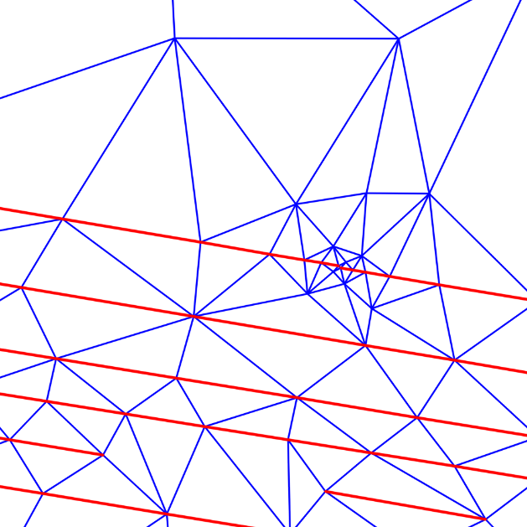
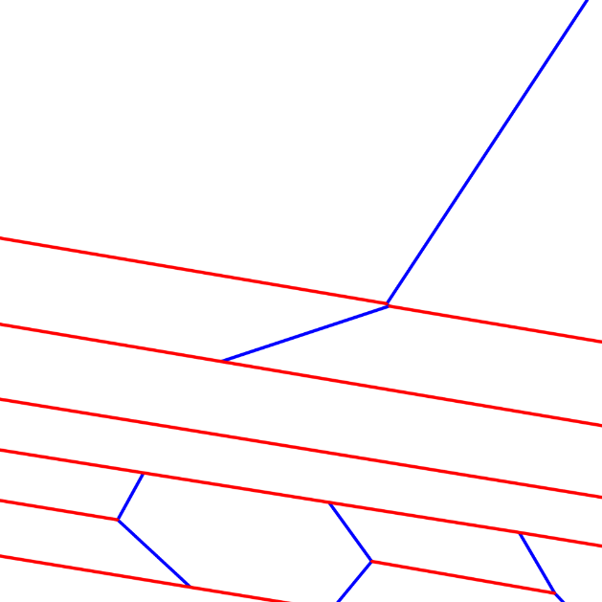
Algorithm
Line Segment Detector (LSD)
LSD Refinement
Triangulation
Merge triangles into convex polygons
Compute the reconstructed image

Slide 18
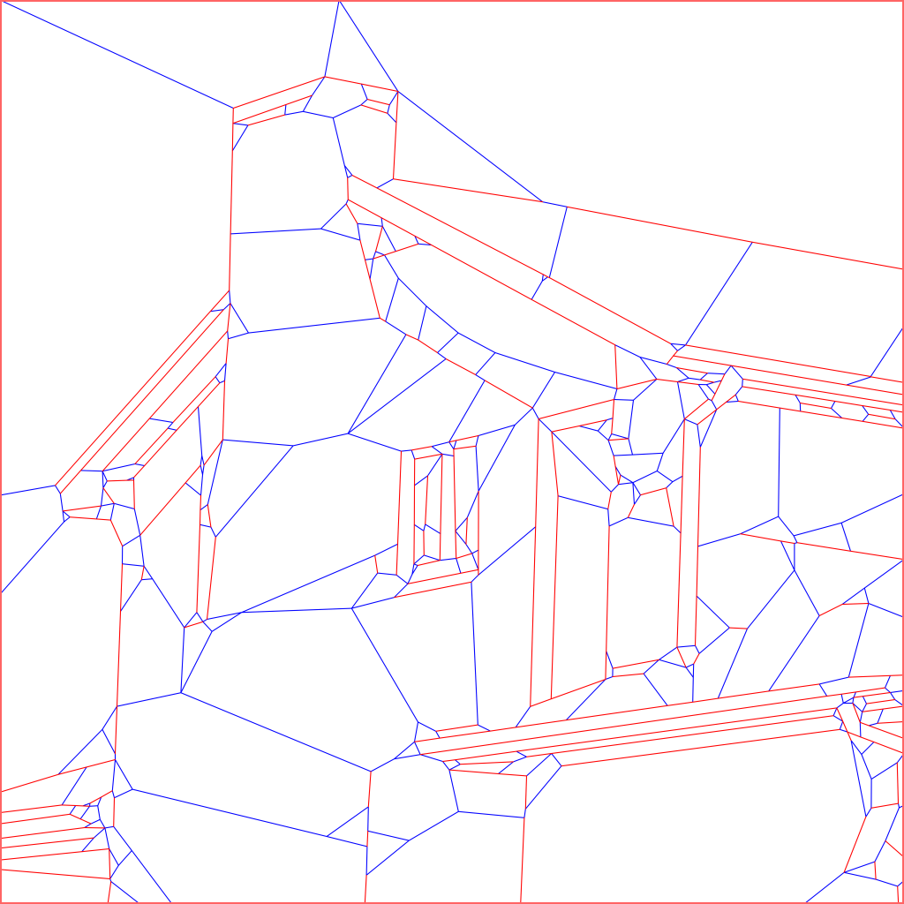
Algorithm
Line Segment Detector (LSD)
LSD Refinement
Triangulation
Merge triangles into convex polygons
Compute the reconstructed image

Slide 19
Algorithm
Line Segment Detector (LSD)
LSD Refinement
Triangulation
Merge triangles into convex polygons
Compute the reconstructed image

Slide 20
Algorithm
Line Segment Detector (LSD)
LSD Refinement
Triangulation
Merge triangles into convex polygons
Compute the reconstructed image
Reconstruction Error (RE) =
$$\text{min} \sum_{pixels p}{\left(Intensity\left(p\right)− \sum_{j=1}^{s}{Area(p}∩Fj)Color(Fj)\right)2}$$
Normalized Root Mean Square
$$\text{nRMS}\text{ =} \sqrt{\frac{RE}{n}}∙\frac{100\%}{255}$$

Slide 21
Algorithm
Line Segment Detection
LSD Refinement
Triangulation
Merge triangles into convex polygons
Compute the reconstructed image

Slide 22
Convex Constrained Mesh (CCM)
Reconstruction Problem

Slide 23
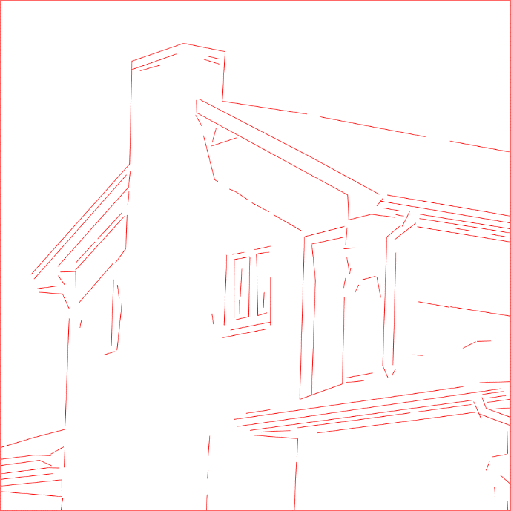
Definition - CCM
Graph G, all angles $φ≤60°$
CCM(G)
2D convex polygonal mesh
Edges of CCM(G) $∈$ G
All mesh angles $≥Min_Angle$

Slide 24
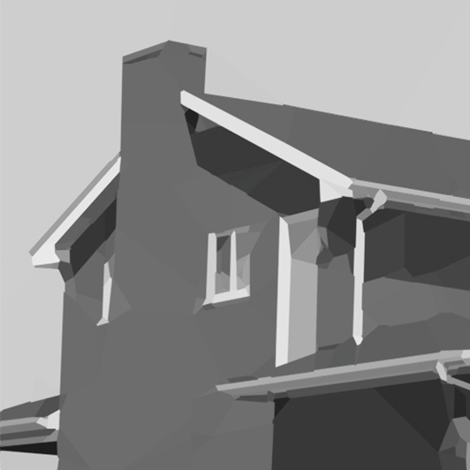
Voronoi vs. CCM
275 faces
246 faces
Notes:
275 faces vs 246 faces

Slide 25
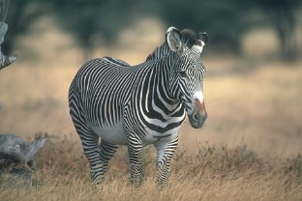
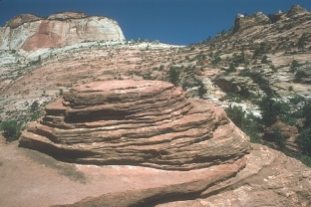
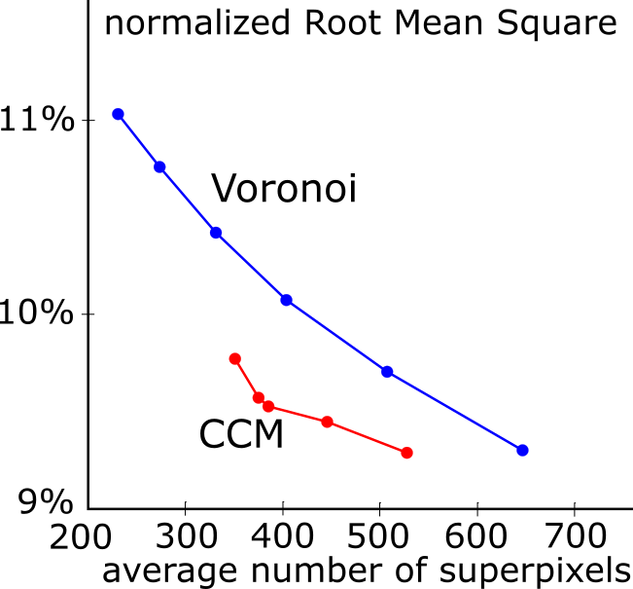
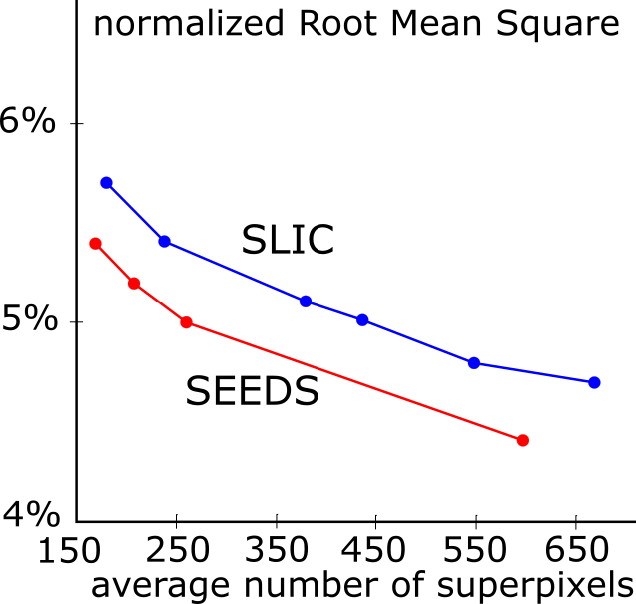
Results
nRMS - compared to input image
Tested on BSDS500 image dataset
Avg. time for CCM ~0.15 seconds
Notes:
Images tested on BSD500 image library
Each point (on graph) is an average over these 500 images
nRMS compares reconstructed images to input images

Slide 26
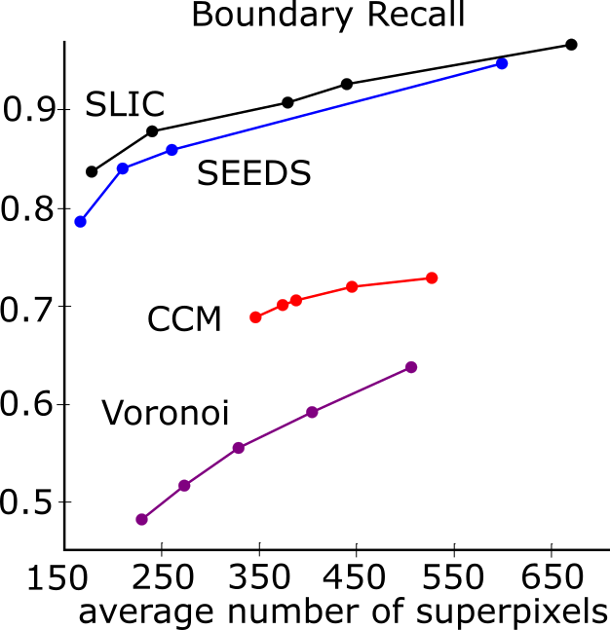
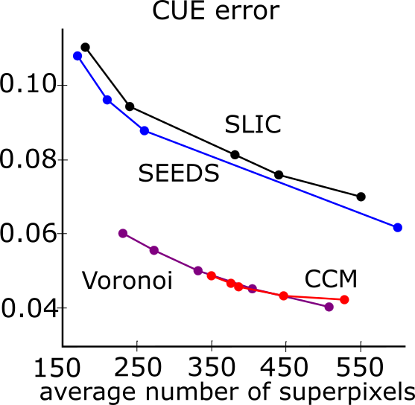
Results
Boundary Recall
CUE – Corrected Undersegmentation Error
Notes:
CUE – Corrected Undersegmentation Error

Slide 27
Conclusions
Main contributions
Parameter controlled angle guarantee
CCM(G) can be built to cover a graph G
nRMS error improves on Voronoi Superpixels
CUE error improves on pixel-based methods
Notes:
Detecting/ exploiting structure produces less error compared to the input image

Slide 28
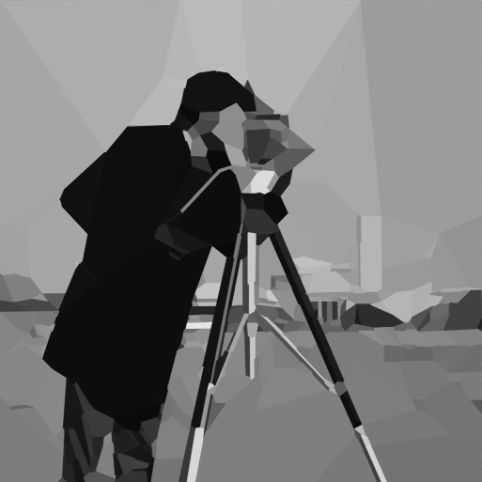
Thank you

