Slide 1
Prefiltered Anti-Aliasing on Parallel Hardware
Thomas Auzinger
Institute of Computer Graphics and Algorithms
Vienna University of Technology

Slide 2
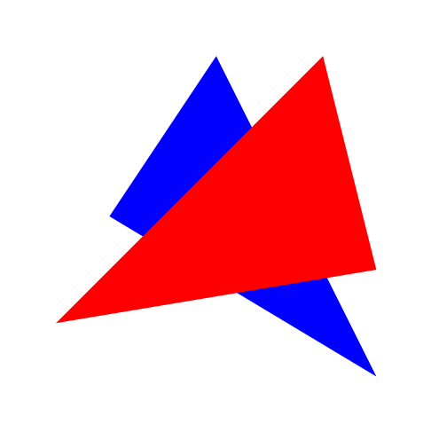

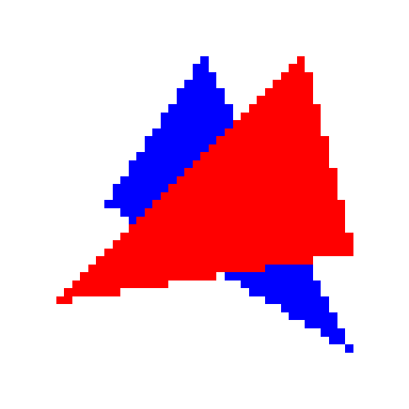


Motivation
Rasterization
?
Vector input
Raster grid
Rastered output
Better output quality

Slide 3
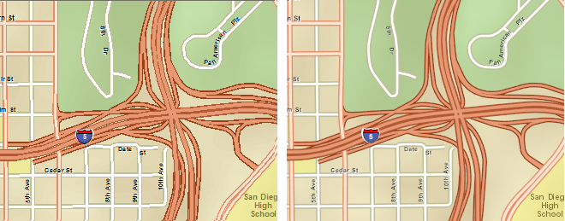
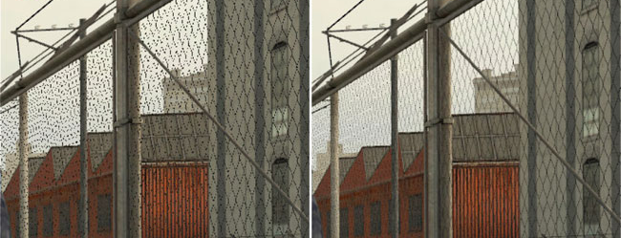
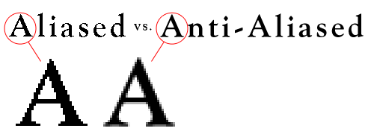
Examples
Font Rendering
Vector Graphics Display
Mesh Rendering
smashingmagazine.com
server.arcgis.com
techarp.com
Notes:
http://www.smashingmagazine.com/2009/11/02/the-ails-of-typographic-anti-aliasing/
http://server.arcgis.com/en/server/latest/publish-services/linux/drawing-behaviors-of-the-map-service.htm
http://www.techarp.com/showarticle.aspx?artno=466&pgno=1

Slide 4
Design Choices
Which filter?
How to evaluate it?
Performance
Quality

Slide 5
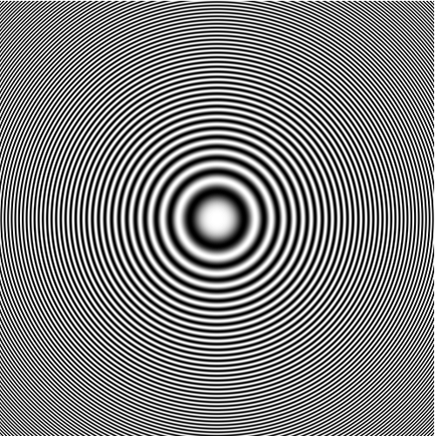
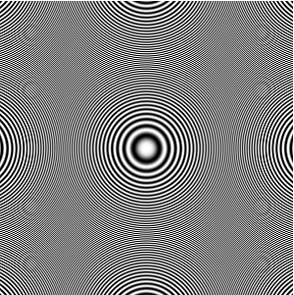
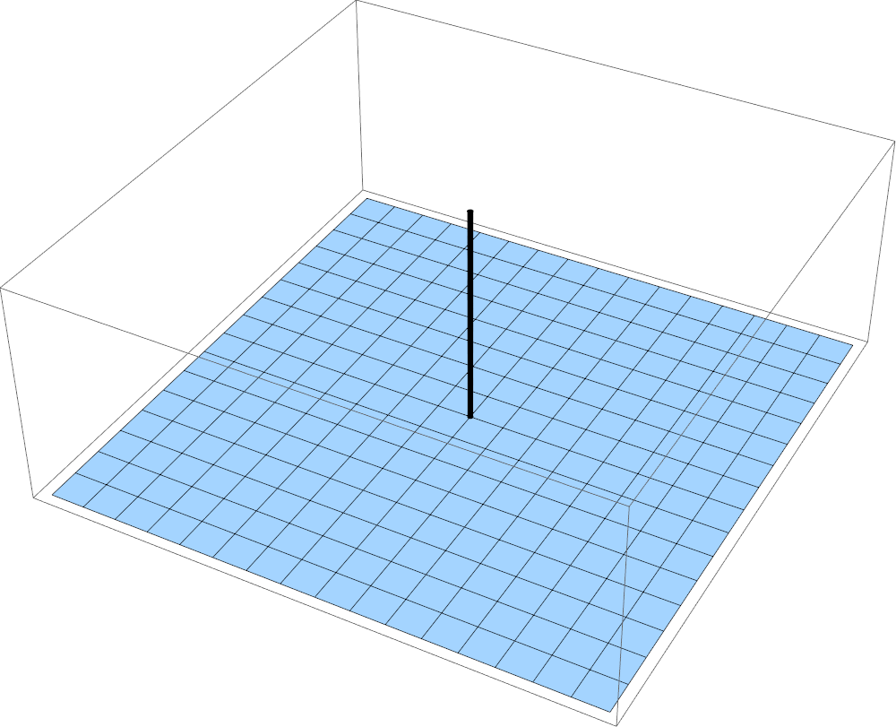
Filter Choice
Downsampling to half resolution:
Delta filter

Slide 6
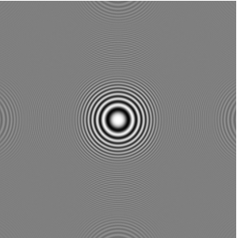
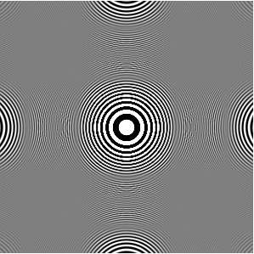
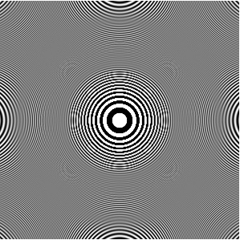
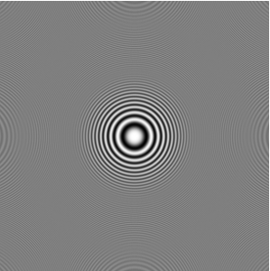
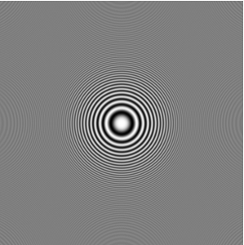
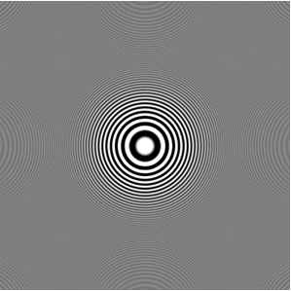
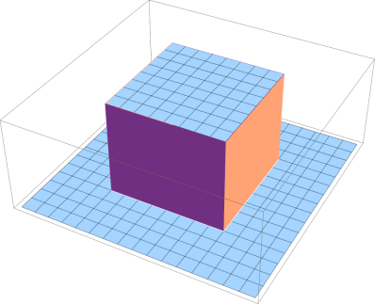
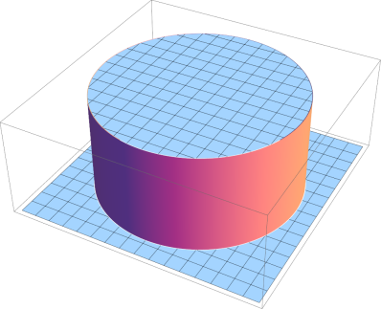
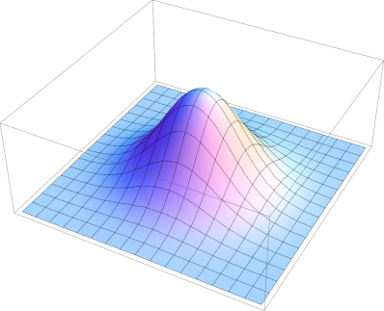
Filter Choice
Downsampling to half resolution:
Box filter
Hat filter
Gaussian filter

Slide 7
Design Choices
Simple Higher Order
Which filter?
How to evaluate it?
Performance
Quality

Slide 8
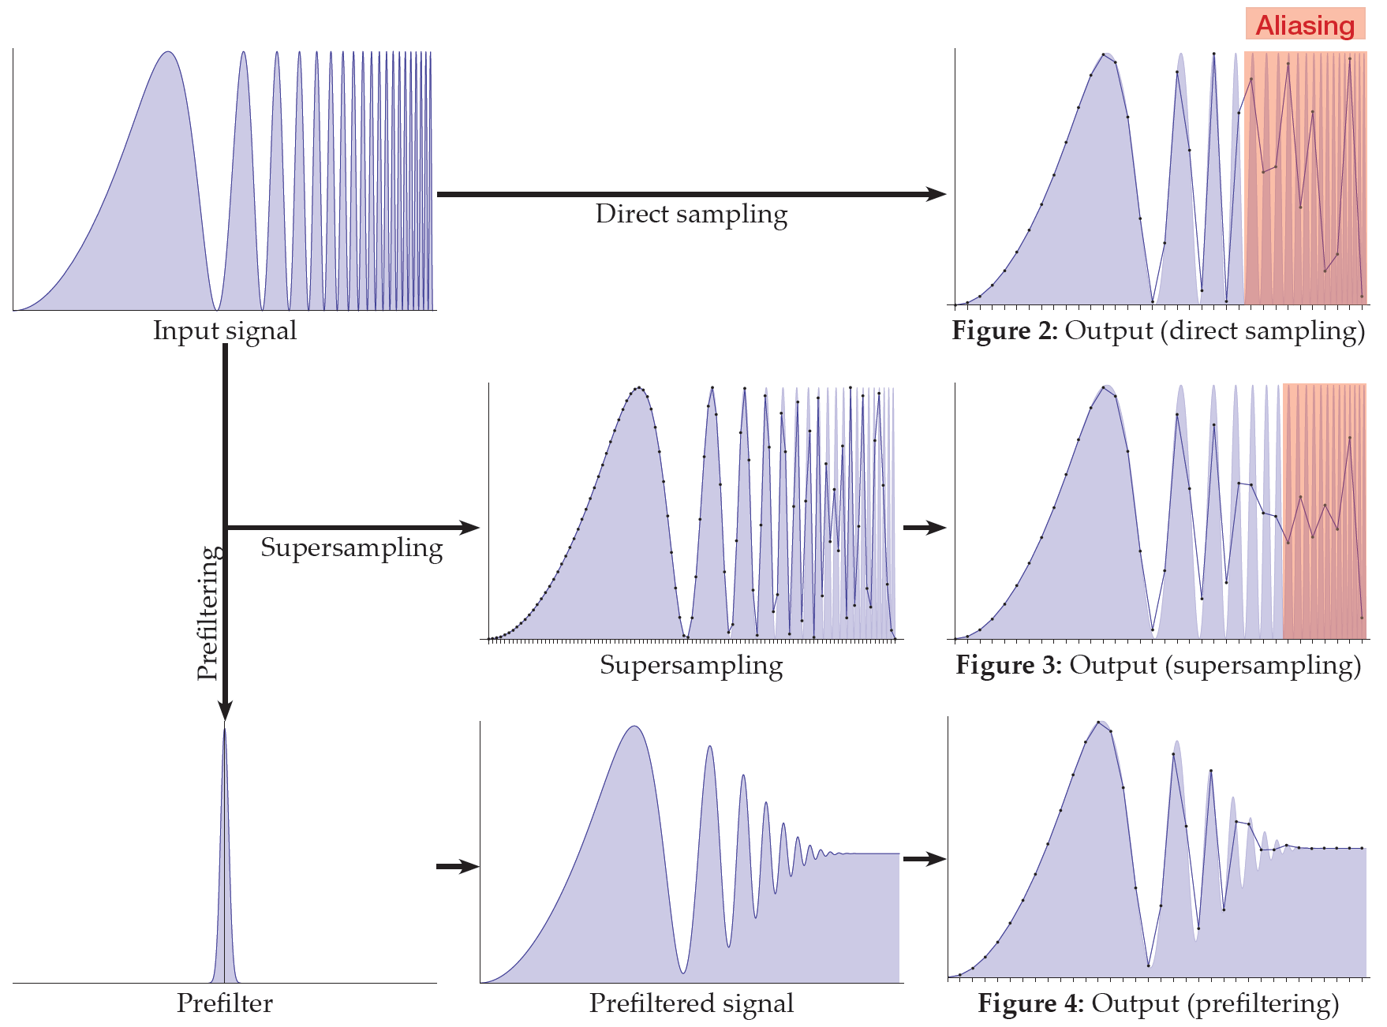
Motivation – Filter Evaluation

Slide 9
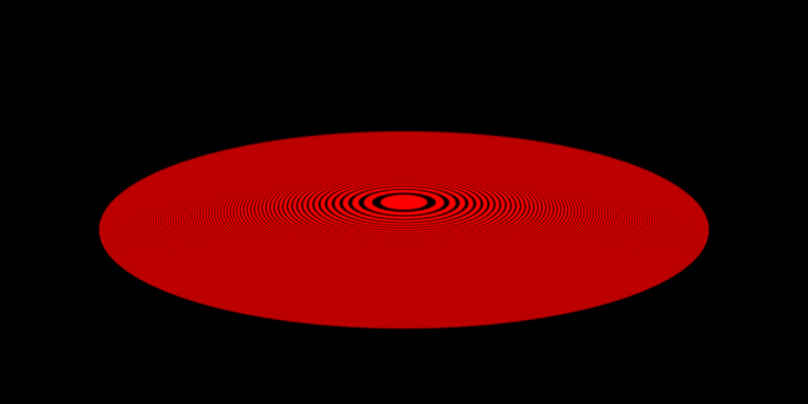
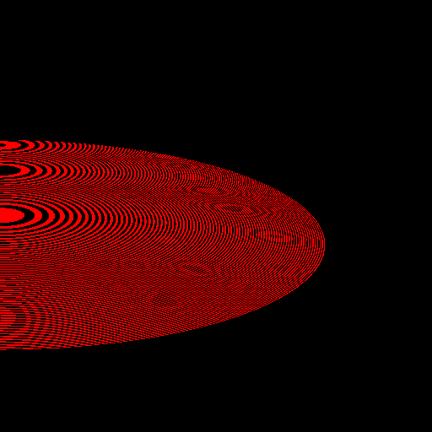
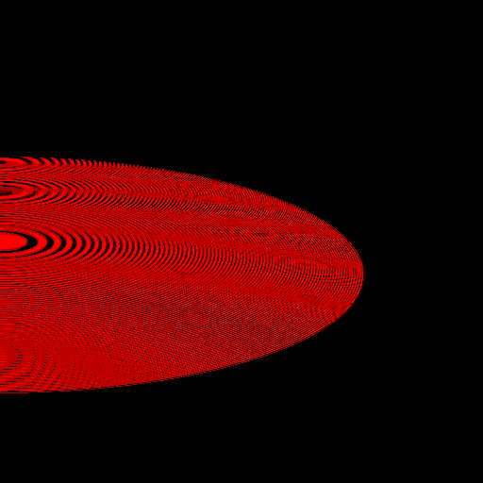


Motivation – Filter Evaluation
Ground truth
1 sample per pixel
4 samples per pixel
16 samples per pixel
256 samples per pixel
Prefiltering

Slide 10
Design Choices
Simple Higher Order
Which filter?
How to evaluate it?
Sampling Supersampling Prefiltering
Performance
Quality

Slide 11
Publications
TA*, Gabriel Mistelbauer*, I. Baclija, R. Schernthaner, Eduard Gröller, Stefan Bruckner
Vessel Visualization using Curved Surface Reformation
SciVis 2013 (IEEE Trans. Vis. Comp. Graph.)
TA, Michael Guthe, Stefan Jeschke
Analytic Anti-Aliasing of Linear Functions on Polytopes
Eurographics 2012 (Comp. Graph. Forum)
TA, Michael Wimmer, Stefan Jeschke
Analytic Visibility on the GPU
Eurographics 2013 (Comp. Graph. Forum)
TA, Przem Musialski, Reinhold Preiner, Michael Wimmer
Non-Sampled Anti-Aliasing
VMV 2013

Slide 12
Publications
TA*, Gabriel Mistelbauer*, I. Baclija, R. Schernthaner, Eduard Gröller, Stefan Bruckner
Vessel Visualization using Curved Surface Reformation
SciVis 2013 (IEEE Trans. Vis. Comp. Graph.)
TA, Michael Guthe, Stefan Jeschke
Analytic Anti-Aliasing of Linear Functions on Polytopes
Eurographics 2012 (Comp. Graph. Forum)
TA, Michael Wimmer, Stefan Jeschke
Analytic Visibility on the GPU
Eurographics 2013 (Comp. Graph. Forum)
TA, Przem Musialski, Reinhold Preiner, Michael Wimmer
Non-Sampled Anti-Aliasing
VMV 2013

Slide 13
Design Choices
Simple Higher Order
Which filter?
How to evaluate it?
Sampling Supersampling Prefiltering
Performance
Quality

Slide 14
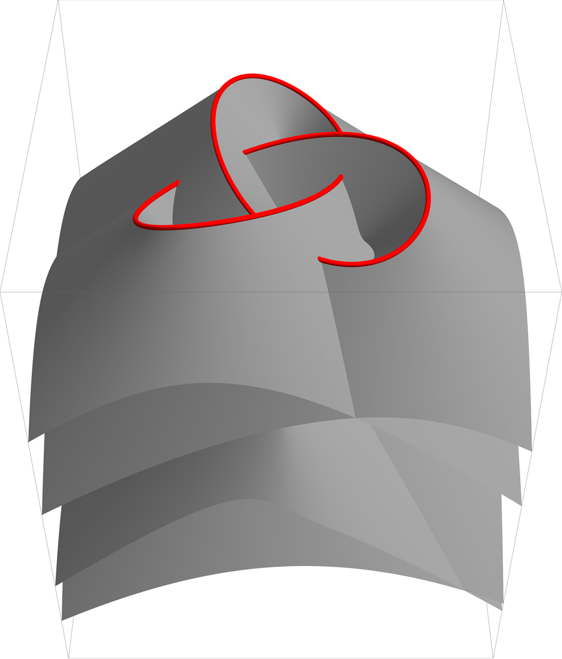
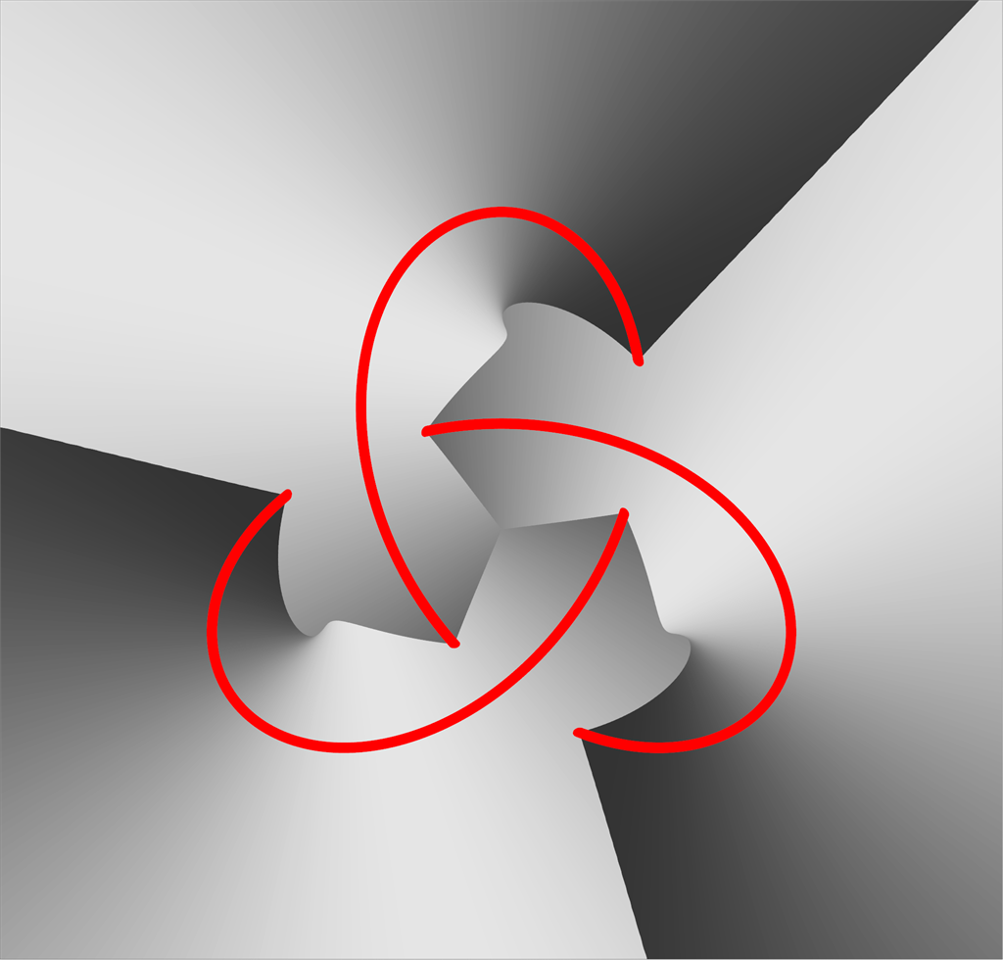
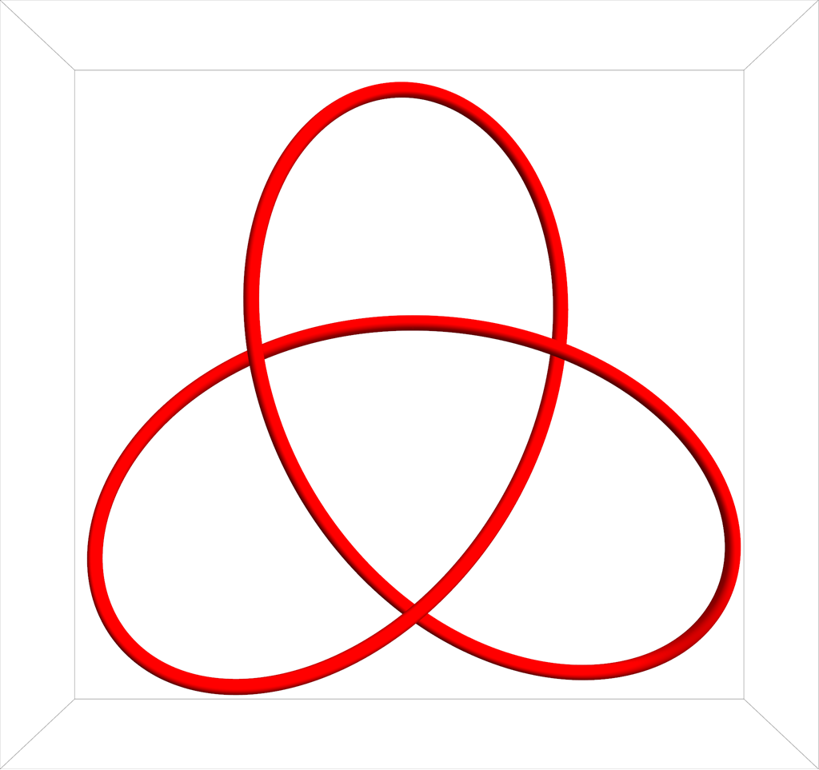
Curved Surface Reformation
Sampling visibility
Supersampling shading
Interactive performance
View direction

Slide 15
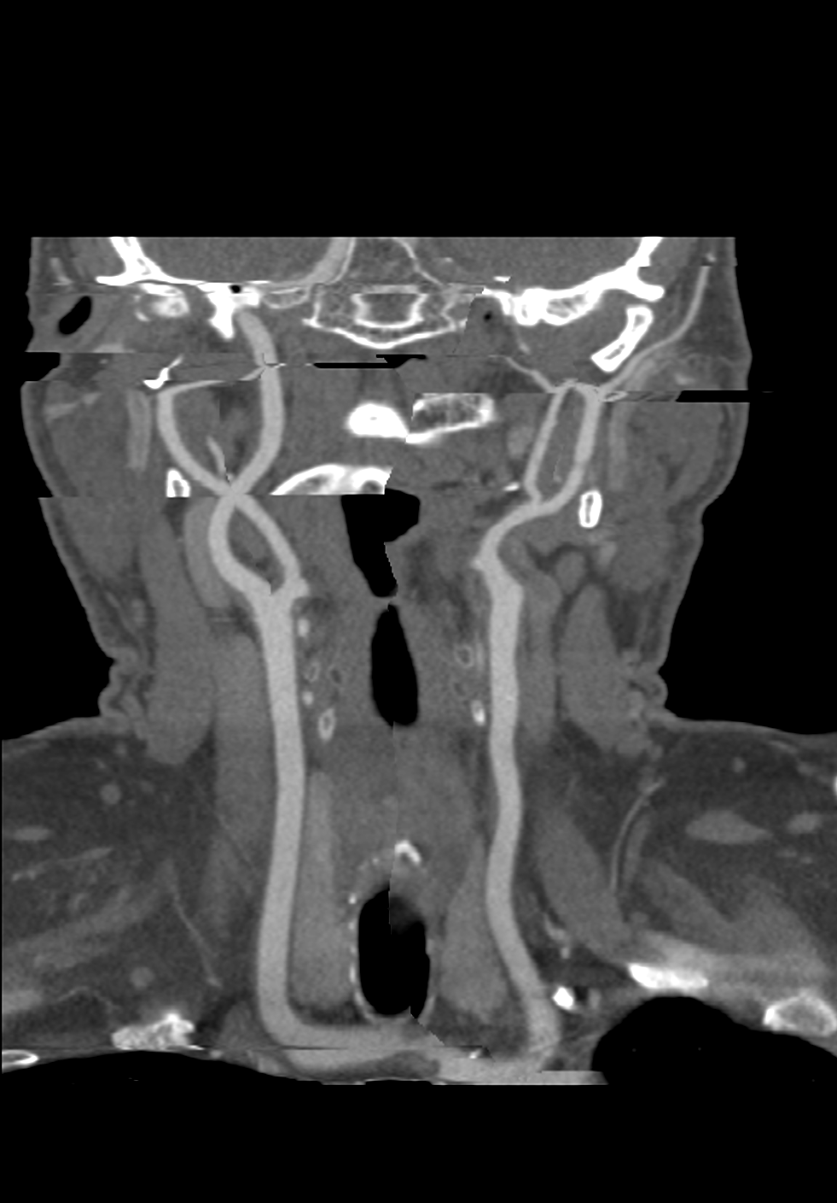
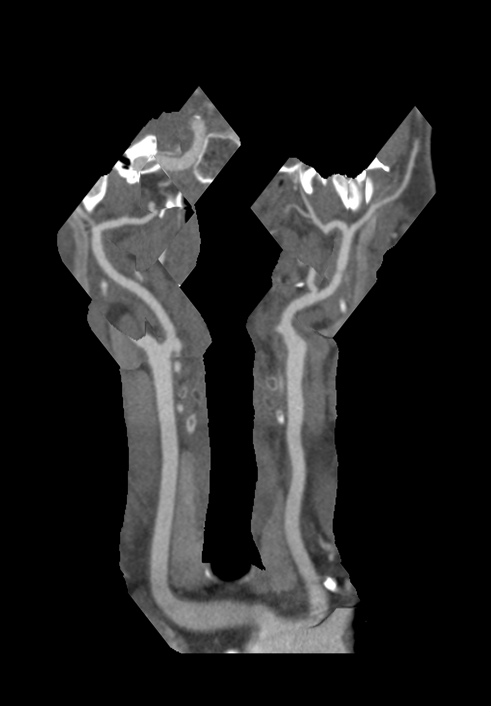
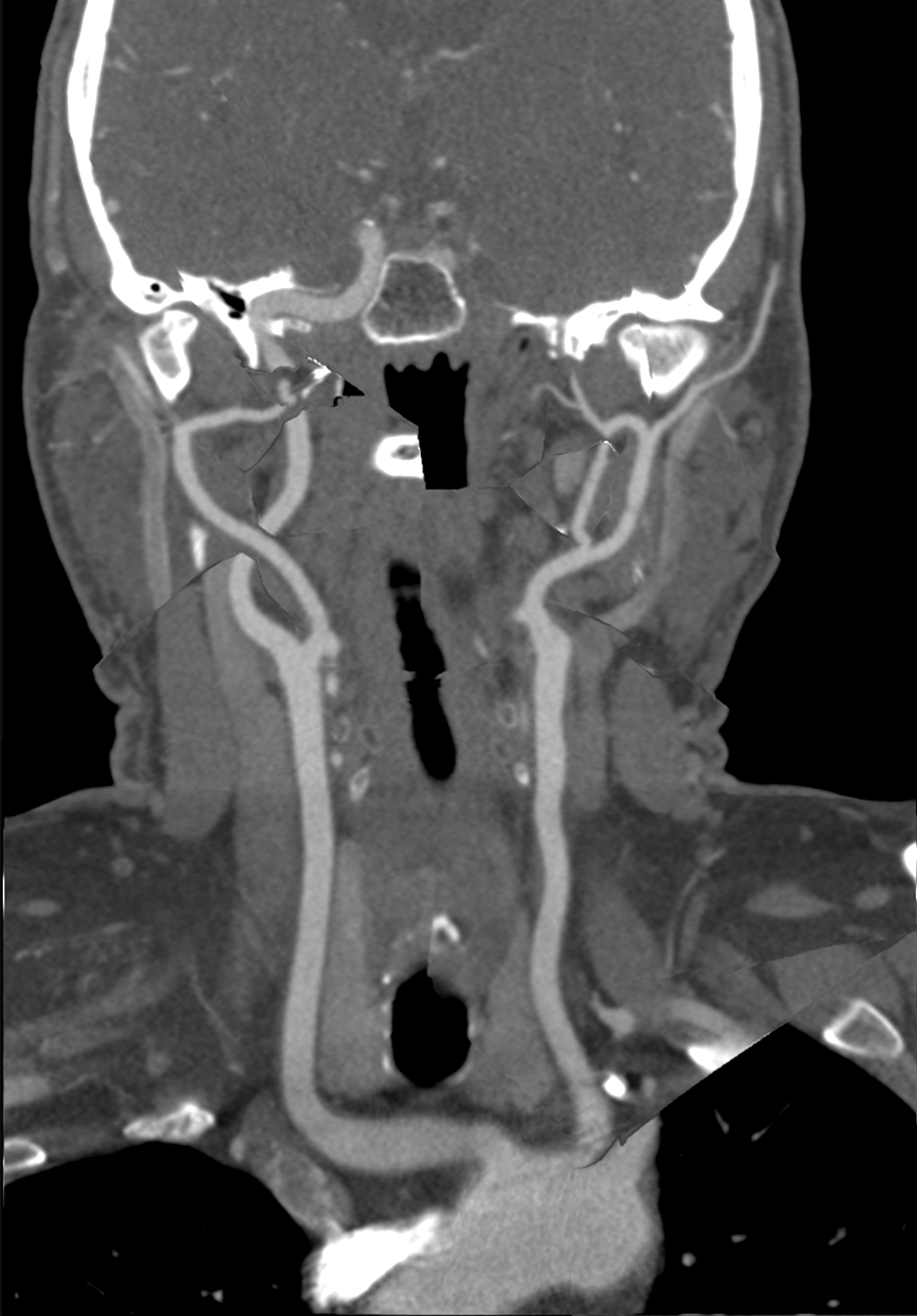
Curved Surface Reformation
mpCPR
CR
CSR

Slide 16
Publications
TA*, Gabriel Mistelbauer*, I. Baclija, R. Schernthaner, Eduard Gröller, Stefan Bruckner
Vessel Visualization using Curved Surface Reformation
SciVis 2013 (IEEE Trans. Vis. Comp. Graph.)
TA, Michael Guthe, Stefan Jeschke
Analytic Anti-Aliasing of Linear Functions on Polytopes
Eurographics 2012 (Comp. Graph. Forum)
TA, Michael Wimmer, Stefan Jeschke
Analytic Visibility on the GPU
Eurographics 2013 (Comp. Graph. Forum)
TA, Przem Musialski, Reinhold Preiner, Michael Wimmer
Non-Sampled Anti-Aliasing
VMV 2013

Slide 17
Publications
TA*, Gabriel Mistelbauer*, I. Baclija, R. Schernthaner, Eduard Gröller, Stefan Bruckner
Vessel Visualization using Curved Surface Reformation
SciVis 2013 (IEEE Trans. Vis. Comp. Graph.)
TA, Michael Guthe, Stefan Jeschke
Analytic Anti-Aliasing of Linear Functions on Polytopes
Eurographics 2012 (Comp. Graph. Forum)
TA, Michael Wimmer, Stefan Jeschke
Analytic Visibility on the GPU
Eurographics 2013 (Comp. Graph. Forum)
TA, Przem Musialski, Reinhold Preiner, Michael Wimmer
Non-Sampled Anti-Aliasing
VMV 2013

Slide 18
Design Choices
Simple Higher Order
Which filter?
How to evaluate it?
Sampling Supersampling Prefiltering
Performance
Quality

Slide 19
Publications
TA*, Gabriel Mistelbauer*, I. Baclija, R. Schernthaner, Eduard Gröller, Stefan Bruckner
Vessel Visualization using Curved Surface Reformation
SciVis 2013 (IEEE Trans. Vis. Comp. Graph.)
TA, Michael Guthe, Stefan Jeschke
Analytic Anti-Aliasing of Linear Functions on Polytopes
Eurographics 2012 (Comp. Graph. Forum)
TA, Michael Wimmer, Stefan Jeschke
Analytic Visibility on the GPU
Eurographics 2013 (Comp. Graph. Forum)
TA, Przem Musialski, Reinhold Preiner, Michael Wimmer
Non-Sampled Anti-Aliasing
VMV 2013

Slide 20
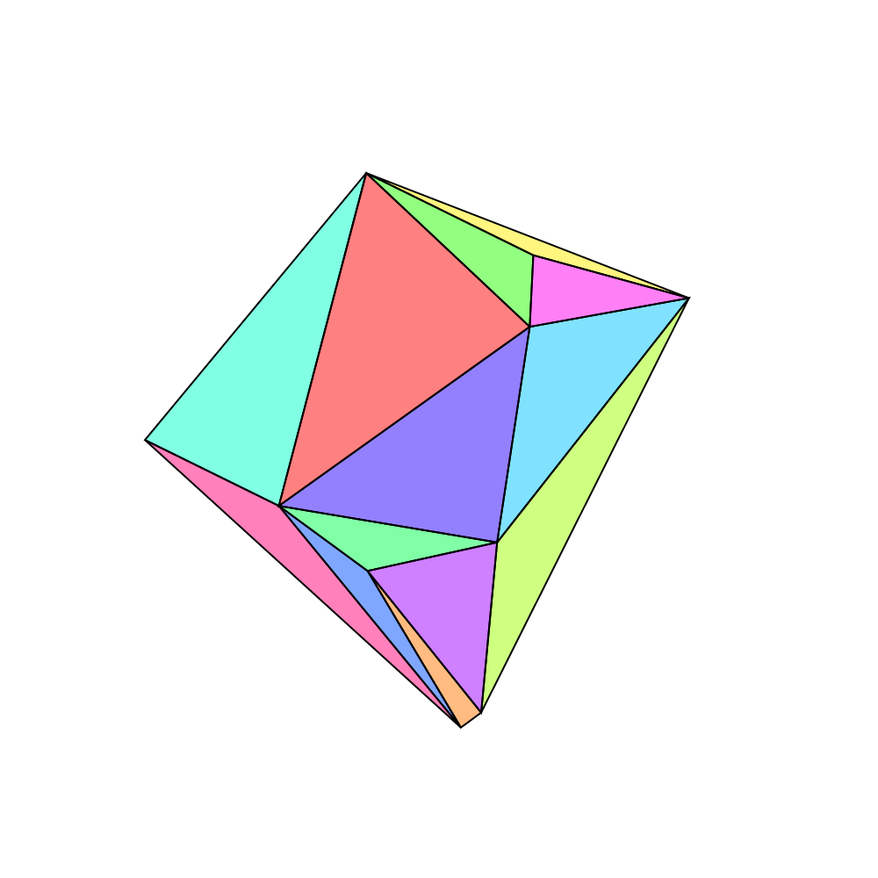
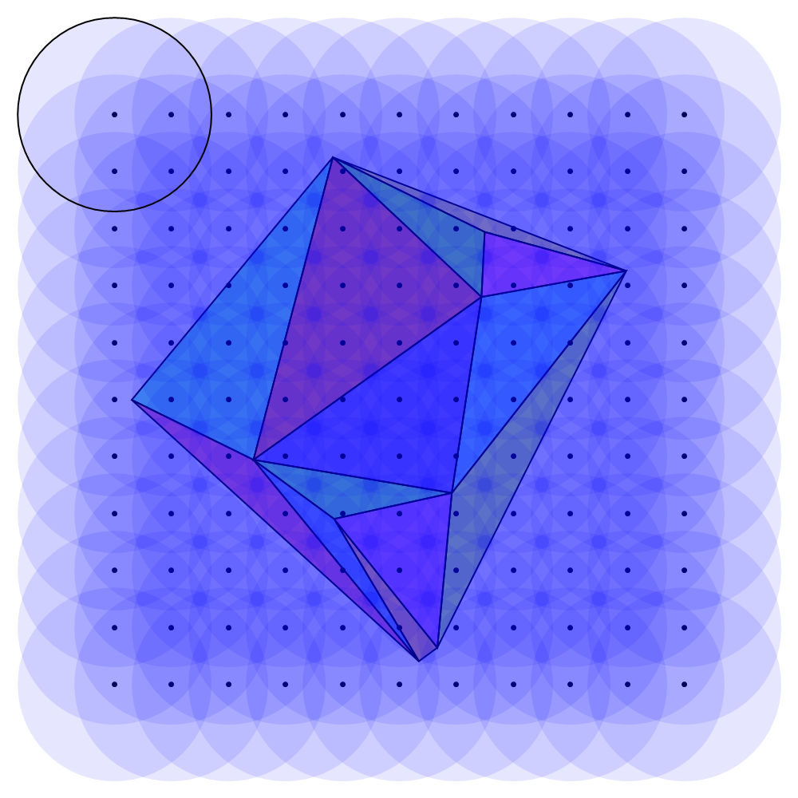

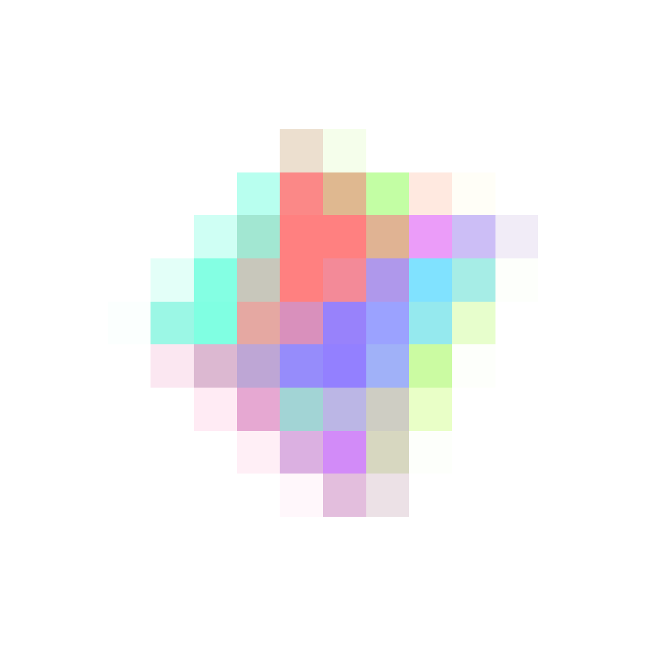
Prefiltering Overview
Overview:
Sample positions
Filter supports
Mesh input
Output

Slide 21

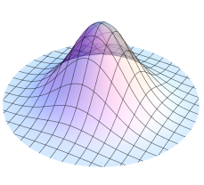
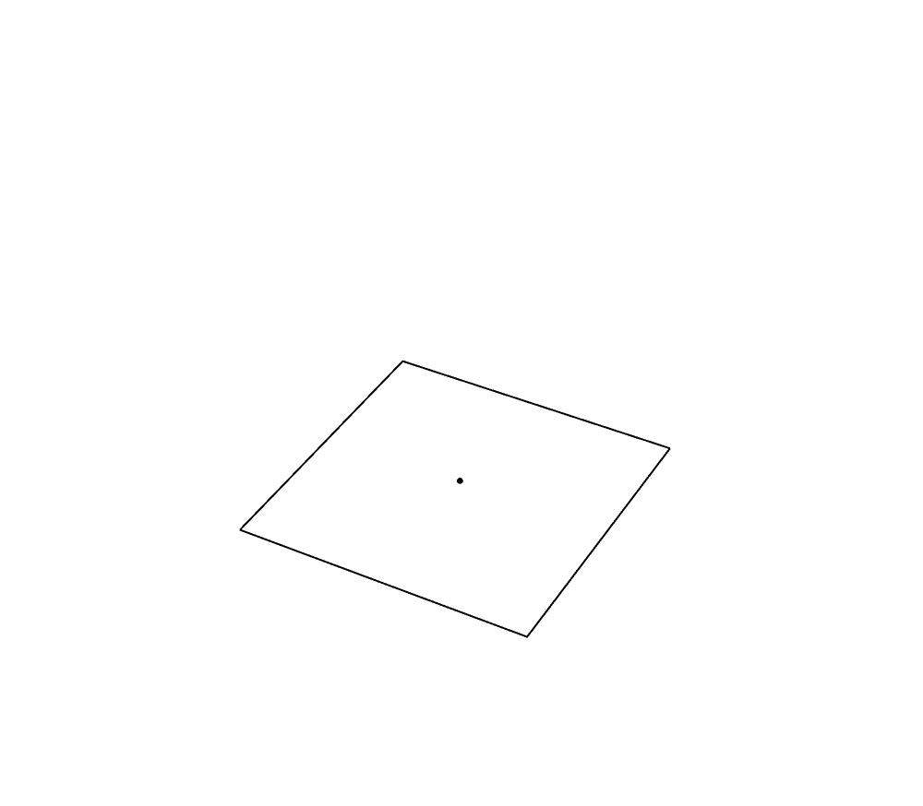
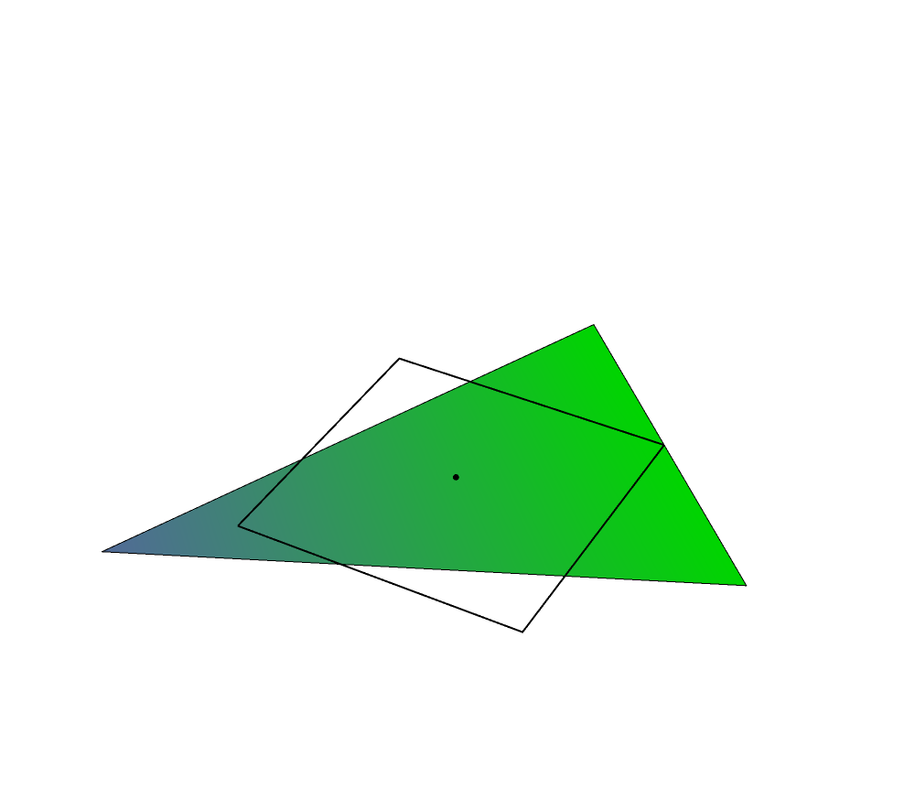
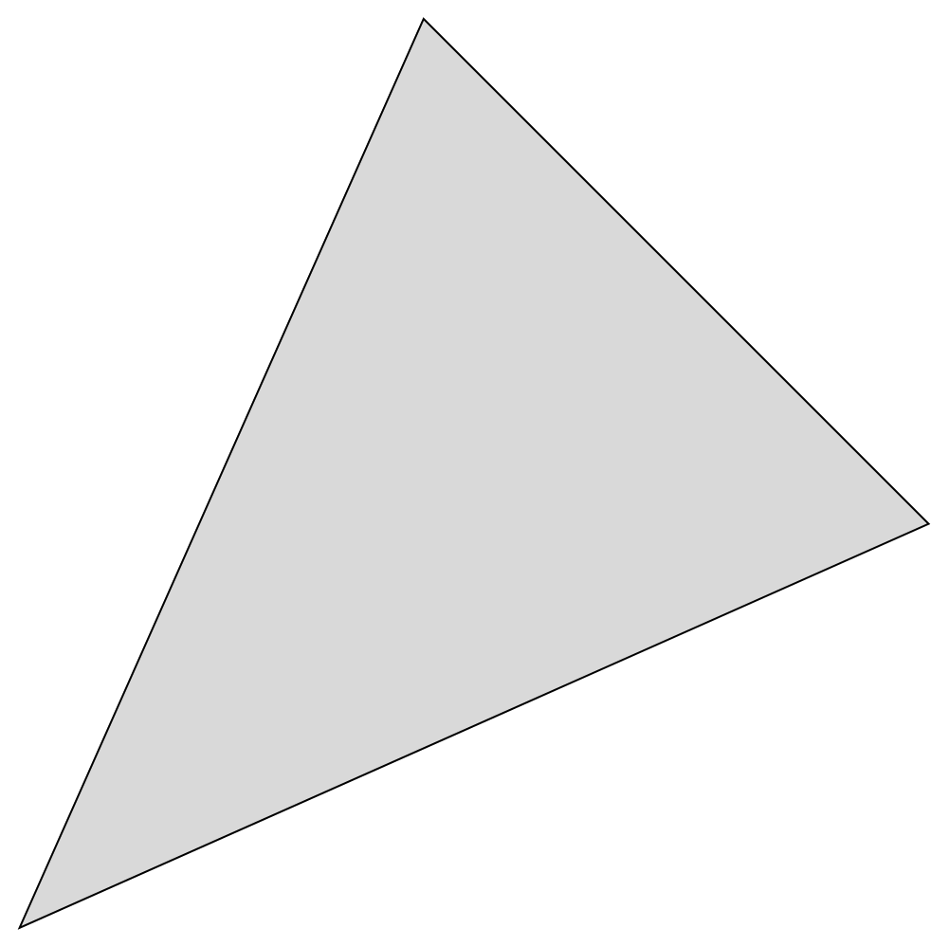
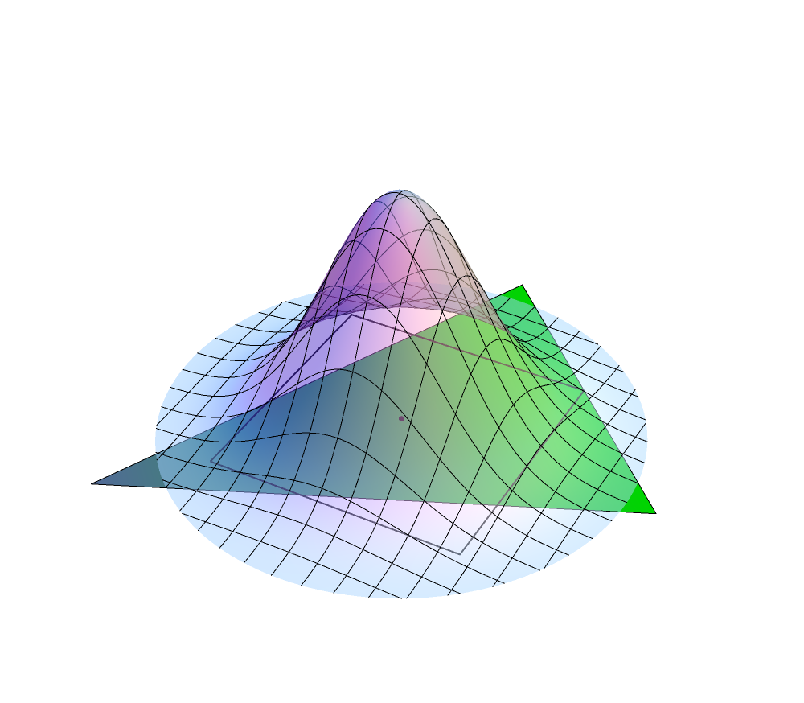
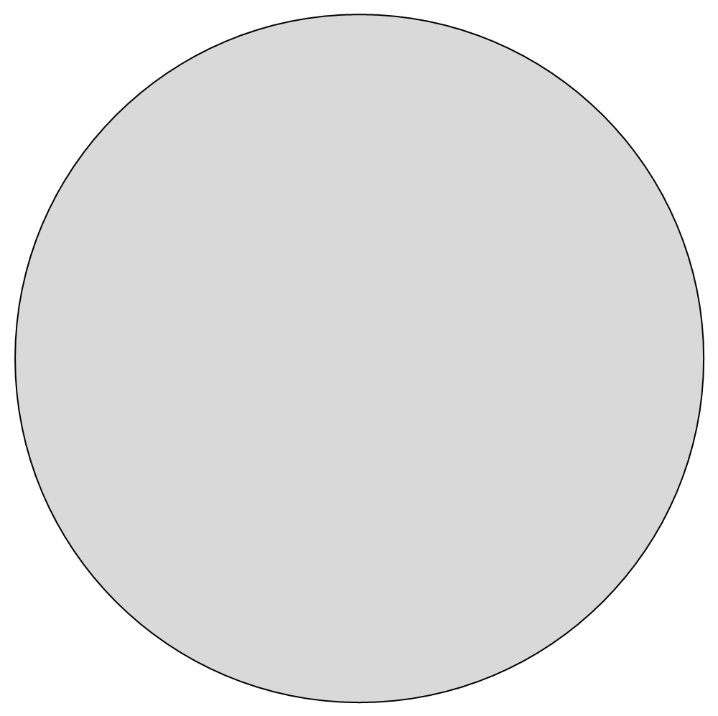
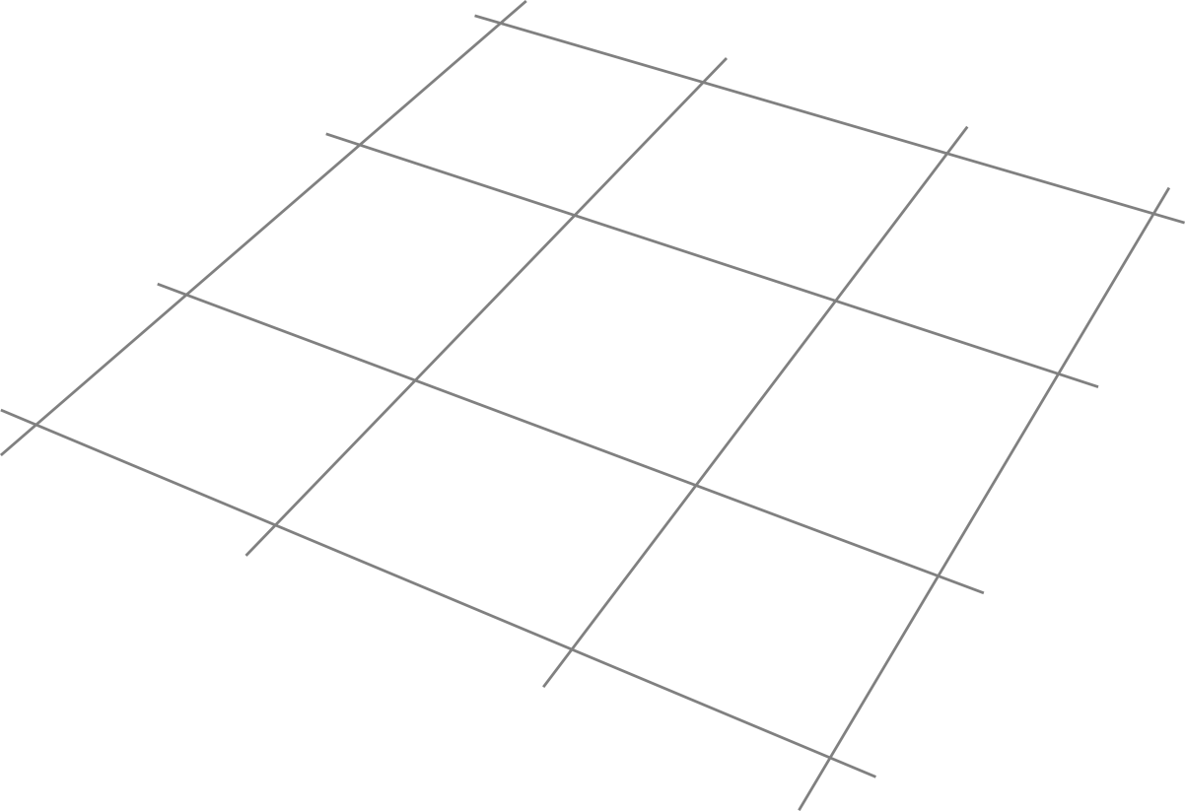
Prefiltering in 2D
Filter convolution:
Sample location
Filter function
Mesh data

Slide 22


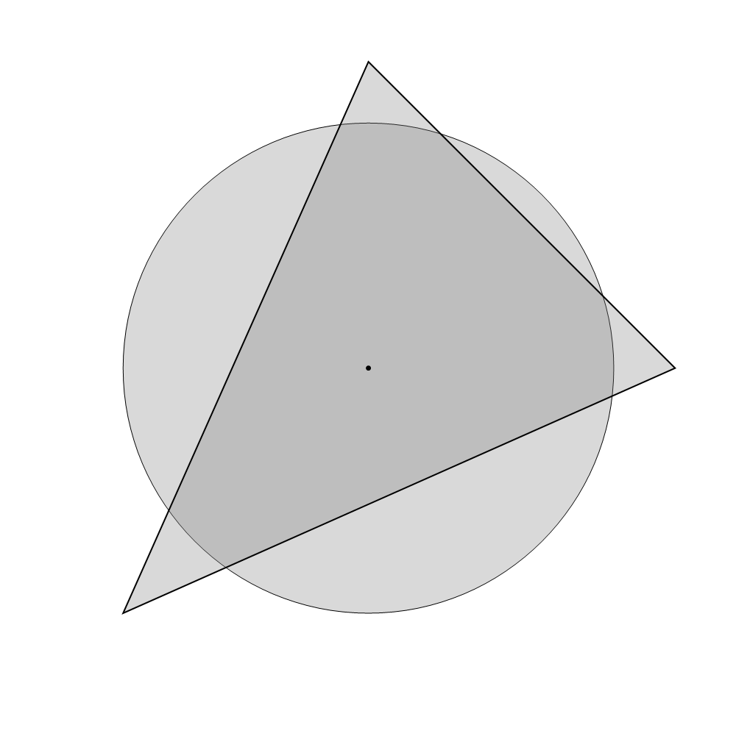
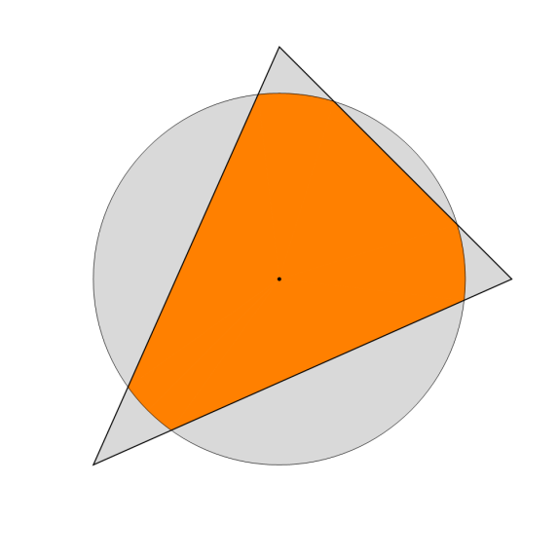

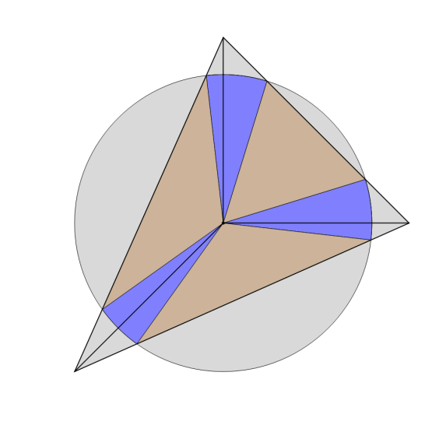
Prefiltering in 2D
Filter convolution:
Complicated integration domain
Intersection area
Subdivision
Integration domains

Slide 23
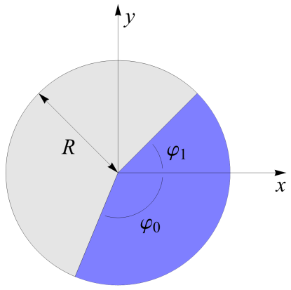
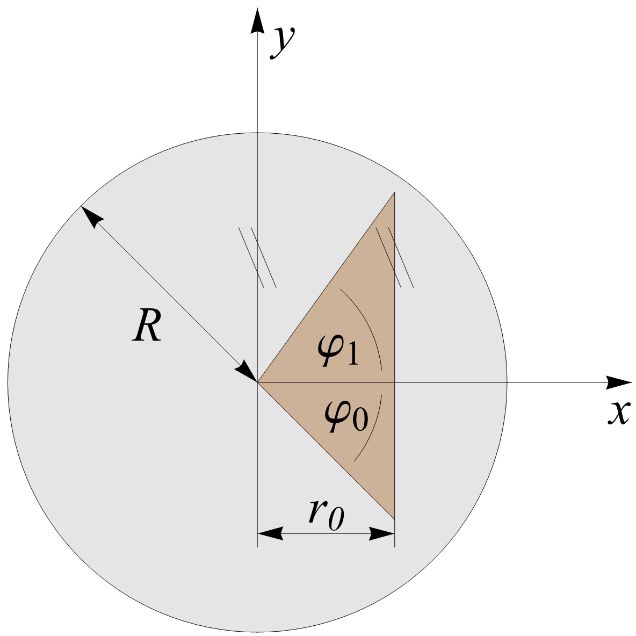
Prefiltering in 2D
Filter convolution:

Slide 24

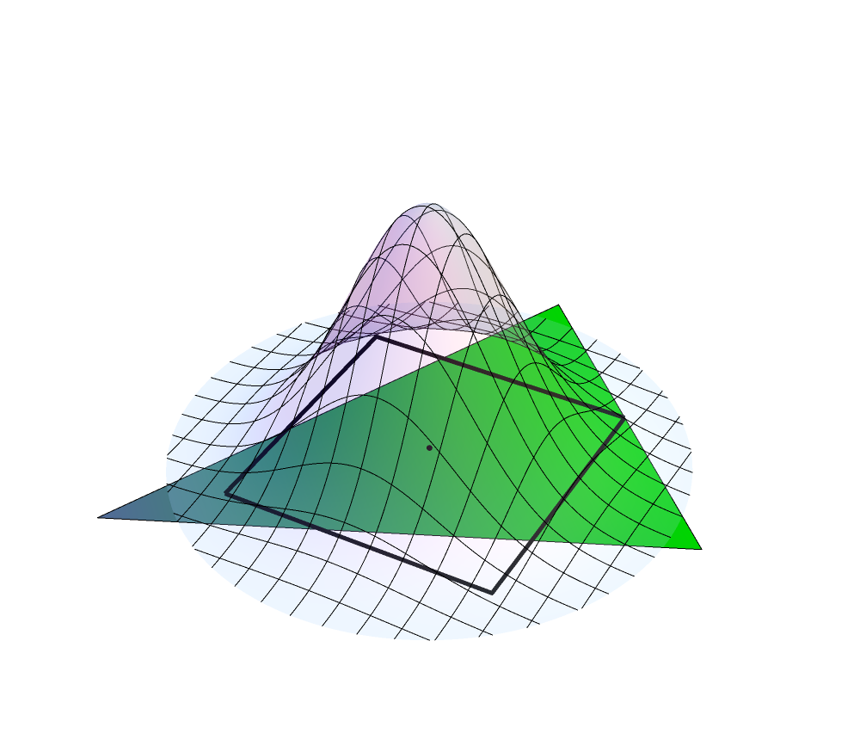
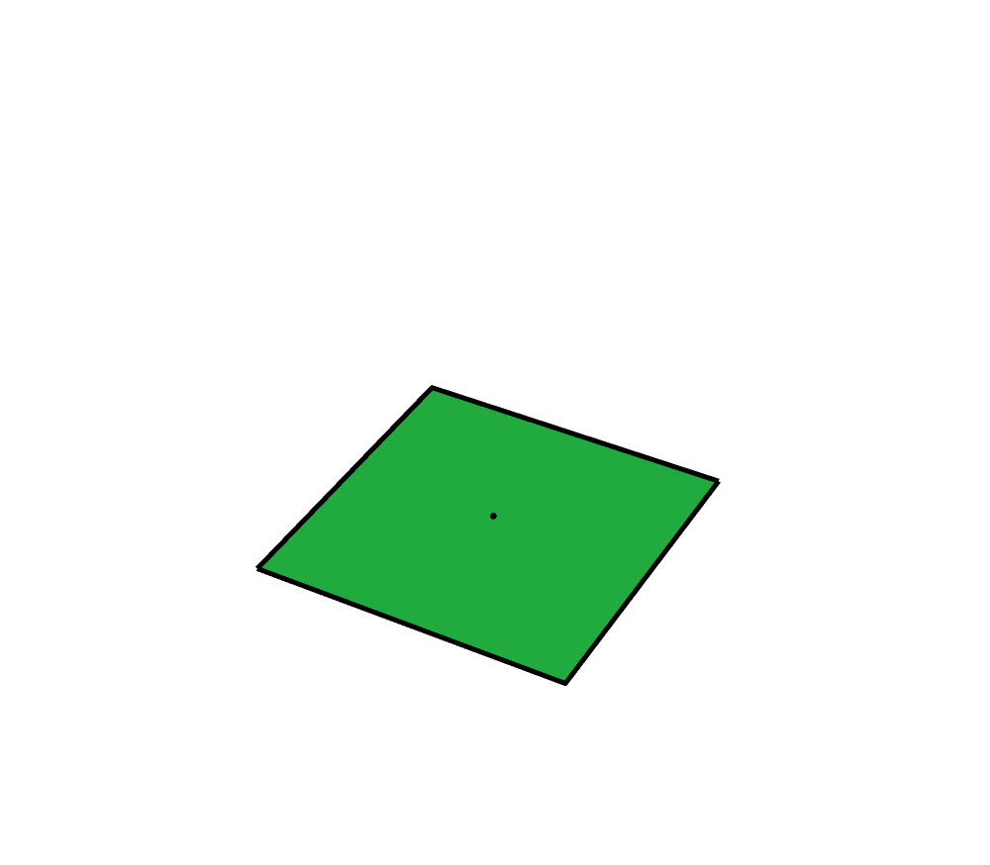
Prefiltering in 2D
Filter convolution:
Mesh data & filter
Sample location

Slide 25
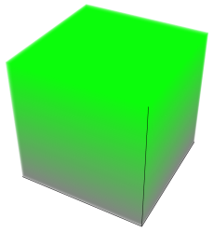

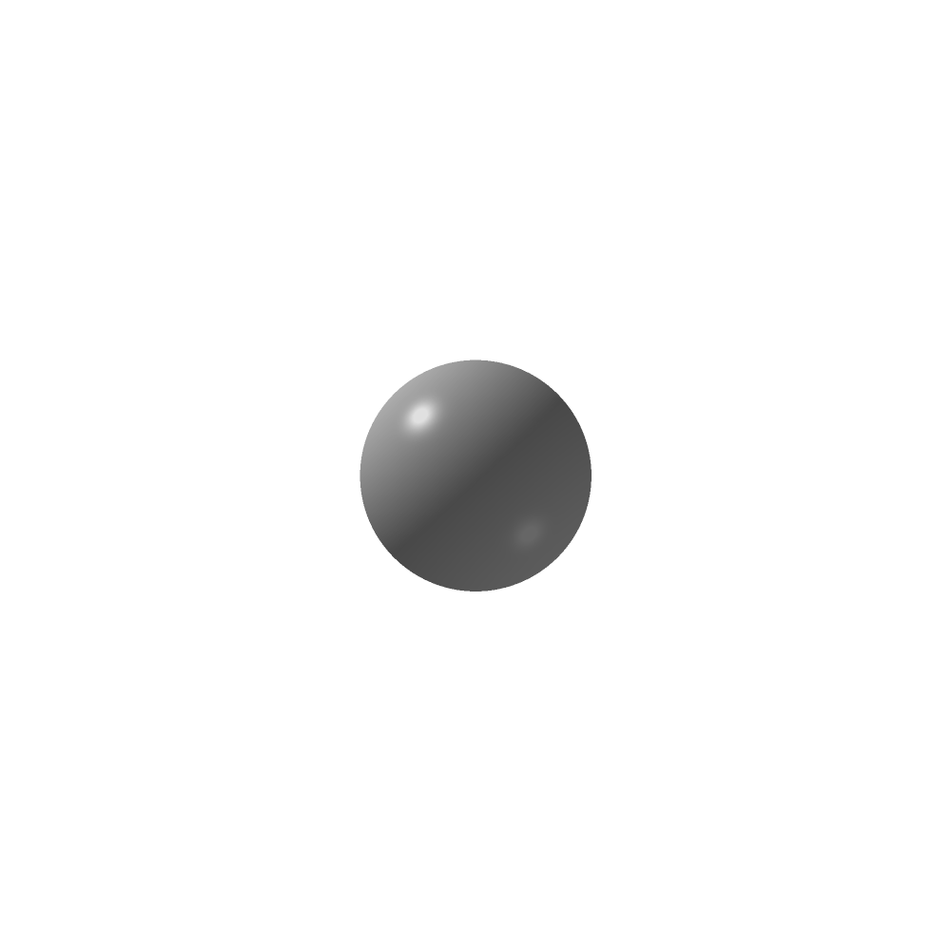
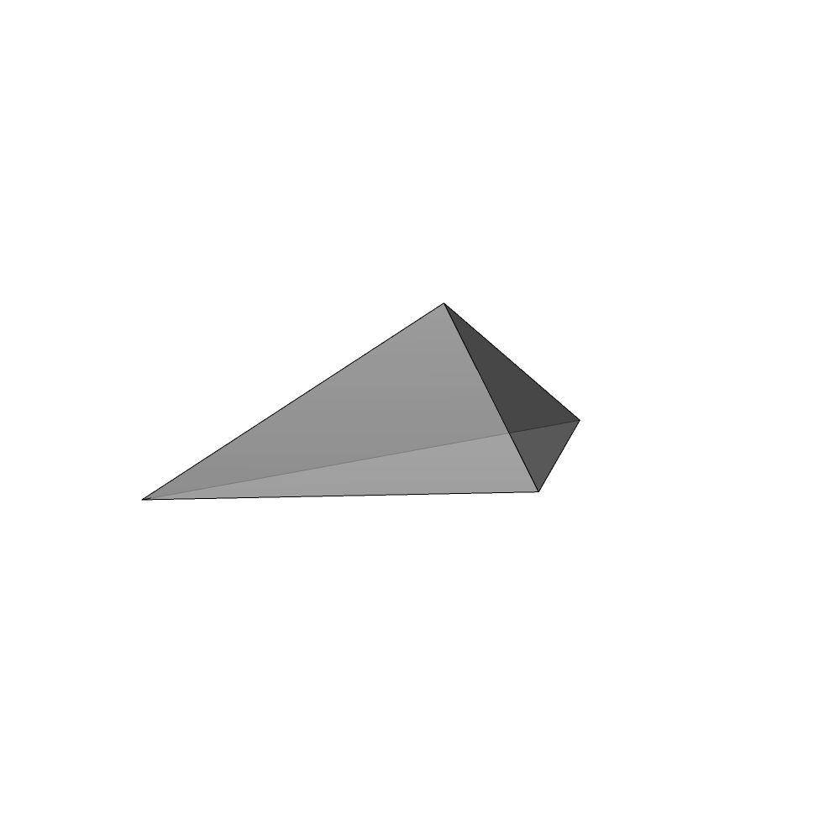
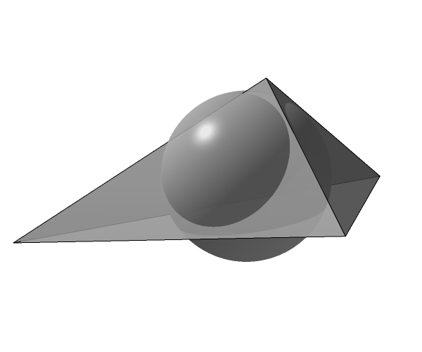

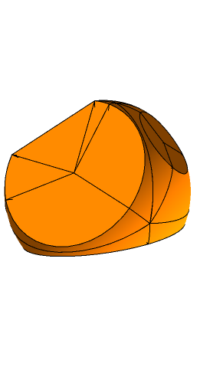
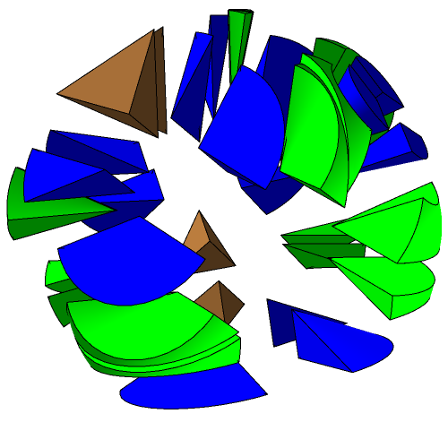




Bonus: Prefiltering in 3D
Filter convolution:
Decomposition:
Intersection volume
Subdivision
Integration domains

Slide 26


Results
Alias-free sampling of complex scenes:
Area filtering
2
2.5
3
Gaussian filtering
2M tetrahedra
at different filter radii
(shown right)
2
2.5
3

Slide 27
Publications
TA*, Gabriel Mistelbauer*, I. Baclija, R. Schernthaner, Eduard Gröller, Stefan Bruckner
Vessel Visualization using Curved Surface Reformation
SciVis 2013 (IEEE Trans. Vis. Comp. Graph.)
TA, Michael Guthe, Stefan Jeschke
Analytic Anti-Aliasing of Linear Functions on Polytopes
Eurographics 2012 (Comp. Graph. Forum)
TA, Michael Wimmer, Stefan Jeschke
Analytic Visibility on the GPU
Eurographics 2013 (Comp. Graph. Forum)
TA, Przem Musialski, Reinhold Preiner, Michael Wimmer
Non-Sampled Anti-Aliasing
VMV 2013

Slide 28
Pipeline
Traditional Analytic
Input
Input
Vertex Geometry Tessellation
Vector
Vertex Geometry Tessellation
Discretization
(Rasterizer)
Visibility
Visibility
Shading
Anti-aliasing
Shading
Anti-aliasing
Discretization
(Integrator)
Output
Raster
Output

Slide 29






Analytic Filtering
Visible edges not enough → boundary completion

Slide 30
Results
Single zone plate

Slide 31


Results
Another (white) zone plate below
Analytic rasterization
1 sample per pixel

Slide 32
Publications
TA*, Gabriel Mistelbauer*, I. Baclija, R. Schernthaner, Eduard Gröller, Stefan Bruckner
Vessel Visualization using Curved Surface Reformation
SciVis 2013 (IEEE Trans. Vis. Comp. Graph.)
TA, Michael Guthe, Stefan Jeschke
Analytic Anti-Aliasing of Linear Functions on Polytopes
Eurographics 2012 (Comp. Graph. Forum)
TA, Michael Wimmer, Stefan Jeschke
Analytic Visibility on the GPU
Eurographics 2013 (Comp. Graph. Forum)
TA, Przem Musialski, Reinhold Preiner, Michael Wimmer
Non-Sampled Anti-Aliasing
VMV 2013

Slide 33

Limitations
Shading prefiltering
  Needs closed-form solution
  Only possible for simple shading models
    Linear gradients in image space
    No perspective interpolation
    No non-linear illumination models

Slide 34
Our Contribution
Analytic Rasterization
  Visibility prefiltering
  Shading prefiltering
Non-Sampled Anti-Aliasing (NSAA)
  Visibility prefiltering
  Shading sampling

Slide 35

Our Contribution
Analytic Rasterization
  Visibility prefiltering
  Shading prefiltering
Non-Sampled Anti-Aliasing (NSAA)
  Visibility prefiltering
  Shading sampling

Slide 36
Pipeline
Design
  Fragment gathering
  Weight computation
  Final blending
Polygon input
Fragment gathering
Weight computation
Final blending
Raster image

Slide 37
Pipeline – Fragment Gathering
Polygon input
Fragment gathering
Weight computation
Final blending
Raster image

Slide 38
Pipeline – Fragment Gathering
Steps
  Fragment count (DX)
  Scan (GPGPU)
  Fragment gathering (DX)
0 | 1 | 2 | 1 | 0
1 | 2 | 2 | 1 | 1
1 | 2 | 2 | 2 | 1
0 | 1 | 1 | 1 | 0
fragment histogram
0 | 0 | 1 | 3 | 4 | 4 | 5
...
offset buffer
...
B | B | G | G | G | G | B | B | G
primitive ID buffer

Slide 39
Pipeline – Weight Computation
Polygon input
Fragment gathering
Weight computation
Final blending
Raster image

Slide 40

Pipeline – Weight Computation
Steps
  Parallel hidden surface elimination (GPGPU)
  Parallel visibility prefiltering (GPGPU)
analytic visibility
analytic convolution

Slide 41
Pipeline – Weight Computation
Steps
  Parallel hidden surface elimination (GPGPU)
  Parallel visibility prefiltering (GPGPU)
...
...
B | B | G | G | G | G | B | B | G
0.1 | 0.2 | 0.2 | 0.7 | 0.2 | 0.4 | 0.3 | 0.6 | 0.4
primitive ID buffer
weight buffer

Slide 42
Pipeline – Final Blending
Polygon input
Fragment gathering
Weight computation
Final blending
Raster image

Slide 43
Pipeline – Final Blending
Steps
  Compute shading (DX)
  Weighted blending (DX)
0.1 | 0.2 | 0.2 | 0.7 | 0.2 | 0.4 | 0.3 | 0.6 | 0.4
...
weight buffer
+
...
shading values

Slide 44
Pipeline
Polygon input
Fragment gathering
Weight computation
Final blending
Raster image

Slide 45




Results
Zone plate
MSAA8
NSAA

Slide 46




Results
Log grid
MSAA8
NSAA

Slide 47





Results – Filter Comparison
Radial filters
Radial box
Radial tent
Gauss

Slide 48

Timings
Bunny model at different LoDs
Implementation in CUDA
Output resolution: 1024²
GPU: Nvidia GTX 680
Timings in milliseconds
3-4 orders of magnitude
slower than super-
sampling
# triangles | visibility | integration
7k | 25 | 9.1
26k | 50 | 21
70k | 121 | 51

Slide 49
Conclusions
We presented methods for
High-performance sampling
Perfect-quality prefiltering
Future work
Supersampled shading
Polynomial shader interpolation
Transparency effects

Slide 50

Fin
Thank you for your attention!
Any questions?

Slide 51
Intersection
In parallel for all edges
Unordered output → global sort
Scan-based visible edge determination

Slide 52
Tiling

Slide 53

Related Work
Josiah Manson and Scott Schaefer
Analytic Rasterization of Curves with Polynomial Filters
Eurographics 2013 (Comp. Graph. Forum)
Josiah Manson and Scott Schaefer
Wavelet Rasterization
Eurographics 2010 (Comp. Graph. Forum)
G. Mistelbauer, A. Varchola, H. Bouzari, J. Starinsky, A. Köchl, R. Schernthaner, D. Fleischmann, E. Gröller, M. Srámek
Centerline Reformations of Complex Vascular Structures
Pacific Visualization Symposium 2012

