Slide 3
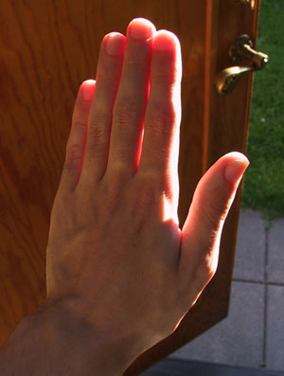
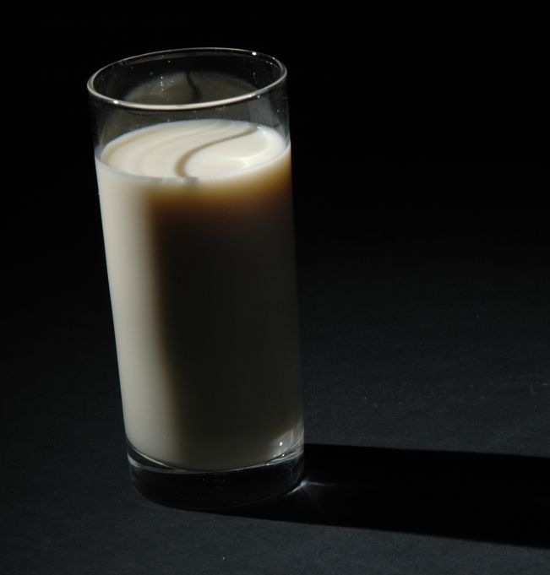
Subsurface Scattering

Slide 4
Subsurface Scattering

Slide 5
Subsurface Scattering

Slide 6
Subsurface Scattering

Slide 7
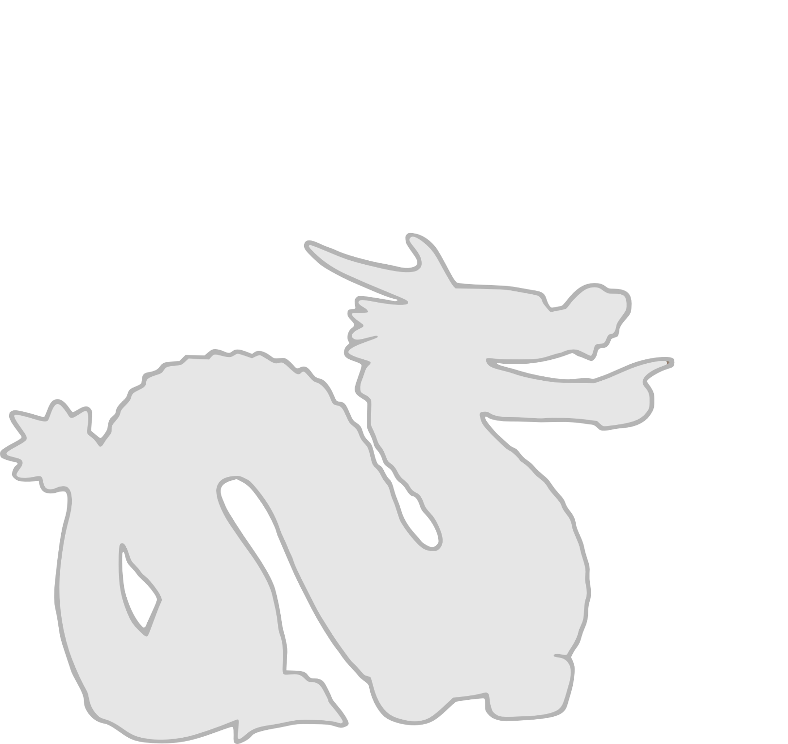
Subsurface Scattering

Slide 8
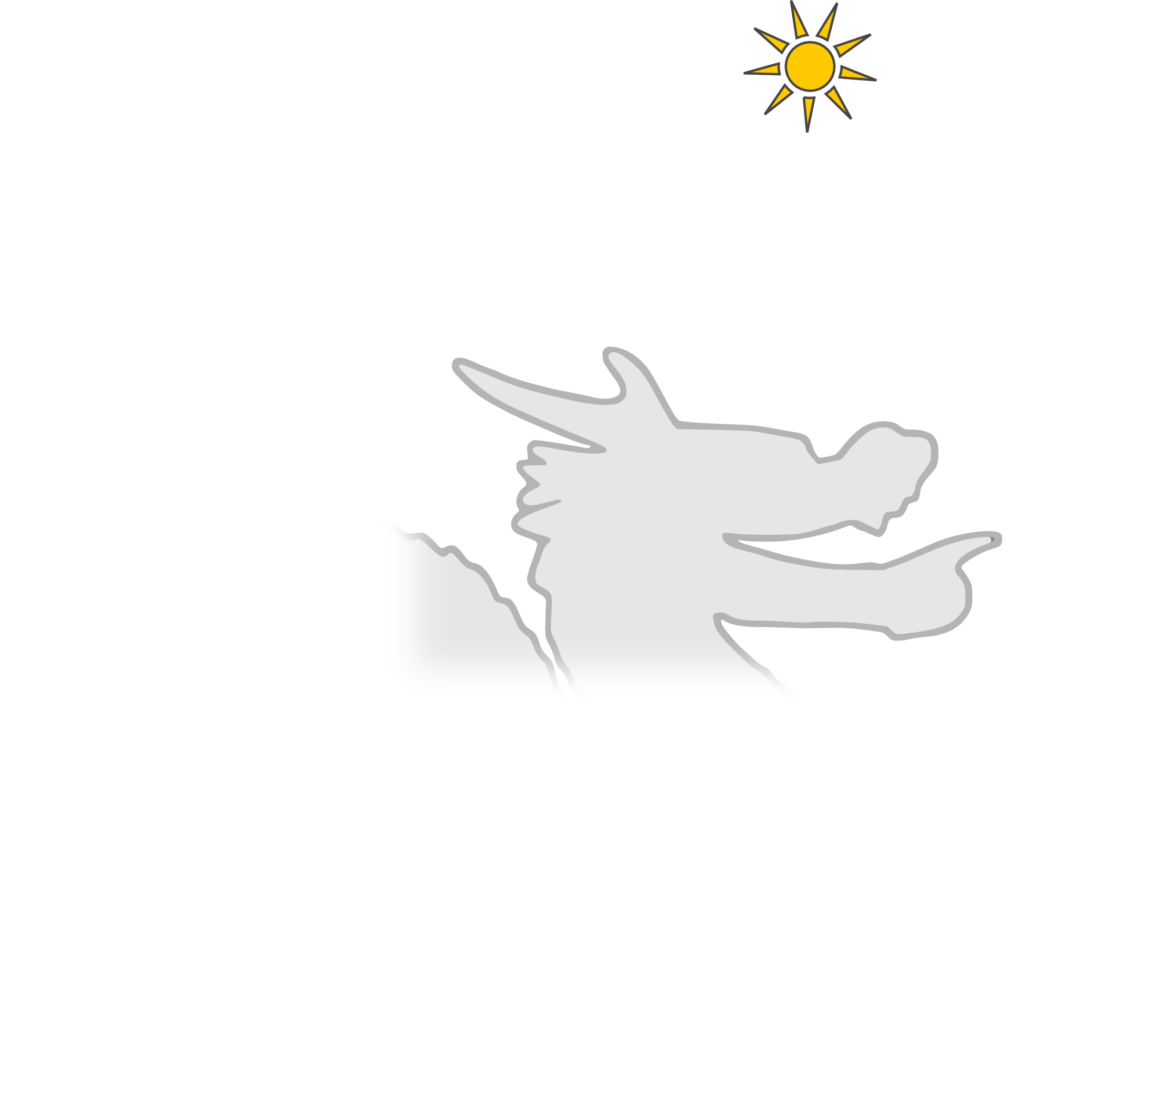
Subsurface Scattering

Slide 9
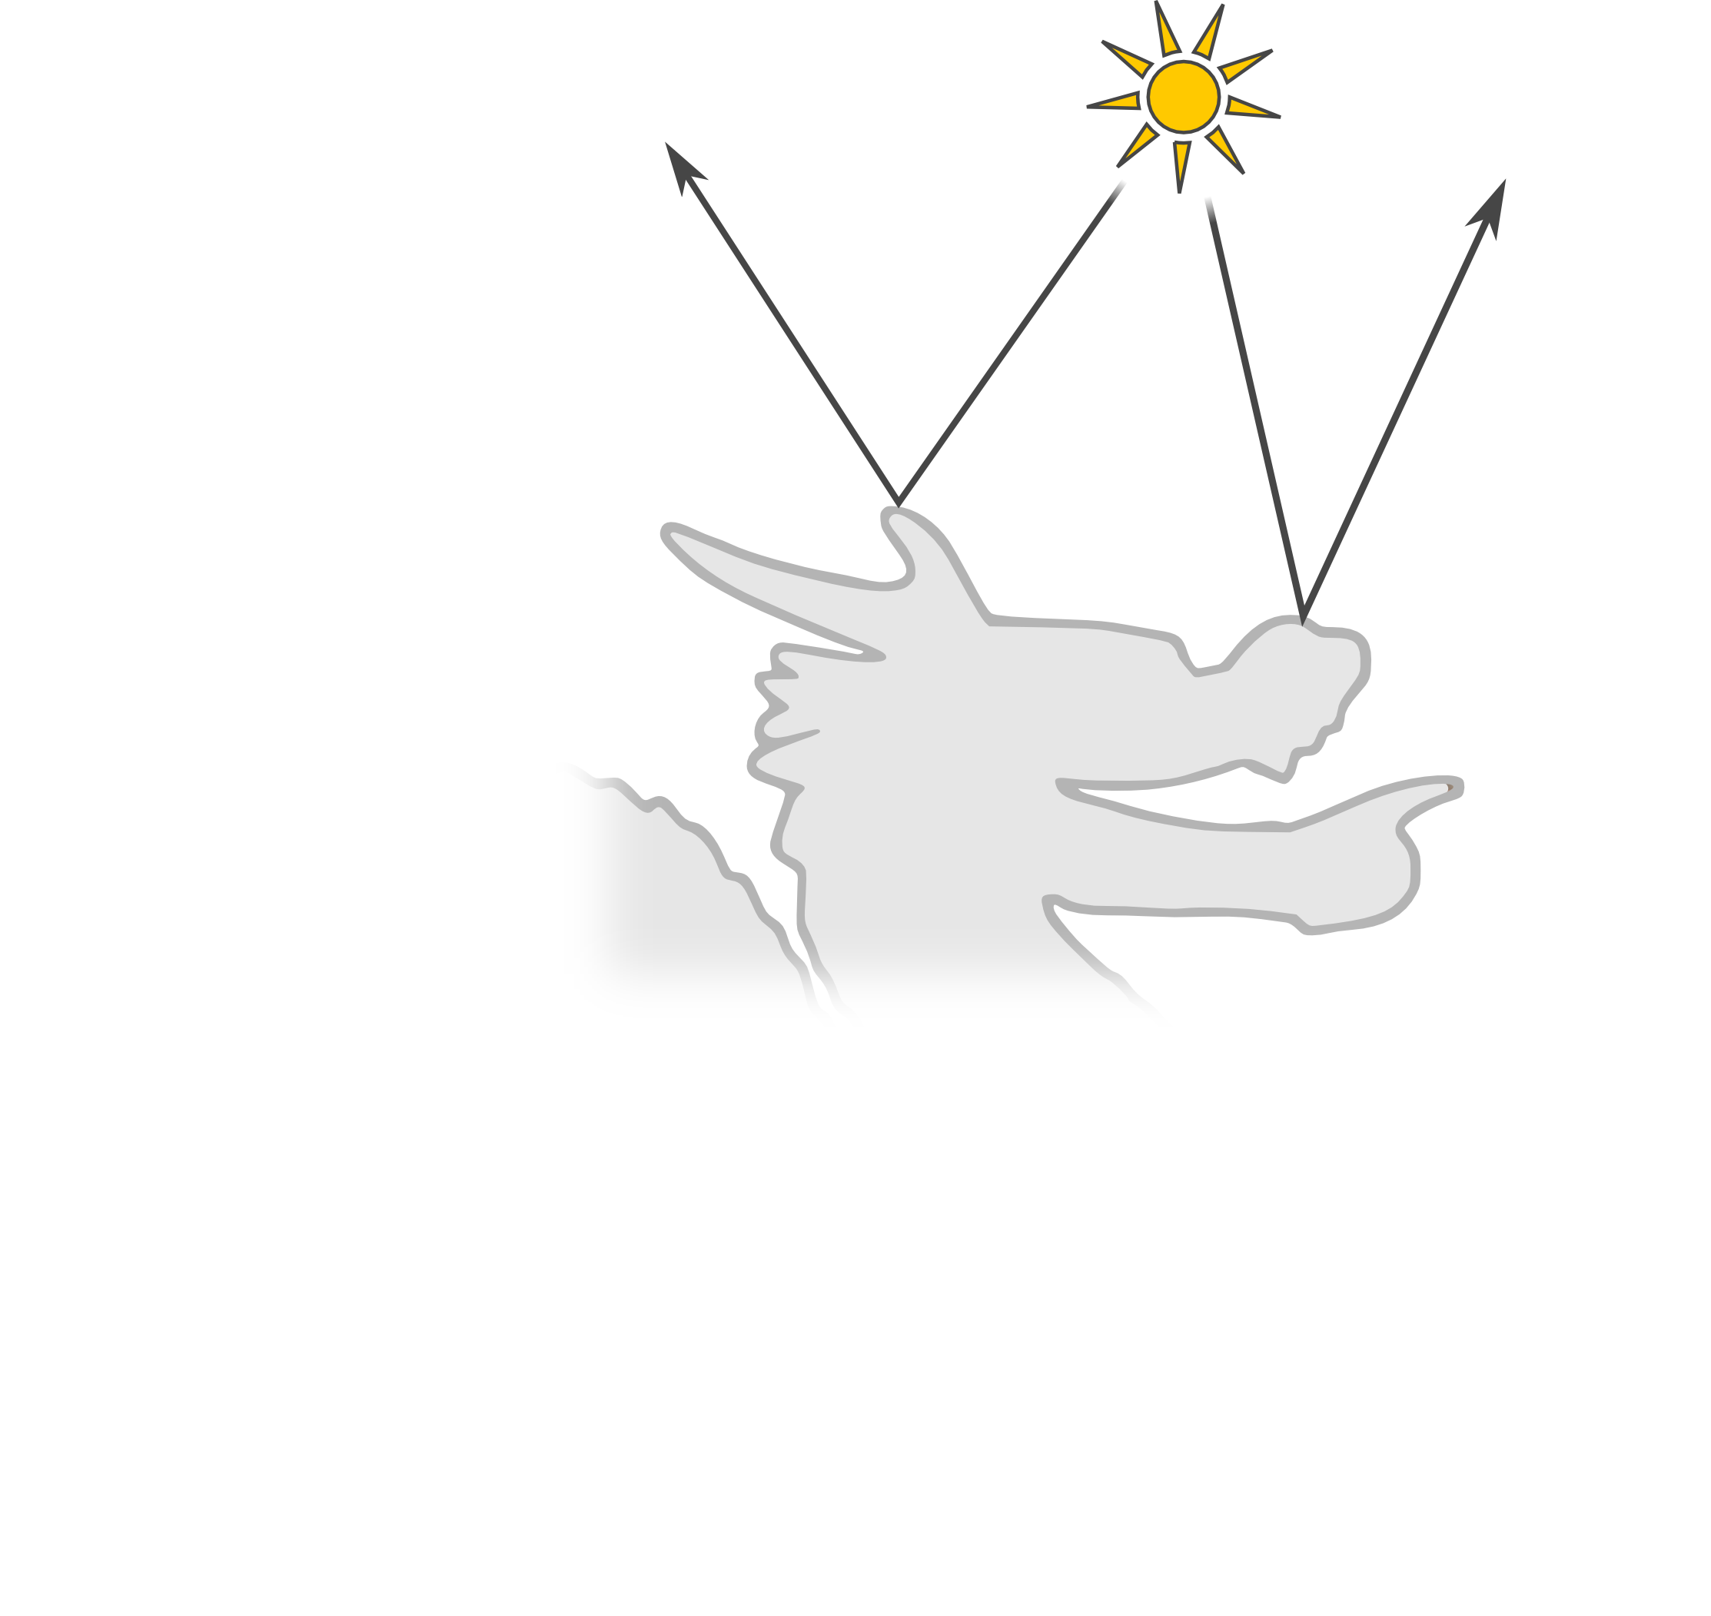
Subsurface Scattering

Slide 10
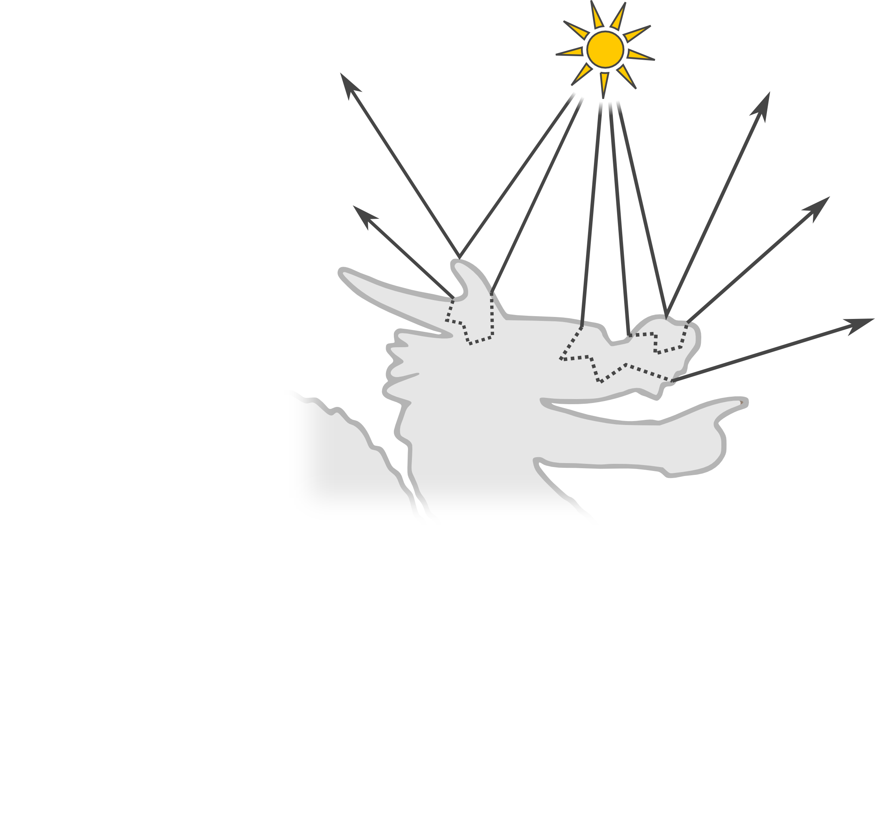
Subsurface Scattering

Slide 11
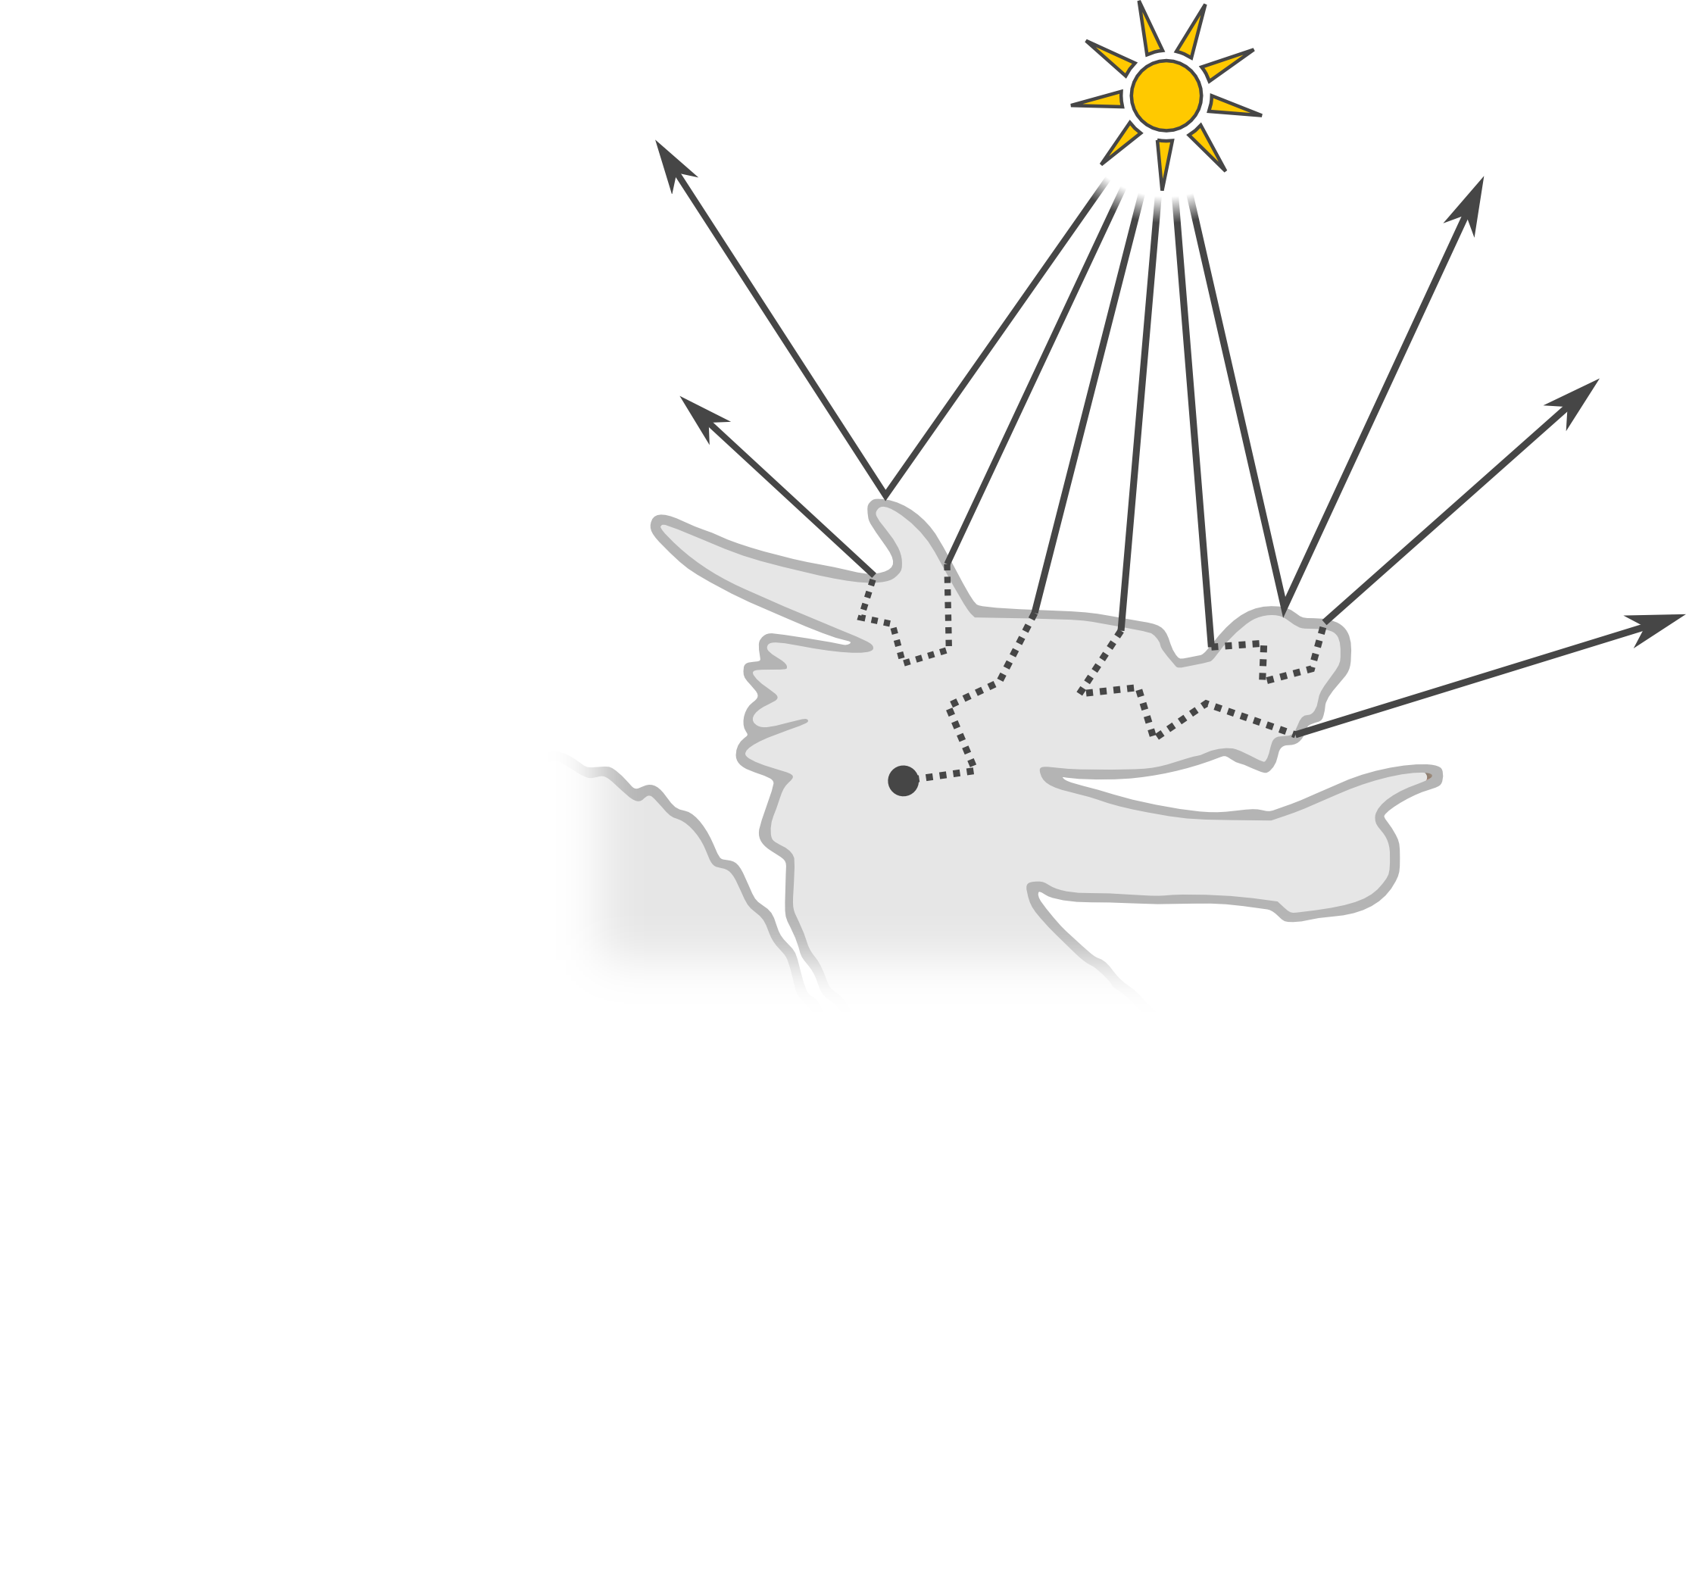
Subsurface Scattering

Slide 12
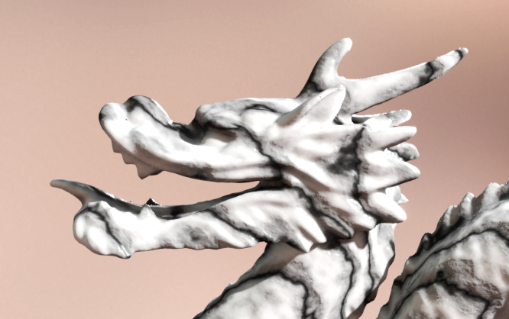
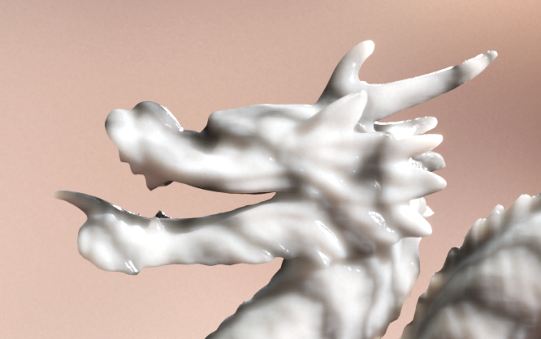
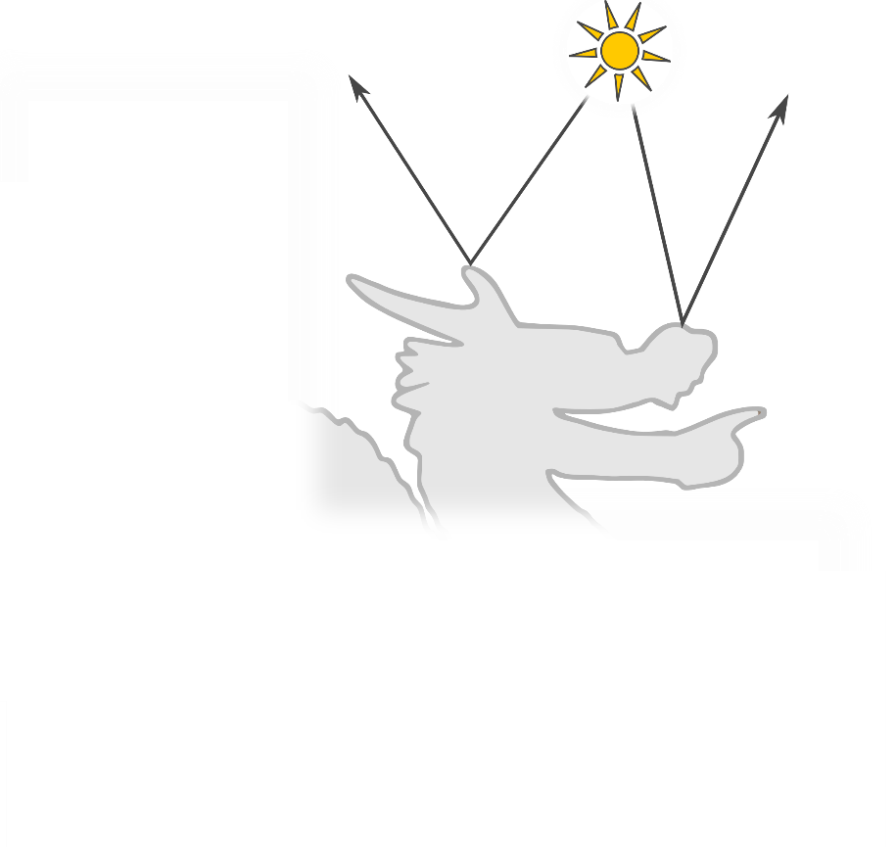
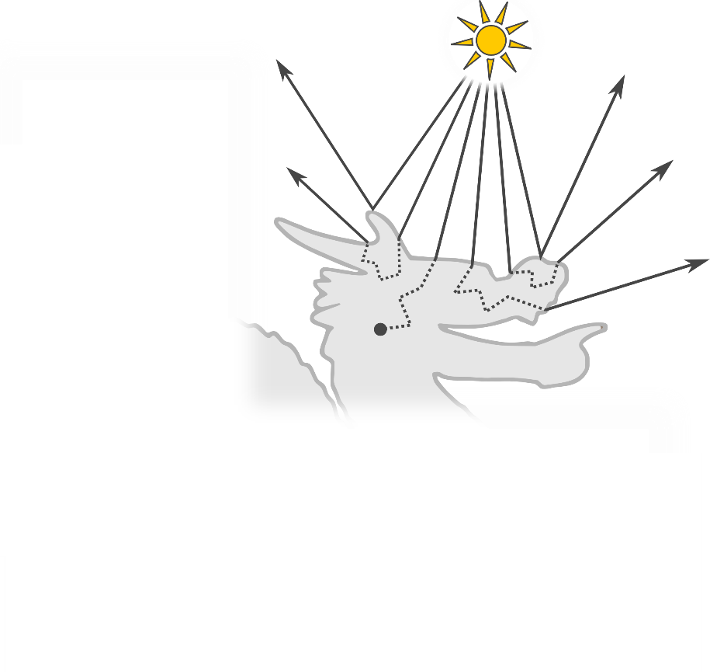
Subsurface Scattering

Slide 13
Simplified Model

Slide 14
Simplified Model

Slide 15
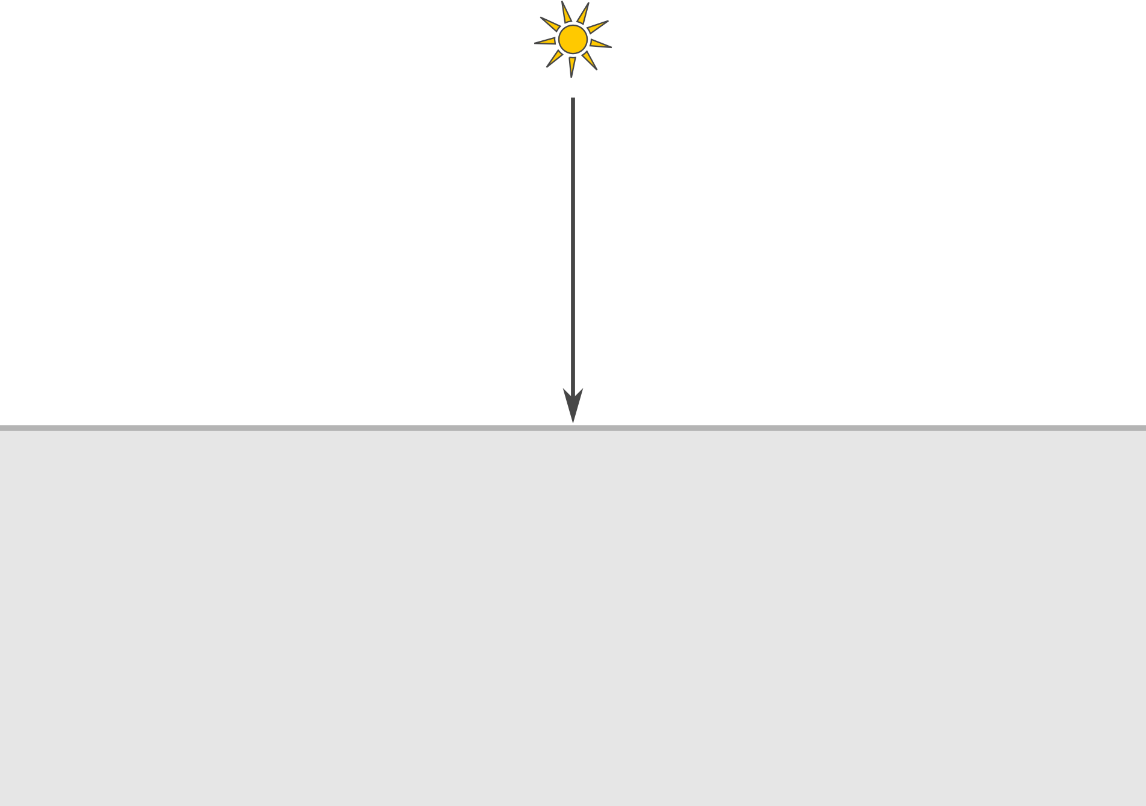
Simplified Model

Slide 16
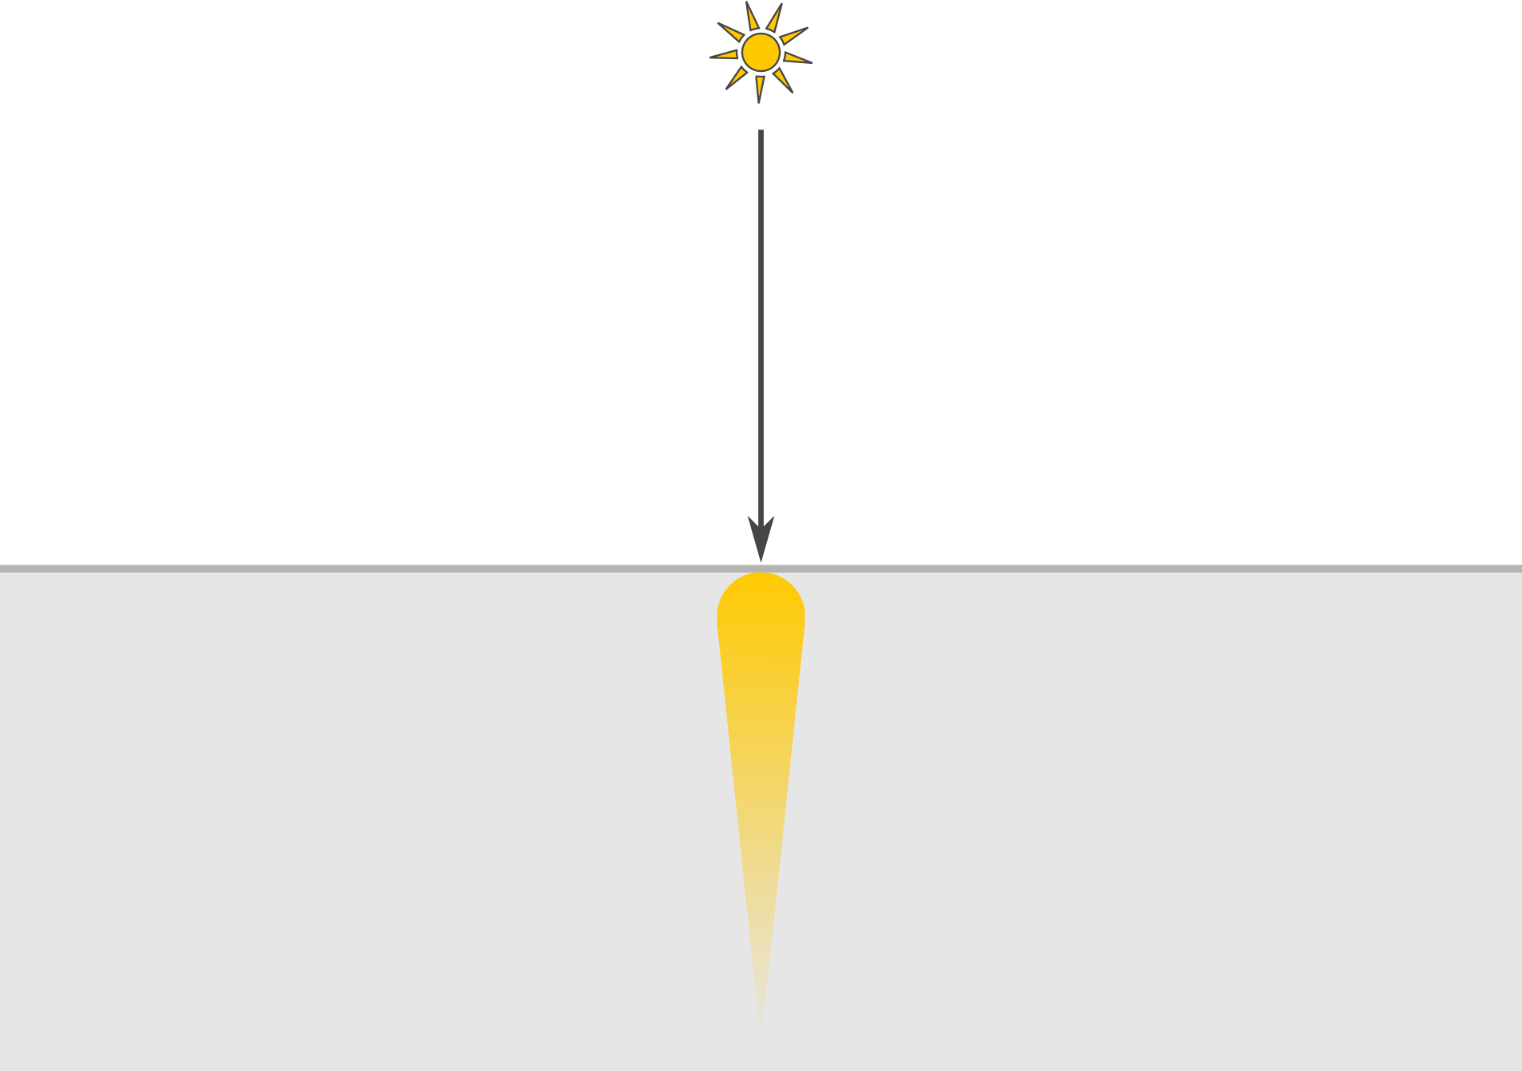
Simplified Model

Slide 17
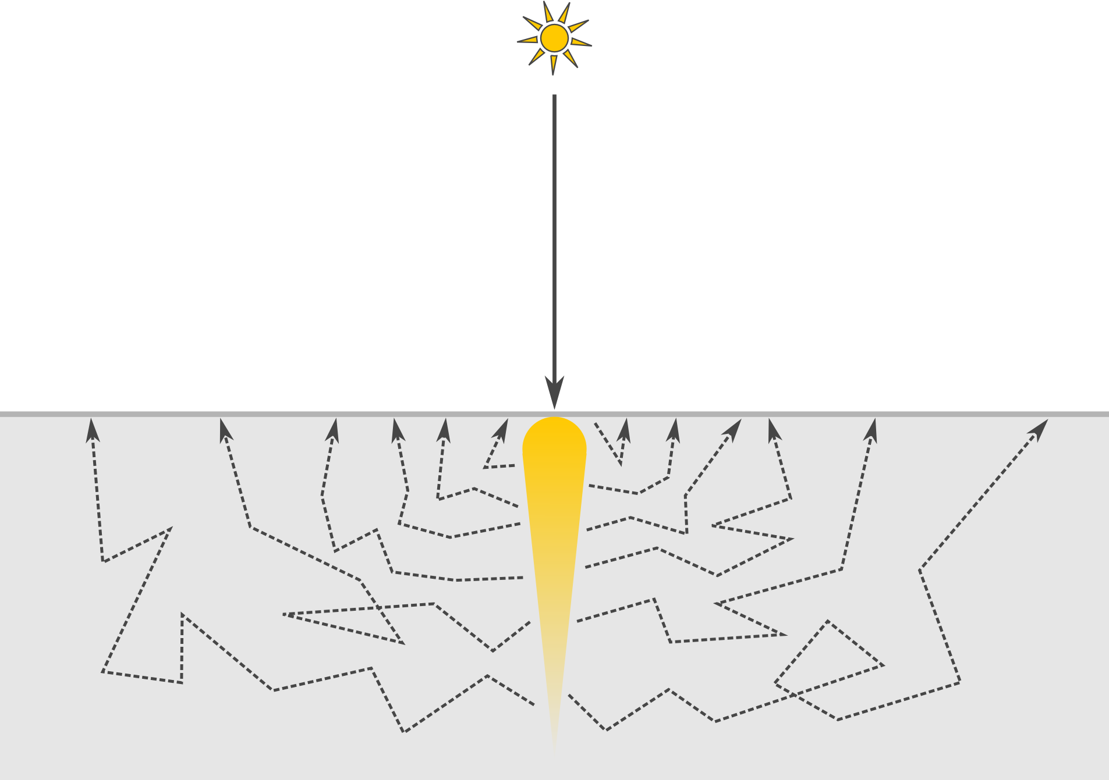
Simplified Model

Slide 18
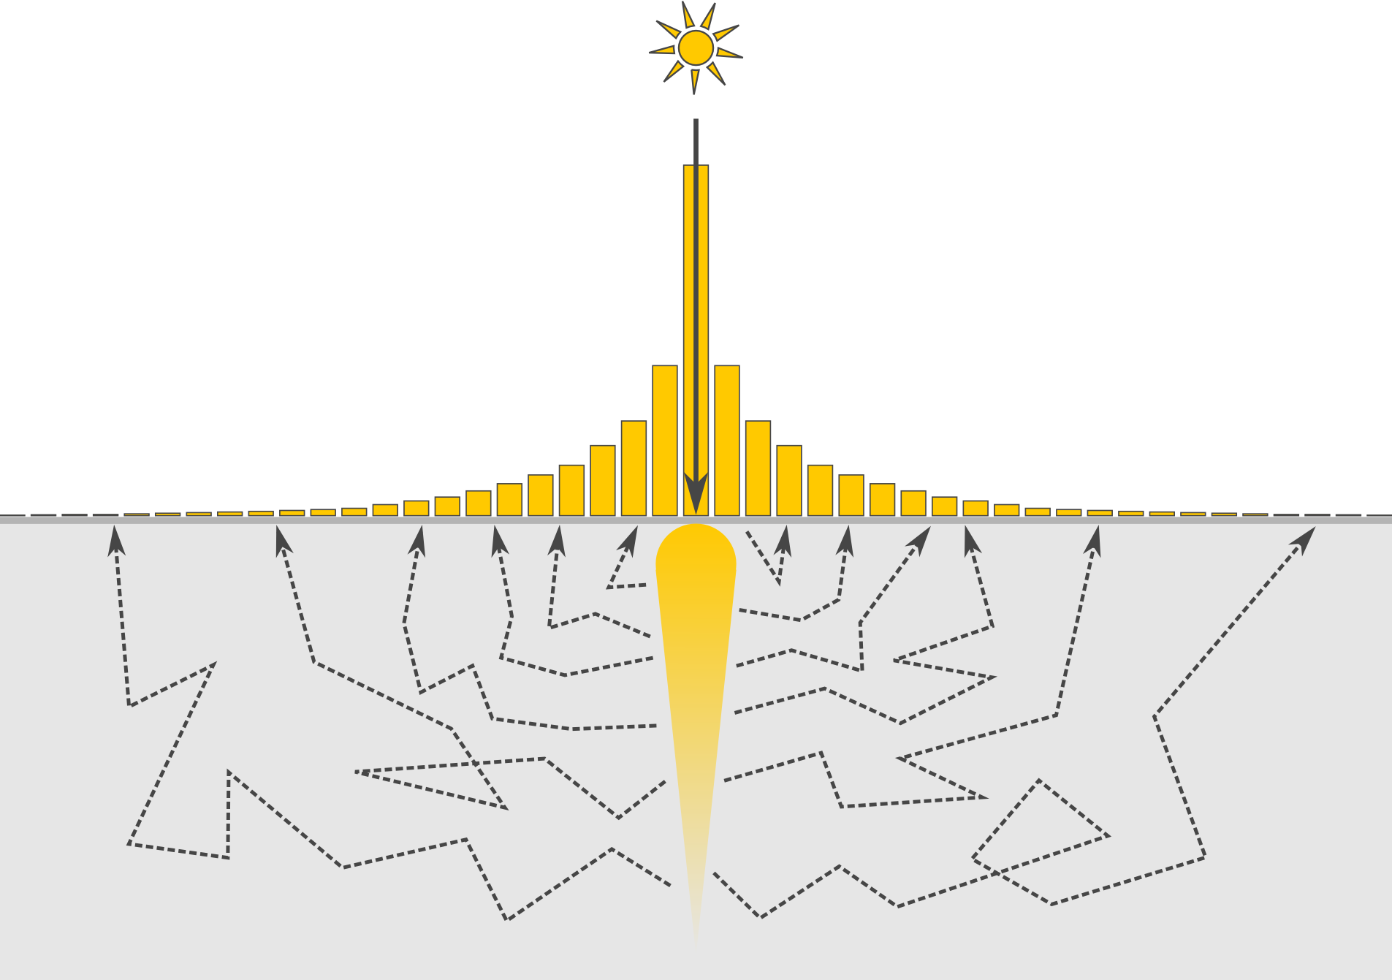
Simplified Model

Slide 19
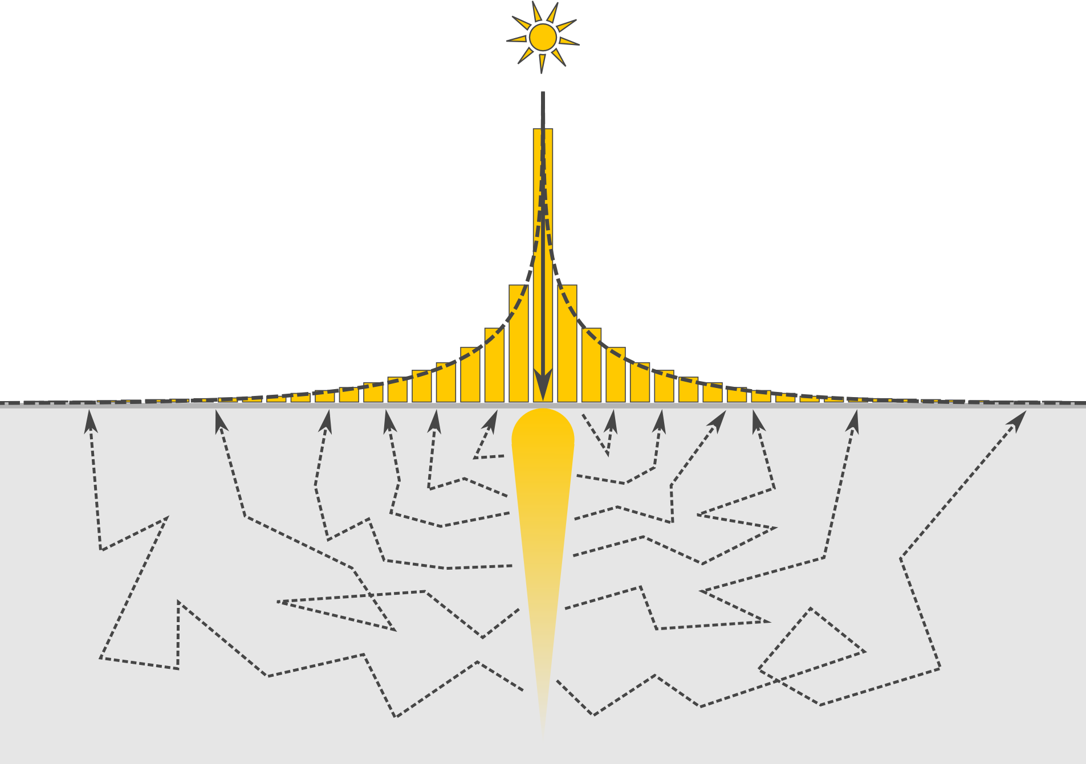
Simplified Model

Slide 20
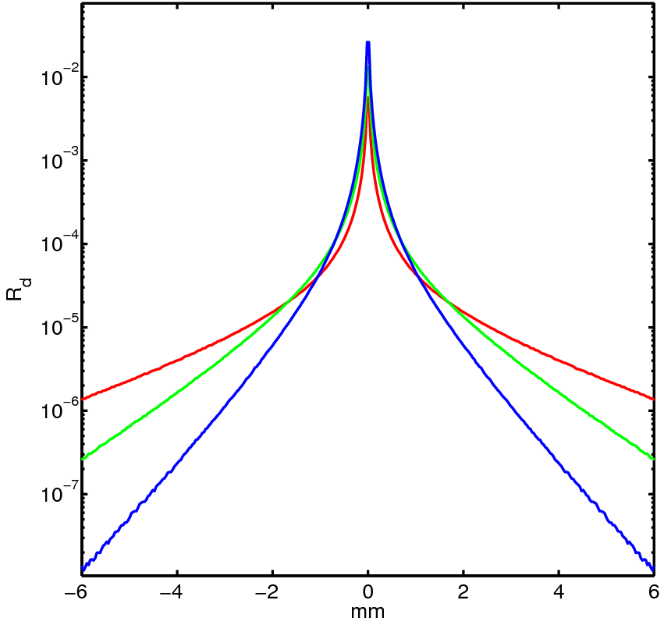
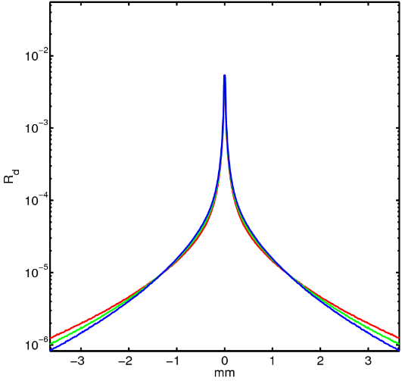
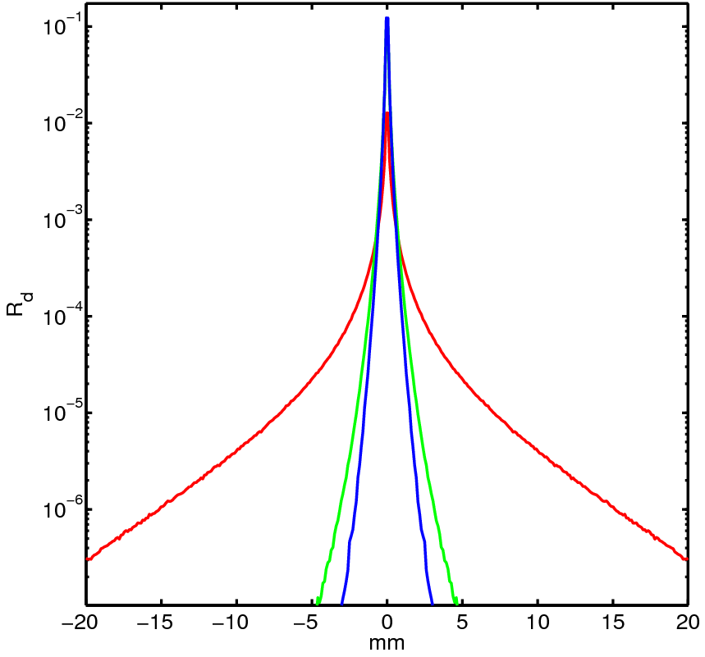
Diffuse Reflectance Profiles
Human Skin
Marble
Ketchup

Slide 21
Subsurface Scattering via Image Filtering
Diffuse reflectance profile
as
Filter

Slide 22
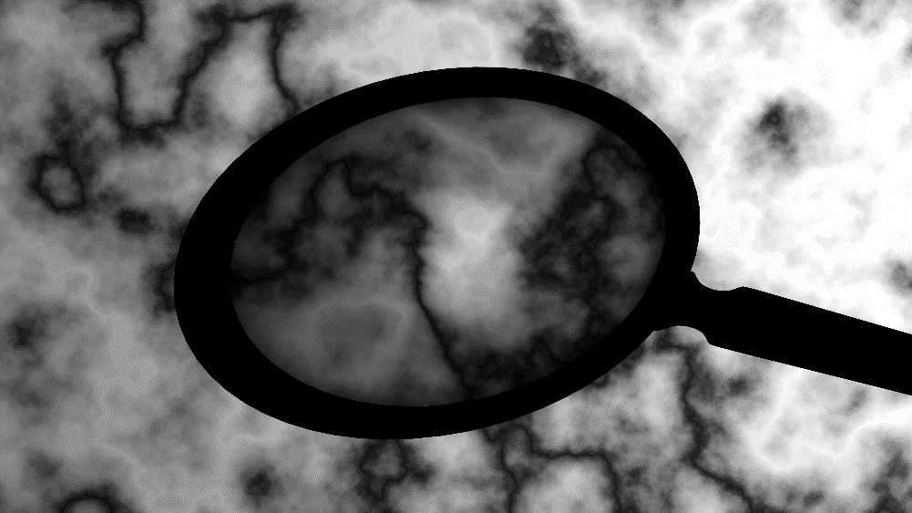
Subsurface Scattering via Image Filtering
Surface Illumination
Diffuse reflectance profile
as
Filter

Slide 23
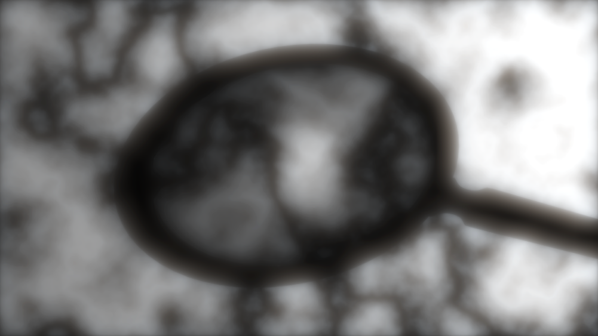
Subsurface Scattering via Image Filtering
Surface Illumination
Diffuse reflectance profile
as
Filter
Subsurface Scattering

Slide 24
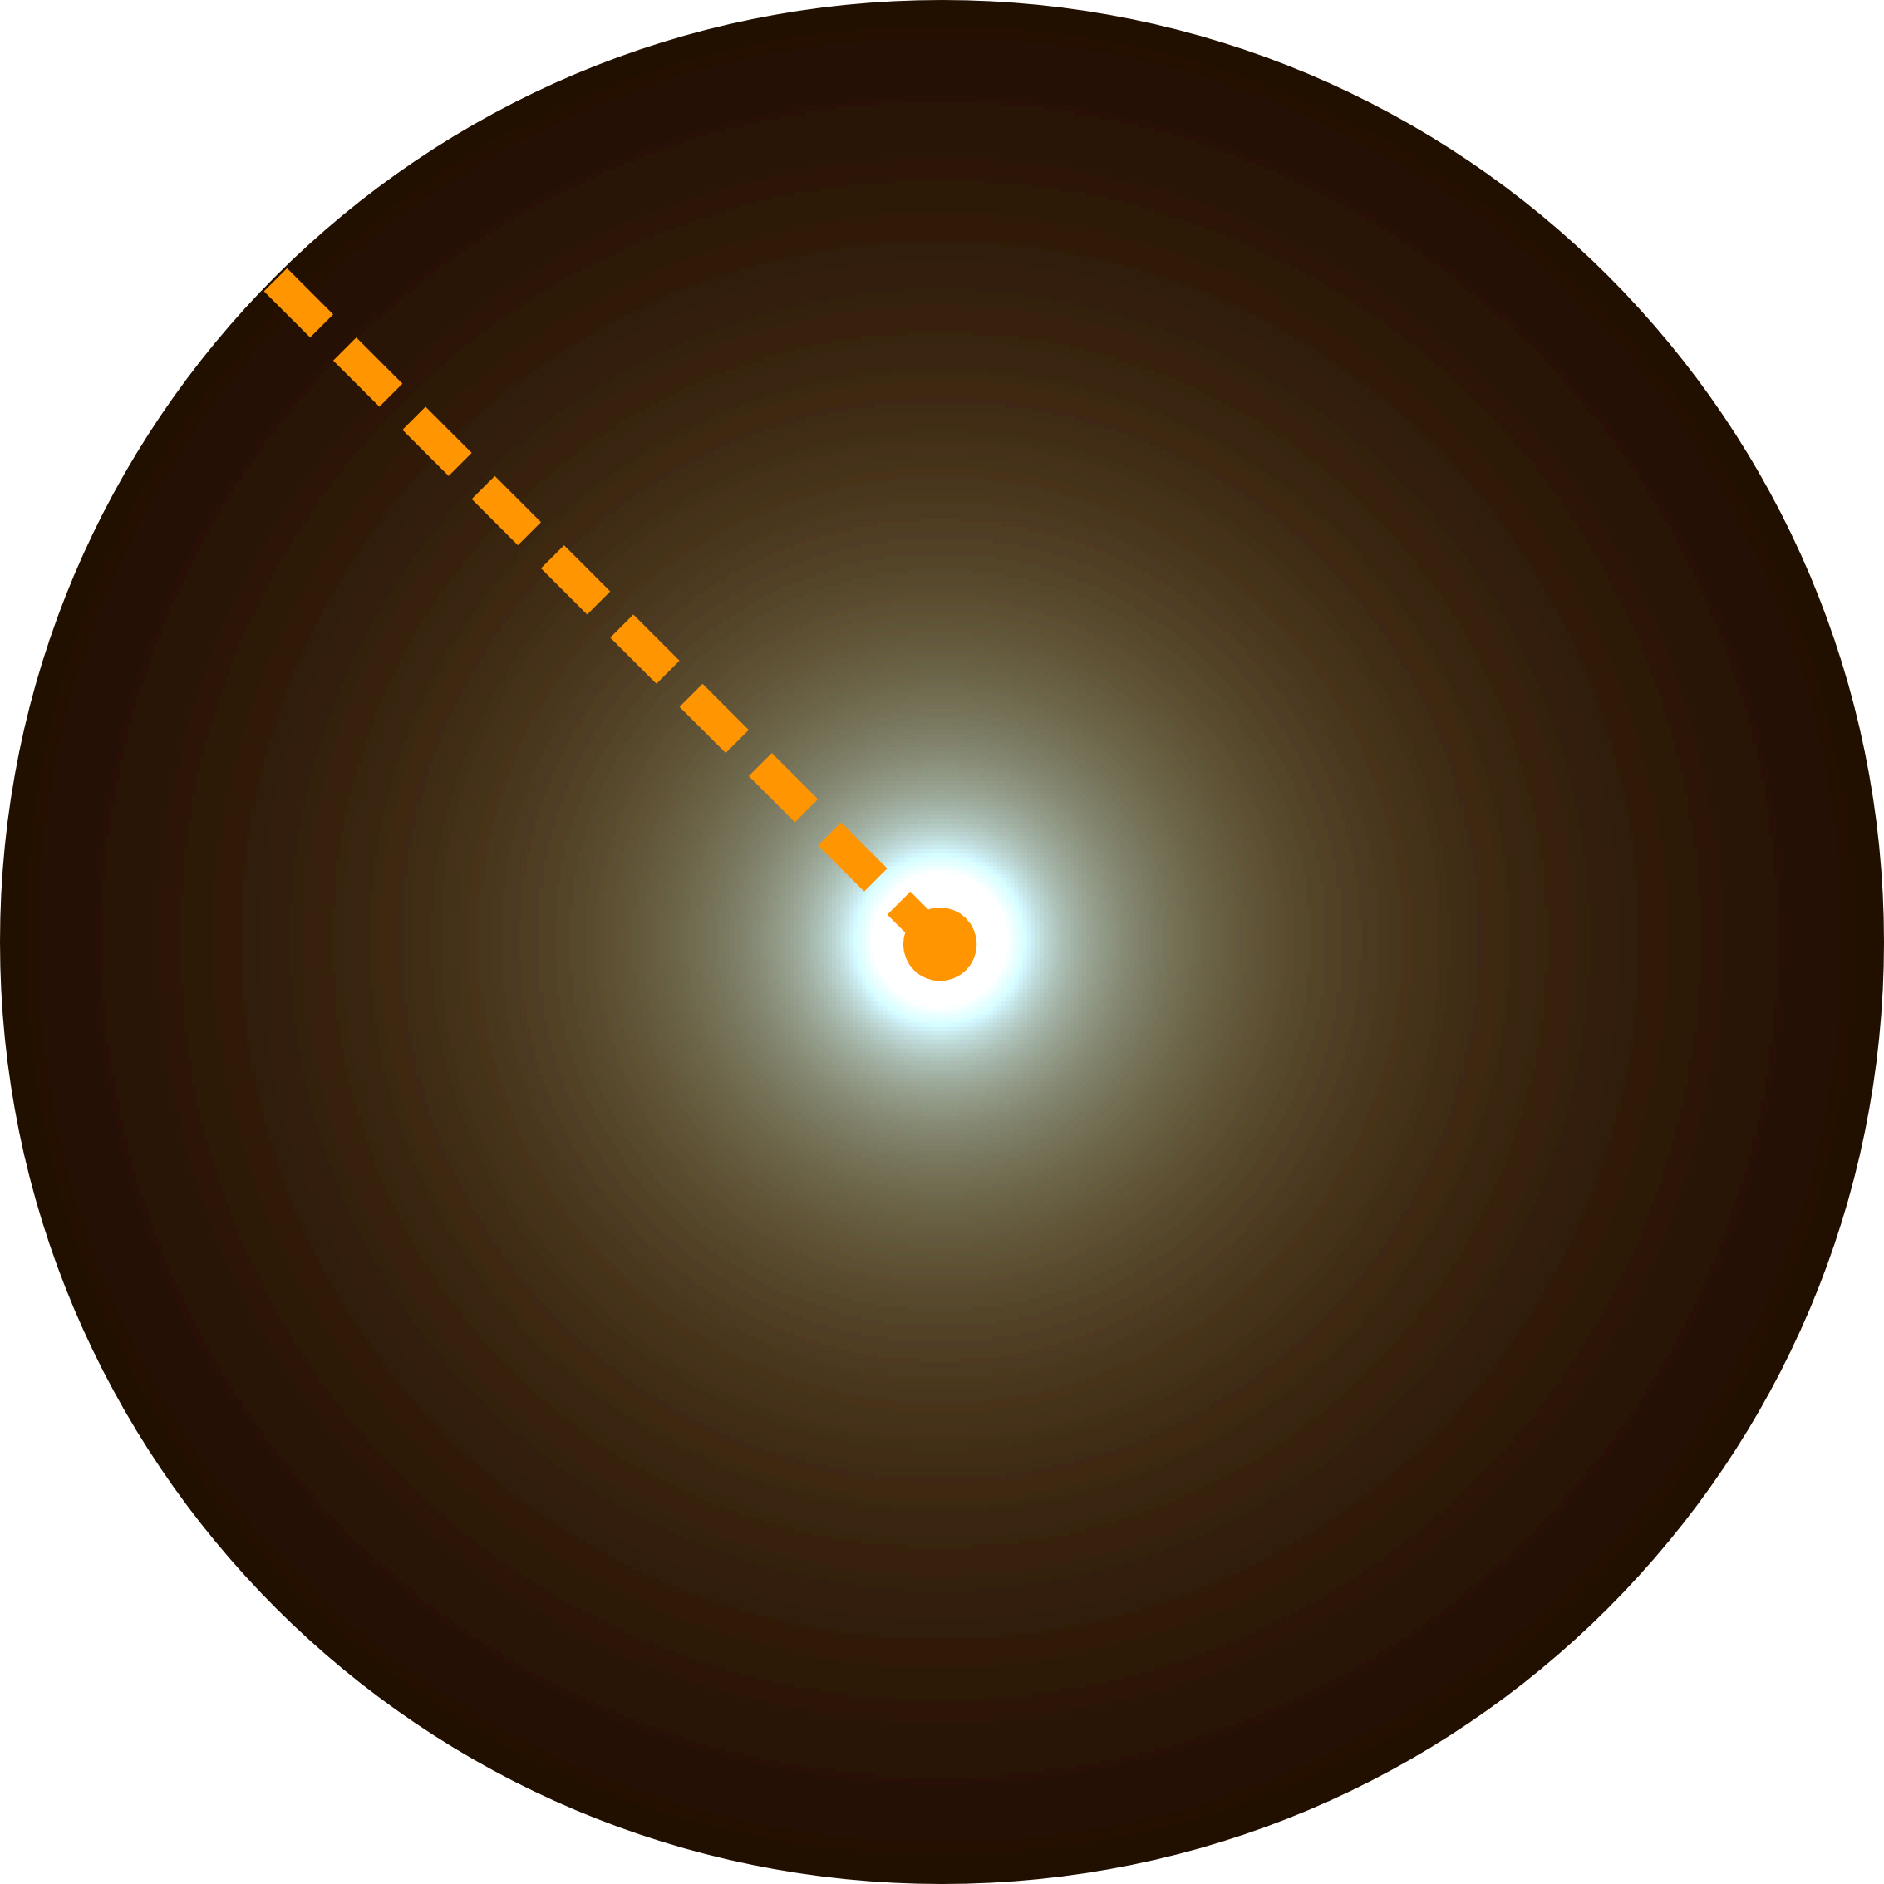
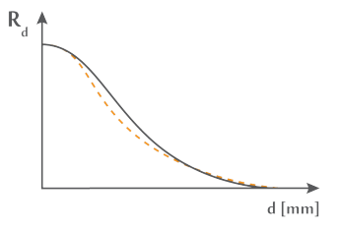
State of the Art
Eugene d'Eon et al., Efficient rendering of human skin, 2009

Slide 25
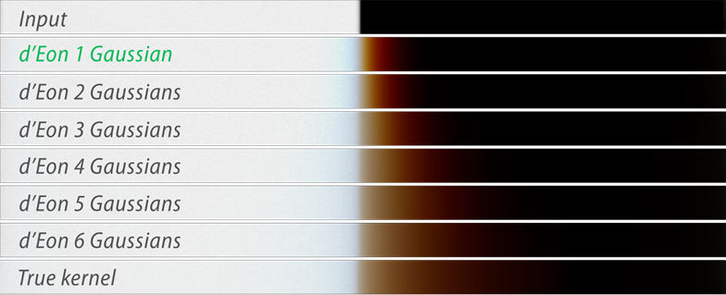
State of the Art

Slide 26
Separable Subsurface Scattering
Reference

Slide 27
Separable Subsurface Scattering
≈
Reference
Separable
approximation

Slide 28
Separable Subsurface Scattering
$$∗$$
≈
=
Reference
Separable
approximation
1D Components

Slide 29
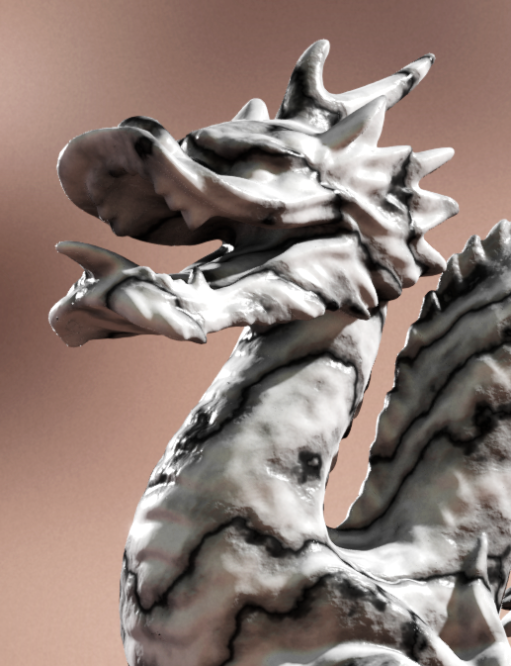
Rendering Pipeline
Input

Slide 30
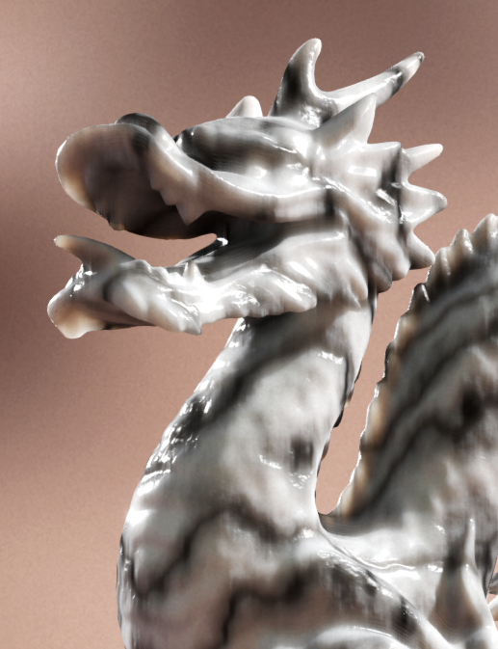
Rendering Pipeline
Input
$$∗$$

Slide 31
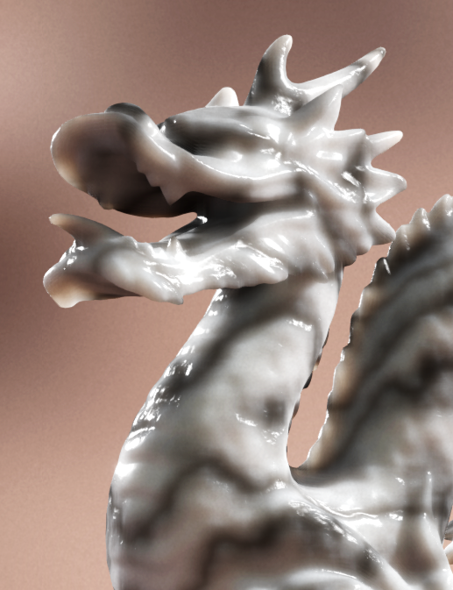
Rendering Pipeline
Input
Result
$$∗$$
$$∗$$

Slide 32
Main Contributions
Three filter approximation models
Not controllable
Filter quality
Controllable
Faster
Generation speed
Slower

Slide 33
Main Contributions
Three filter approximation models
Pre-Integration
Not controllable
Filter quality
Controllable
Faster
Generation speed
Slower

Slide 34
Main Contributions
Three filter approximation models
Guided Optimization
Pre-Integration
Not controllable
Filter quality
Controllable
Faster
Generation speed
Slower

Slide 35
Main Contributions
Three filter approximation models
Guided Optimization
Manual Approximation
Pre-Integration
Not controllable
Filter quality
Controllable
Faster
Generation speed
Slower

Slide 36
Pre-Integration
Separable 1D
component
derived via
pre-integration

Slide 37
Pre-Integration

Slide 38
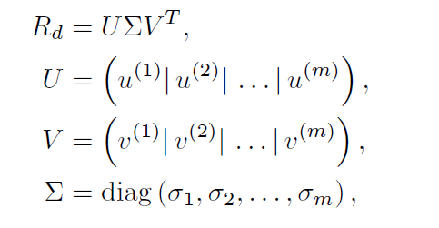
Guided Optimization
Weight
Ref.
Approx.

Slide 39
Guided Optimization
Weight
Ref.
Approx.

Slide 40
Guided Optimization
Weight
Ref.
Approx.

Slide 41
Guided Optimization
Weight
Ref.
Approx.
Center Approx.

Slide 42
Guided Optimization
Weight
Ref.
Approx.
Center Approx.
Falloff Approx.

Slide 43
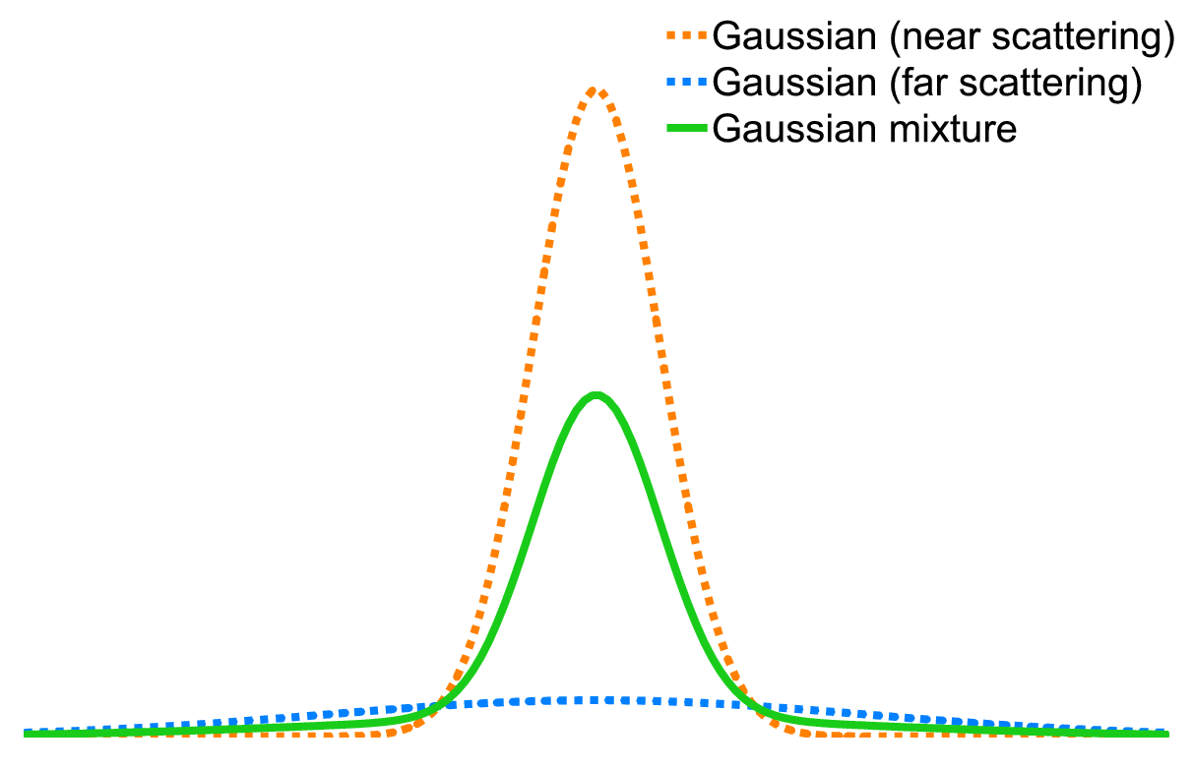
Manual Approximation
$$∗$$

Slide 44
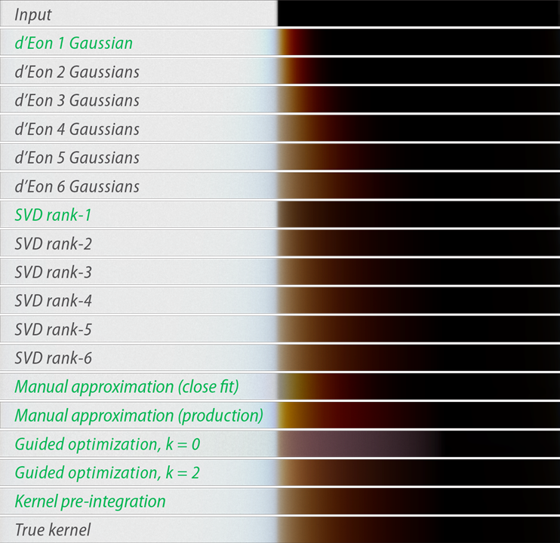
Overview

Slide 45
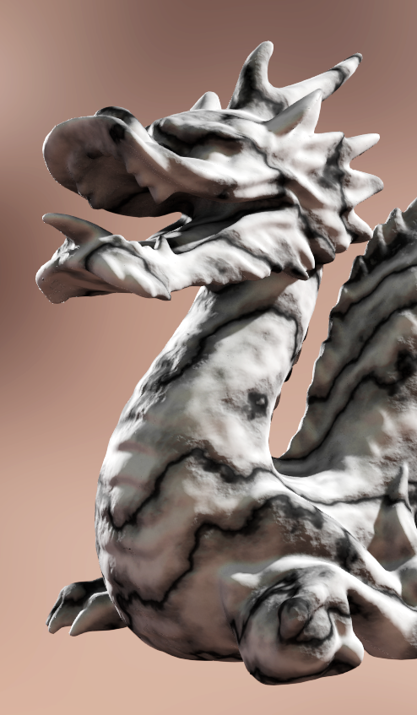
Input

Slide 46
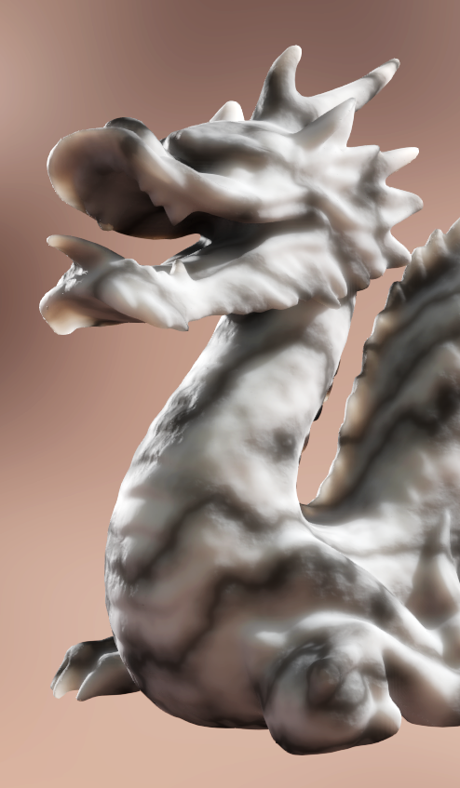
Input
Reference

Slide 47
Input
Reference
Guided Optimization

Slide 48
Input

Slide 49
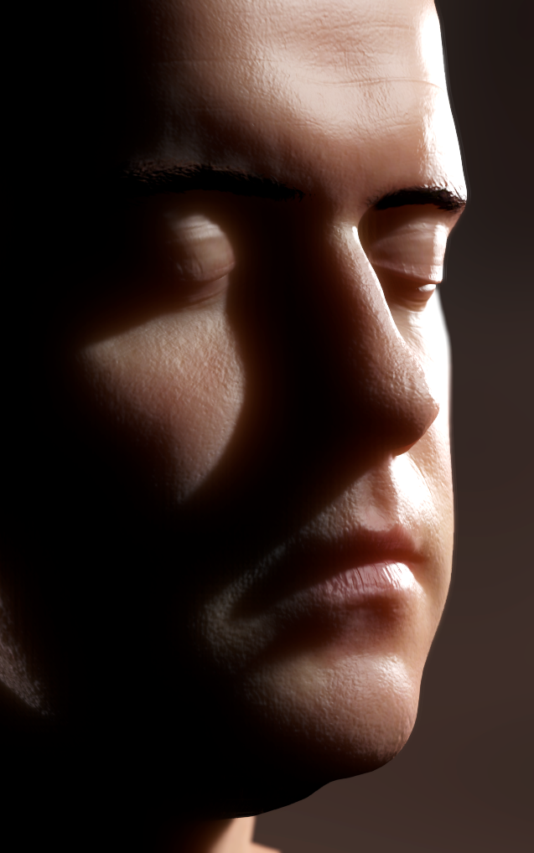
Input
Reference

Slide 50
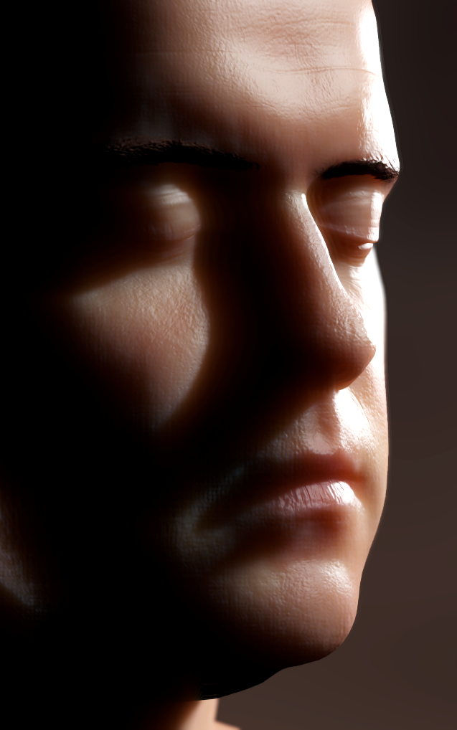
Input
Reference
Pre-Integration

Slide 51
Input

Slide 52
Input
Reference

Slide 53
Input
Reference
Manual Approximation

Slide 54
Conclusion
Real-time Subsurface Scattering for arbitrary materials

Slide 55
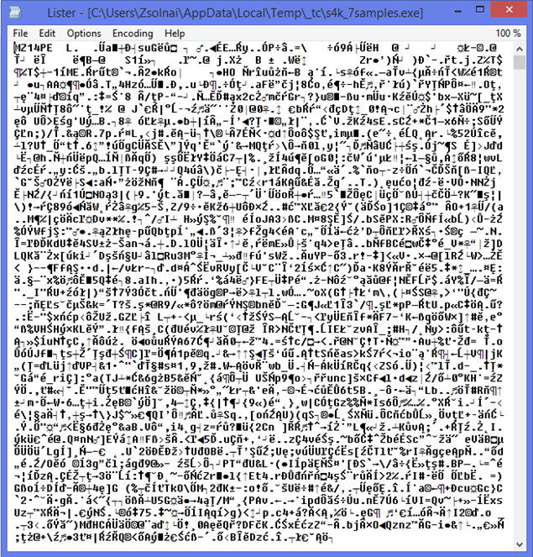
Conclusion
Real-time Subsurface Scattering for arbitrary materials

Slide 56
Conclusion
Real-time Subsurface Scattering for arbitrary materials

