Slide 1
Automatic Generation of Tourist Brochures
Michael Birsak¹, Przemyslaw Musialski¹,
Peter Wonka^{2,3}, Michael Wimmer¹
¹Vienna University of Technology, Austria
²KAUST, Saudi Arabia
³Arizona State University, USA

Slide 2
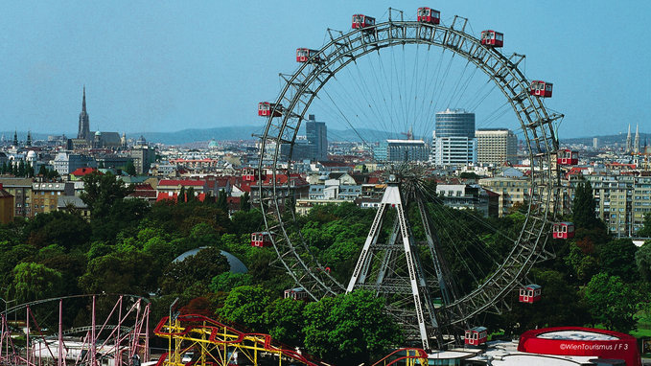
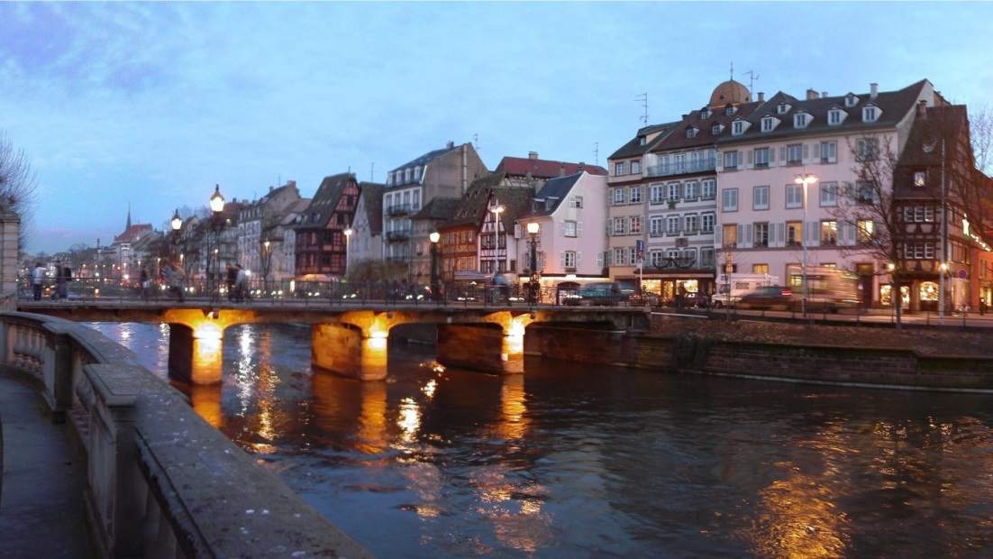
Motivation
Seattle
Vienna
Strasbourg
Notes:
Imagine you spend your vacation in a city like Seattle, Vienna, or Strasbourg. Then, in your hotel you often get a classic travel brochure as a handout.

Slide 3
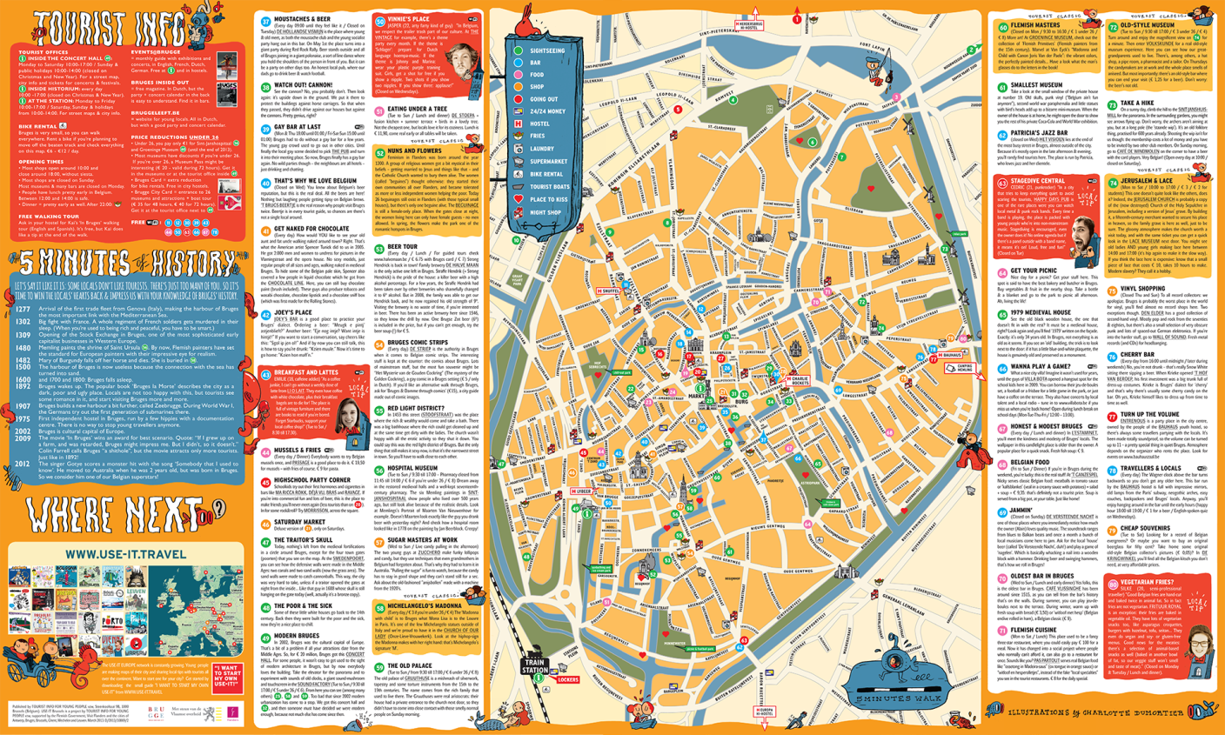
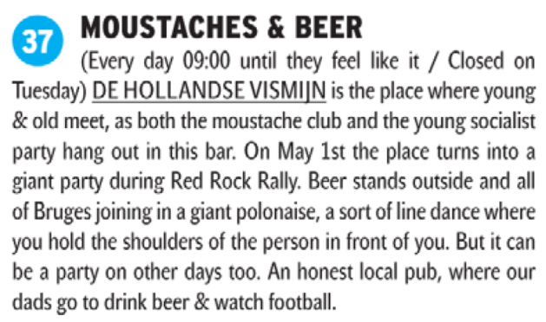
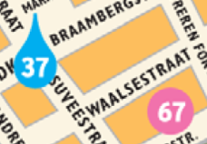
Motivation
Classic Travel Brochures
To find out about points of interest (POIs)
How to get to those POIs
3
Notes:
Such travel brochures allow to find out about points of interest (POIs) in the city, and sometimes how to get to those POIs (maybe by the closest metro station).
<showing travel brochure>
Such a travel brochure may look like this one. Here, the POIs in the map have numbered cross-references to an arbitrarily sorted list with descriptions of the POIs. However, finding of information about nearby POIs is often tedious. In this example, information about the POI with number 37 can be found at the top left, while the information about the nearby POI with number 67 can be found at the bottom right.

Slide 4
Motivation
Problems of classic Travel Brochures
Not suitable for larger areas
Tedious to ﬁnd information
about nearby POIs
Layout Problem
Do not offer guidance for
efﬁcient travel
Routing Problem
4
Notes:
So we can see, that classic travel brochures suffer from several problems.
Usually, they are not suitable for larger areas because the map level-of-detail will be too low near important areas like the POIs.
Then, what we‘ve just seen in the example, it is tedious to ﬁnd information about nearby POIs.
Finally, they do not offer guidance for efficient travel from one POI to another.
Problems 1 and 2 lead to a layout problem: „How can the POIs and detail information about them be laid out on a map so as to allow efﬁcient cross-referencing between the map and the detail, even for larger areas.
Problem 3 leads to a routing problem: How is it possible to represent on a single static map efﬁcient routes between multiple POIs, such that we can get from any POI to any other POI?

Slide 5
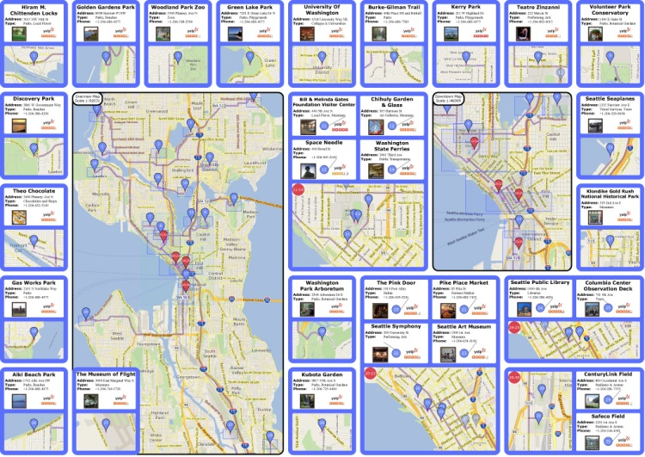
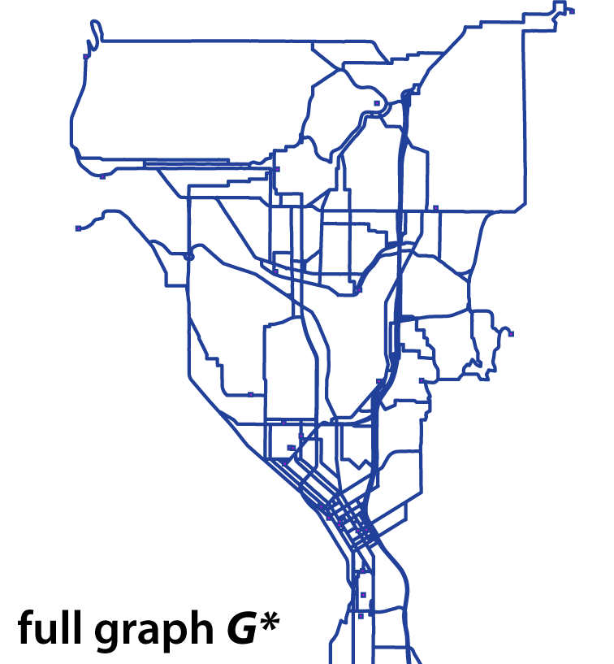
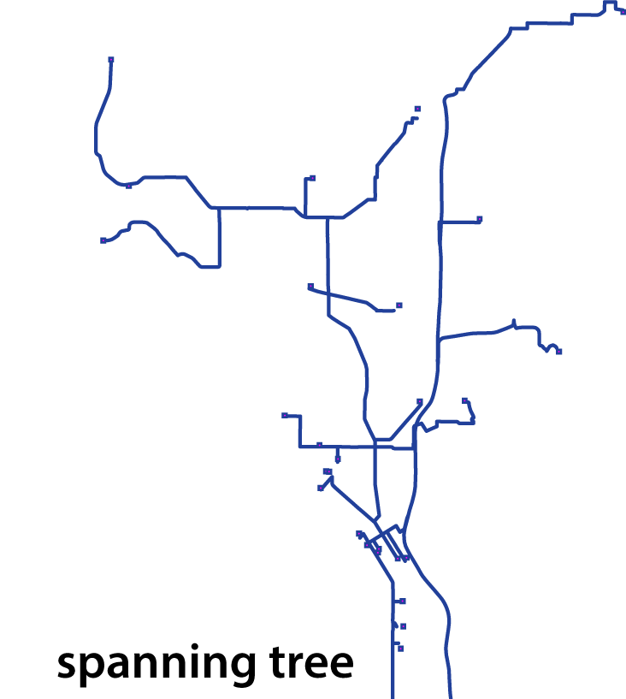
Contributions
Problems
Solutions
Not suitable for larger areas
Detail Lenses
Tedious to ﬁnd information
about nearby POIs
Automatic Layout
Algorithm
Do not offer guidance for
efﬁcient travel
Efficient Paths
Notes:
In our work, we propose solutions to these problems.
To address problem 1, we provide detail about the POIs in so-called detail lenses, which contain a high-resolution map cut-out for one or more POIs, together with auxiliary information like name, address, or a photo.
To address problem 2, we propose an automatic layout algorithm that optimizes spatial proximity between a lens and its corresponding marker on the map. This then allows easy cross-referencing between the overview map and the detail lenses.
To address problem 3, we calculate efﬁcient paths between all POIs by solving a multi-route problem.

Slide 6
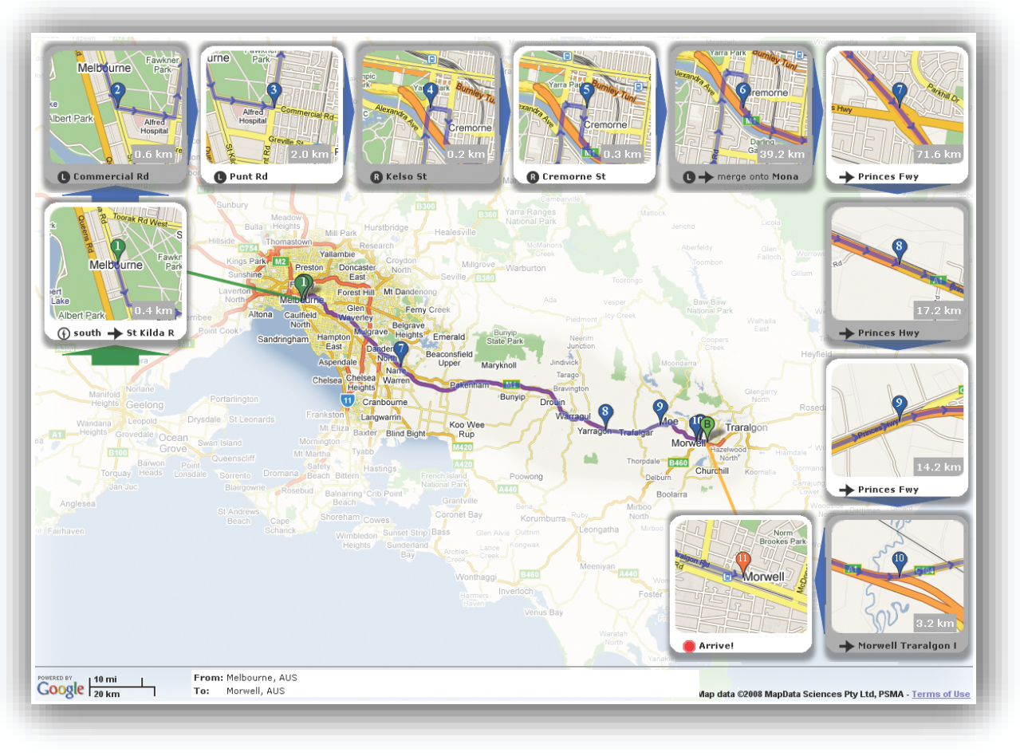
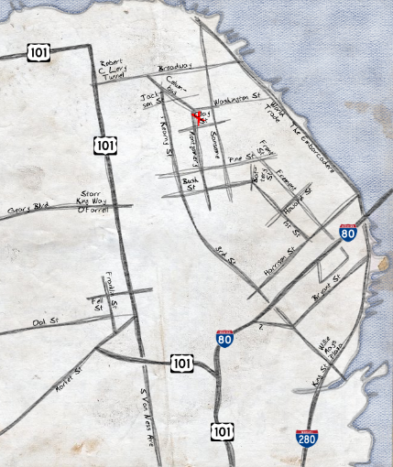
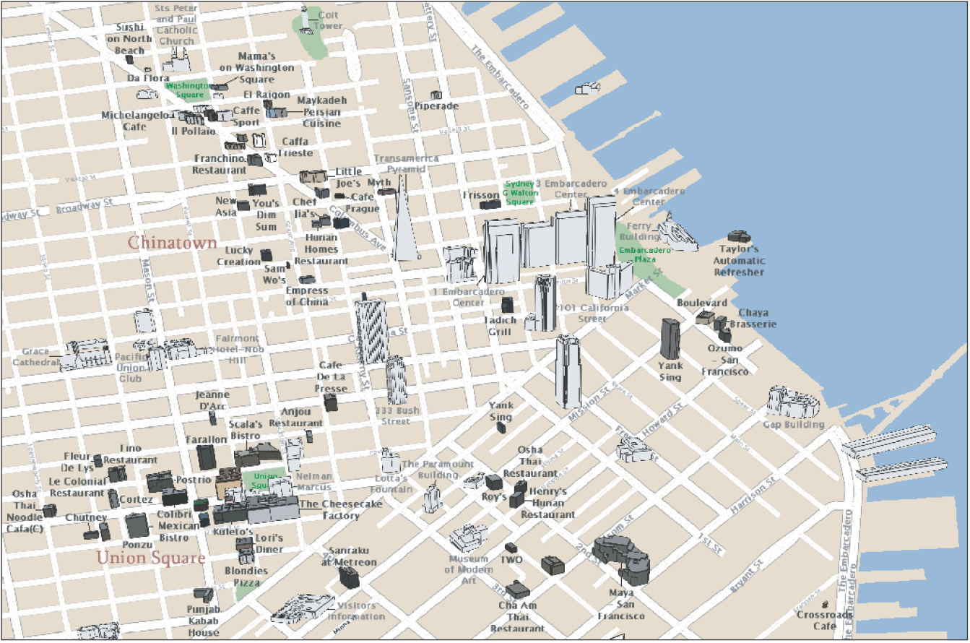
Related Work
Routing
Maps and Layouts
A to B
Anywhere to A
[Karnick et al. 2010]
[Kopf et al. 2010]
[Grabler et al. 2008]
Notes:
In contrast to our work, previous research on route visualization has focused on single route maps (from point A to point B) and on destination maps (from anywhere to a point A).
For example, Agrawala and Stolte created route maps that are similar to hand-drawn sketches. Karnick et al. introduced a system to visualize routes using local detail lenses automatically placed on the canvas. In this work we continue the idea of detail lenses that are used to amplify particular regions of the map.
Kopf et al. Proposed a system for selecting and laying out the important roads based on mental representations of road networks.
The idea of automatically generated Tourist maps is not entirely new. Grabler et al. proposed a system for the automatic generation of tourist maps that simplify the overall visual complexity and reduce the appearance to a small number of signiﬁcant and easily recognizable landmarks placed on a simpliﬁed street network.

Slide 7
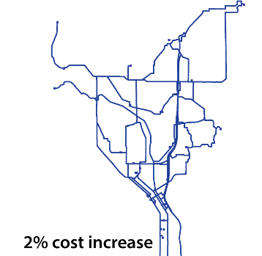
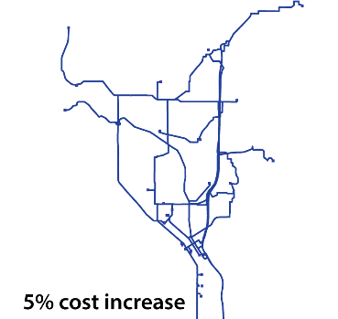
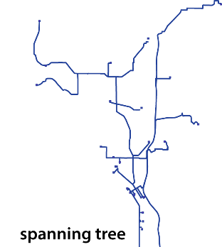
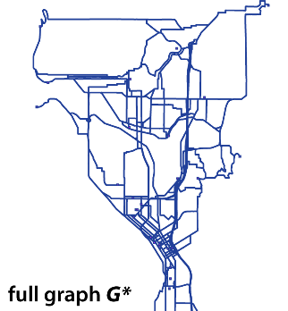
Design Principles
We identified four design principles:
Spatial Grouping (P1)
Spatial Proximity (P2)
1
6
4
1-6
5
3
2
5
5
Arrangement Similarity (P3)
Route Simplicity (P4)
1
2
1
2
3
4
3
4
Notes:
Based on previous work, we identiﬁed four design principles that should be fulﬁlled as best as possible to produce a tourist brochure. The principles can also be viewed as evaluation criteria by which the effectiveness of our design can be evaluated. The results of this evaluation will be shown later.
The ﬁrst design principle is the idea of spatial grouping: in the case when the pins on the overview map become too close and cannot be rendered without overlap, they are grouped. We do this using multi-POI lenses, which are represented by their own map pin.
The second principle relies on the observation that a layout is easier to understand if coherent pieces of information are placed in proximity of one another and are not scattered across the page. In particular, lenses and their corresponding map pins should be placed as near as possible to each other.
The third design principle states that the spatial arrangement of the map pins should resemble as best as possible the arrangement of the respective lenses on the brochure page. We assume the user will ﬁnd the correspondences more intuitively if both arrangements are similar.
The fourth design principle is the clarity of the routing graph. A major goal of our customized brochures is to provide the user routing directions from any point to any other point in a manner that is easy to follow, so the graph should not be too dense and too cluttered.

Slide 8
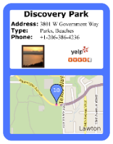
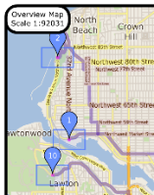
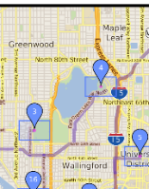
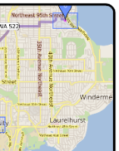
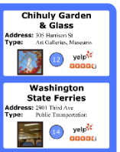
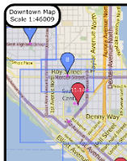
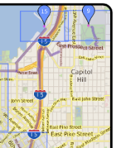
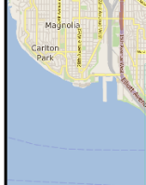
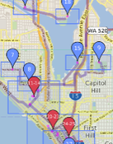
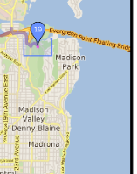
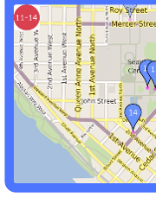
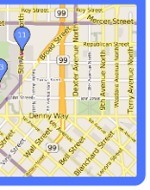
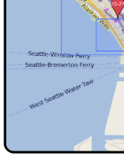
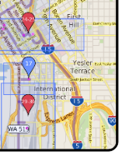
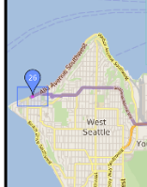
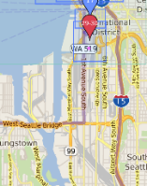
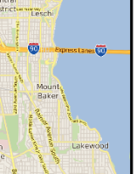
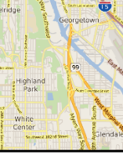
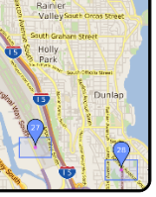
Tourist Brochures – Overview
Grid $G$
(e.g. 5x9)
Single
POI
Lens
Canvas $S$
(e.g. DIN A3 landscape)
Main Overview Map
Multi
POI
Lens
Optional
Overview
Map
Empty
Cell
Notes:
Our automatically generated Tourist Brochures consist of the following items:
A canvas S, which is a rectangular 2d domain with userspeciﬁed format (e.g., DIN A3 landscape).
A regular grid G that subdivides the canvas into a set of equally sized cells with integer coordinates.
The grid is filles three types of elements:
Map cells: elements that form overview maps. We distin-guish between the main overview map and optional
overview maps which are at a higher zoom´level and cover subregions the main overview map. Each map is composed of a 4-connected set of tiles that does not have to be convex.
Lens cells: a lens is a unit of additional information that describes a particular site. We distinguish between single-POI and multi-POI lenses.
Empty cells: grid cells which have not been assigned any information tiles remain empty. Our system ﬁlls them with random photographs, but they could be used to display advertisements or additional information.

Slide 9
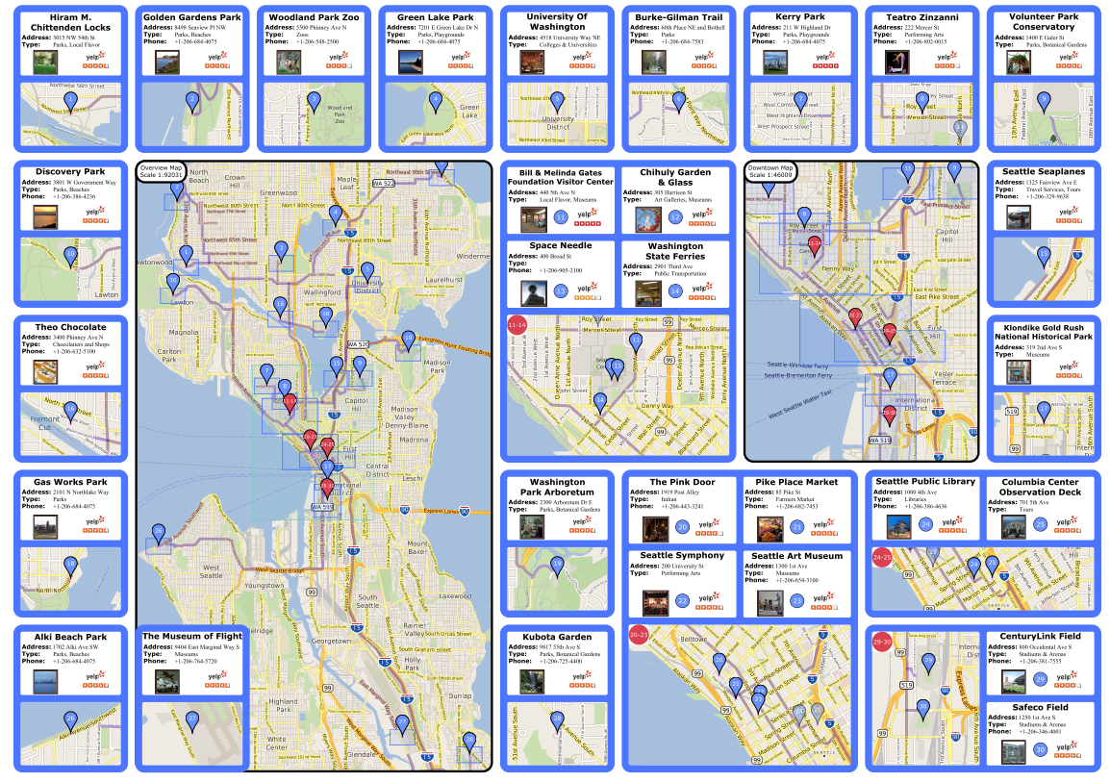
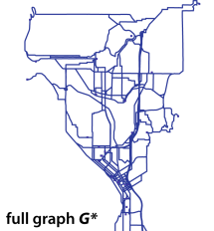
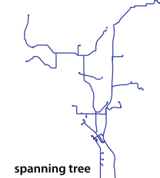
System Overview
Input
Automatic Layout
$$P:$$
Optimized Travel Brochure
$$S,G,M:$$
Routing Graph
Notes:
Now I want to give an overview of our system.
First, the user defines a set of POIs in a particular region. Furthermore, the user defines the dimensions of the canvas, the size of the grid, and the number and position of the overview maps.
The user input is then passed to the Automatic Layout optimzation, where an accurate number of lenses and a layout is calculated. The user input is also passed to the Routing Graph simplification algorithm, where effective routes are calculatd. Since these two stages are independent, they are implemented in parallel. The routes are then rendered into the maps of the brochures to get the final output, an optimized travel brochure.
I want to start with the explanation of the Automatic Layout algorithm.

Slide 10
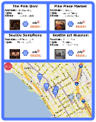
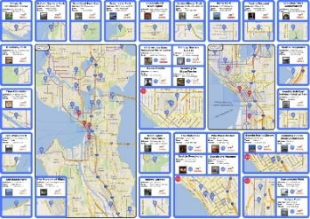
Automatic Layout Optimization
Automatic Layout Optimization
POI Grouping
$$l$$
$$l++$$
yes
no solution
$$C_{2}$$
$$l<n_{P}$$
$$C_{1}$$
$$C_{l}$$
k-means
no
$$P=\left\{P_{1},P_{2},…,P_{n_{P}} \right\}$$
$$C=\left\{C_{1},C_{2},…,C_{l}\right\}$$
yes
Successful?
Lens Generation
Layout Optimization
$$S,G,M:$$
$$L_{1}$$
$$L_{2}$$
$$L_{l}$$
$$L=\left\{L_{1},L_{2},…,L_{l}\right\}$$
Optimized Layout
Notes:
The POIs defined by the user are first clustered where we start with a small number l of clusters. For each cluster, we then generate a lens (either single or multi). The lenses, as well as the canvas, grid and set of maps are given to the Layout Optimization stage.
The Layout Optimization stage can also fail, e.g. when there is not enough space to place all the lenses. Therefore we have to check afterwards, if it was successful. If it was successful, we are done. If not, we have to check if l < n_p, so if we can produce more clusters and therefore more but smaller lenses. If this is possible, we increment l and try again. However, if l is equal to n_p, there is no solution for the current setup. In this case, the user has to adapt the input (less POIs or bigger canvas).
For the clustering, we simply use k-means where we usually start with a number of clusters of 1.
Now, I want to explain the generation of the Detail lenses.

Slide 11
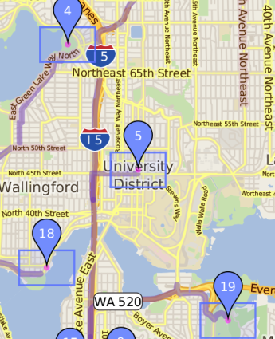
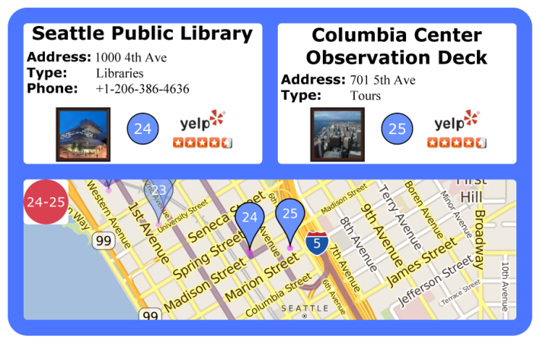
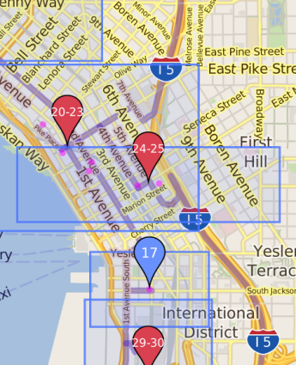
Detail Lens Generation
One Detail Lens per cluster
Information
Block
Detailed
Map
$$M_{O}$$
Single POI
Lens
Multi POI
Lens
$$M_{O}$$
Notes:
We create one Detail Lens per cluster.
When there is just POI in the cluster, we create a single POI lens, that occupies exactly one grid cell. In the top region of the lens, we present some information of the POI, like the name, address, a photo and a user ranking. At the bottom, we show a detailed map of the environment of the POI.
When there is more than one POI in the cluster, we create a multi POI lens. We start by finding an accurate number of cells to show the map region that contains all the POIs. Then, we incrementally enlarge the lens until there is enough space to contain all the information blocks.

Slide 12
Automatic Layout Optimization
Automatic Layout Optimization
POI Grouping
$$l$$
$$l++$$
no
yes
$$C_{2}$$
$$l<n_{P}$$
$$C_{1}$$
$$C_{l}$$
k-means
no
$$P=\left\{P_{1},P_{2},…,P_{n_{P}} \right\}$$
$$C=\left\{C_{1},C_{2},…,C_{l}\right\}$$
yes
Successful?
Lens Generation
Layout Optimization
$$S,G,M:$$
$$L_{1}$$
$$L_{2}$$
$$L_{l}$$
$$L=\left\{L_{1},L_{2},…,L_{l}\right\}$$
Optimized Layout
Notes:
Now I want to explain the Layout Optimization.

Slide 13
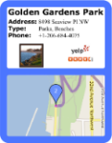
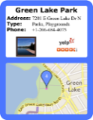
Automatic Layout Optimization
Definition of global cost function with 2 terms
$e_{prox}$ (for Spatial Proximity (P2))
$e_{sim}$ (for Arrang. Similarity (P3))
Cost for placing lens $L_{k}$ at position $\left(i,j\right)$in $S$:
5
5
1
2
1
2
3
4
3
4
$$f_{i,j,k}=w_{k}\left(λ_{1}e_{prox}+λ_{2}e_{sim}\right)$$
Notes:
For the layout optimization, we start with the definition of a global cost function consisting of two terms.
The first is $e_{prox}$ (for the Spatial Proximity), and the second is $e_{sim}$ (for Arrangement Similarity).
Our cost function now expresses the cost for placing the lens L_k at pos (i,j) and is defined as $f_{i,j,k}$

Slide 14
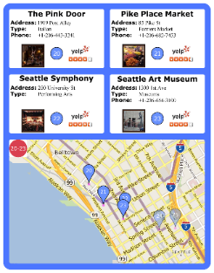
Automatic Layout Optimization
$$j$$
e.g. $f_{1,4,7}:$
$$0$$
1
$$2$$
$$3$$
$$4$$
$$5$$
$$6$$
$$7$$
$$8$$
$$i$$
$$0$$
1
$$2$$
$$L_{7}$$
$$3$$
$$f_{i,j,k}=w_{k}\left(λ_{1}e_{prox}+λ_{2}e_{sim}\right)$$
$$4$$

Slide 15
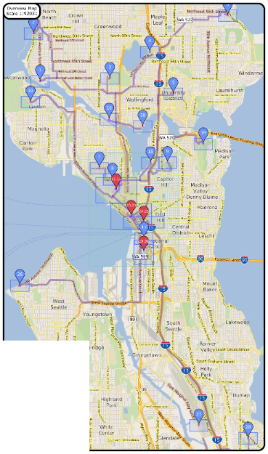
Automatic Layout Optimization
$$f_{i,j,k}=w_{k}\left(λ_{1}e_{prox}+λ_{2}e_{sim}\right)$$

Slide 16
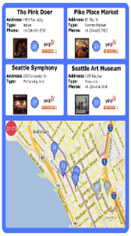
Automatic Layout Optimization
$$f_{i,j,k}=w_{k}\left(λ_{1}e_{prox}+λ_{2}e_{sim}\right)$$
$${\overline{M}}_{O}$$
$$\overline{S}$$

Slide 17
Automatic Layout Optimization
$$f_{i,j,k}=w_{k}\left(λ_{1}e_{prox}+λ_{2}e_{sim}\right)$$
$$M_{O}$$
$$S$$
$${\overline{M}}_{O}$$
$$\overline{S}$$

Slide 18
Automatic Layout Optimization
$$f_{i,j,k}=w_{k}\left(λ_{1}e_{prox}+λ_{2}e_{sim}\right)$$
$${\overline{M}}_{O}$$
$$\overline{S}$$

Slide 19
Automatic Layout Optimization
Problem is formulated as binary integer program (BIP)
$$E=\min_{x_{i,j,k}}{\sum_{i=1}^{m}{\sum_{j=1}^{n}{\sum_{k=1}^{l}{f_{i,j,k}x_{i,j,k}}}}}$$
subject to constraints C1 to C4

Slide 20
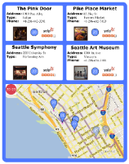
Binary Integer Program - Hard Constraints
C1: Any lens $L_{k}$ is
positioned exactly once
C2: Lenses must be contained
entirely inside the grid
C1
C2
C3
C4
C4: Map areas must not
be occupied by lenses
C3: No more than one
lens is placed at any grid cell
Notes:
The l constraints of type C1 ensure that any lens Lk is positioned exactly once, to avoid a situation shown in this figure here.
For details about the formulas, please refer to the paper.

Slide 21
System Overview
User Input
Automatic Layout
$$P:$$
Optimized Travel Brochure
$$S,G,M:$$
Routing Graph
Notes:
This was our Automatic Layout algorithm, I now want to explain how we calculate the routes for our brochures.

Slide 22
Routing Graph
Goal
We want to provide efficient paths between all POIs
Set of all shortest paths
Idea: Simplification Algorithm
– Keeping the number of segments low
– Still allow fast connections between POIs
→ Balancing Task

Slide 23
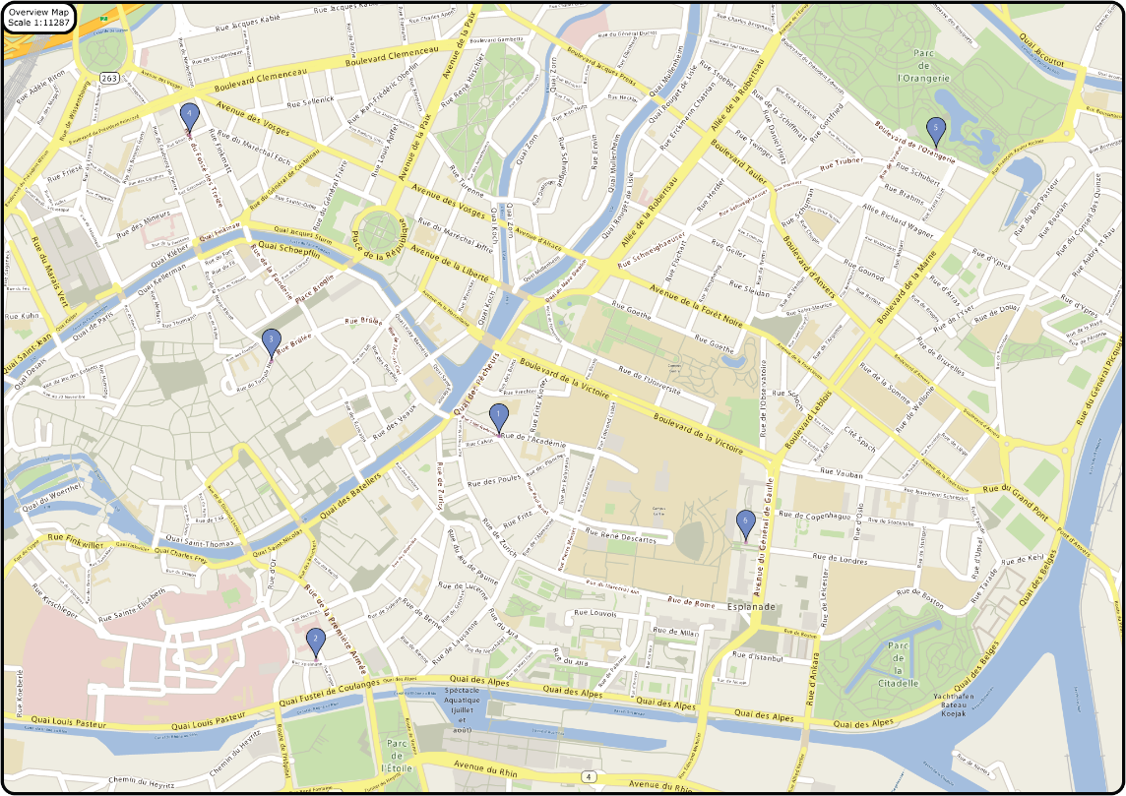
Routing Graph
Starting point
Set of of all streets in $M_{O}$: $G=\left(N,A\right), P⊂N$
e.g. $M_{O}:$
1
2
3
4
6
5

Slide 24
Routing Graph
Based on $G$
Computation of $G^{∗}=\left(N^{∗},A^{∗}\right)$ based on all shortest paths
1
2
3
$$G^{∗}:$$
4
6
5

Slide 25
Routing Graph
Init ${\overline{G}}^{∗}=G^{∗}$
while (!ready)
$E_{min}=∞$
$s_{r}=null$
for each $s$ in ${\overline{G}}^{∗}$
${{\overline{G}}^{∗}}^{′}={\overline{G}}^{∗}∖s$
if ($E\left({{\overline{G}}^{∗}}^{′}\right)<E_{min})$
$$E_{min}=E\left({{\overline{G}}^{∗}}^{′}\right)$$
$$s_{r}=s$$
$$s_{r}≠null→{\overline{G}}^{∗}={\overline{G}}^{∗}\backslash s_{r}$$
Simplification Algorithm:
Working on residual graph ${\overline{G}}^{∗}$
Greedy approach
Each iteration
Find and remove segment $s$ for which energy increase is minimal
1
2
$$s$$
3
$${\overline{G}}^{∗}:$$
4
$$G^{∗}:$$
6
5

Slide 26
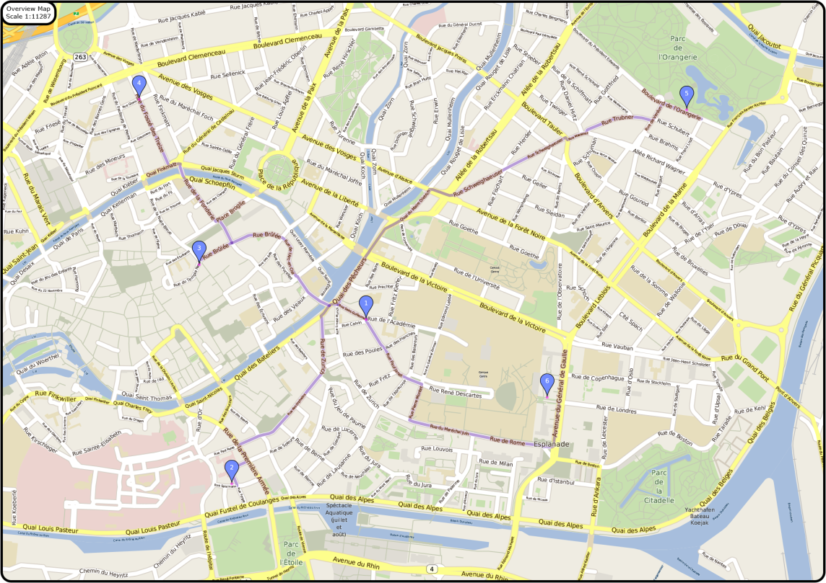
Routing Graph
Final Result
Is rendered as polyline into the maps
1
2
3
4
6
5

Slide 27
System Overview
User Input
Automatic Layout
$$P:$$
Optimized Travel Brochure
$$S,G,M:$$
Routing Graph
Notes:
This was our whole system. My colleague Przem will now present the evaluation and the results.

Slide 28
Evaluation
Test 1
Quantitative, Objective
Test 2
Qualitative, Subjective

Slide 29
Evaluation (1)
Find correspondence between lens and map
Online user study with 55 participants
Quantitative evaluation:
time t the user needs to find the correspondence
click

Slide 30
Evaluation (1)
Find correspondence between lens and map
Online user study with 55 participants
Quantitative evaluation:
time t the user needs to find the correspondence

Slide 31
Evaluation (1)

Slide 32
Evaluation (1)

Slide 33
Evaluation (2)
How “good” is our graph?
Subjective & quantitative
Pen & paper user study with 27 participants
We asked participants to draw a graph they would prefer
We compare the user results to our automatically computed graph

Slide 34
Evaluation (2)
How “good” is our graph?
Subjective & quantitative
Pen & paper user study with 27 participants
We asked participants to draw a graph they would prefer
We compare the user results to our automatically computed graph

Slide 35
Evaluation (2)
How “good” is our graph?
Subjective & quantitative
Pen & paper user study with 27 participants
We asked participants to draw a graph they would prefer
Comparison to our automatically computed graph

Slide 36
Evaluation (2)

Slide 37
Prototypic GUI

Slide 38
Prototypic GUI

Slide 39
Results
Strasbourg
San Francisco
Vienna
Los Angeles
Seattle

Slide 40
Results
Strasbourg
San Francisco
Vienna
Los Angeles
Seattle

Slide 41
Thank You For Your Attention!
Questions?
www.cg.tuwien.ac.at

Slide 42
Automatic Generation of Tourist Brochures
Thank you for your attention!
visit us at
www.cg.tuwien.ac.at

Slide 43
Binary Integer Program
Gurobi Optimization Library
Leverages a linear programming based branching bound algorithm

Slide 44
Routing Graph
Calculation done using Lemon Graph Library
Greedy algorithm implemented in parallel

