Slide 1
InSpectr: Multi-Modal Exploration, Visualization, and Analysis of Spectral Data
Artem Amirkhanov¹, Bernhard Fröhler¹, Johann Kastner¹, Eduard Gröller², and Christoph Heinzl¹
¹ University of Applied Sciences Upper Austria, Campus Wels
² Vienna University of Technology
Notes:
Good Morning Ladies and Gentleman, my name is Bernhard Fröhler. Welcome to my presentation of InSpectr, a tool for the exploration, visualization and analysis of spectral and scalar data
Screen resolution: 4:3 (see http://eurovis.swansea.ac.uk/presenter-guidelines.htm)
All-Caps for slide caption

Slide 2
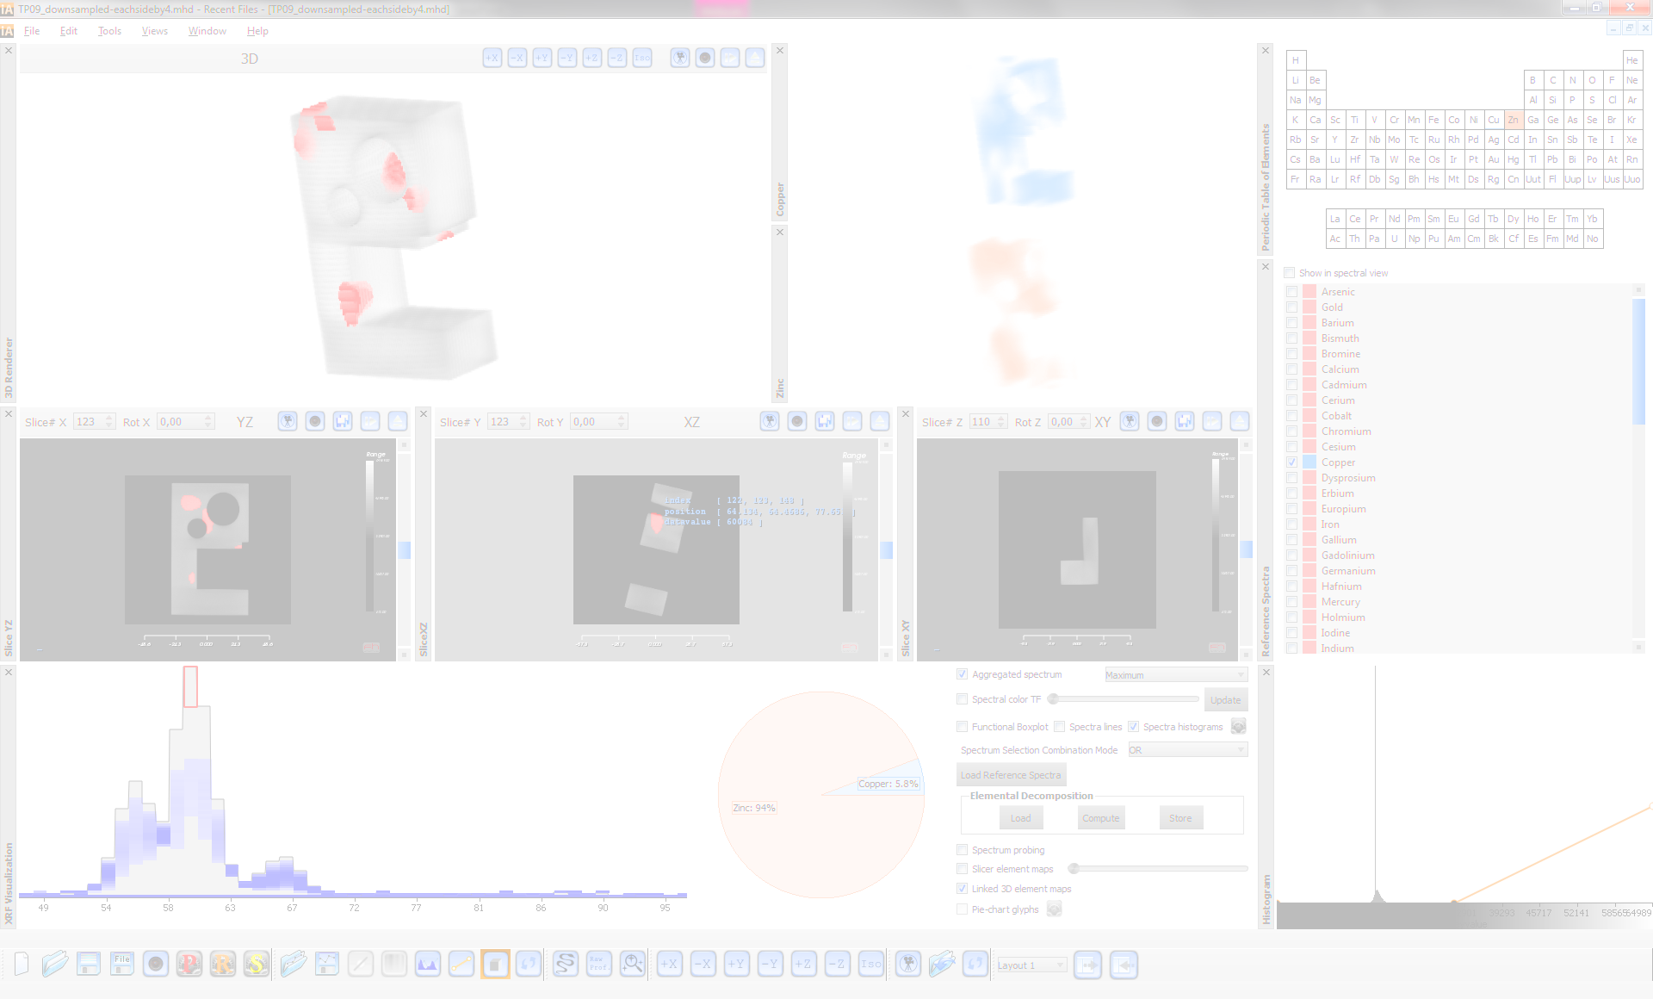
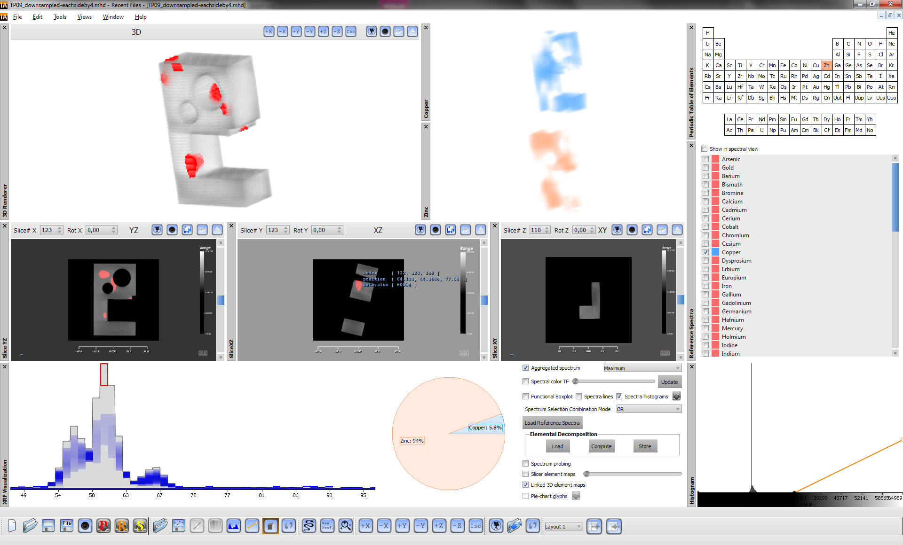
Contribution
Tool for exploring combination of
High resolution scalar
Lower resolution spectral data
Visualization methods to solve user tasks
Evaluation
Notes:
Our contribution consists of three main aspects:
We developed an integrated tool for the multi-modal exploration of high-resolution scalar data and possibly lower resolution spectral data obtained from the same specimen
In this tool, we implemented several visualization methods to allow material scientists to solve their daily tasks
And we evaluated our tool with an online questionnaire regarding its usefulness and ability to solve the predetermined tasks

Slide 3
Overview
Introduction
Application Field
Motivation & Tasks
Workflow
Input
Visualization & Analysis Methods
Global
Local
Evaluation
Notes:
I will shortly talk about the domain this tool will be used in;
and I will explain the motivation for creating it;
then I will describe the tool in detail;
and in the end I will show a summary of our evaluation results

Slide 4
Overview
Introduction
Application Field
Motivation & Tasks
Workflow
Input
Visualization & Analysis Methods
Global
Local
Evaluation

Slide 5
Application Field
Non-destructive testing
Characterization of object features
Structural analysis
Chemical analysis
Internal and external features
Down to nanometer scale
➔ Integrated Device + Software to analyze and visualize
Notes:
Non-destructive testing is a rapidly growing field in the industry.
The goal is to analyze industrial products, either to inspect them during the production process, or to determine the cause of problems after a failure.
So we need to analyze an objects internal and external features, as well as it’s structure and chemical composition.
To support newest production techniques for example in the electronics industry, the measurement modalities should support a resolution down to the nanometer scale.
All of this should be achieved by one integrated device; this also leads to the need for software to explore and analyse the data delivered by this device.

Slide 6
X-Ray Computed Tomography (XCT)
Reconstruction
Projections
3D Volume
Notes:
X-Ray Computed Tomography is already widely used in the field of nondestructive testing.
The devices used in industry operate on slightly different principles than the well-known medical CT devices.
Here, the object to be scanned is placed on a rotary plate; an X-Ray-Source on one side directs its beam toward the object.
On passing through the object, the beam is attenuated due to the object‘s internal structure.
On the other side of the object a detector is placed.
The object rotates on the rotary plate, and for each rotation step, one projection image is recorded.
Reconstruction algorithms then allow to calculate a 3D representation of the object from these projection images.

Slide 7
X-Ray Fluorescence Tomography (XRF)
>
Projections
Notes:
X-Ray Fluorescence Tomography works with similar components.
We also have a rotary plate on which the object is placed, an X-Ray source and a detector.
Here the detector is however placed orthogonal to the X-Ray source, since we want to measure a different phenomenon:
An X-Ray incident on an atom can cause electrons of the inner orbits of the atom to get expelled.
This makes the electron structure of the atom unstable, and an electron from a higher orbit will „fall“ into the lower orbit to fill the gap.
In falling into the lower orbit, energy is released in the form of a photon charged with the energy difference between the two orbits, this is called fluorescence.
The detector measures the number of emitted photons and their energies.
Contraptions such as pinholes in front of the detector allow acquiring a full fluorescence image over the whole object.
Each atom has its own characteristic energy emissions, so the resulting spectrum will reflect the contained elements.
Similar to Computed Tomography, also here we take one projection image per rotation step.

Slide 8
X-Ray Fluorescence Tomography (XRF)
Reconstruction
Intensity
Projections
Energy
Notes:
From these projection images, reconstruction algorithms can again calculate a 3D representation of the object.
Here, we get one spectrum per voxel (a function mapping Energy to the number of photons of this energy that were recorded, the Intensity).
Each element has its own characteristic spectrum with a varying number and location of peaks, and differing intensity relations between these peaks.
When multiple elements are mixed, their combined spectrum can be thought of as a weighted sum of their spectra, with each element weighted by its concentration.

Slide 9
Imaging Modalities Comparison
Modality
Spatial Resolution
Internal Features
Chemical Analysis
XCT
High
Yes
No
XRF
Low
Limited
Detailed
Notes:
Computed Tomography reaches a high spatial resolution and can measure internal as well as external features.
The different attenuation values can however provide no real chemical analysis, so that it can be hard to determine contained elements without prior knowledge.
And materials can have the same or similar attenuation values, making it hard to impossible to distinguish them
X-Ray fluorescence on the other hand delivers a detailed chemical analysis.
However, the measurement of internal features is limited due to self-absorption of the emitted photons.
Furthermore, the spatial resolution is much lower than with CT.

Slide 10
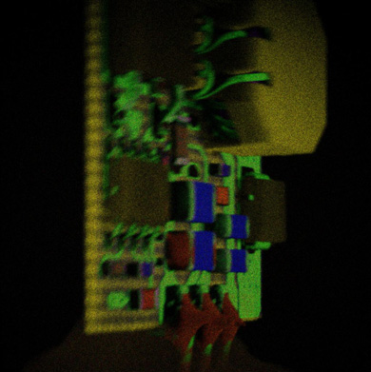
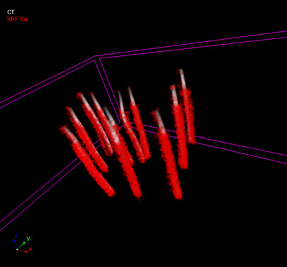
Motivation
Combining spectral and scalar data
Current tools limited
Fill in the gaps
Visual exploration and analysis workflow
➔ InSpectr
[Source: Bruyndonckx et al., 2011]
[Source: Mutina, A. and Bruyndonckx, 2012]
Notes:
In order to achieve a more complete material analysis, both modalities have to be combined.
There are currently only few tools available which deal with this combination, and they provide only limited visualizations, usually in the form of color-coded overlays.
Our goal was to create a tool which fills these gaps, by allowing to analyse and explore both modalities together in an integrated visualization workflow.
The outcome of our effort was the InSpectr tool.
TODO: pyMCA, (HyperSpy)?
With our tool we fill the gaps (from paper)

Slide 11
Tasks
Global Analysis
Which Materials?
How Much?
Where?
Local Analysis
Exploring regions of interest
Defects, irregularities
Notes:
Together with material scientists we worked out the tasks they need to perform in order to achieve their goals of analysing industrial objects.
The first step in analysing an object usually is a global analysis.
There, questions like „which materials“, „Where are they located?“ and „How much of each material“ need to be answered.
In a second step, it is often necessary to close in on localised parts of the object.
It therefore needs to be possible to explore the material combination in regions of interest, and to detect and visualize defects and irregularities.
As we will see, InSpectr provides various methods to address each task.

Slide 12
Overview
Introduction
Application Field
Motivation & Tasks
Workflow
Input
Visualization & Analysis Methods
Global
Local
Evaluation
Notes:
We will now take a close look on the workflow of the InSpectr tool

Slide 13
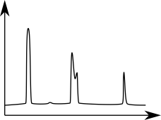
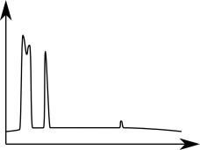
InSpectr: Input
Scalar data (XCT)
Spectral data (XRF)
Reference Spectra
Element Maps
Notes:
InSpectr takes single scalar data as it results from a CT scan, where we have an attenuation value for each voxel.
We combine this with spectral data, where for each voxel a spectrum function is available.
If available, InSpectr can take advantage of reference spectra; these are single spectrum measurements from single elements, ideally measured with the same device as the spectral data.
InSpectr furthermore works with Element maps.
An element map is a 3D image where a voxel value represents the concentration of this element at that voxel.
Ideally, we have one element map per element contained in the object.
InSpectr can perform a simplified decomposition using linear least squares to calculate these element maps given the spectral data and reference spectra.
There are other tools using a more accurate physical model for the decomposition; InSpectr can also make use of element maps calculated with such external tools

Slide 14
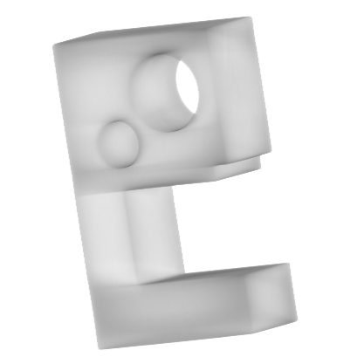
InSpectr: Test Specimen 1/2
Virtual 3D „9“ Specimen
CT scan
981x981x881 voxels
Virtual spectral data
Spectra from literature
Brass alloy
124x124x111 voxels
512 energy bins per spectrum
3D rendering of the CT Image
Notes:
This work is part of a project in which also the imaging device will be built.
This device is currently being built and is in an early prototype stage.
This means that we don‘t have a combined scalar and spectral dataset available from this device yet.
The first dataset we used to test our methods was therefore a virtual test specimen we built out of a real CT scan and spectral data from literature.
It is designed to emulate a brass alloy.

Slide 15
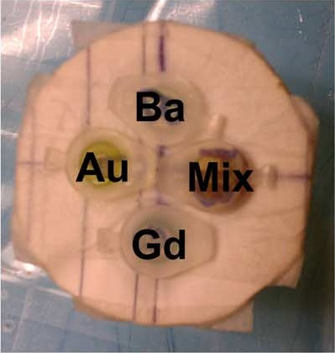
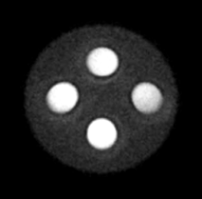
InSpectr: Test Specimen 2/2
Real-world 2D Phantom Scan
Water with insertions of
Barium, Gadolinium and Gold
Scanned at Stanford (Kuang et al. 2013 *)
CT scan: 315x315x1 voxels
XRF scan: 27x27x1 voxels
1024 energy bins per spectrum
[Source: Foto of Phantom, Kuang et al., 2013]
[Source: CT scan of phantom, Kuang et al., 2013]
Notes:
Our second dataset is a scan by a XRF CT prototype device graciously provided by Stanford university.
It contains insertions of Barium, Gadolinium and Gold into a water phantom.
Short refs

Slide 16
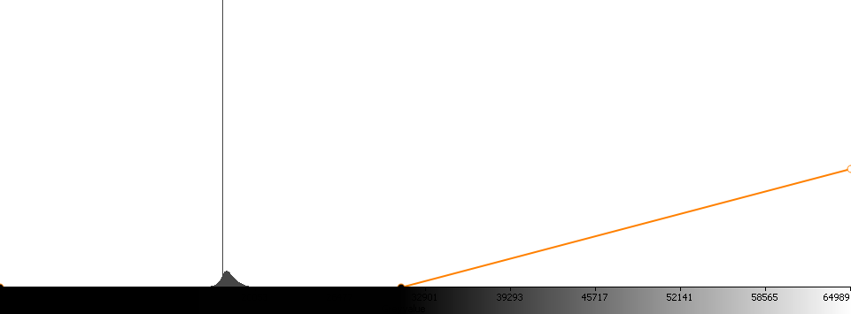
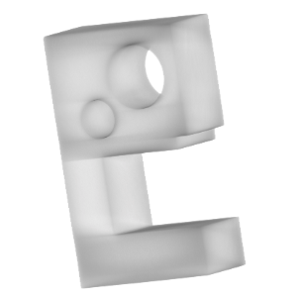
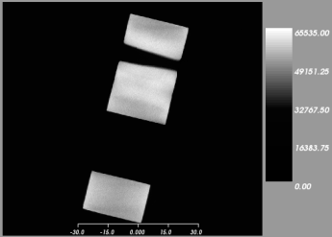
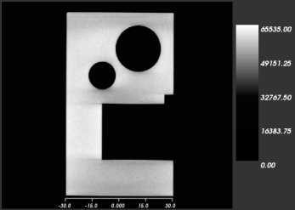
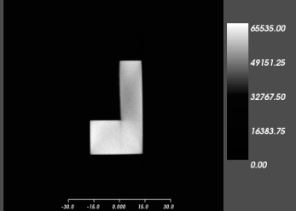
InSpectr: Interface
3D volume rendering view
Histogram & Transfer Function
Slice XZ
Slice YZ
Slice XY
Notes:
We started our design with the interface that material scientists familiar with CT analysis software are used to –
We provide a 3dimensional rendering of the data according to a definable transfer function,
and several slice views which show axis-aligned cuts through the object.

Slide 17
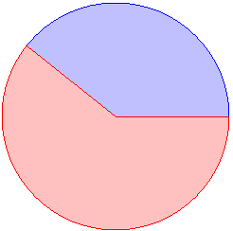
InSpectr: Interface
Periodic table view
3D volume rendering view
Histogram & Transfer Function
Pie-chart view
Copper: 39%
Zinc: 61%
Slice XZ
Slice YZ
Slice XY
Spectrum view
Element maps
Intensity
Composite
Copper
Zinc 3D
Energy
Notes:
We then added a spectrum view for visualizing the raw spectral function data.
Additional views like a pie chart widget or single or combined element map views are used when required.
All of the views are linked and thus allow interactive exploration.

Slide 18
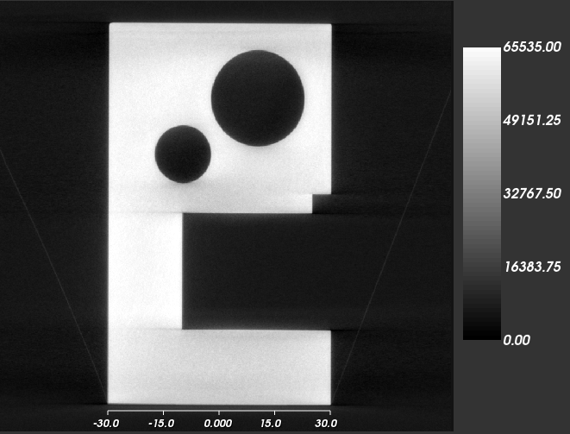
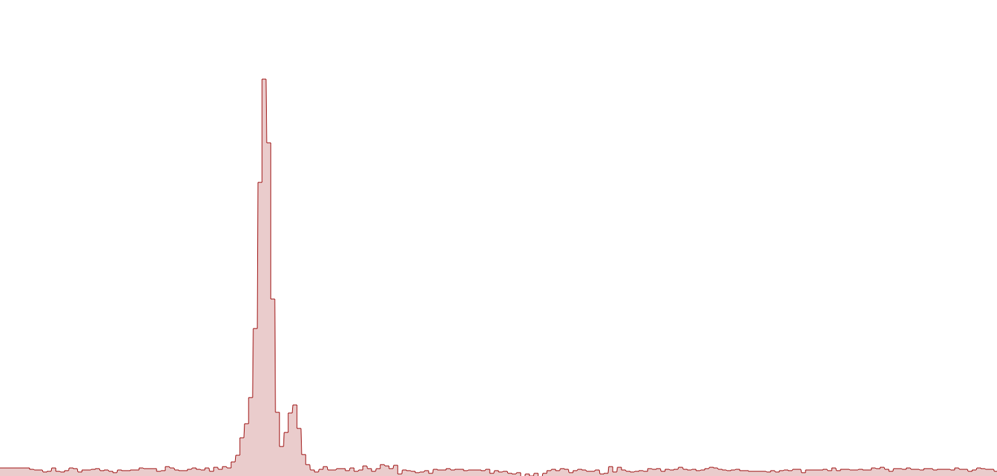
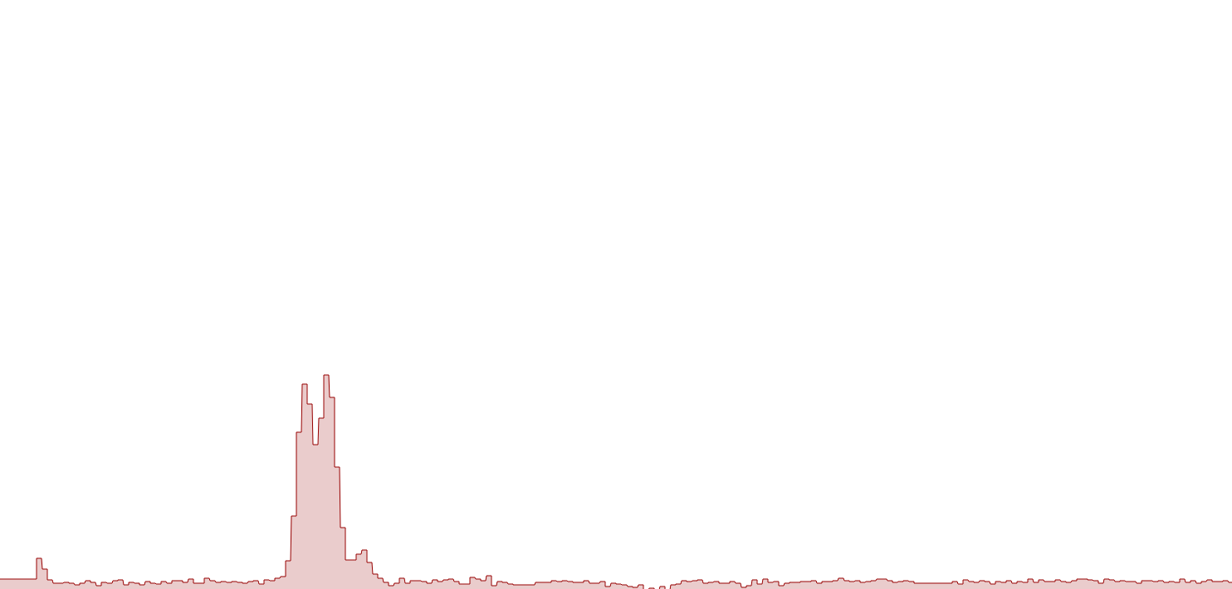
InSpectr: Interface
3D volume rendering view
Histogram & Transfer Function
Periodic table view
Pie-chart view
Slice XZ
Slice YZ
Slice XY
Copper: 39%
Intensity
Zinc: 61%
Spectrum view
Element maps
Intensity
Composite
Copper
Zinc 3D
Energy
Energy
Notes:
Spectral analysis software allows users to view single voxel spectra.
We provide this functionality by linking slicer and spectrum views.

Slide 19
Global Analysis: Which Materials are contained in the object?
Notes:
The first task when looking at the scan of a specimen is to find out which materials are contained in it.

Slide 20
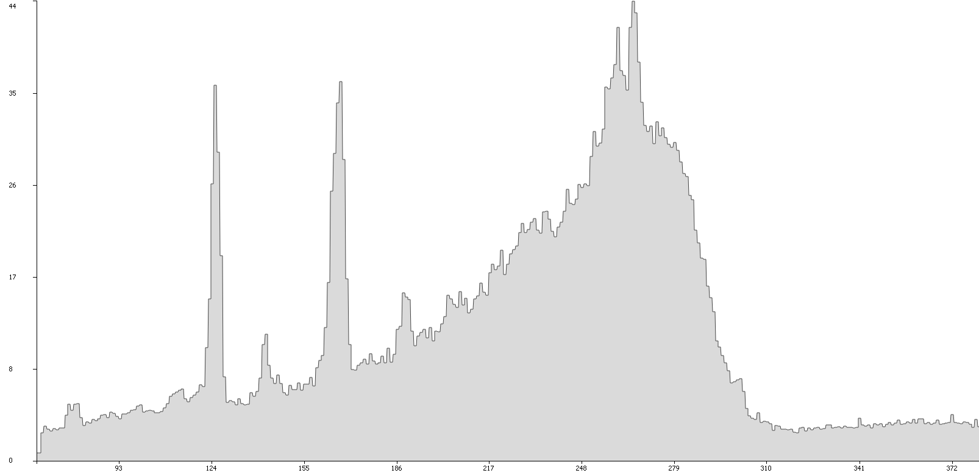
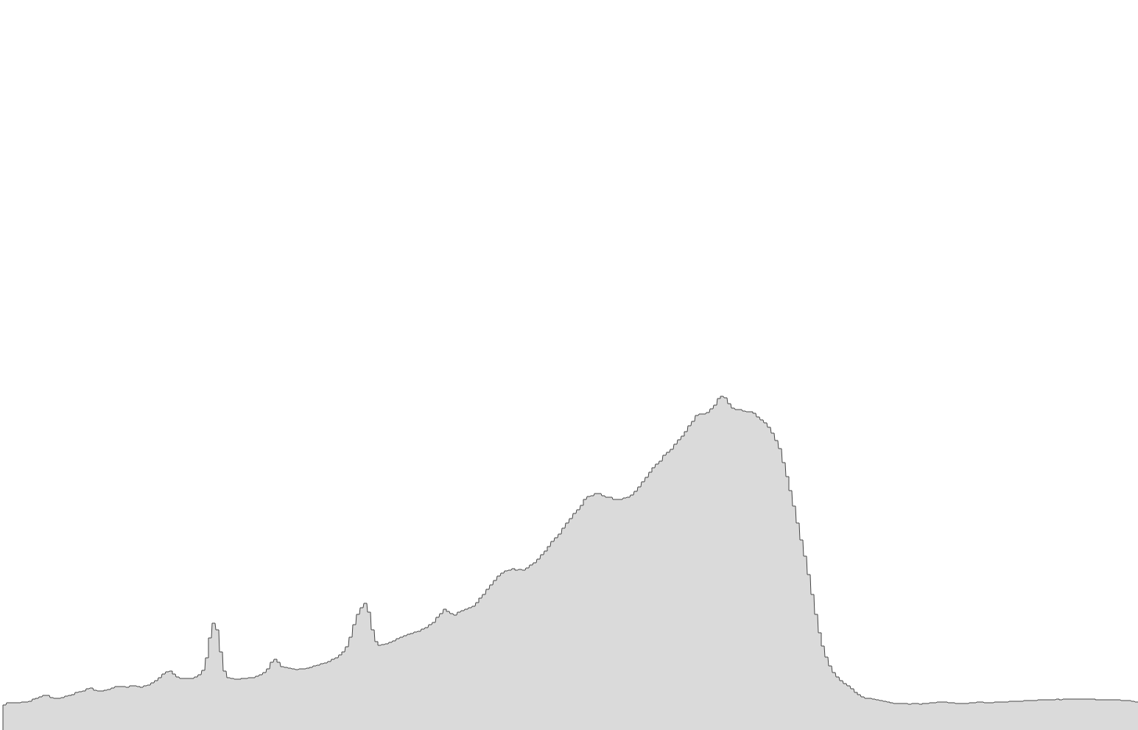
Aggregated Spectrum
Which material?
Minimum
Average
Maximum
Au
K_{α1}
Ba
K_{α}
Gd
K_{α}
Au
K_{α2}
Intensity
Ba
K_{β}
Gd
K_{β}
Au
K_{β}
Energy
Notes:
For this task, we calculate aggregated spectra, where we determine the minimum, maximum and average over all voxel spectra.
The minimum provides an overview over the general noise level.
The average gives a rough estimate of the relative distribution of materials when considering how pronounced different peaks are.
The maximum for example provides a good first impression of how many materials there are in the object, and also gives a first clue about which elements that are.
We can clearly distinguish two sharp, high peaks on the left, each with a smaller secondary peak to its right; the broad peak is due to the X-Ray source used for this scan; on top of it, two more small peaks can be distinguished.
With help of the orbital energy differences we can now easily map each peak to the element it belongs to.

Slide 21
Global Analysis: How much of each material is contained in the object?
Notes:
Next, we want to determine how much of each material is contained in the object

Slide 22
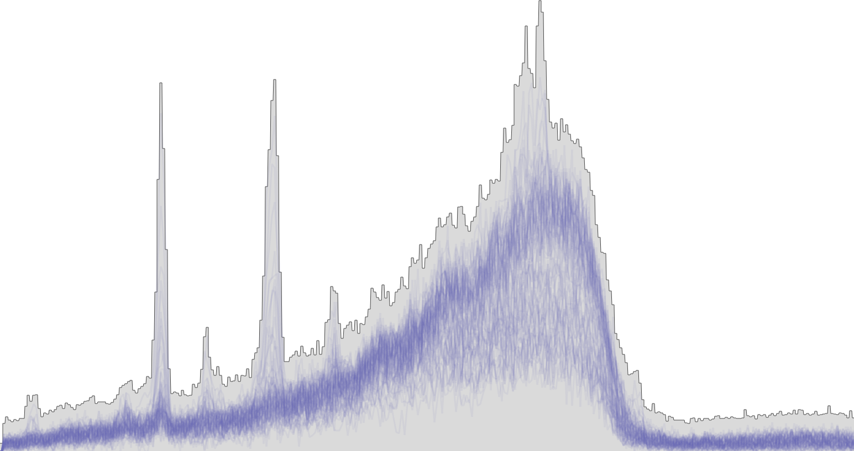
Semi-Transparent Spectra Lines
How much?
Intensity
Energy
Notes:
Improving on the average spectrum, we provide the Spectra lines visualization for an overview over the element distribution.
We draw all spectrum functions on top of each other with high transparency.
That way, only regions where many spectrum functions pass through, are colored with high intensity.
The fact that in this image the peaks are barely colored, tells us that the materials

Slide 23
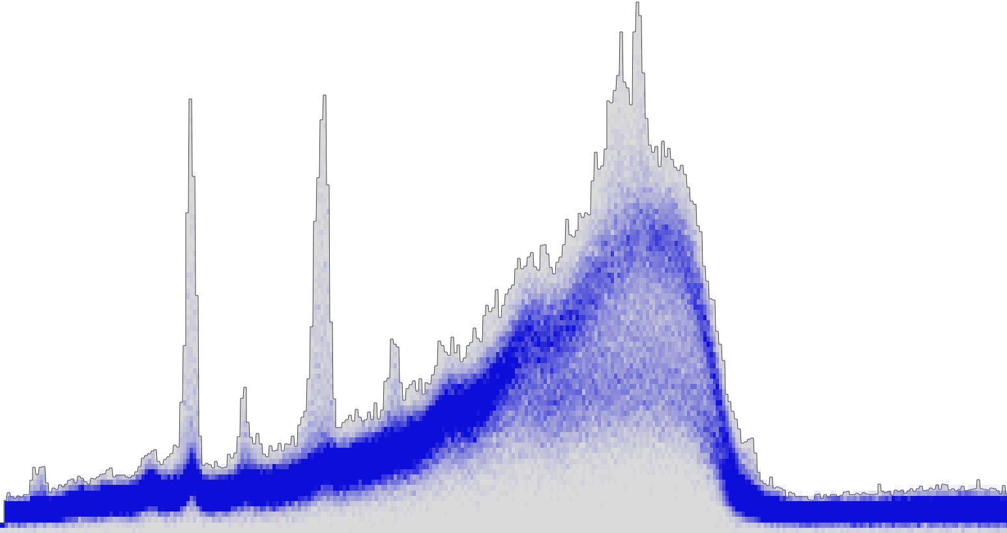
Spectra Histogram
How much?
Intensity
Intensity
Frequency
Energy
Notes:
Thinking how we could build an even more enhanced visualization of the element distribution, we came up with the Spectra histogram.
For each Energy, we count how many spectra pass through each intensity; one such energy is highlighted as example.
From this we create one normalized histogram per Energy.
We then condense those histograms into a color map, to be able to display all of the data at once.
We then draw this color data in the spectral view for each energy simultaneously; so that each pixel in the diagram is colored by the frequency by which spectra lead through this one pixel.
We again see that the peaks are only sparsely colored, hinting at a low concentration of the elements they‘re characteristic for.
We can also see two more frequent curves leading through the broad peak on the right. These hint at the two most frequent materials in the object, namely water and air.

Slide 24
Global Analysis: Where are the occurrences of each material in the object?
Notes:
Having determined which materials there are, and how much of each,
What remains is to find out where these materials are in the object.

Slide 25
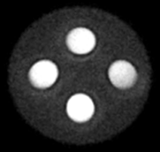
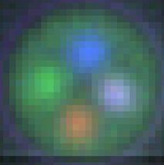
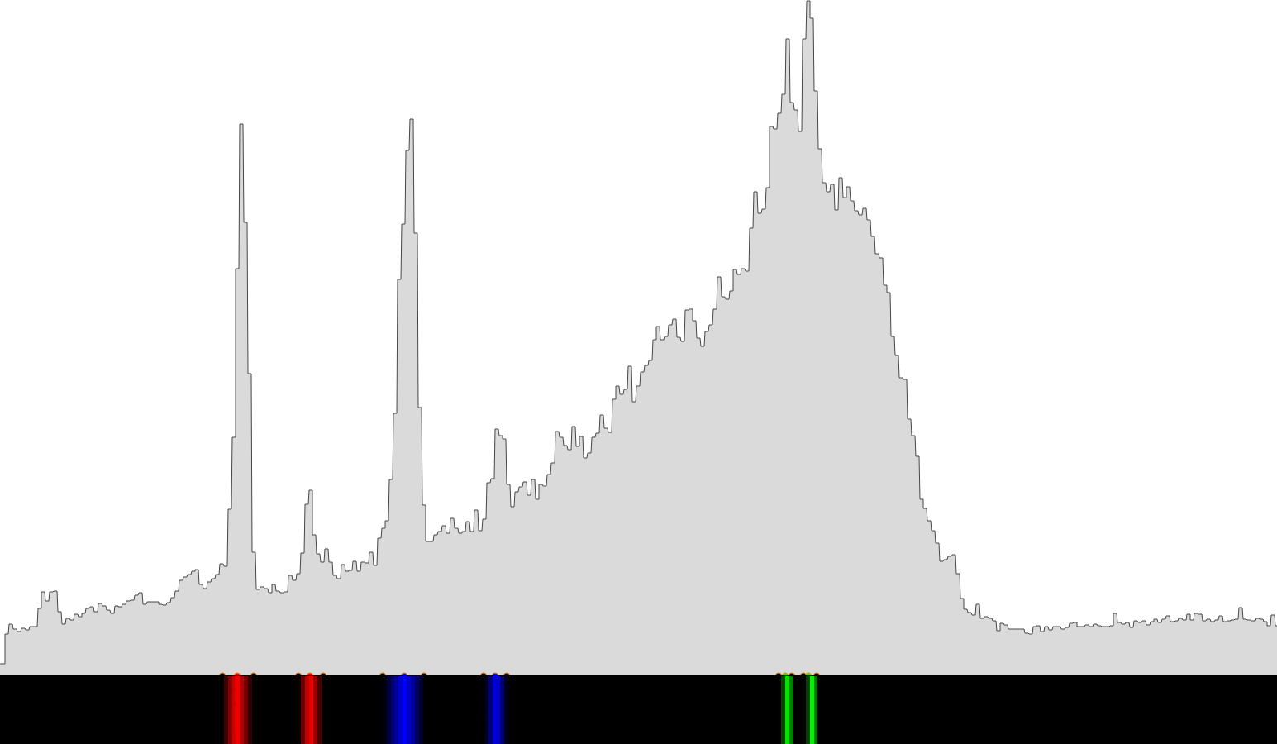
Spectral Transfer Function
Where?
Intensity
Spectral Color Image
CT Image
Energy
Notes:
To address this starting from a spectral perspective, InSpectr allows to define a transfer function on the spectrum so that the intensities of each peak can be mapped to a different color.
So the higher the peak in a local voxel spectrum, the higher will be the contribution of this energy‘s color for the color of this voxel.
In the example given here, you will notice that two neighbouring peaks are colored alike –
that‘s because they belong to the same element as shown before with the energy lines.
The resulting spectral color image is then overlayed over the CT Image.
The example here clearly shows three spots of the three different elements as marked in the transfer function.
The one white-ish peak on the right is a mix of the three elements.

Slide 26
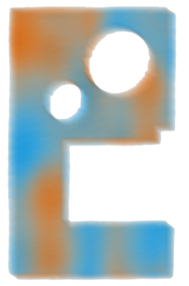
Element Maps
Notes:
TODO: adjust sampling distance in Renderer settings
When element maps are available, a straight-forward visualization is to attach a transfer function to each of the elements.
In this case, the transfer function maps to always the same color for one element, and differs the opacity according to the concentration of the element – higher concentration means less transparency.
We provide a linked element map view, where each element map is rendered separately next to the 3D rendering of the CT view.
When interacting with any of the views through zooming, rotating or translating, the other views will always adapt to show the same perspective.
We also provide a combined visualization of element maps, which is suitable for objects with not too many different elements.

Slide 27
Local Analysis: Exploring regions of interest

Slide 28
Spectrum Probing
Notes:
For probing the local composition we visualize the spectrum of a picked voxel.
Probing local spectra is a method also employed by tools specialized on spectral data alone.
We enhance this by not only showing it in the context of the CT image, but also allowing to show it in the context of the aggregated spectrum and all other spectral visualizations shown before.

Slide 29
Spectral Magic Lens

Slide 30
Local Analysis: Defects, irregularities

Slide 31
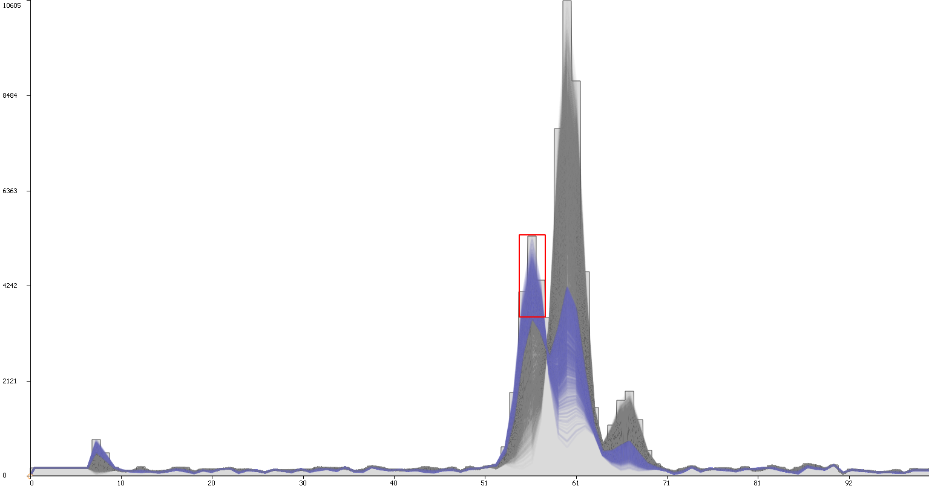
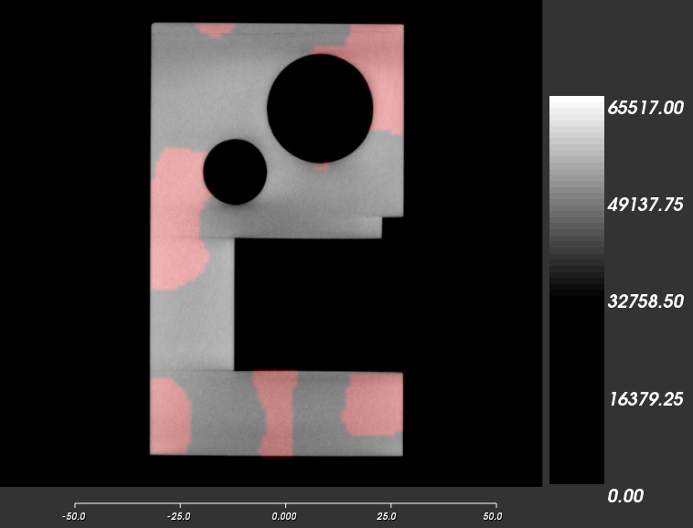
Selection in Spectrum
Locating specific
material configuration
Notes:
TODO: stanford dataset? More interactive -> first without interaction; labels
Spectrum zoom-in
Spectra lines überlagern
Reference spectra?
Projection of selection on axes / selection on axes

Slide 32
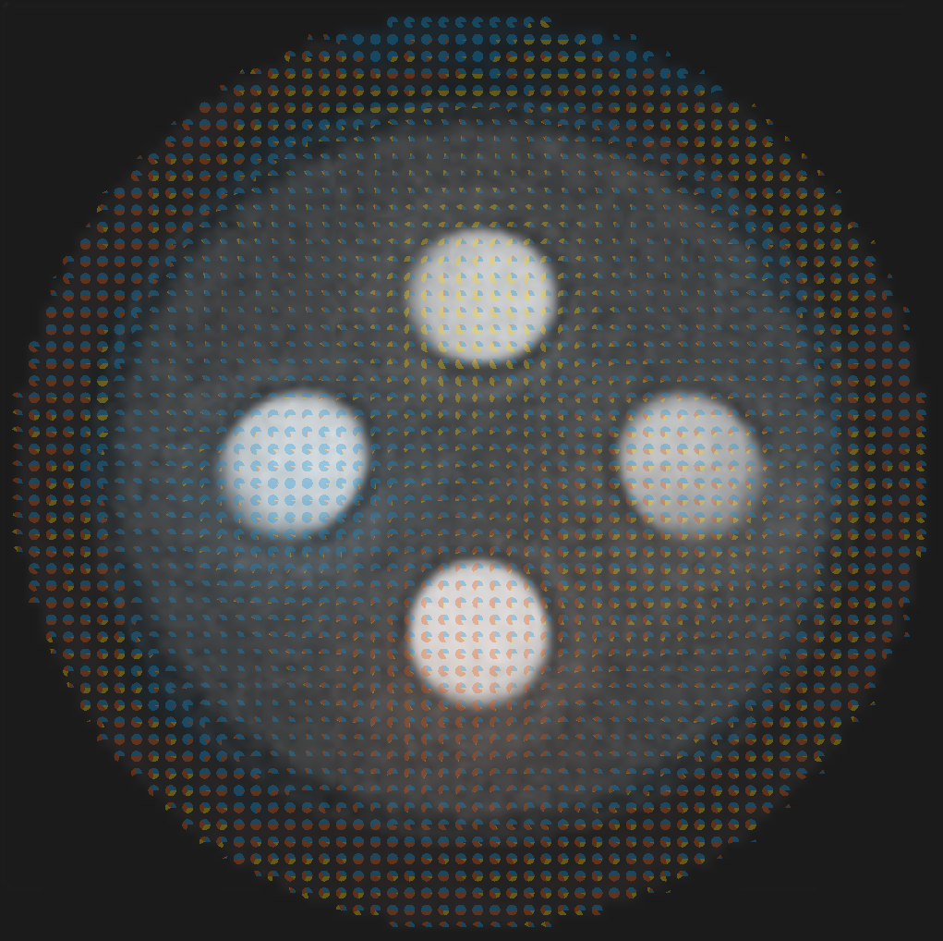
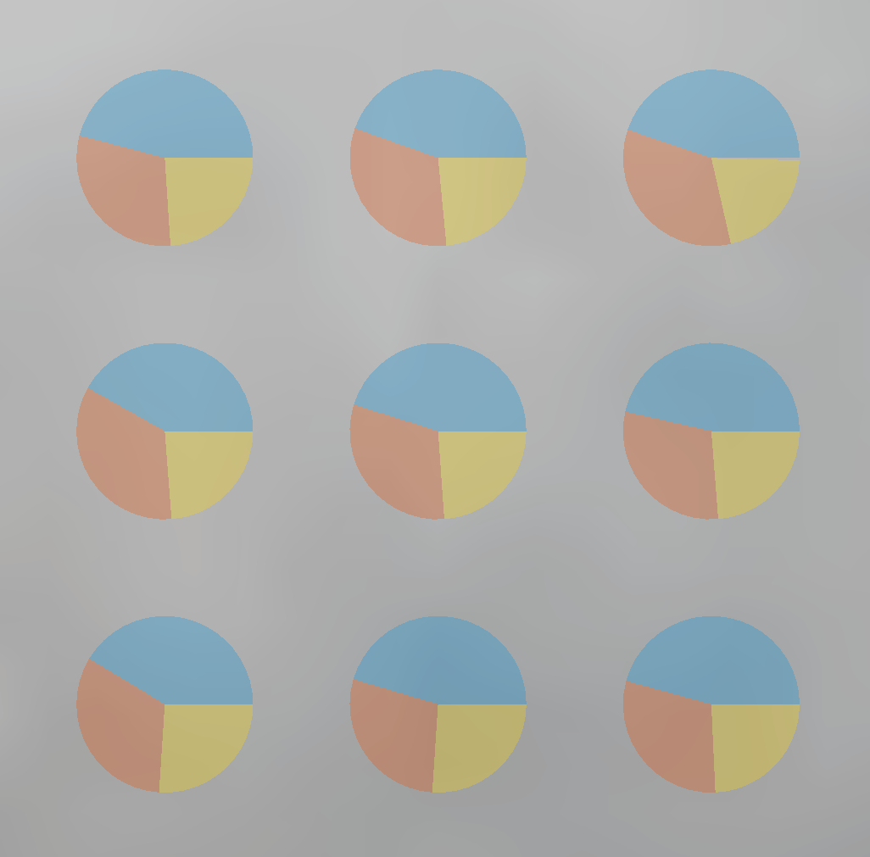
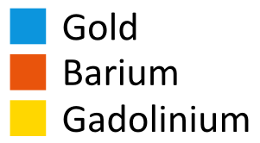
Pie Chart Glyphs
Notes:
TODO: bigger glyphs, less spacing
Improve registration?
Increase contrast
Uncertainty?
No difference between black&white -> instead show comparison of left and right white circle

Slide 33
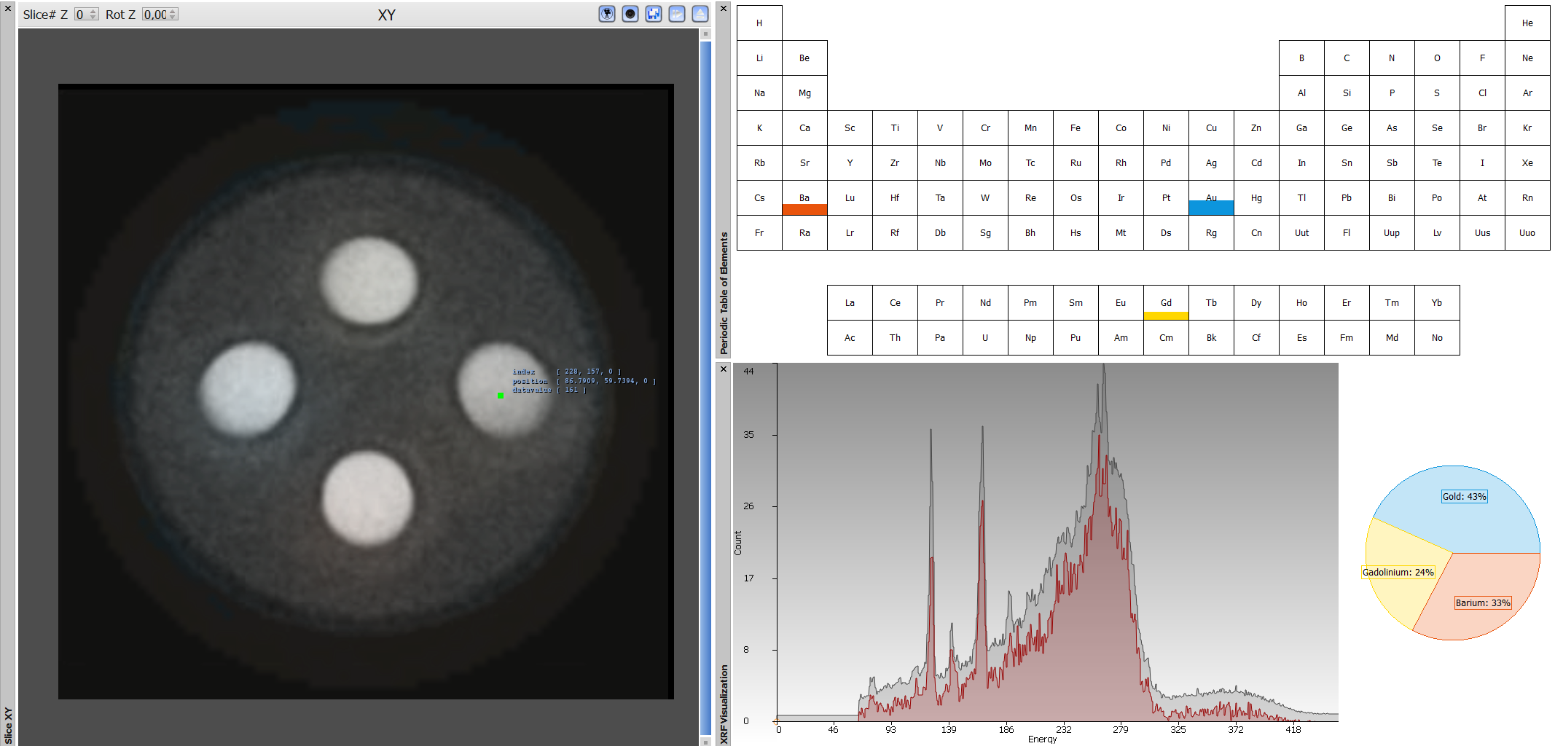
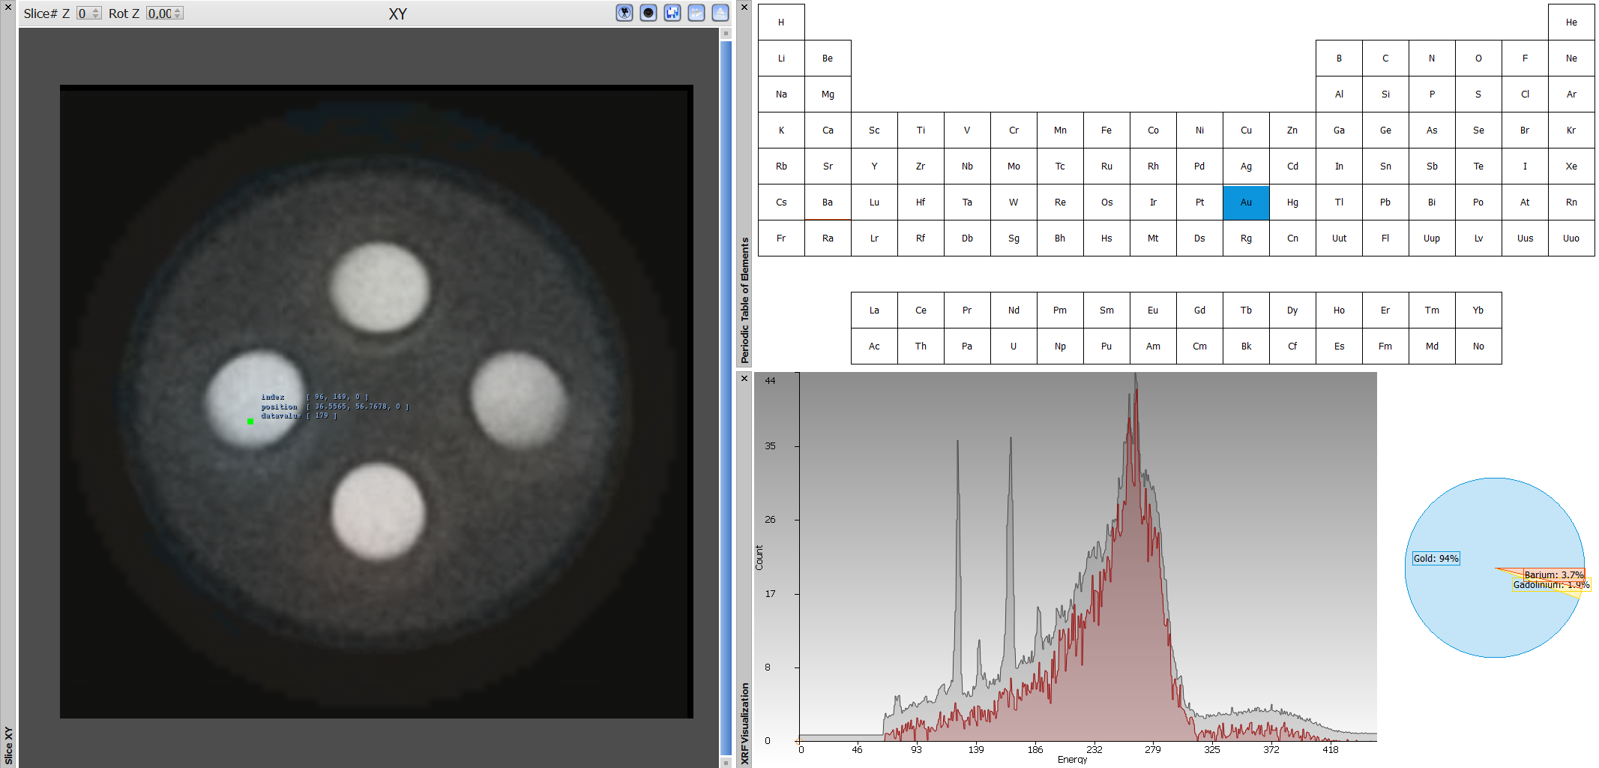
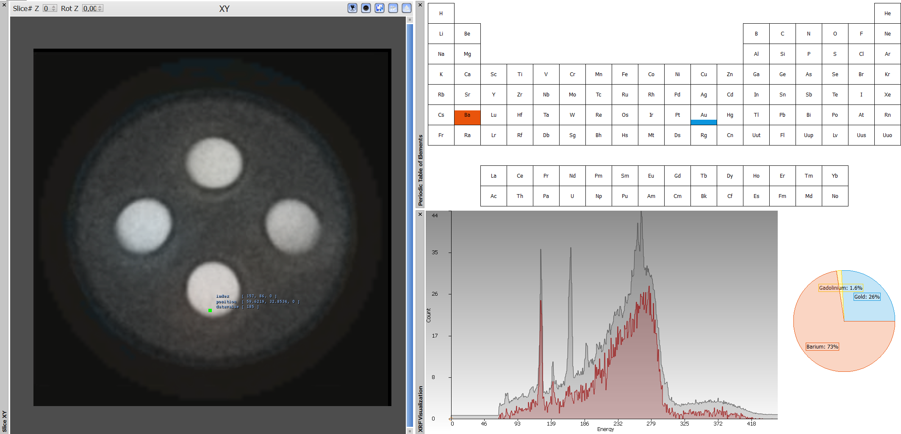
Concentration Probing
Notes:
TODO: Video?

Slide 34
Overview
Introduction
Application Field
Motivation & Tasks
Workflow
Input
Visualization & Analysis Methods
Global
Local
Evaluation

Slide 35
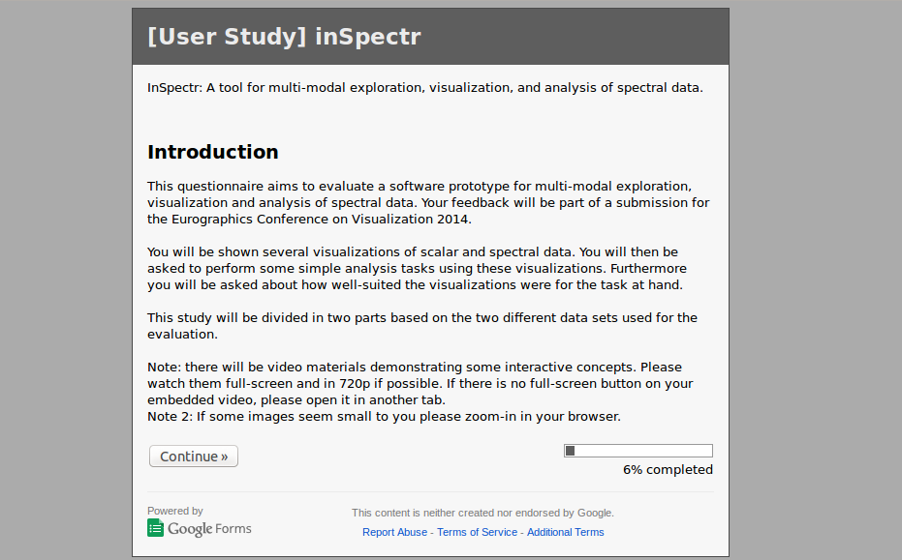
Evaluation: Overview
Online-Questionnaire
14 participants
5 Visualization experts
9 Material science experts

Slide 36
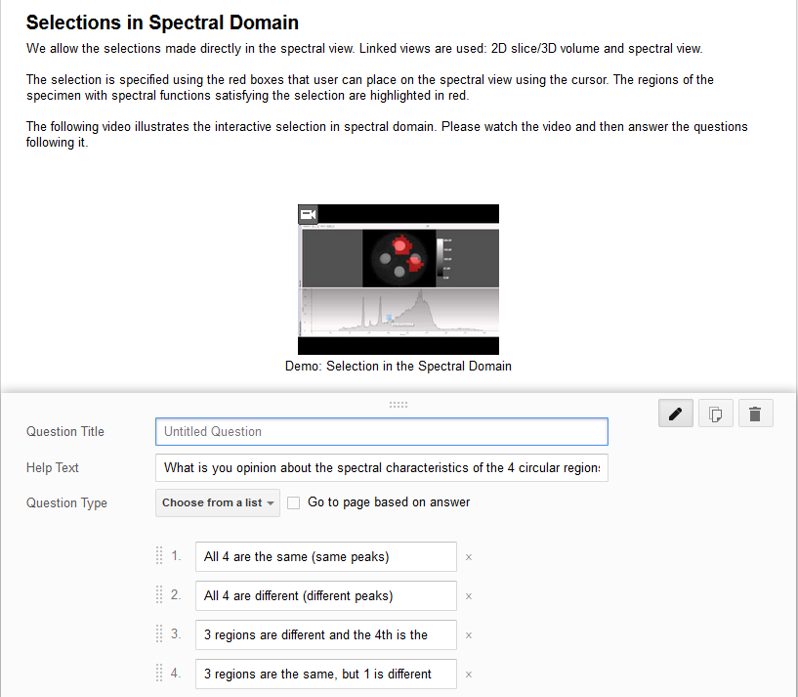
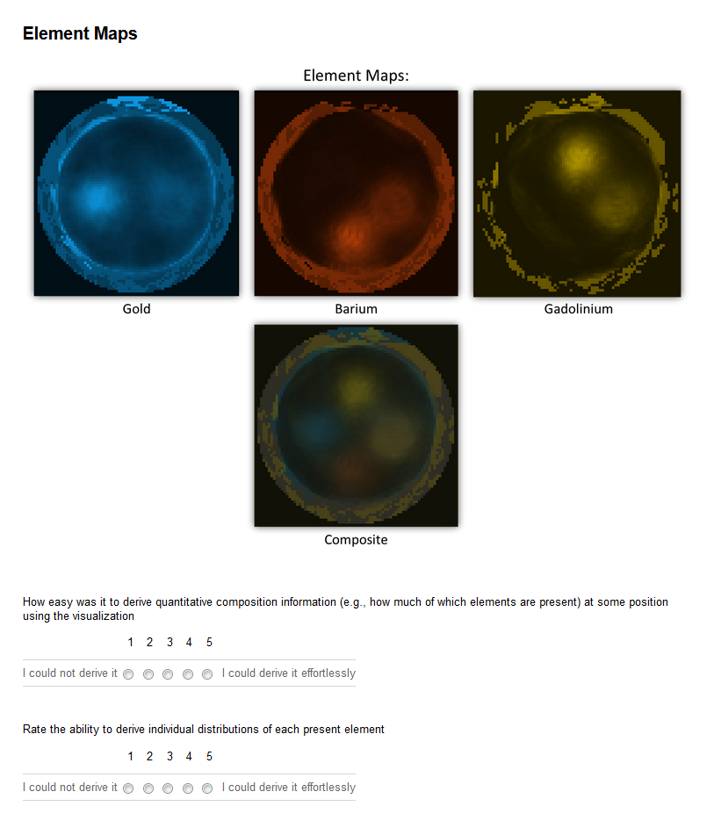
Evaluation: Questions
Questions
Tasks to solve
Perceived usefulness

Slide 37
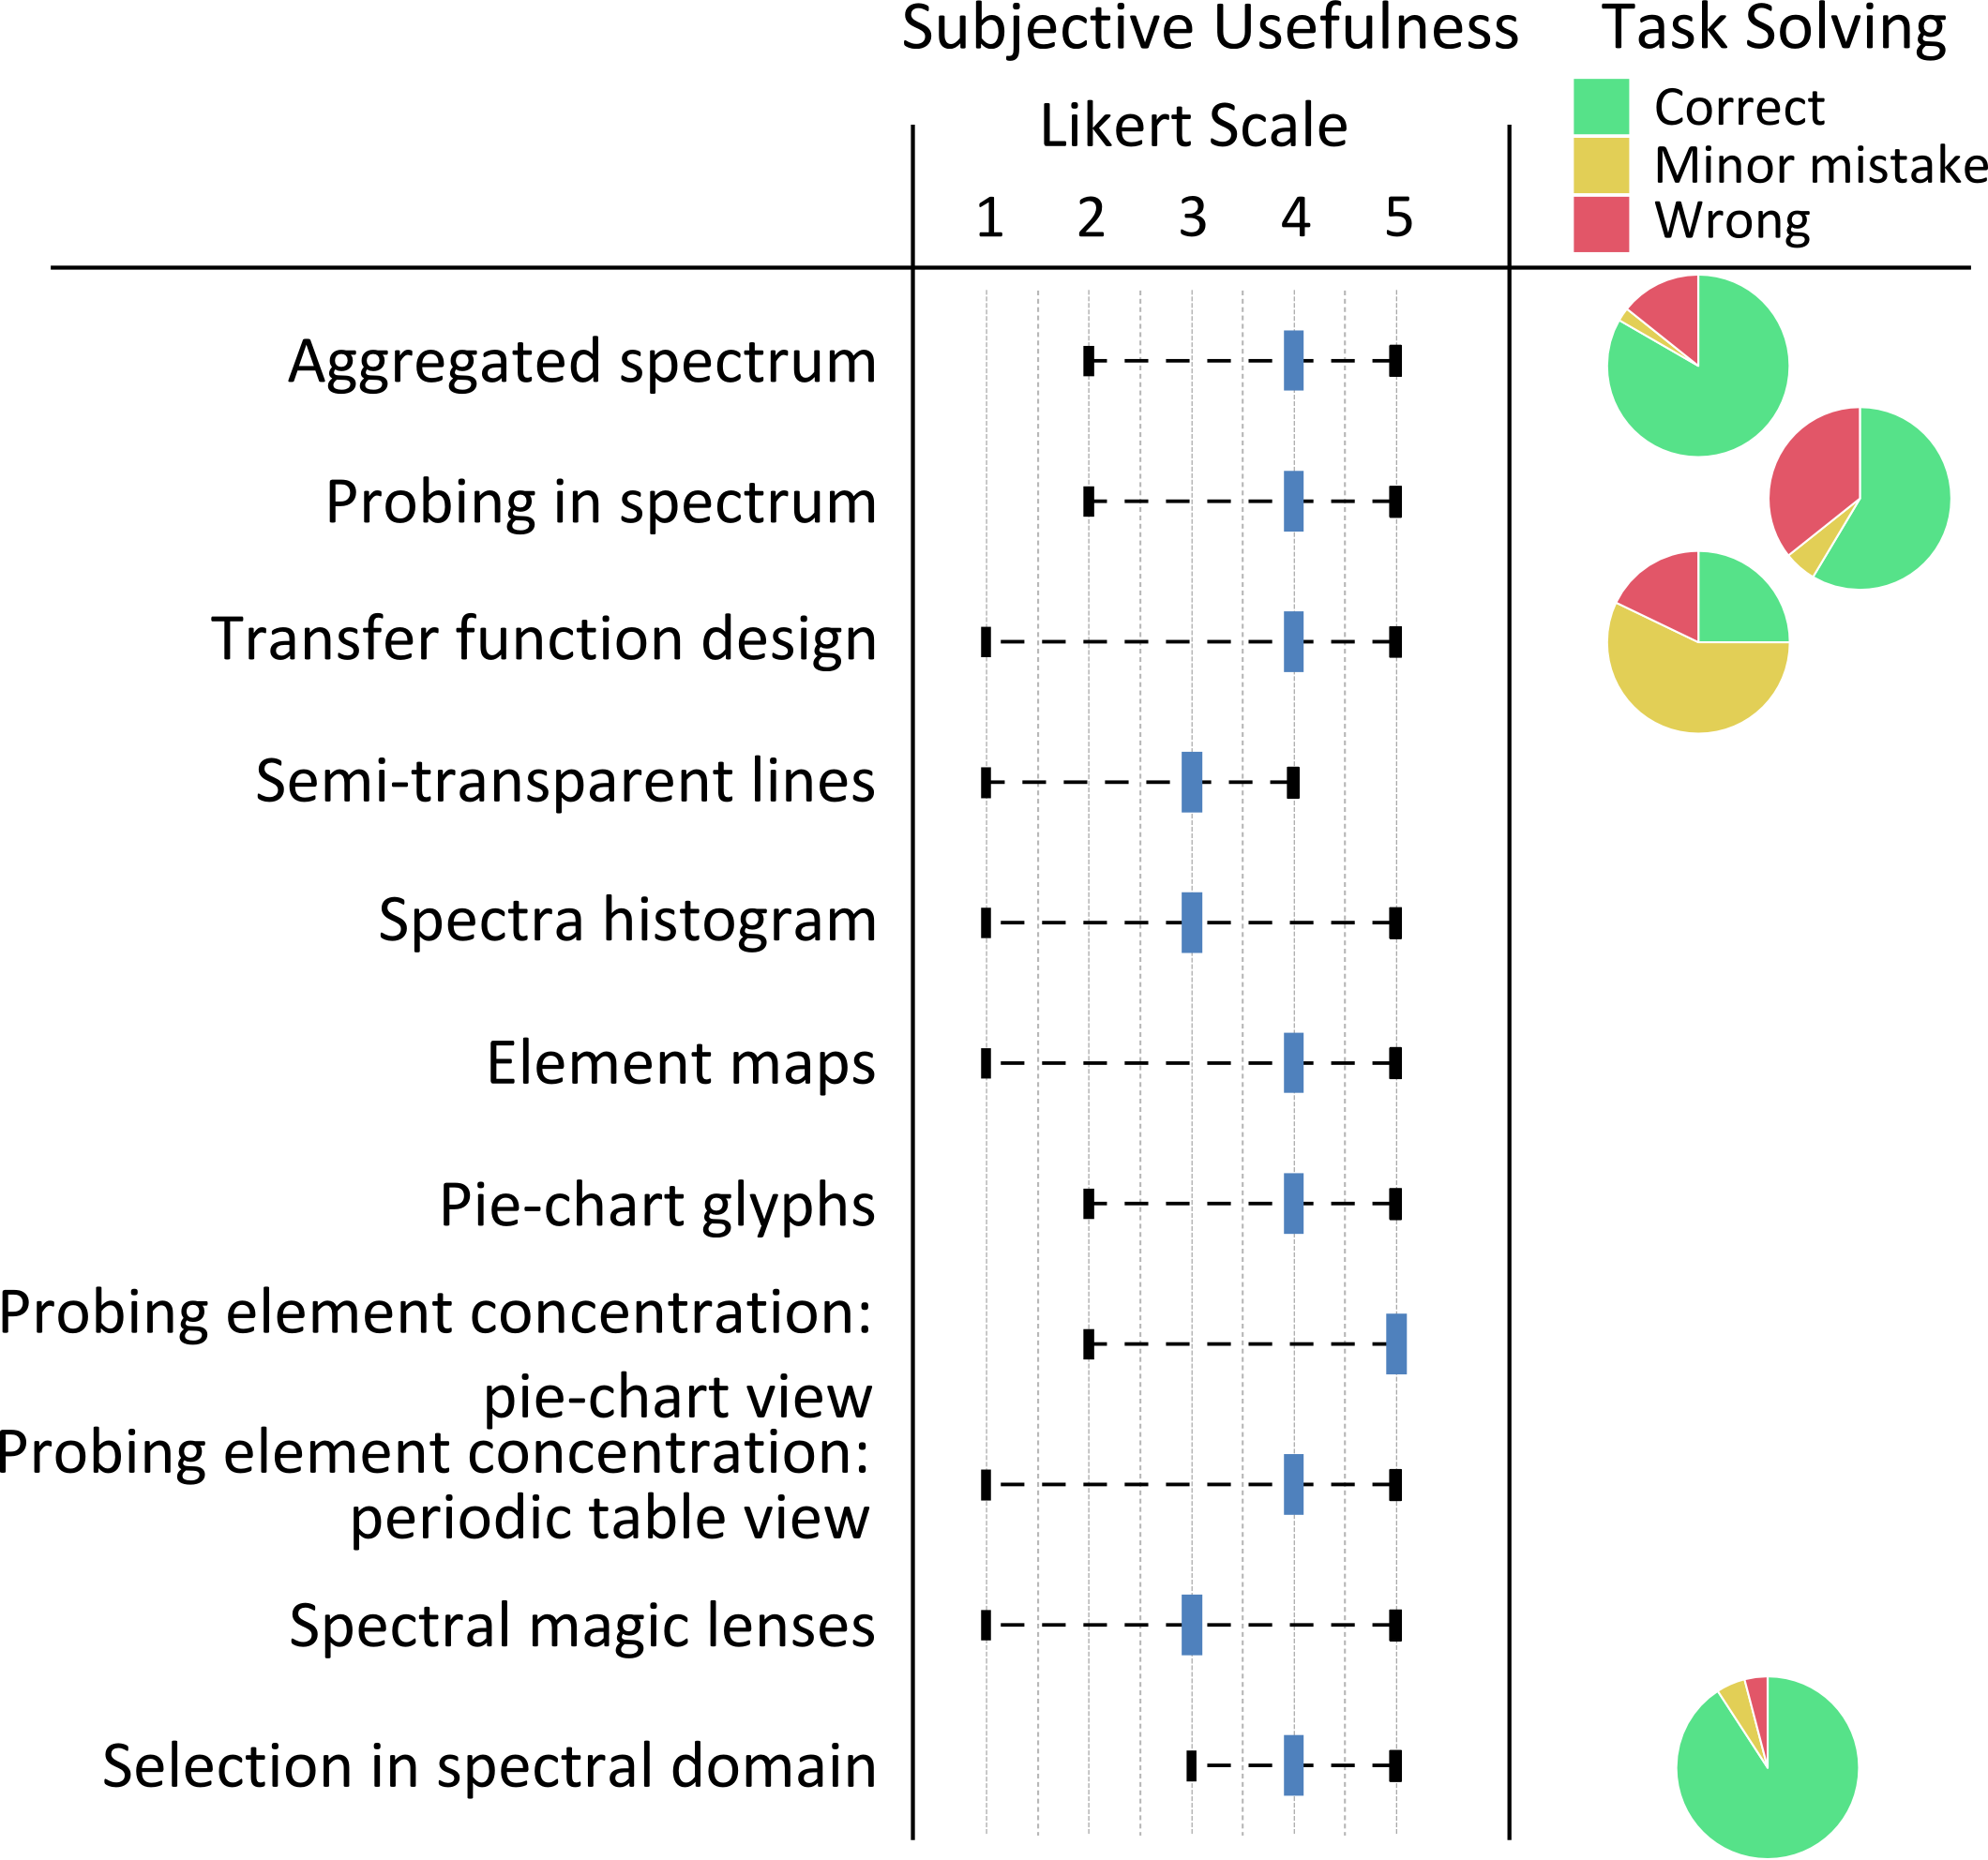
Evaluation: Feedback
Positive
Probing element concentration
Selection in spectrum
Aggregated spectrum
Potential for improvement
Not all methods equally suited for each dataset
Spectra histograms
Color blending
color transfer function
composite element maps

Slide 38
Conclusion
Novel multi-modal analysis tool
Covers broad range of tasks
Well-received by experts
What remains to be done
Range of real datasets
Notes:
TODO: reiterate motivation, more on what we did

Slide 39
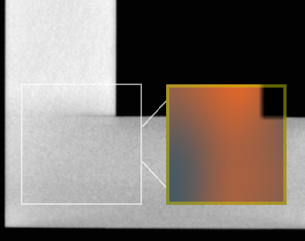
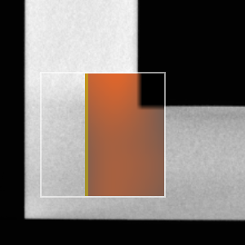
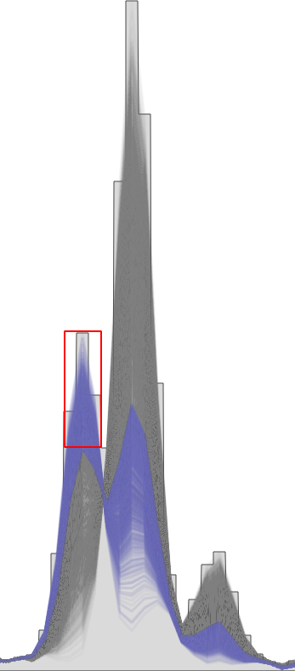
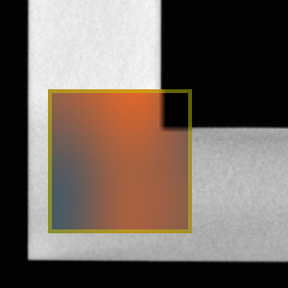
Thanks for your Attention!
Bernhard Fröhler
bernhard.froehler@fh-wels.at
Artem Amirkhanov
artem_ogre@gmail.com
University of Applied Sciences Upper Austria, Wels Campus
Research Group Computed Tomography, www.3dct.at
(nanoxct.eu)
The research leading to these results has received funding from the European Union’s Seventh Framework Programme (FP7/2007-2013) under grant agreement number 280987
Notes:
TODO: ack?
Main images
Contact details – check
Acknowledgement Eu project – check

Slide 40
References
Bruyndonckx P., Sasov A., Liu X. : Laboratory 3D Micro-XRF/Micro-CT Imaging System. AIP Conference Proceedings 1365, 1 (2011), 61–64.
Kuang Y., Pratx G., Bazalova M., Meng B., Qian J., Xing L.: First Demonstration of Multiplexed X-Ray Fluorescence Computed Tomography (XFCT) Imaging. IEEE Transactions on Medical Imaging 32, 2 (Feb. 2013), 262–267.
Mutina, A. and Bruyndonckx, P.: Micro-CT/micro-XRF study of reservoir rocks examination of technique applicability for core analysis. Micro-CT Meeting 2012

