Slide 1
Visual Parameter Exploration in GPU Shader Space
Peter Mindek¹, Stefan Bruckner^{2,1},
Peter Rautek³, and M. Eduard Gröller¹
¹ Institute of Computer Graphics and Algorithms
Vienna University of Technology
² Department of Informatics
University of Bergen
³ Geometric Modeling and Scientific Visualization Center
King Abdullah University of Science and Technology

Slide 2
Motivation
GPU shaders implementing visualization algorithms are complex
Effects of shader variables and their combinations are examined by trial and error

Slide 3
Visual Shader-Space Exploration A novel method for analysis and exploration of visualization algorithms.

Slide 4
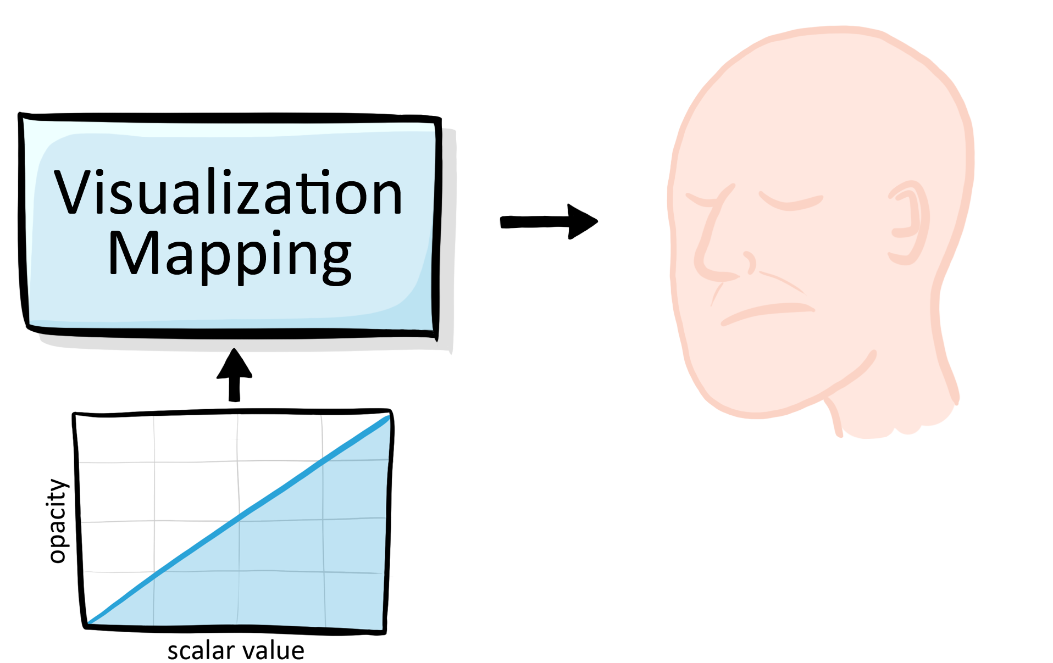
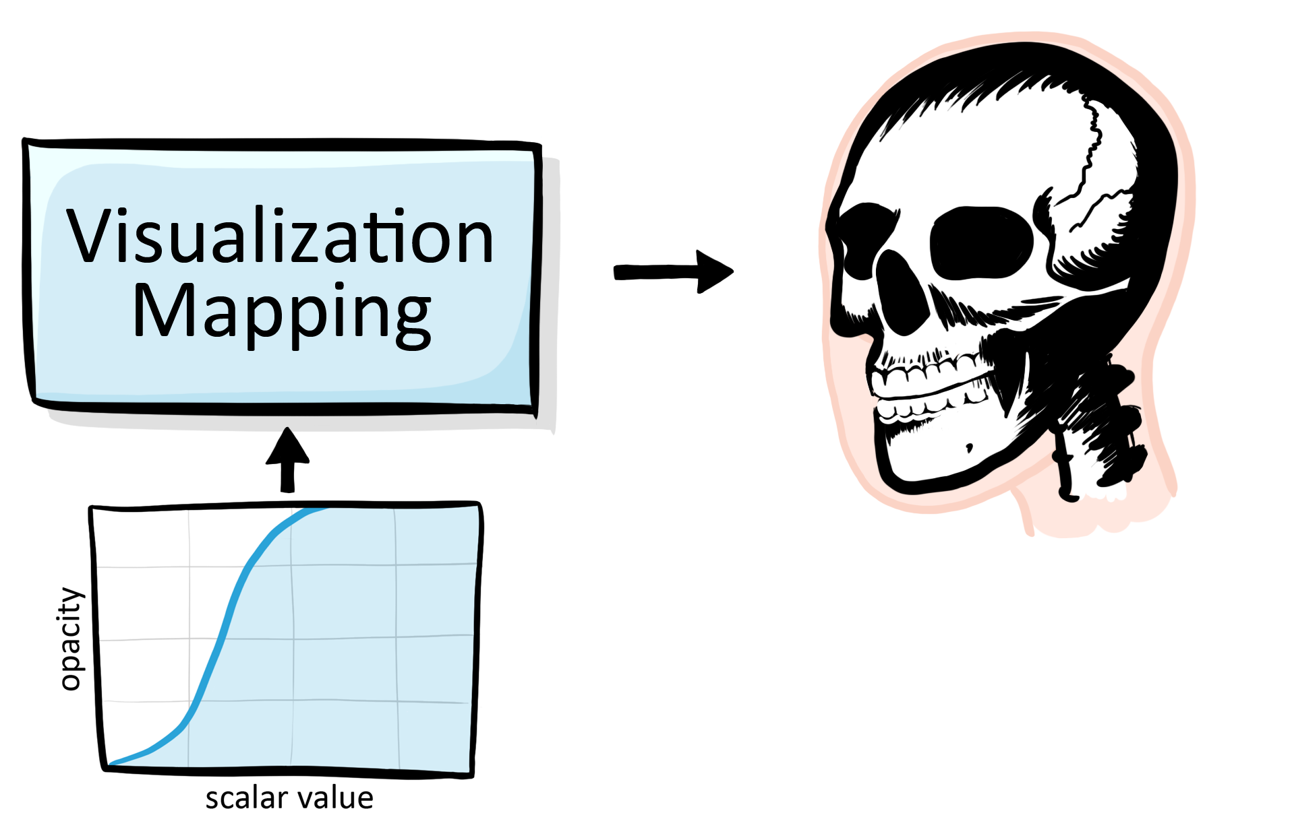
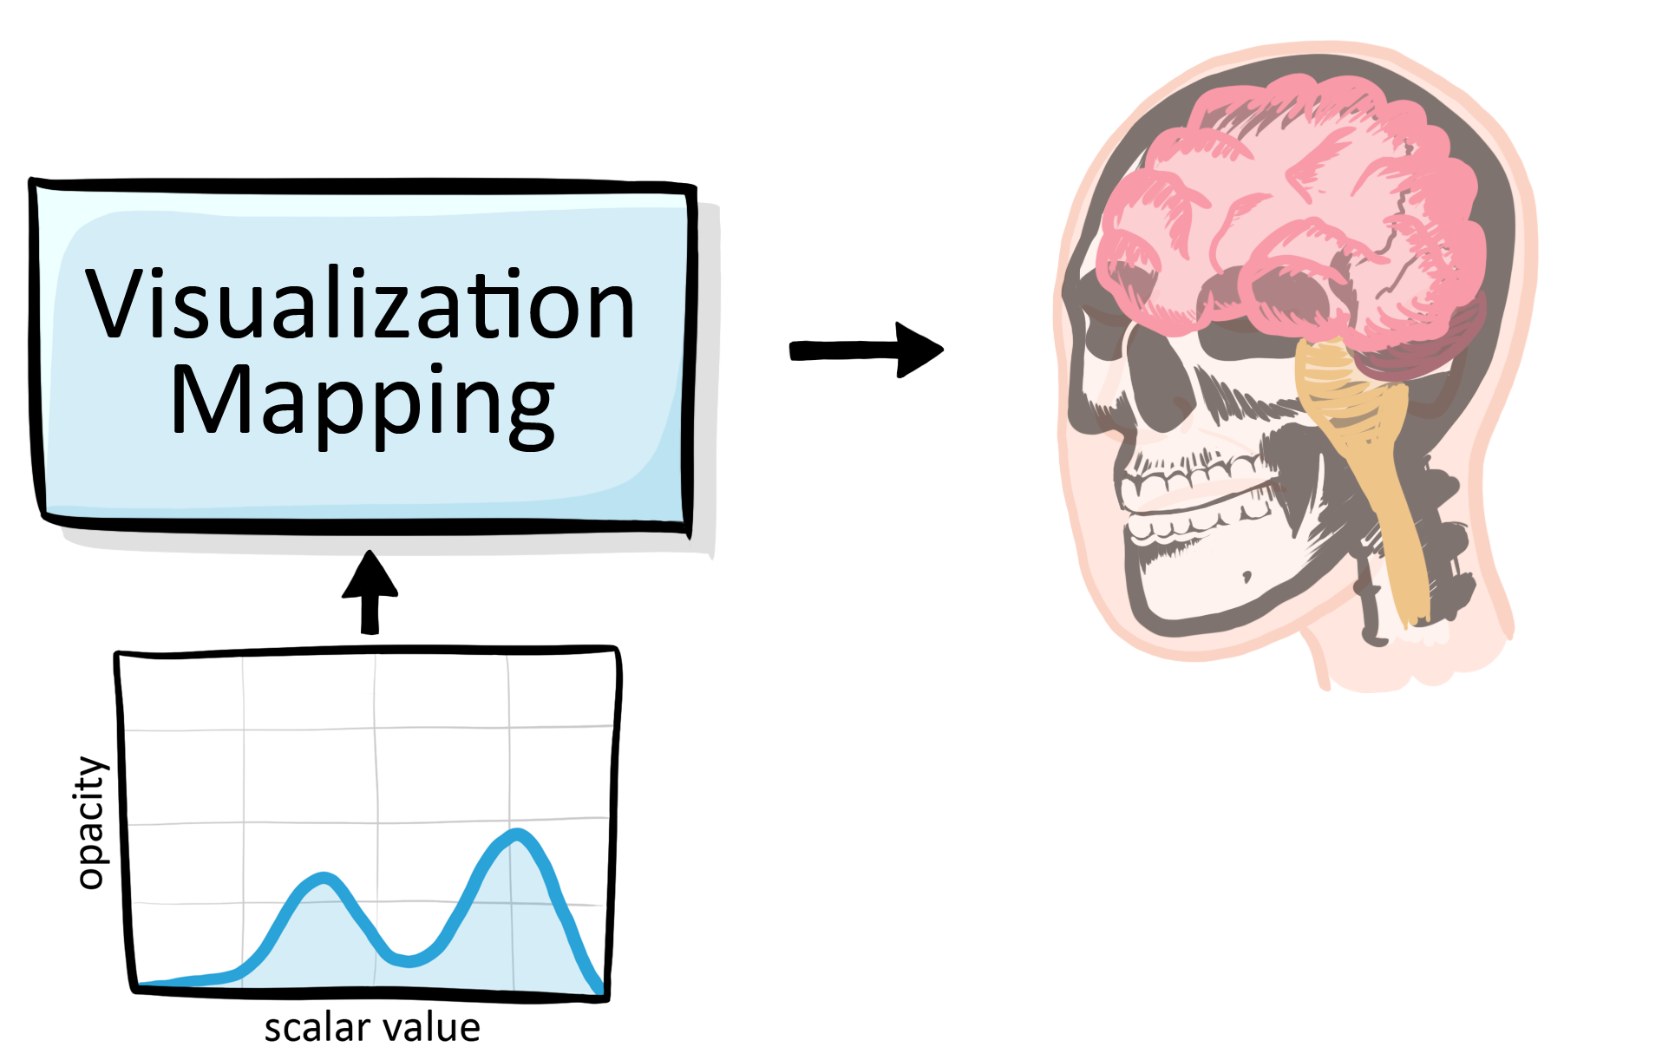
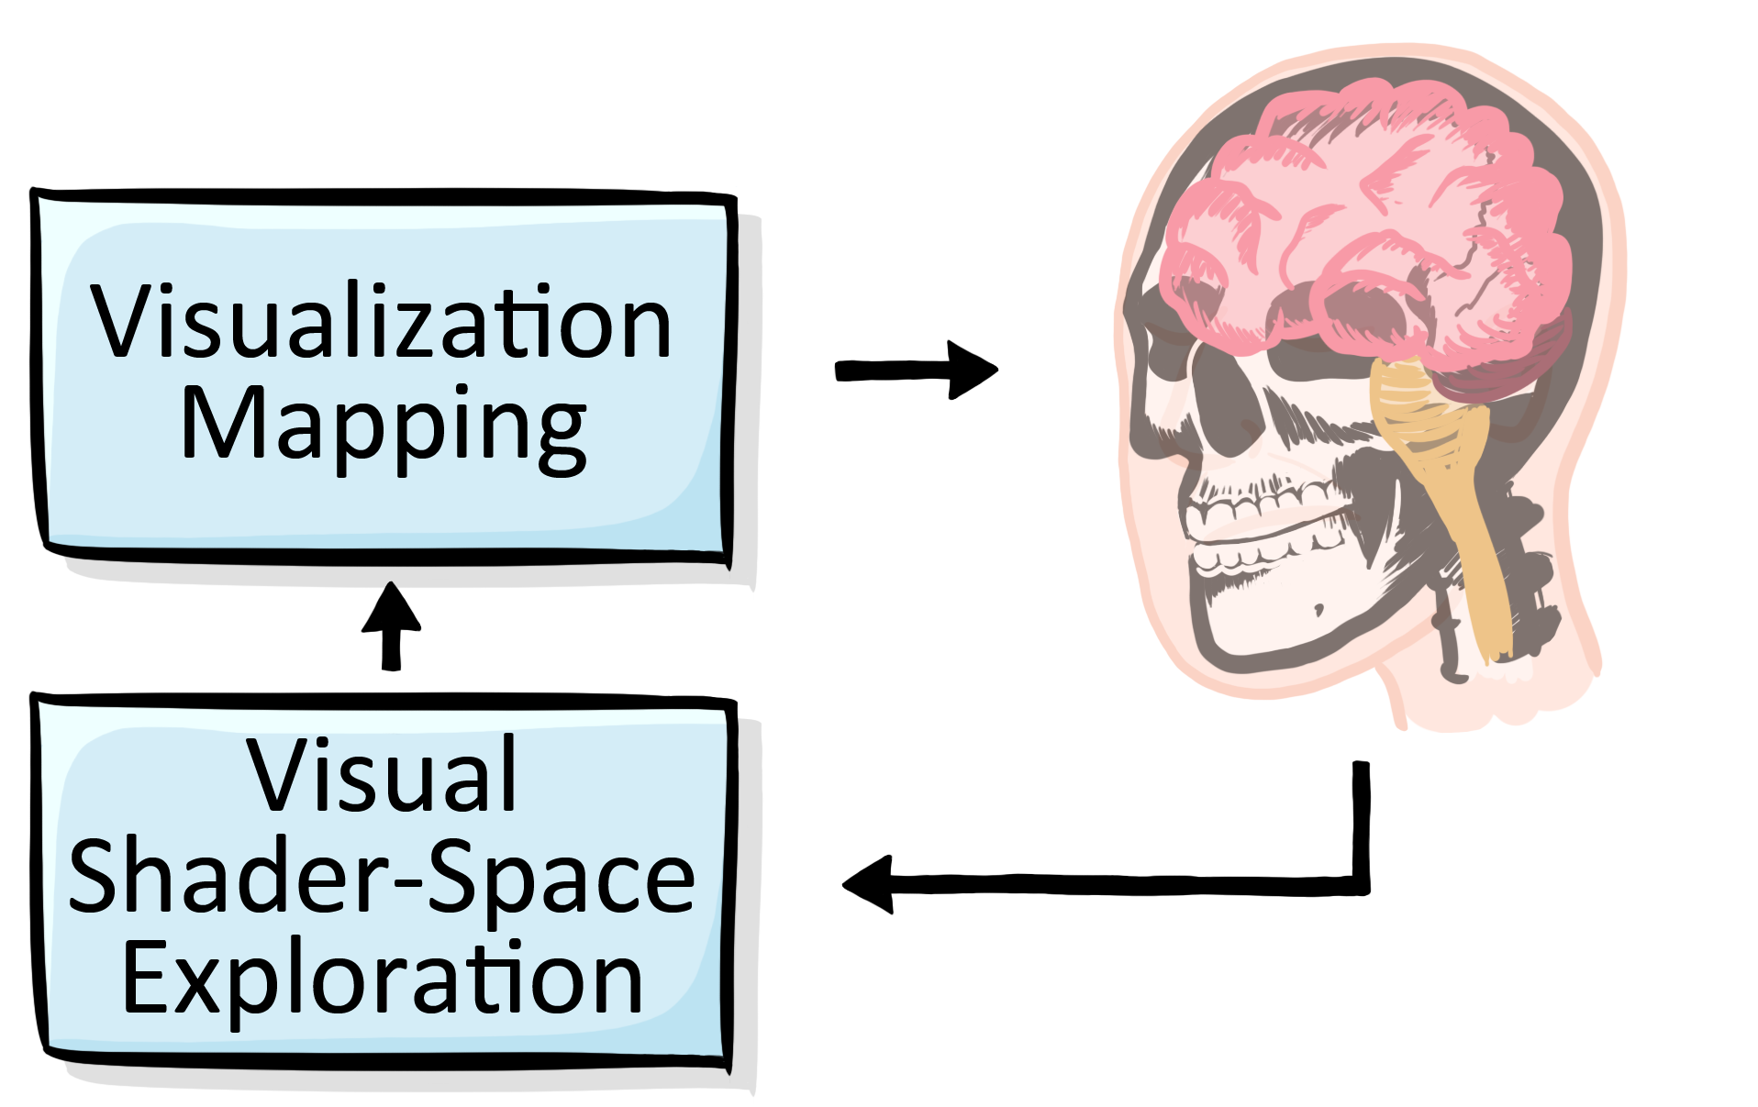
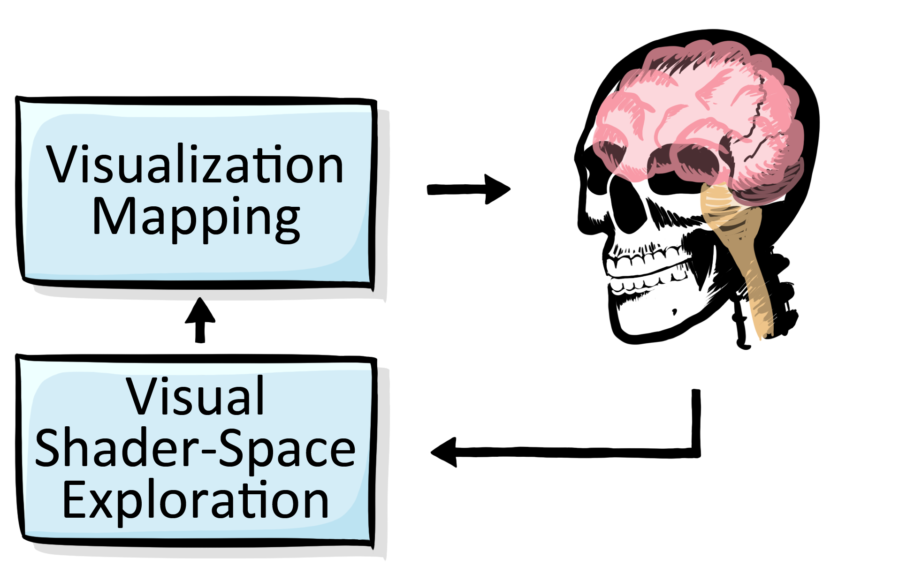
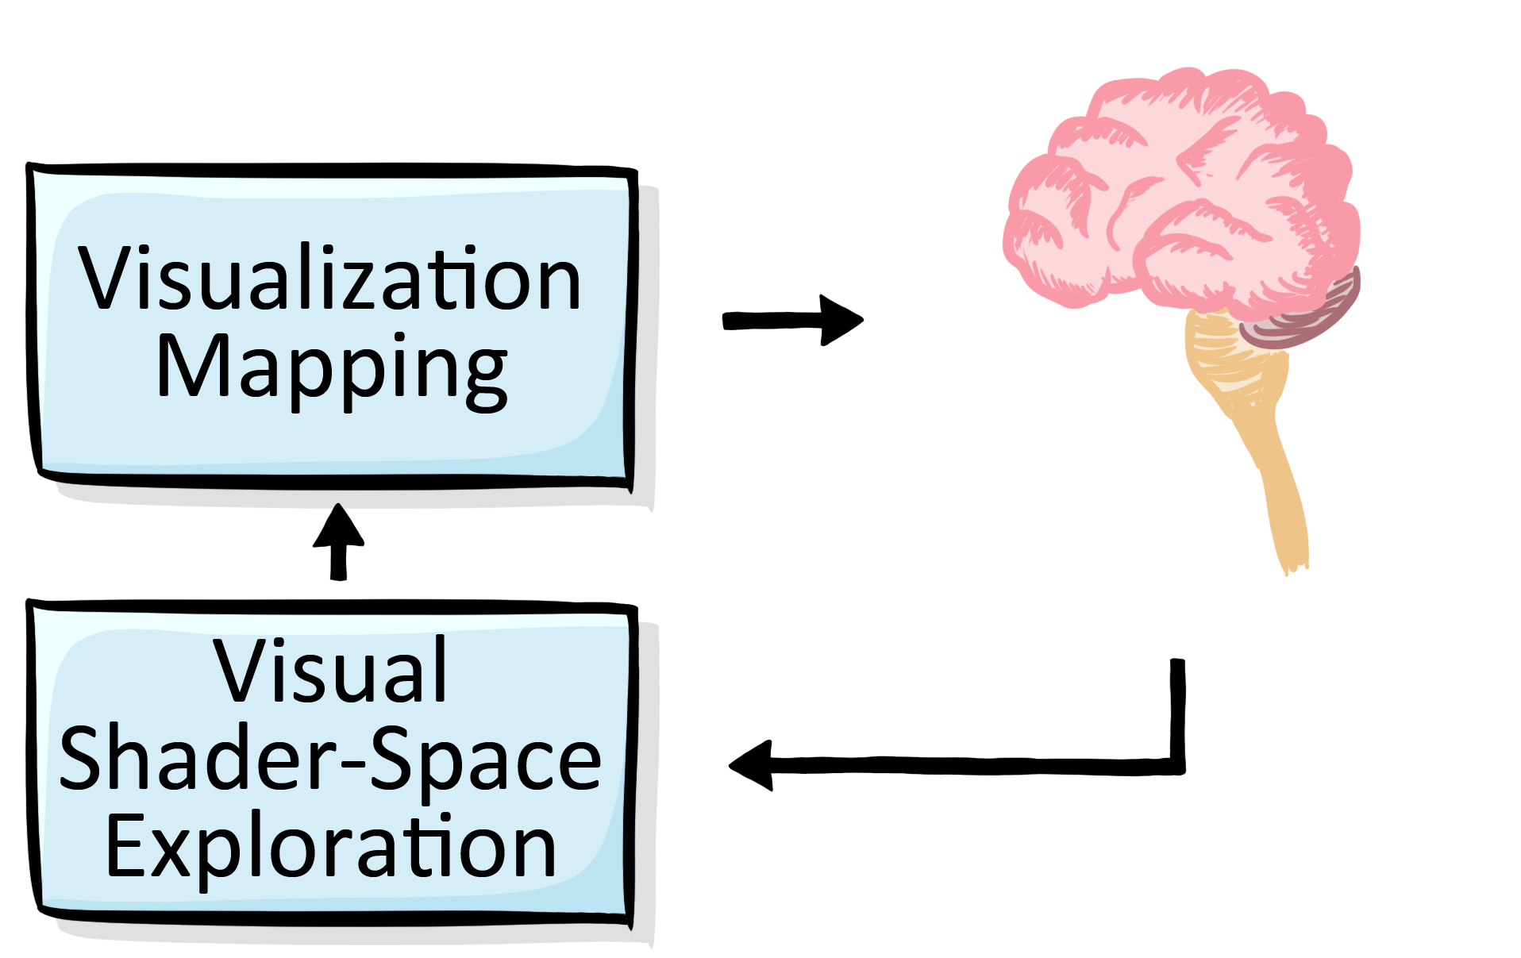
Overview

Slide 5
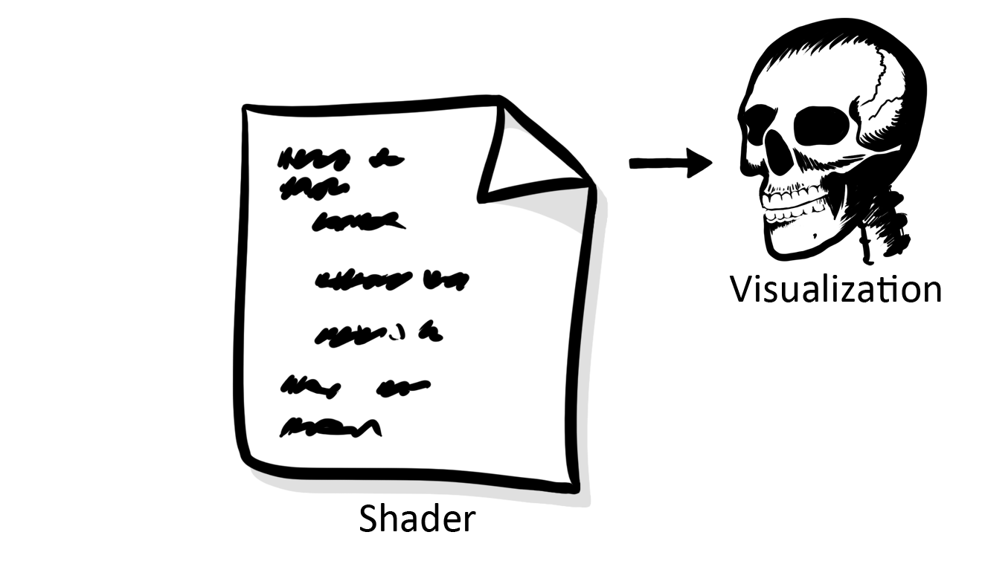
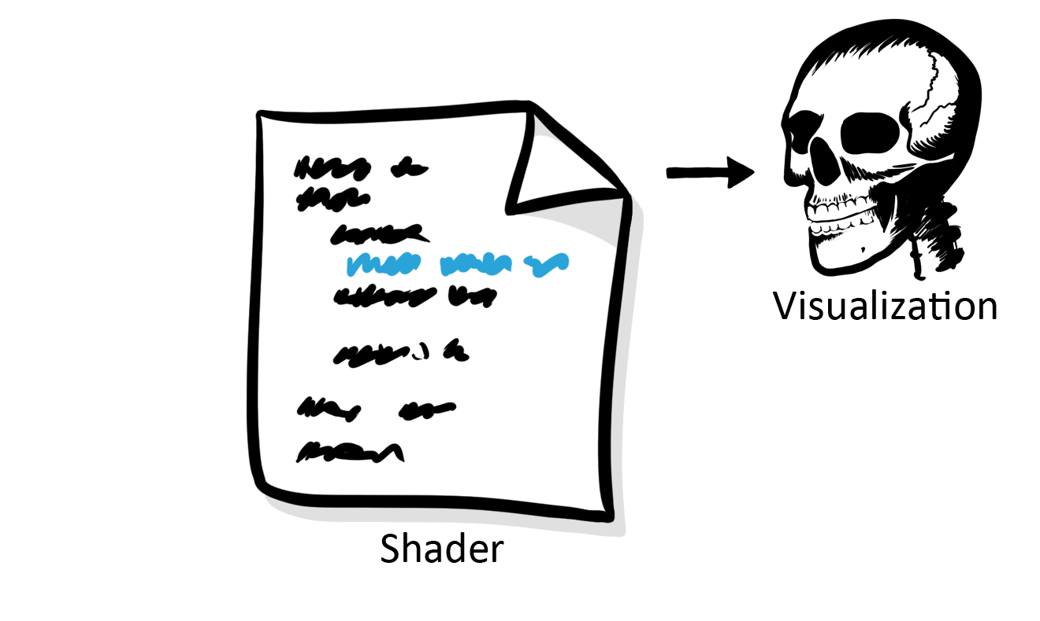
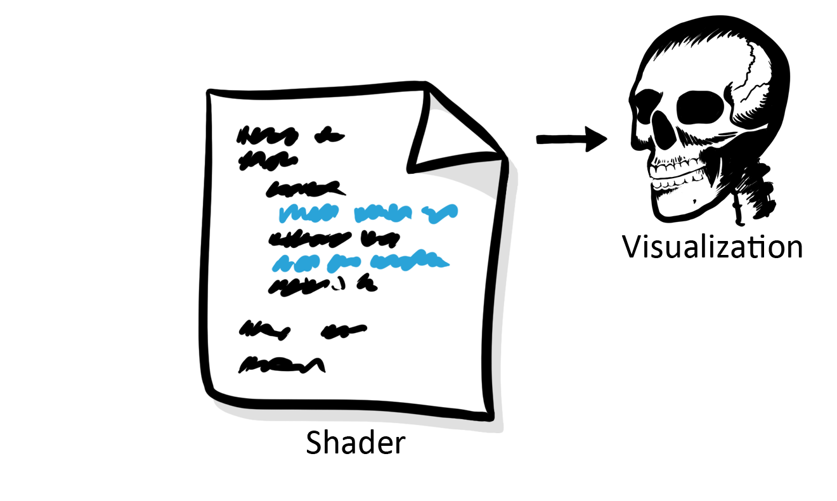
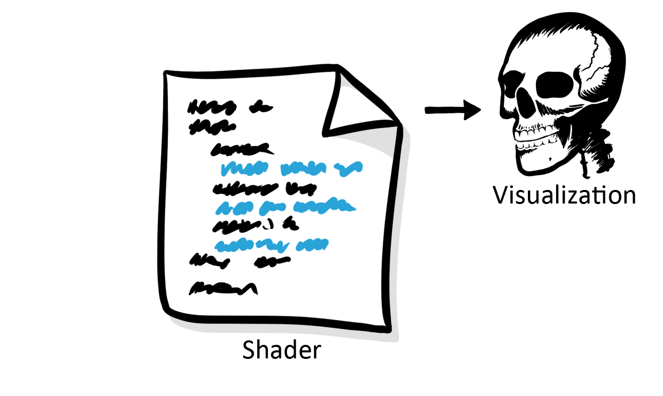
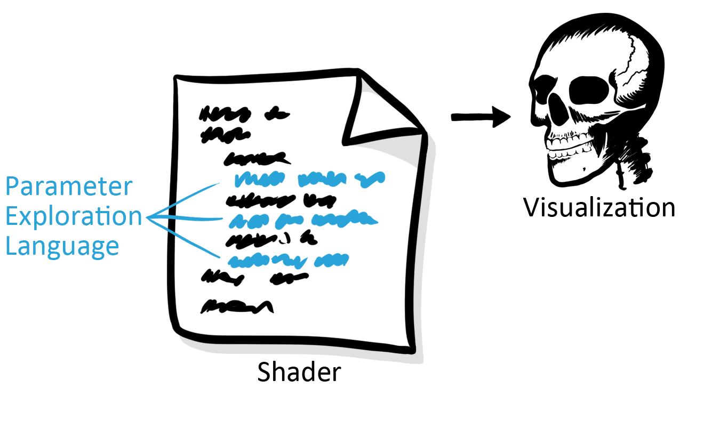
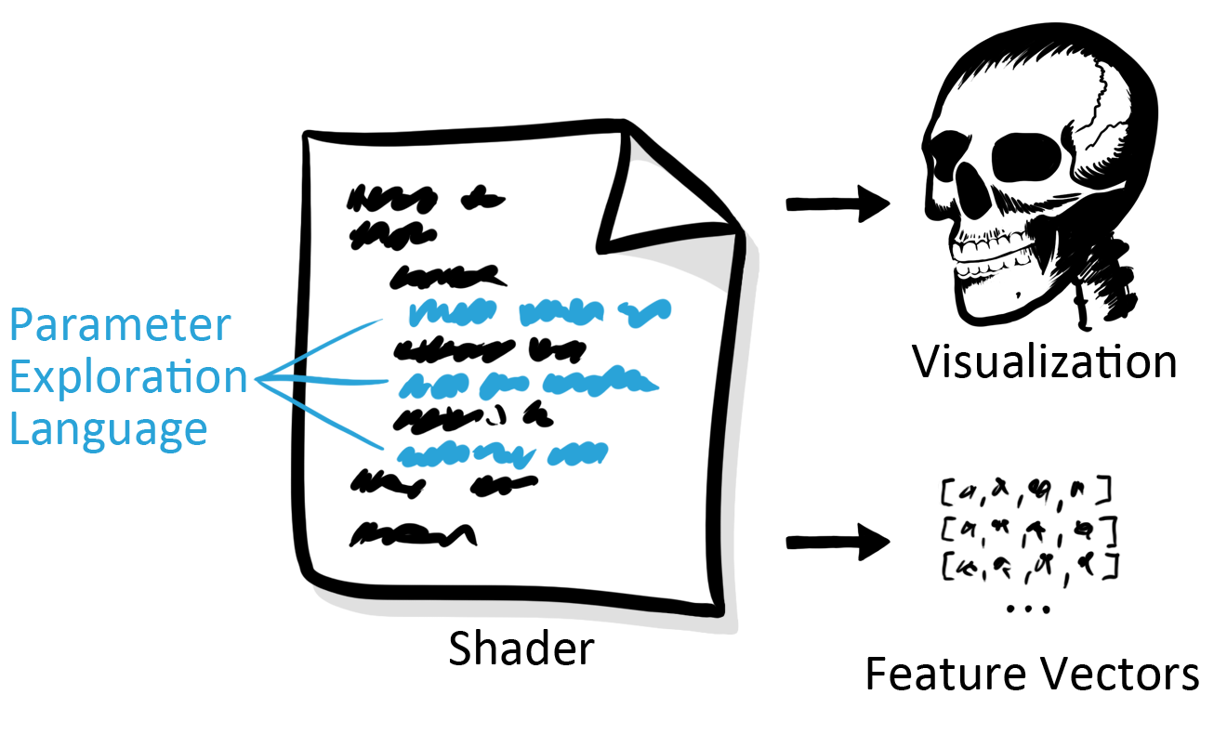
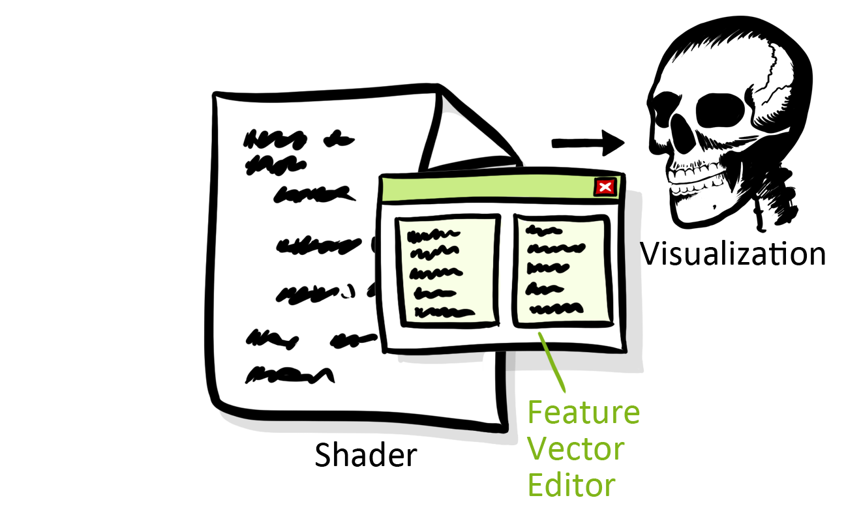
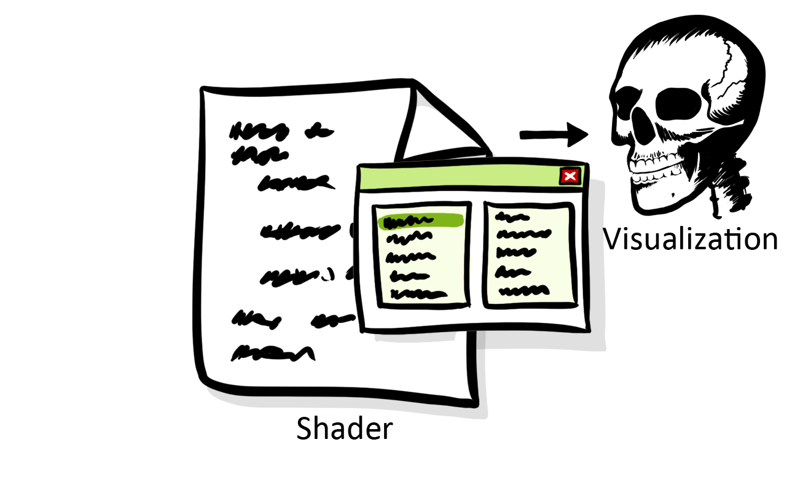
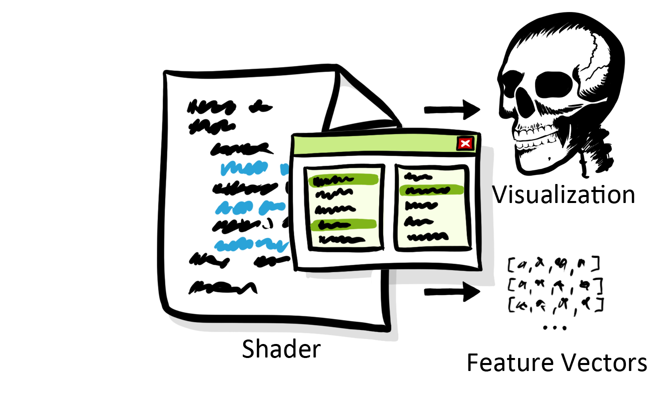
Approach

Slide 6
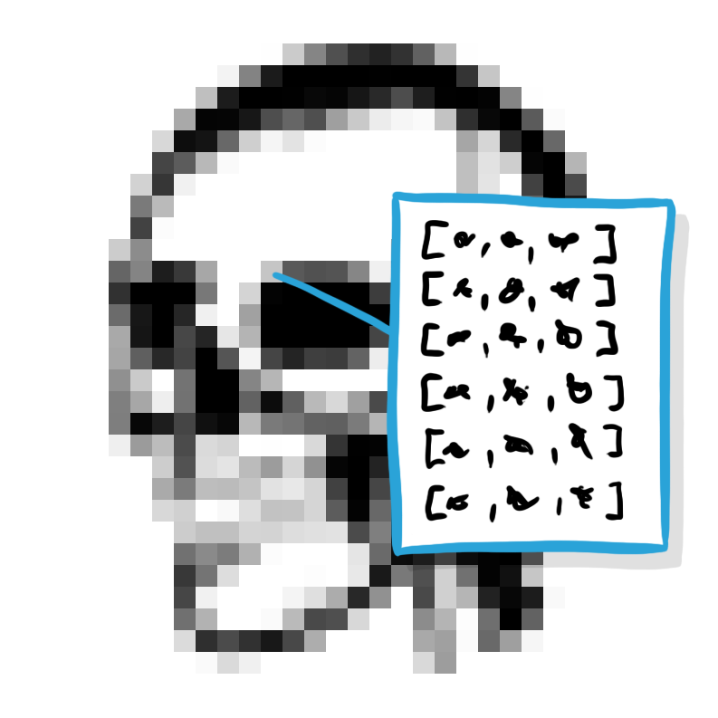
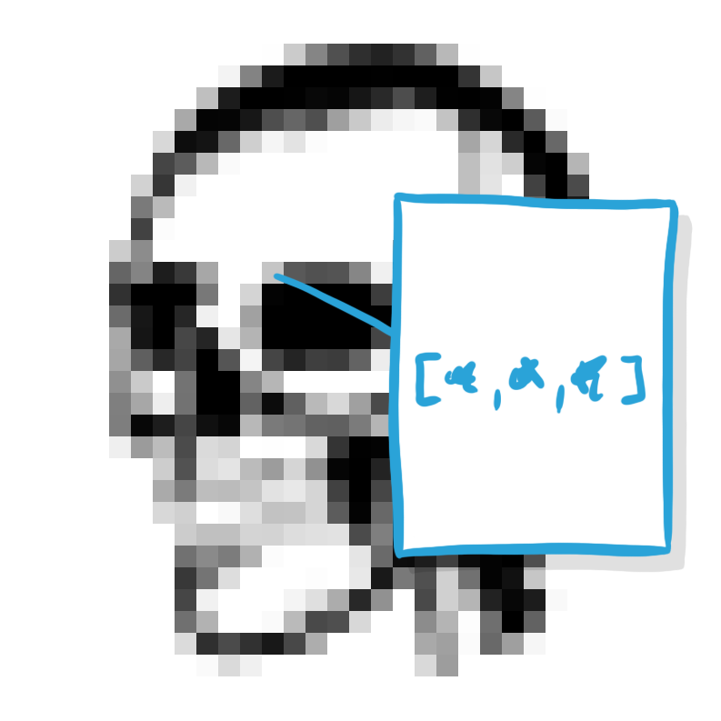
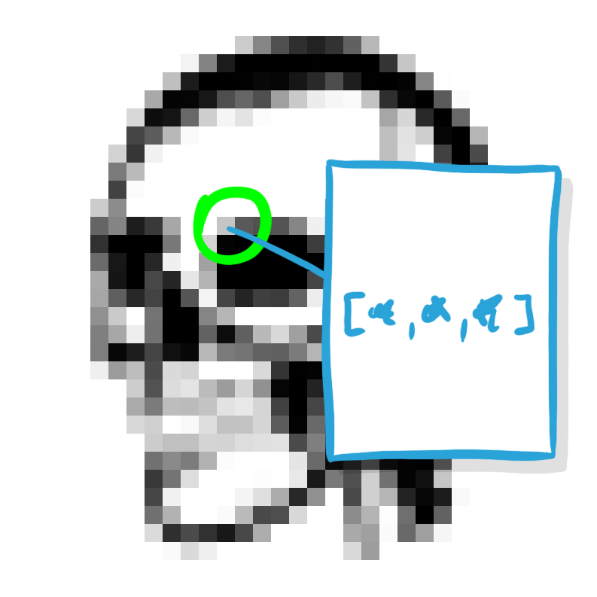
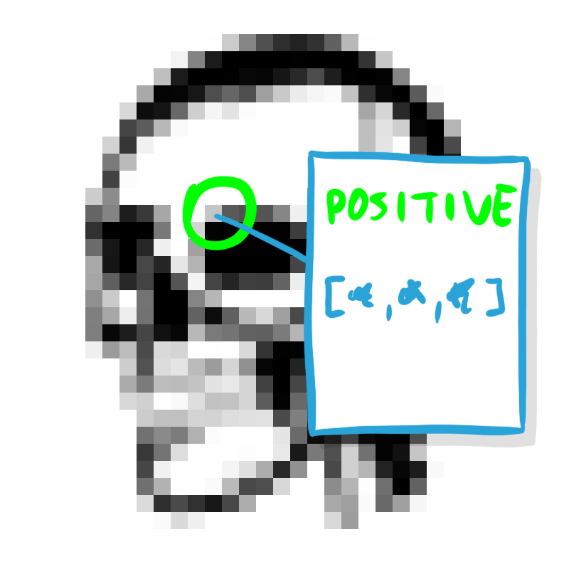
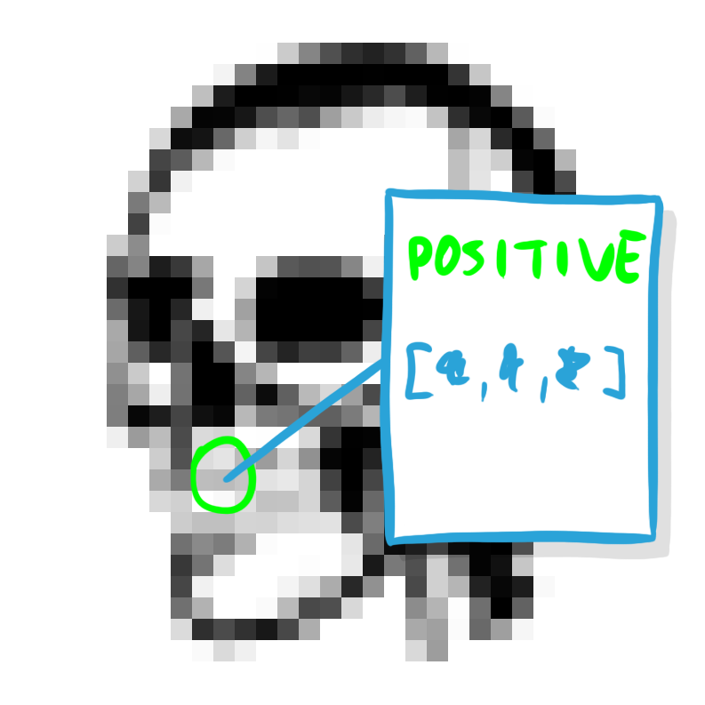
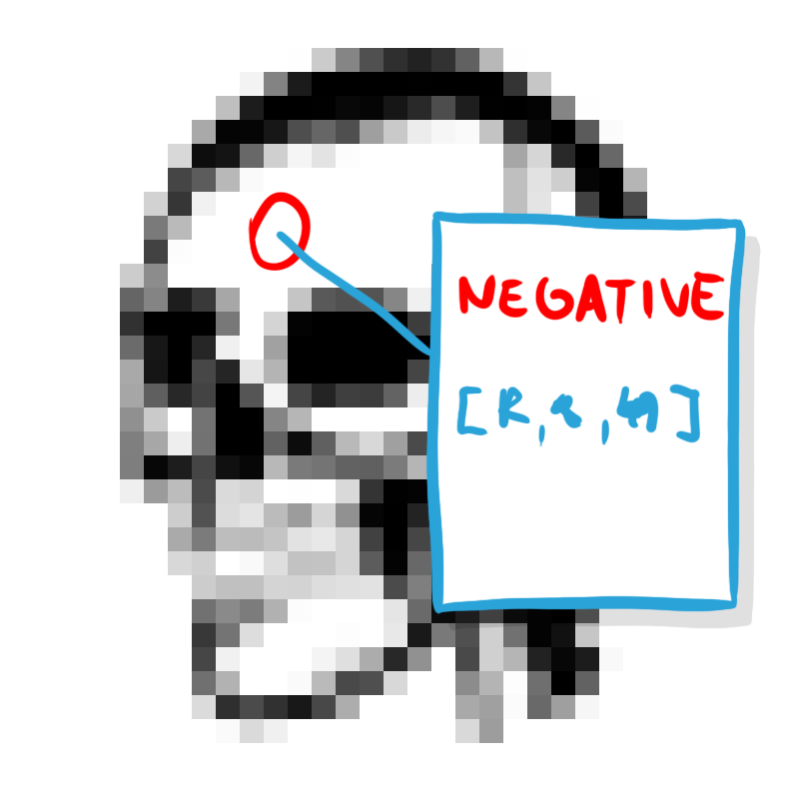
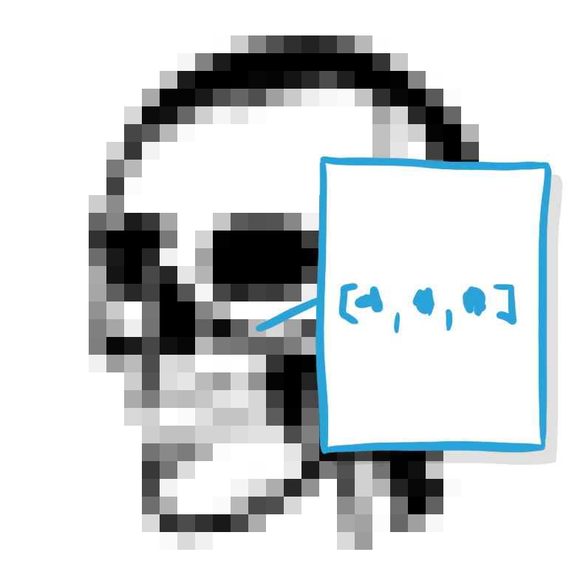
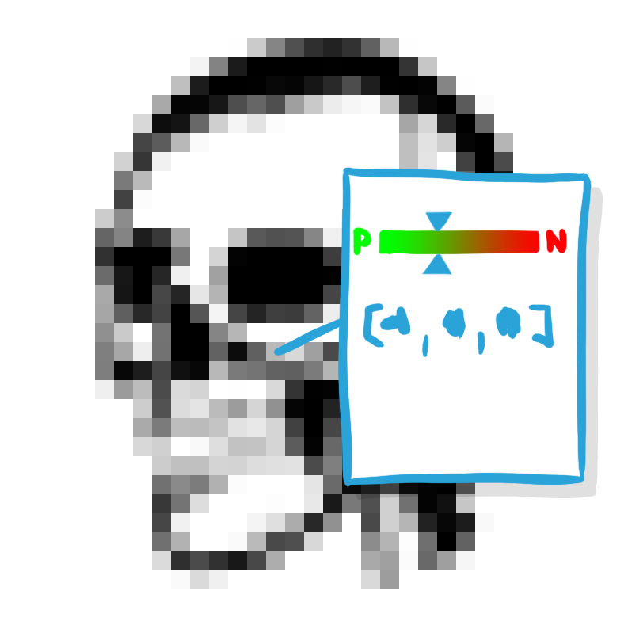
Feature Vectors

Slide 7
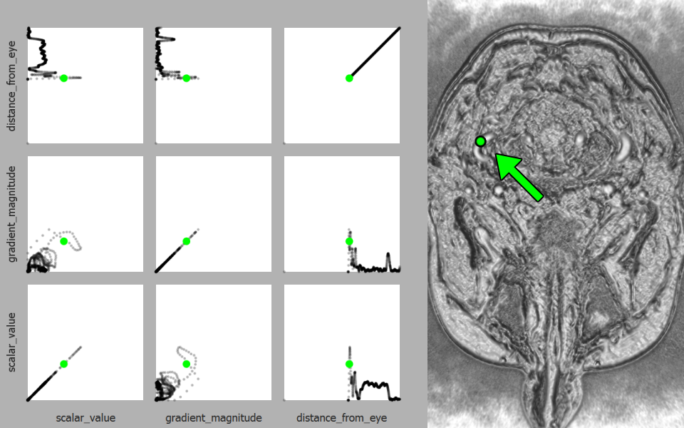
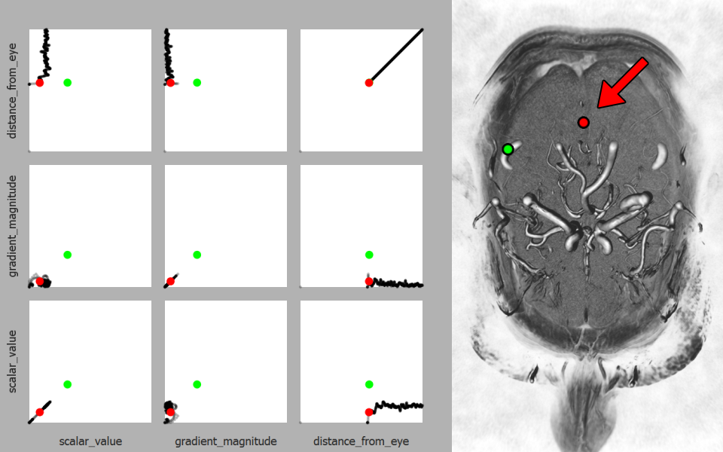
Parameter Space Visualization

Slide 8
Use Case

Slide 9
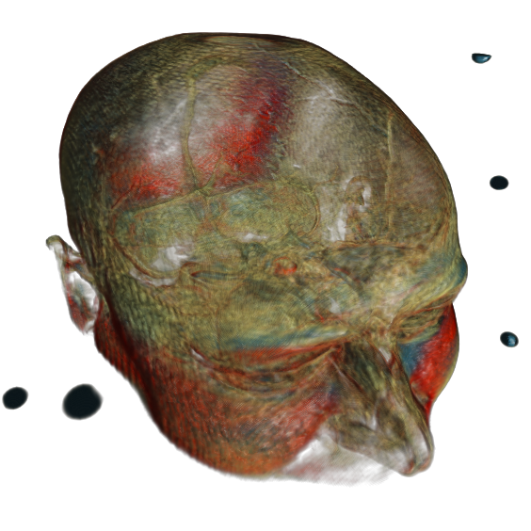
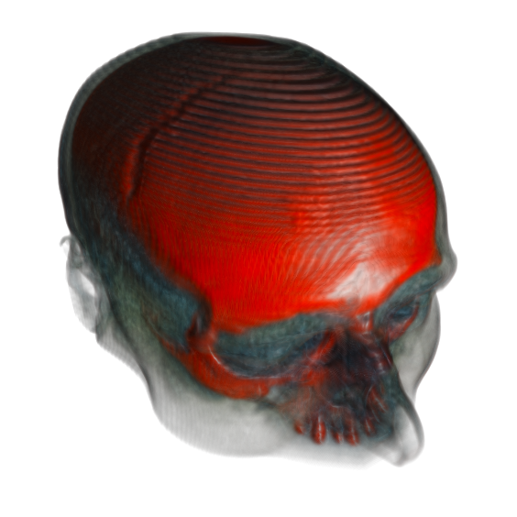
Data
Dual-modality medical scan
MRI CT

Slide 10
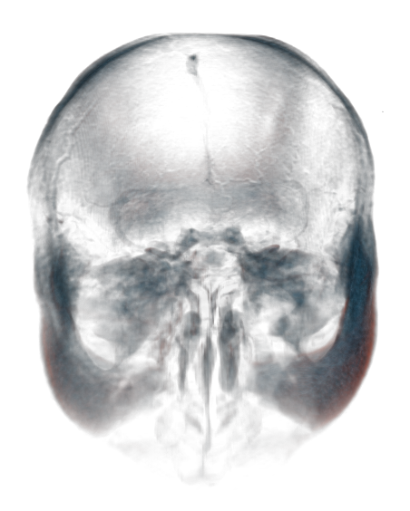
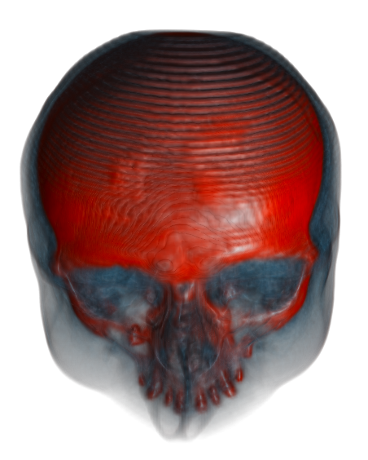
Data
Hard Tissues
MRI CT

Slide 11
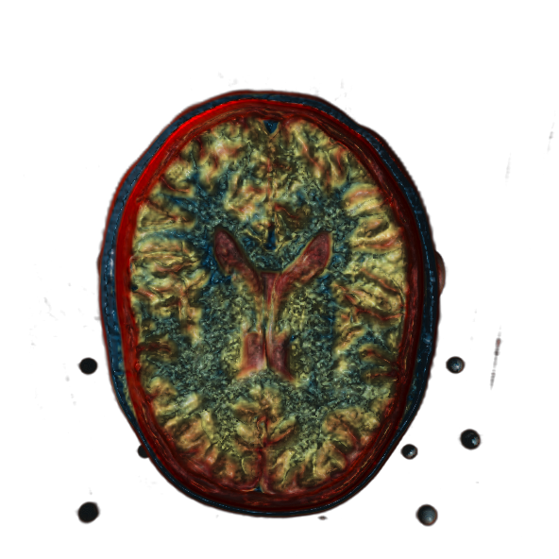
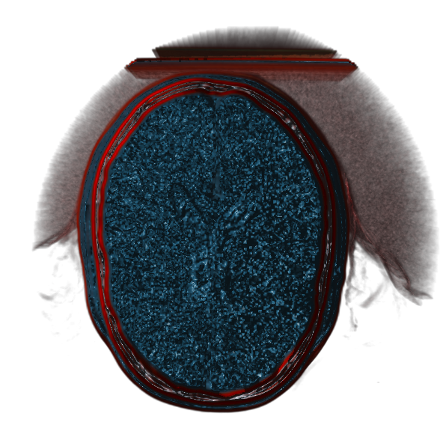
Data
Soft Tissues
MRI CT

Slide 12
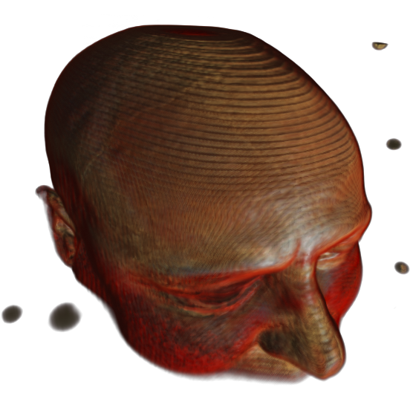
Data
MRI CT
Co-registered CT and MRI scan of
a human head

Slide 13
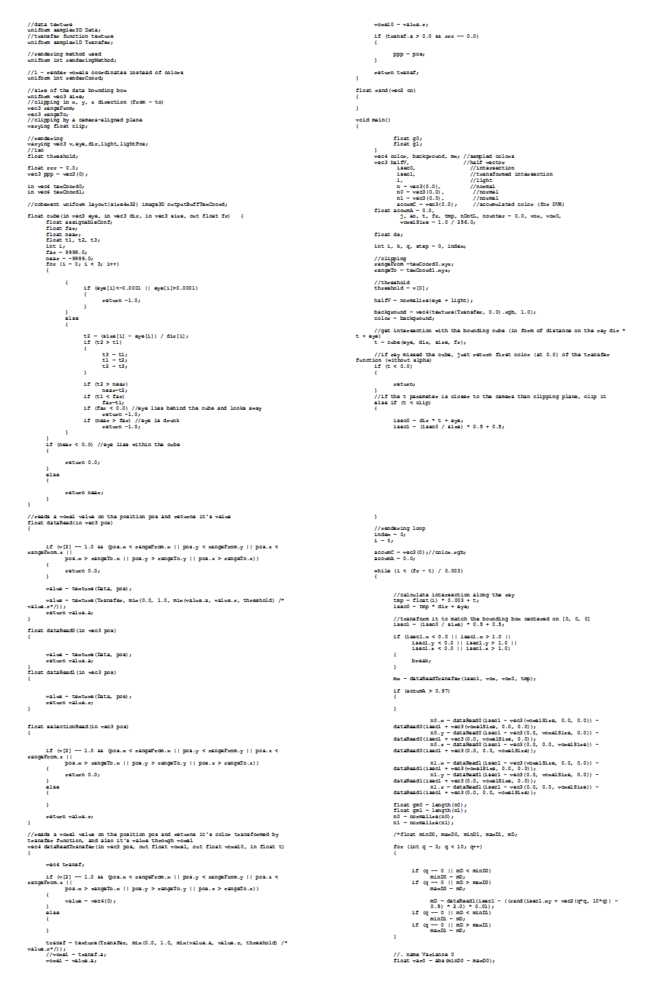
Data Attributes

Slide 14
Data Attributes
Data Attribute | Shader Variable
CT scalar value | voxCT
MRI scalar value | voxMRI
CT gradient magnitude | gmCT
MRI gradient magnitude | gmMRI
abs(voxCT – voxMRI) | voxDiff
abs(gmCT – gmMRI) | gmDiff
max(voxCT, voxMRI) | voxMax
max(gmCT, gmMRI) | gmMax

Slide 15
Goal
Identifying which data attributes can be used to differentiate the brain from other tissues.

Slide 16
Results
voxMRI

Slide 17
Results
voxMRI

Slide 18
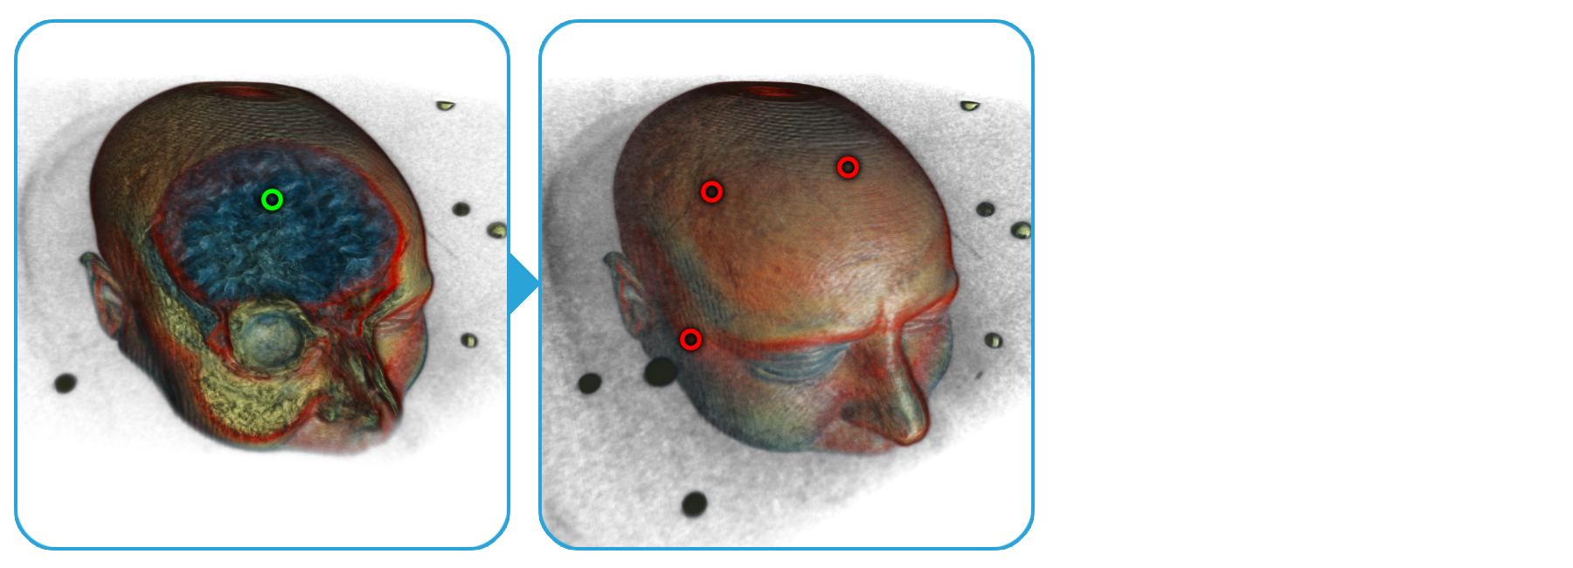
Results
voxMRI

Slide 19
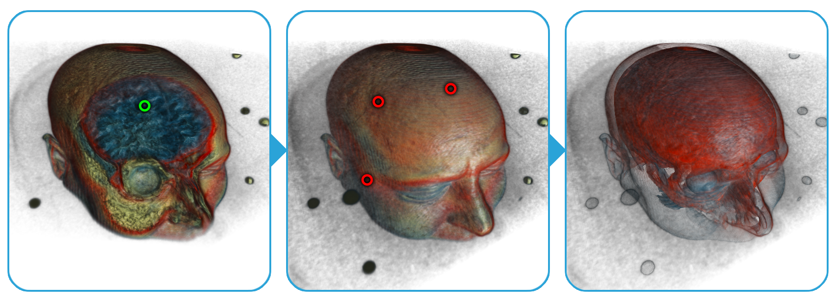
Results
voxMRI

Slide 20
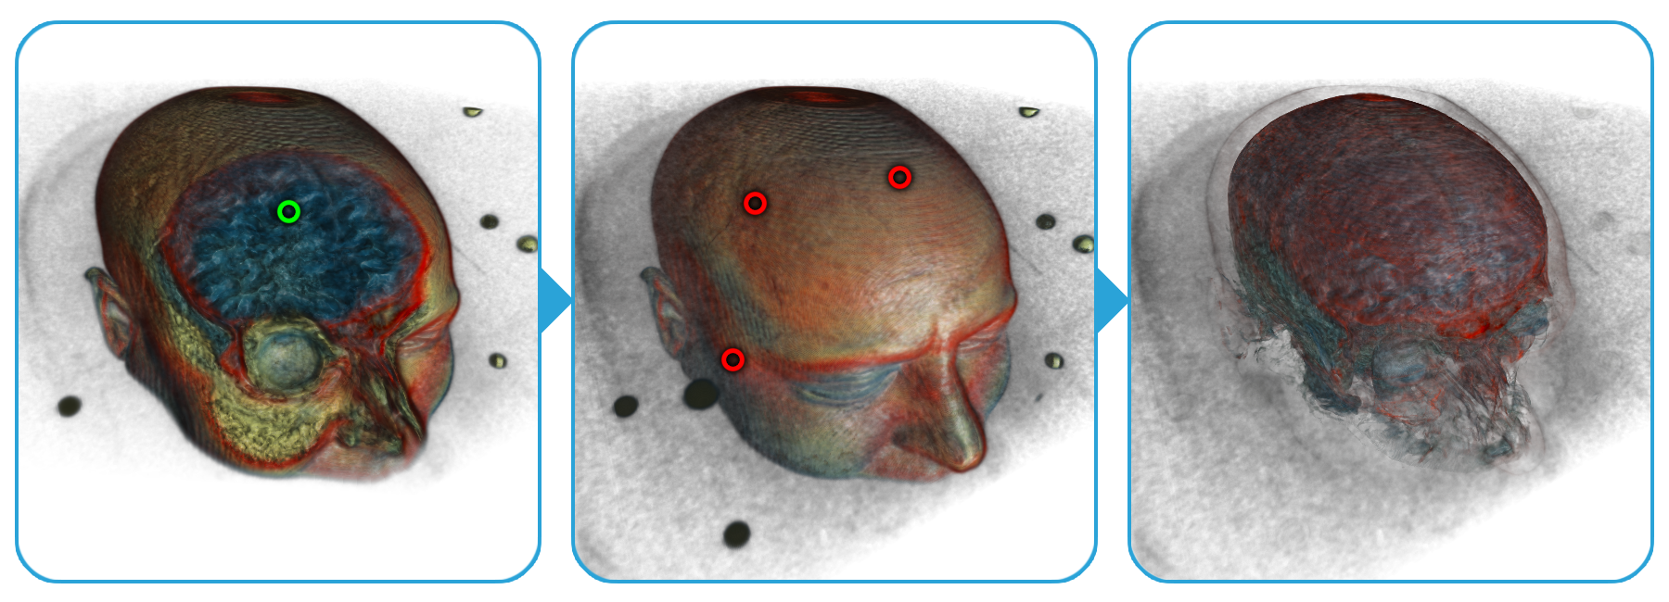
Results
voxMRI
gmMRI

Slide 21
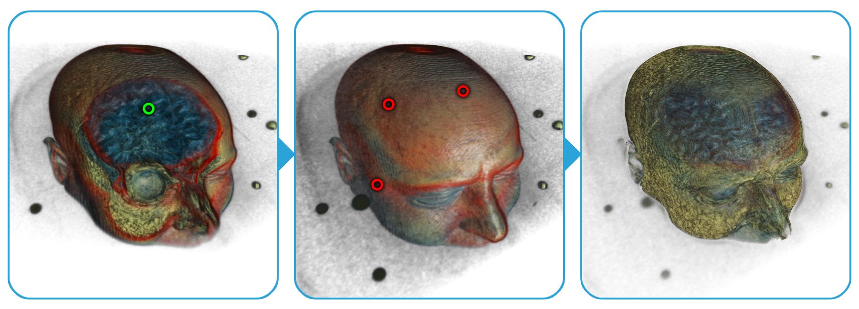
Results
voxCT voxDiff
voxMRI voxMax
gmCT gmDiff
gmMRI gmMax

Slide 22
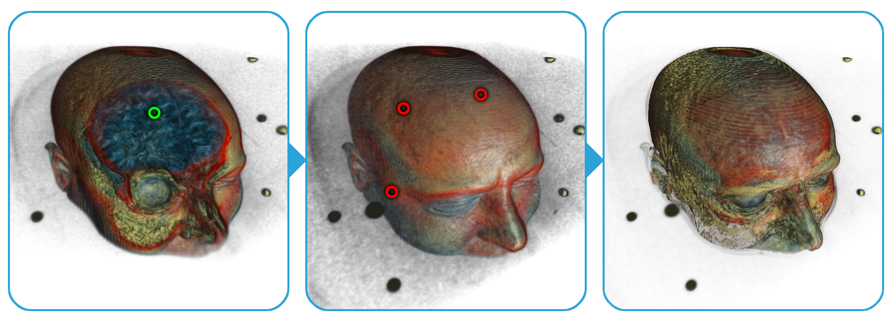
Results
voxMax
gmDiff

Slide 23
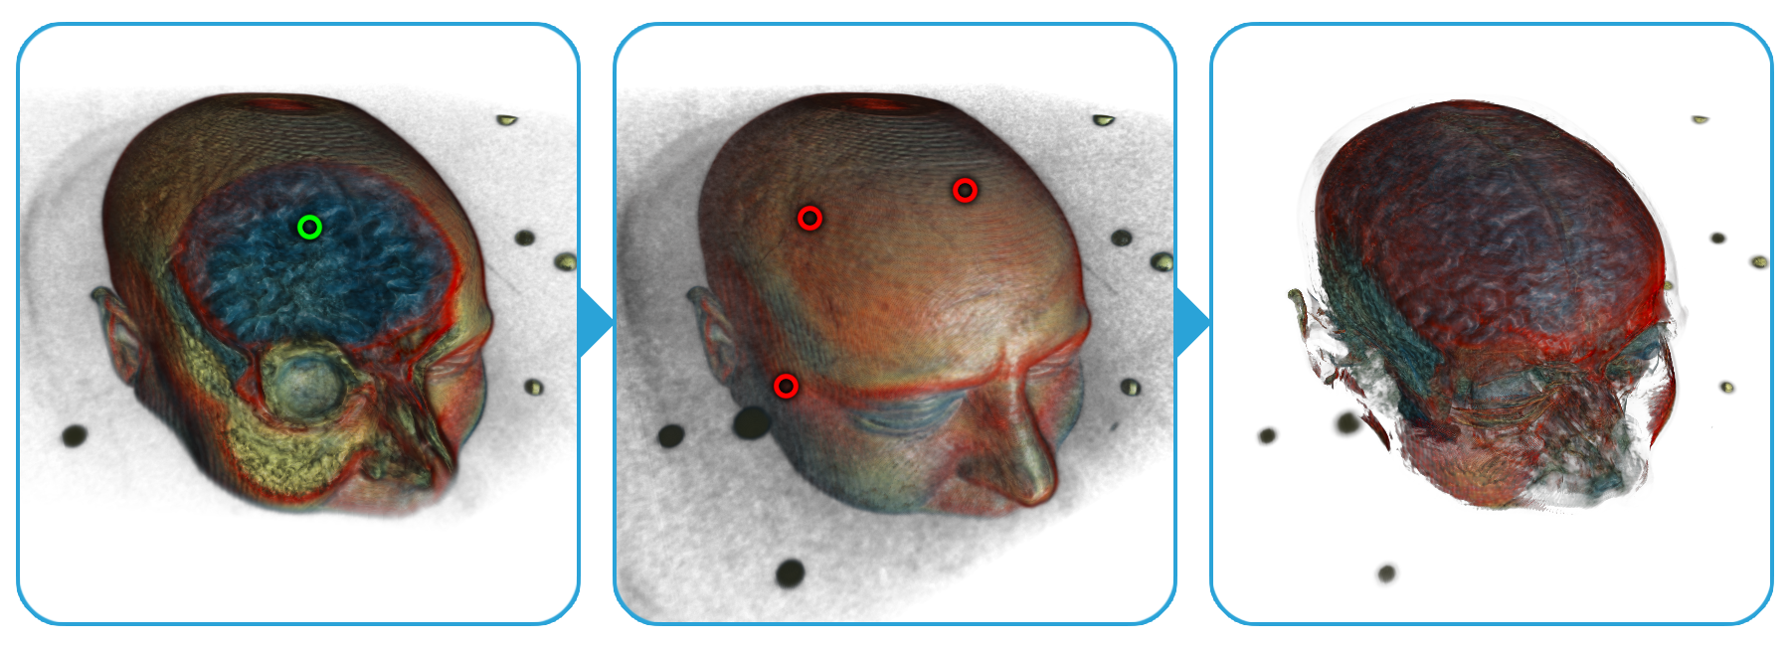
Results
voxDiff
gmMRI

Slide 24
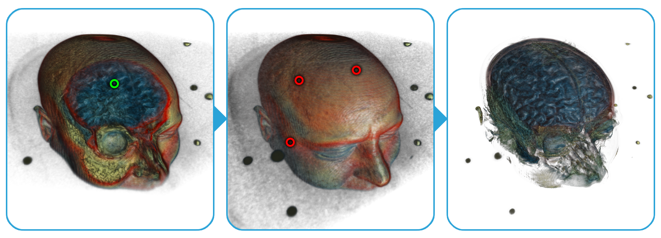
Results
voxDiff
gmMax

Slide 26
Summary
A novel method for analysis and exploration of visualization algorithms
Examining effects of shader variables on the resulting images
Real-time, calculations executed on the GPU

Slide 27
Thank you for your attention!
^{mindek@cg.tuwien.ac.at}

Slide 28
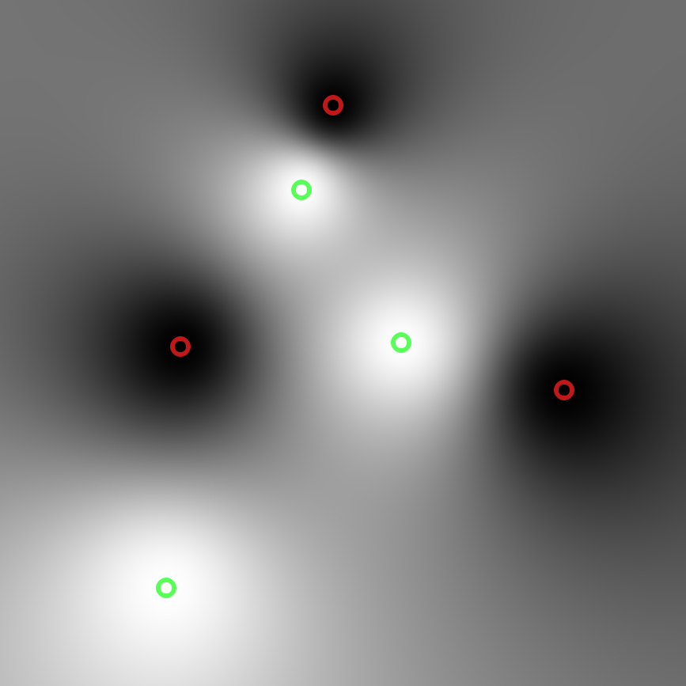
Membership Function
variable B
variable A

Slide 29
Parameter Exploration Language
//. accumulation0 WAVG
//. name Scalar Value
float vox = dataRead(p);
//. name Gradient Magnitude
float gm = length(gradient);
//. vector vox; gm; (1.0 - accumA) * vox
voxMRI *= 1.0 /*. + confidence0 */;
accumC += (1.0 - accumA) * color.rgb * vox;
accumA += (1.0 - accumA) * vox;

