Slide 1
Reflective and Refractive Objects for Mixed Reality
PA-203
Martin Knecht¹, Christoph Traxler²,
Christoph Winklhofer¹ and Michael Wimmer¹
¹ Institute of Computer Graphics and Algorithms
Vienna University of Technology
² VRVis - Zentrum für Virtual Reality und Visualisierung Forschungs-GmbH

Slide 2
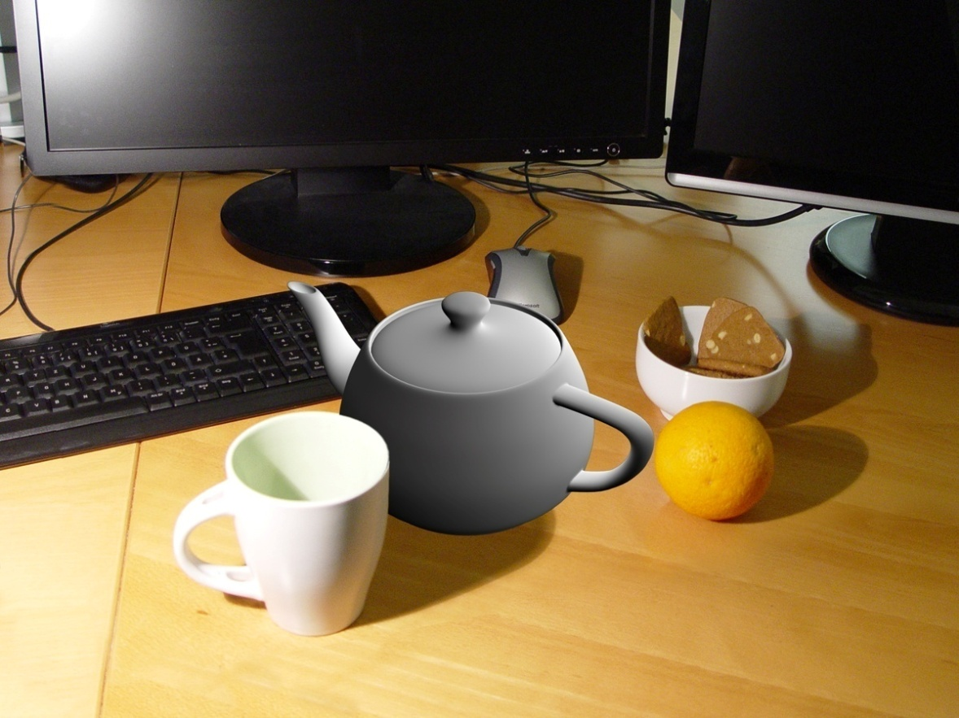
Motivation
Visually plausible mixed reality important for:
  Virtual prototyping
  Product presentations
  …

Slide 3
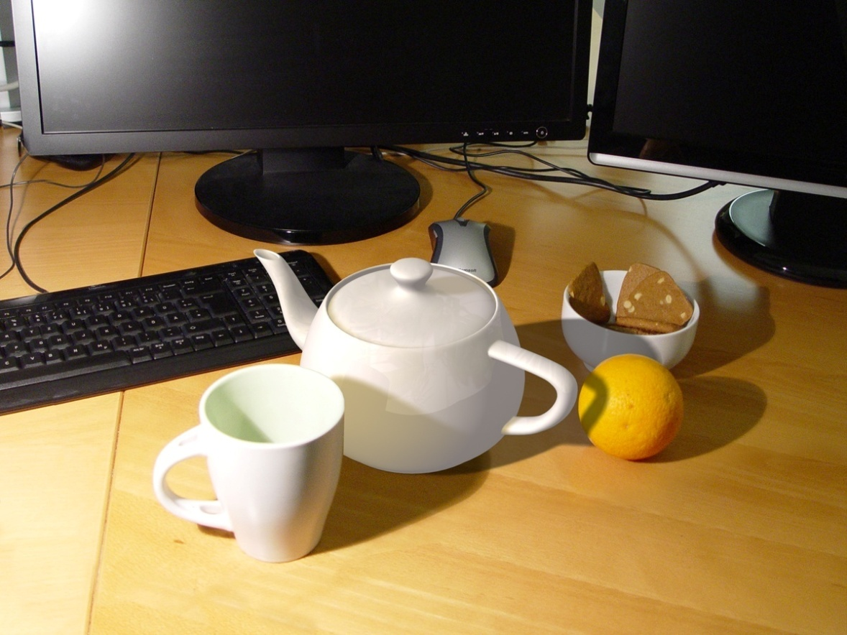
Motivation
Visually plausible mixed reality important for:
  Virtual prototyping
  Product presentations
  …

Slide 4
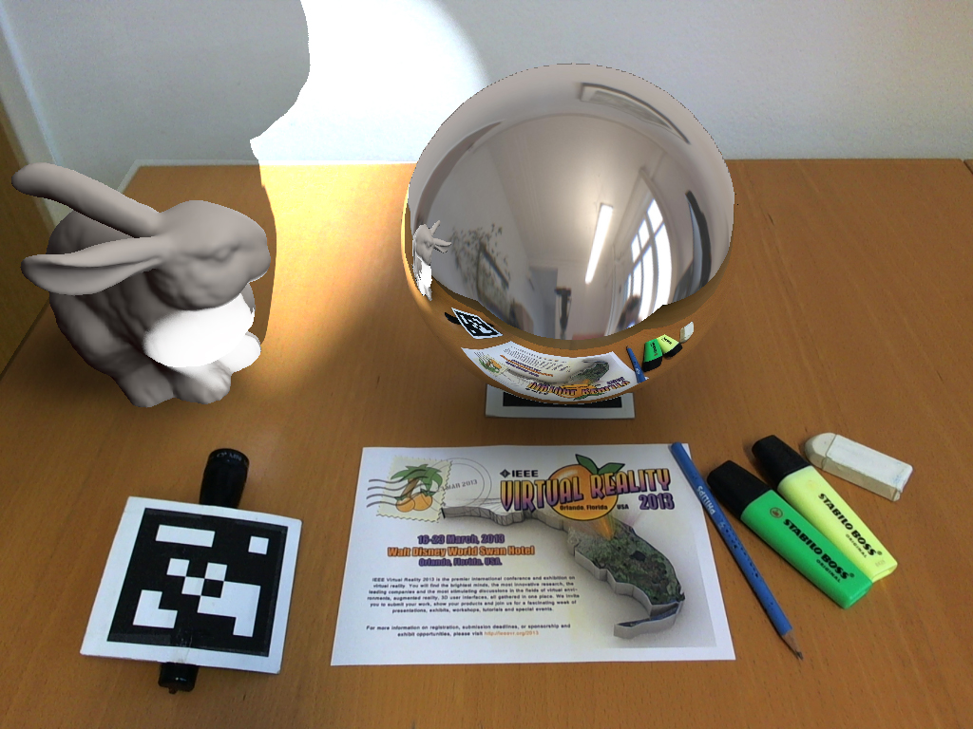
Motivation
Visually plausible mixed reality…
  …means lots of reflective or refractive objects
  ➔ We need to take them into account!

Slide 5
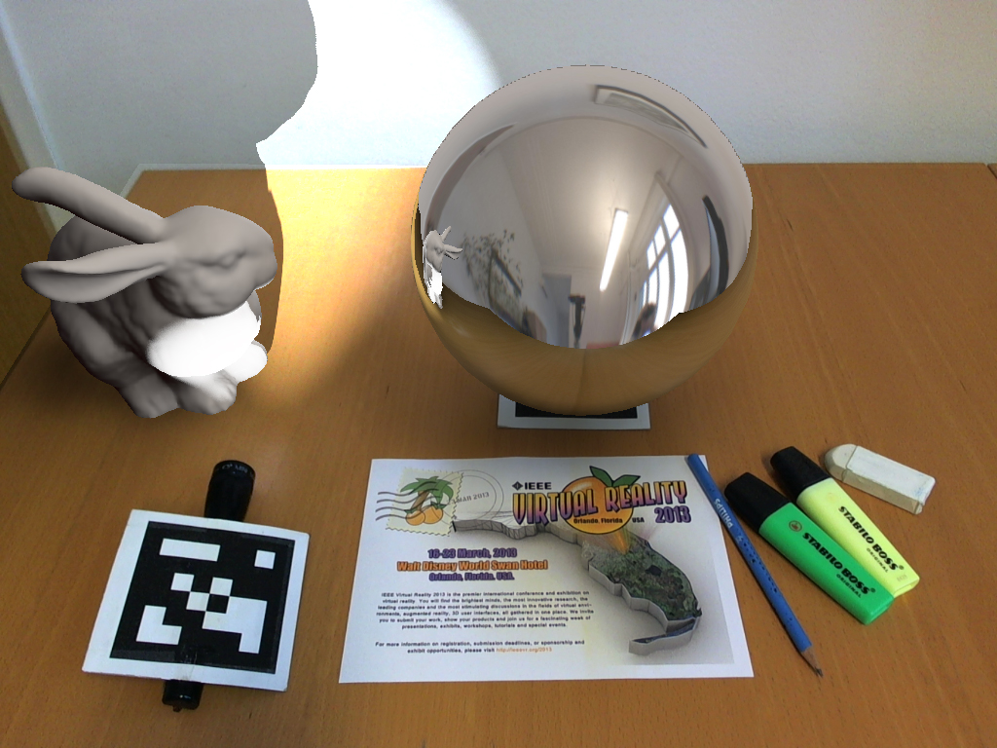
Motivation
Visually plausible mixed reality…
  …means lots of reflective or refractive objects
  ➔ We need to take them into account!

Slide 6
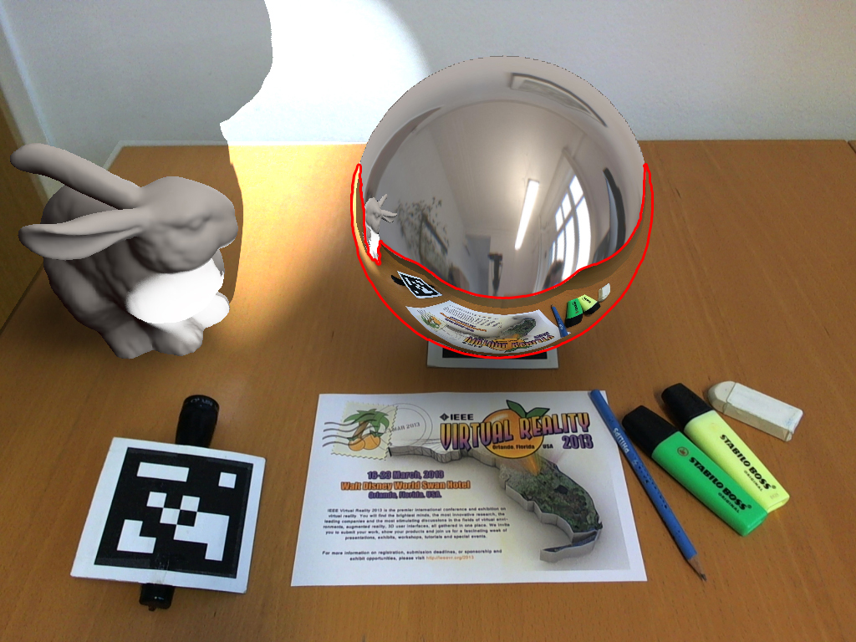
Motivation
Visually plausible mixed reality…
  …means lots of reflective or refractive objects
  ➔ We need to take them into account!

Slide 7
Related Work
Differential Rendering by Debevec, 1998
Differential Photon Mapping by Grosch, 2005
Differential Instant Radiosity (DIR) from 2010
Real-time methods for reflections, refractions and caustics:
  Reflections based on Popescu et al., 2006
  Refractions similar to Wyman, 2005
  Caustics by Wyman and Davis, 2006

Slide 8
Differential Rendering
Method to add virtual objects into real scene images
Compute two global illumination solutions and add only difference to real scene image
+ Minimizes visual error from wrong BRDF approximations
- DR does not support reflective or refractive objects very well

Slide 9
Differential Rendering
Differential Rendering consists of two main parts
  In the first two Global Illumination (GI) buffers are computed and their difference is calculated
  In the second a masked video image and the differential buffer are added together

Slide 10
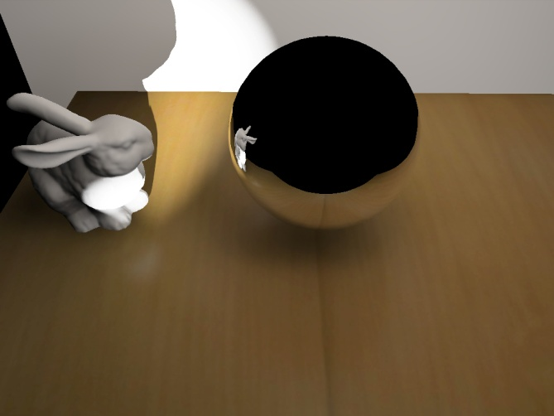
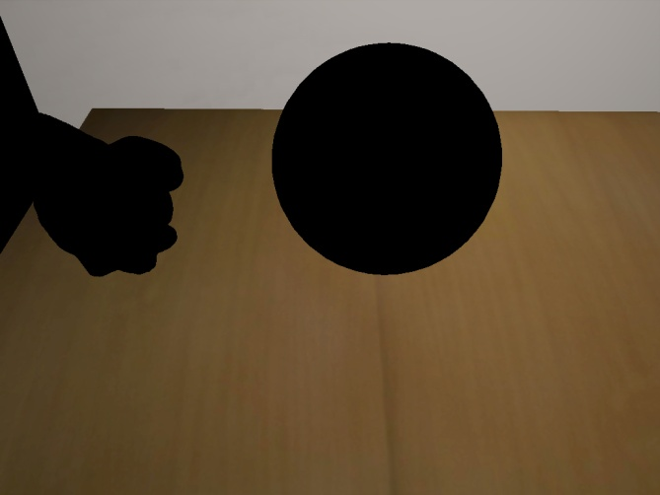
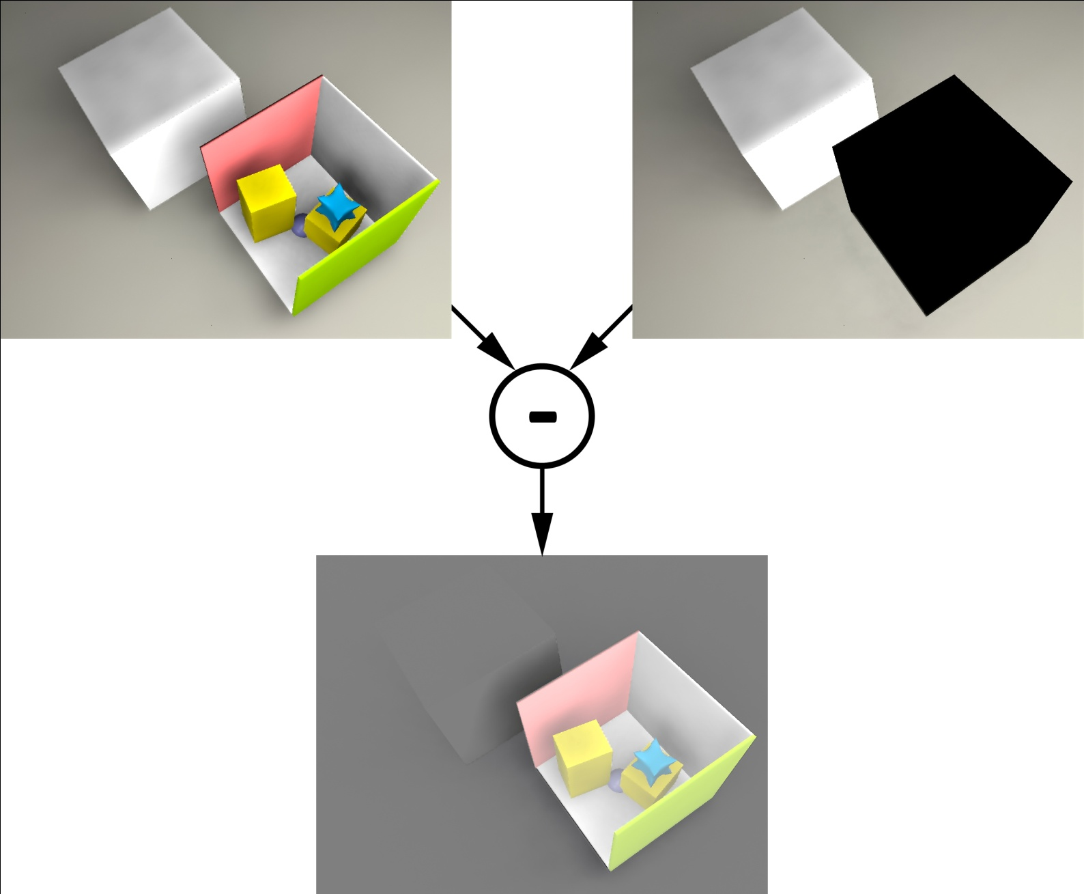
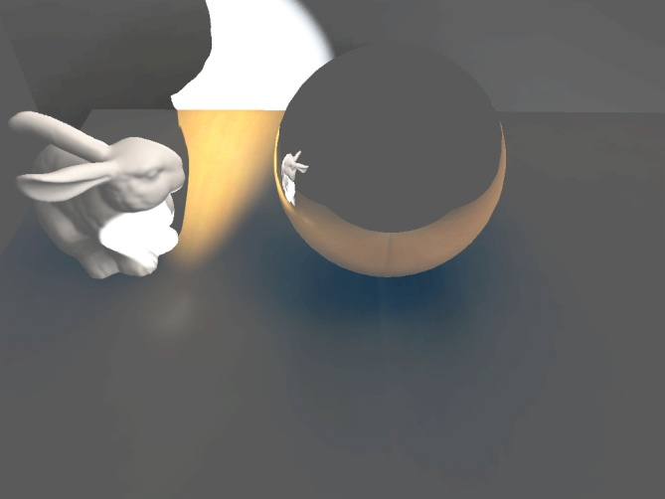
1st stage: Difference Buffer Computation
R
R
V
V
V
R
V
R
GI(Real + Virtual) GI(Real)
R
V
V
R
Difference Buffer
Grey means no difference

Slide 11
1st stage: Difference Buffer Computation
R
R
V
V
V
R
V
R
GI(Real + Virtual) GI(Real)
R
V
V
R
Difference Buffer
Grey means no difference

Slide 12
1st stage: Difference Buffer Computation
R
R
V
V
V
R
V
R
GI(Real + Virtual) GI(Real)
R
V
V
R
Difference Buffer
Grey means no difference

Slide 13
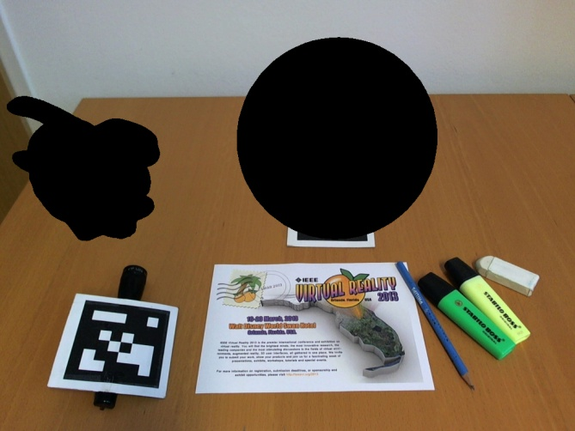
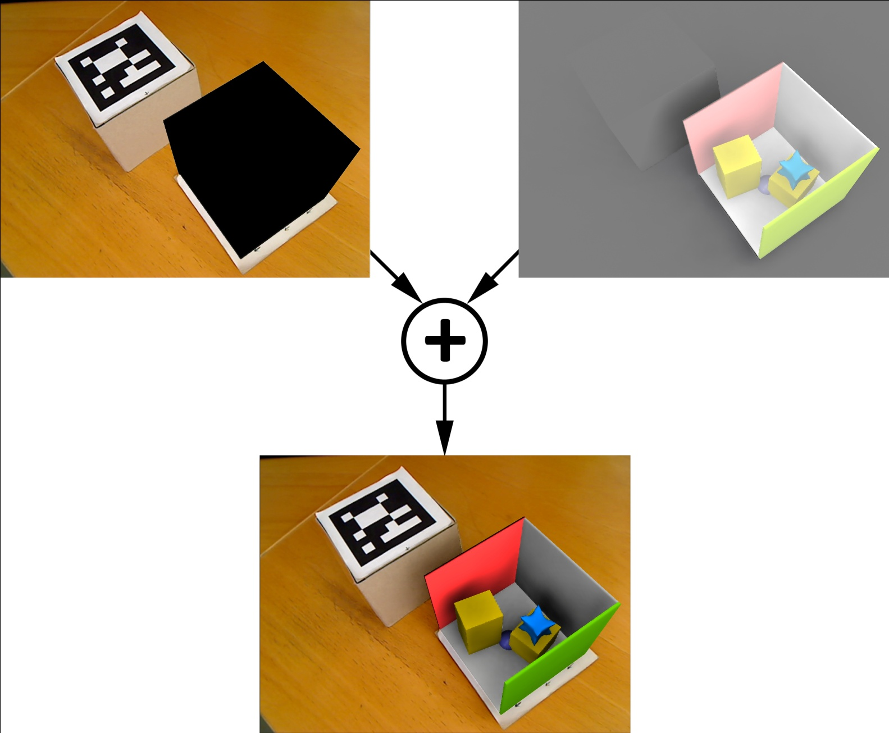
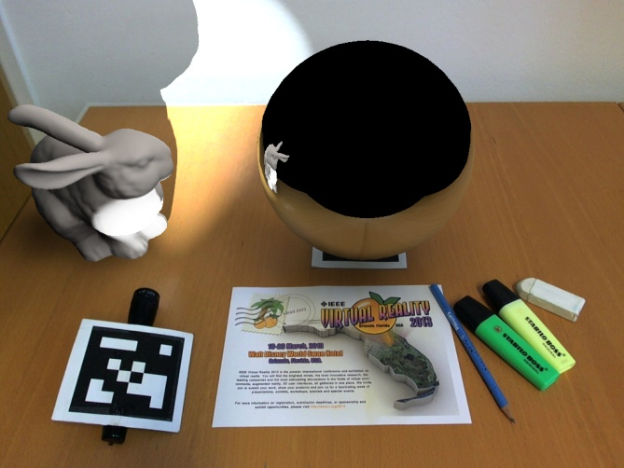
2nd stage: Compositing
R
R
V
V
V
R
V
R
V
Masked Video Image Difference Buffer
R
V
V
R
V
Final Image

Slide 14
2nd stage: Compositing
R
R
V
V
V
R
V
R
V
Masked Video Image Difference Buffer
R
V
V
R
V
Final Image

Slide 15
2nd stage: Compositing
R
R
V
V
V
R
V
R
V
Masked Video Image Difference Buffer
R
V
V
R
V
Final Image

Slide 16
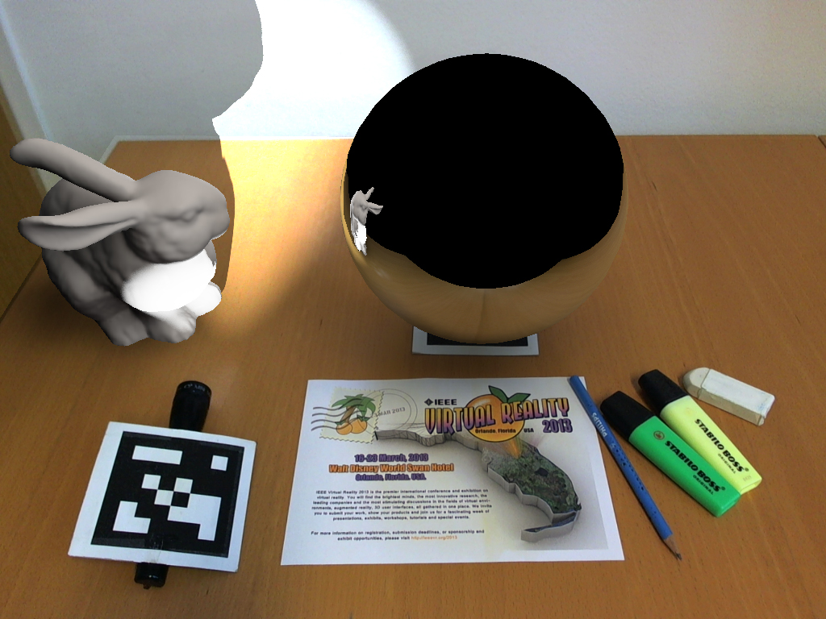
2nd stage: Compositing
R
V
V
R
V
Final Image

Slide 17

2nd stage: Compositing
R
V
V
R
V
Final Image

Slide 18
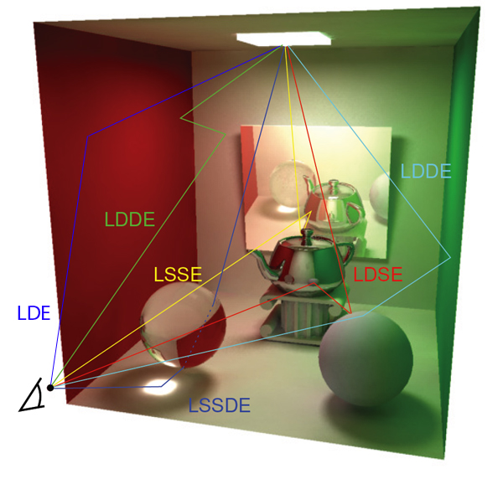
Differential Instant Radiosity
Courtesy of Paul Guerrero
How to get GI(Real+Virtual) and GI(Real)?
  Keep track of the light paths
Heckberts classification
L: Lightsource
D: Diffuse light bounce
S: Specular light bounce
E: Eye

Slide 19
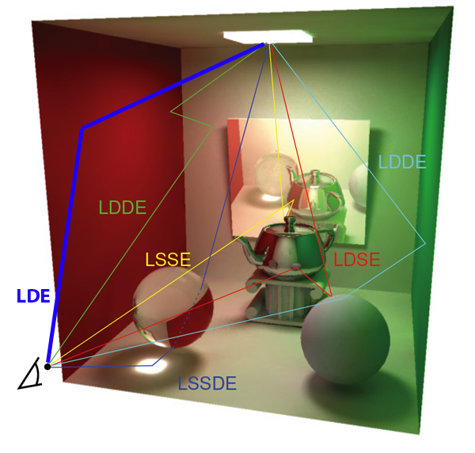
Differential Instant Radiosity
Courtesy of Paul Guerrero
How to get GI(Real+Virtual) and GI(Real)?
  Keep track of the light paths
Heckberts classification
L: Lightsource
D: Diffuse light bounce
S: Specular light bounce
E: Eye
Direct illumination: LDE

Slide 20

Differential Instant Radiosity
Courtesy of Paul Guerrero
How to get GI(Real+Virtual) and GI(Real)?
  Keep track of the light paths
Heckberts classification
L: Lightsource
D: Diffuse light bounce
S: Specular light bounce
E: Eye
Caustic: LSSDE

Slide 21
Differential Instant Radiosity for MR
Decide on path information to which GI solution the result belongs
L_{[x]}D_{[x]}E
L_{[x]}D_{[x]}D_{[x]}E
[x] can be „real“ or „virtual“
All „real“ then add to GI(Real+Virtual) and GI(Real)
One [x] „virtual“, only add to GI(Real+Virtual)

Slide 22

Differential Instant Radiosity
L_{V}D_{V}D_{R}E path
R
V
V
R
V
GI(Real + Virtual) GI(Real)

Slide 23
Differential Instant Radiosity
L_{V}D_{V}D_{R}E path
Contains virtual
object!
R
V
V
R
V
GI(Real + Virtual) GI(Real)

Slide 24

Differential Instant Radiosity
R
L_{R}D_{R}E path
R
V
V
R
V
GI(Real + Virtual) GI(Real)

Slide 25
Differential Instant Radiosity
R
L_{R}D_{R}E path
Virtual object
blocks path!
R
V
V
R
V
GI(Real + Virtual) GI(Real)

Slide 26
Differential Instant Radiosity
R
V
V
R
V
Final Image

Slide 27
Problem Statement
- No differential effects applied for reflections or refractions
➔ GI(real) only contains data of pixel belonging to real objects
Idea
  Add real reflected or refracted objects also to GI(real) buffer
  Back-project camera image if possible (Grosch, 2005)

Slide 28

1st stage: Difference Buffer Computation
Shall contribution of p_{refl} be added to GI(real)?

Slide 29
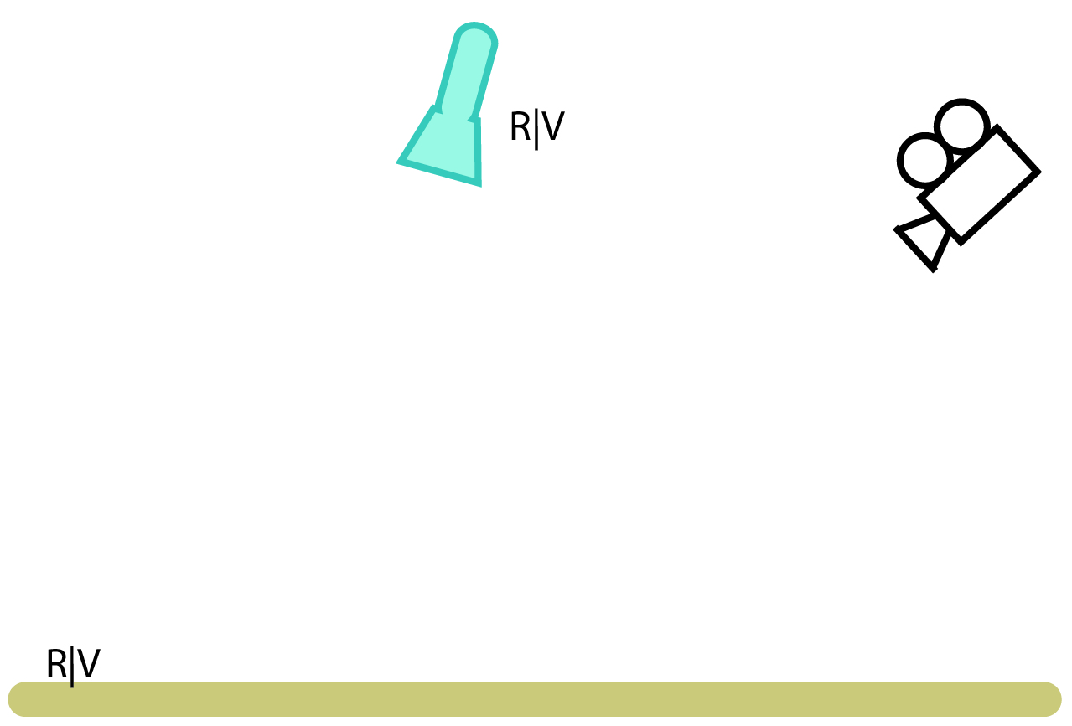
1st stage: Difference Buffer Computation
Shall contribution of p_{refl} be added to GI(real)?

Slide 30
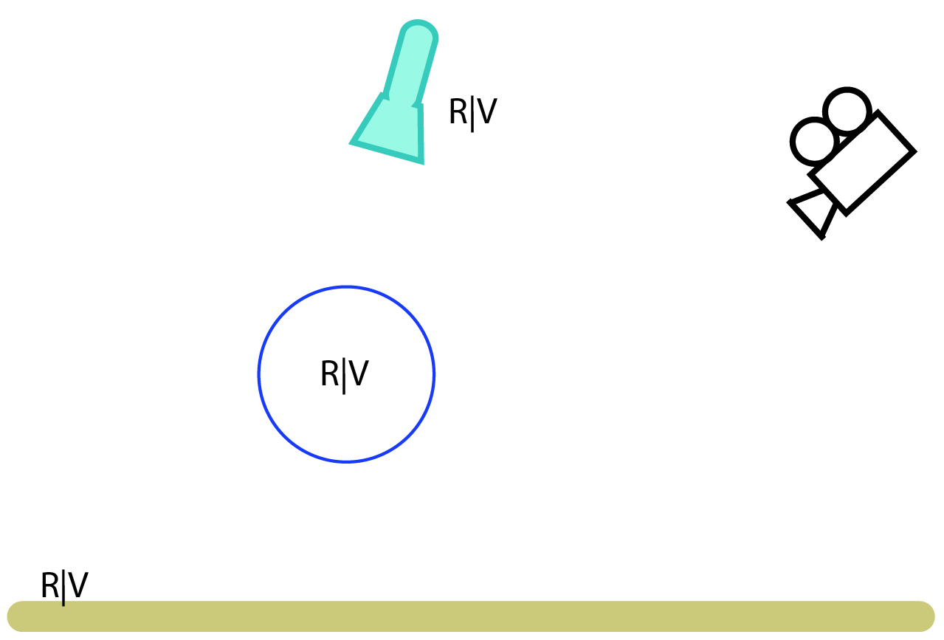
1st stage: Difference Buffer Computation
Shall contribution of p_{refl} be added to GI(real)?

Slide 31
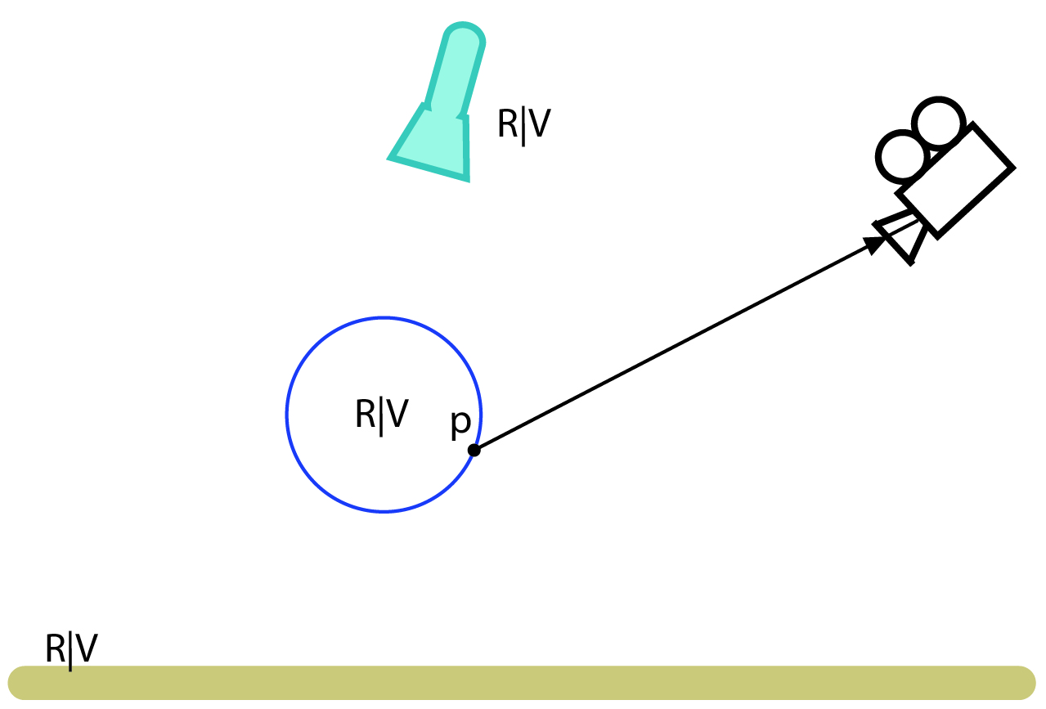
1st stage: Difference Buffer Computation
Shall contribution of p_{refl} be added to GI(real)?
Light: S_{[x]}E

Slide 32
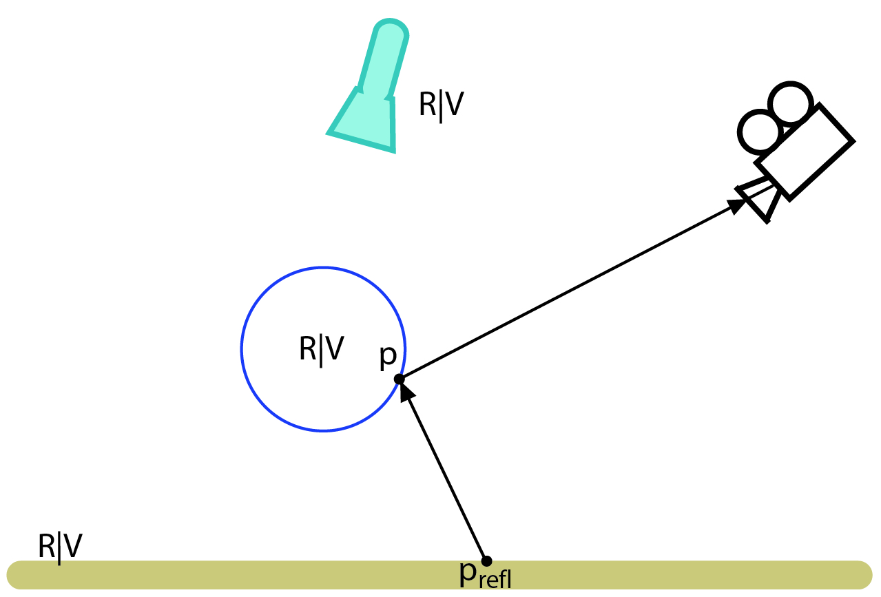
1st stage: Difference Buffer Computation
Shall contribution of p_{refl} be added to GI(real)?
Light: D_{[x]}S_{[x]}E

Slide 33
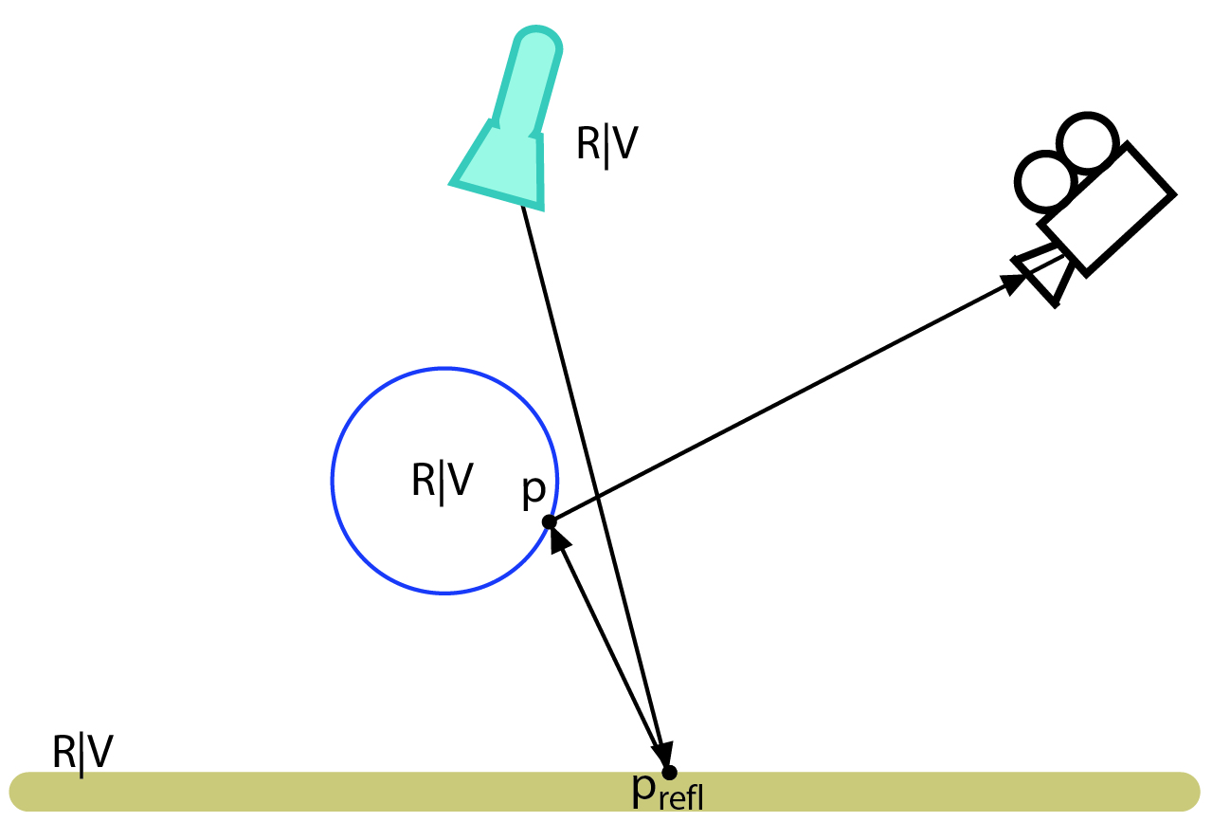
1st stage: Difference Buffer Computation
Shall contribution of p_{refl} be added to GI(real)?
Light: L_{[x]}D_{[x]}S_{[x]}E

Slide 34
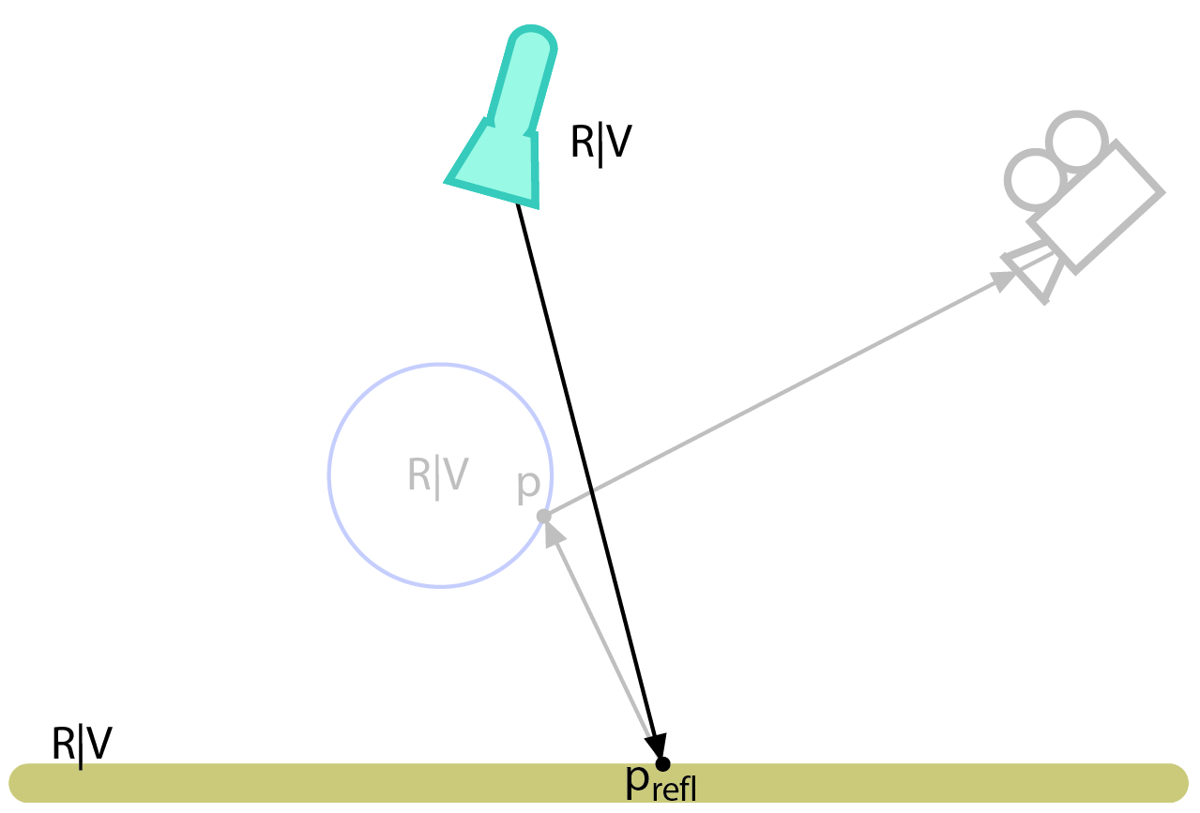
1st stage: Difference Buffer Computation
Shall contribution of p_{refl} be added to GI(real)?
Light: L_{[x]}D_{[x]}

Slide 35
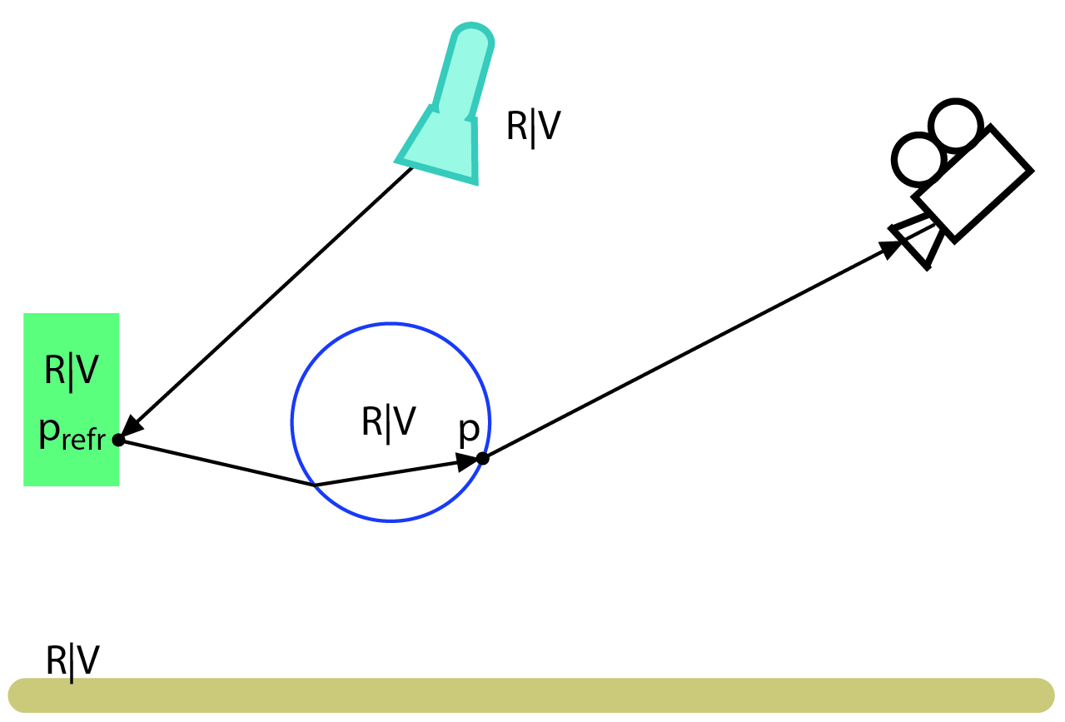
1st stage: Difference Buffer Computation
Everything applies also for refracted rays…
Light: L_{[x]}D_{[x]}S_{[x]}S_{[x]}E

Slide 36


Comparison
Differential Instant Radiosity
R
R
V
V
R
R
V
V
GI(Real + Virtual) GI(Real)

Slide 37
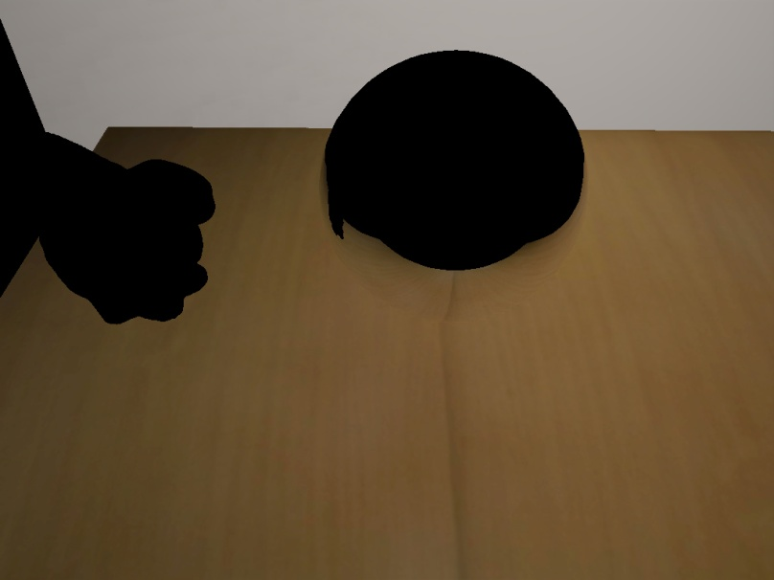
Comparison
New method
R
R
V
V
R
R
V
V
GI(Real + Virtual) GI(Real)

Slide 38
1st stage: Difference Buffer Computation
R
R
V
V
V
R
V
R
GI(Real + Virtual) GI(Real)
R
V
V
R
Difference Buffer
Grey means no difference

Slide 39

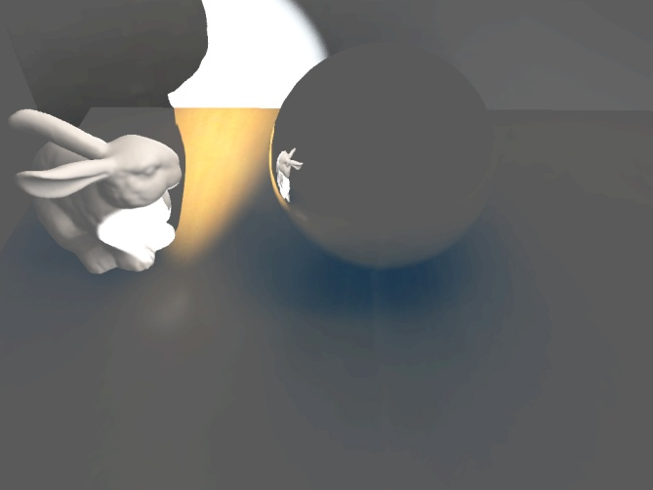
1st stage: Difference Buffer Computation
R
R
V
V
V
R
V
R
GI(Real + Virtual) GI(Real)
R
V
V
R
Difference Buffer
Grey means no difference

Slide 40
2nd stage: Compositing
+ Differential effects also available for reflections or refractions
- We need to obtain color values from the camera image of the reflected or refracted real objects

Slide 41

Back-projection
R
V
V
P
R
V

Slide 42
Back-projection
R
V
V
P
R
V
P_{refl}

Slide 43
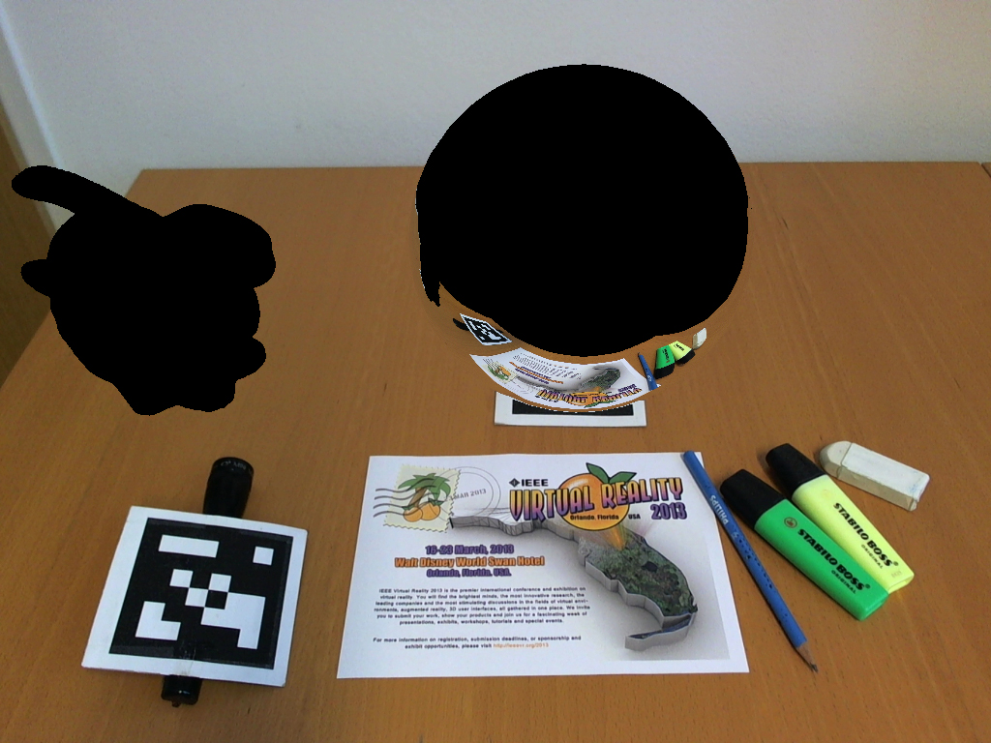
Back-projection
R
V
V
P
R
V
P_{refl}

Slide 44
Back-projection
R
V
V
R
V

Slide 45

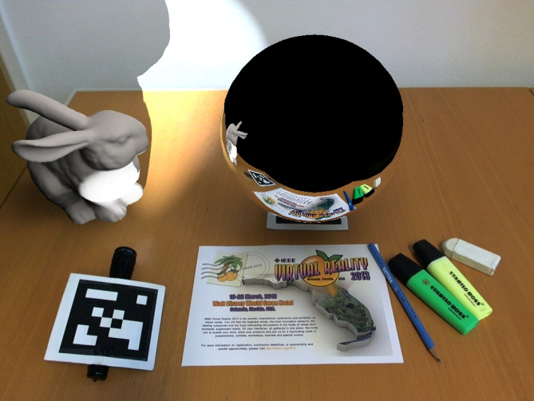
2nd stage: Compositing
R
R
V
V
V
R
V
R
Masked Video Image Difference Buffer
+ Back-projection
R
V
V
R
Final Image

Slide 46
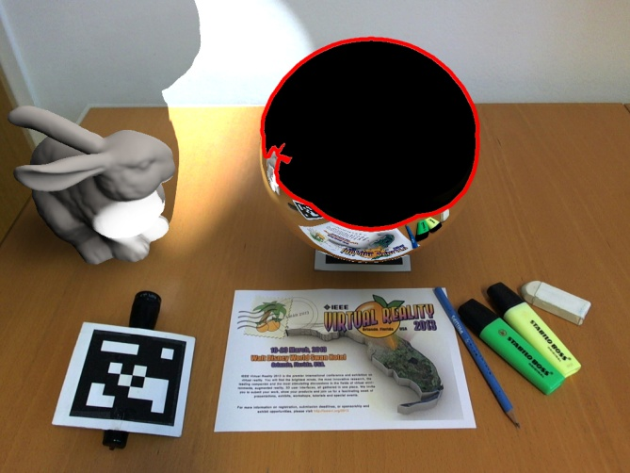
2nd stage: Compositing
R
R
V
V
V
R
V
R
Masked Video Image Difference Buffer
+ Back-projection
R
V
V
R
Final Image

Slide 47
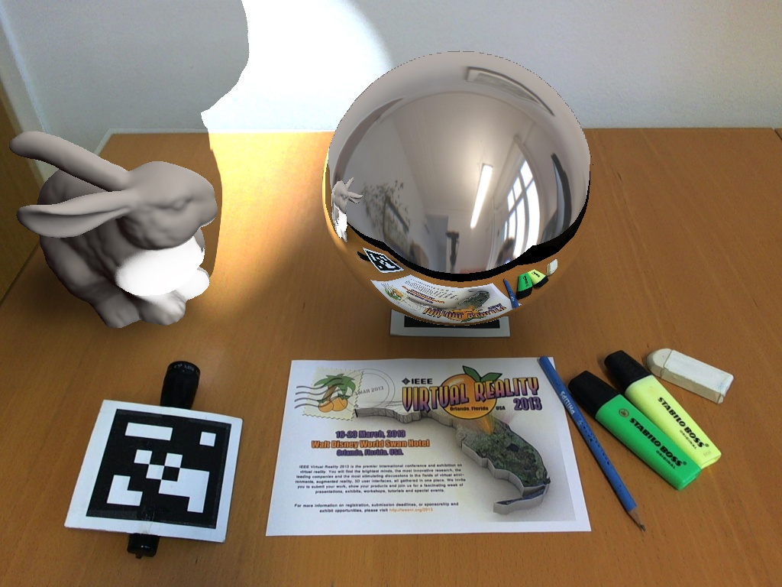
Dealing with missing data
Rays may not hit any geometry
➔ Lookup color in environment map
R
V
V
R
V

Slide 48

Dealing with missing data
Rays may not hit any geometry
➔ Lookup color in environment map
R
V
V
R
V

Slide 49

Dealing with missing data
If back-projected point is outside of camera image ➔ Use data of GI(Real+Virtual) buffer
R
V
V
R
V

Slide 50
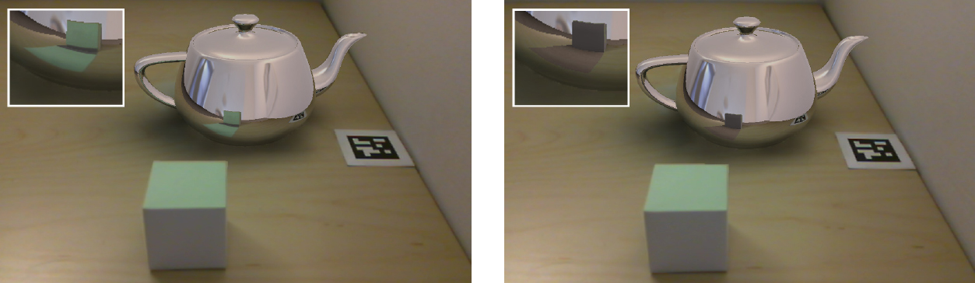
Dealing with missing data
Validation function ensures that back-projected point can be used
  Does ray hit geometry?
  Is back-projected point in video frustum?
  Depth tests, …
V
V
R
R
R
R

Slide 51
Dealing with missing data
Validation function ensures that back-projected point can be used
  Does ray hit geometry?
  Is back-projected point in video frustum?
  Depth tests, …
V
V
R
R
R
R

Slide 52
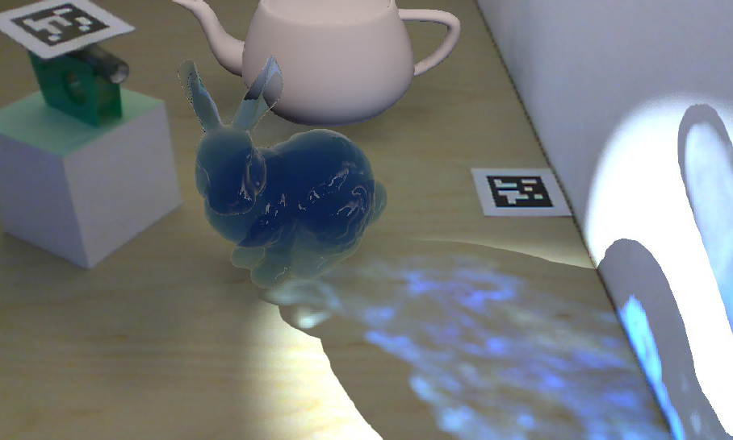
Caustics
V
V
V
R
R

Slide 53
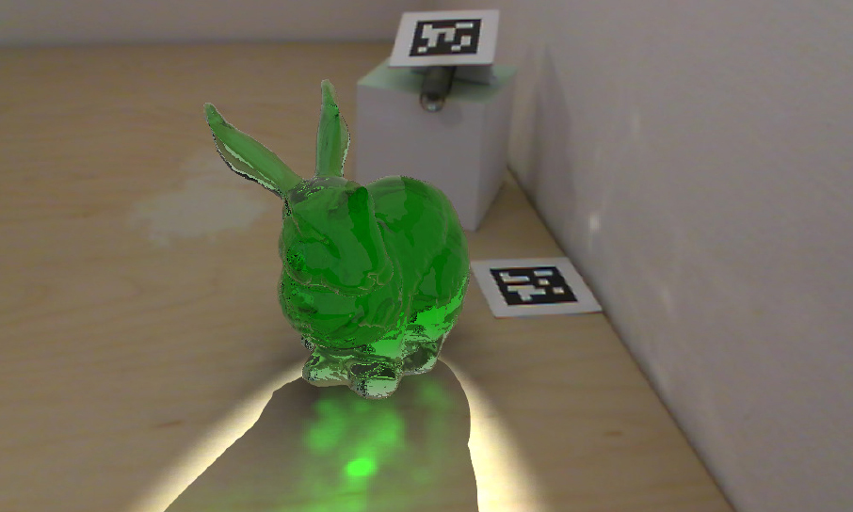
Creating Reflected and Refracted VPLs
Virtual point lights (VPLs) can be placed at hit points of reflected or refracted rays
Causes indirect color-bleeding on wall
V
R
V
R
Without VPLs

Slide 54
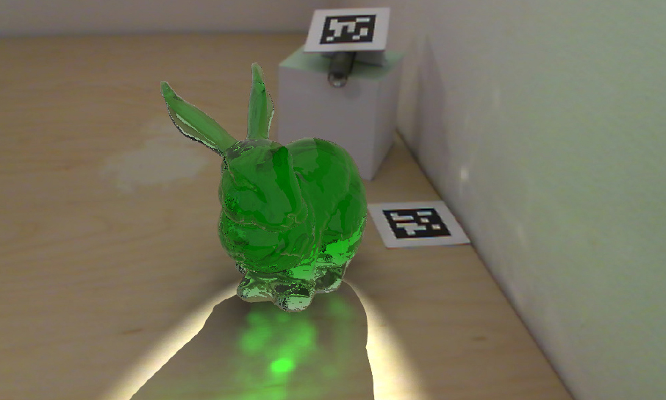
Creating Reflected and Refracted VPLs
Virtual point lights (VPLs) can be placed at hit points of reflected or refracted rays
Causes indirect color-bleeding on wall
V
R
V
R
With VPLs

Slide 55
Limitations
No support for multiple bounces
VPL creation is limited
Only spotlights are able to create caustics
Currently only single reflections and refractions

Slide 56
Limitations
Visible artifacts due to missing data
R
V
V
R
V

Slide 57
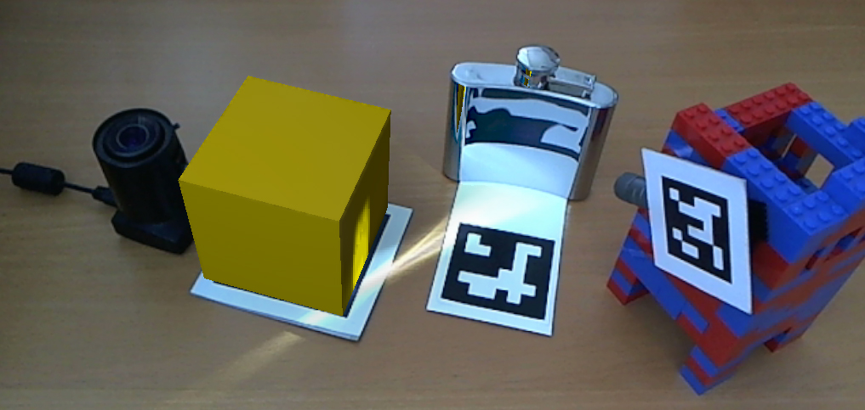
Limitations
Cancelation of real caustics might fail
R
V
R
R

Slide 58
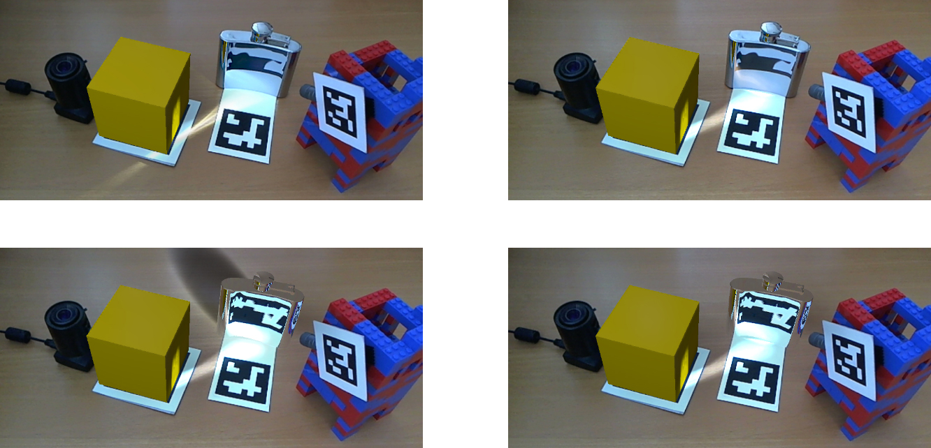
Results
Real Spotlight
Virtual Spotlight
V
R
V
R
Real
V
R
V
V
V
V
Virtual
R
V
All images rendered at 20 fps

Slide 59

Result Video

Slide 60
Conclusions
Extended differential instant radiosity to work with reflective or refractive objects
  Spotlights are able to create caustics in a mixed-reality scenario
  Caustics also cause indirect color bleeding effects
Runs at 15 – 25 frames per second

Slide 61
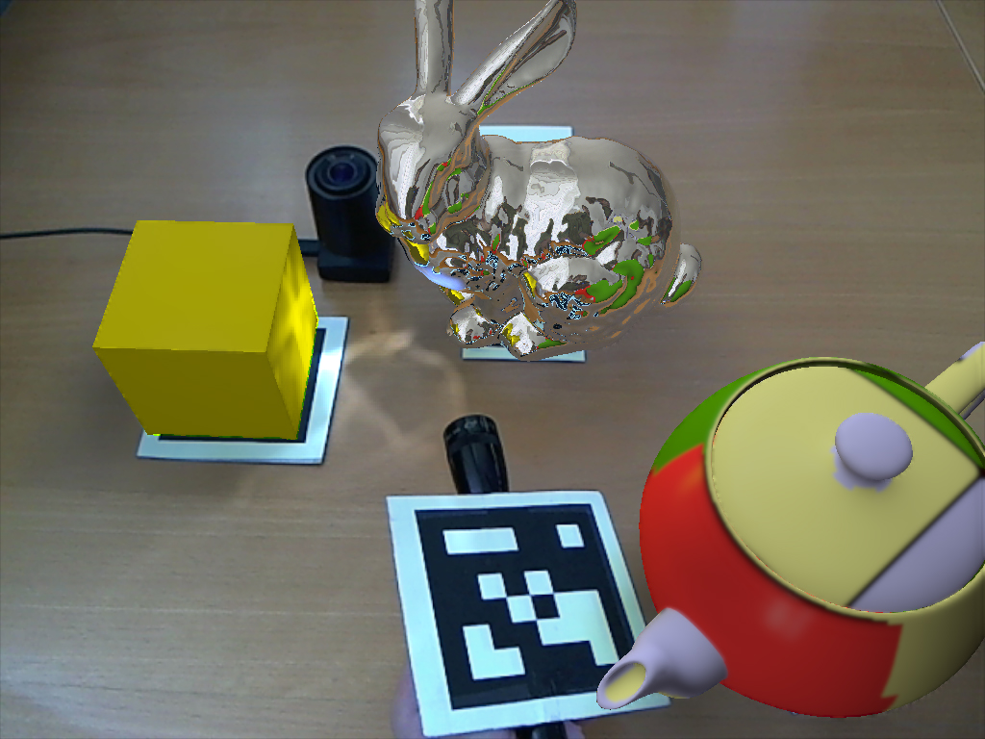
Thank you for your attention!

Slide 62
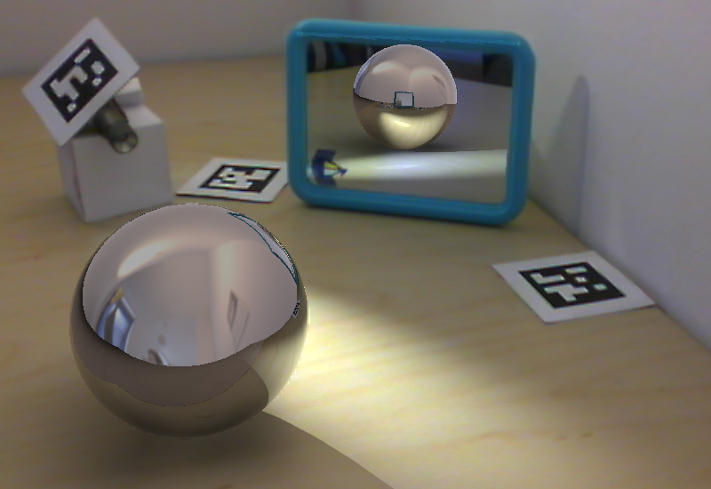
Multiple Reflections
V
R
R
V
R

