Slide 1
Freeform Shadow Boundary Editing
Oliver Mattausch¹, Takeo Igarashi², Michael Wimmer³
University of Zurich¹ The University of Tokyo² Vienna Technical University³

Slide 2
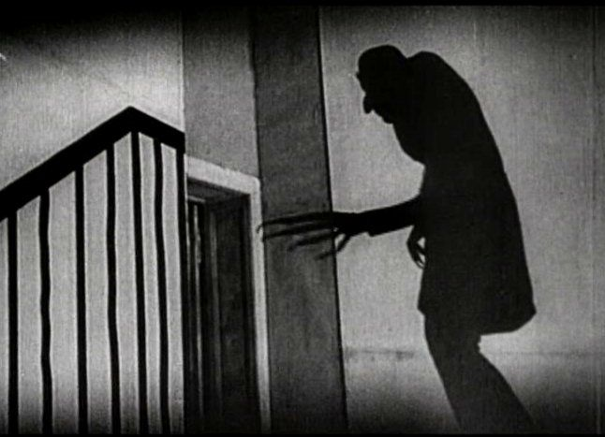
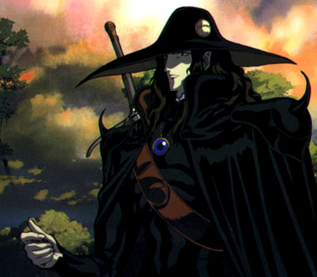
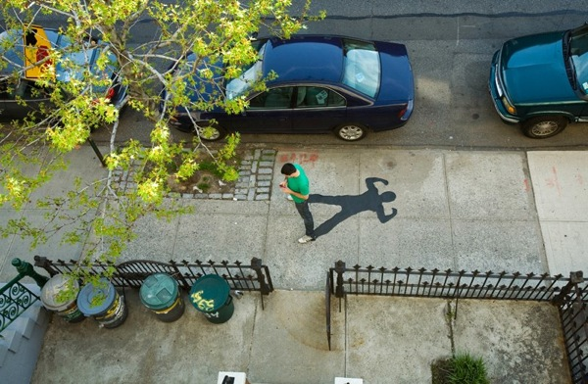
Shadows are Important Artistic Tool
Convey atmosphere
Define a character
Play with perception
Artists want control over it

Slide 3
Shadow Editing: Video Demonstration

Slide 4
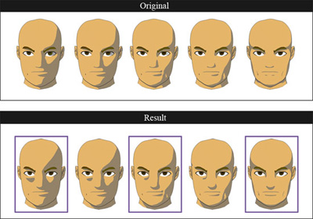
Previous Work: Inspiration
Locally Controllable Stylized Shading [Todo07]
Locally change lighting
Consistency over keyframes
Cannot handle shadows

Slide 5
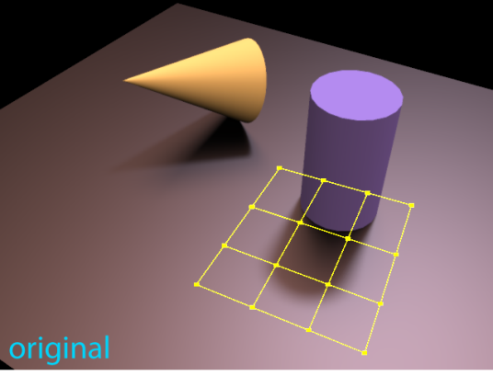
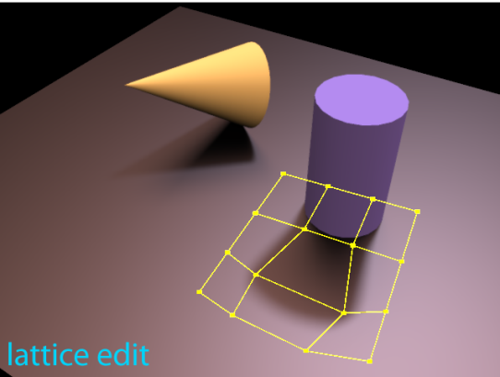
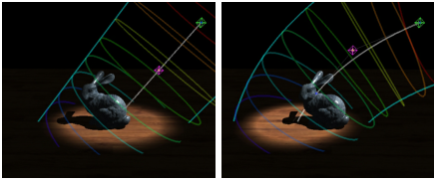
Previous Work on Shadow Editing
All-frequency shadow design [Olbert10]
Separate frequencies
Limited interactivity
BendyLight [Kerr10]
Animation
Hard to edit fine details
On-Surface Signal Deformation [Ritschel10]
Intuitive control
No object interaction

Slide 6
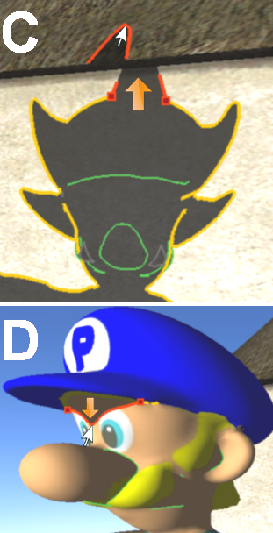
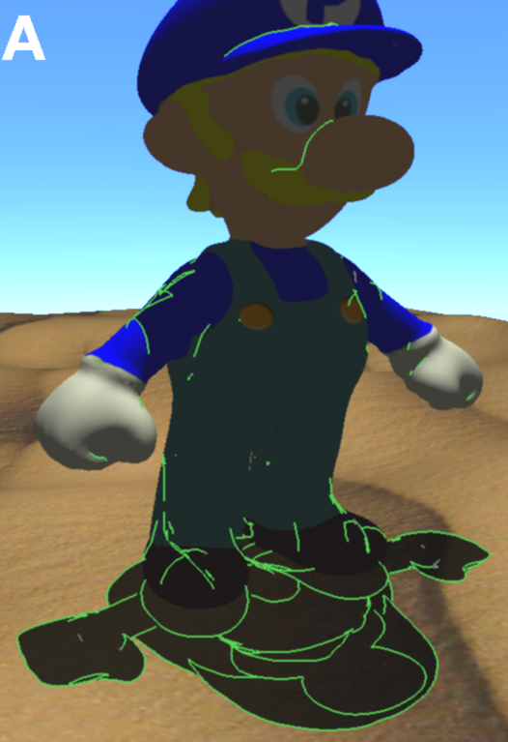
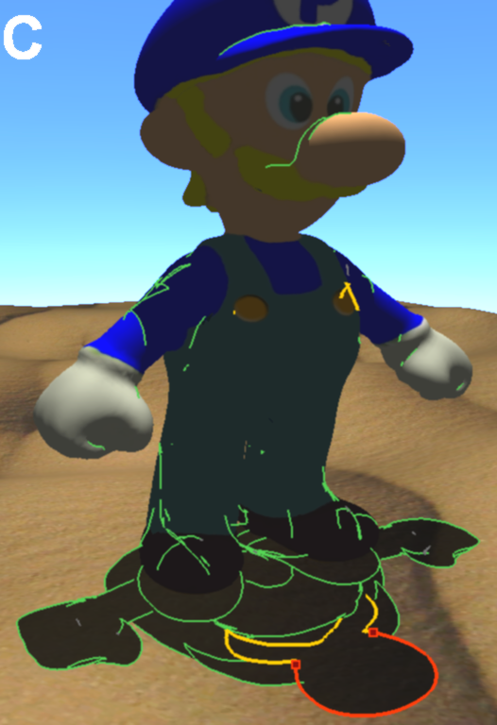
Our Method: Features
Intuitive interface for fine local edits
Edit shadow topology
Notes:
Change this slides!!

Slide 7
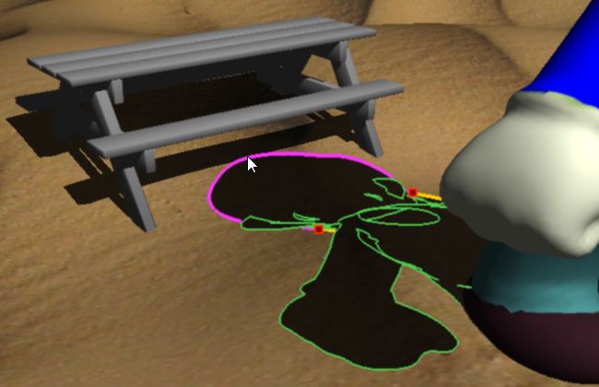
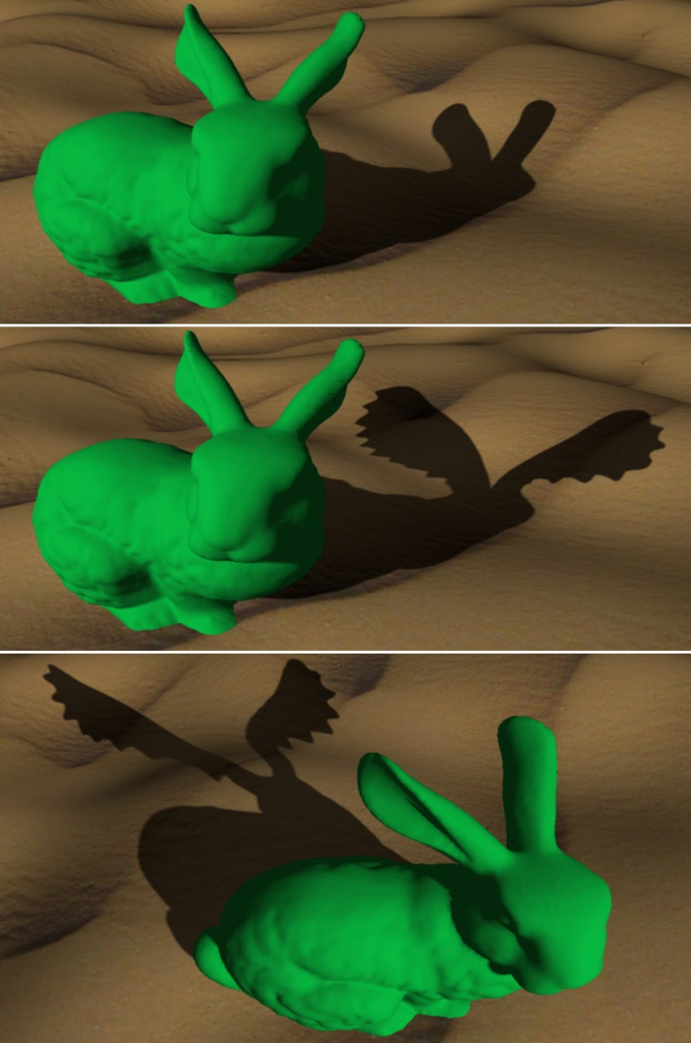
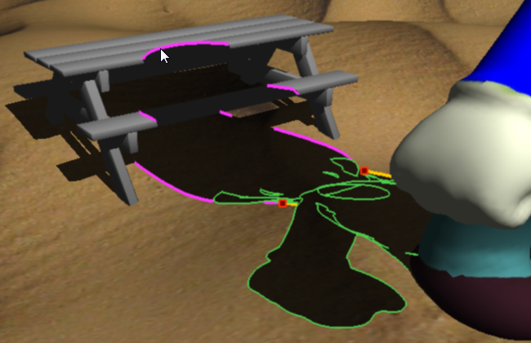
Our Method: Features
Plausible object interaction
animation, change of scene configuration

Slide 8
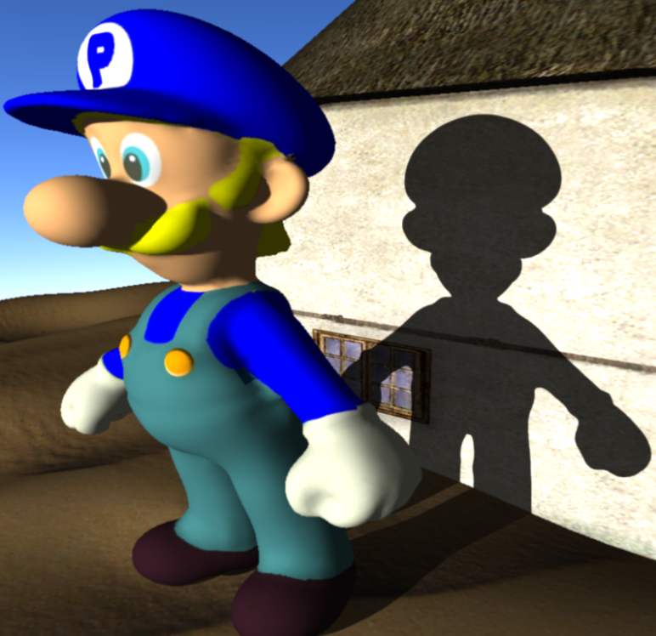
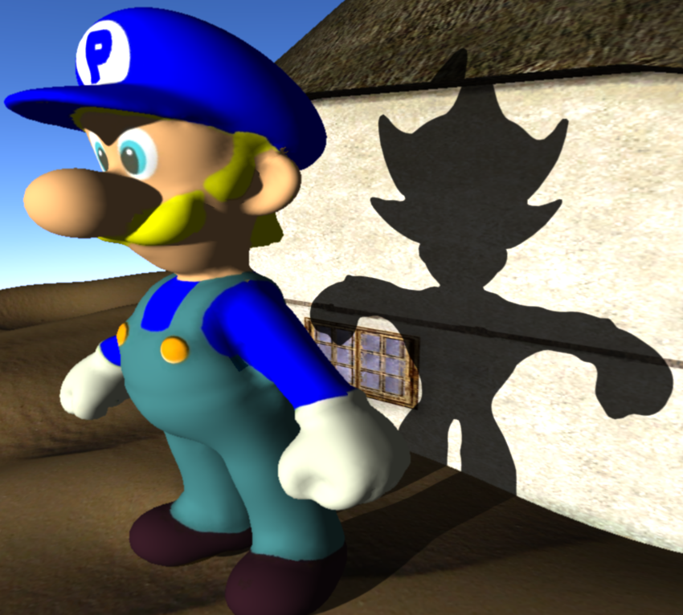
Our Method: Outline
Artistic edits of physical shadow boundary
Make shadow edits consistent over time
Render edited shadows

Slide 9
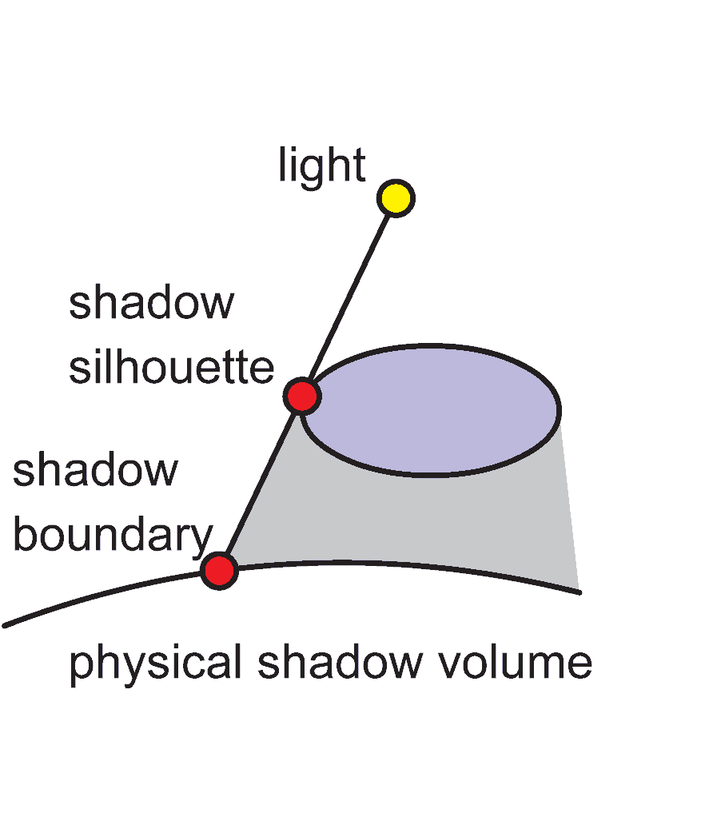
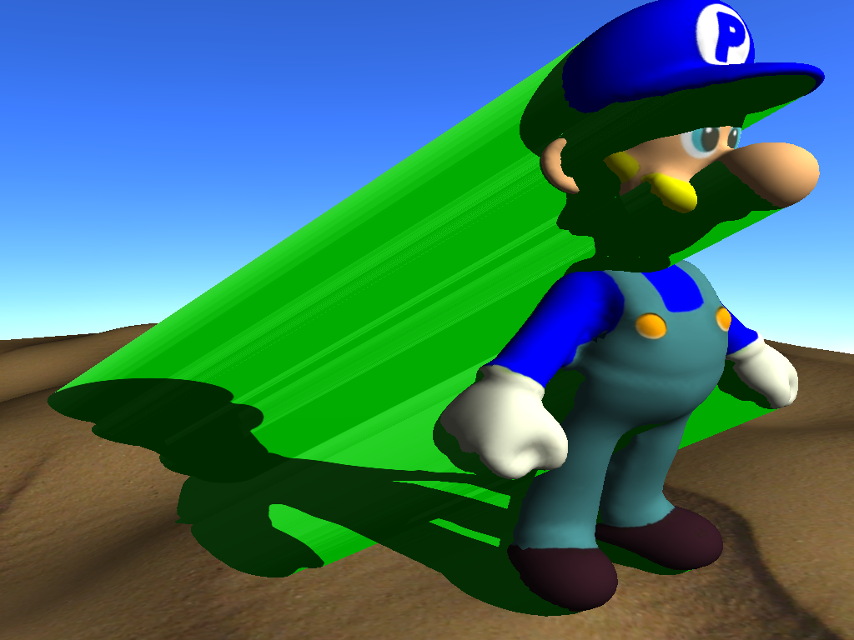
Initialization: Physical Shadow Rendering
Shadow volumes [Crow77]
Extrude polygons from silhouette vertices
Perform inside-outside test (using stencil buffer)
Edit shadows by modifying silhouettes

Slide 10
Our Framework: Outline
Artistic edits of physical shadow boundary
Make shadow edits consistent over time
Render edited shadows

Slide 11
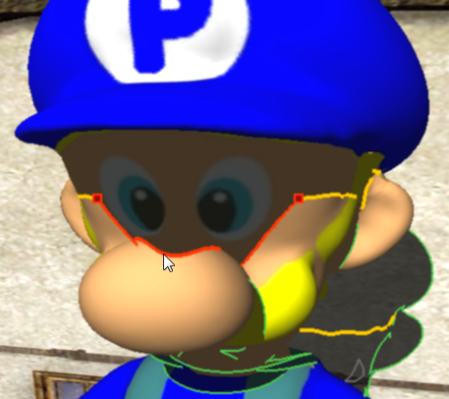
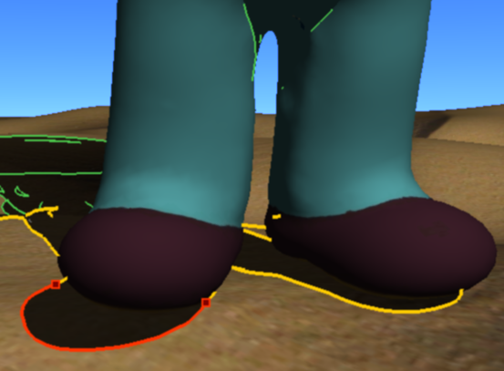
Step 1) Shadow Boundary Editing
Edit shadow boundaries directly on receiver geometry
Use uniform interface for all cases
self shadows + non planar receivers
contact shadows

Slide 12
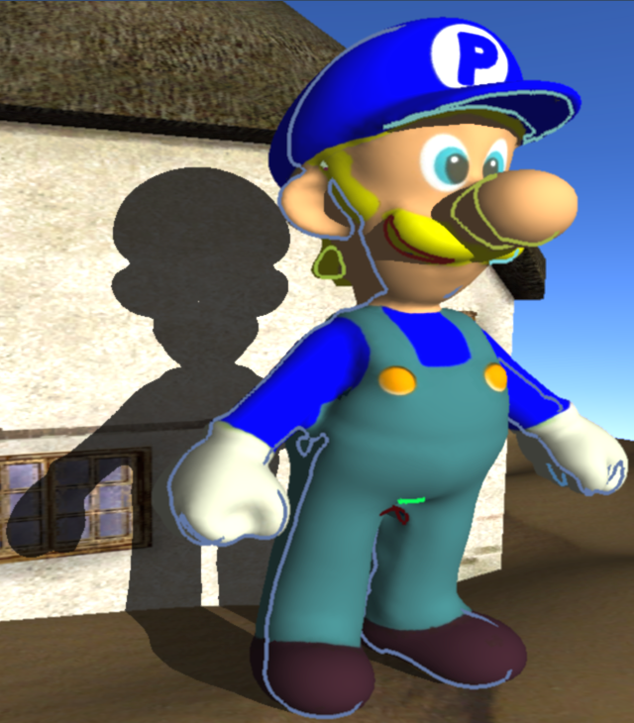
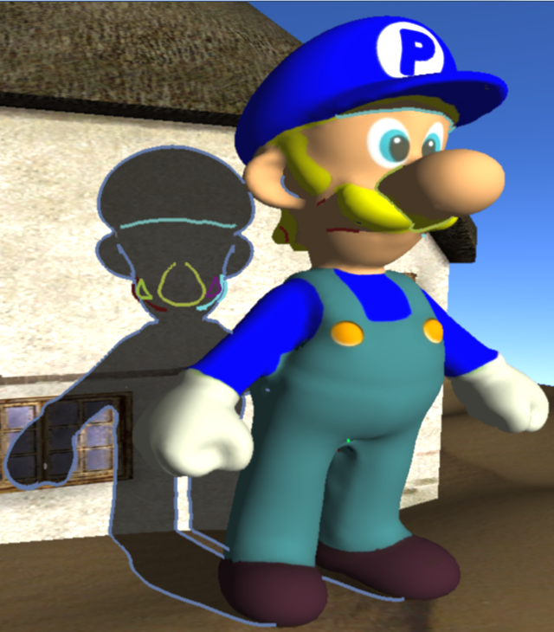
Step 1) Shadow Boundaries
Project silhouette curves into scene to get boundaries

Slide 13
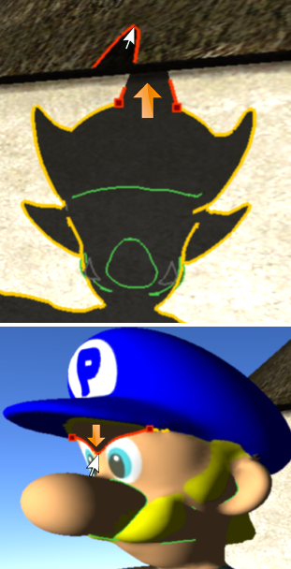
Step 1) Interactive Update
mouse dragging
recompute + render shadow
Notes:
Look for upper-lowercase consistency

Slide 14
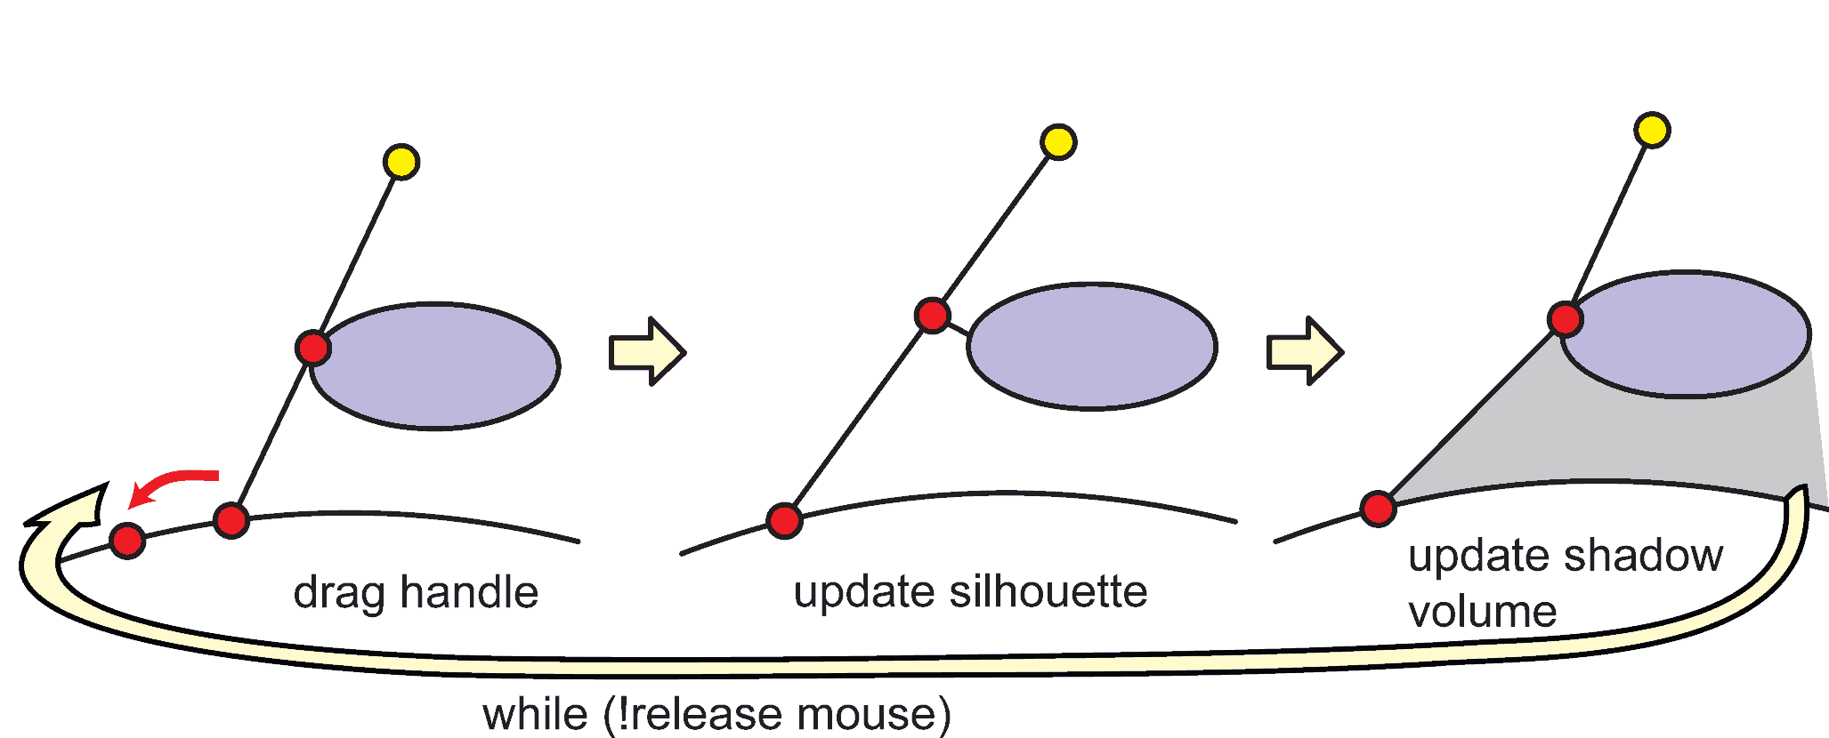
Step 1) Interactive Update
Edit shadow boundary by dragging shadow handles

Slide 15
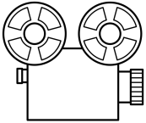
Step 1) Mouse Dragging
Obtain silhouette a and handle b from physical shadow
Drag handle in screen space from c to d
Project handle to ground e
Compute modified silhouette f (choose plane perpendicular to light)
Cast ray from f to e to find final handle position g
screen
c
f
a
d
g
b
e

Slide 16
Step 1) Freeform curve editing
Handles are control points for freeform curve editing
2D deformation on surface
We use moving least squares [Schaeffer06] (fast!)
Shadow boundary closely follows mouse input
Notes:
Todo: show illustration here

Slide 17
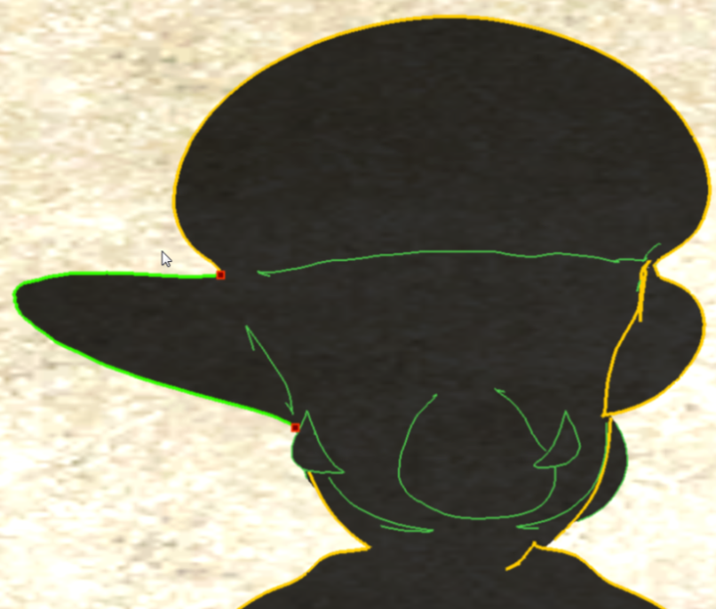
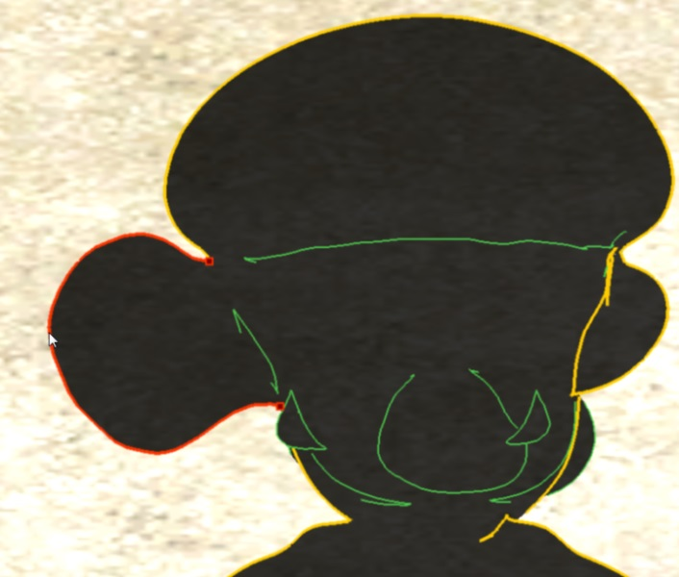
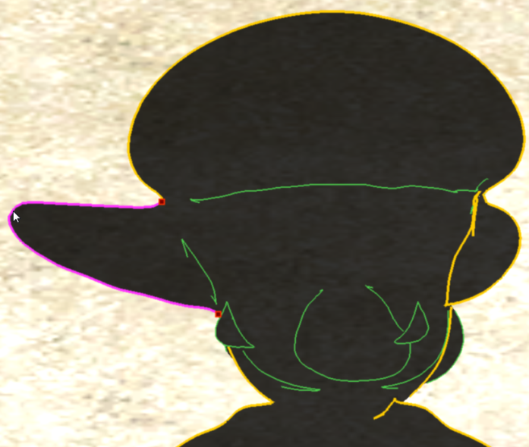
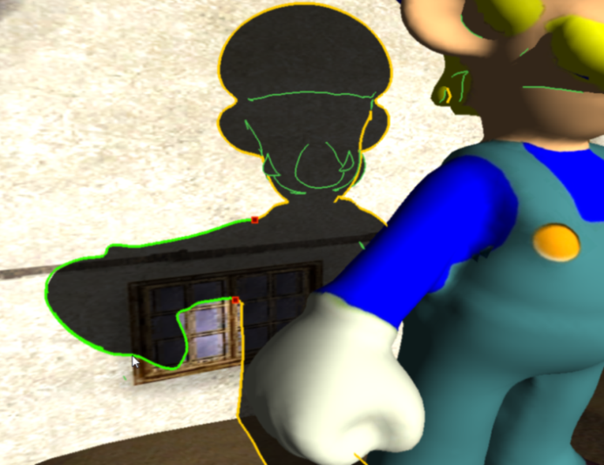
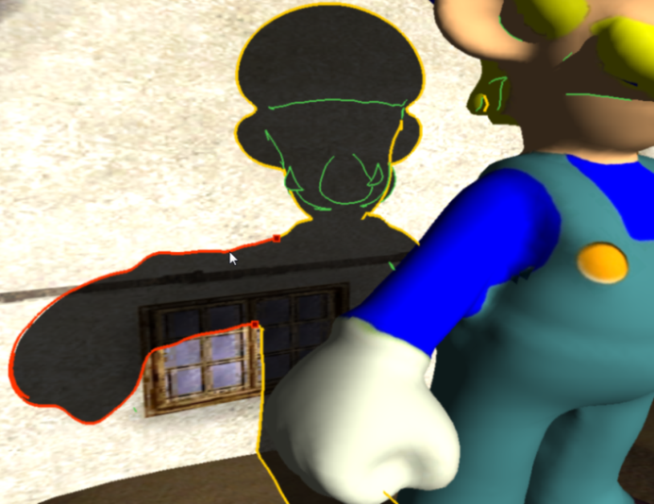
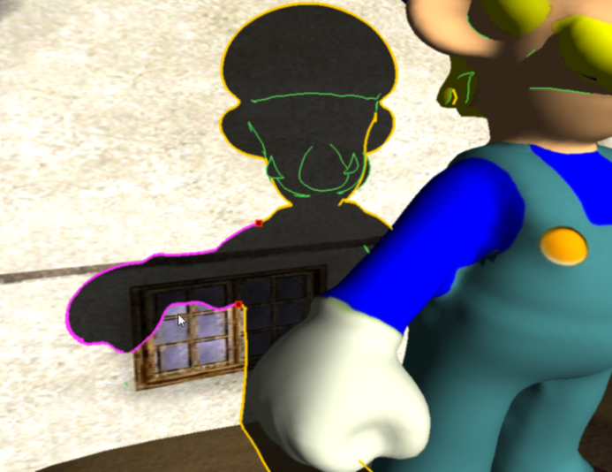
Step 2) Shadow Boundary Editing: Styles
affine
similar (preserves shapes)
as-rigid-as possible
Notes:
Make lines thicker (photoshop

Slide 18
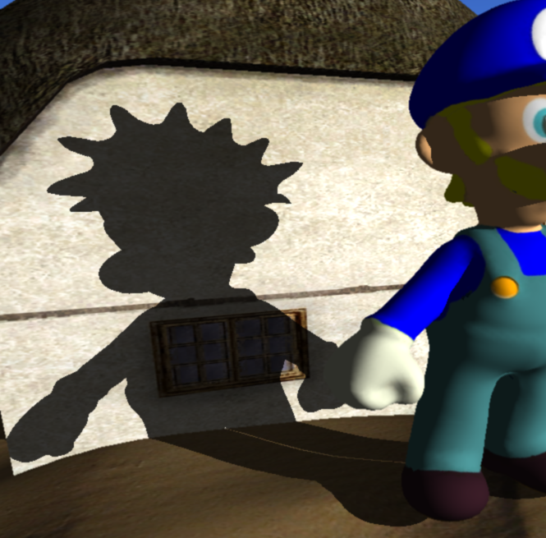
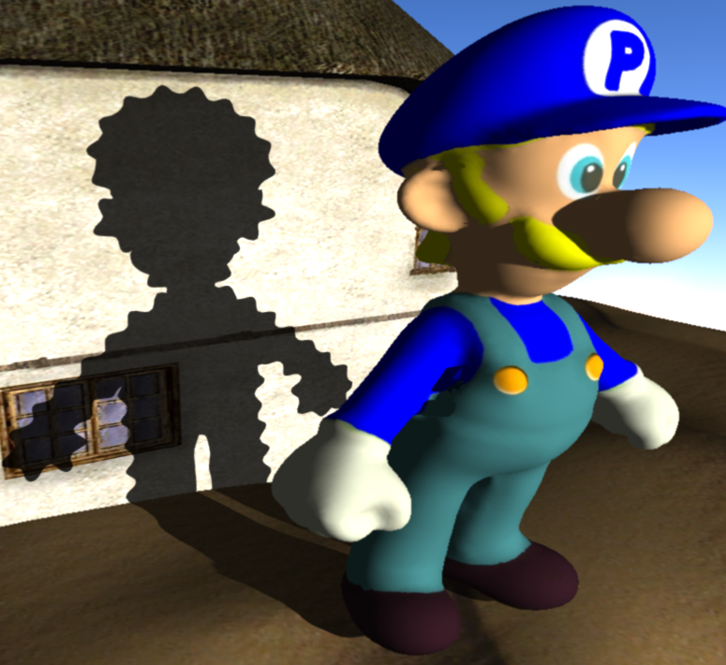
Step 2) Alternative Editing Styles
Other editing methods possible, e.g., sinusoidal noise

Slide 19
Our Framework: Outline
Artistic edits of physical shadow boundary
Make shadow edits consistent over time
Render edited shadows

Slide 20
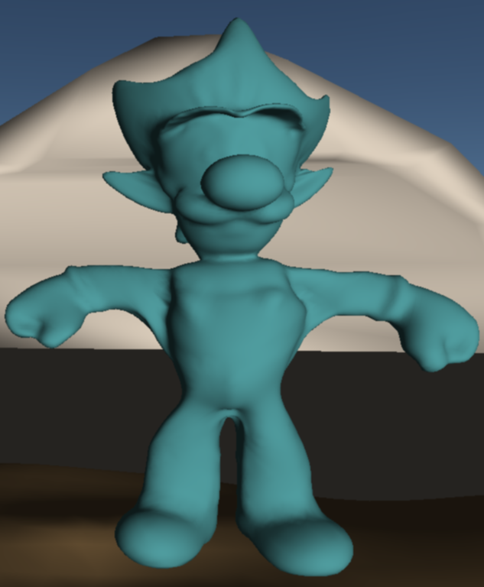
Step 2) Make Shadows Consistent
Deform original mesh to satisfy modified silhouettes (“shadow mesh”)

Slide 21
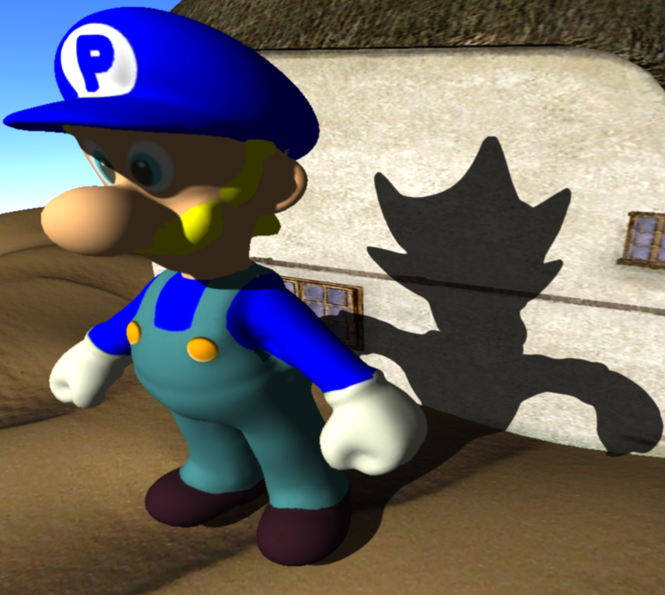
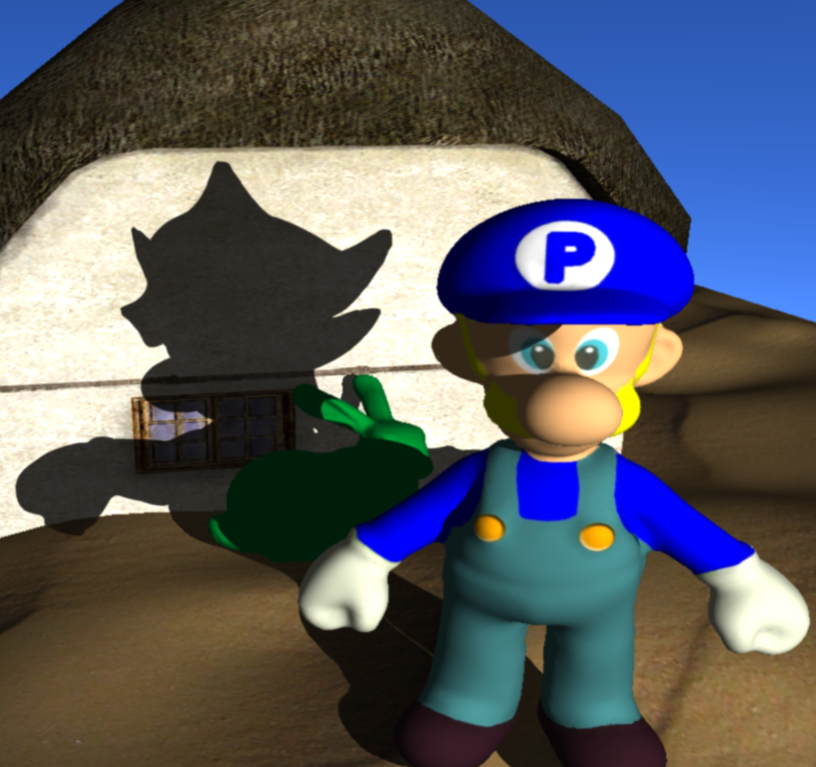
Step 2) Shadow Mesh
Allows dynamic changes
scene configuration
lighting

Slide 22
Step 2) Shadow Mesh
Deform mesh according to modified silhouettes
Shadows should change smoothly
Laplacian Editing on silhouette vertices [Nealen07]
Solve linear system
Constraints on modified silhouettes
Notes:
Improve this slide: show illustration

Slide 23
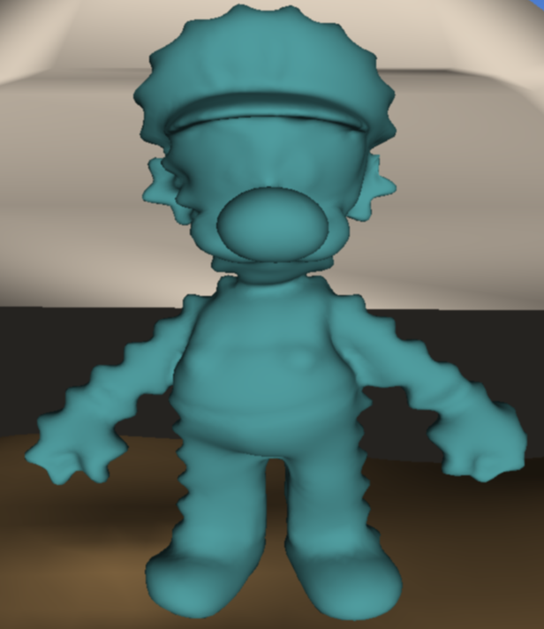
3) Make Shadows Consistent
Note that this is almost 2D problem =>
Rotate coordinate system so that z-axis approximately corresponds to light direction
Scale in z so silhouette changes persist in shadow
Notes:
Note: this slide is too complicated

Slide 24
Our Framework: Outline
Artistic edits of physical shadow boundary
Make shadow edits consistent over time
Render edited shadows

Slide 25
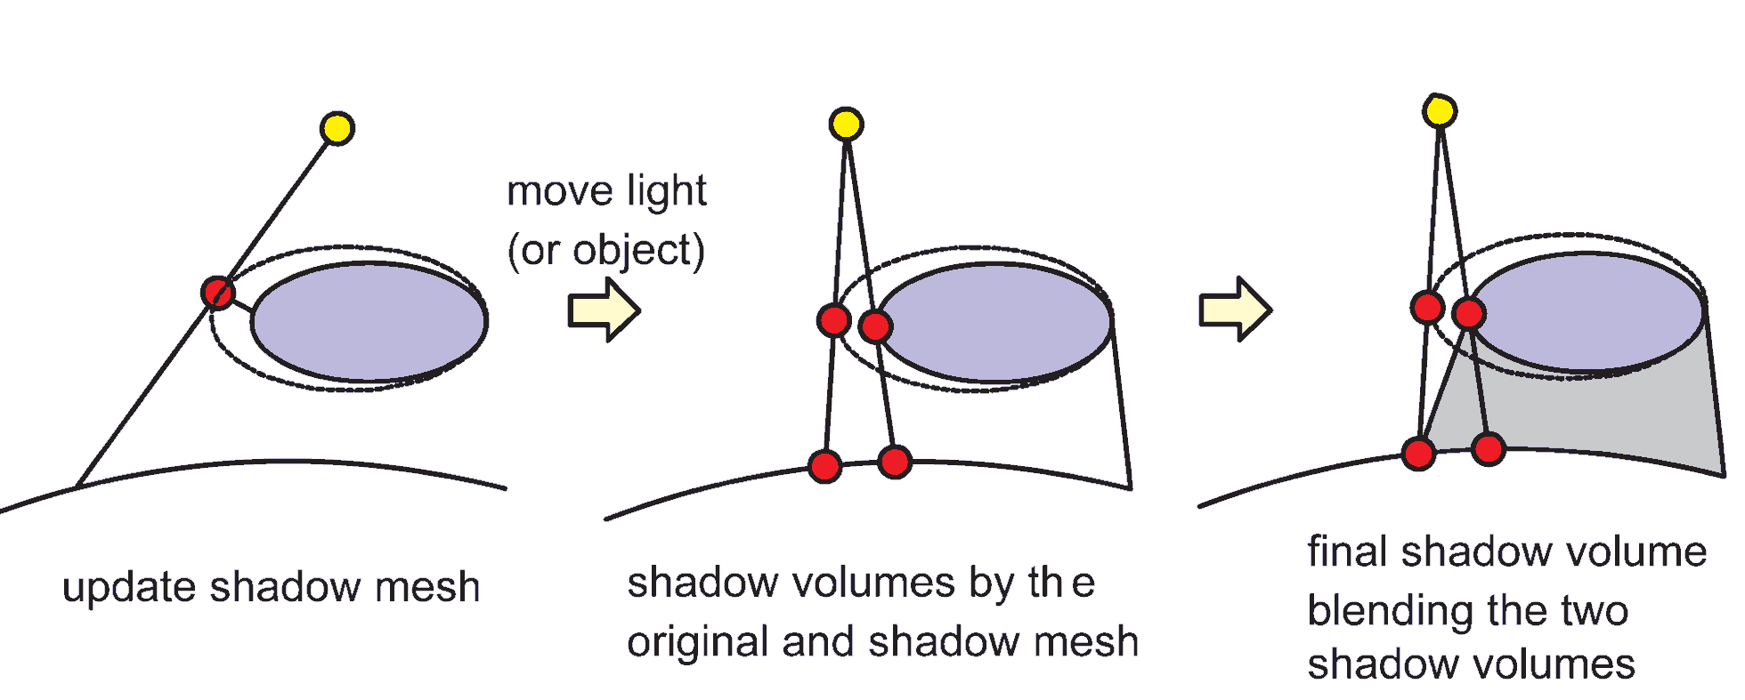
Step 3) Shadow Rendering
First idea: Render shadow of shadow mesh
But shadows everything between caster and receiver
We want smooth transition between
original shadow at caster
modified shadow at receiver
Notes:
Show example here for problem

Slide 26
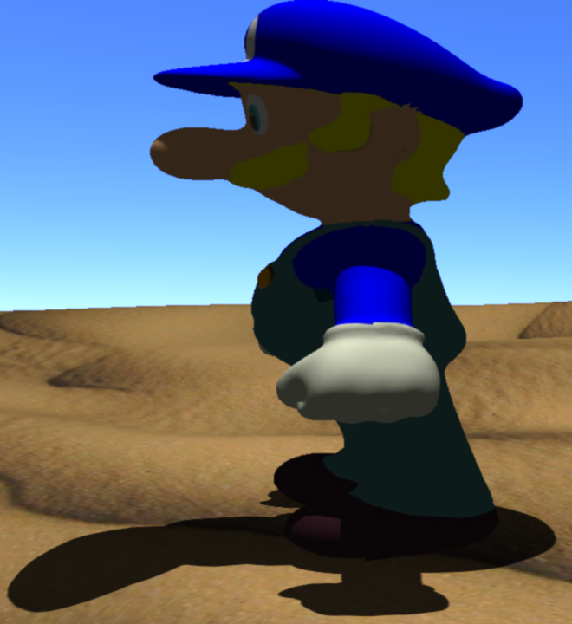
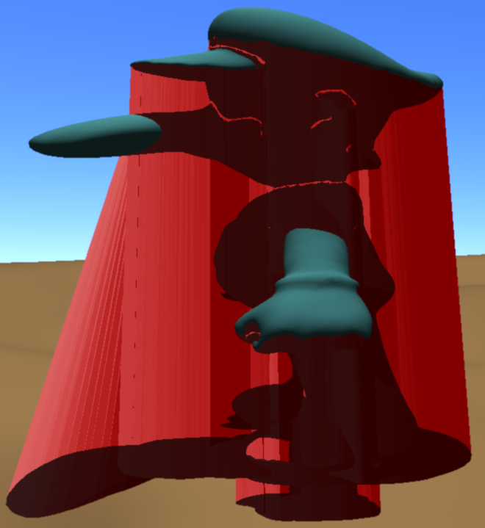
3) Blend between original and modified shadow
Original shadow at caster
Modified shadow volume
modified shadow at receiver
Notes:
Needs example!!!! (show artifact)

Slide 27
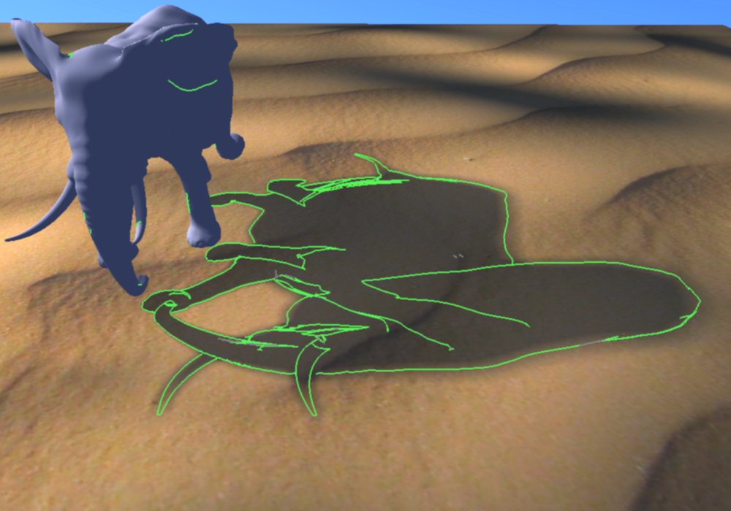
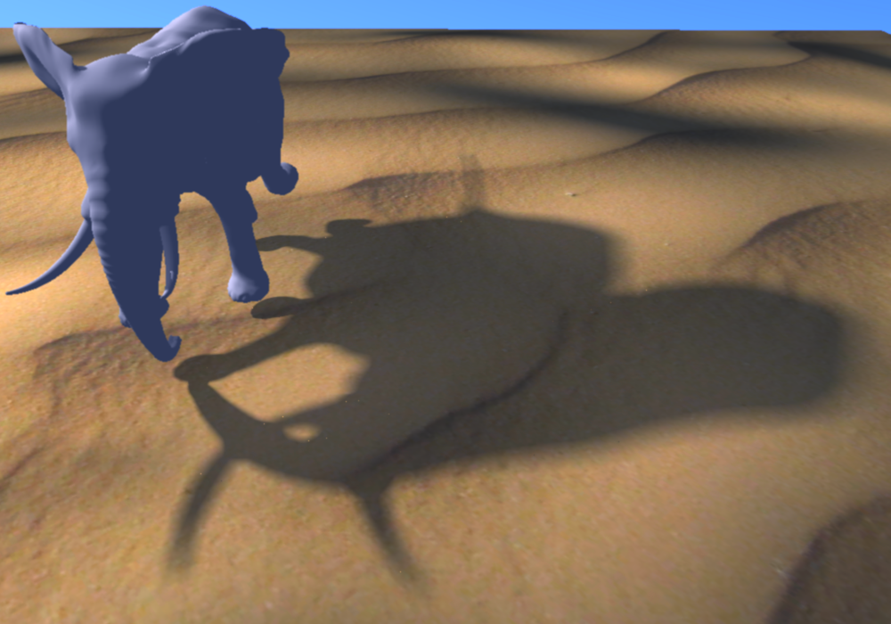
Step 3) Soft Shadow Rendering
Use Modified Penumbra Wedges [Assarson03]
Fast approximate technique
Uses hard shadow boundary to add / subtract visibility
Just modify hard boundaries as usual
Notes:
Show ainamtion here

Slide 28
Video: Editing + Skeletal Animation

Slide 29
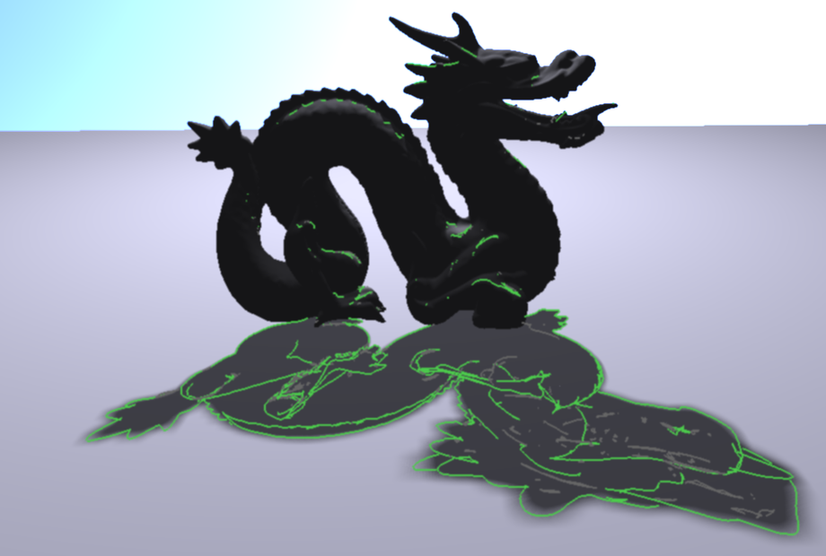
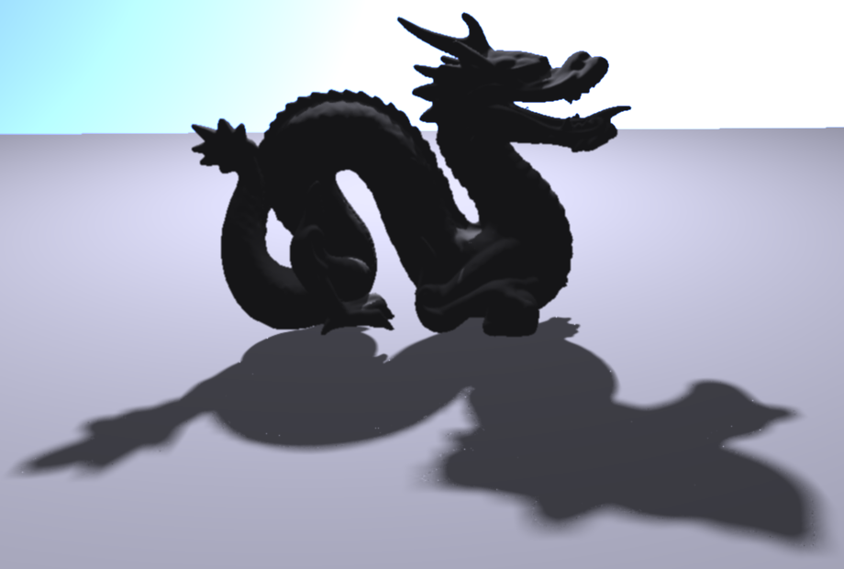
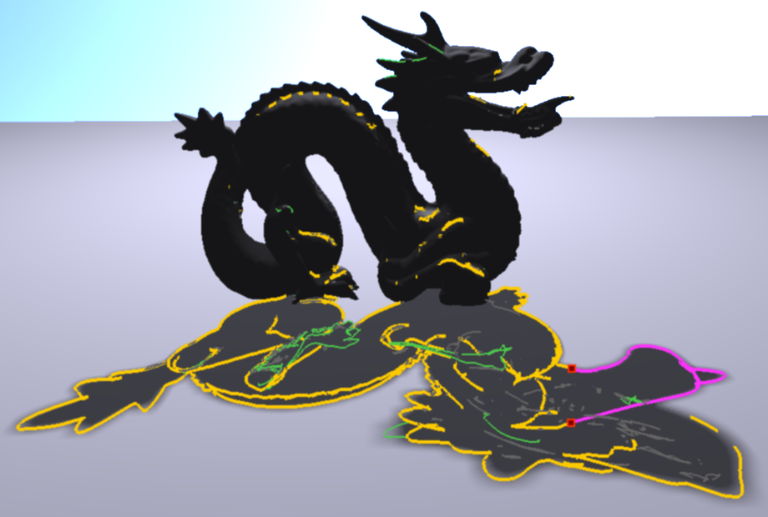
More results: Complex Silhouettes

Slide 30
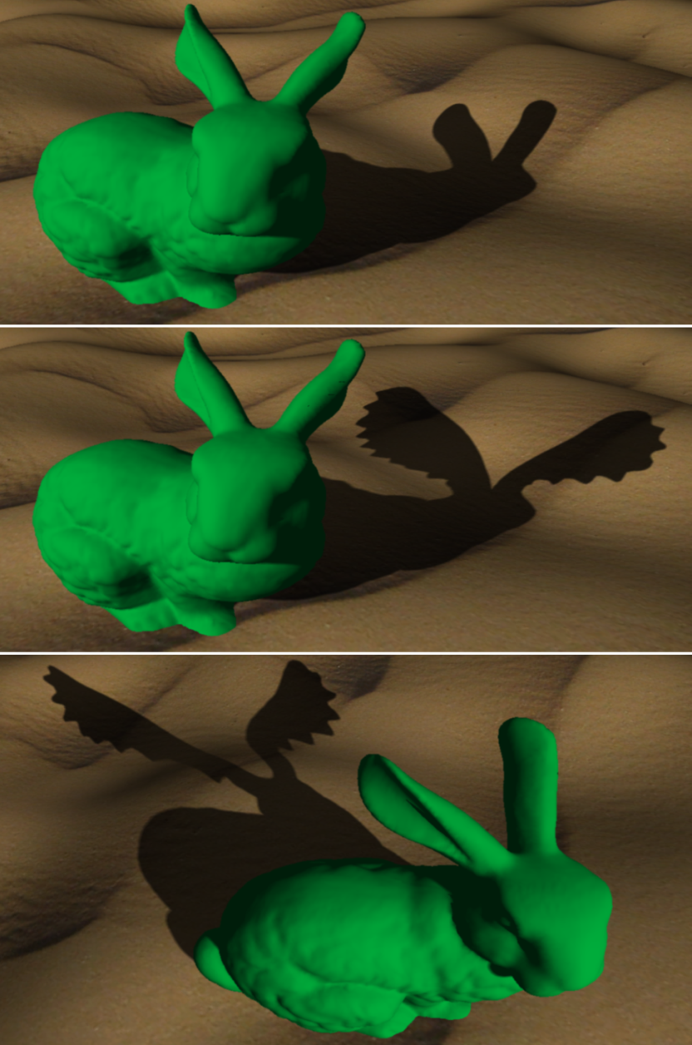
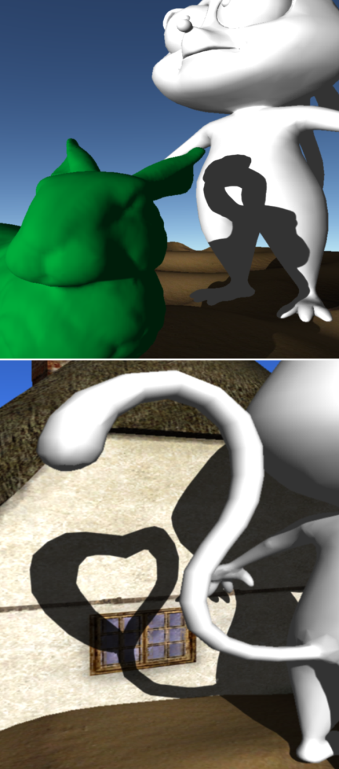
More Results

Slide 31
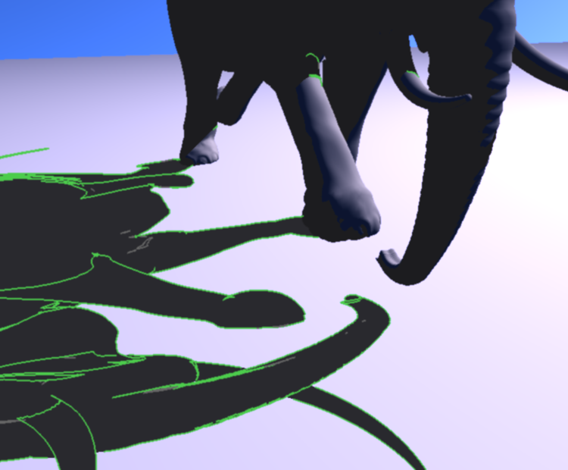
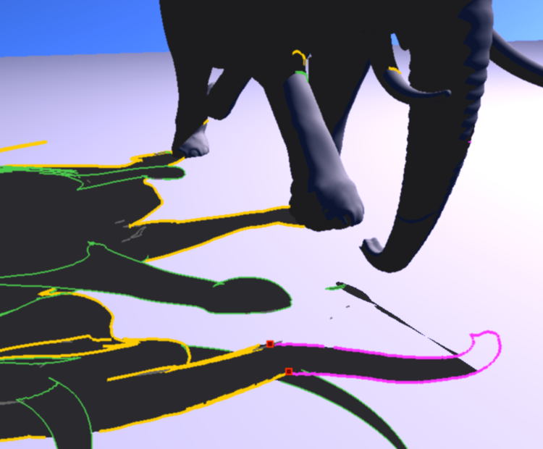
Problem Case
Large deviation from physical shadow
Notes:
Keep limitations short

Slide 32
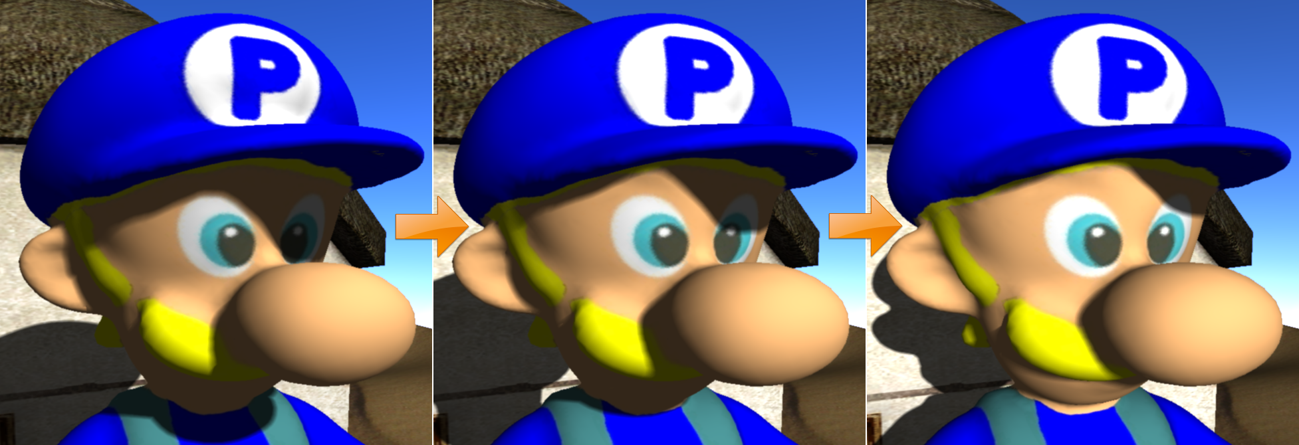
Problem Case
Big changes of scene configuration (e.g., light)
Shadow may become undesirable
Instead, use smooth falloff depending on cos(L _{current}, L_{editing})

Slide 33
Video: Smooth Falloff

Slide 34
Conclusions
Uniform interface for all cases and shadow types
Direct + local control, animation and object interaction
Can break down if physics is bent too much
Currently uses ray casting for intersection finding
Precision depends on mesh resolution
Applications in keyframe animation, interactive games

Slide 35
Thank you for your attention!

Slide 36
Comparison with STAR
 | Direct Control | Local Control | Animation | object-shadow interaction | Topology change
Olbert10 All-Frequency | limited | limited | limited | no | no
Kerr10 BendyLight | limited | no | yes | yes | no
Ritschel10 On-Surface | good | good | limited | no | no
Shadow Boundary | good | very good | yes | yes | yes
Notes:
Explain terms or shorten slide (difference between direct and local)

Slide 37
Questions?
This work has been supported by the EU FP7 People Programme (Marie Curie Actions) under REA Grant Agreement no. 290227 and the JSPS scholarship

Slide 38
Step 1) Shadow Handles
For each silhouette vertex
Compute intersection of shadow ray with receiver
Use as handle on shadow boundary
Move handles to modify shadow boundary
Modify silhouettes accordingly (+ render shadows)
light
shadow ray
Notes:
Improve this slide!! note: show movie here

