Slide 1
Analytic Visibility on the GPU
Thomas Auzinger¹, Michael Wimmer¹ and Stefan Jeschke²
¹ Institute of Computer Graphics and Algorithms
Vienna University of Technology
² Computer Graphics Group
IST Austria
Notes:
Thomas Auzinger, Michael Wimmer and Stefan Jeschke; Analytic Visibility on the GPU, Computer Graphics Forum (Proceedings of EUROGRAPHICS 2013), 2013
Paper page: http://www.cg.tuwien.ac.at/research/publications/2013/Auzinger_2013_AnaVis/
This text contains the accompanying notes to the slides.
They are not identical to the presentation at EG 2013.
The symbol -> indicates that a button click has to be performed at this position in the presentation (to synchronize the text with the slide animations).
Starting a slide show in presenter mode shows both the slides and notes.
Note that this presentation gives an illustrative high-level view of our method.
The paper contains pseudo code and essential details for all the stages of our method.

Slide 2
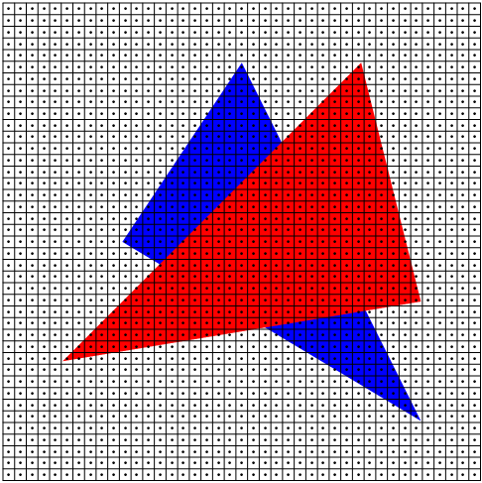
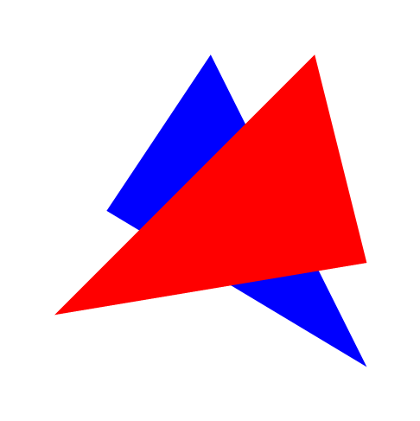
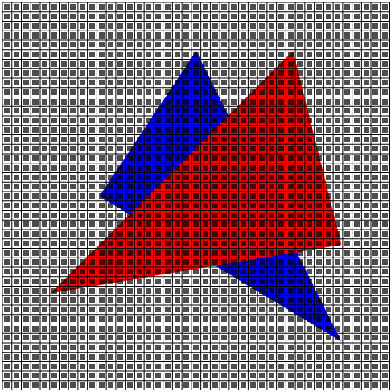
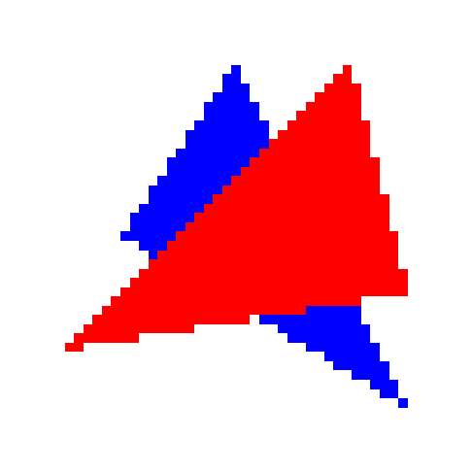
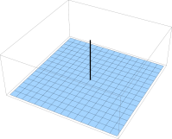
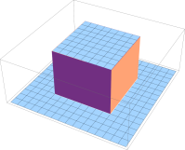
Motivation
Rasterization
*
Area sample
Vector input
Raster grid
Center sample
Rastered output
Higher quality output
Notes:
The domain of our work is rasterization – the conversion from vector input to raster output.
-> An exemplary input of two overlapping triangles..
-> A raster grid is superimposed, which dictates the output format. A zoom in shows details of the setting.
-> A possible rasterization strategy is to evaluate the input data at each pixel center and assign this value to the pixel.
-> This yields the raster representation on the right.
-> Sampling at a discrete location is equivalent to convolving the input data with a Dirac distribution (delta function).
Aliasing artifacts in the form of staircasing at the triangle edges are clearly visible and a result of the chosen convolution pre-filter.
-> By the use of a better filter this situation can be improved.
-> Using the contribution of the input over a whole area is one possibility and is equivalent to a convolution with a box filter.
-> This yields a smoother output on the right, as high frequencies of the input signal (that could not be represented in the discrete raster anyhow) are suppressed.
A central question is now how to evaluate such a filter convolution.
Traditionally, this is done by placing discrete samples on the filter footprint.

Slide 3
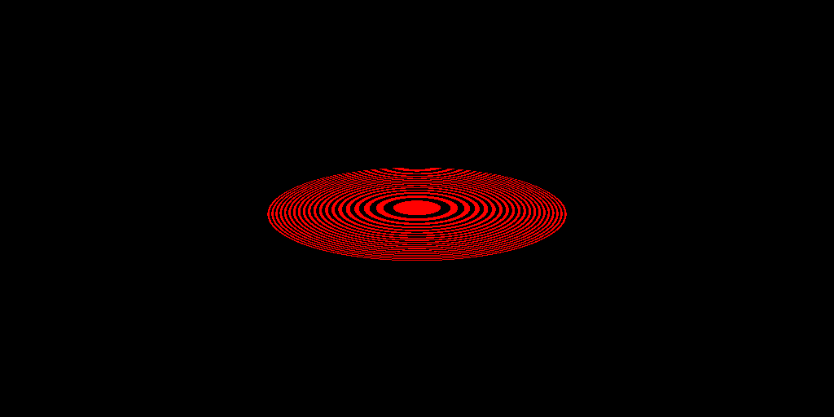
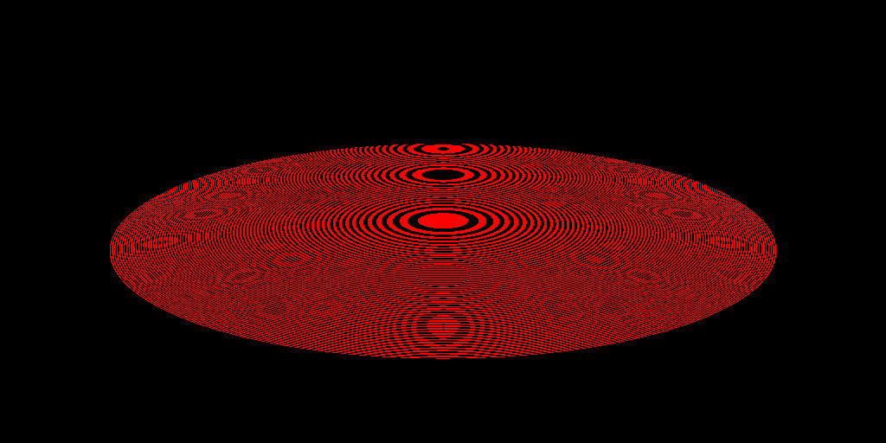
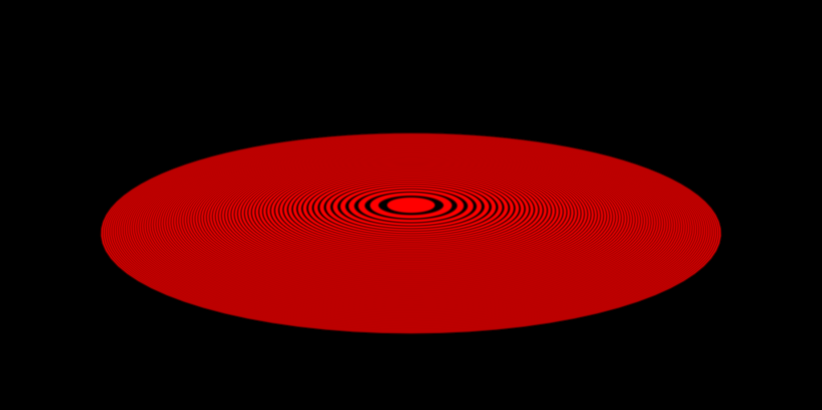
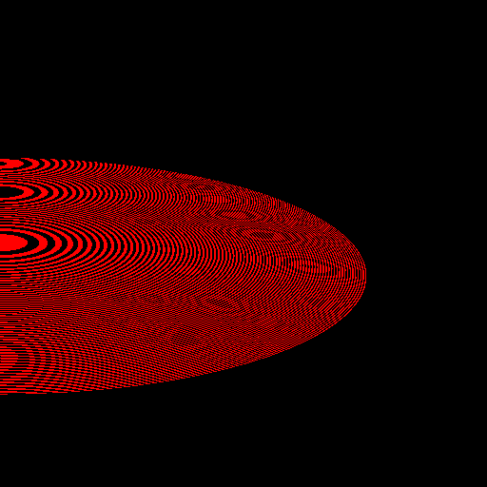
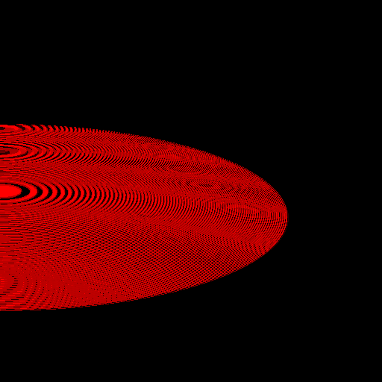
Motivation
Sampling artifacts
Ground truth
Aliasing artifacts
Zone plate input
1 sample per pixel
4 samples per pixel
16 samples per pixel
256 samples per pixel
Analytic sampling
Notes:
We illustrate the problems with this approach on another input example – concentric rings of decreasing width. This is also called a zone plate.
We ignore the discussion on a optimal choice of the filter function and simply use a Gaussian filter.
We start with one centered sample per pixel.
This works reasonably well for scenes with low geometrical details.
-> Smaller details, however, lead to aliasing artifacts seen as additional rings (as non-suppressed high frequency information intrudes into the lower output frequencies).
-> The smaller the details get, the worse the aliasing can become.
-> Comparing with the ground truth that is given by the exact convolution of the input zoneplate with a Gaussian filter.
-> Using more samples to evaluate the filter function generally leads to a better approximation of the ground truth.
But even for a large number of samples, there is still perceivable aliasing.
-> The method we strive for - analytic rasterization - gives a near-perfect result out of the box and corresponds roughly to using infinitely many samples.

Slide 4
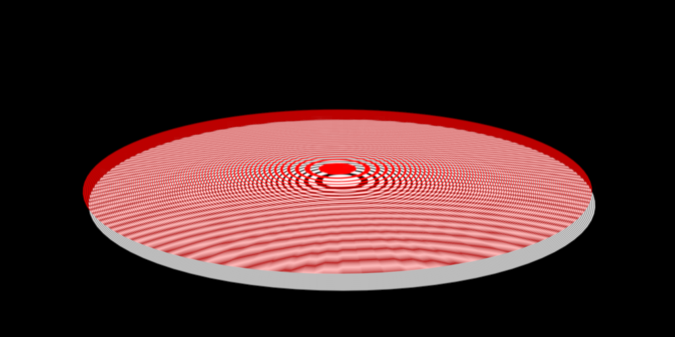
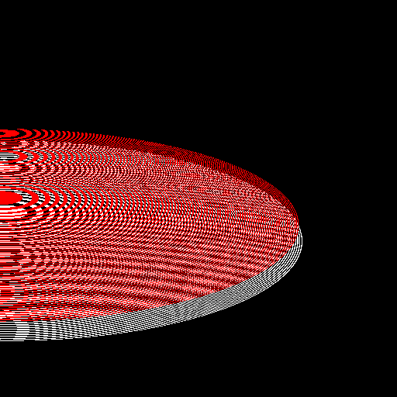
Motivation
Analytic visibility
Analytic rasterization
1 sample per pixel
Notes:
Previous works on analytic rasterization only operated in the same dimensions for input and output (i.e. 2D input to 2D output or 3D input to 3D output).
-> In our work, we present a visibility method to enable full 3D to 2D analytic rasterization.
The example here is a complex scene of a white zoneplate behind the red one. Both zoneplates show a high degree of detail and lead to a very high-frequency visibility signal, especially in the outer regions.
-> Using one centered evaluation sample as before for both the visibility and the filter convolution leads to severe aliasing artifacts.

Slide 5
Overview
Traditional Analytic
Input
Input
Vertex Geometry Tessellation
Vector
Vertex Geometry Tessellation
Discretization
(Rasterizer)
Visibility
Shading
Anti-aliasing
Visibility
Shading
Anti-aliasing
Shading
Anti-aliasing
Discretization
(Integrator)
Output
Raster
Output
Notes:
We now take a look on how a fully analytic rasterization pipeline differs from the traditional sampling based graphics pipeline.
For the traditional pipeline we have
-> usually a mesh input that is modified in vertex, geometry and tessellation stages.
-> This modified input is then discretized to raster format in the rasterizer stage.
-> Visibility, shading and anti-aliasing computations are then performed on discretized data to finally yield the raster image output.
-> There is, however, information lost in the rasterizer stage due to the sampling of the input data.
These undersampling issues can cause disturbing aliasing artifacts in the output.
Usually this is counteracted with higher sampling rates (i.e. multisampling) or post-processing techniques to recover some lost information (i.e. post-process anti-aliasing).
-> The analytic pipeline, in contrast, uses the vector information as long as possible.
-> Only in the very end, the integrator performs the analytic filter convolutions to
-> yield the raster output.
This removes all undersampling issues from the intermediate stages.
There are 3 main stages that make up the main difference to the traditional rendering pipeline.
-> The Shading/Anti-aliasing stage was covered by previous work on filtering theory and we review the main examples.

Slide 6
Related Work – Analytic Filtering
Manson & Schaefer (EG 2010) Wavelet Rasterization
Auzinger et al. (EG 2012) Analytic Anti-Aliasing
Manson & Schaefer (EG 2013) Analytic Rasterization of Curves with Polynomial Filters
Notes:
A recent trend in analytic rasterization methods was mainly started by the paper on
Wavelet Rasterization by Manson & Schaefer where they perform analytic convolution with the Haar wavelet filter.
Our own work at Eurographics 2012 presented analytic convolution with radial filters in 2D and 3D and linear functions on the respective polytopes.
At the same conference as this paper, Manson & Schaefer presented a follow up on analytic convolution of general filters with curved shapes.

Slide 7
Overview
Traditional Analytic
Input
Input
Vertex Geometry Tessellation
Vector
Vertex Geometry Tessellation
Discretization
(Rasterizer)
Visibility
Visibility
Visibility
Shading
Anti-aliasing
Shading
Anti-aliasing
Discretization
(Integrator)
Output
Raster
Output
Notes:
-> Scene visibility has to be resolved exactly in the context of analytic rasterization, i.e. by exactly determining which parts of the scene are seen from a given viewpoint.
This is an old problem and has various names such as ‘exact visibility’, ‘analytic visibility’, or ‘hidden surface elimination’.
We will also review the most relevant related word for our application of it.

Slide 8
Related Work - Visibility
Computer graphics lore
Appel (1967) Quantitative invisibility
Catmull (1984) Analytic visible surface algorithm
Computational geometry
Dévai (2011) Optimal hidden surface algorithm
Notes:
Most of the research into exact visibility methods in computer graphics happened in the 60s to 80s when hardware was still limited by memory sizes and cost.
With the advent of affordable memory, the z-buffer methodology became the prevalent technique in rasterization and cemented the sampled visibility approach.
To give two examples of early works we have:
Appel in 1967, who presented the first algorithm for hidden line elimination (but as serial code for single core CPUs).
Catmull in 1984 sketched a system where analytic visibility is used together with analytic rasterization but did not present an implementation.
-> The field of computational geometry showed continued interest, however, and our method is based on a recent work of Dévai in 2011.
In it he gives an optimal parallel algorithm for hidden surface elimination but due to the theoretical character of the work, its implementation is not easily inferred.
Our work gives a practical solution for the hidden surface problem for massively parallel hardware.

Slide 9
Overview
Traditional Analytic
Input
Input
Vertex Geometry Tessellation
Vector
Vertex Geometry Tessellation
Discretization
(Rasterizer)
Visibility
Visibility
Shading
Anti-aliasing
Shading
Anti-aliasing
Discretization
(Integrator)
Discretization
(Integrator)
Output
Raster
Output
Notes:
-> As a last stage in the analytic pipeline, a final integration converts the processed vector data into raster format.
As this stage behaves radically different compared with the traditional rasterizer, we will give a short description.

Slide 10
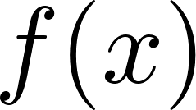
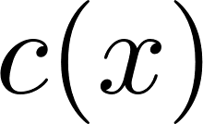
Analytic Filtering
Sampling
Notes:
The evaluation of the filter convolution with traditional sampling has to following components:
-> An input signal (in our case a triangle with color function c(x)).
-> A location at which we want to determine the resampled output value v.
-> A prefilter f(x) designed to reduce the aliasing.
-> A set of samples x_i at which both the input signal and the filter are evaluated.
The output v is then given as a weighted sum of these sampled values.

Slide 11
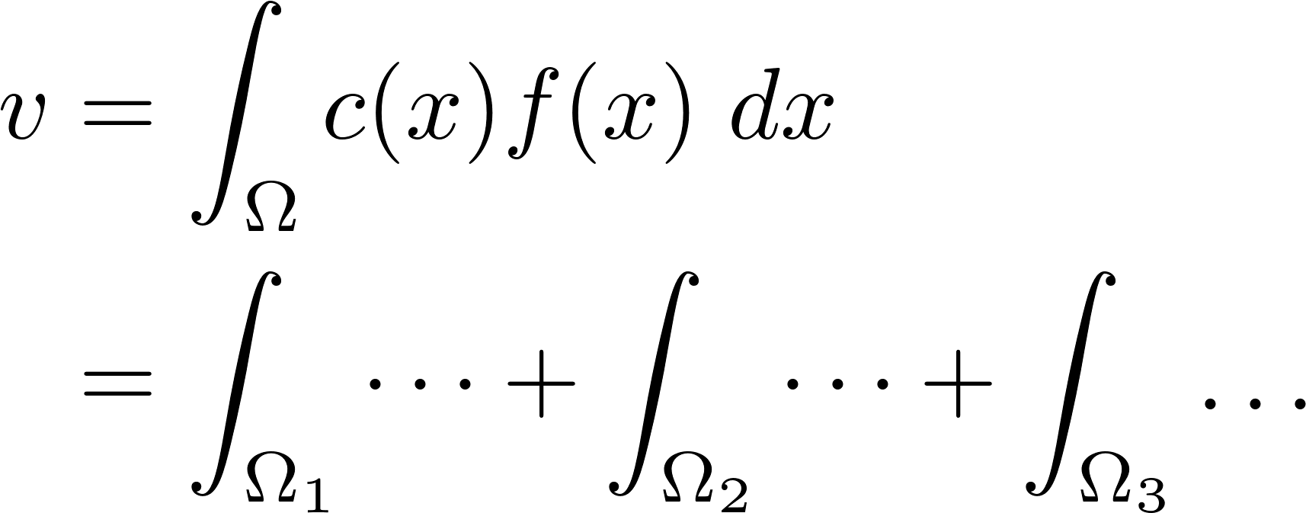
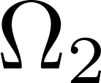
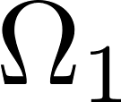
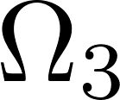
Analytic Filtering
Sampling
Analytic
Notes:
Analytic filtering, in contrast, evaluates the convolution exactly.
-> This uses the whole input signal, i.e. the color function c(x) on the whole triangle footprint Omega.
-> Which is integrated with the filter function f(x) to yield the output value v.
-> We observe that the linearity of the integral permits a split of the integral into three parts, one for each triangle edge.
The subregions Omega_1 to Omega_3 are obtained by forming a triangle between the output sample location and the respective edge.
Note that the integral can also be represented as a boundary integral via the divergence theorem.
Consult the works of Manson and Schaefer on analytic rasterization (Eurographics 2010 and 2013) for a derivation.

Slide 12
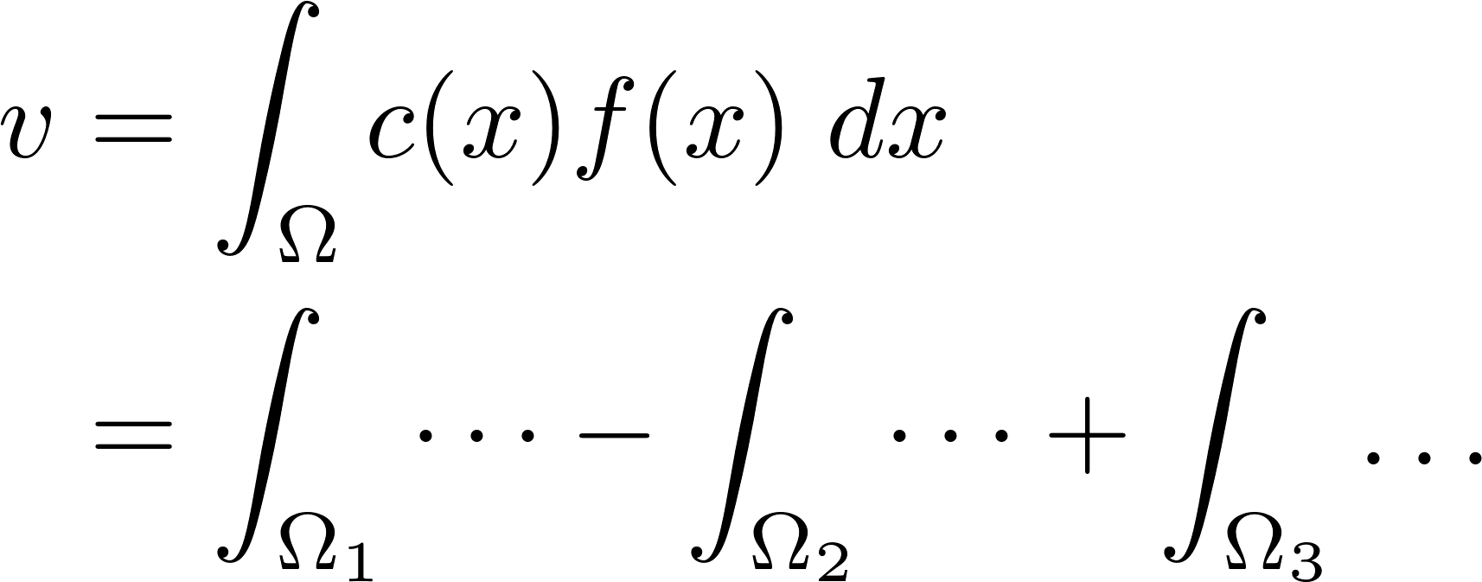
Analytic Filtering
Sampling
Analytic
Notes:
The orientation of the triangle boundary relative to the output sample automatically cancels superfluous integration domains if the output sample location is not contained in the triangle footprint.
-> In this example input the integration domains of Omega_1 and Omega_3 extend outside the triangle footprint and the Omega_2 subregion lies outside the triangle.
-> By subtracting the contribution of the integral on Omega_2 the correct output value is obtained.
Note that the boundary orientation relative to the output sample location can be used to automatically obtain the correct signs.

Slide 13
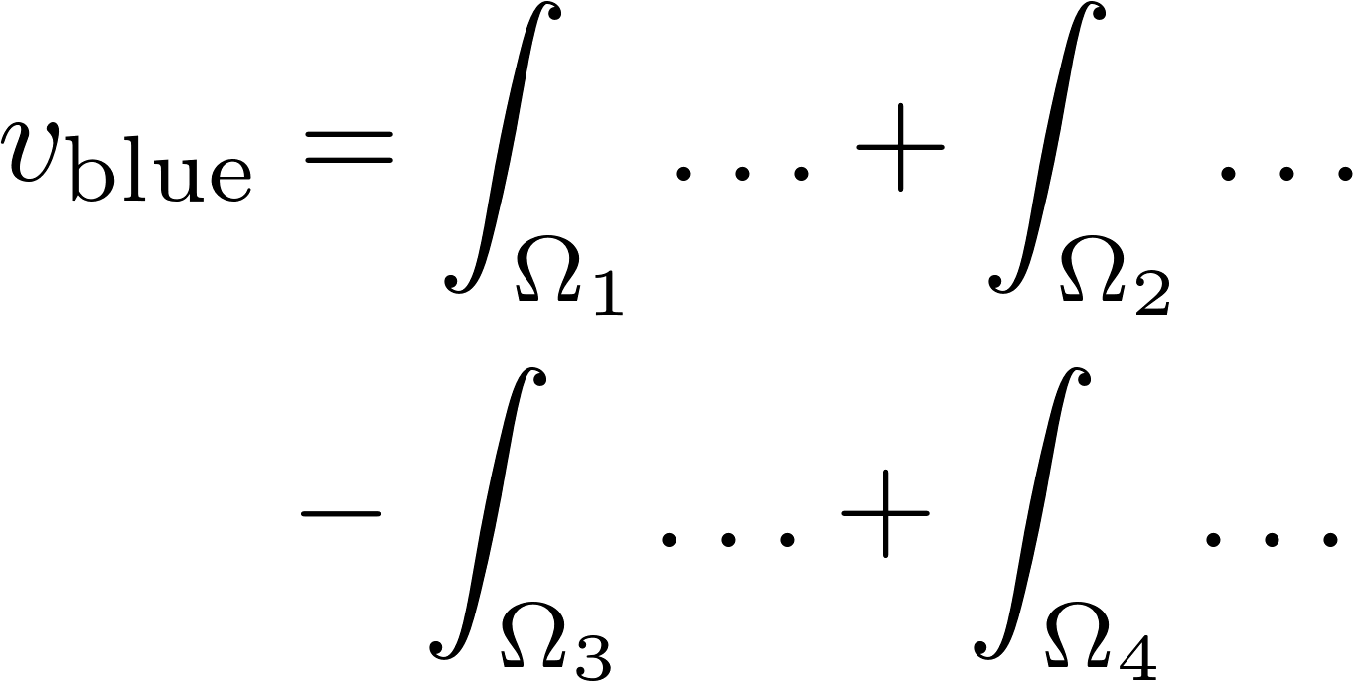
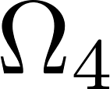
Analytic Filtering
Visible edges not enough → boundary completion
Triangle integration order irrelevant
Edge integration order irrelevant
Notes:
We now add visibility to the mix by adding a blue triangle behind the red one.
-> From the linearity of integration follows again that the contribution of different triangles can be computed independently and summated to yield the correct output.
-> It has to be ensured, however, that only the visible region of the occluded input is used as integration domain.
-> In out example the contribution of subregion Omega_3 has to be subtracted.
Note that Omega_3 is spanned by the output sample location and a line segment on the right edge of the red triangle.
This segment is NOT part of the edges of the blue triangle.
This indicates that it is not only necessary to compute the visible parts of all the triangles’ edges (see Omega_1, _2, _4) but that we have to complete the boundary of all visible regions (Omega_3).
As it will become relevant later one, we note that
-> the triangles can be integrated in an arbitrary order and
-> that the contributions of each edge can be integrated in an arbitrary order.

Slide 14
Visibility Stage
Input
List of triangles
Consistently oriented
Non-intersecting
Output
Unordered set of all boundaries of the visible regions of all triangles
Input
Vertex Geometry Tessellation
Visibility
Visibility
Shading
Anti-aliasing
Discretization
(Integrator)
Output
Notes:
Having discussed the integration stage, we are now able to formulate the specification of our visibility algorithm.
-> As an input we use the projected scene triangles (where the depth component is still present in the vertex coordinates).
The triangles have to be consistently orientated in order to make the correct cancellation of integration domains work.
This is equivalent to requiring that the scene allows backface culling.
To keep our method practical, we also request non-intersecting input geometry.
If a scene does not fulfill this, a pre-processing step has to be added.
-> The output of our visibility stage is the set of boundaries of all visible regions represented by the endpoint of their respective line segments.
All output segments have a reference to their corresponding triangle to enable a lookup of its color function.
As said before, the ordering of the output is irrelevant and we will not enforce any particular ordering.

Slide 15
Pipeline - Visibility
Intersection Edge intersections between triangles
Hidden line elimination Visible edge segments
Boundary completion Missing boundary segments
Input
Vertex
Visibility
Visibility
Intersection
Shading
Anti-Aliasing
Hidden line
elimination
Discretization
(Integrator)
Boundary completion
Output
Notes:
-> Our visibility stage consists of three major substages.
-> In the Intersection stage the intersection between the edges of the scene triangles are computed.
-> In the Hidden Line Elimination stage the visible parts of all edges are computed (see Omega_1, _2, _4 of slide 13).
-> The final Boundary Completion ensures that each visible region has a complete boundary (see Omega_3 of slide 13).

Slide 16
Intersection
Per edge computations (one SIMD per edge)
Add endpoints
Add intersections with other triangles (one triangle per thread)
Notes:
In the following we will show the internal working of our stages on exemplary input of two triangles where the blue triangle occludes the red in the projected space we operate.
-> All stages operate on the edges of the scene triangles in parallel.
-> Each SIMD unit (called warp for Nvidia GPUs or wavefront for AMD GPUs) is assigned an edge.
In the intersection stage we record the intersection with other triangles along the (infinitely long) line which contains the edge in screen space.
-> In a first step we store the endpoints of each edge in an intermediate buffer.
-> Then each of the SIMD threads fetches a scene triangle and computes the (possible) intersection(s) with the edge line.
In this stage we already prune degenerated cases of only one intersection for a given triangle (i.e. when only a vertex of the triangle lies on the edge line).
After having stored the intersection to the intermediate buffer, the SIMD unit‘s threads fetch the next set of triangles.
This is repeated until all relevant scene triangles are processed.
Then the SIMD is assigned the next scene edge until all edges are processed.
We will here elaborate on the algorithm design a bit.
Parallel SIMD hardware (e.g. CPU vectorization extensions and GPUs) have a number of SIMD units with various threads that process their respective data in lockstep.
This causes a rather high penalty for code that has diverging code paths for the threads inside a single SIMD unit, as both code paths have to be executed sequentially.
(This phenomenon is called warp divergence in CUDA.)
Diverging code paths for different SIMD units, however, do not incur a penalty as they fetch their commands from the scheduler independently.
Looking at the problem of exact visibility, we observe the same two-level parallelism.
We have diverging code paths for the computations of each edge, mainly given by number of intersections along the edge.
If the threads of a SIMD unit would be assigned to edges, then all threads will be occupied until the edge with the highest amount of intersection is finished.
Thus we assign the edges to different SIMD units.
The computation of the intersection of the edge line with a scene triangle has a very well defined length and can be run in lockstep inside the SIMD unit.
Thus we execute the intersection computations in chunks of SIMD thread count in parallel.

Slide 17
Intersection
Add edge index
Add parameter along edge
0
0
0
0
-0.3 0.0 0.4 1.0
Notes:
As the intersection stage outputs the intersection in an unordered fashion, we have to sort them afterwards.
To enable this, we augment each intersection with additional information.
-> We store a reference to the current edge for each intersection.
In the example the edge has index 0.
-> Furthermore, we add a parameter that indicates the intersection‘s location along the edge line.
This parameter is 0.0 at the starting point of the edge and 1.0 at the endpoint as shown in the example.

Slide 18
Intersection
In parallel for all edges
Unordered output → global sort performed
Notes:
-> As described before, the intersection computations are executed in parallel for all edges.
Massive parallel hardware architectures are easily saturated with this method as the number of scene edges (usually >> 10^3) is considerably greater as the number of SIMD units (~10^2 for GPUs).
As the intersections are outputted in an unordered fashion, we perform a global radix sort to arrange the intersections according to edge index and running parameter.
This allows efficient lookup and processing along the edges in the two later stages.
(This stage is an extension of the work of Dévai 2011.)

Slide 19
Hidden Line Elimination
Take endpoints and occluding intersections
✘
✘
Notes:
In the following hidden line elimination phase, we compute the visible parts of all edges.
We select a subset of all computed intersection in this phase as only endpoints and intersections that stem from occluding triangles are relevant.
This comes from the fact that we want to eliminate the occluded parts of all edges and are interested in only those parts of the scene that lie in front of a given edge.
-> For the red edge all intersection are used since they are either endpoints or come from an occluder (i.e. the blue triangle).
-> For the blue edge the two center intersection stem from the red triangle which is occluded.
-> Therefore we ignore them in this phase.
-> We present the hidden line elimination stage on the example of the red edge.

Slide 20
Hidden Line Elimination
Take endpoints and occluding intersections
Notes:
Again, we assign the edge to SIMD units and process the intersection along the edge with the SIMD‘s threads.
Each intersection is then augmented with additional data.

Slide 21
Hidden Line Elimination
Take endpoints and occluding intersections
Assign occlusion flag
flag | 1 | -1 | -1 | 1
Notes:
To record if occlusions along the edge line start or end, we assign an occlusion flag (1 or -1) to each intersection.
To each intersection where an occlusion starts we assign 1 and where it ends -1.
The start- and endpoint of the current edge is assigned -1 and 1 respectively.
This is the opposite sign compared to the occlusions and can be seen as if the occlusion by infinity ends at the startpoint and as if the occlusion by infinity starts at the endpoint.
Note that the correct determination of the start and end intersection of an occlusion is enabled by the consistent orientation of the triangles.

Slide 22
Hidden Line Elimination
Take endpoints and occluding intersections
Assign occlusion flag
Perform scan along edge
flag | 1 | -1 | -1 | 1
scan | 1 | 0 | -1 | 0
Notes:
To propagate the occlusion information along the edge, we perform an inclusive scan of the occlusions flag.
At each intersection we thus get a count of the occlusions that are currently present at it.

Slide 23
Hidden Line Elimination
Report visible edge segments
flag | 1 | -1 | -1 | 1
scan | 1 | 0 | -1 | 0
visible | ✘ | ✘ | ✔ | ✔
Notes:
The start- and endpoints of visible edge segments have characteristic signatures such as the -1/-1 for a starting intersection point and 1/0 for the ending intersection point, as shown in the example.
As these start and endpoint form pairs, we can report them as the endpoints of a single visible edge segment.

Slide 24
Hidden Line Elimination
Report visible edge segments
flag | 1 | -1 | -1 | 1
scan | 1 | 0 | -1 | 0
visible | ✘ | ✘ | ✔ | ✔
Notes:
The resulting visible segment of the exemplary edge is shown in green.
We now outline how the adaptation to a SIMD hardware architecture can be done.
The SIMD unit that is assigned to a given edge performs the scan for all intersections by sequentially progressing along the edge in chunks of its size.
The N threads of the SIMD unit perform the scan for N occlusion flags by binary reduction and the value of the last value is stored in a local cache.
Then the next N occlusion flags are taken, the cached value is added and the scan performed.
This is repeated until all intersections along the current edge are processed.
After each scan chunk, the visible line segments are reported by writing them into intermediate segment buffers in global memory.
The correct offsetting is performed via atomic memory operations.
Note that the final integration order can be arbitrary and we do not have to respect any ordering of the outputted line segments.

Slide 25
Hidden Line Elimination
Perform over all edges in parallel
All hidden edges eliminated
Boundaries not complete
Notes:
-> These computations are performed in parallel for all edges, as the different SIMD units can efficiently run in parallel.
-> In the end all hidden parts of the scene edges are eliminated and only the visible edge segments written to an intermediate buffer.
-> A short comparison with the input data shows the correct visibility computed on the example.
-> However, not all visible regions have complete boundaries as can be seen in the visible region of the red triangle.
The boundary that is determined by the occlusion of blue triangle is missing.
Note that this boundary segment is not part of the edges of the red triangle and has to be computed differently.
(This stage follows in spirit the work of Appel 1967.)

Slide 26
Boundary Completion
Take endpoints and occluded intersections
Report upper-most occluded line segments
Notes:
This is rectified in the final boundary completion phase of our visibility stage.
Similar to before, we again take a subset of the intersections.
-> This time we are interested in the parts of the scenes that lie behind a given edge and we drop all intersection that stem from occluders.
This set of triangle is exactly the set that was dropped before together with the endpoints of the edges.
-> Using a similar technique as before, we report to the uppermost occluded line segments which complete the boundary of the visible region of the red triangle.
Note that in the hidden line elimination stage before we were interested in determining if there is one or more triangles in front of a given edge segment.
In this stage, however, we have to determine the triangle that lies right behind the current edge.
This is a more complicated situation and requires a more elaborate algorithm.
We refer to the paper for more details.

Slide 27
Boundary Completion
Take endpoints and occluded intersections
Report upper-most occluded line segments
Boundaries complete
Notes:
This procedure completes the boundaries of all visible regions, as shown in the example.

Slide 28
Visibility Stage
Input
List of triangles
Consistently oriented
Non-intersecting
Output
Unordered set of all boundaries of the visible regions of all triangles
Input
Vertex Geometry Tessellation
Visibility
Visibility
Shading
Anti-aliasing
Discretization
(Integrator)
Output
Notes:
Visibility stage is now complete and we have provided the necessary data for subsequent analytic shading and filtering in the form of a set of line segments with references to their respective triangles.
Note that we reported the line segments in an arbitrary order, as permitted by the subsequent stages.

Slide 29
Integration
In parallel for all sample locations and for all reported line segments:
Analytic convolution of triangle data with filter
Notes:
In the final integration stage we convert the modified vector data into raster format.
The necessary integrations can be performed in parallel for each sampling location and boundary segment from the intermediate buffer.

Slide 30
Result - Spikes
See video
Notes:
This video result shows that our method robustly handles complex visibility signals as the tips of the spikes in the back generate a multitude of intersections and boundary segments.
(If the video is not included you can obtain it from the paper page: http://www.cg.tuwien.ac.at/research/publications/2013/Auzinger_2013_AnaVis/ )

Slide 31
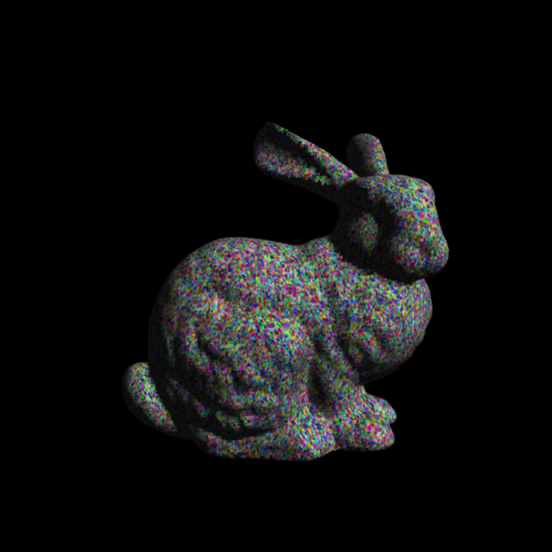
Timings
Bunny model at different LoDs
Implementation in CUDA
Output resolution: 1024²
GPU: Nvidia GTX 680
Timings in milliseconds
# triangles | intersection | hidden line elimination | boundary completion | visibility | integration
7k | 9.9 | 0.8 | 1.6 | 25 | 9.1
26k | 26 | 1.6 | 4.2 | 50 | 21
70k | 77 | 3.4 | 11 | 121 | 51
Notes:
We implemented our visibility algorithm in CUDA.
We added several optimizations such as static binning and bounding boxes to speed up both the intersection and integration computations.
On recent hardware we can show that for normal scene data, such as the bunny model, the time consumption of our visibility stages stays in the order of the integration stage, thus enabling interactive rendering.

Slide 32
Result - Zoneplates
See video
Notes:
This video result shows that complex input data with many small details are resolved robustly.
(If the video is not included you can obtain it from the paper page: http://www.cg.tuwien.ac.at/research/publications/2013/Auzinger_2013_AnaVis/ )

Slide 33
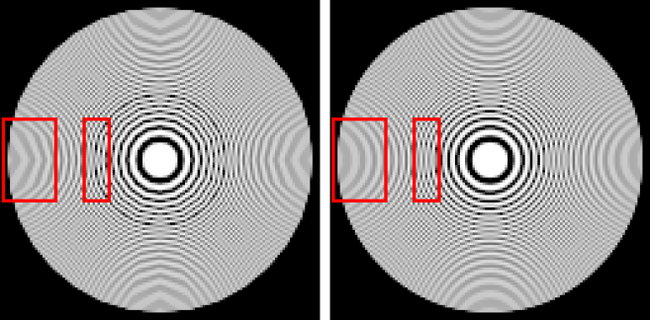
Future work
Analytic visibility:
Adaptive binning / queuing
Exact geometric computations
General input (quads, curved surfaces)
General applications:
Ground truth solution
Analytic shadow maps
Render to vector graphics
Analytic depth peeling
Polygonal approximation Exact circles
Manson & Schaefer, EG 2013
Notes:
The main future avenues we anticipate are the improvement of our method and to explore different applications of it.
Our method would benefit from more advanced load balancing methods such as adaptive binning and using a queuing method instead of our radix sort dependant variant.
The use of exact geometric computations could provably harden our intersection computations against all kinds of degenerate cases.
The use of more general input, from quads to curved surfaces, could generalize our results.
Our methods serves as a ground truth computation for rasterization with a given convolution filter and could be used to validate and measure sampling based approaches.
Our method allows the use of analytic shadow maps to enable exact hard shadow computations.
Furthermore the character of fully analytic pipeline could be exploited by generating vector images as output.
We conjecture that modifications of the visibility stages could allow depth peeling and analytic transparency effects.

Slide 34
Fin
Thank you for your attention
Notes:
This concludes the presentation.
If there are any remarks, suggestions or questions feel free to contact us under thomas.auzinger@cg.tuwien.ac.at.

