Slide 1
Graph-based Guidance in
Huge Point Clouds
Claus Scheiblauer
Michael Wimmer
Institute of Computer Graphics and Algorithms,
Vienna University of Technology, Austria

Slide 2
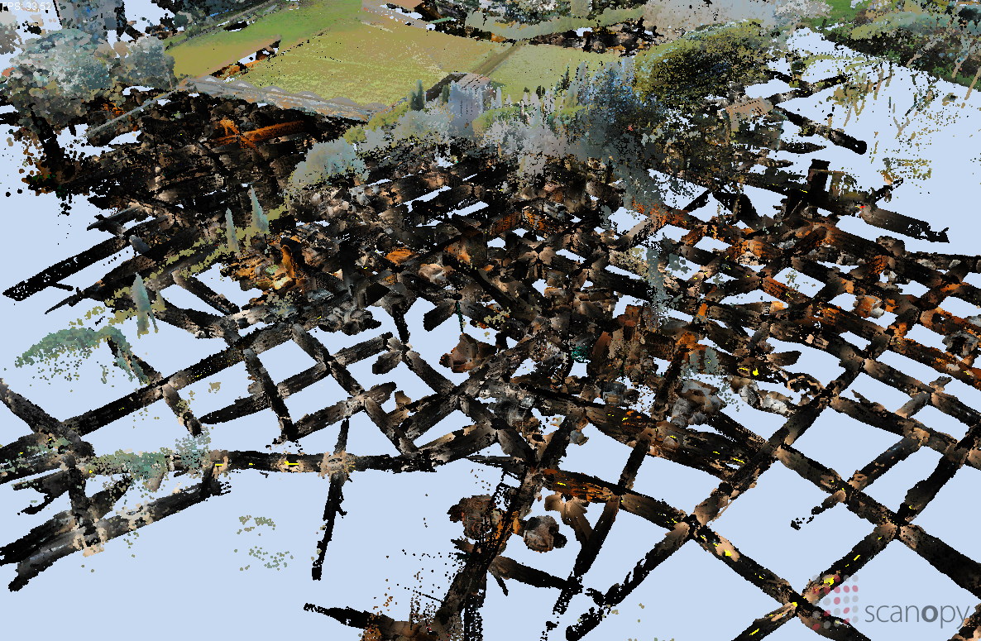
Notes:
To give you an idea which problem we are trying to tackle, I am showing a view from above of a real point cloud model. This is the Domitilla catacomb in Rome, scanned by the FWF funded START project “The Domitilla Catacomb in Rome. Archaeology, Architecture and Art History of a Late Roman Cemetery”. Most of the catacomb is dug into subsoil (Untergrund), but some parts are also visible from above the surface, like the upper part of the basilica. In general it is a late Roman early Christian necropolis consisting of about 12 km of galleries underground, distributed on 4 floors. Due to this huge size of the point cloud one gets easily lost when finding the way through the catacomb.
why no simple camerapath?
The splines, which are used for a camera path for soft movement around corners, are not so easy to set in tight and winding galleries.

Slide 3
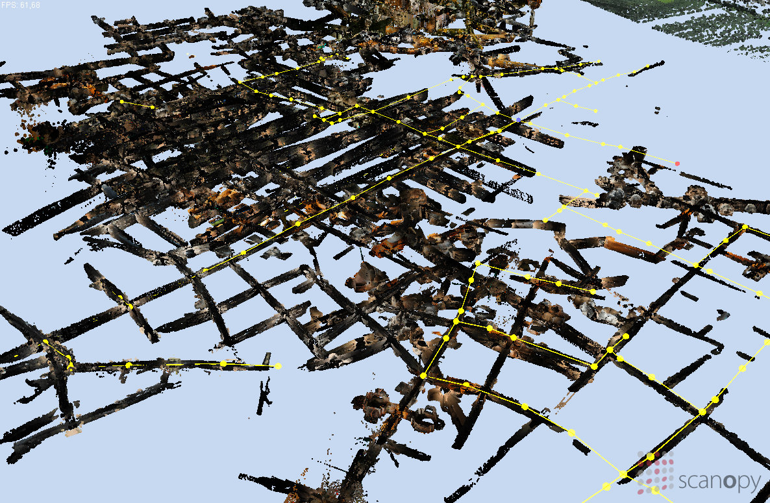
Notes:
What would be really helpful when navigating around this point cloud model is a path you can cling to, so you can avoid parts of these labyrinth like galleries which are not so interesting, and you are guided to the places of interest. We thought about a graph representation of the point cloud model, which acts as kind of a rail system on which the user can move forward and backward, but he cannot leave it. The user can also look around freely while moving on the graph. The graph consists of edges, which are the straight lines, and nodes, which are the dots. Nodes are used to define curves or junctions.
So whats the difference to a simple camerapath? A camera path has the movement speed and the viewing direction always given, for each position on the camera path, so following a camera path is not an interactive experience, at all. You are tightly bound to the pre-defined angles of view along the camera path, and you cannot explore the world around you. With the graph based guidance you can look around freely and also choose, at least to some degree, which way you want to go.

Slide 4
Scanning Data
The amount of scanned data increases
The time for scanning per scan position decreases
Huge models become more common
Interaction with models difficult
  Due to amount of data
  Due to complexity of geometry
Notes:
The amount of scanned data increases and the time for scanning per scan position decreases.
These first two points are due to the latest generation of laser scanners, which produce more data in shorter time, and they are easier to handle during operation.
Because of these new generation laser scanners, huge point models become more common.
The interaction with the models is still difficult, because the amount of data is so big, it does not fit into the memory of computers, and therefore processing and visualization of these amounts of data have to resort to out-of-core algorithms, which means that only parts of the data are loaded from disk to memory, and only these parts of the data are processed or visualized.

Slide 5
Different Usertypes
Expert user
  Interacts often with the data
  Knows the point model
  Knows the program controls
Interested layman
  Visitor to an exhibition
  Interacts once with the data
  Does not know the data
  Does not know the program controls
Notes:
We were thinking about, what kind of usertypes are interacting with point cloud models?
So on the one hand we have the expert user. This is the person who knows all about the scanned object, maybe the employer (Auftraggeber) who ordered a scan from a specific site, or he even scanned the site himself. He interacs often with the data to inspect it, to judge the quality of the scans, and so on. He knows the point model, the layout of the geometry, and he also knows the program controls, how to move around and interact with the data.
On the other hand there is the interested layman, which can be described as a visitor in an exhibition. He will interact with the data for the first time, so it is probably more difficult to orient himself inside the model, he also does not know where to search for the places of interest in the model.
With the graph based guidance we want to aid the interested layman in exploring huge point clouds by presenting the most interesting ways through the data.

Slide 6
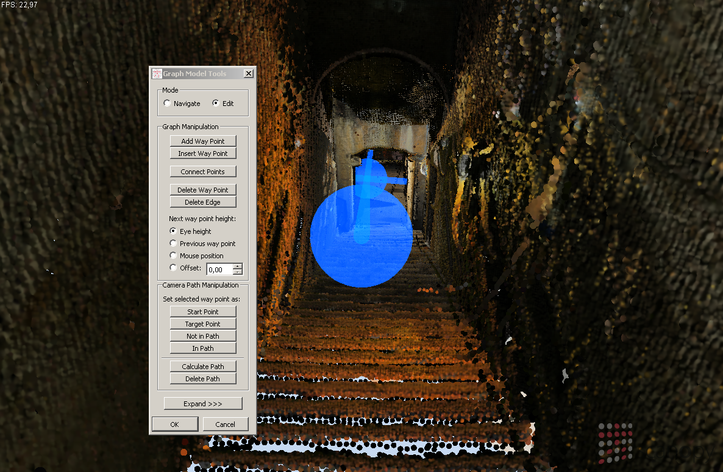
Notes:
This is just a quick view to the editing tools for graph-based models. Defining a graph model goes like setting nodes at appropriate positions, and the edges then connect the nodes. A node can have an arbitrary number of direct neighbors, and this way junctions can be defined. Nodes can be positioned freely in 3D space, and there are also different tools to ease positioning a new node, like using the current mouse position for the new node position.

Slide 7
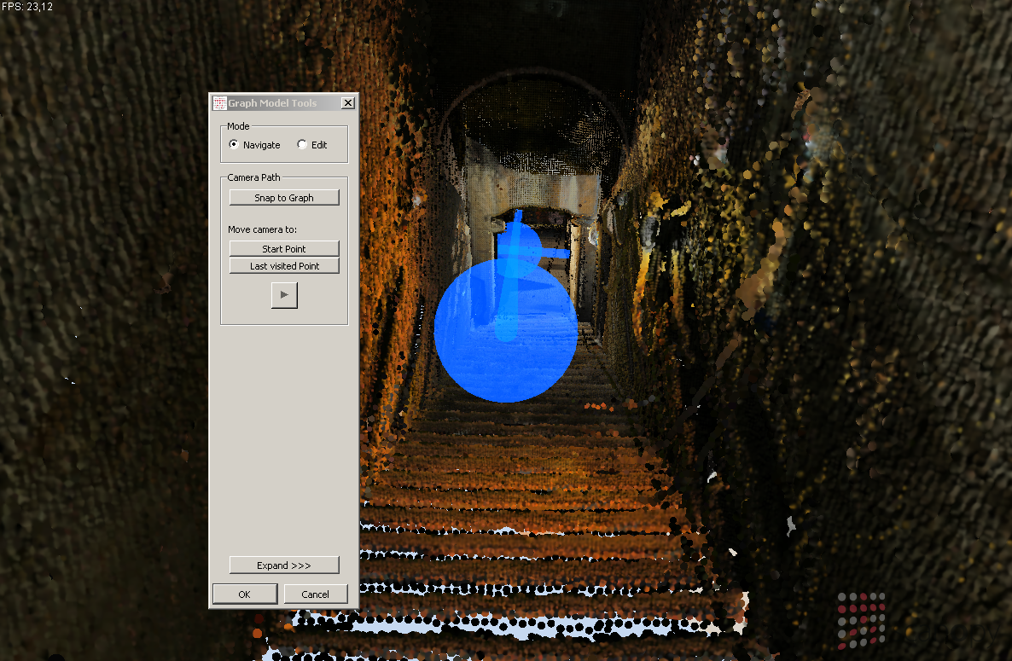
Notes:
This is the interface a user would see, but actually only the „PLAY“ button is needed when used for an exhibition. The play button means the viewpoint is moved along the edges of the graph, the speed can be controlled by the user. The view direction can also be changed by the user, the default view direction is along the direction of movement. The movement can of course also be stopped at any time.

Slide 8

Notes:
When a junction is reached the movement stops and the user can decide which way to follow. This can be done with the mouse, and I will show this later in the live demo.
What you see here is a textured mesh. While the whole Domitilla catacomb was scanned by laser scanners, some areas of the catacomb were also reconstructed by photogrammetry methods. This was done in areas where interesting wall paintings exist. In our viewer we can combine the point cloud models with these textured meshes, and can give a complete view of the catacomb. The point cloud and the textures of the meshes are managed out-of-core, because the data for these resources are too large to fit into memory.

Slide 9
Acknowledgements
FFG FIT-IT Projekt “Terapoints”
FWF funded START project “The Domitilla Catacomb in Rome. Archaeology, Architecture and Art History of a Late Roman Cemetery”
Wiener Dombauhütte zu St.Stephan
Imagination Computer Services
Notes:
Before I show the live demo I would like to thank
the FFG FIT-IT project „Terapoints“ for sponsoring our work,
the FWF funded START project “The Domitilla Catacomb in Rome. Archaeology, Architecture and Art History of a Late Roman Cemetery”,
the Wiener Dombauhütte zu St.Stephan,
and to Imagination Computer Services for their support.

Slide 10
Live Demo
Domitilla catacomb point model
  1.9 billion points
  40 virtually textured models
  34 GB on disk
Stephansdom point model
  470 million points
  7 GB on disk

Slide 11
Light Background Slides
The standard color scheme is light background with dark text – it must be used by default
Select “Format / Slide Design…” and “Color Schemes” on the right side panel
By right-clicking on a color scheme you can apply it to the current slide

Slide 12
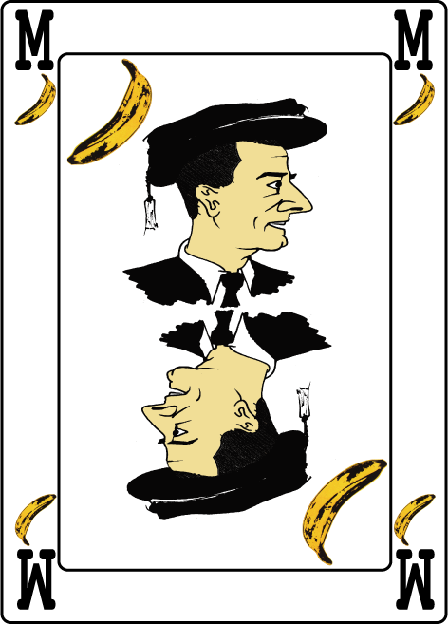
Motivation
The quick brown fox jumps over the lazy master
The quick brown fox jumps over the lazy dog
The quick brown master jumps over the lazy dog

Slide 13
Outline
The quick brown fox jumps over the lazy dog
  The quick brown fox jumps over the lazy master
    The quick brown fox jumps over the lazy dog
      The quick brown fox jumps over the lazy dog
The quick brown fox jumps over the lazy master
  The quick brown fox jumps over the lazy dog

Slide 14
Conclusions
The quick brown fox jumps over the lazy dog
The quick brown master jumps over the lazy dog
The quick brown fox jumps over the lazy dog
The quick brown master jumps over the lazy dog
The quick brown fox jumps over the lazy dog

