Slide 1



Visualization of
Industrial 3DX-ray Computed Tomography Data
Artem Amirkhanov ^{1,2}
Supervisors: Ao.Univ.Prof. Dipl.-Ing. Dr.techn Eduard Gröller
Dipl.-Ing.(FH) Dr.techn Christoph Heinzl
¹ Institute of Computer Graphics
and Algorithms
Vienna University of Technology
² University of Applied Sciences Upper Austria
Wels Campus, Austria

Slide 2
Industrial 3D X-ray Computed Tomography (3DXCT)
Reconstruction
Projections
3D Volume

Slide 3
Placing the specimen
Specimen
Rotary plate

Slide 4

Placing the specimen
Duct tape
Foam

Slide 5
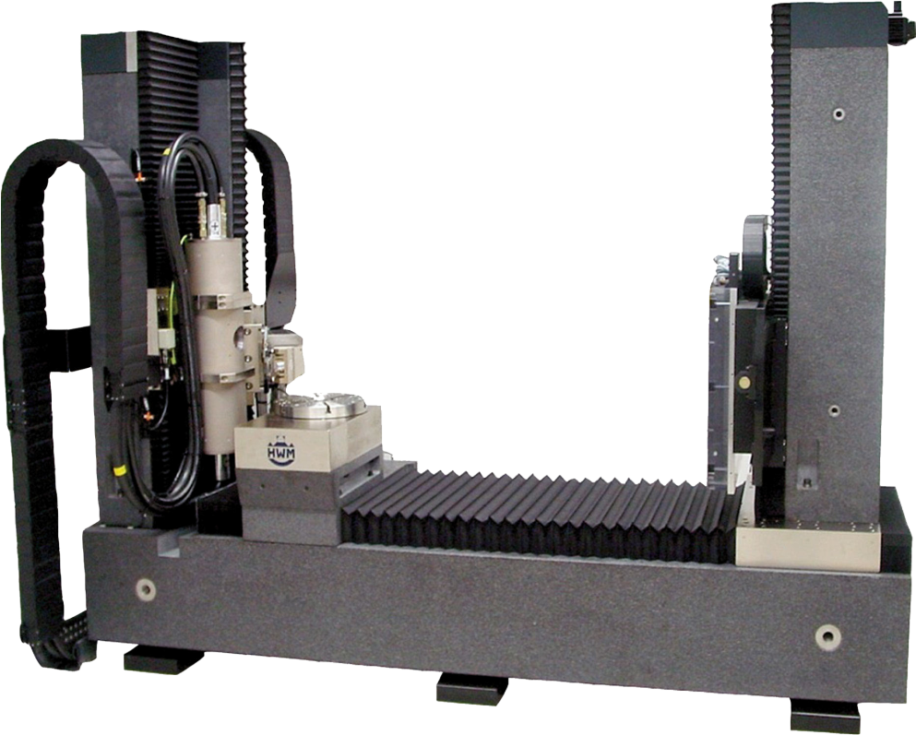
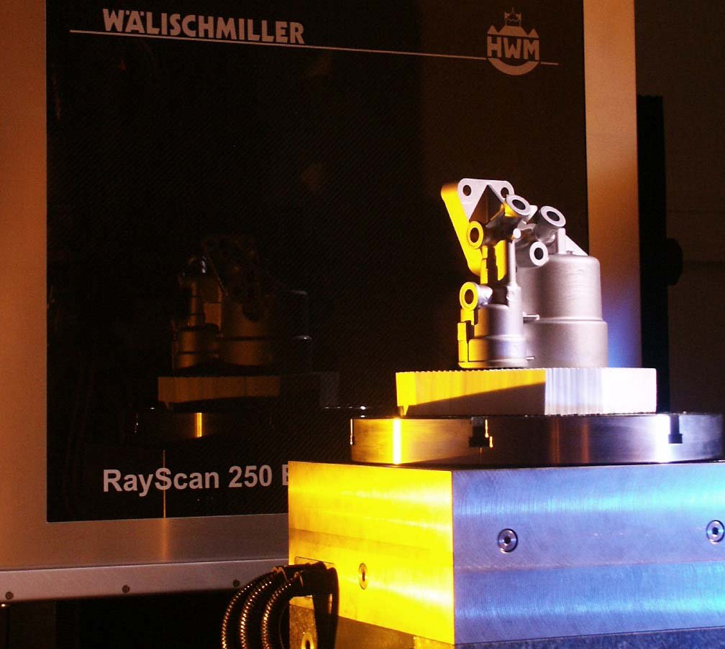
Industrial 3D X-ray Computed Tomography (3DXCT)

Slide 6
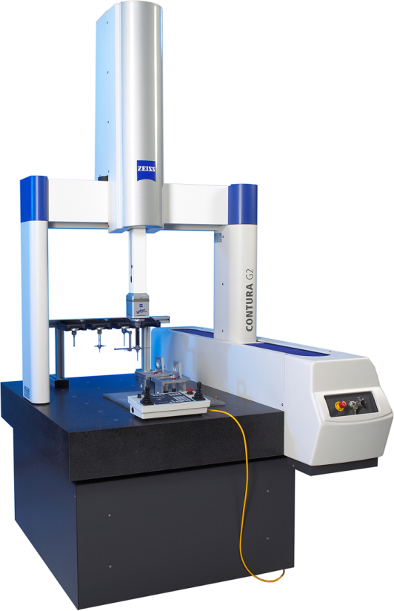
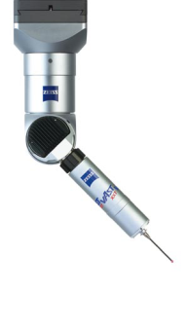
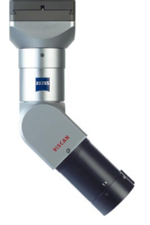
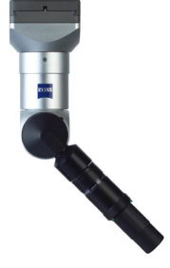
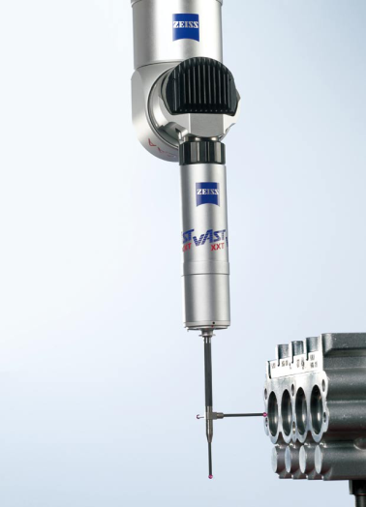
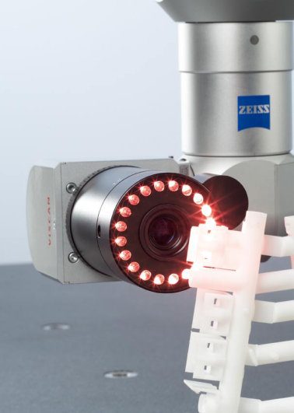
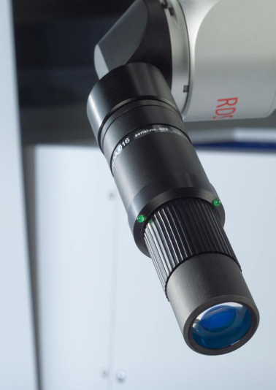
Industrial Metrology and Geometric Tolerancing
Coordinate measurement machines
  Tactile
  Optic

Slide 7
3DXCT Advantages
Powerful technique for generating a digital 3D volumetric dataset of a specimen from 2D projections
Wide range of materials
Full characterization of the specimen’s exterior and interior structures without destroying or disassembling it
Used for non-destructive testing and quality control

Slide 8
Industrial 3DXCT Scanning Workflow
Contribution 1
Contribution 2
Contribution 3
Scan planning and setup
Scanning
Reconstruction and data enhancement
Visualization and analysis
?
Scan parameters
2D projections
3D volume
Insight

Slide 9
Contributions
A. Amirkhanov et al. Visual Optimality and Stability Analysis of 3DCT Scan Positions. IEEE Transactions on Visualization and Computer Graphics, 17(6): 1477 – 1486, Nov. – Dec. 2010.
A. Amirkhanov et al. Projection-Based Metal-Artifact Reduction for Industrial 3D X-ray Computed Tomography. IEEE Transactions on Visualization and Computer Graphics, 17(12): 2193 – 2202, Dec. 2011.
A. Amirkhanov et al. Fuzzy CT metrology: Dimensional measurements on uncertain data. Technical report, Institute of Computer Graphics and Algorithms, Vienna University of Technology, Sept. 2012. Contact: technical-report@cg.tuwien.ac.at.

Slide 10
Visual Optimality And Stability Analysis Of Scan Positions
Contribution 1
Contribution 1
Scan planning and setup
Scanning
Reconstruction and data enhancement
Visualization and analysis
Scan planning and setup
?
?
Scan parameters
Scan parameters
2D projections
3D volume
Insight

Slide 11

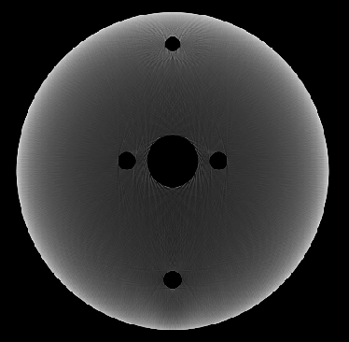
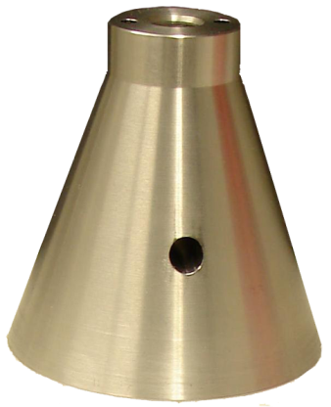


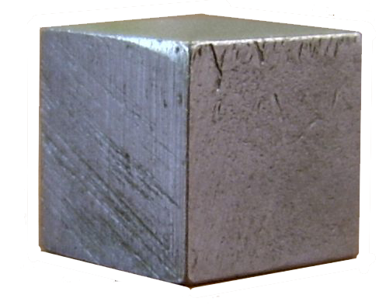
Motivation: Artifacts Affected by Placement
Beam-hardening
no artifacts
artifacts
Bad planar faces
no artifacts
artifacts
Artem Amirkhanov
10
Notes:
10

Slide 12
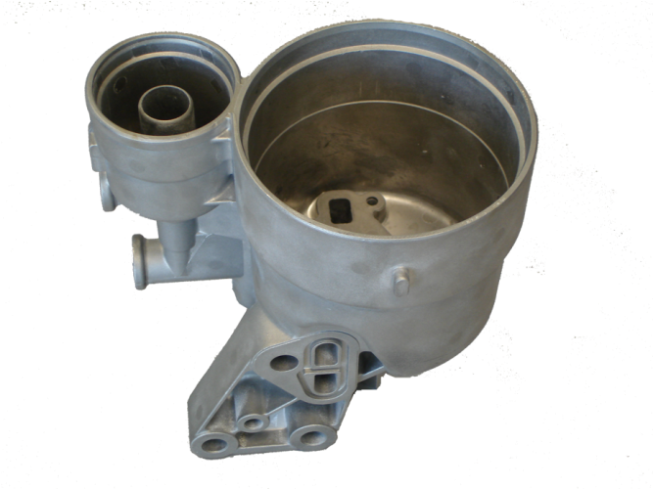
Specimen Placement
Placement is
  Crucial
  Hard to find
  Based on knowledge of technicians

Slide 13
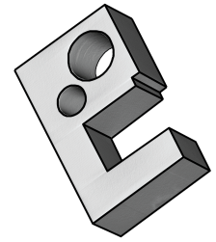
Motivation
CAD Model
Our Method
Assisted Good Placement
Artem Amirkhanov
12
Notes:
12

Slide 14
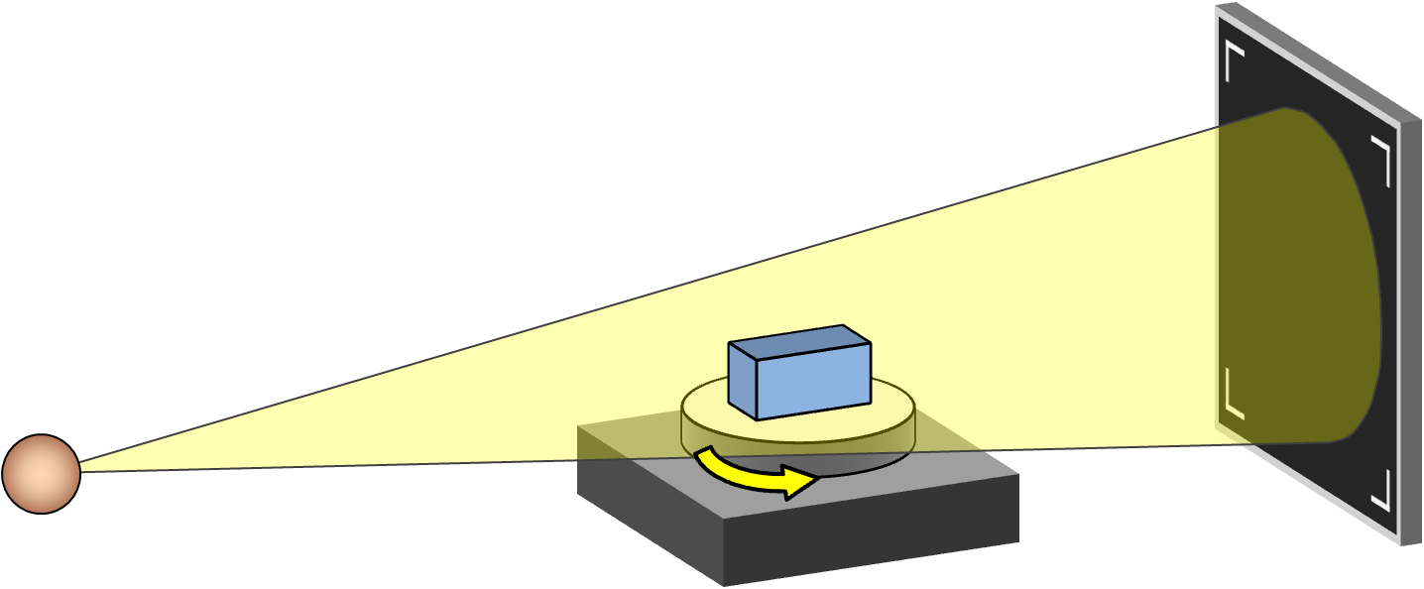
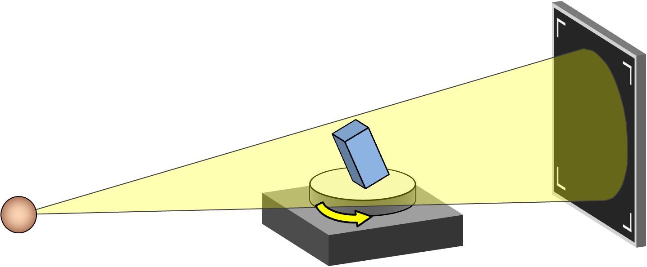
Good/Bad Placement Example
Bad:
Good:
Artem Amirkhanov
13
Notes:
13

Slide 15
Criteria and Methods
Shortest penetration lengths
    Method: ray casting
Smallest bad planar faces area
    Method: Radon-space analysis
Stable within a certain range of reliability
    Method: stability widget

Slide 16
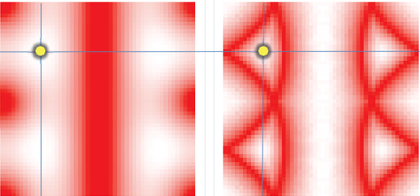
Workflow
CAD model
Simulation
Parameter
spaces
Assisted good placement
Visual
analysis

Slide 17
Simulation
Set of candidate placements
Placement is defined by the orientation
Orientation is defined by two Euler angles α and β
β
α

Slide 18
Ray Casting Simulation
Reflects the scanning geometry
Set of projections for every placement
Parameters
  Maximum penetration length
  Average penetration length

Slide 19
Radon-Space Analysis
Supporting planes → points in Radon space
Finding bad points in Radon space
Parameter
  Bad faces area percentage

Slide 20
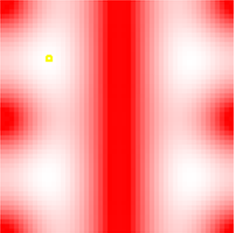
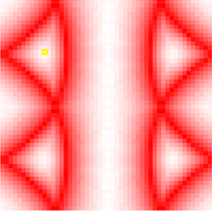
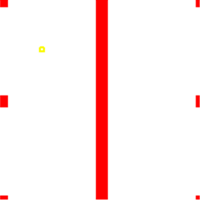
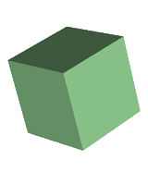
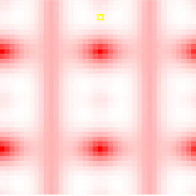
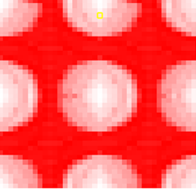
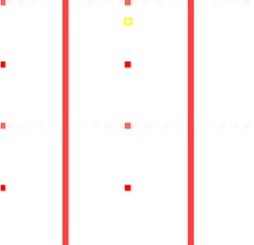

Objective Measures Representation
Average penetration length
Maximum penetration length
Bad faces surface percentage
β
Specimen 1
α
Specimen 2
Best
Worst
Parameter value:

Slide 21
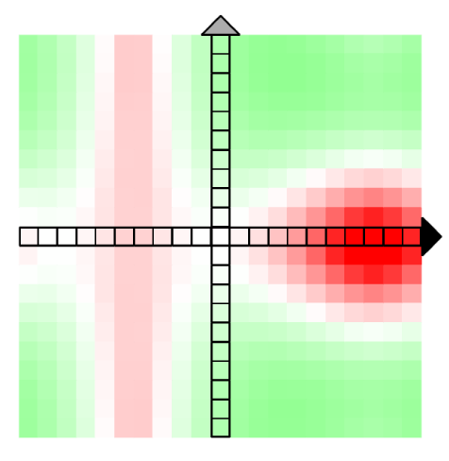
Stability Widget
β-axis stability arrow
β
Good placement
Current placement
Bad placement
α-axis stability arrow
α
Parameter value:
Better
Same
Worse

Slide 22
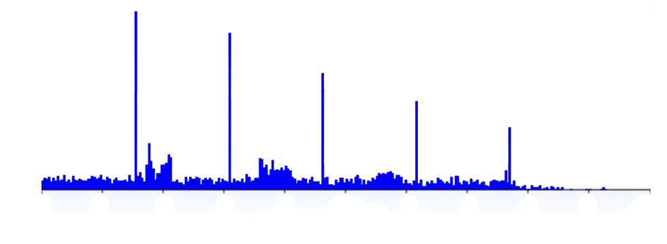
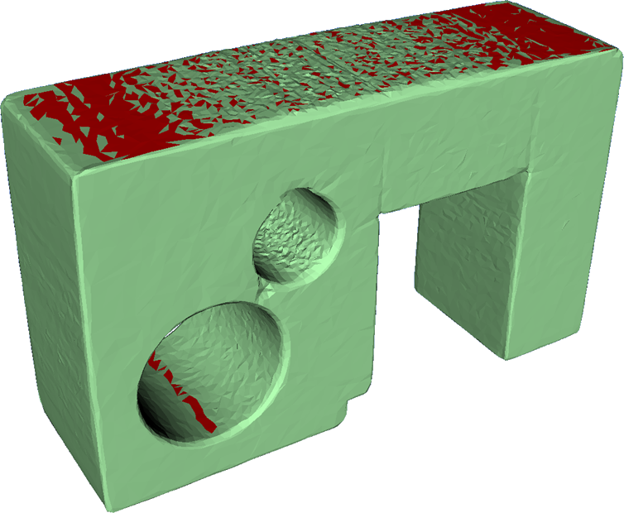
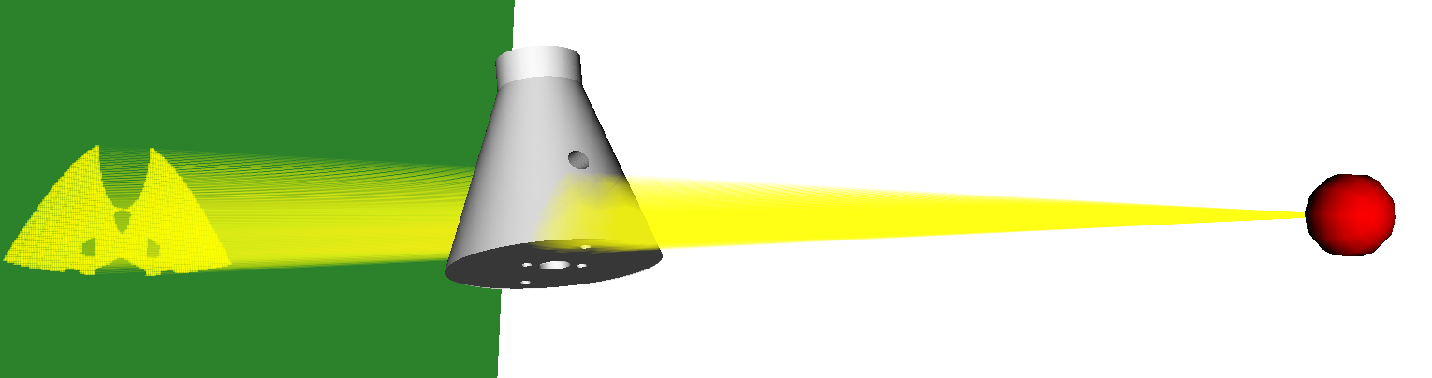
Data Visualization and Exploration
Penetration-length histograms
Visualizing ray subsets .
Color coding bad faces .
Bad triangles
Number of rays
Detector
Source
0
Projection
30
Rays
60
Penetration length, mm

Slide 23
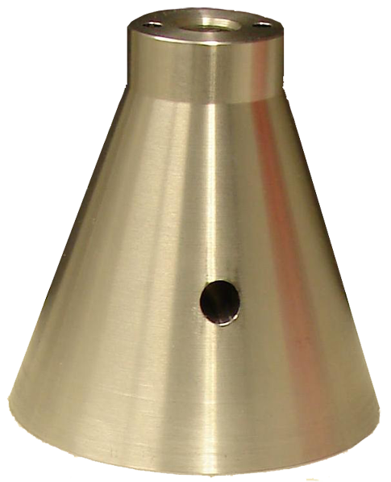
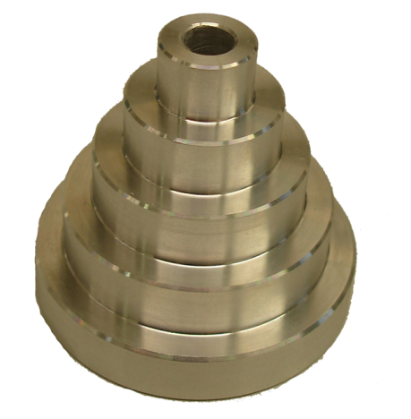
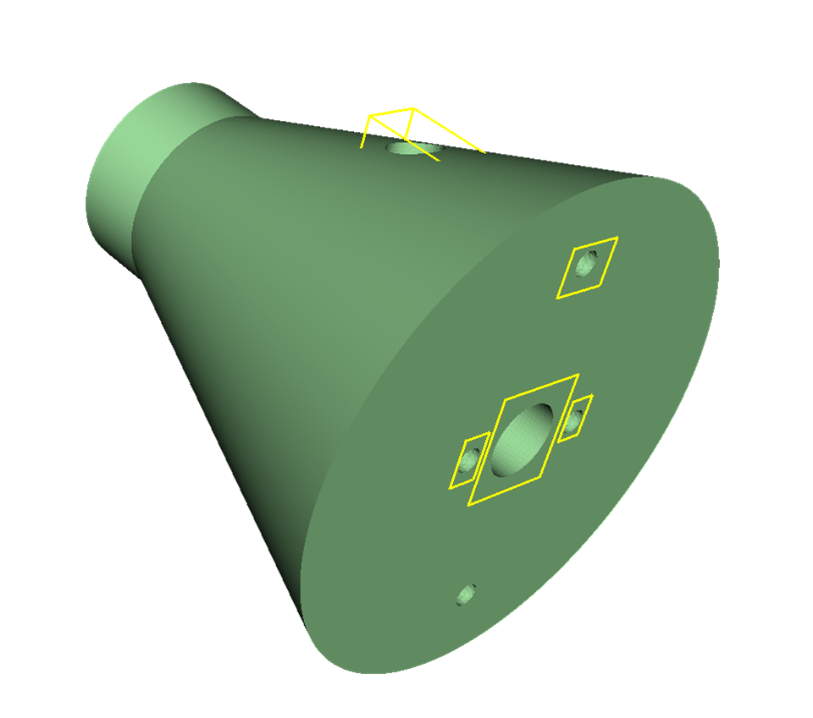
Evaluation Using Dimensional Measurements
Two test-parts
Set of placements with
different tilts
Measurement features
  Radius
  Distance
Measurement quality estimated
and compared with simulation
predictions
Selected features

Slide 24
Evaluation Using Dimensional Measurements
Radii are predicted by penetration lengths
  Average length: 5/9 and 5/7
  Maximum length: 7/9 and 6/7
Linear distances are correlated with radon-space analysis results

Slide 25
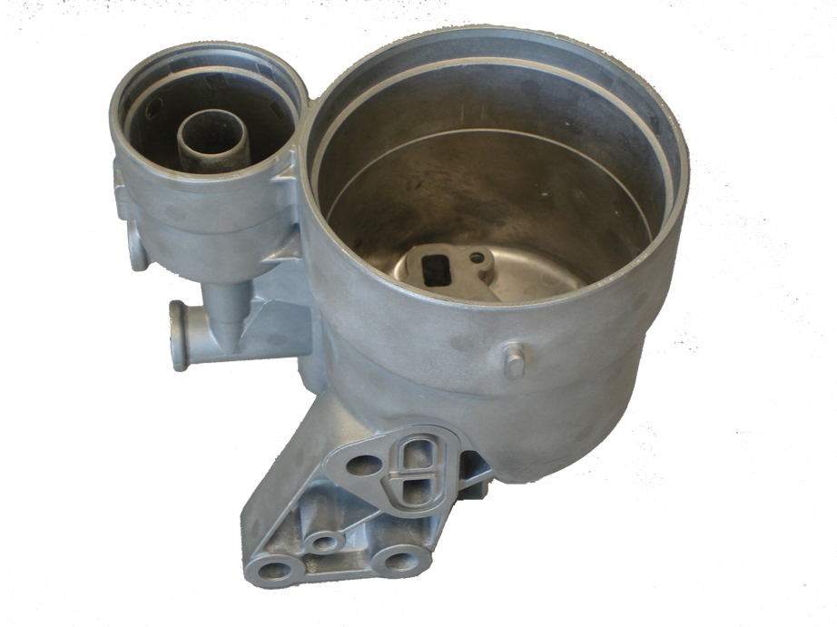
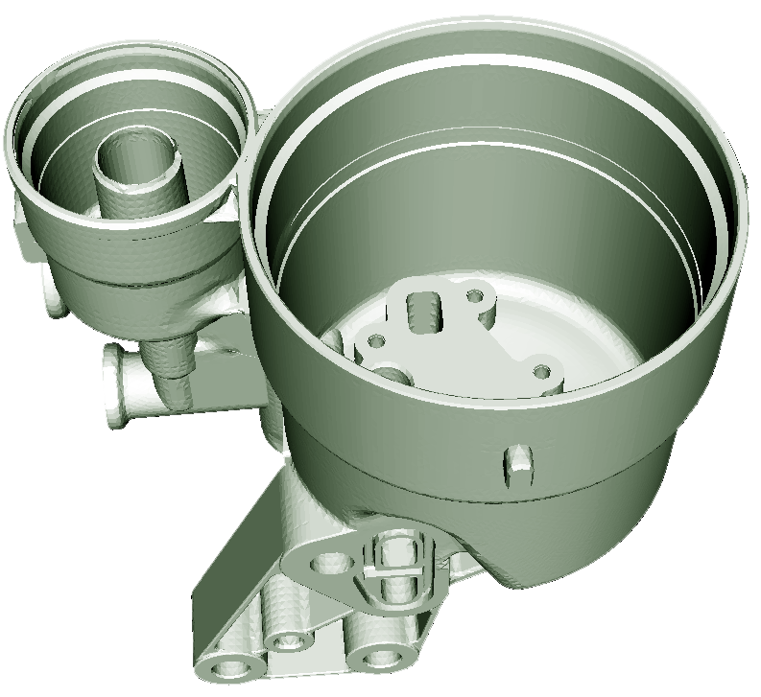
Evaluation Using Variance Comparison
Complex real world specimen
Best and worst placements
Variance comparison of the iso-surfaces with the CAD model

Slide 26

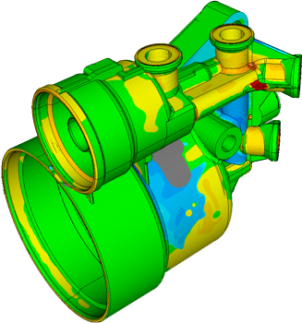
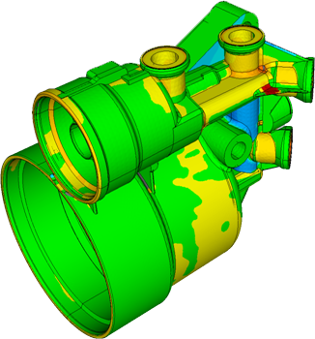
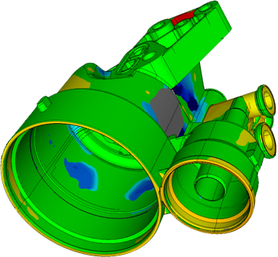
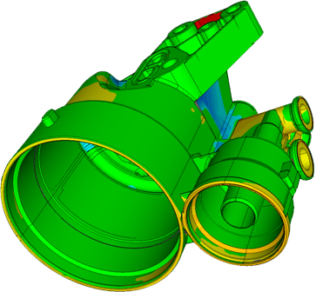


Evaluation
Bad Placement
Good Placement
Position deviation spectrum in [mm]
Position deviation spectrum in [mm]
2
1
0
-1
-2
2
1
0
-1
-2

Slide 27
Limitations and Future Work
Orientation only
  Detect orientation and position in sequence
Still requires user interaction
  Combining parameters

Slide 28
Projection-Based Metal-Artifact Reduction
Contribution 2
Contribution 2
Scanning
Reconstruction and data enhancement
Visualization and analysis
Scan planning and setup
Reconstruction and data enhancement
?
Scan parameters
3D volume
2D projections
3D volume
Insight

Slide 29
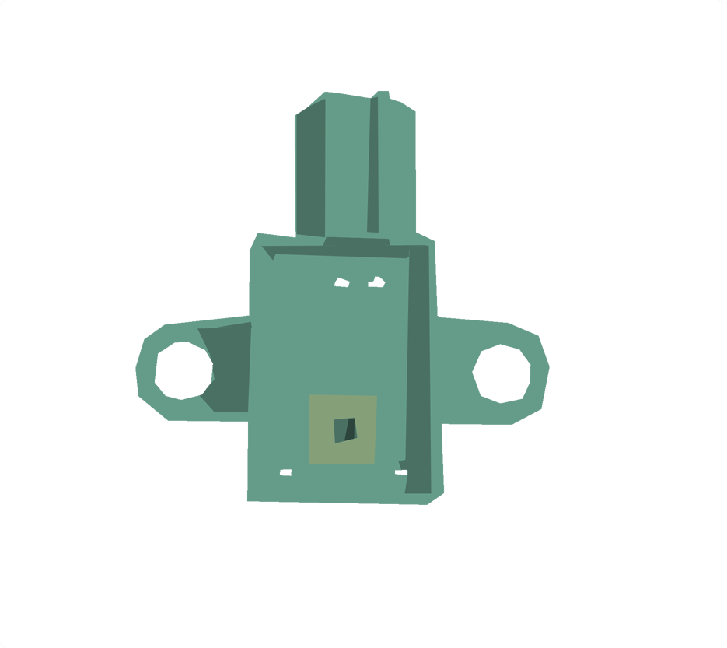

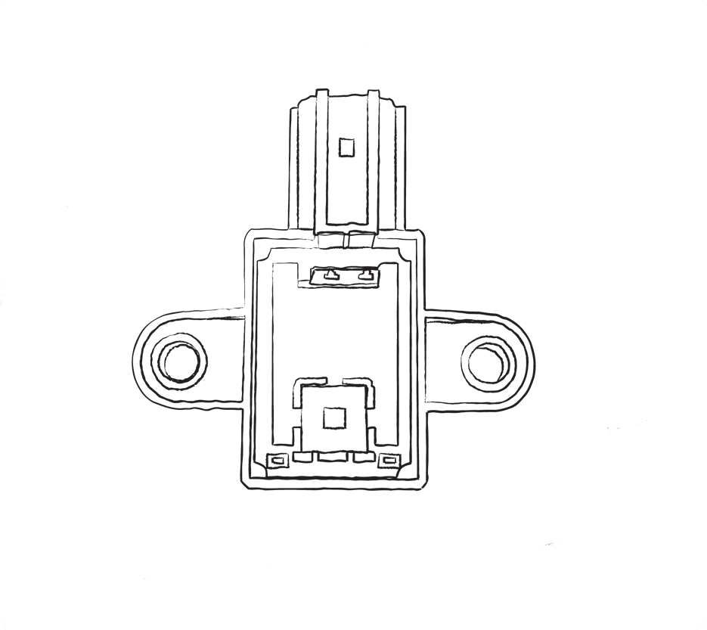

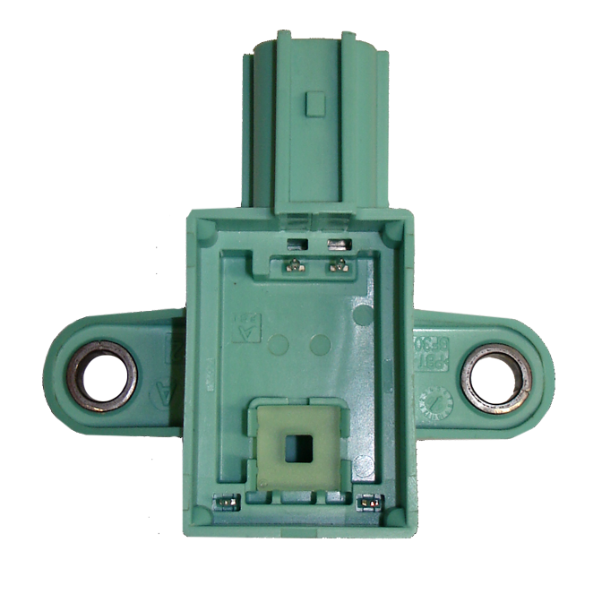
Multi-Material Components (MMCs)
Most industrial parts are MMCs
Materials:
  Air
  Plastic
  Metal

Slide 30
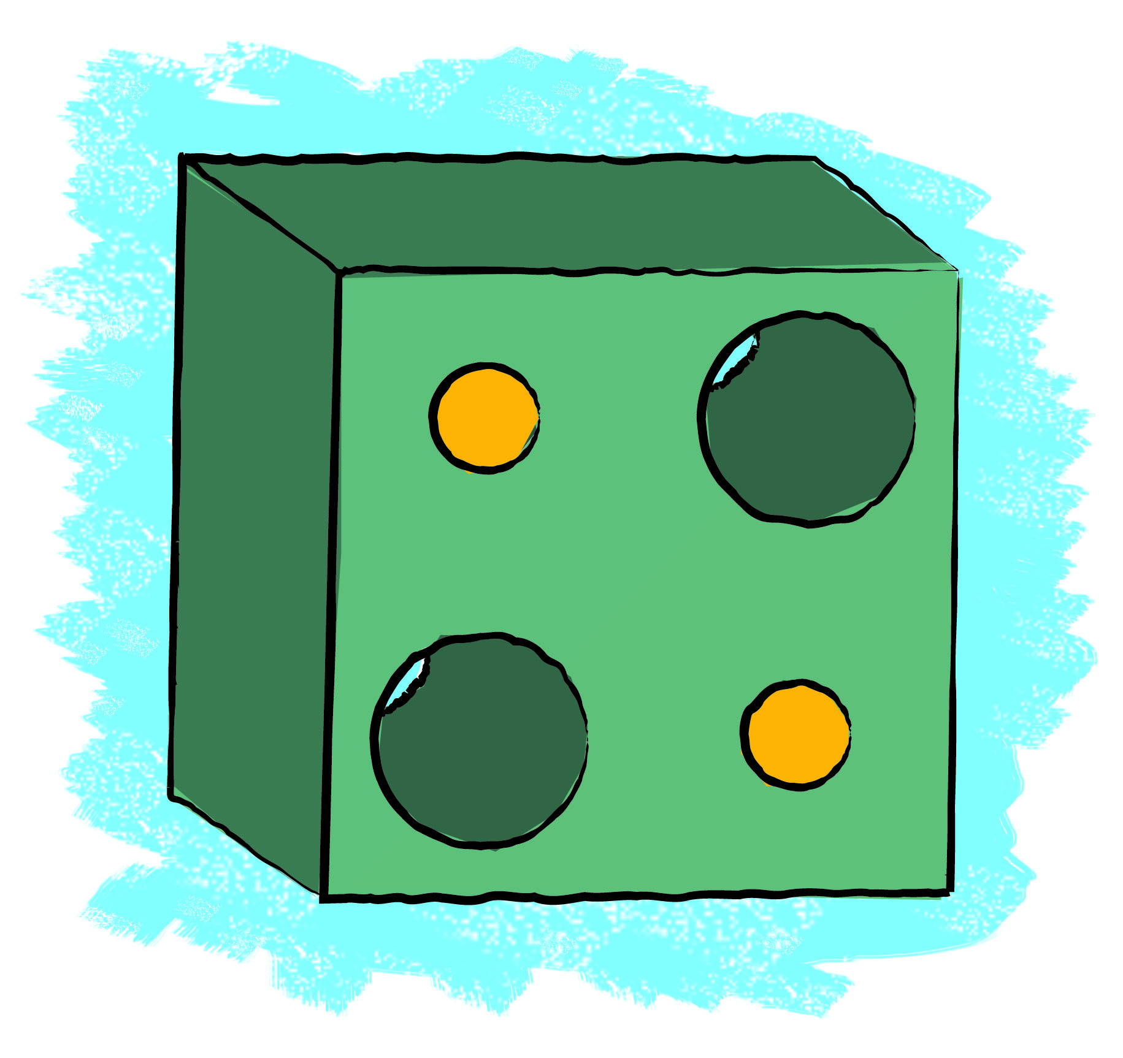

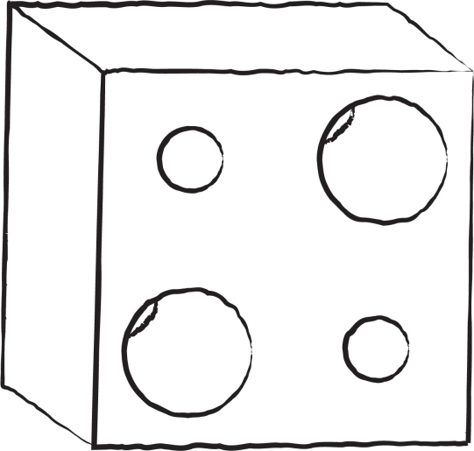
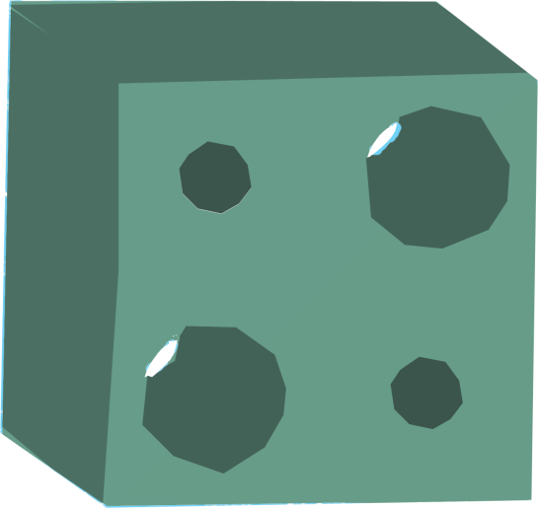

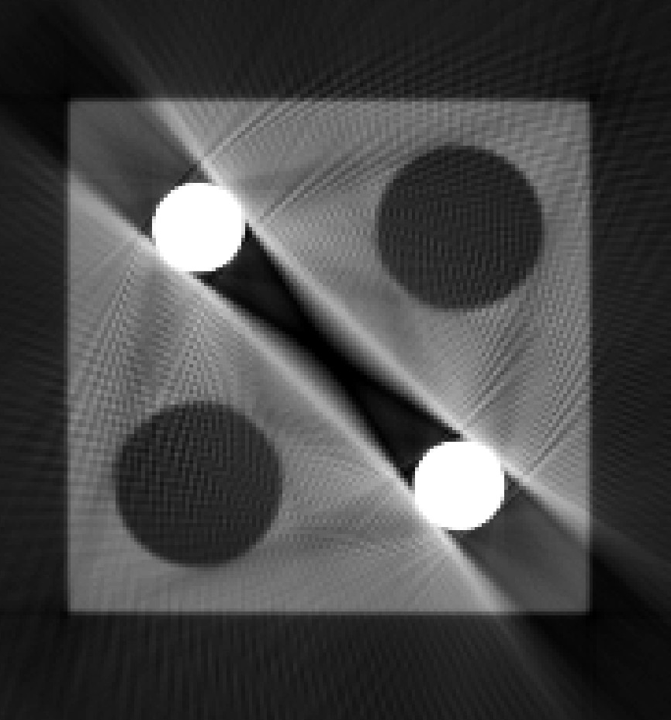

Metal Artifacts
Appear in MMCs
Metal artifacts
  Dark-band artifacts
  Streak-noise artifacts
Caused by beam hardening
Bad for
  Material characterization
  Measurements
Dark-band artifacts
Streak-noise artifacts

Slide 31
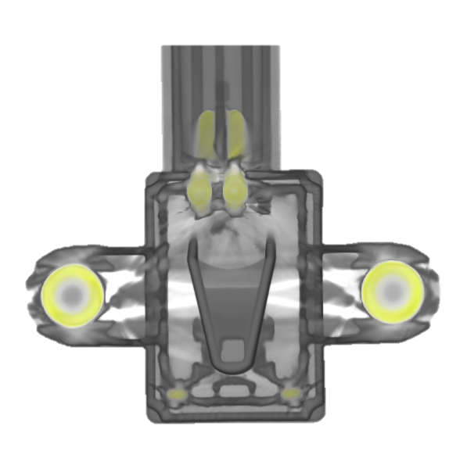
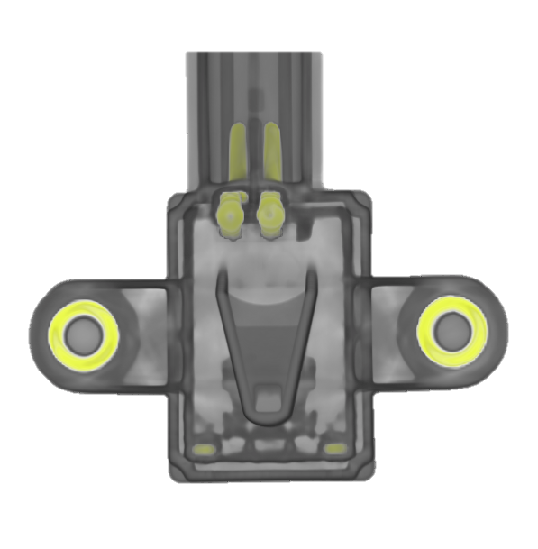
Our Contributions
Adaptation of a projection-based metal artifacts reduction (MAR) workflow for 3DXCT
Integrated visual analysis tool
Integrated VA Tool
MAR Workflow

Slide 32
Metal Artifact Reduction (MAR) Workflow
X-ray source
Detector
Rotary plate

Slide 33
Metal Artifact Reduction Workflow
Projections
3D Volume
Reconstruction
Segmentation
Forward projection

Slide 34
Metal Artifact Reduction Workflow
Projections
3D Volume
Reconstruction
Interpolation
Forward projection

Slide 35
Metal Artifact Reduction Workflow
3D Volume
Result
Fusion

Slide 36

Material Separation
Attenuation coefficient thresholding
Artem Amirkhanov
35
Notes:
35

Slide 37
Forward Projection
Project every metal voxel on every projection
Projection
Covered pixels
Voxel center
Metal voxel
Projected
voxel diagonal
Artem Amirkhanov
36
Notes:
36

Slide 38
Interpolation
Row-wise linear interpolation along the X axis
Artem Amirkhanov
37
Notes:
37

Slide 39
Interpolation
Row-wise linear interpolation along the X axis
Artem Amirkhanov
38
Notes:
38

Slide 40
Interpolation
Row-wise linear interpolation along the X axis
Start of the gap
End of the gap
Artem Amirkhanov
39
Notes:
39

Slide 41
Interpolation
Row-wise linear interpolation along the X axis
Start of the gap
End of the gap
Artem Amirkhanov
40
Notes:
40

Slide 42

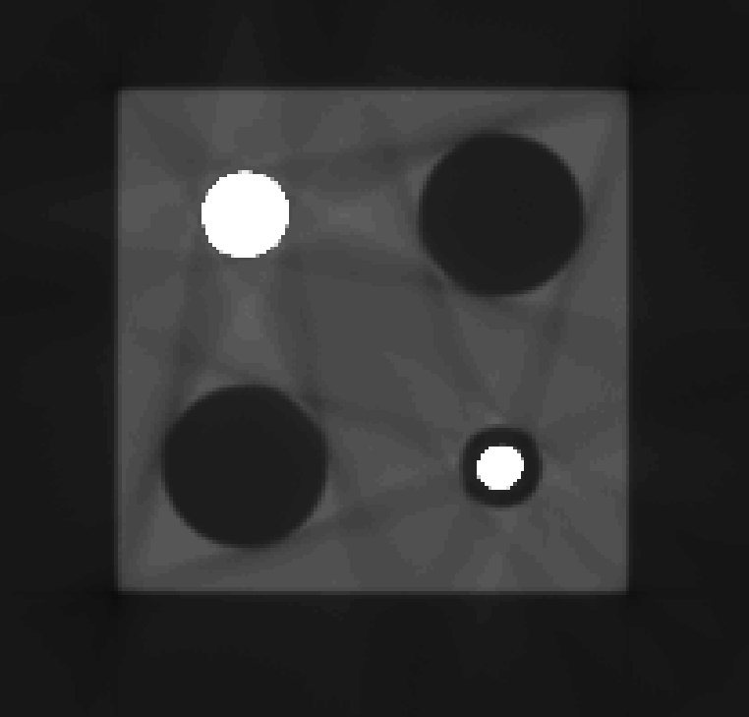
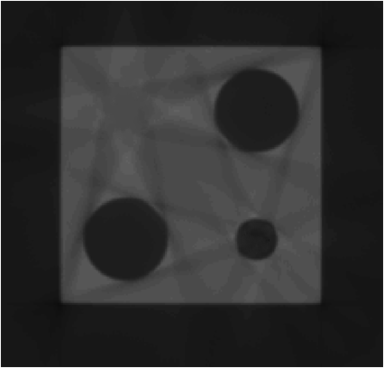
Fusion
Interpolation on the metal boundaries for smooth appearance
Artem Amirkhanov
41
Notes:
41

Slide 43
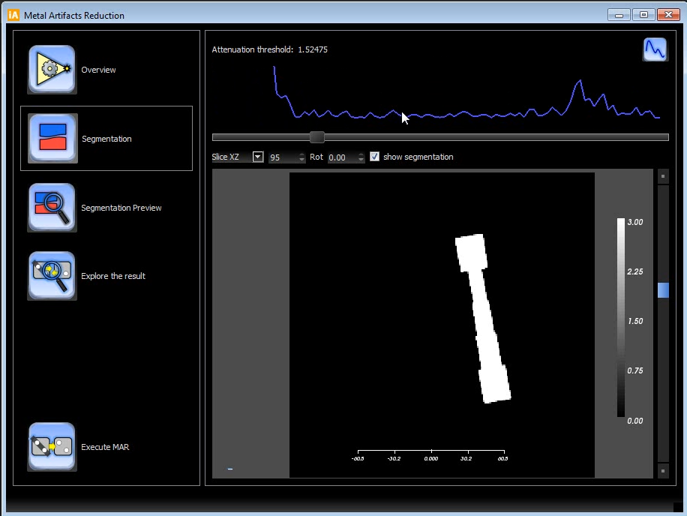
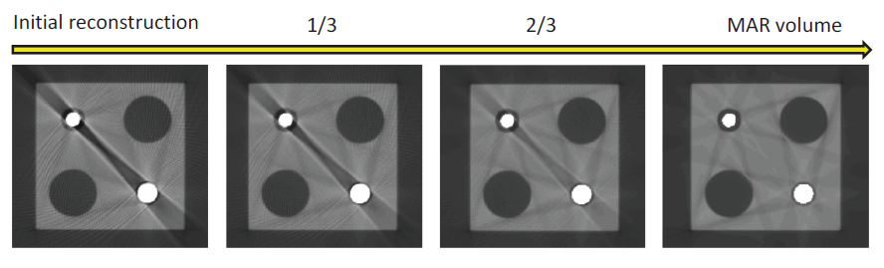
Integrated Visual Analysis Tool
Steps of the workflow are integrated
Visual threshold estimation
  Segmentation preview
  Result preview
Visual result exploration
Artem Amirkhanov
42
Notes:
42

Slide 44

Integrated Visual Analysis Tool
Artem Amirkhanov
43
Notes:
43

Slide 45


Results (1)
Artem Amirkhanov
44
Notes:
44

Slide 46


Results (2)
Artem Amirkhanov
45
Notes:
45

Slide 47


Results (3)
Artem Amirkhanov
46
Notes:
46

Slide 48


Limitations
Interpolation introduces blurring in the result
Limiting factor: metal projected area

Slide 49


Limitations
Interpolation introduces blurring in the result
Limiting factor: metal projected area

Slide 50
Conclusions
MAR for 3D industrial MMCs
  Significant artifact reduction
  Works for various datasets
Integrated visual analysis tool
  Assisting user in threshold estimation
  Exploring the result
GPU implementation (CUDA)
  Reconstruction
  Forward-projection
  Interpolation

Slide 51
Fuzzy CT Metrology:
Dimensional Measurements on Uncertain Data
Contribution 3
Contribution 3
Visualization and analysis
Scan planning and setup
Scanning
Reconstruction and data enhancement
Visualization and analysis
?
Scan parameters
2D projections
3D volume
Insight
Insight

Slide 52
Geometric Tolerancing
Features of interest: measurement plan
Properties of features are evaluated
Common tolerances
  Straightness
  Circularity
  Flatness

Slide 53
Straightness
symbol of
geometric tolerance
tolerance value
0.1
label
specimen crossection

Slide 54
Straightness
tolerance value
tolerance value = 0.1
0.1
deviation
position on reference primitive

Slide 55
Circularity
tolerance value = 0.1
0.1

Slide 56
Flatness
tolerance
value = 0.1
0.1

Slide 57

Industrial 3DXCT Metrology
Carl Zeiss Calypso

Slide 58

Industrial 3DXCT Metrology
Conventional
3DXCT
Actual Specimen
Measurement Plan
Extracted
Surface Model
Measurement Plan
Coordinate Measurement Machine
Software
Measurements
Measurements

Slide 59
Overview
Extracted
Surface Model
Measurement Plan
Reconstructed
3D Volume
Statistical Analysis
Measurements
Material Interface Uncertainty

Slide 60
Overview
Measurements
Material Interface Uncertainty
Uncertainty Visualization
3D Labels
Reference Shapes
Measurement plots
Overview
Levels-of-Detail
Details

Slide 61


Statistical Analysis
Bayesian classification
Material interface probabilities
$$P(air) \\ P(plastic) \\ P(metal)$$
$$P(air/plastic)$$
$$or \\ P(plastic/metal)$$
$$or \\ P(air/metal)$$

Slide 62







Labels
Collapsed
Expanded
Straightness
Circularity
Flatness

Slide 63



Reference Shapes
Deviation Color Coding
Uncertainty to Thickness
Positive Deviation
Negative Deviation
Tolerance Zone

Slide 64




Measurement Plots
Conventional
Plot
Uncertainty Aura
High
Uncertainty
as Context
Low

Slide 65





Use Cases: Reconstruction Artifacts

Slide 66



Use Cases: Duct Tape
Duct tape

Slide 67



Use Cases: Beam Hardening Artifacts

Slide 68

Video Demonstration

Slide 69
Evaluation: Domain Experts Feedback
Deviation color coding on the reference shapes
Interactivity of the measurement plots
3D labeling
Uncertainty visualizations are limited when
  Lower resolution
  Reconstruction artifacts

Slide 70
End

Slide 71
Conclusions
Targeted issues
  Scan parameters tuning
  Material characterization of MMCs
  Minimization and reduction of 3DXCT artifacts
  Measurements and geometric tolerancing using 3DXCT scans
Contributions
  Finding of optimal placement
  Metal-artifact reduction for MMCs
  Dimensional 3DXCT measurements on uncertain data

Slide 72
Conclusions
Three visual analysis systems implemented within iAnalyse framework
Results evaluated with respect to metrology applications
Results were demonstrated and validated using test parts and real-world industrial components

Slide 73


The End
Thank you!
artem@cg.tuwien.ac.at

