Slide 1
Fast Accurate Soft Shadows with Adaptive Light Source Sampling
Michael Schwärzler¹, Oliver Mattausch², Daniel Scherzer³, Michael Wimmer⁴
¹VRVis Research Center, ²University of Zürich, ³MPI für Informatik, ⁴Vienna UT

Slide 2
Physically Correct Soft Shadows…
… are cast by a light source with a certain extent,
… consist of umbra und penumbra,
… and can be generated by sampling the light source.
umbra
penumbra

Slide 3
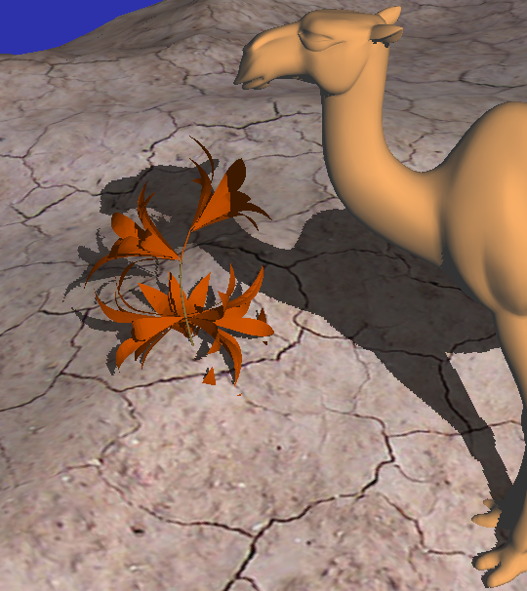
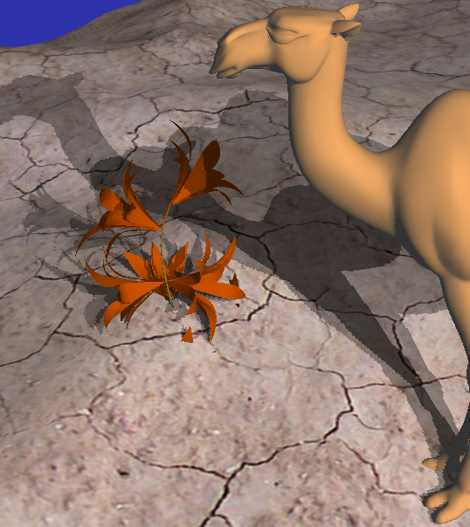
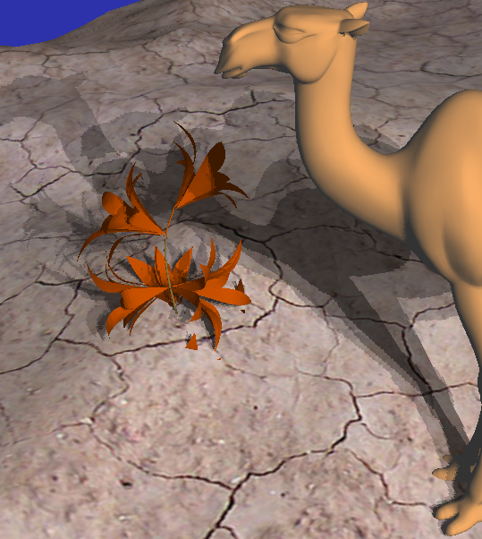
Physically Correct Soft Shadows…
… are cast by a light source with a certain extent,
… consist of umbra und penumbra,
… and can be generated by sampling the light source.

Slide 4
The sampling of the light source…
… is computationally expensive!
Interactive / Real-time frame rates hard to achieve
“Fake” approaches are fast, but inaccurate
# samples: 256
Undersampling: Banding artifacts!

Slide 5
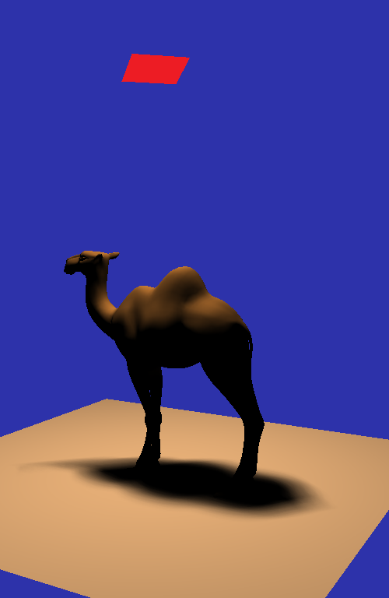
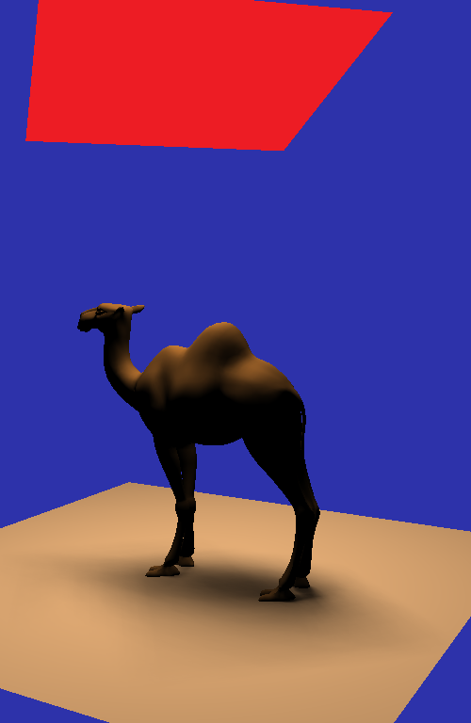
The number of samples…
… depends on the size of the penumbra region,
and therefore on the scene configuration
Light source size

Slide 6
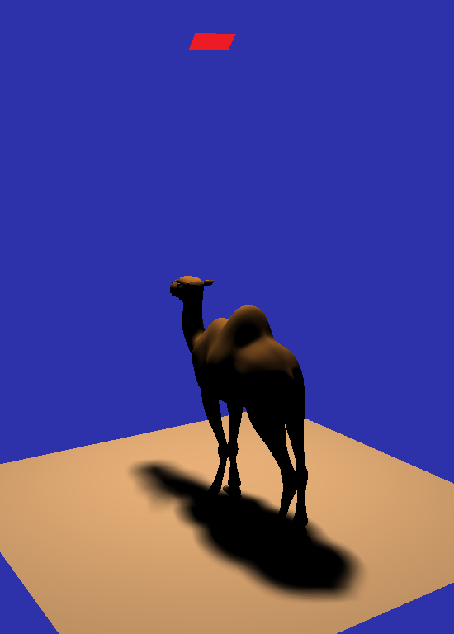
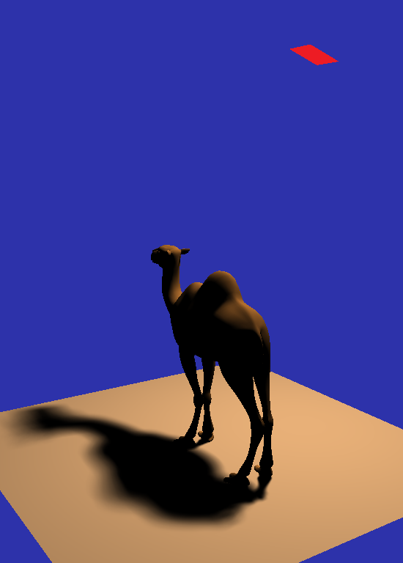
The sampling of the light source…
… depends on the size of the penumbra region,
and therefore on the scene configuration
Relation between light, occluder and receiver

Slide 7
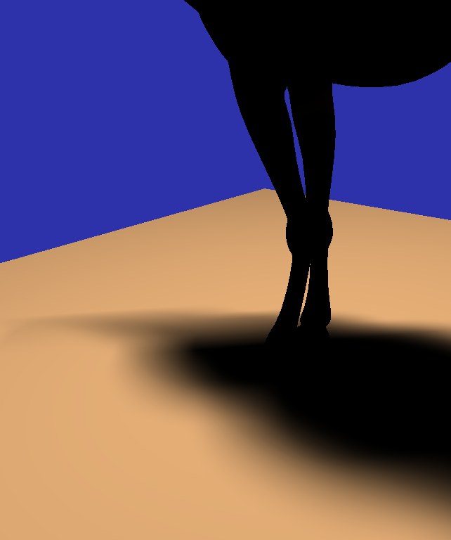
The sampling of the light source…
… depends on the size of the penumbra region,
and therefore on the scene configuration
Camera position / projection onto screen!

Slide 8
The sampling of the light source…
… depends on the size of the penumbra region,
and therefore on the scene configuration
How can we find the optimal number of samples?

Slide 9
Our observations / requirements:
Banding artifacts appear in screen space!
Penumbra size can change every frame
Detect regions where banding occurs with current # of samples (GPU!)
Add more samples only if necessary

Slide 10
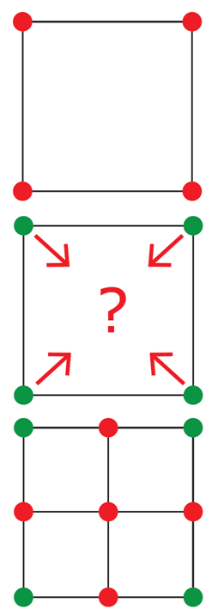
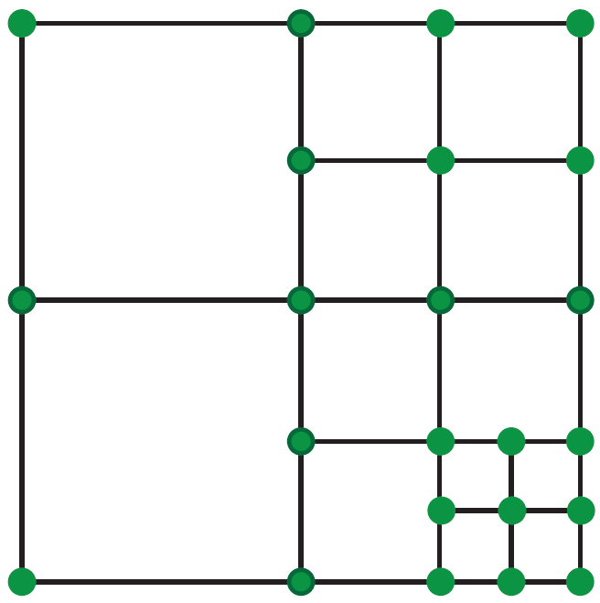
Algorithm Overview:
Use shadow mapping algorithm
Rectangular light source; 4 initial samples
Evaluate subdivision level/banding in screen space
Subdivide using a Quad-Tree-like pattern
Generate new shadow maps
Repeat steps for every new quad!

Slide 11
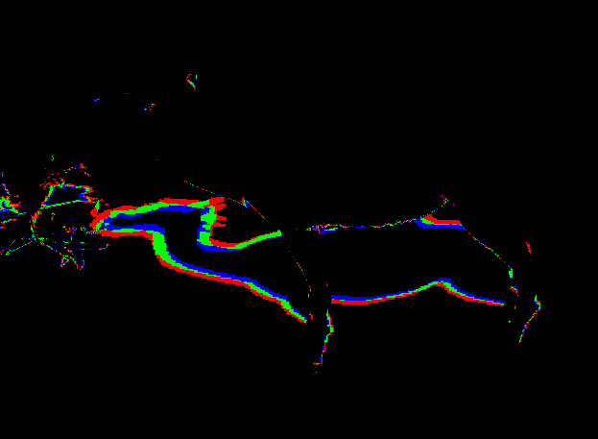
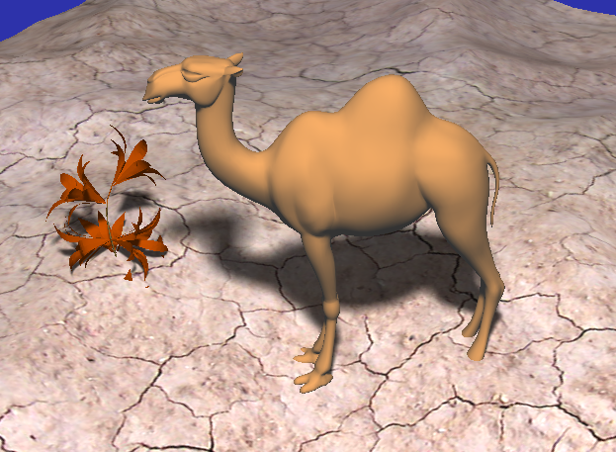
Subdivision Evaluation (Pass 1):
Black = 0 / 4 Red = 1 Green = 2 Blue = 3
Project 4 corner SMs into view space; accumulate shadow values
Σ = 0: no shadow, Σ = 4: umbra
0 < Σ < 4: penumbra region: search for banding artifacts!

Slide 12
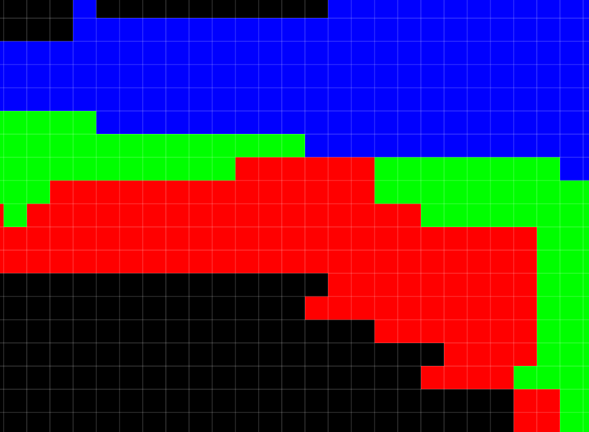
Subdivision Evaluation (Pass 2):
Investigate 1-ring neighborhood of penumbra pixel with value x:
If all neighbors have the same value: Banding! ➔ keep pixel
Otherwise: discard pixel
keep
discard

Slide 13
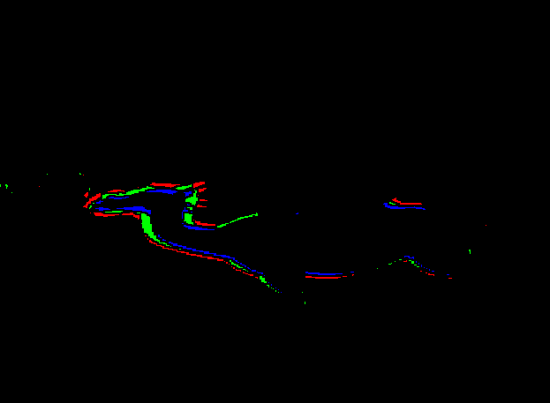
Subdivision Evaluation (Pass 2):
Result of pass 2: Pixels that lie in regions with banding artifacts
If at least one pixel is kept, banding occurs: Subdivide light source
Count using GPU occlusion queries!
➔

Slide 14
Result Video

Slide 15
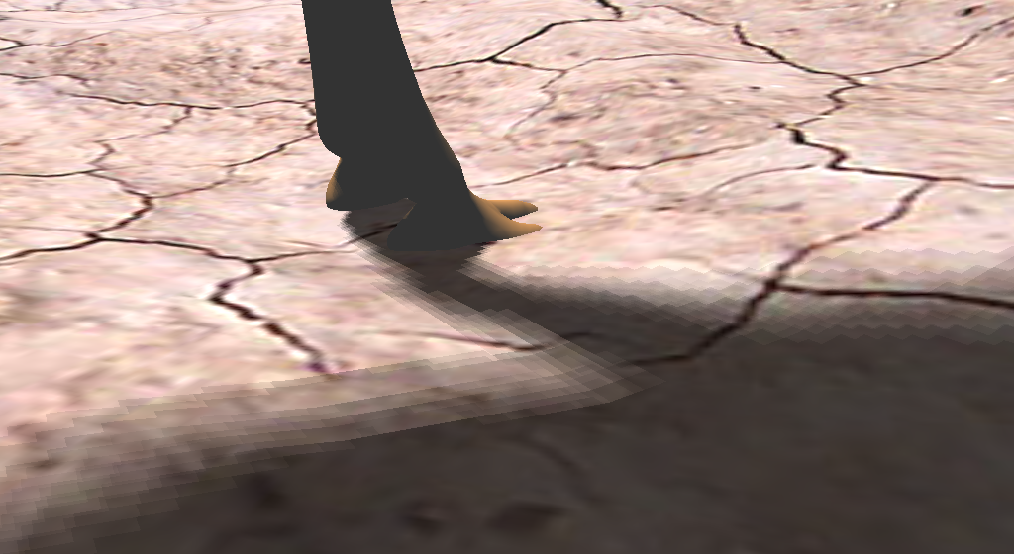
“Tweaking” the algorithm:
Trade physical accuracy for higher performance
Introduce configurable pixel count threshold, and/or
Decrease comparison render target resolution
Banding can be hidden with PCF filter

Slide 16
Result Video: Smaller Comparison Render Target with PCF Filtering

Slide 17
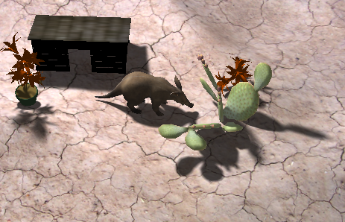
Evaluation
Fixed sampling rate (reference) 289 shadow maps 8 FPS
Our approach 93 shadow maps 17 FPS

Slide 18
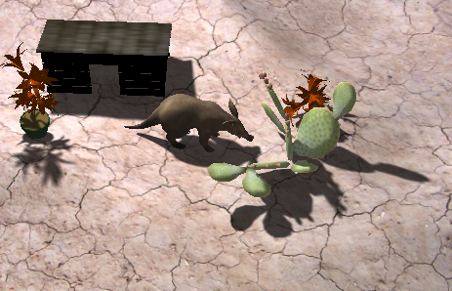
Evaluation
Fixed sampling rate (reference) 289 shadow maps 8 FPS
PCSS “fake” soft shadows 1 shadow map 64 samples blocker search 64 samples filtering 370 FPS

Slide 19
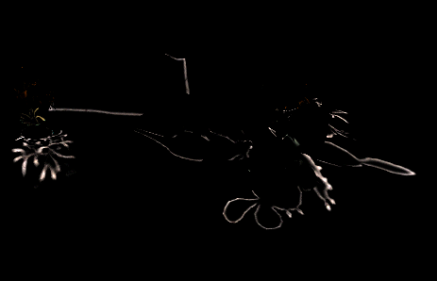
Evaluation
Our approach Difference to reference x 5
PCSS “fake” soft shadows Difference to reference x 5

Slide 20
Evaluation
Fixed sampling rate 289 shadow maps 2.5 FPS
Our approach 163 shadow maps 5 FPS
Our approach Half-size comparison render target 3x3 PCF filter 14 shadow maps 40 FPS

Slide 21
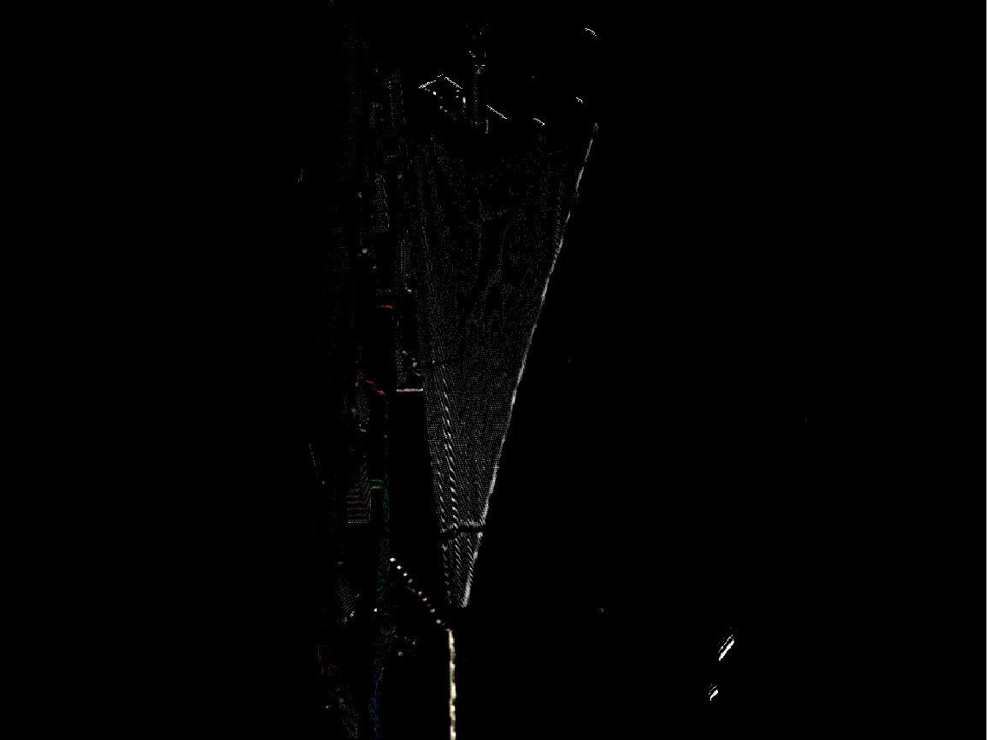
Evaluation
Our approach Difference to reference x 40
Our approach - half-size comparison RT - 3x3 PCF filter Difference to reference x 40

Slide 22
Limitations
No constant frame rate!
Not usable in real-time games…
Subdivision evaluation produces overhead
~ 30% of rendering time / frame ☹
No Performance gain if penumbras are constantly too large

Slide 23
Conclusion
Faster physically correct soft shadow in most cases
Only samples which contribute to visual quality!
Interactive / Real-time frame rates
Application in modeling and design scenarios
Physical accuracy vs. performance
Allow certain amount of banding, use PCF filtering
Easy to configure / handle
Future work:
Exploit temporal coherence (re-use subdivision state)
Better scheduling for GPU occlusion queries
Automatic local screen space filtering instead of PCF
Randomized sampling / volumetric light sources

Slide 24
Thank you for your attention!
Reference 289 SMs, 10 FPS
Our method 105 SMs, 18 FPS
Please visit us at
http://www.VRVis.at/

Slide 25
Further Considerations:
Render generated shadow maps in final illumination pass
Texture arrays, deferred rendering
Account for varying distribution of samples in quad tree:
Assign weights: , where d=subdivision depth

