Slide 1
Analytic Anti-Aliasing of Linear Functions on Polytopes
Thomas Auzinger¹, Michael Guthe² and
Stefan Jeschke^{1,3}
¹ Institute of Computer Graphics
and Algorithms
Vienna University of Technology
²Department of Mathematics and Computer Science
Philipps-University Marburg
³ Computer Graphics Group
IST Austria
Notes:
I want to welcome you to the presentation of our paper on Analytic Anti-Aliasing.
My name is Thomas Auzinger and I developed this work together with Michael Guthe from Marburg and Stefan Jeschke from Vienna.

Slide 2
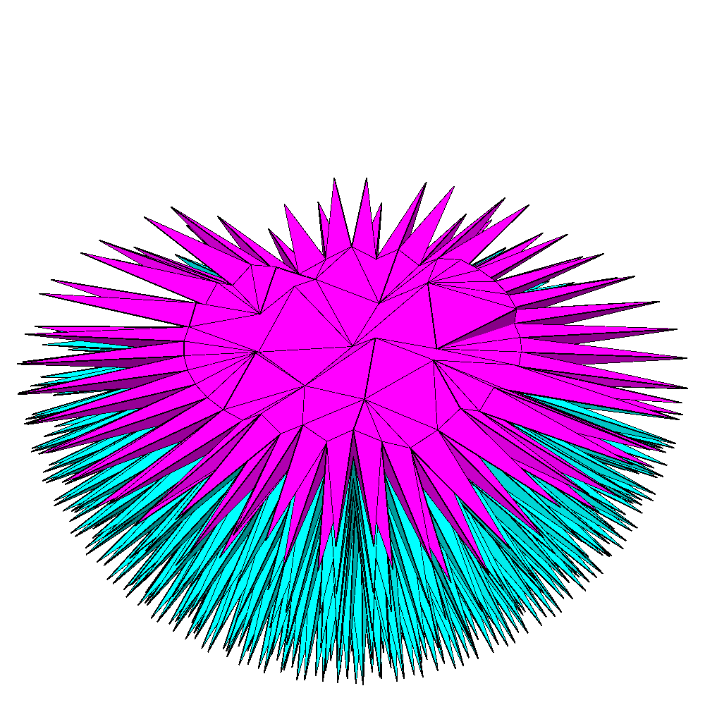
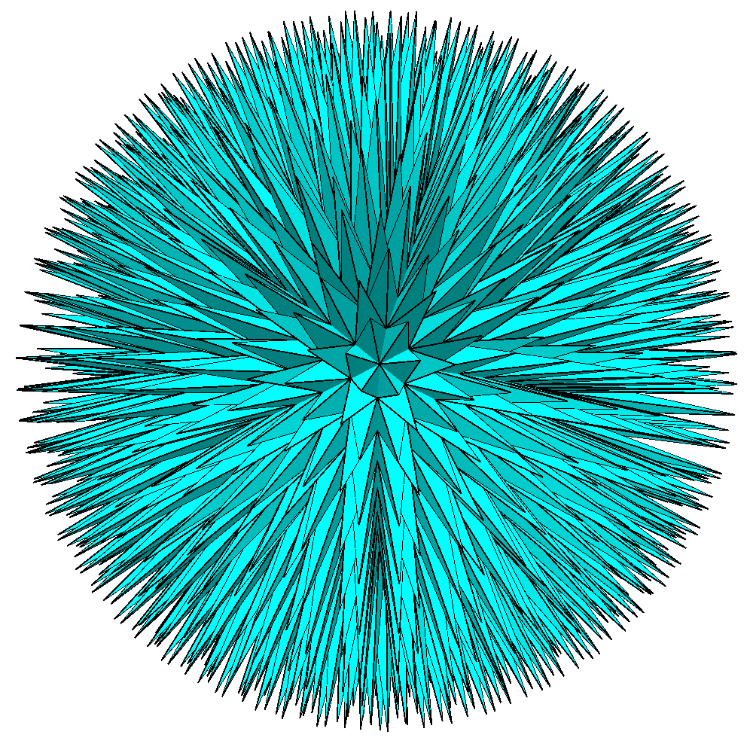
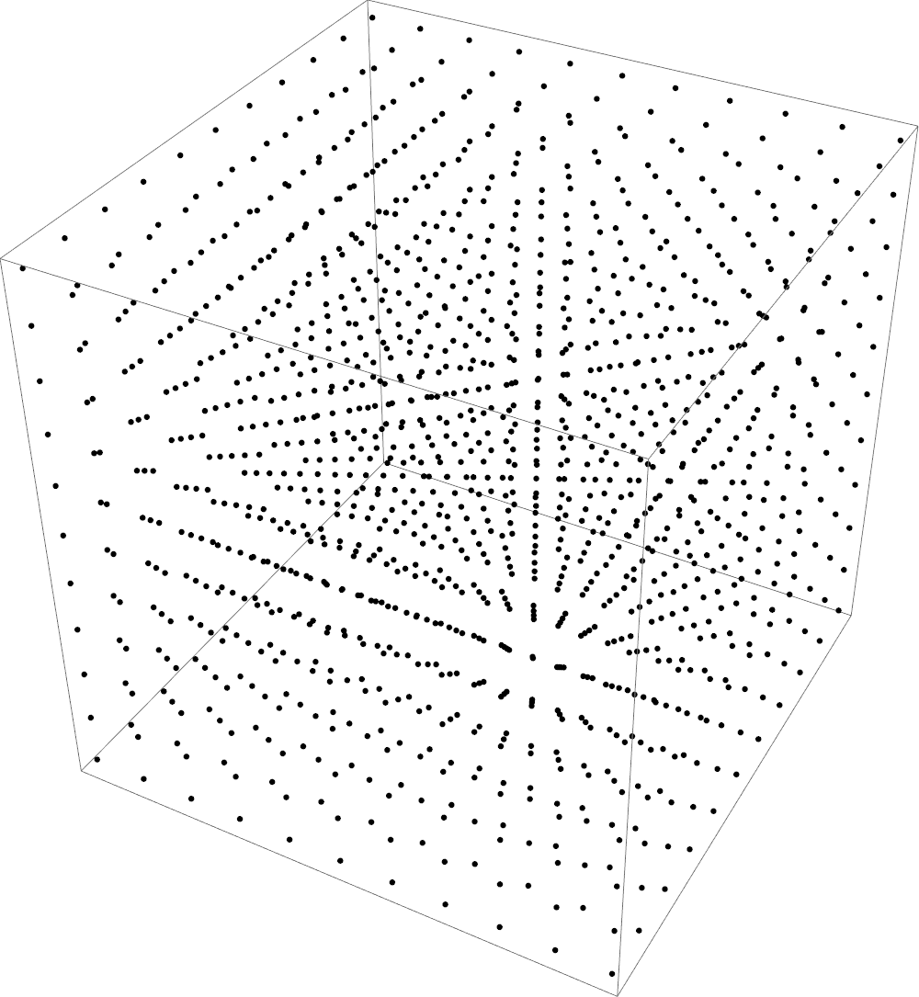
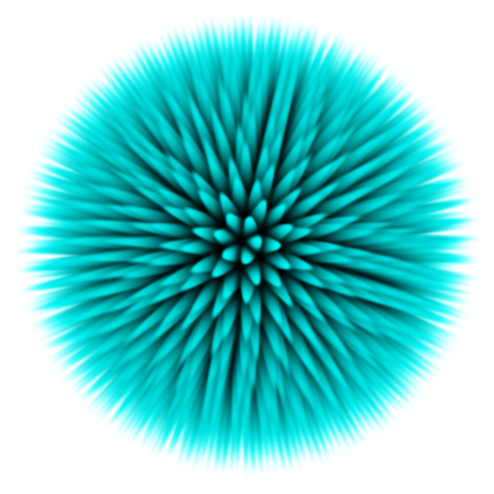
Motivation
Sampling of 2D and 3D meshes
Our domain
Mesh input
Sampling
Reconstruction
Notes:
Sampling is a very common core technique of Computer Graphics and widely used.
The main use case is the sampling of data to regular grids as shown in this example.
Starting with a 3D mesh, in this case a (->) tetrahedral mesh, (->) the data is sampled onto a regular 3D grid, shown in the middle.
A later (->) reconstruction step is employed to recover the data. In this case volume rendering.
(->) The domain of our work is the sampling step to grids.

Slide 3
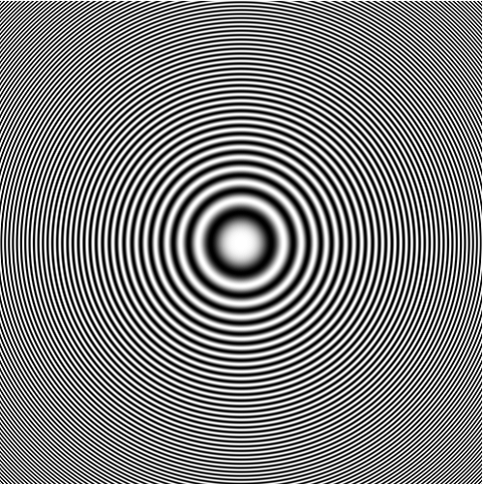
Primer on Sampling
Example test pattern:
Analytic zone plate – contains high spatial frequencies
Notes:
Before presenting our method, I will give a short primer on sampling and the problems that can arise.
As input data we use a analytic zone plate function, which is shown in the center. It varies between 0 and 1 and contains high spatial frequencies.
Note that the input data consists only of concentric circles.
We downsample this picture to half the resolution in the following step.

Slide 4
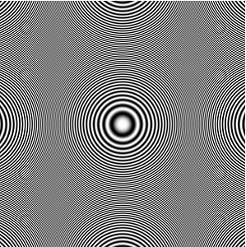
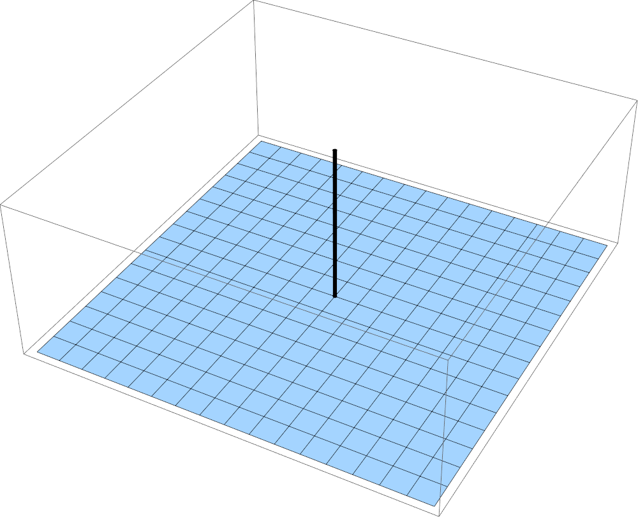
Naïve Sampling
Downsampling to half resolution:
Result
Aliasing
Filter
Notes:
The simplest method takes the value at the center of each pixel in the output image.
(->) The corresponding filter is a delta function which takes only one value (shown on the right).
The downsampled image (on the left) shows severe aliasing as all circular patterns are artifacts of the sampling process (->) shown in red.
To lessen or remove this artifacts, filtered sampling has to be used.

Slide 5
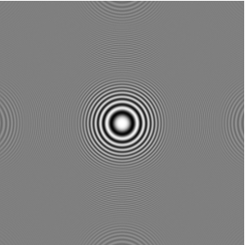
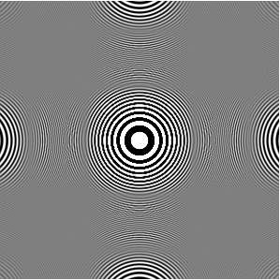
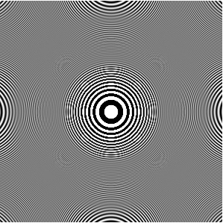
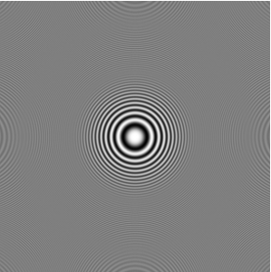
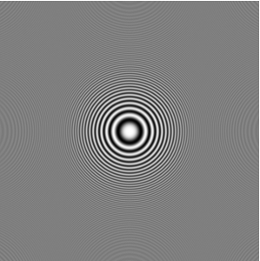
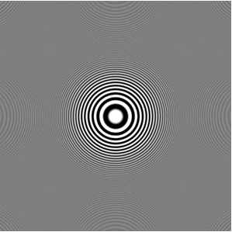
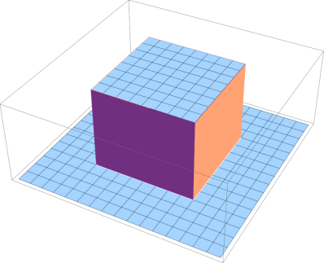
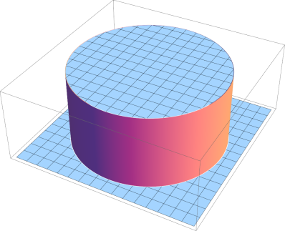
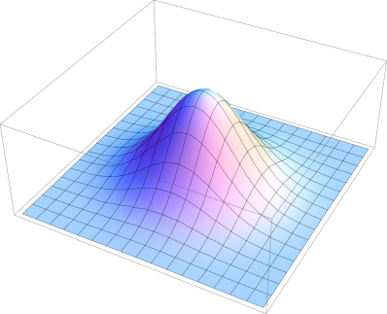
Filtered Sampling
Downsampling to half resolution:
Box filter
Hat filter
Gaussian filter
Anisotropic
oversmoothing
Isotropic
oversmoothing
Good
performance
Notes:
We show the results of 3 different filters.
On the left box filtering is used, where the filter function is a constant non-zero on a square region.
In the middle you see the result of hat filtering, where the filter function is constant non-zero on a disk region.
On the right you can see Gaussian filtering.
(->) If we enhance the contrast of the result image, box filtering shows anisotropic oversmoothing. This can be seen in the highlighted red region (->) . The reason for this behaviour is the non-radial support of the filter function.
(->) The hat filter shows isotropic oversmoothing. Again we highlight the problematic region (->).
(->) The Gaussian filter does not suffer from this problems.
This examples showed the impact of the filter choice.
Another aspect of filtered sampling is the evaluation of the filter itself.

Slide 6
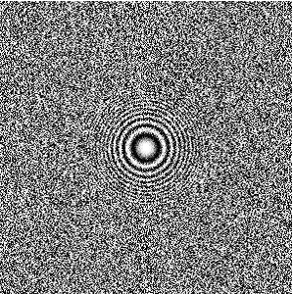
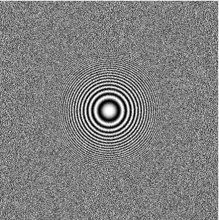
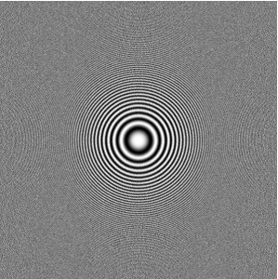
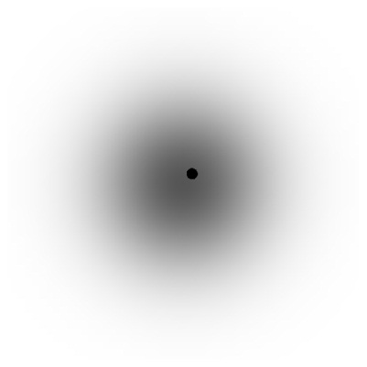
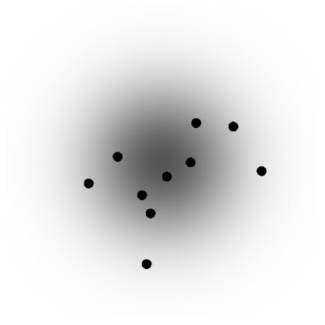
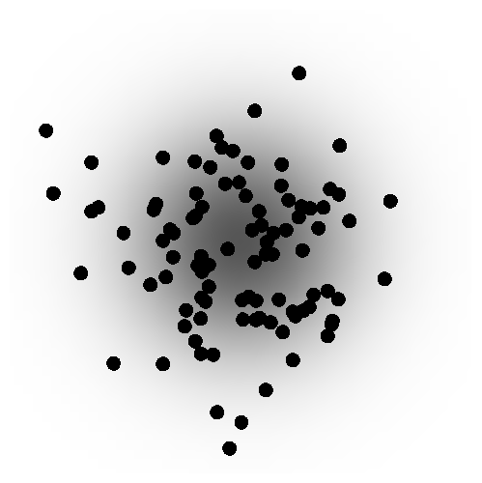
Sampled Filtering
Stochastic filter evaluation:
1 Sample
10 Samples
100 Samples
Notes:
Usually, the filter function is applied to every output sample with the use of numerical methods.
In the top row we show the increase of quality if the numerical method uses more samples. In this examples we use a Gaussian filter and an example distribution of the samples for a single filter evaluation is shown below.
We see that the correct filtering of high spatial frequencies needs a high number of samples in the filter evaluation.

Slide 7
Filtered Sampling
Conclusions:
Simple box/hat filters insufficient for high quality anti-aliasing
We allow higher order filter functions
Use radial filters to avoid anisotropic artifacts
We use radial filters
Use a lot of samples
We use analytic calculations,
i.e. ‘infinitely many’ samples
Notes:
The lessons we learned from this short overview are threefold:
We see that simple box or hat filters are insufficient due to oversmoothing.
Anisotropic artifacts can be removed by the use of radial filters.
Many filter evaluation samples are needed for high quality anti-aliasing.
Our contribution takes this into account as
(->) we allow the use of higher order filter functions. Complicated filters can be represented as polynomials in our framework.
(->) we use radial filters
(->) and we use analytic calculations. This can be seen as using infinitely many samples in the filter evaluation.
As filtered sampling is a core technique in computer graphics, it has a rich history

Slide 8
Related Work
T. Duff: Polygon scan conversion by exact convolution. 1989
    Covers analytic anti-aliasing in 2D with separable polynomial filters on CPUs.
    (becomes intractable in 3D, no radial filters)
J. Manson, S. Schaefer: Wavelet rasterization. 2011
    Covers analytic anti-aliasing in 2D and 3D with wavelets based on the box filter on CPUs.
    (restricted to box filtering and binary attributes)
Notes:
We present two related works as examples for analytic anti-aliasing:
In 89 Duff presented analytic anti-aliasing in 2D with separable polynomial filters on CPUs.
In his works, he argues that polynomial integrals can be evaluated symbolically but gives no concrete calculations. We observed that the use of separable filters becomes intractable in 3D as the integral formulas become extremely large. They span more than 10 pages for lower order filters functions.
Last EG Manson and Schaefer presented wavelet rasterization in which they use analytic anti-aliasing in 2D and 3D with wavelets based on the box filter.
Due to the nature of the Haar wavelets, their technique is restricted to box filtering and uses constant values on the polygons or polyhedra.
Most research in the field of filtered sampling uses numeric methods to evaluate the filter functions but we believe that the recent advances in the programmability of graphic cards enables the use of analytic methods.
We now give an overview of our method.

Slide 9
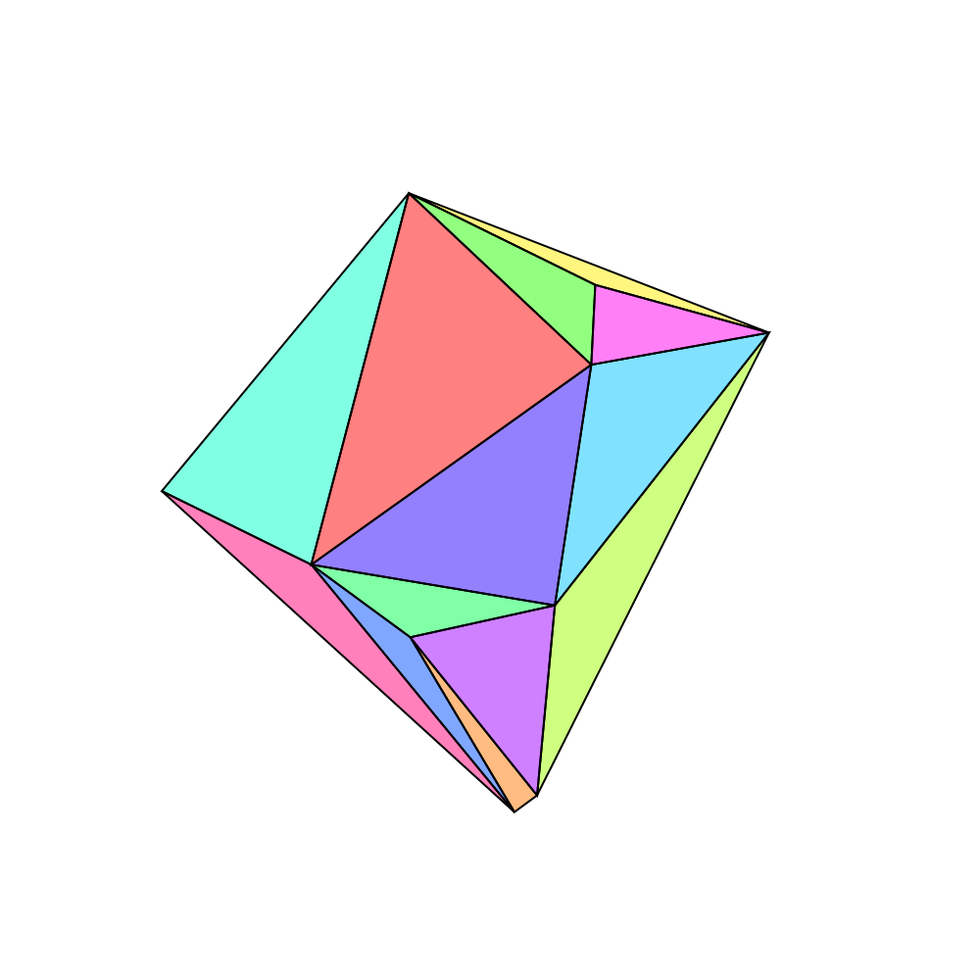
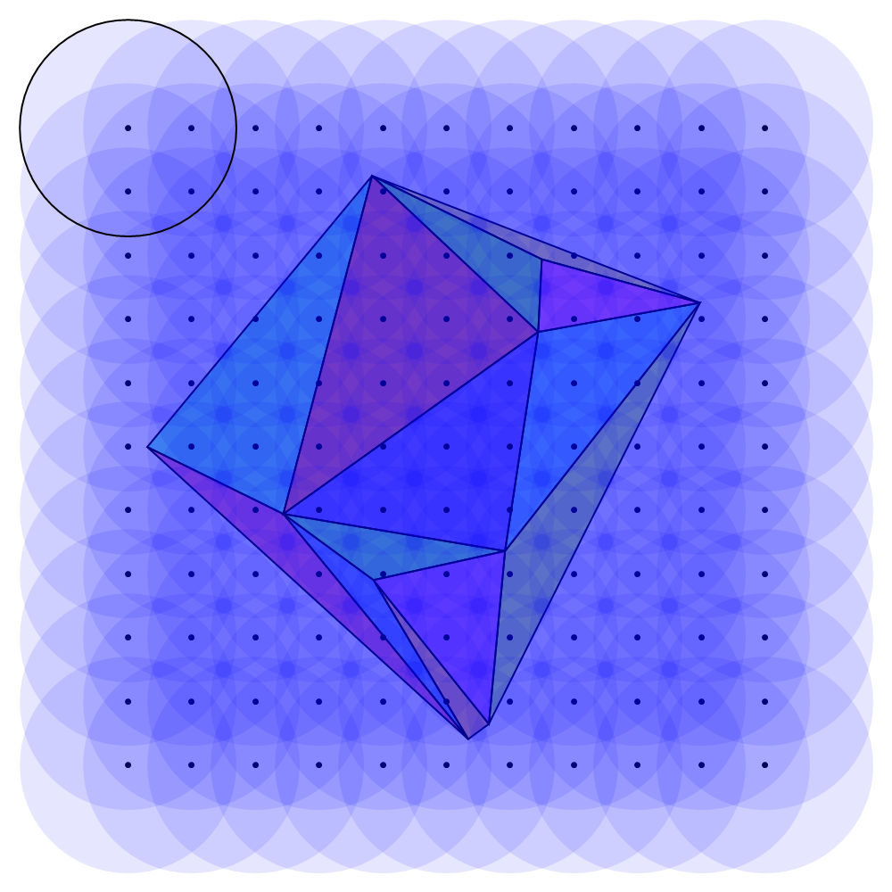

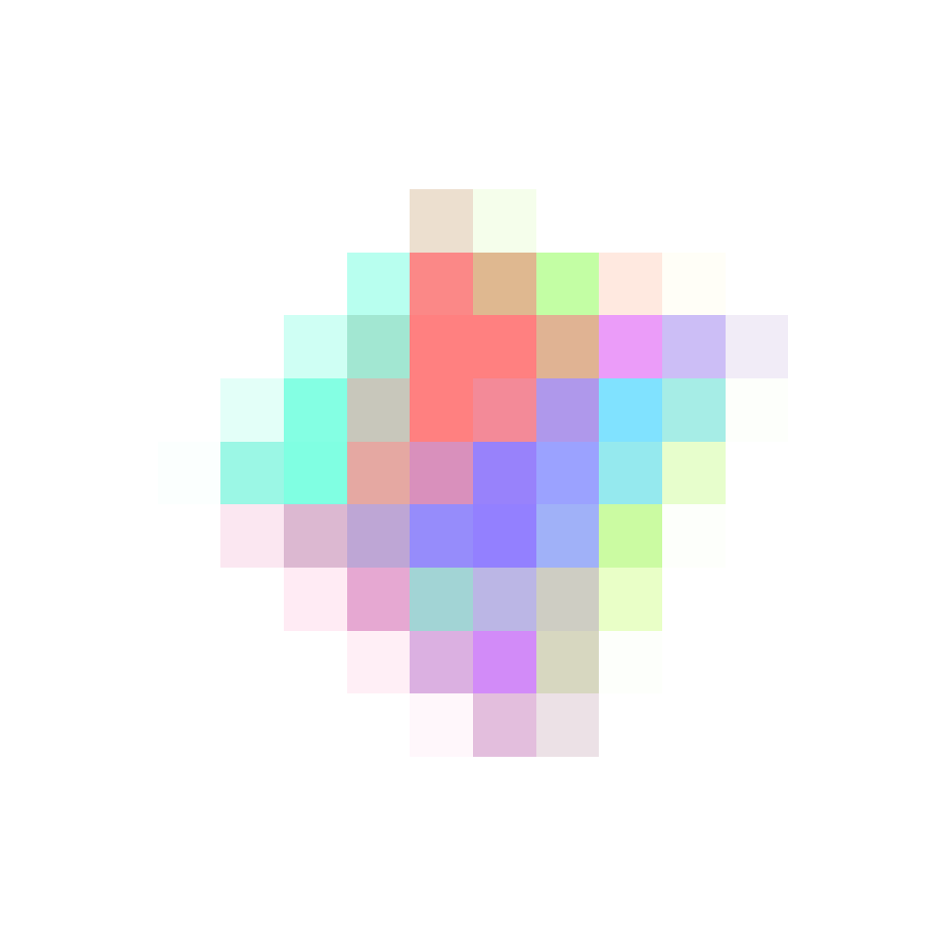
Analytic Sampling Overview
Overview:
Sample positions
Filter supports
Mesh input
Output
Notes:
In a first step we explain the 2D case as the following 3D case builds on it.
In this example we use a 2D mesh, consisting of triangles as input.
(->) Our goal is to sample this data onto a set of sample location. In this case a regular grid.
(->) The value of each sample is obtained by convolving the data with a radial filter. The filter support are depicted in blue and the boundary of a single filter support is shown for the upper left sample location.
(->) The filter convolutions are evaluated and we get a sampling of the input data (shown on the right).
It should be noted that convolutions can be executed in parallel for each sample location and each triangle. Therefore we will show the calculations for a single triangle and single sample location. The final value for each sample is obtained by a final summation.

Slide 10

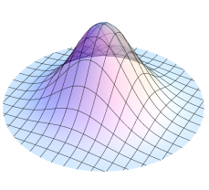
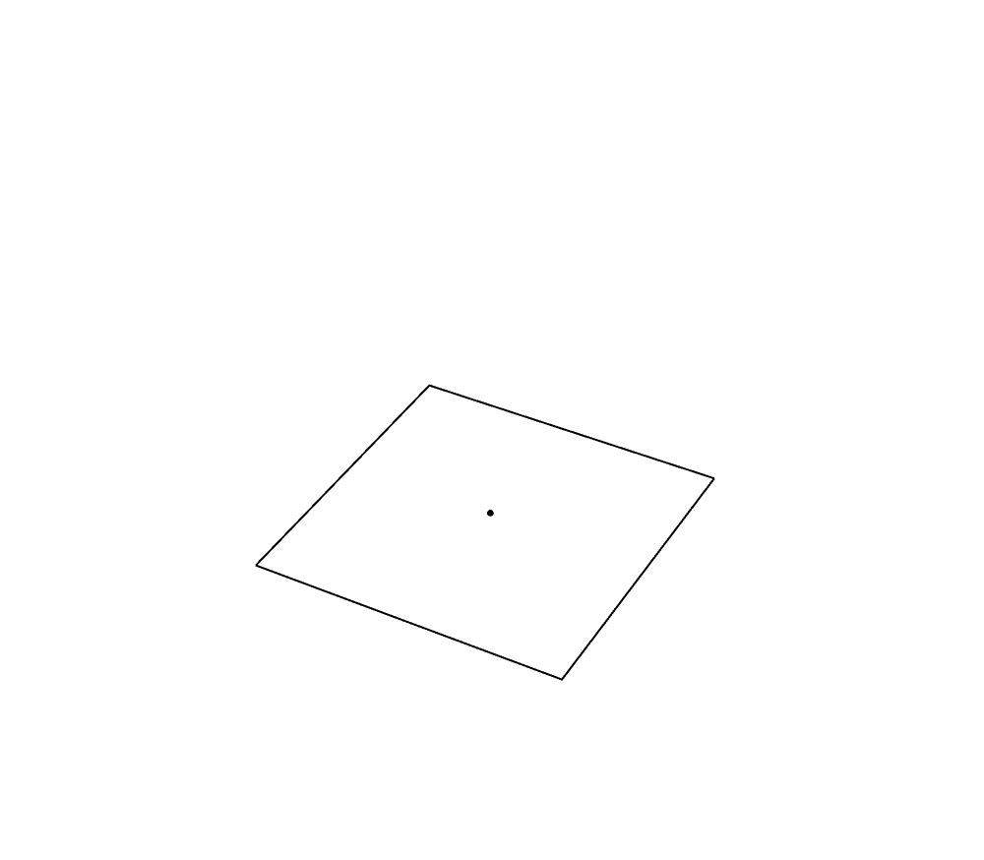
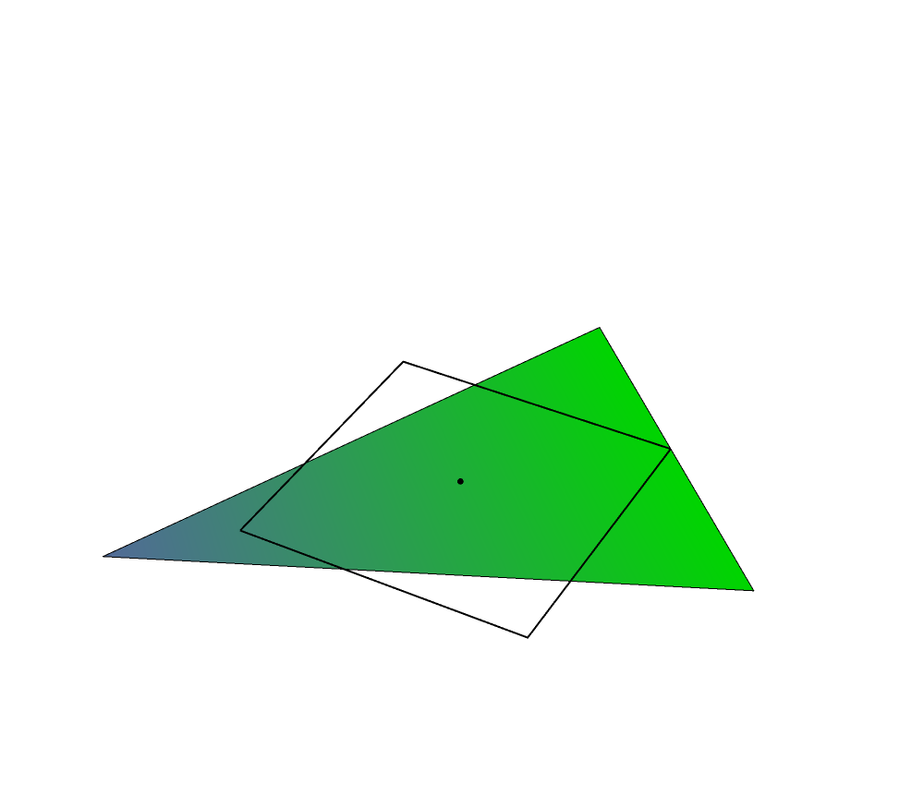
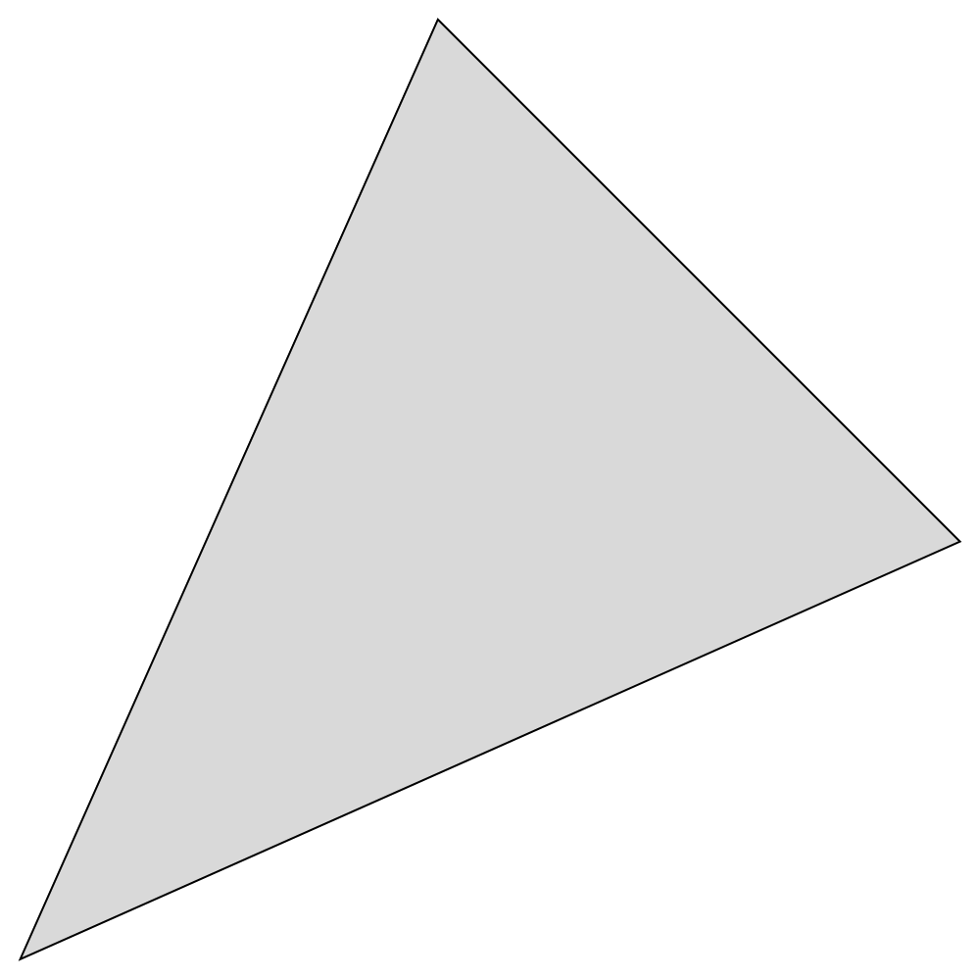
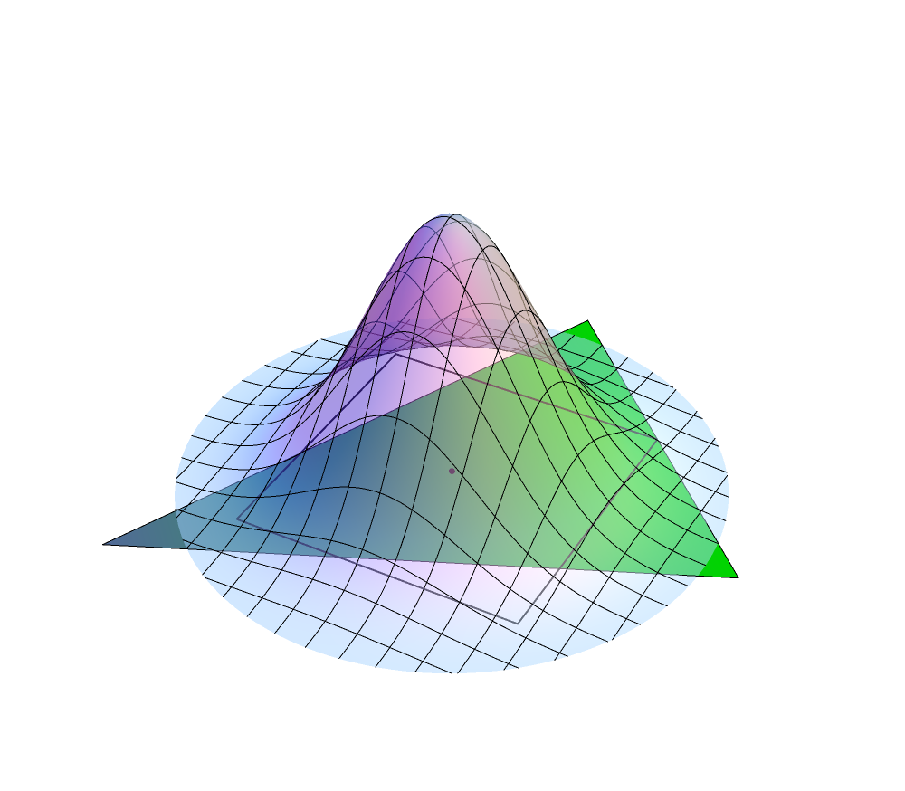
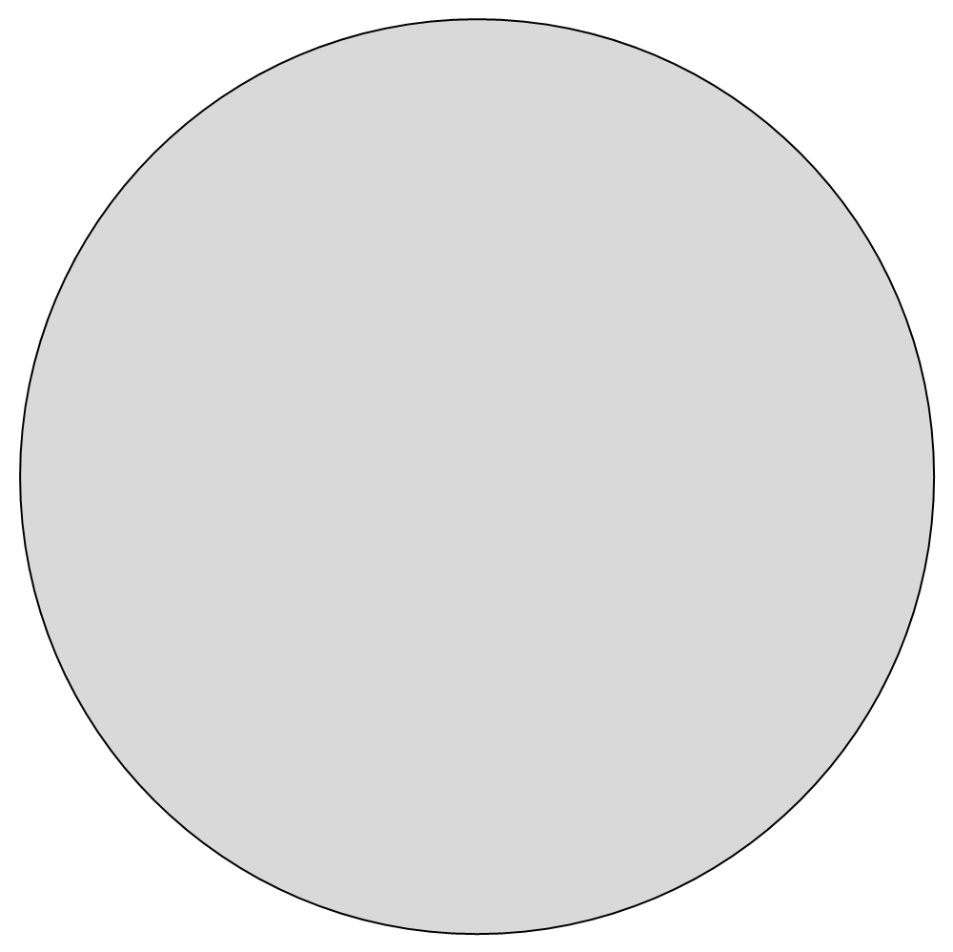
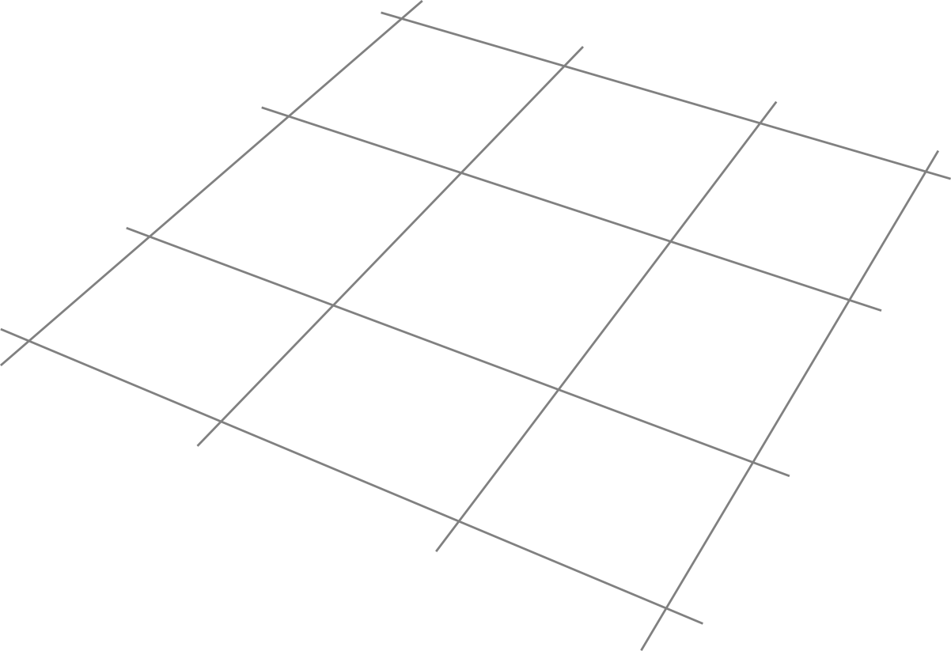
Analytic Sampling in 2D
Filter convolution:
Sample location
Filter function
Mesh data
Notes:
The evaluation of the filter at a sample location boils down to a convolution integral of the input data with the filter function.
The skeleton of such an integral is shown here. Note that ‚y‘ denotes the integration variable.
(->) At a given sample position ‚x‘ this integral is evaluated and yields the value ‚v‘ of ‚x‘. The square shows the grid cell, which corresponds to ‚x‘.
We will now complete the convolution formula:
(->) The mesh input, depicted by the triangle with linear color interpolation, gives us the linear data function in the integrand and the triangular domain over which the integral has to be evaluated.
(->) The filter kernel gives us the filter function in the integrand and the filter support in the integration domain.
This completes our filter convolution integral.
Our method shows now how to evaluate this term analytically. We do not use numerical approximation such as Monte Carlo Sampling and thus remove all sampling artifacts.
The main complication in doing this, is the integration domain.

Slide 11


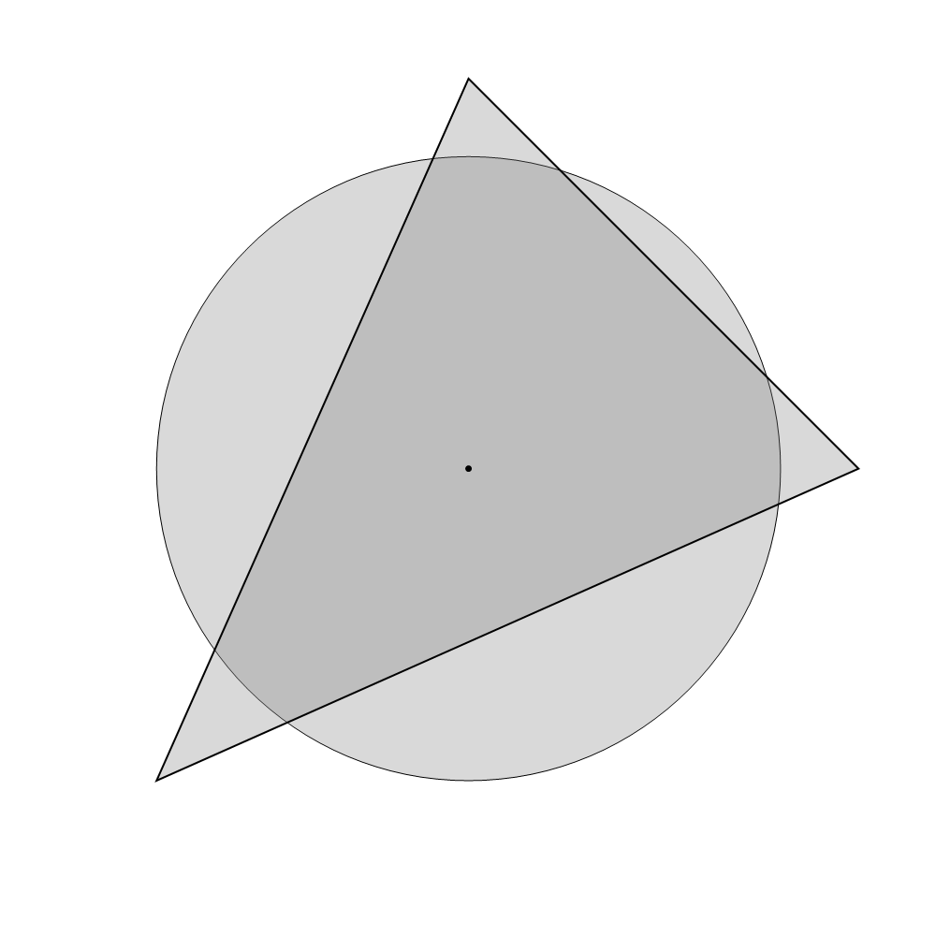
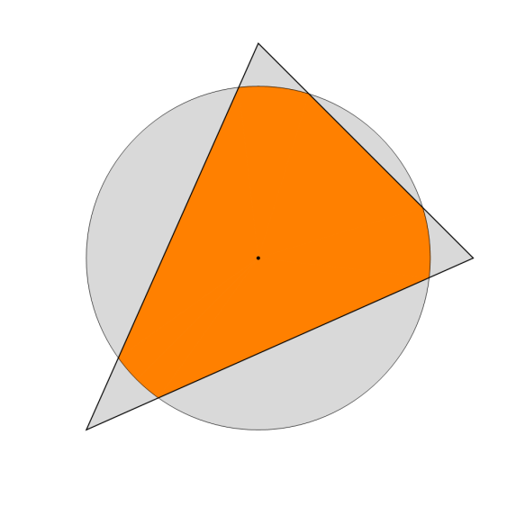

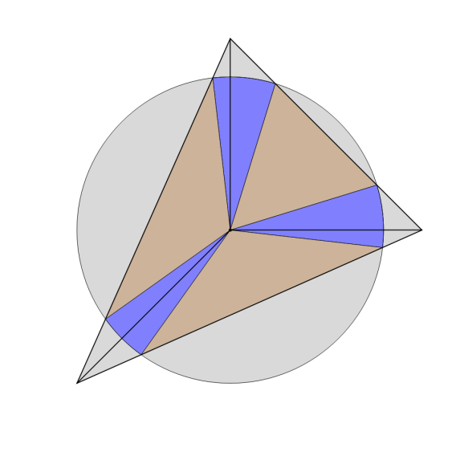
Analytic Sampling in 2D
Filter convolution:
Complicated integration domain
Intersection area
Subdivision
Integration domains
Notes:
(->) In the 2D case it is the intersection of a disk with a triangle.
(->) This area can not be described easily in analytical form as its boundary consists of curved and straight elements.
(->) We solve this problem by treating every edge of the triangle separately. Each edge is extruded to the sample location which yields a triangle per edge. In our example this gives a subdivision of our integration domain.
(->) Each of this three domains can be split into two types of fundamental integration domains.
A sector of the disk, depicted in blue and triangular integration domains, depicted in brown. These are the only two possible shapes that can arise in our method.
Due to the linearity of integration, we can evaluate the filter convolution by summing the contribution of all integration domains.
We thus have reduced the integration over the complicated intersection area to two fundamental integrals.

Slide 12
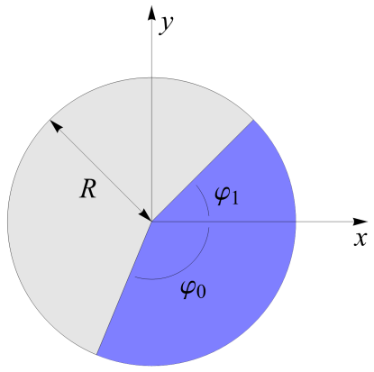
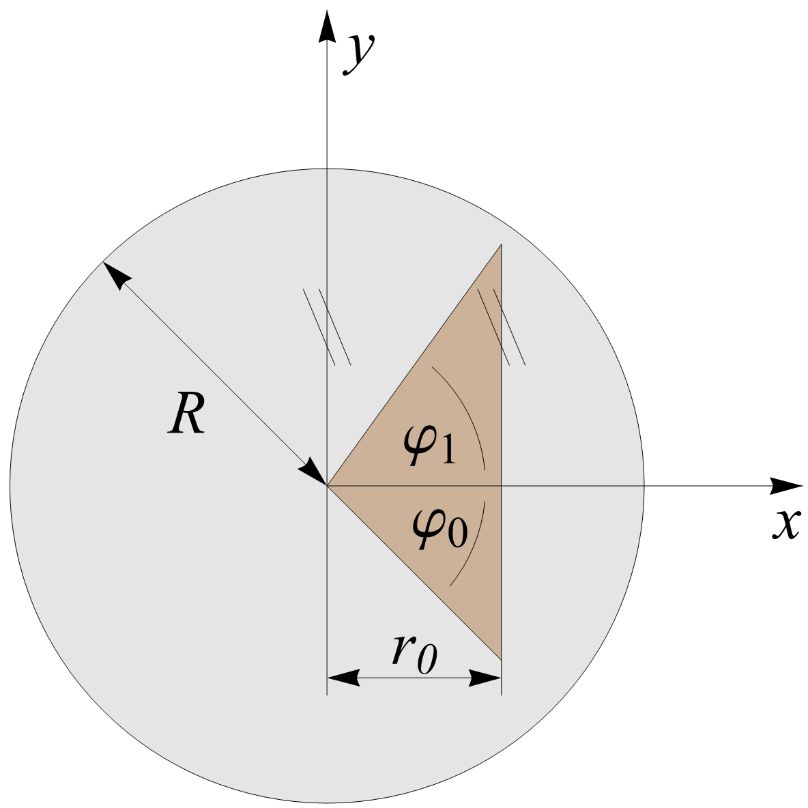
Analytic Sampling in 2D
Filter convolution:
Notes:
The integral over the blue disk sector with a linear data function and a polynomial filter function can be evaluated symbolically and we obtain a formula for the result.
(->) On the right you can see the parametrization of the integration domain and below the result.
(->) The same can be done for the triangular integration domain.

Slide 13

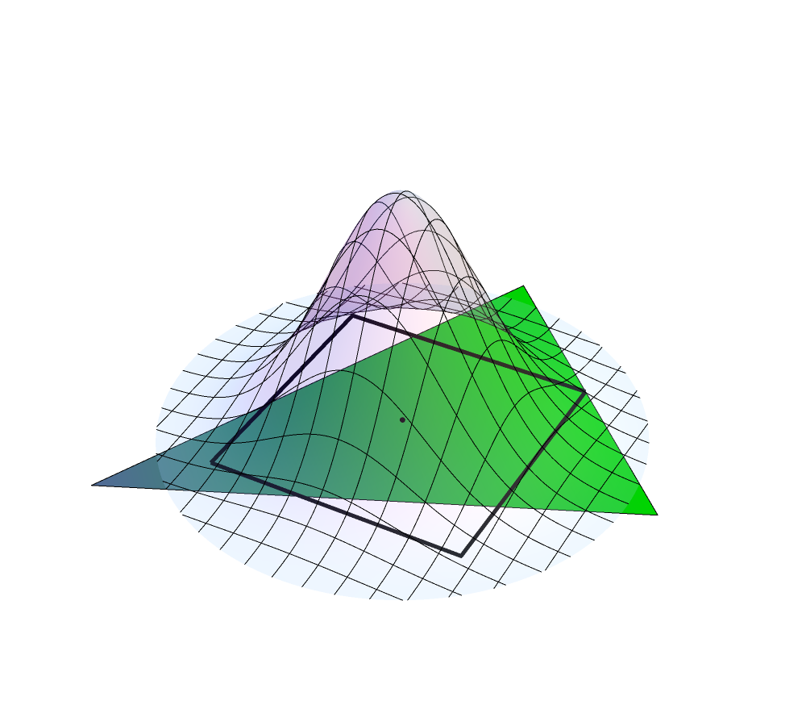
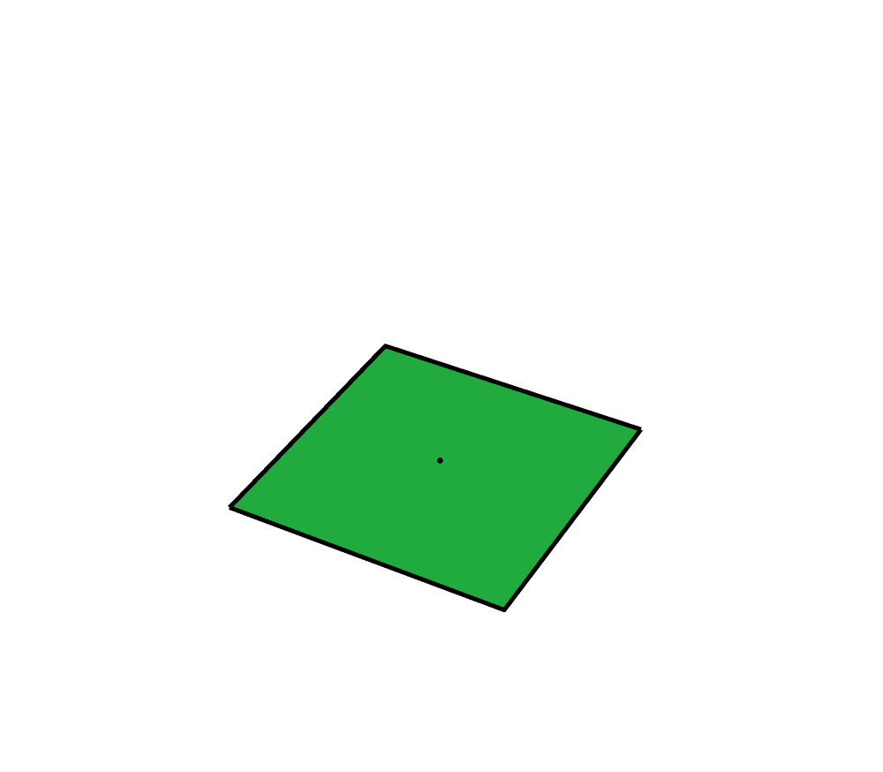
Analytic Sampling in 2D
Filter convolution:
Mesh data & filter
Sample location
Notes:
The value at the sample location ‚x‘ can now be obtained by summing the contributions of all integration domains.
This covers our method in 2D and we now show the extensions to 3 dimension. One key ingredient to make this work is the use of radial filters as we will see later.

Slide 14
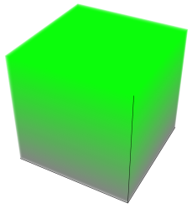

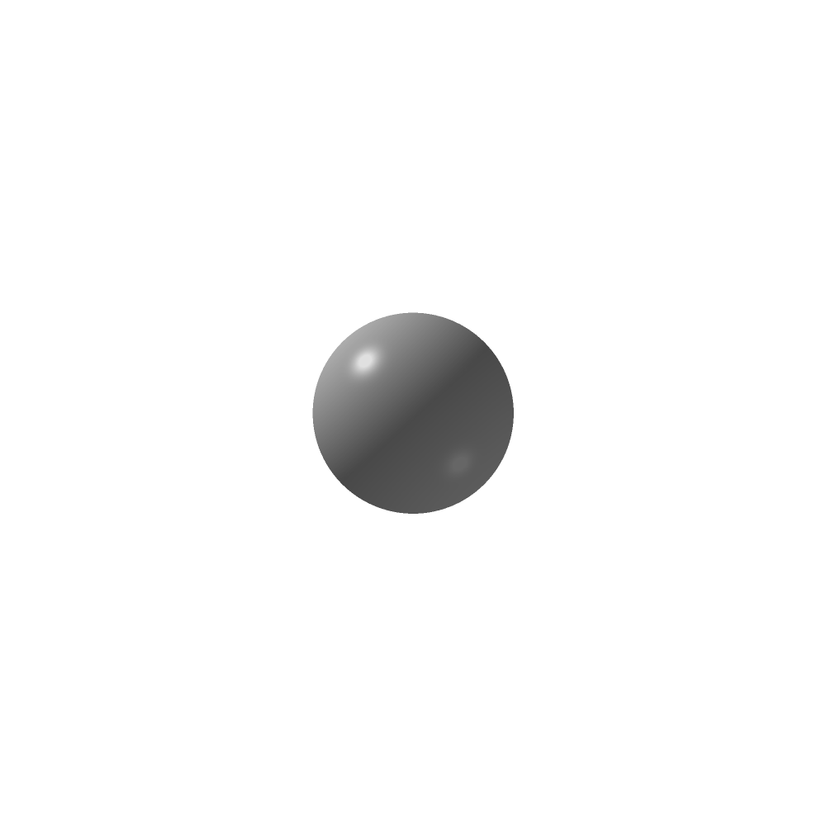
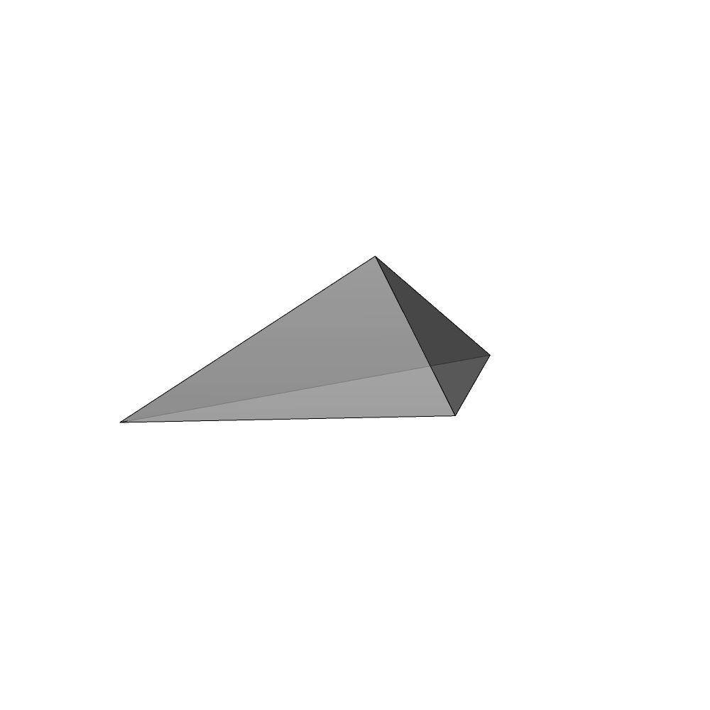
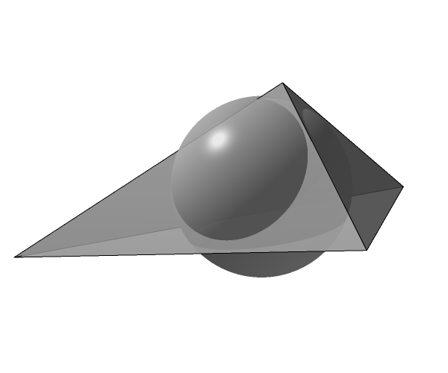
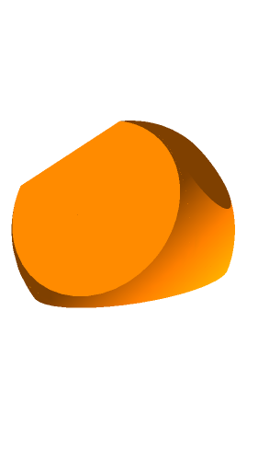

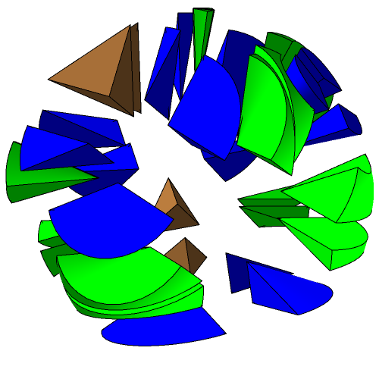
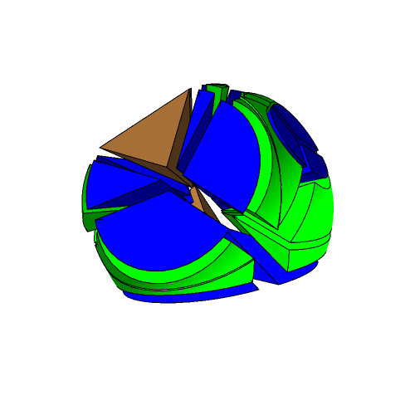
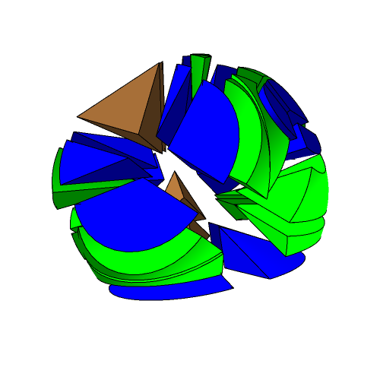
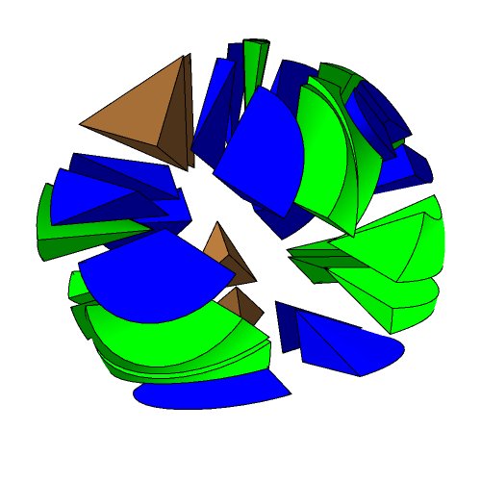
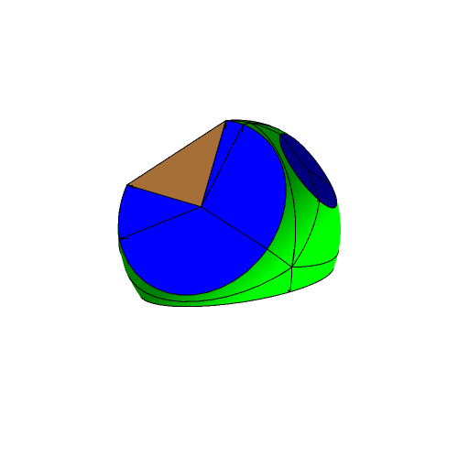
Analytic Sampling in 3D
Filter convolution:
Decomposition:
Intersection volume
Subdivision
Integration domains
Notes:
In 3D we have again the same form of the convolution integral.
The mesh data example is now a tetrahedron and a 3D linear data function, depicted by the gray to green cube in the integrand.
The filter is now confined to a sphere and given by a 3D function.
(->) As in the 2D case, the complication stem from the integration domain which is the intersection of a tetrahedron and a sphere.
(->) This produces a complex intersection volume on which the integral has to be evaluated.
(->) As in the 2D case we treat the boundary faces separately. Each face of the tetrahedron is extruded to sampling location which yields 4 tetrahedra. Each of these is intersected with the filter support‘s sphere.
(->) While we had 2 fundamental integration domains in the 2D part, in the 3D case we have 3 fundamental shapes, colored in blue, brown and green.
(->) The exploded view shows the decomposition of the intersection volume.
As before we evaluate the integral by summing the contributions of all fundamental integration domains.

Slide 15
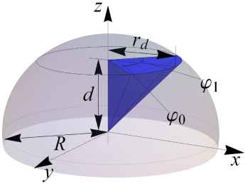








Analytic Sampling in 3D
Filter convolution:
Notes:
The data function and filter polynomial can be convolved analytically on these fundamental domains.
The blue shape is the wedge of a cone and its parametrization and the resulting formula is shown on the right.
(->) The green pyramid with a curved base is given in the second line.
(->) Finally we show the result for the tetrahedral brown domain.

Slide 16

Analytic Sampling in 3D
Filter convolution:
Notes:
The final contribution to a sampling location can be obtained by summing the results of the fundamental integral.
This concludes the presentation of our method in 3D.
Note that this methodology can be extended to higher dimensions.
Will now give some results.

Slide 17

Implementation
Implementation in Direct3D 10 (2D) and CUDA C (3D).
Timings (3D):
 |  | Grid
 |  | 64³ | 256³
Tetrahedra | 19k | 2.5s | 90s
 | 1.9M | 15.3s | 216s
Hardware: GeForce 580 GTX, 1.5 GB SDRAM
Notes:
The evaluation of the convolutions can be done in parallel for all polyhedra and sampling locations, we use GPUs as our implementation platform.
We implemented the 2D case in Direct3D 10 and the 3D case in CUDA C. While the use of shaders is very convenient in 2D, an implementation in 3D would become very cumbersome.
As a 3D test scene we subdivided a cube into tetrahedra with vertex colors, which were linearly interpolated.
In the table we show the runtimes of our implementation for two different grid sizes and two different tetrahedral subdivision.
We used a GeForce 580 for these results.
Note that the runtime increases linearly with the number of sampling locations but decisively sublinear with the number as tetrahedra, since each of the smaller tetrahedra overlaps less sampling locations.
Our timings are in the range of seconds to minutes.

Slide 18


Results
Alias-free sampling of complex scenes:
Area filtering (previous methods)
2
2.5
3
Gaussian filtering (our method)
2M tetrahedra
at different filter radii
(shown right)
2
2.5
3
Notes:
Our method allows the usage of complex filters, which considerably improves the anti-aliasing quality.
As an example we use an extruded zone plate pattern consisting of 2 million tetrahedra. We sample them to a 256^3 grid with filters of varying kernel radius.
The images are a reconstruction of our sampled data with simple direct volume rendering.
(->) In the upper row you see a zoom in to the results of using area filtering with different filter radii.
Our method allows the use of complex filters, such as Gaussians, shown in the bottom row.
Note that the area filtering above shows severe oversmoothing for all filter radii, while the Gaussian filtering preserves the details.

Slide 19

Results
Alias-free sampling of linear data functions:
256³ / 2k
64³ / 2k
256³ / 12k
Linear color interpolation between spike base (black) and spike tip (cyan)
Notes:
In this second example we show the direct volume renderings of our sampling of a spiky ball figure.
The spike tetrahedra carry a linear color interpolation from black at the bottom to blue at the tip.
The left images shows the example for 2000 tetrahedra and a grid of 256³. The center and right picture show decreasing grid resolution or a higher number of spikes.
In both cases our method robustly provides near-perfect analytic anti-aliasing.

Slide 20
Conclusions
We presented analytic anti-aliasing of polygons and polyhedra allowing for:
Linear functions on the mesh (e.g. colors, densities,…)
Higher order radial filter functions
Regular and non-regular sampling grids
Notes:
This concludes the presentation of our method and I will summarize:
We presented analytic anti-aliased sampling of polygons and polyhedra. Our method allows for:
Linear functions defined on the mesh data (e.g. Interpolated colors or densities)
It is possible to use higher order radial filter functions, given as spherically symmetric polynomials.
Our method is completely agnostic of the sampling pattern and allows the use of both regular and non-regular sampling grids.

Slide 21
Future Work
Generalization to temporal filtering
Wavelet approach to general filters and/or data functions
Analytic rendering
Notes:
Future extensions of our work are possible
In the domain of temporal filtering, where the integration domains are moving polytopes.
An approach similar to wavelet rasterization can be employed for general filters to allow for convenient level of detail.
The use of analytic visibility would allow the use of analytic rendering.

Slide 22
Fin
Questions?
Notes:
This concludes the presentation and I will be happy to answer questions.
Thank you.

Slide 23

Fin
Questions?
Notes:
This concludes the presentation and I will be happy to answer questions.
Thank you.

