Slide 1
Interactive Modeling of City Layouts using Layers of Procedural Content
Markus Lipp¹, Daniel Scherzer¹, Peter Wonka² and Michael Wimmer¹
¹ Institute of Computer Graphics and Algorithms
Vienna University of Technology
² Department of Computer Science and Engineering
Arizona State University

Slide 2
Motivation
Virtual urban layouts for movies and computer games
Manual modeling very expensive
Automate with procedural generation
Notes:
first, what is it all about?
in movies and computer you often need virtual urban layouts.
Manual modeling of them is very expensive
therefore there are many methods to automate this with procedural generation

Slide 3
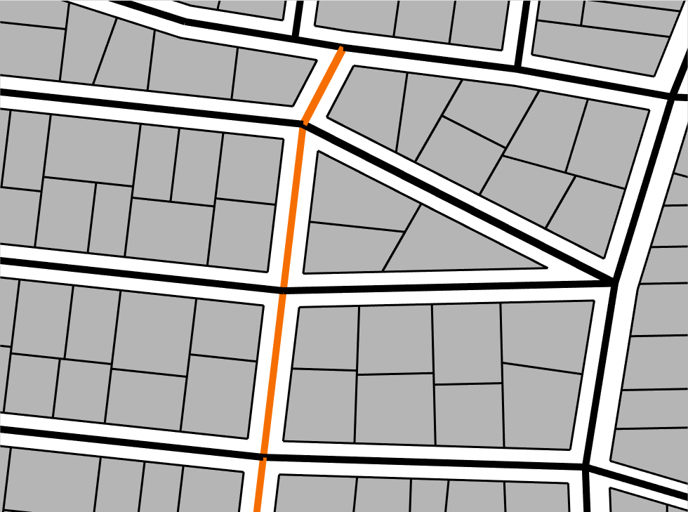
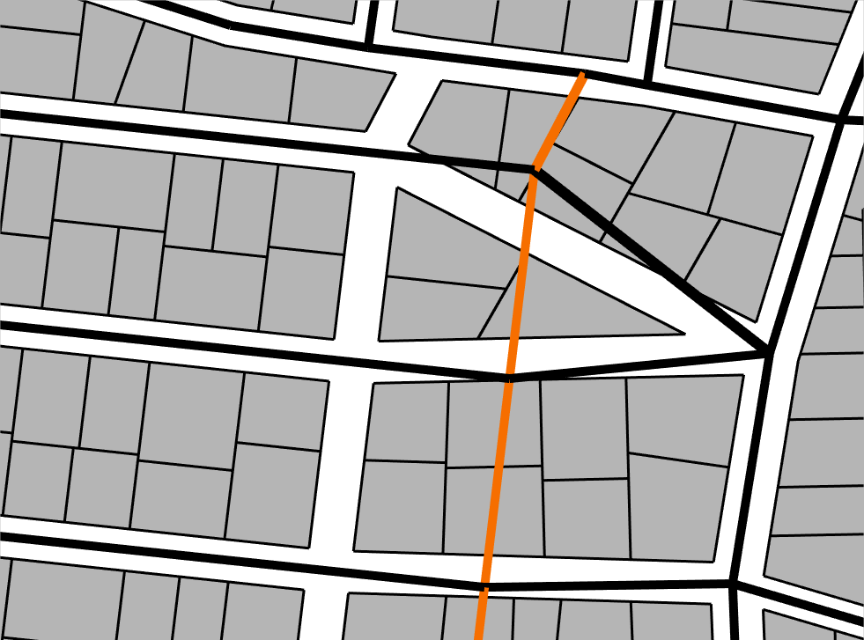
Motivation
Previous work: focus on generation
Only low-level editing of output
Main problem: Maintaining validity after direct edits
Notes:
now, in previous work a lot of such algorithms were introduced.
however, they mainly focus on the generation aspect.
to tweak and adjust the output, only low-level editing operations like moving single streets were employed.
the main problem with this is that it is hard to maintain validity after such edits. here you see an example of such an invalid layout after an edit.

Slide 4
Motivation
We want to enforce valid layouts after edits…
Notes:
We want to solve this by enforcing valid layouts after edits (click)
(during video) here‘s an example: you have large scale transformations, and the layout is always intersection free.

Slide 5
Motivation
…circular editing capabilities
Notes:
but we want more.
we want to enable circular editing (click)
(during video) here the street is moved left and right, and at the end the same layout is obtained.

Slide 6
Motivation
…and merging of content.
Notes:
finally, we also want to enable merging of content. (click)
(during video) here two different styles are merged: rome and manhattan.
this can be very helpfull when multiple artists work on one project.

Slide 7
Motivation
Notes:
now, in previous work a lot of such algorithms were introduced.
however, they mainly focus on the generation aspect.
to tweak and adjust the output, only low-level editing operations like moving single streets were employed.
the main problem with this is that it is hard to maintain validity after such edits. here you see an example of such an invalid layout after an edit.

Slide 8
Solution Overview
1. non-topological
transform T
2. flexible merge M_{f}
4. layering system
3. anchored
assignments
Notes:
how can we do all this?
here is an overview of our solution. it consists of a non-topological transform operator T, a flexible merge operator mf.
further we have anchored assignments and a layering system.
we will now explain those parts one after the other.

Slide 9
Non-Topological Transform
Urban layout: streets and parcels
Notes:
first, lets talk about the Non-toplogical transform operator.
before we can dive into this we need to define a few basics.
here you see an urban layout, consisting of streets and parcels.

Slide 10
Non-Topological Transform
Valid layout: no intersections
invalid layout!
Notes:
we define a layout to be valid if it does not have any intersections. here is an example of an invalid layout, with intersections.

Slide 11
Non-Topological Transform
Goal: Maintain validity of urban layout after transformations of streets
Restriction: don’t allow topology changes
„non-topological“
valid
Notes:
now, the goal of the Non-toplogical transform is to Maintain validity of urban layout after transformations of streets.
as a restriction, this operator only works when the topology is not changed.
here you see an example on a valid version of the previous layout.

Slide 12
Non-Topological Transform: Solution
1. Create relation parcel → block
blocks
Notes:
so, how can we achive this? lets look at our solution consisting of three steps.
we need one more definition: a block is a face in the street graph. (click) as seen here
first, we create a relation from parcels to blocks.
this way, every parcels knows which block it belongs to.
the relation is created using a block finding algorithm and inside/outside tests.

Slide 13
Non-Topological Transform: Solution
2. When a street is transformed, find every affected block
blocks
unaffected
Notes:
then, when a street is transformed, we find every affected parcel.
here is an example.
finding affected parcels can simply be done by looking at the graph and the mentioned relation.

Slide 14
Non-Topological Transform: Solution
3. Update parcels in affected blocks
i) Transform using mean-value coordinates
Notes:
finally, the parcels are updated. for this we provide three possibilities, best shown in videos. (click)
the first option is transforming the parcels using mean-value coordinates. here is an example (click)
the advandate is that the original parcel layout is retained. as a disadvantage, distorted parcels can occur.

Slide 15
Non-Topological Transform: Solution
ii) Regenerate parcels
Notes:
the second option is regenerating the parcels, as shown here (click)
this always creates undistorted parcels, however the original layout is lost.

Slide 16
Non-Topological Transform: Solution
iii) Hybrid approach
Notes:
finally, we also provide a hybrid approach. a metric decides wether to use mean-value transformations or regeneration. (click)
this has both advantages.

Slide 17
Solution Overview
Notes:
ok, How can we do this?
our key observation is that this problem can be mapped to graph cut

Slide 18
Solution Overview
1. non-topological
transform T
2. flexible merge M_{f}
Notes:
ok, this solves the first problem, lets move on to the flexible merge.

Slide 19
Flexible Merge
Goal: Merge two layouts, result should be valid
Notes:
The goal here is to merge two urban layouts, with the main difficulty that the result should be valid.
her is an example of such a merge. (click)
(during video) one layout is moved around, and the resulting layout is always valid.

Slide 20
Flexible Merge
Artist should be able to control this process using weights
Notes:
Additionally, the artist should be able to control this process using weights.
here is an example where an artists changes weights to control the merging. (click)
(during video) weights are represented as grey values. the artist moves them around.

Slide 21
Flexible Merge
How to do this?
Key observation: Problem can be mapped to graph cut
Notes:
ok, How can we do this?
our key observation is that this problem can be mapped to graph cut

Slide 22
Graph Cut Introduction
graph
Notes:
to explain how this works, let us first describe the graph cut algorithm.
first, graph cut works on one graph.

Slide 23
Graph Cut Introduction
sink
source
edge weights/costs: 0 1
Notes:
the edges of the graph need to have a weights.
here they are encoded by grey-values, where white=1 and black = 0.
finally, we need to define a source and a sink node. (click)
we could just define two existing nodes for this, as seen here.
however, in most cases we want multiple sources and sinks. this is done as follows (click)

Slide 24
Graph Cut Introduction
source
sink
constraint edges (weight ∞)
Notes:
first, 2 new nodes are added.
then, edges with infinity weight are added to other nodes (click)
this essentially makes those nodes to sources or sinks. (click)
such edges are also called constraint arks

Slide 25
Graph Cut Introduction
remove edges to separate source & sink with
minimal sum of edge weights
Notes:
finally, we have everything to define graph cut.
in a graph cut we seperate the source and sink by removing edges.
the main constraint is that the sum of the weight of removed edges should be minimal.
the line you see here represents a possible cut, where every edge it intersects is removed, like this (click).

Slide 26
Graph Cut Introduction
remove edges to separate source & sink with
minimal sum of edge weights
Notes:
to actually find such a minimal cut, for example the Edmonds and Karp algorithm can be used, which is referenced in the paper.

Slide 27
Merge Layouts Using Graph Cut
How to apply to urban layouts?
Streets: planar straight line graphs
layout 1
layout 2
Notes:
ok, now that we know what graphcut is about, and how it is performed, how can it be applied to merge urban layouts?
lets explain this by looking at an example, using those two layouts.

Slide 28
Merge Layouts Using Graph Cut
1. Define weights for edges
click
Notes:
the first thing we need to do is define weights for the edges.
to achive this we provide the artist a weight assignment tool with radial faloff.
it works like this: first, the artist clicks somewhere. (click)
this defines a radial faloff, and we set the edge weights according to the distance.
of course the artist can also set the weight for each edge manually.

Slide 29
Merge Layouts Using Graph Cut
2. Combine two layouts into one graph
Notes:
for the next few steps we ignore the parcels, they will be added later.
now we have two weighted graphs, but graphcut always works on one graph.
therefore we have to combine the two graphs into one graph.

Slide 30
Merge Layouts Using Graph Cut
2. Combine two layouts into one graph
Notes:
to make this more obvious, from now on we color the lines of the graphs differently, and do NOT show the weights anymore.

Slide 31
Merge Layouts Using Graph Cut
2. Combine two layouts into one graph
Notes:
First, they are moved over each other, just as the artist specified.
then, we search for edge intersections, and add a new node for every intersection. (clicK)
all intersected edges are rerouted along those new nodes.
this way we get one graph.

Slide 32
Merge Layouts Using Graph Cut
3. Add source & sink and constraint edges
sink
source
for merging, cuts should be in overlap region!
Notes:
next, we AUTOMATICALLY add the source and sink.
placing correct constraint arks is very important, because using constraint arcs we can prevent cuts that make no sense.
for example we want to avoid cuts like this. (click)
this cut for does not make any sense, as it is completely in the green layout. (click)
we want to merge the layouts, therefore the cut should be in the overlapping region of the layouts

Slide 33
Merge Layouts Using Graph Cut
3. Add source & sink and constraint edges
sink
source
i) find all nodes just outside the overlap region
how to enforce this?
Notes:
ok, how can we enforce that cuts are in the overlap region?
first, we find all nodes just outside the overlap region. (click) (those that have connection to intersection node but are not inside a foreign block). Special case: containment -> highest edge cost nodes
for details on how to do this look at the paper.

Slide 34
Merge Layouts Using Graph Cut
3. Add source & sink and constraint edges
sink
source
ii) connect to source/sink with constraint edges
Notes:
then we connect them to the source or sink respectively using constraint arks. (click)
this forces the cut to be in the overlapping region

Slide 35
Merge Layouts Using Graph Cut
4. Calculate graph cut
Notes:
finally, we can calculate the graph cut.
for clarity we now hide the source and sink and the overlap region.
the cut could be this line (click)

Slide 36
Merge Layouts Using Graph Cut
5. Remove every edge that is on the wrong side
Notes:
now, we remove every edge that is on the wrong side of the cut.
first all the cut edges are removed (click)
there are still some edges on the wrong side, they are deleted too. (click)
all green edges on the sink side are deleted and the other way round.

Slide 37
Merge Layouts Using Graph Cut
6. Mend holes by adding back some streets
Notes:
finally, as the deletions can create holes in the overlapping region, we add some streets back again. here the violet streets were added back.
this is done using a depth first serch, explained in the paper.
this completes the street graph merging.

Slide 38
Merge Layouts Using Graph Cut
What about parcels?
Notes:
but what about parcels?
As the very last step we need to add the parcels again. fortunately this is rather simple.
for the areas unaffected by the graph cut, we just copy the parcels as they were in the original layouts (click).
in all other areas new parcels are created. (click)

Slide 39
Merge Layouts using Graph Cut
Notes:
now, we remove every edge that is on the wrong side of the cut.
first all the cut edges are removed (click)
there are still some edges on the wrong side, they are deleted too. (click)
all green edges on the sink side are deleted and the other way round.

Slide 40
Solution Overview
1. non-topological
transform T
2. flexible merge M_{f}
3. anchored
assignments
Notes:
ok, lets move on to anchored assignments

Slide 41
Anchored Assignments
Flexible and persistent parameter assignment
Notes:
here it is about flexible and persistent parameter assignments. parameters could be building types or height.
unfortunately there is not enough time to explain this in detail, here is just a little teaser (click)
for details, look into the paper.
(during video) here you can see parameter assignments anchored to a street. they automatically move with the street.
here you see a height assignment that is moved around.

Slide 42
Anchored Assignments
Assignment =
key/value-pairs
e.g., height, type, geometric object, …
target object
e.g., parcel, block, or major street
position
anchor
pointer to one element
Persistent independent of geomery
Notes:
here it is about flexible and persistent parameter assignments. parameters could be building types or height.
unfortunately there is not enough time to explain this in detail, here is just a little teaser (click)
for details, look into the paper.
(during video) here you can see parameter assignments anchored to a street. they automatically move with the street.
here you see a height assignment that is moved around.

Slide 43
Solution Overview
1. non-topological
transform T
2. flexible merge M_{f}
4. layering system
3. anchored
assignments
Notes:
now that you have seen at least aproximately what the assignments are about, lets move on to the last part.

Slide 44
Layering System
Layouts on multiple layers
Lm
L2
L1
L0
Notes:
just like in image processing applications we allow content on multiple layers.
lets provive an example:
in the layer 0 you see a city layout. (click)
in layer 1 is a street. (click)
in layer 2 may be a park.
of course, in the end we need a merged result to display and export. here is the merged layer (click)

Slide 45
Layering System
Big picture?
T
M_{f}
Lm
L2
Layer
Assg.
L1
L0
Notes:
now, how does this work?
lets now explain the big picture, how all the things we introduced work together:
how do we get the merged layer? of course We apply the merging iteratively (click)
Iterative application of flexible merging makes the layer system work (click)
and what about transformations and assignments? they can be applied individualy for ever layer. (click)
the merging operation makes sure that all transformation or parameter assignment affect the merged result.

Slide 46
Notes:
To allow topological changes and circular editing, just use multiple layers as shown here

Slide 47
Solution Overview
1. non-topological
transform T
2. flexible merge M_{f}
4. layering system
3. anchored
assignments
Notes:
finally we know how everything works and how it works together.
lets now explain how the advanced editing operations shown in the beginning work.

Slide 48
Advanced Editing Operations
Enforce valid layouts after large scale editing
Transformation with soft influence radius, T
Notes:
enforcing valid layouts can be done using the non-topological transform. here a transformation with a soft influence radius is used.

Slide 49
Advanced Editing Operations
Topological changes, circular editing
Just use multiple layers
Notes:
just like in image processing applications we allow content on multiple layers.
lets provive an example:
in the layer 0 you see a city layout. (click)
in layer 1 is a street. (click)
in layer 2 may be a park.
of course, in the end we need a merged result to display and export. here is the merged layer (click)

Slide 50
Advanced Editing Operations
Topological changes, circular editing
Just use multiple layers
Notes:
just like in image processing applications we allow content on multiple layers.
lets provive an example:
in the layer 0 you see a city layout. (click)
in layer 1 is a street. (click)
in layer 2 may be a park.
of course, in the end we need a merged result to display and export. here is the merged layer (click)

Slide 51
Advanced Editing Operations
Topological changes, circular editing
Just use multiple layers
Notes:
just like in image processing applications we allow content on multiple layers.
lets provive an example:
in the layer 0 you see a city layout. (click)
in layer 1 is a street. (click)
in layer 2 may be a park.
of course, in the end we need a merged result to display and export. here is the merged layer (click)

Slide 52
Advanced Editing Operations
Topological changes, circular editing
Just use multiple layers
Notes:
just like in image processing applications we allow content on multiple layers.
lets provive an example:
in the layer 0 you see a city layout. (click)
in layer 1 is a street. (click)
in layer 2 may be a park.
of course, in the end we need a merged result to display and export. here is the merged layer (click)

Slide 53
Advanced Editing Operations
Topological changes, circular editing
Just use multiple layers
Notes:
To allow topological changes and circular editing, just use multiple layers as shown here

Slide 54
Advanced Editing Operations
Content merging of different styles
Two layers, weight assignment with radius
Notes:
and to merge content, you just need two layers, and a weighht assignment with a radius. the weight assignment is then moved around.

Slide 55
Advanced Editing Operations
Persistence of changes
Move changed regions to separate layer
Notes:
using the layering system we can also keep changes persistent during global changes.
the main idea is that the user can mark objects that should be protected. then, when a global change is performed, marked objects are automatically copied to a new layer, as in this video (click)
(during video) the layering system ensures that the changes are persistent.

Slide 56
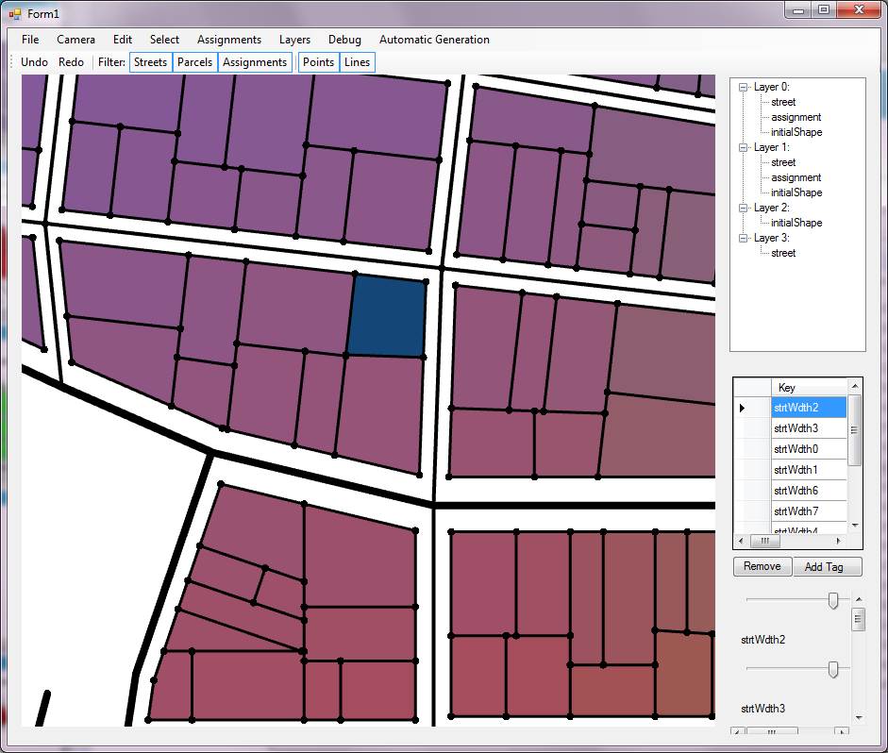
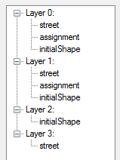
User Interface
M_{f}
Layer
T
Assg.
Notes:
ok, but how are all those things represented to the user?
first, we have a layer manager (click)
here the user can add and remove layers. also, selected objects can be moved between layers.
this mainly controls the layering system and implicitly the flexible merge.
then, there is an interactive viewport (click)
here the merged results or a single layer is rendered in real-time.
the user can select objects by clicking. a tool bar with standard transformations (like move or rotate) is provided.
this mainly controles the transformation (click)
finally, a parameter view allows to edit the assignments.

Slide 57
Results
Exported to CityEngine, building type from color
Notes:
at last, lets show some results.
here you see a city exported from our tool to cityengine. (click)
the building types are defined by the color.
here you see a merged street… and a park… and a city center

Slide 58
Conclusion
Two new operators
Non-topological transform T
Flexible merge M_{f}
Anchored Assignments
Layering System
Enables
Valid layouts, circular editing, merging
Persistence
T
M_{f}
Layer
Assg.
Notes:
to sum it up, we have introduced:
Two new operators: Non-topological transform T and Flexible merge M_{f}
also, Anchored Assignments and a layering System
all those things together enforce valid layouts, enable circular editing, merging and persistence

Slide 59
Thank You for Your Attention!
Questions?

