Slide 1
Spontaneous Social Networks (DAEV)
Michael Hanzl
Institute of Computer Graphics and Algorithms
Vienna University of Technology

Slide 2
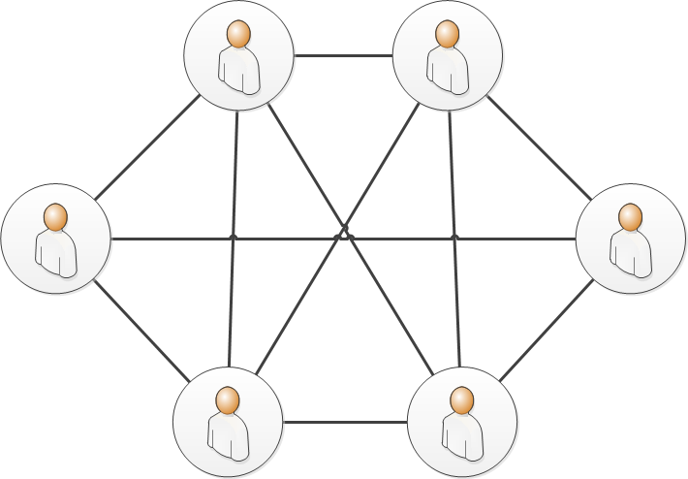
Motivation
Spontaneous Social Network (SSN)
Social Network
Graph
Rigid
Tedious to manipulate
One large social network
Graph
Flexible
Easy manipulation
Ubiquitous availability of social networks
Applications work on top of SSNs

Slide 3
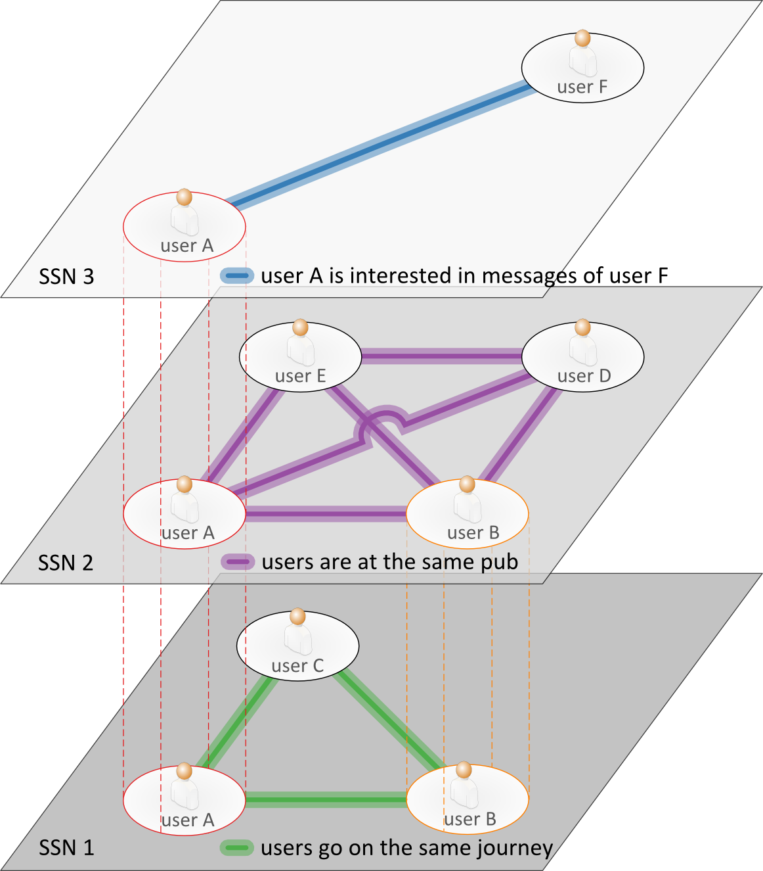
Overview of SSNs
Each SSN defines social relation
Users : SSNs = M : N
Applications work on top of SSNs
Applications : SSNs = 1 : N

Slide 4
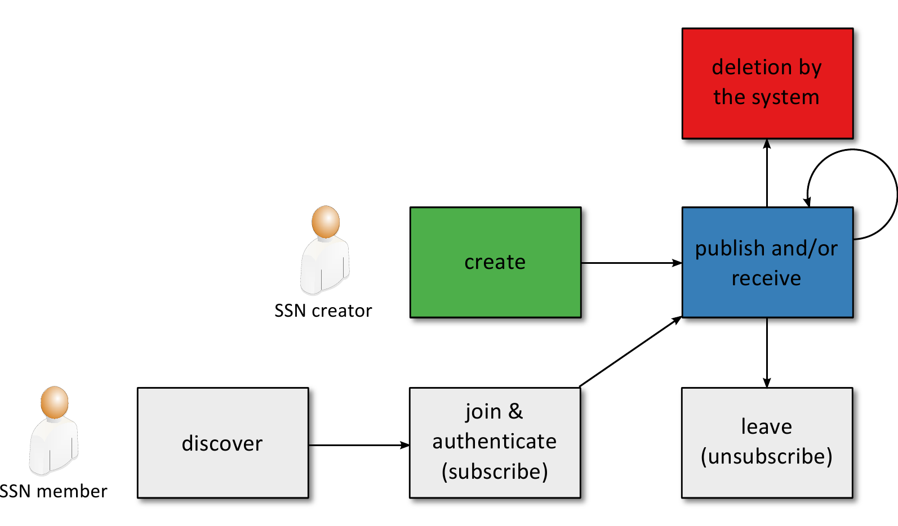
SSN Lifecycle

Slide 5
Share/Discover SSNs
SSN address & SSN application package name shared among users
Invitation
QR code
Tones
Buddies

Slide 6
Goal
Design and implementation of SSN framework using XMPP and PubSub
Implementation of example applications
YouTube Shoutwall
Event Scheduling
Central Notifications
Evaluation
Usability of SSNs
Suitability of XMPP / PubSub

Slide 7
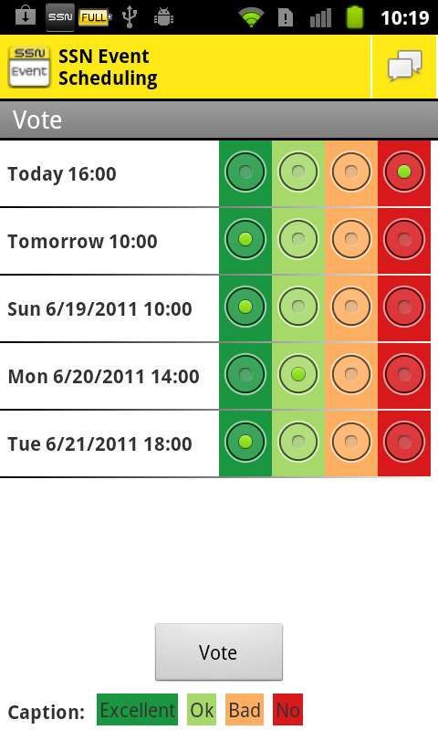
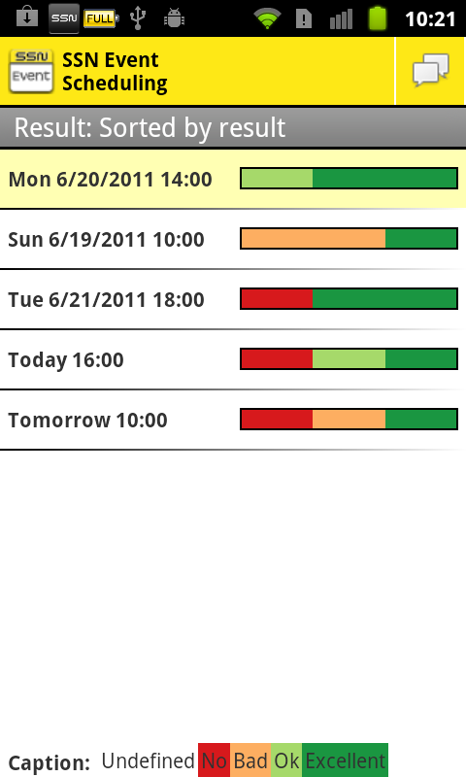
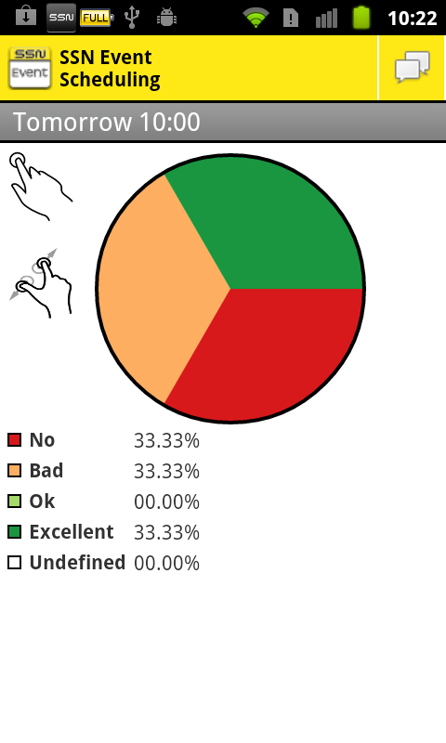
Event Scheduling
Similar to Doodle
Suggest dates, vote, chat
Visualization of the result

Slide 8
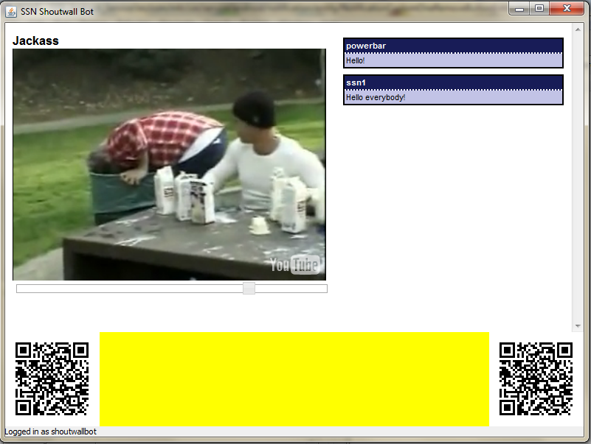
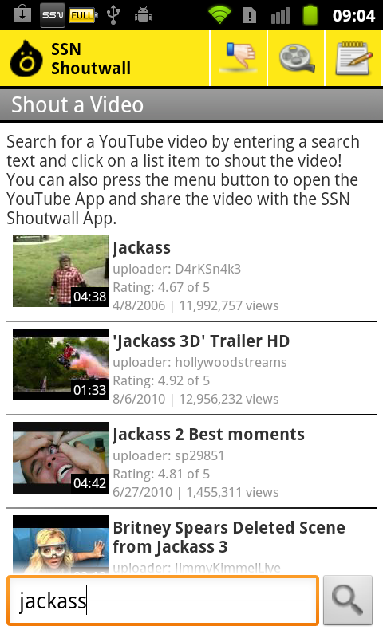
YouTube Shoutwall
Users send videos, text messages and votes
Bot displays these messages
N (senders) to 1 (receiver) communication

Slide 9
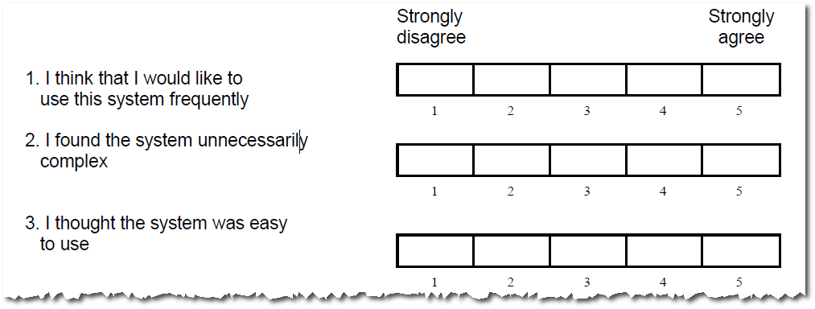
Evaluation
System Usability Scale (SUS)
Ten-items questionnaire
Result is composite measure of overall usability

Slide 10
SUS Results
Beta version test
Final version test
6 people
~65 of 100 points
Standard dev.: 19.1
“Ok“
9 people
~81 of 100 points
Standard dev.: 8.7
“Good“
Mean of ~200 SUS tests: ~70 points (Bangor et. al.)
Accurate result: ≥12 people (Tullis and Stetson)
⇒ “SSNs belong to the better products! (Bangor et. al.)

Slide 11
Suitability of XMPP and PubSub
Good choice for prototype implementation
Solves low-level problems
Libraries readily available
Problems
Security (e.g., access to data)
Automatic deletion
Connection losses
⇒ Substantial changes required!

Slide 12
Summary
Spontaneous Social Networks (SSNs)
Flexible and short-lived
Applications work on top of SSNs
Implementation
SSN Framework
Event Scheduling
YouTube Shoutwall
Central Notifications
Evaluation
“SSNs belong to the better products!“

Slide 13
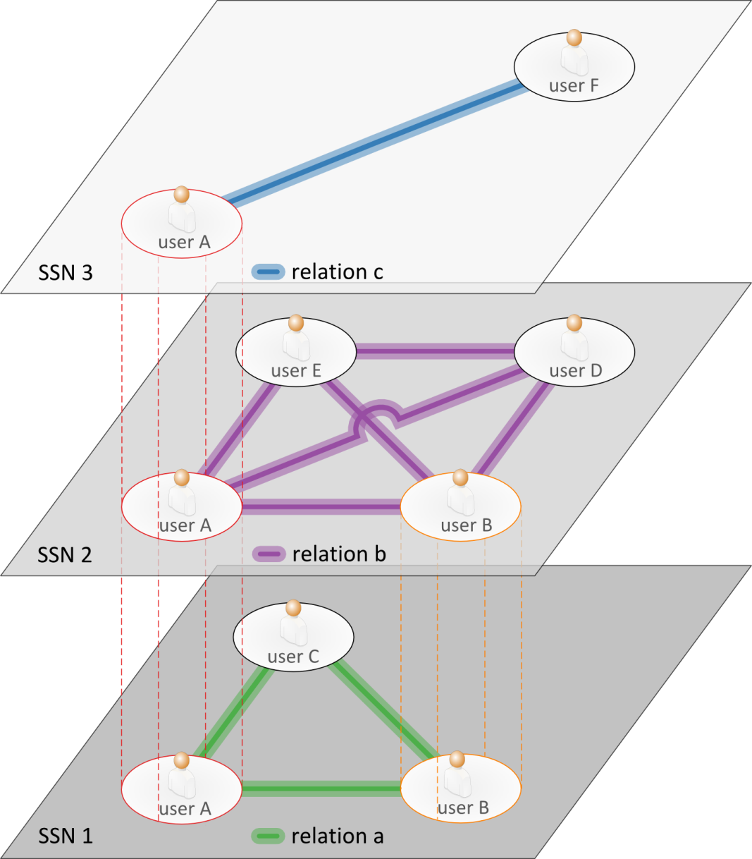
Thank you for your attention!
Questions?

