Slide 1



Projection-Based Metal-Artifact Reduction for Industrial 3D X-ray Computed Tomography
Artem Amirkhanov ^{1,2}
Michael Reiter ²
Johann Kastner ²
Christoph Heinzl ²
M. Eduard Gröller ¹
¹ Institute of Computer Graphics
and Algorithms
Vienna University of Technology
² Upper Austrian University of Applied Sciences
Wels Campus, Austria

Slide 2
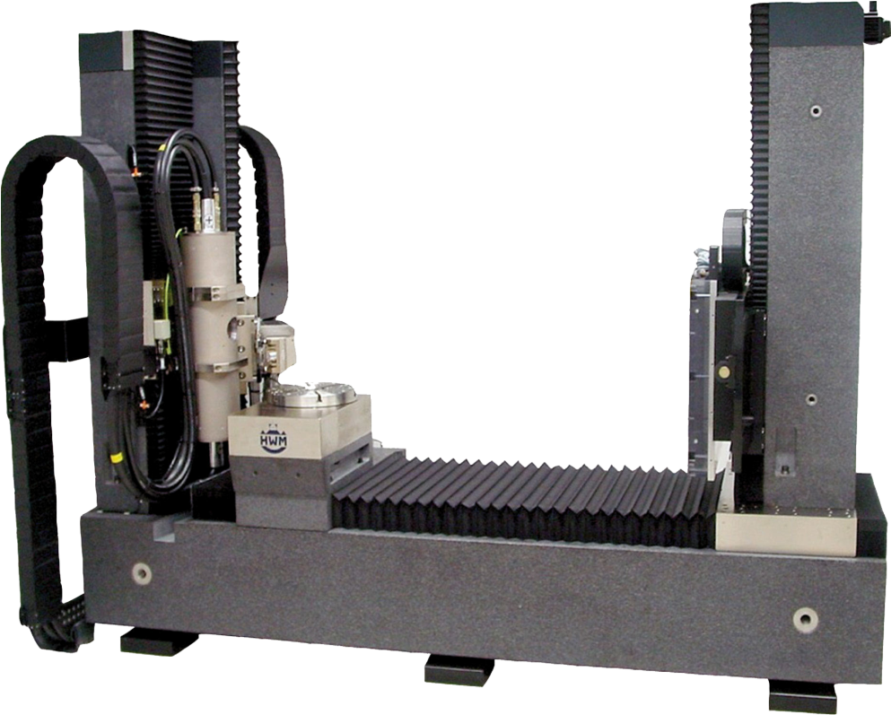
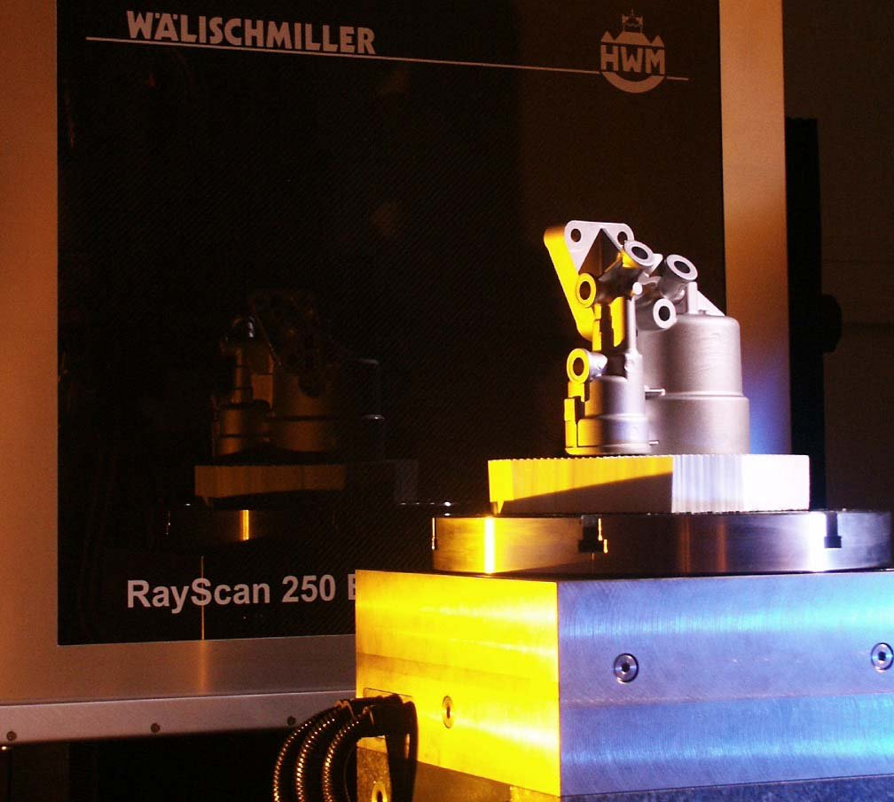
Scanning Geometry

Slide 3
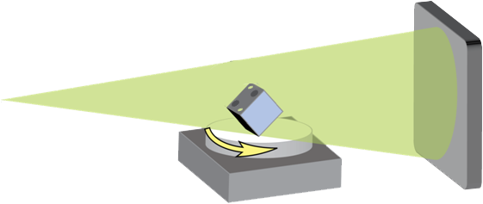

Scanning Geometry
Detector
Specimen
X-ray source
Rotary plate
Reconstruction
Projections
3D Volume

Slide 4
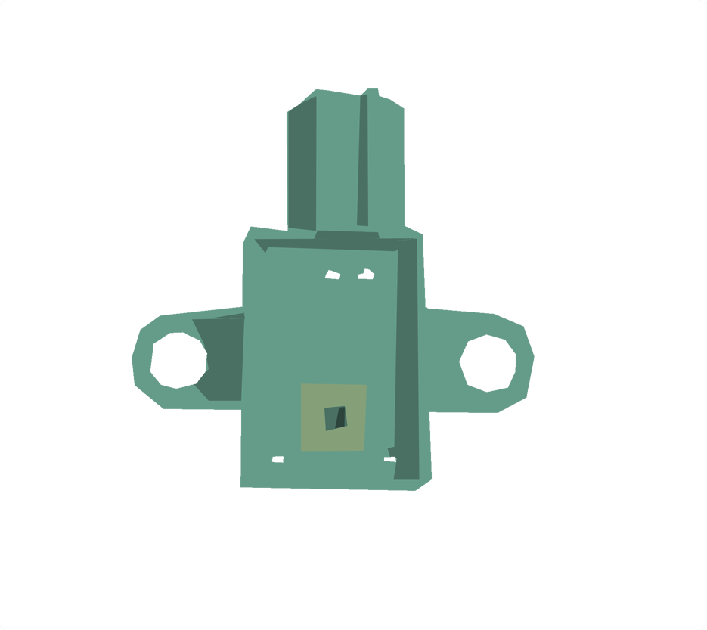

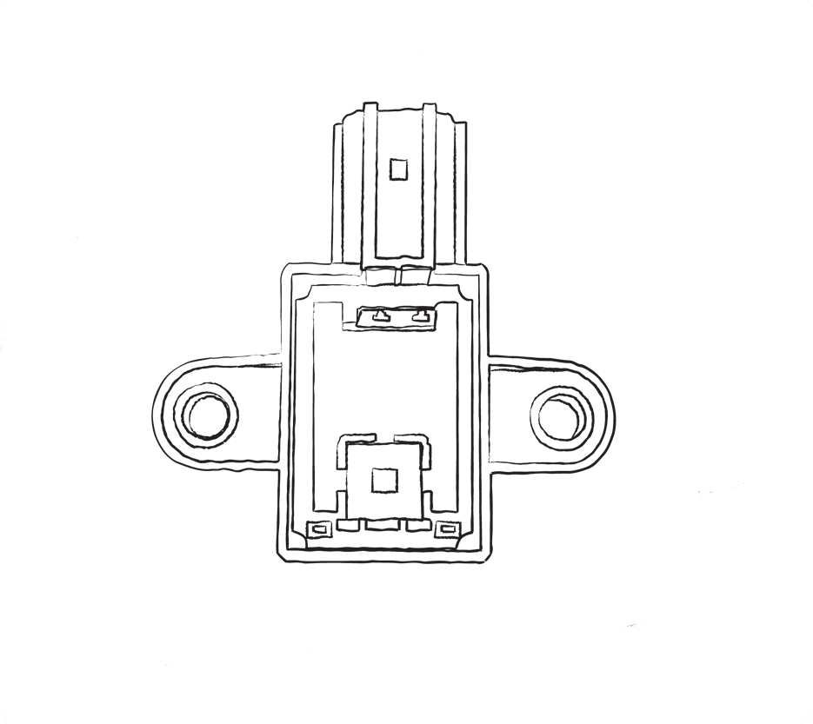

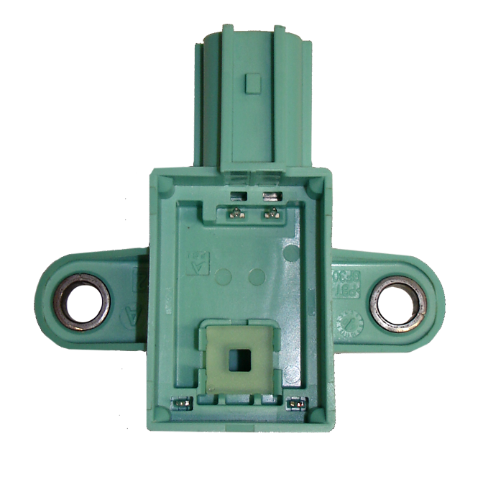
Multi-Material Components (MMCs)
Most industrial parts are MMCs
Materials:
  Air
  Plastic
  Metal

Slide 5
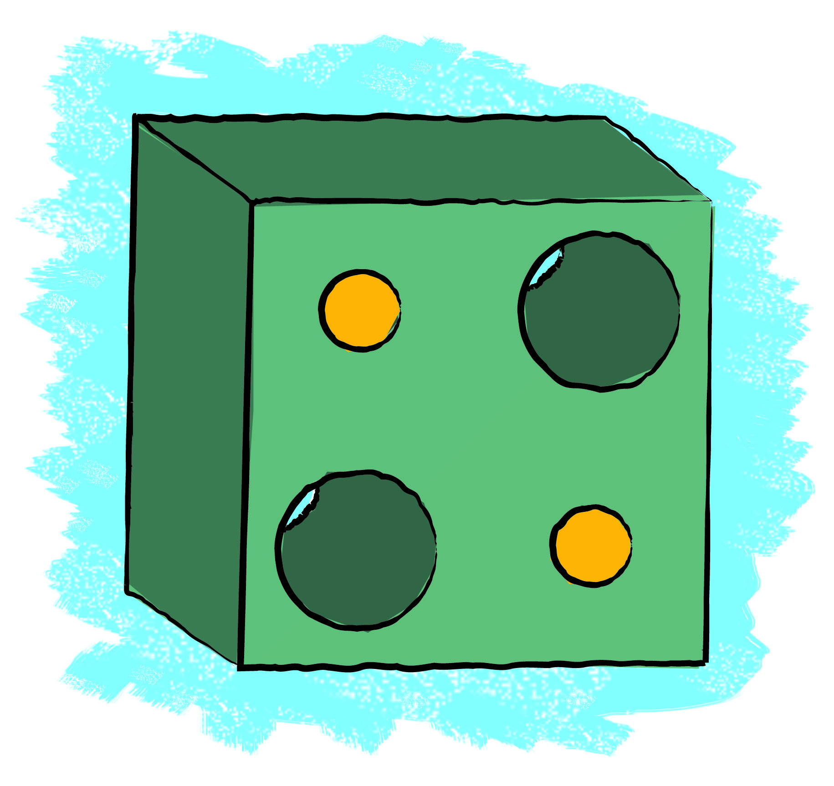
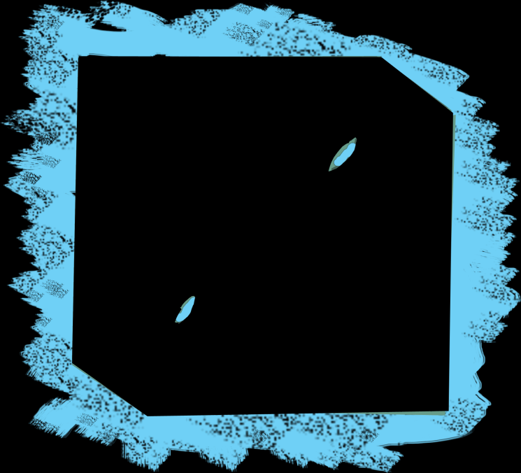
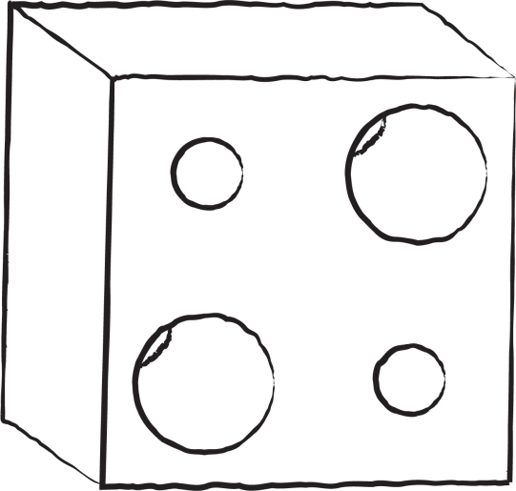
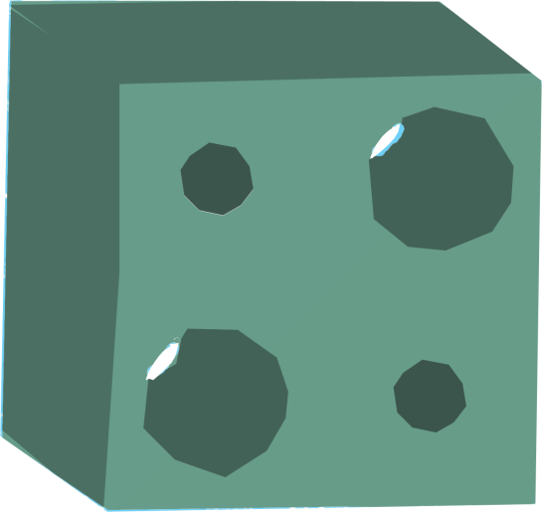

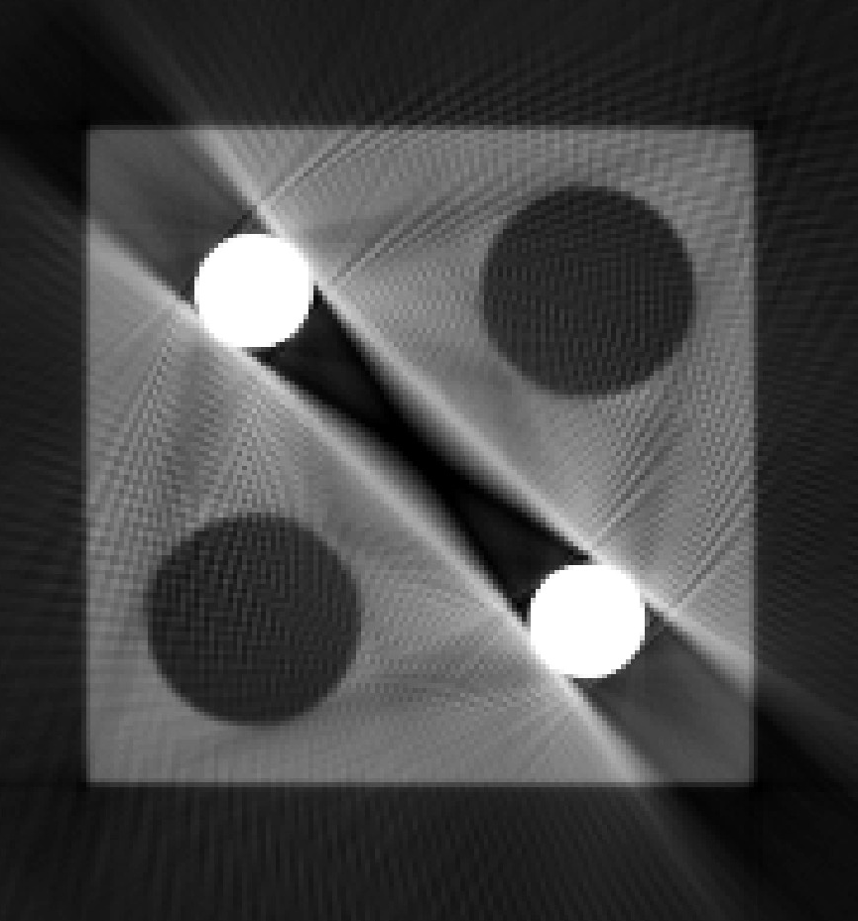

Metal Artifacts
Appear in MMCs
Metal artifacts
  Dark-band artifacts
  Streak-noise artifacts
Caused by beam hardening
Bad for
  Material characterization
  Measurements
Dark-band artifacts
Streak-noise artifacts

Slide 6
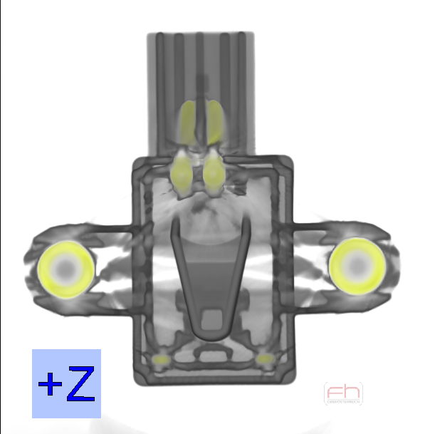
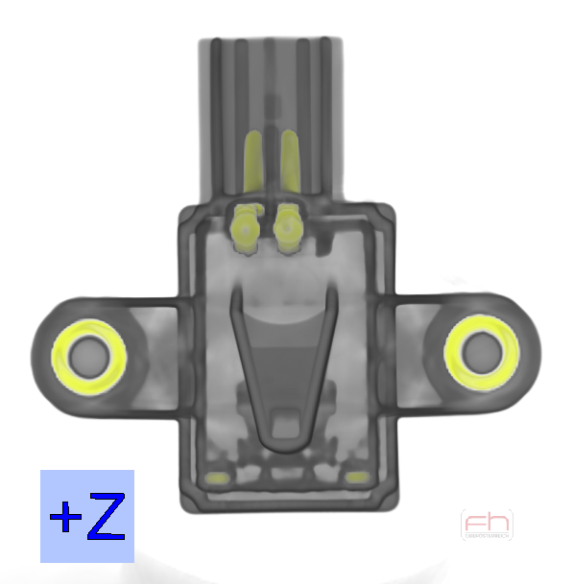
Our Contributions
Adaptation of a projection-based metal artifacts reduction (MAR) workflow for 3DXCT
Integrated visual analysis tool
Integrated VA Tool
MAR Workflow

Slide 7
Main Idea
Artifacts source: projections
We remove metal from projections
We then reconstruct the 3D volume with reduced artifacts
We insert the metal back into this volume
Streak-noise artifacts

Slide 8
MAR Workflow
Input
Projections
Initial Data
Reconstruction
3D Volume
Initial Reconstruction
Projections
3D Volume
Material Separation
3D Volume
Metal
Forward Projection
Workflow
Projections
Without Metal
Interpolation
Projection
Metal Interpolated
Reconstruction
3D Volume
MAR without Metal
Fusion
Output
3D Volume
MAR Volume

Slide 9

Material Separation
Attenuation coefficient thresholding
Artem Amirkhanov
8
Notes:
8

Slide 10
MAR Workflow
Input
Projections
Initial Data
Reconstruction
3D Volume
Initial Reconstruction
Projections
3D Volume
Material Separation
3D Volume
Metal
Forward Projection
Workflow
Projections
Without Metal
Interpolation
Projection
Metal Interpolated
Reconstruction
3D Volume
MAR without Metal
Fusion
Output
3D Volume
MAR Volume

Slide 11
Forward Projection
Works as follows:
  Project every metal voxel on every projection
Projection
Specimen
X-ray source
Rotary plate
Artem Amirkhanov
Notes:
10

Slide 12
Forward Projection
Partially covered pixels
  We overestimate partially covered pixels
Projection
Covered pixels
Voxel center
Metal voxel projection
Length of projected voxel diagonal
Artem Amirkhanov
11
Notes:
11

Slide 13
MAR Workflow
Input
Projections
Initial Data
Reconstruction
3D Volume
Initial Reconstruction
Projections
3D Volume
Material Separation
3D Volume
Metal
Forward Projection
Workflow
Projections
Without Metal
Interpolation
Projection
Metal Interpolated
Reconstruction
3D Volume
MAR without Metal
Fusion
Output
3D Volume
MAR Volume

Slide 14
MAR Workflow
Input
Projections
Initial Data
Reconstruction
3D Volume
Initial Reconstruction
Projections
3D Volume
Material Separation
3D Volume
Metal
Forward Projection
Workflow
Projections
Without Metal
Interpolation
Projection
Metal Interpolated
Reconstruction
3D Volume
MAR without Metal
Fusion
Output
3D Volume
MAR Volume

Slide 15
Interpolation
Row-wise linear interpolation along the X axis
Artem Amirkhanov
14
Notes:
14

Slide 16
Interpolation
Row-wise linear interpolation along the X axis
Artem Amirkhanov
15
Notes:
15

Slide 17
Interpolation
Row-wise linear interpolation along the X axis
Artem Amirkhanov
16
Notes:
16

Slide 18
Interpolation
Row-wise linear interpolation along the X axis
Start of the gap
End of the gap
Artem Amirkhanov
17
Notes:
17

Slide 19
Interpolation
Row-wise linear interpolation along the X axis
Start of the gap
End of the gap
Artem Amirkhanov
18
Notes:
18

Slide 20
MAR Workflow
Input
Projections
Initial Data
Reconstruction
3D Volume
Initial Reconstruction
Projections
3D Volume
Material Separation
3D Volume
Metal
Forward Projection
Workflow
Projections
Without Metal
Interpolation
Projection
Metal Interpolated
Reconstruction
3D Volume
MAR without Metal
Output
Fusion
3D Volume
MAR Volume

Slide 21
MAR Workflow
Input
Projections
Initial Data
Reconstruction
3D Volume
Initial Reconstruction
3D Volume
Material Separation
3D Volume
Metal
Forward Projection
Workflow
Projections
Without Metal
Interpolation
Projection
Metal Interpolated
Reconstruction
3D Volume
MAR without Metal
Output
Fusion
3D Volume
MAR Volume

Slide 22

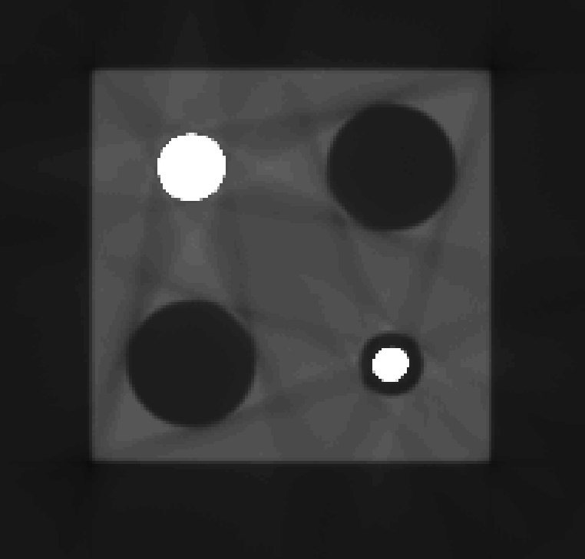
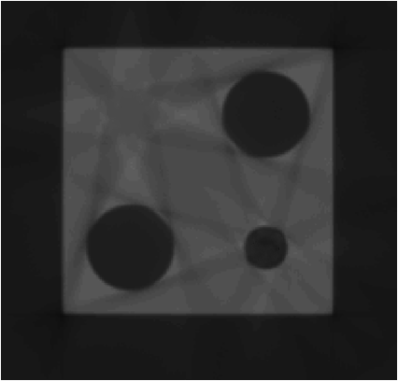
Fusion
Interpolation on the metal boundaries for smooth appearance
Artem Amirkhanov
21
Notes:
21

Slide 23
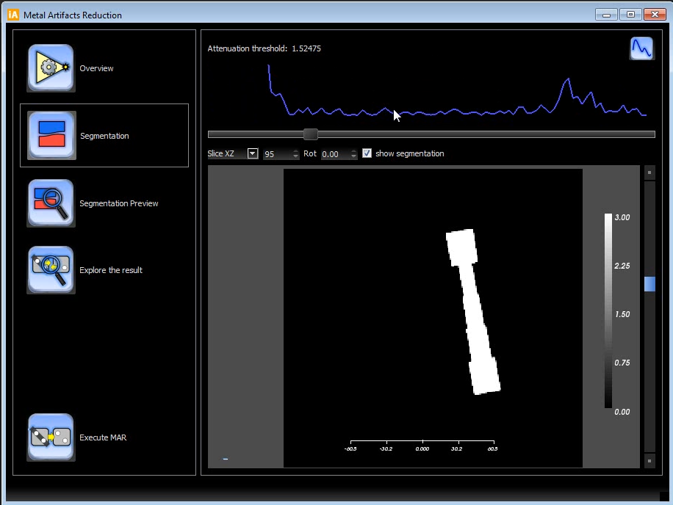
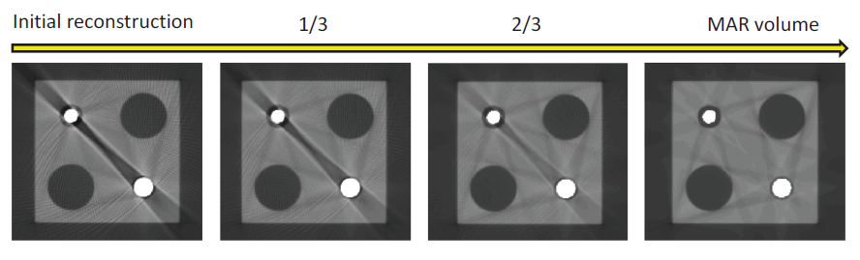
Integrated Visual Analysis Tool
Steps of the workflow are integrated
Visual threshold estimation
  Segmentation preview
  Result preview
Visual result exploration
Artem Amirkhanov
22
Notes:
22

Slide 24
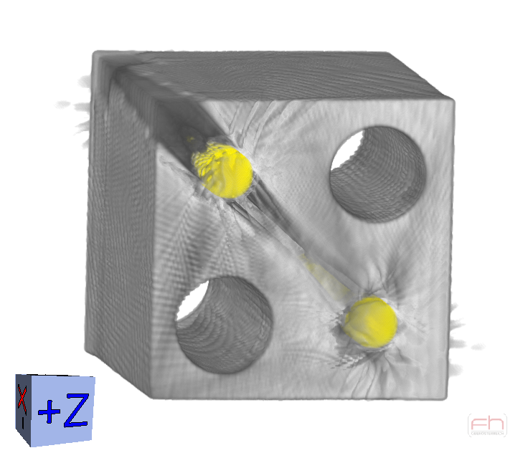
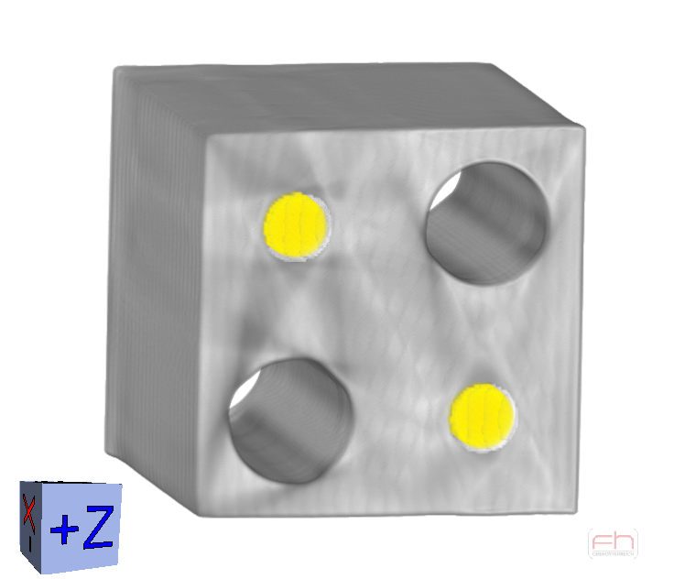
Results (1)
Artem Amirkhanov
23
Notes:
23

Slide 25
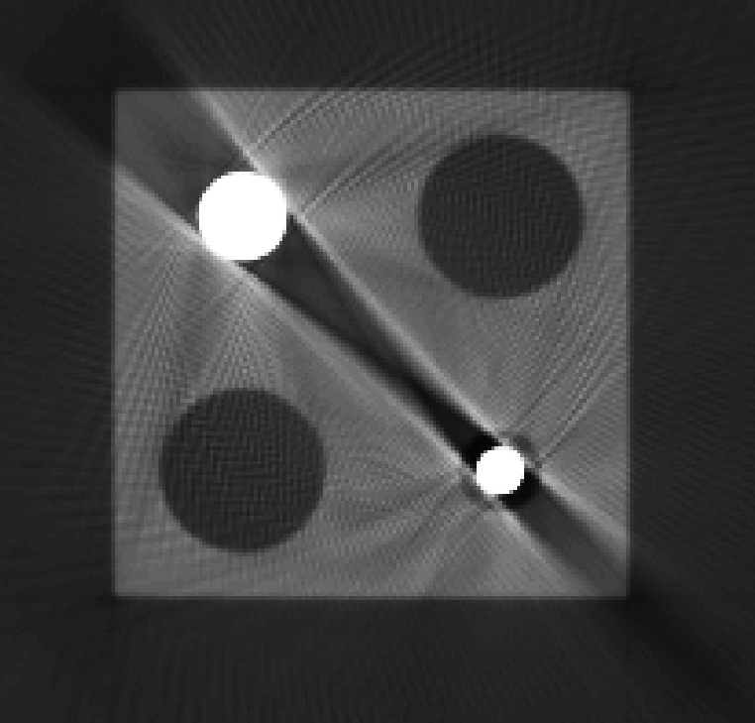
Results (1)
Artem Amirkhanov
24
Notes:
24

Slide 26
Results (2)
Artem Amirkhanov
25
Notes:
25

Slide 27
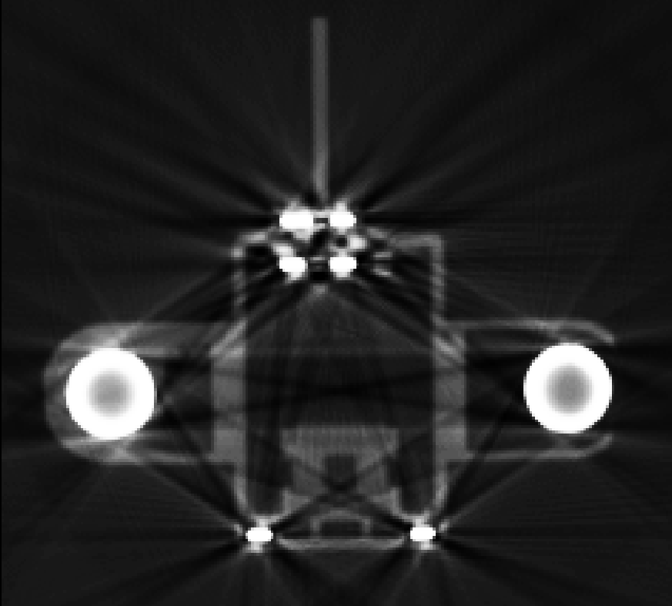
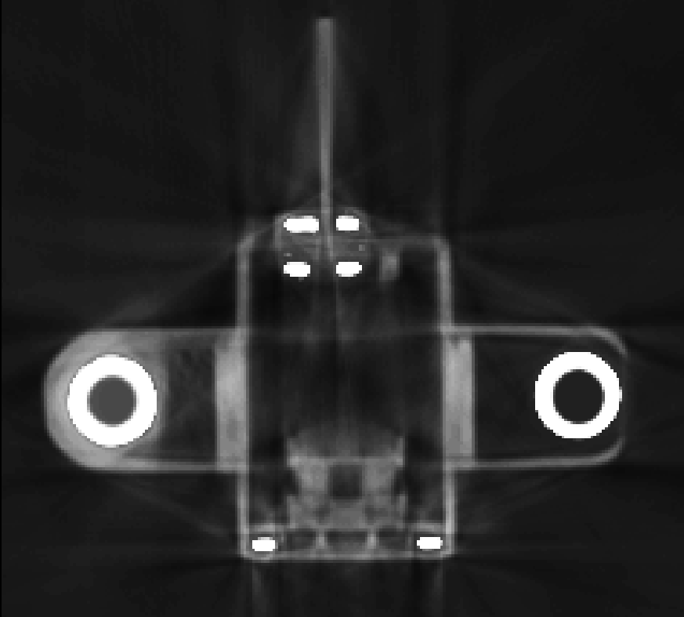
Results (2)
Artem Amirkhanov
26
Notes:
26

Slide 28
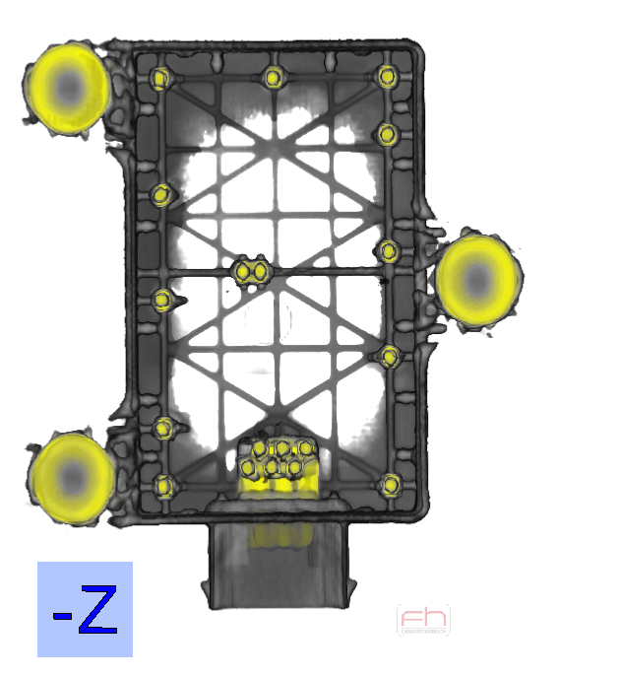
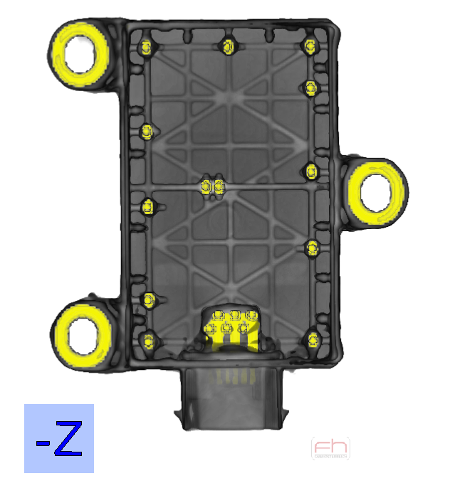
Results (3)
Artem Amirkhanov
27
Notes:
27

Slide 29
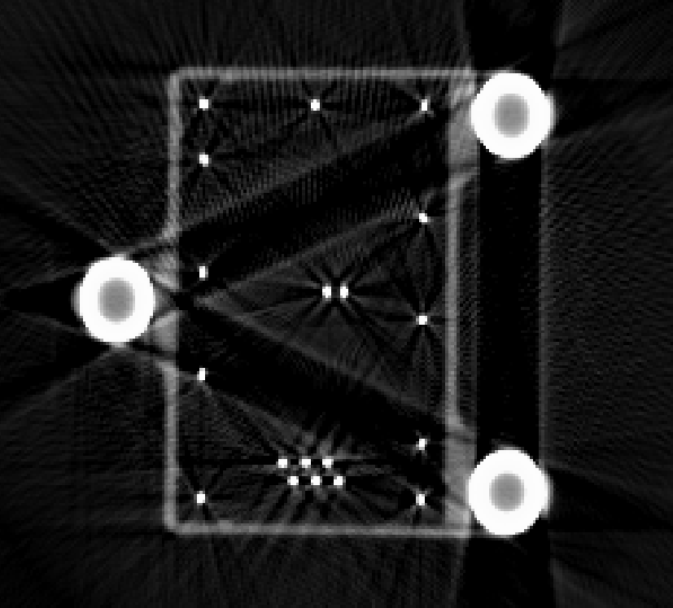
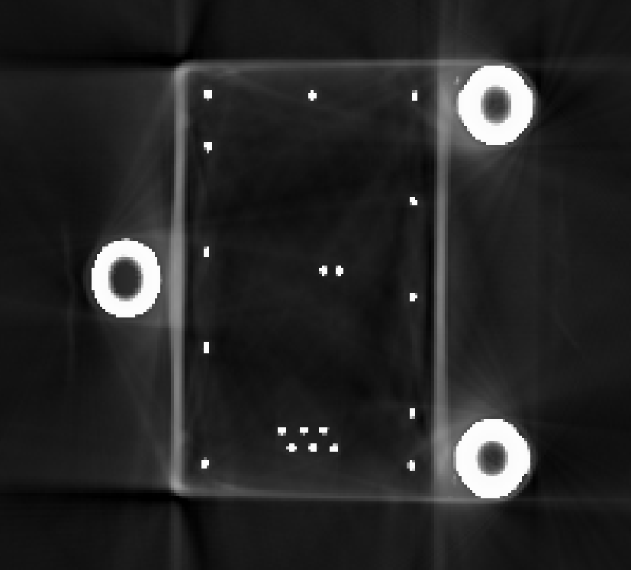
Results (3)
Artem Amirkhanov
28
Notes:
28

Slide 30
Limitations
Interpolation introduces blurring in the result
Limiting factor: metal projected area

Slide 31
Limitations
Interpolation introduces blurring in the result
Limiting factor: metal projected area

Slide 32
Conclusions
MAR for 3D industrial MMCs
  Significant artifact reduction
  Works for various datasets
Integrated visual analysis tool
  Assisting user in threshold estimation
  Exploring the result
GPU implementation (CUDA)
  Reconstruction
  Forward-projection
  Interpolation

Slide 33
Conclusions
VS
Thank you!
Contact: artem@cg.tuwien.ac.at

