Slide 1
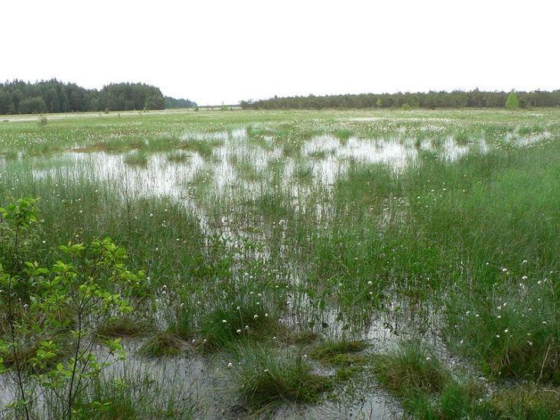
The title will be announced during or at the end of the talk

Slide 2
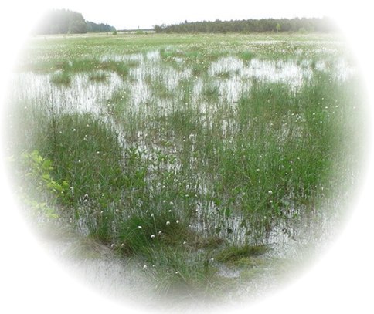
The Haunted Swamps of Heuristics
Eduard Gröller
Institute of Computer Graphics and Algorithms
Vienna University of Technology

Slide 3
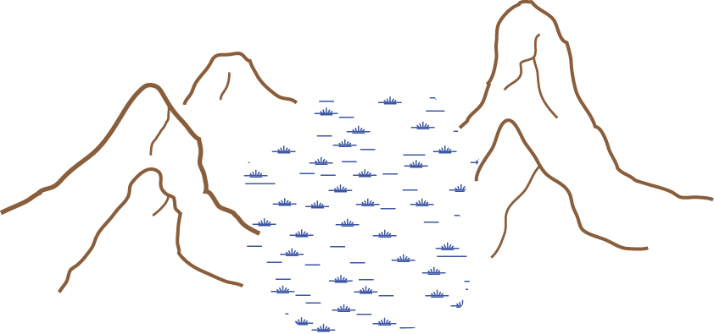



Problem Solving ↔ Path Finding
A
B
High ground of theory ↔ Haunted swamps of heuristics

Slide 4
The
Haunted
Swamps
of
Heuristics
negative
neutral,
positive
negative
Reviewer comments
„ ... only heuristics ...“
„ ... lots of parameter tweaking ...“
„ ... ad hoc parameter specification ...“
„ ... too many heuristic choices ...“
negative
Eduard Gröller
3

Slide 5
Heuristics
Heuristics
  Greek: "Εὑρίσκω", "find" or "discover“
  Experience-based techniques for problem solving, learning, and discovery
  Finding a good enough solution
Examples
  Trial and Error
  Draw a picture
  Assume a solution and work backward
  Abstract problem → examine concrete example
  Solve a more general problem first
[Wikipedia, 2011]

Slide 6
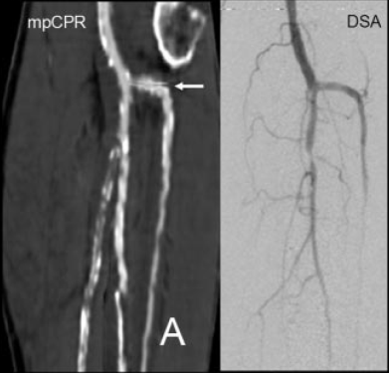
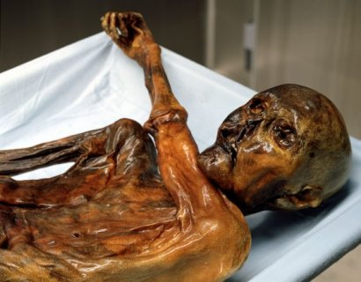
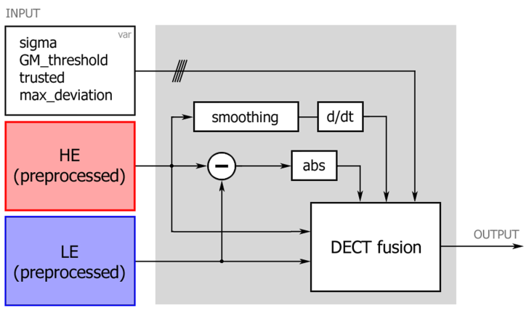
Objects of Desire in Science
Focus objects of scientific interest
  Data
  Artefacts, fossils, mummies
  Algorithms
Multipath CPR
[Roos et al., 2007]
Ötzi the Iceman
[Wikipedia, 2011]
Dual Energy CT
[Heinzl et al., 2009]
Our community is really fond of algorithms

Slide 7
Objects of Desire – Algorithms
Algorithm: set of instructions + constants + variables
And then there are:
Parameters: auxiliary measures (greek)
Constraints, boundary conditions, approximations, calibrations
Whatever does not work
Parameters often specified heuristically
Problem solving: algorithm + parameters
parameters
⇒ encoded in parameters
⇒ encoded in parameters

Slide 8
Heuristic Parameter Specification - Examples

Slide 9
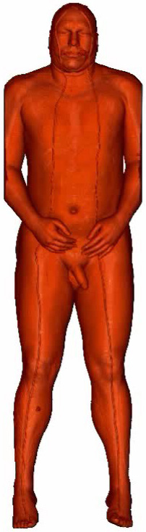
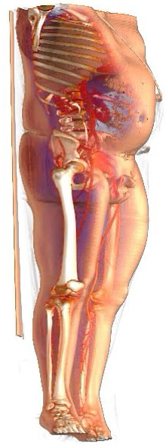
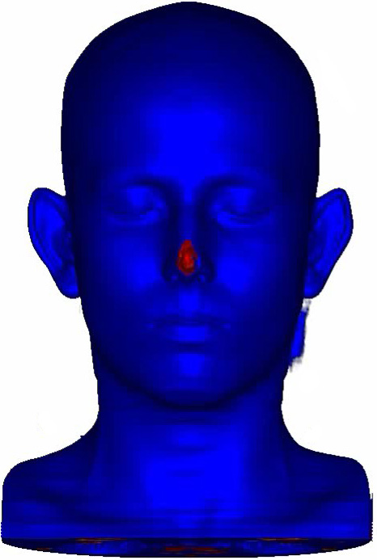
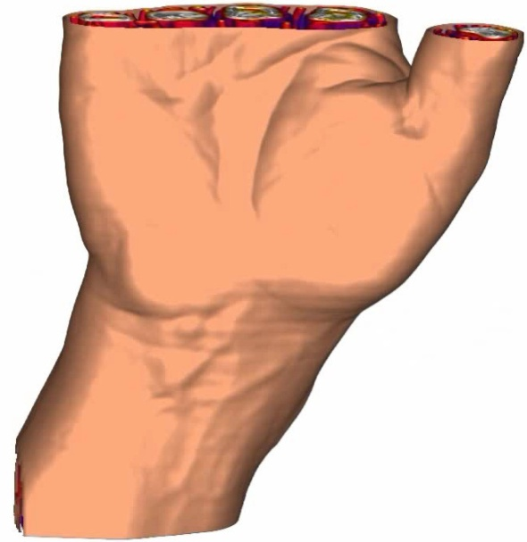
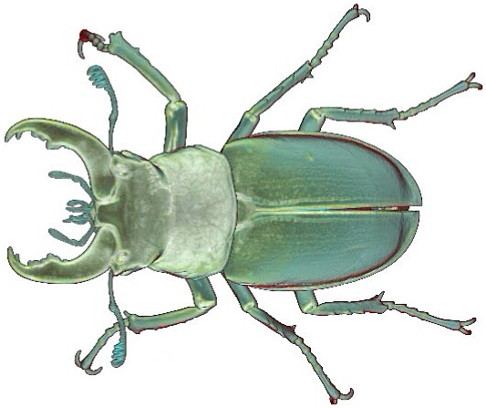
Context-Preserving Rendering (1)
[al. et Gröller, 2006]

Slide 10
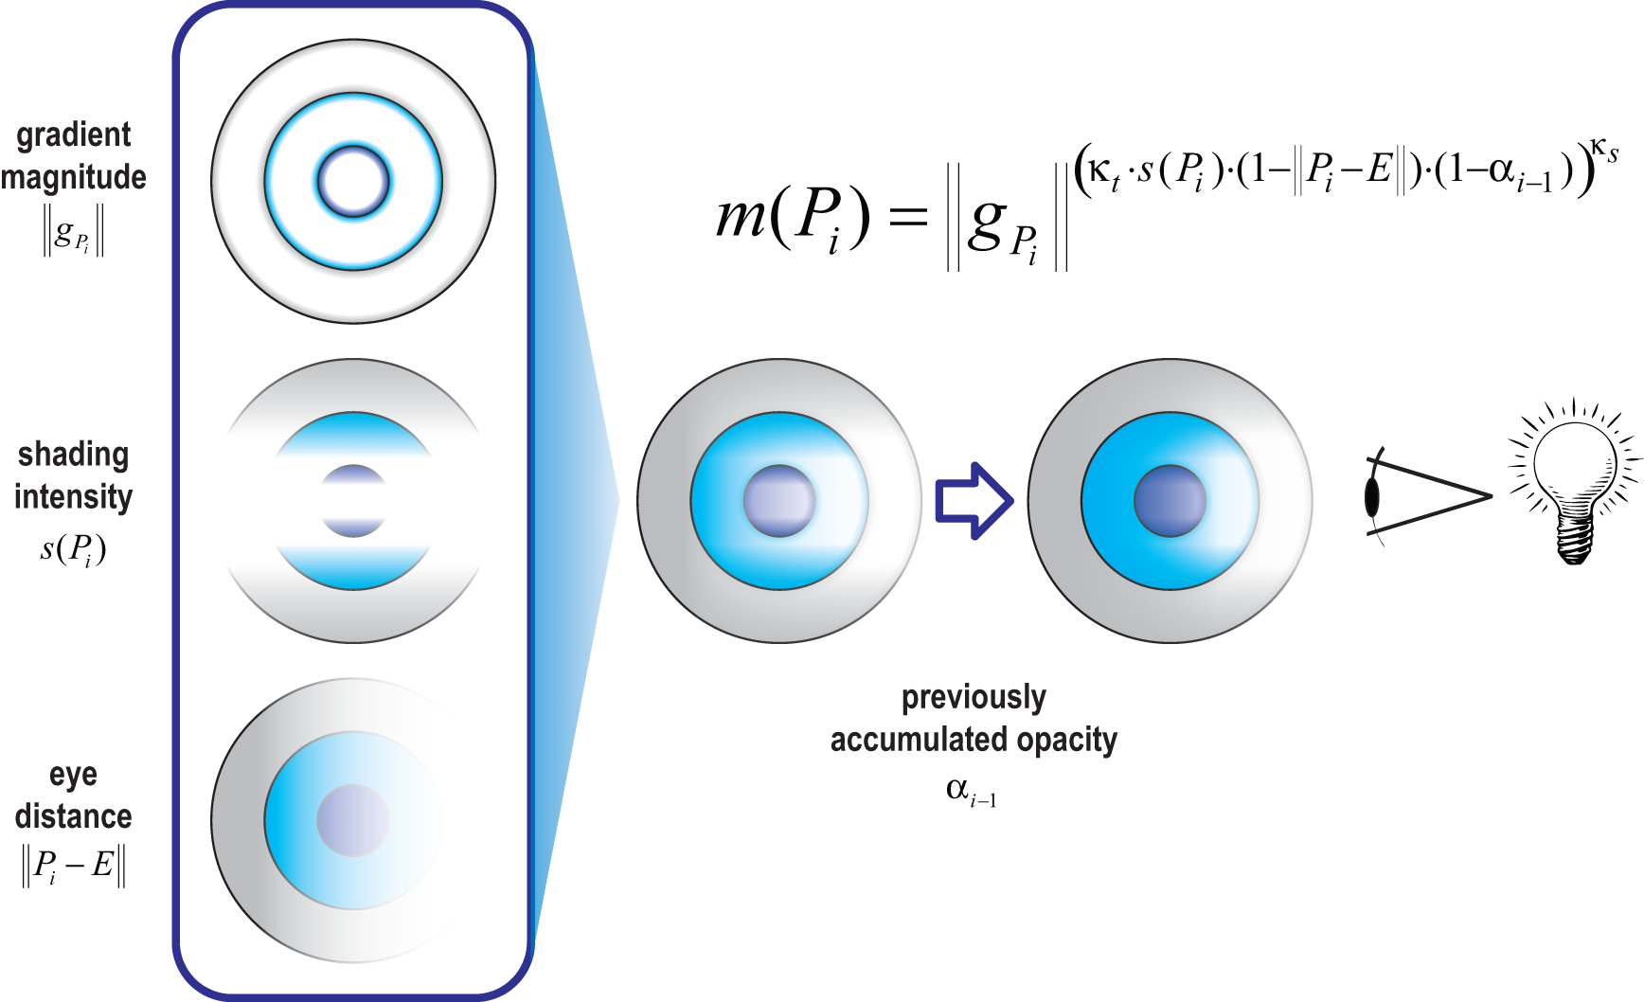
Context-Preserving Rendering (2)
κ_{s}
κ_{t}
Integrate various focus+context approaches with only few parameters

Slide 11
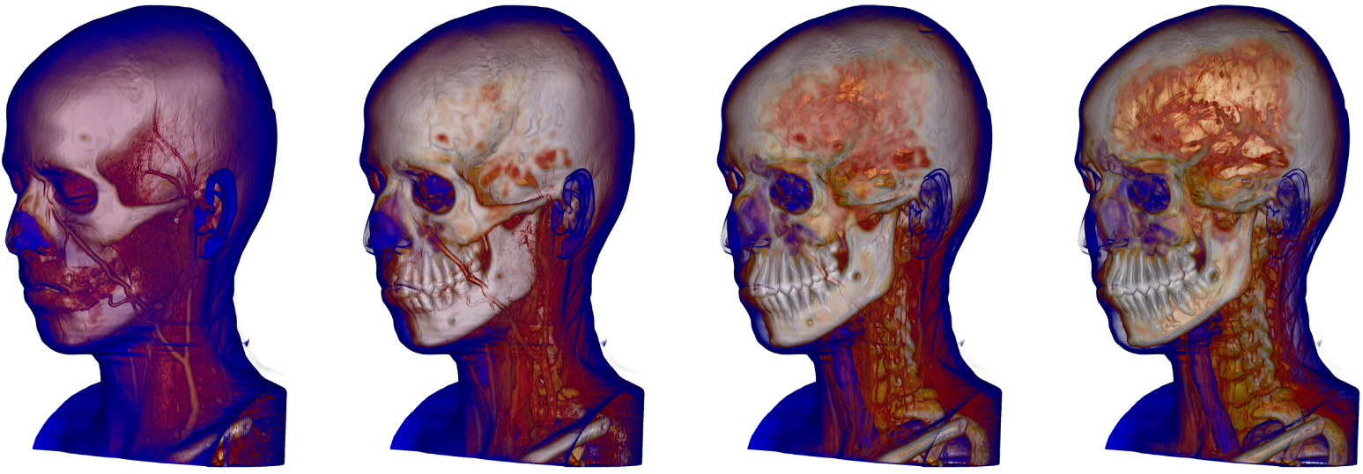
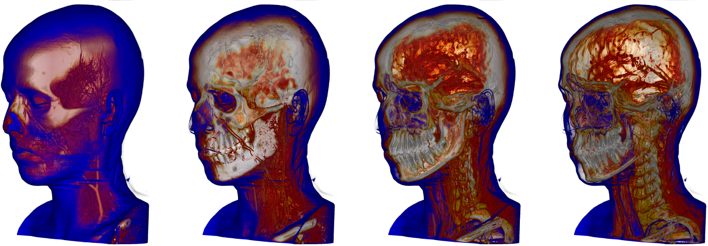
User-Defined Parameters

Slide 12
Heuristic Parameter Specification

Slide 13
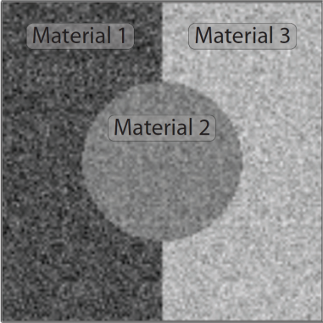
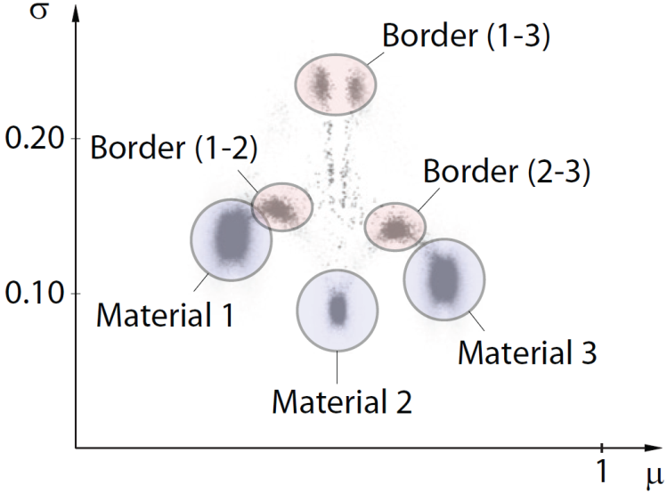
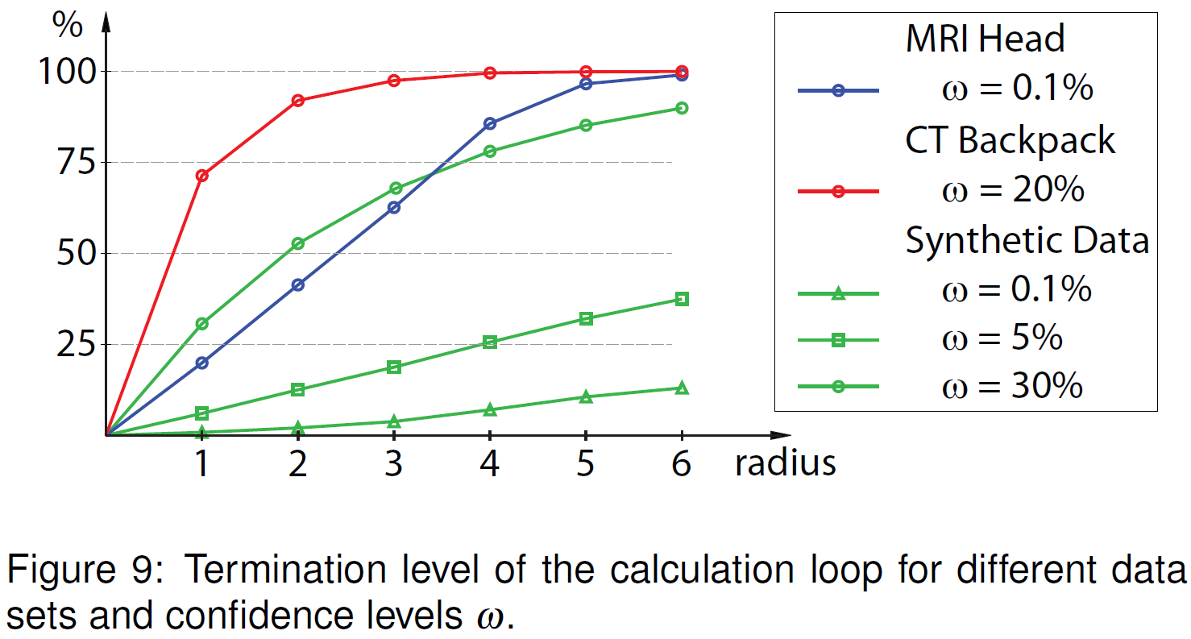
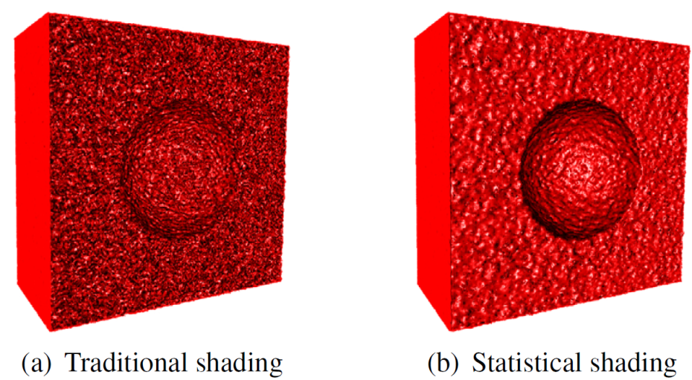
Statistical Transfer-Function Spaces
[al. et Gröller, 2010]

Slide 14

Problem Solving: Algorithm + Parameters
parameters
parameters
algorithm
data
algorithm
image
Parameter space analysis
  Robustness, stability: well established in other disciplines
  Increased interest in visualization
    Variations
    Esembles
    Knowledge-assisted visualization

Slide 15

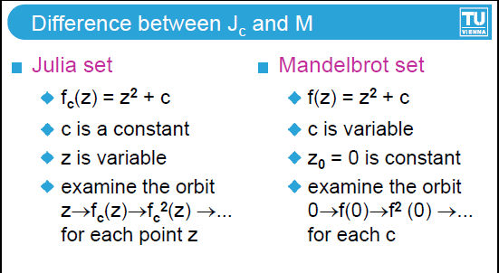
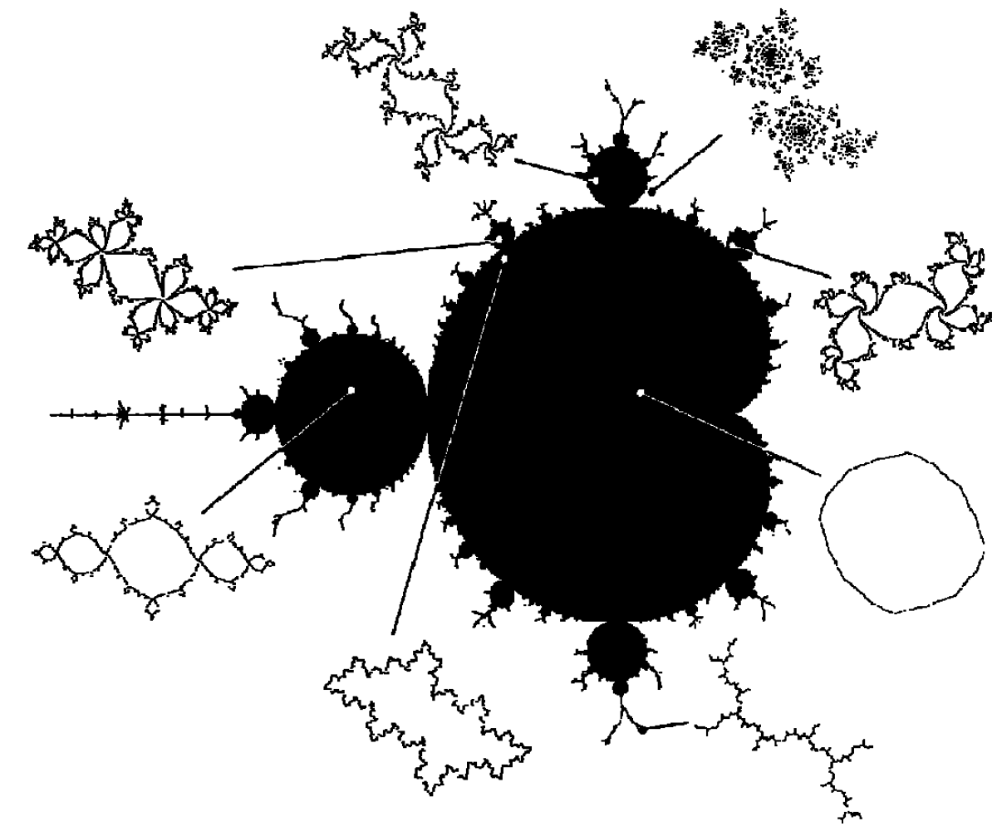
Dynamical Systems – Parameter Space
Mandelbrot set: parameter space for Julia sets

Slide 16
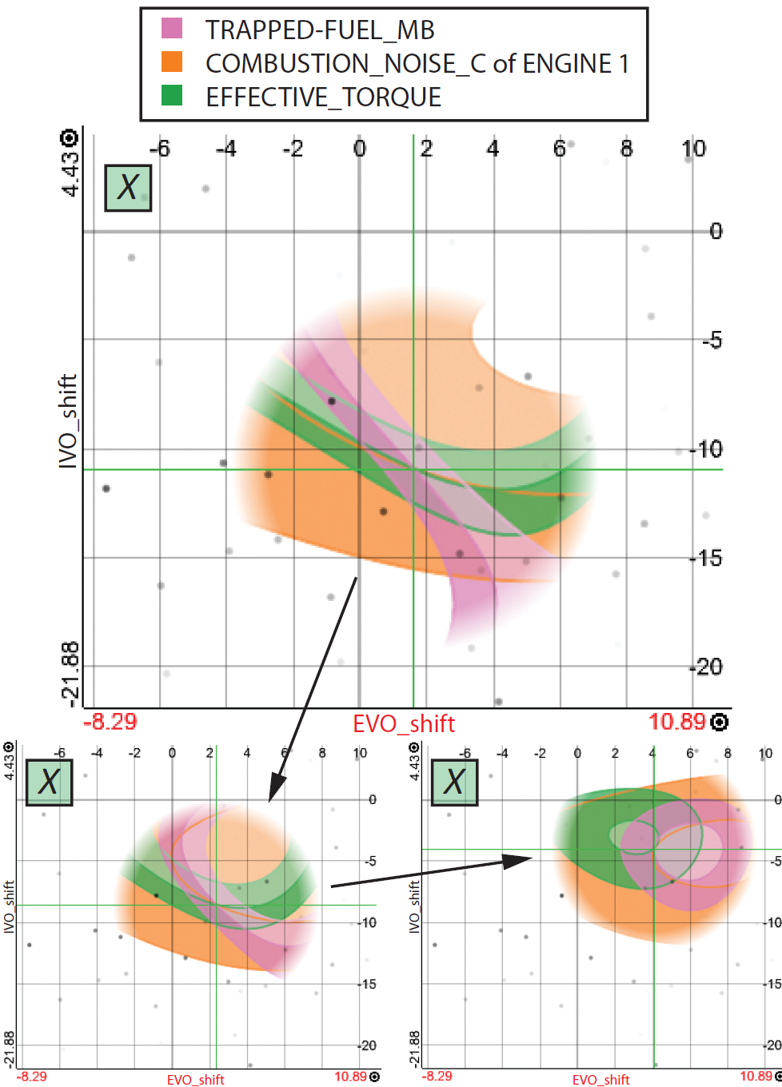
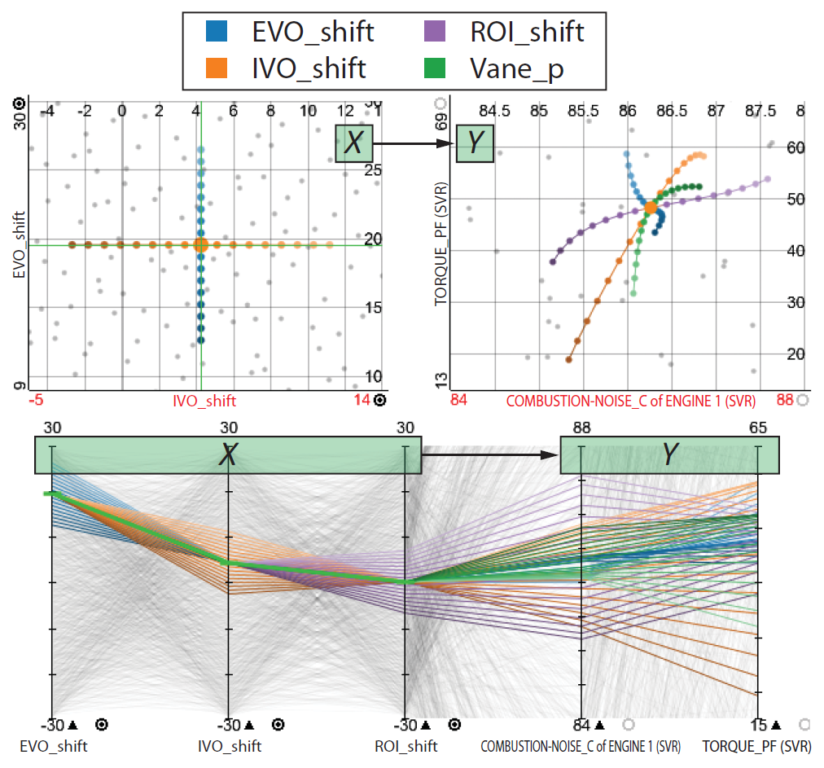
Parameter Space Analysis in Visualization
Uncertainty-Aware Exploration of Continuous Parameter Spaces
Surrogate models ≈ euphemism for heuristics
[Berger, Piringer et al., 2011]

Slide 17
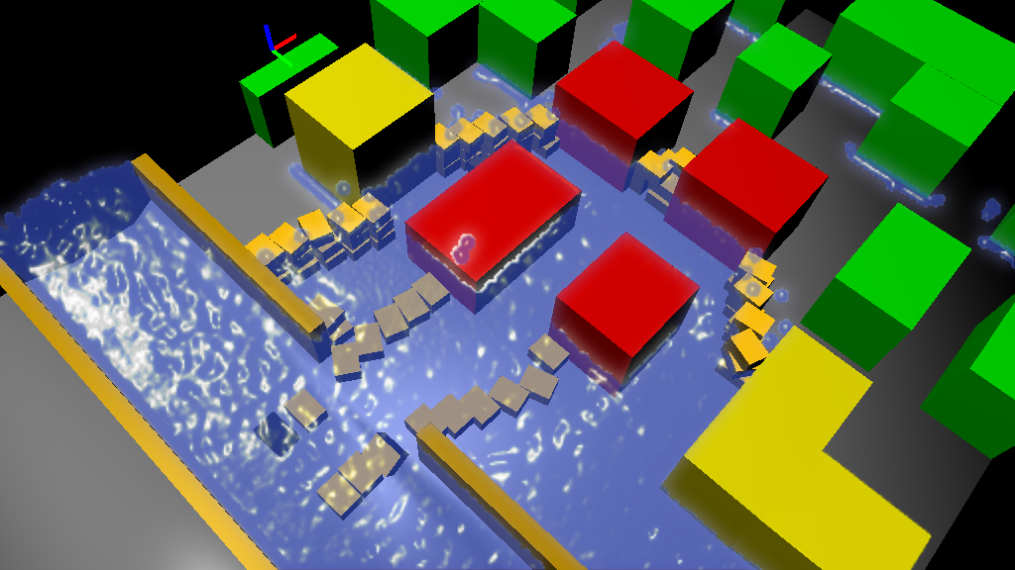
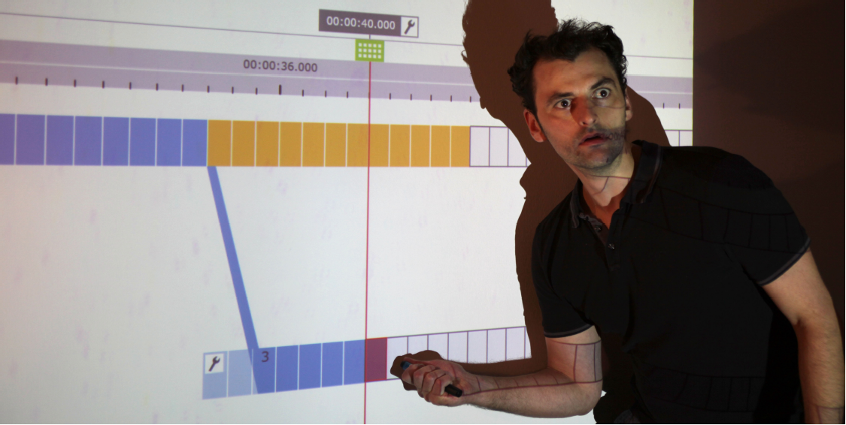
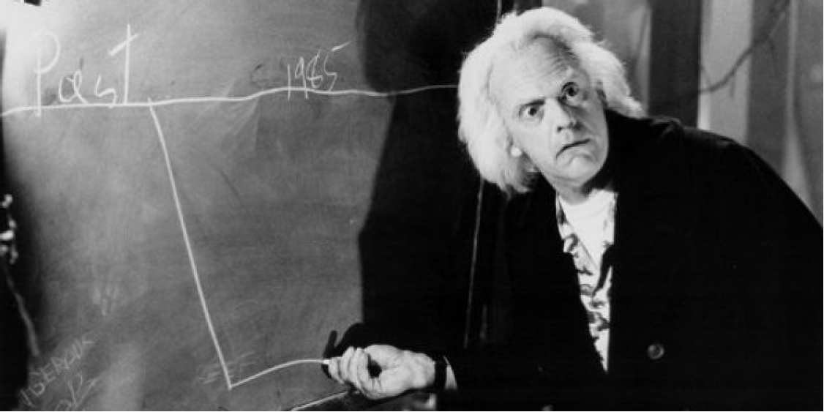
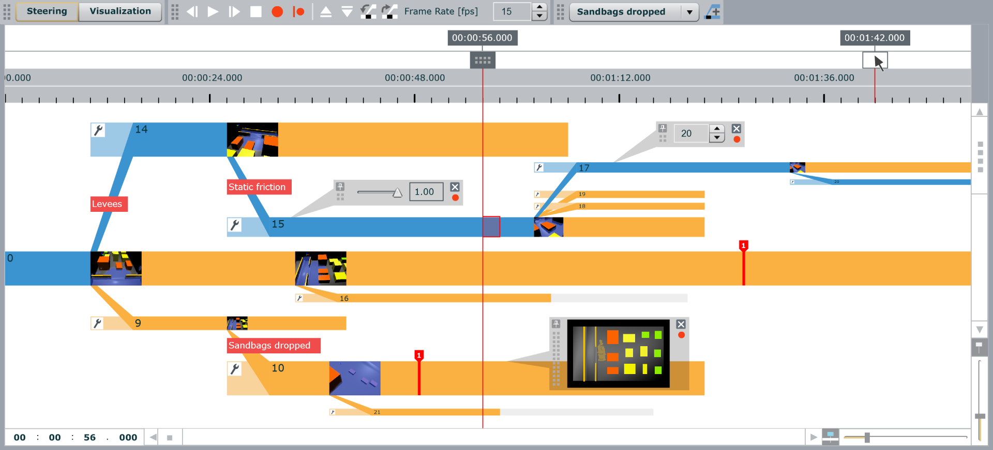
Parameter Space Analysis in Visualization
World Lines
  Flood emergency assistance
  Testing breach closure procedures
  Steer multiple, related simulation runs
  Test alternative decisions
  Analyze and compare multi-runs
[Waser et al., 2010]
Video

Slide 18
Problem Solving: Algorithm + Parameters
Examples
  Exploration of Continuous Parameter Spaces
  World Lines
Visualization algorithms??
⇒ Parameter variation for computational steering
parameters
algorithm
data
image

Slide 19
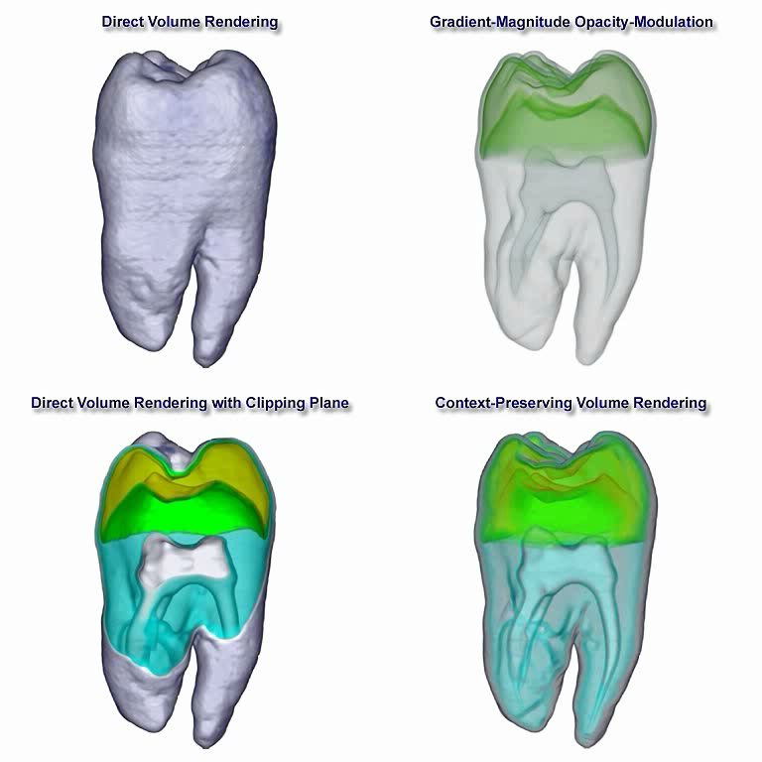
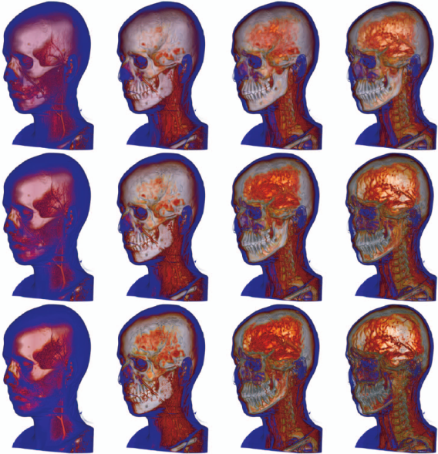
Context-Preserving Rendering
[Bruckner et al., 2006]
[al. et Gröller, 2006]
κ_{t}
GradMagnMod
Compositing
κ_{s}

Slide 20
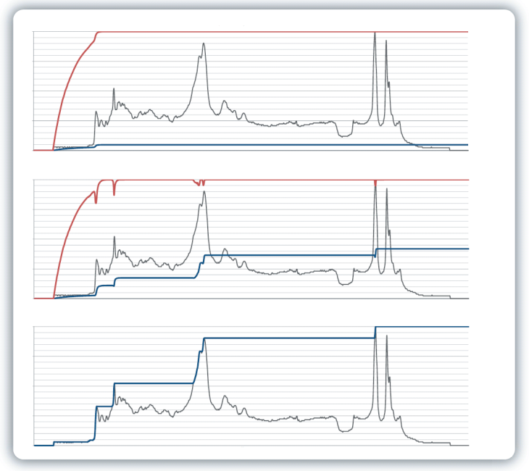
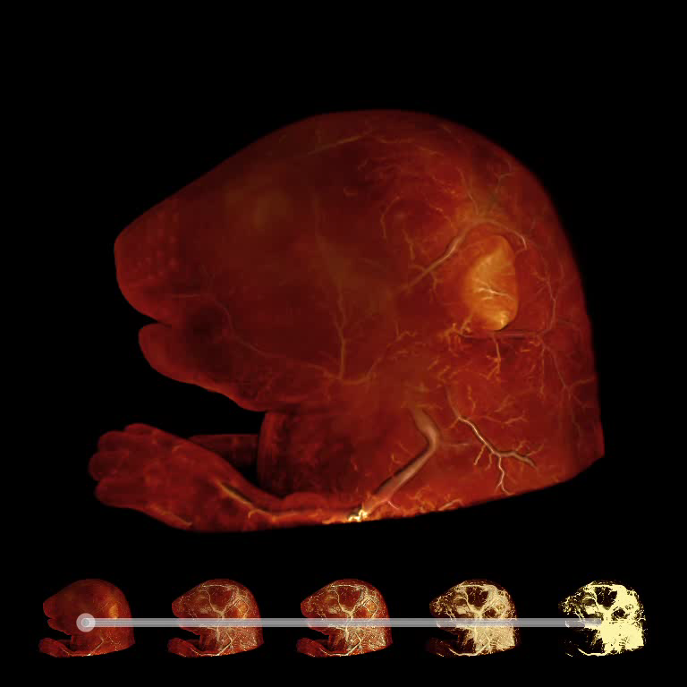

Maximum Intensity Difference Accumulation
Blending of MIP and DVR [Bruckner et al. 2009]
DVR
A_{i} = β_{i}A_{i-1} + (1 - β_{i}A_{i-1})α_{i}
C_{i} = β_{i}C_{i-1} + (1 - β_{i}A_{i-1})α_{i}c_{i}
A_{i} = β_{i}A_{i-1} + (1 - β_{i}A_{i-1})α_{i}
C_{i} = β_{i}C_{i-1} + (1 - β_{i}A_{i-1})α_{i}c_{i}
MIDA
β_{i} = 1-
f_{i} – f_{maxi} if f_{i} > f_{maxi}
0 otherwise
MIP

Slide 21
Problem Solving: Algorithm + Parameters
Algorithms and parameters closely intertwined
Parameters deserve much more attention
Heuristics ok, but do sensitivity analysis
parameters
algorithm
data
image
algorithm + parameters ⇒ „solution cloud“
par
algo

Slide 22
Algo., Parms., Heuristics – Quo Vadis? (1)
Problem solving in visualization
  Algorithmic centric → data/image centric
  Imperative → declarative approaches
  Frameless rendering → algorithmless rendering
  Program verification → image verification
    Algorithms on demand
    Each pixel/voxel gets its own algorithm
  Integrated views/interaction

Slide 23
Algo., Parms., Heuristics – Quo Vadis? (2)
Problem solving in visualization
  Interaction sensitivity
  Comparative visualization
  Topological analysis of parameter spaces
  Interval arithmetics → distribution arithmetics in visualization (uncertainty visualization)
  Publishing in visualization
    More stability/robustness analyses in future?
    Executable Paper Grand Challenge

Slide 24
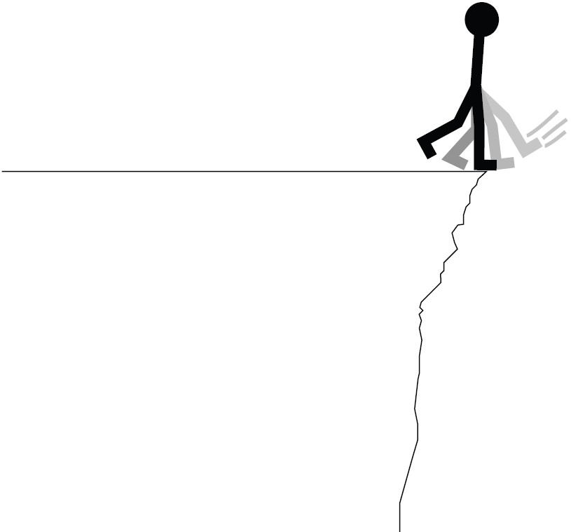
Semantic Layers for Illustrative Volume Rendering
[al. et Gröller, 2007]
„... the work is a significant step backwards ...“
[anonymous reviewer]

Slide 25
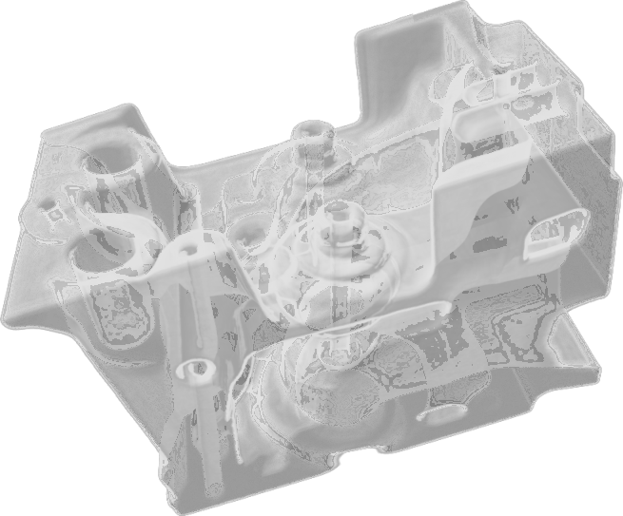
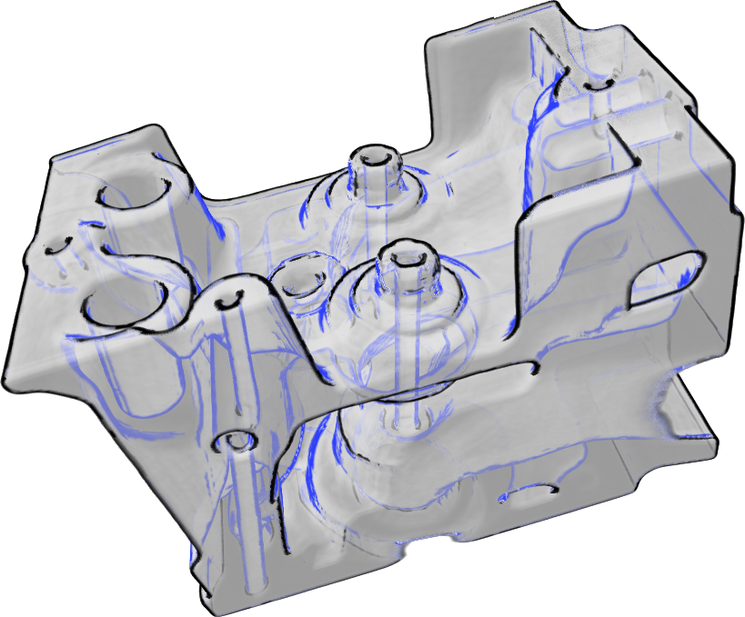
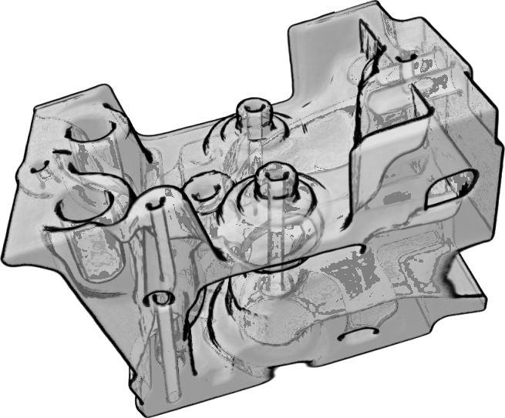
Curvature Based Selective Style Application

Slide 26
Semantic Layers for Illustrative Volume Rendering
Mapping volumetric attributes to visual styles
Use natural language of domain expert (rules)
Rules evaluated with fuzzy logic arithmetics
[Rautek et al., 2007]

Slide 27
Fuzzy Logic as a Black Box
attribute semantics
a …a
style semantics
s …s
1
n
1
m
evaluate attributes a …a
per voxel
fuzzy
logic
parameters for
styles s …s
1
n
1
m
rule base

Slide 28
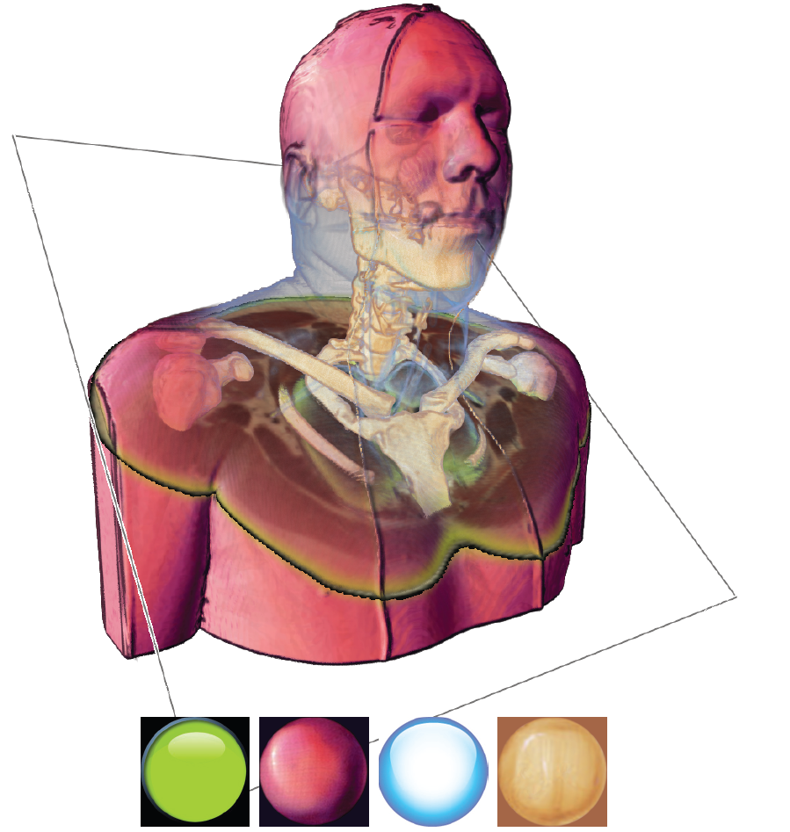
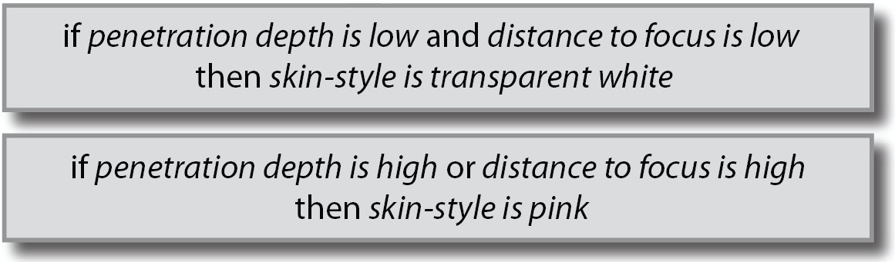
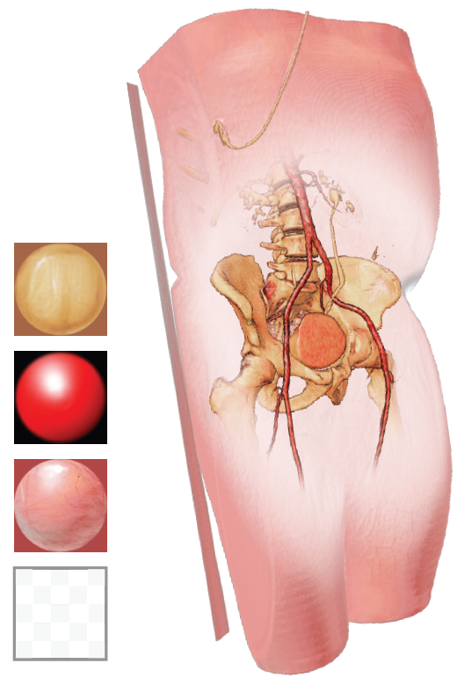
Semantics Driven Illustrative Rendering
Video

Slide 29
Problem Solving ↔ Path Finding
Doubt is not a pleasant condition, but certainty is absurd. [Voltaire]
A
Heuristics are great, BUT, Handle with care
B
High ground of theory ↔ Haunted swamps of heuristics

Slide 30
The title has been announced at the beginning of the talk
Thanks for your attention
Questions ?

