Slide 1
How To Do Research
Eduard Gröller
Institut für Computergraphik und Algorithmen, TU Wien

Slide 2
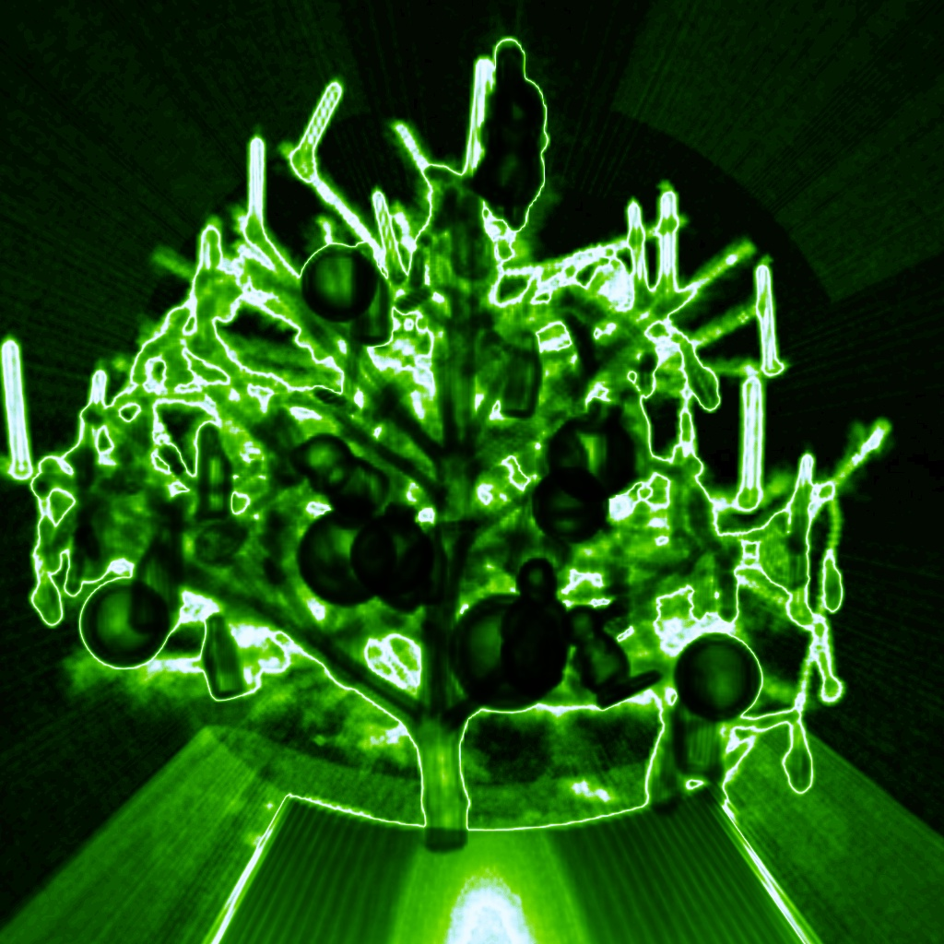
What is Research?
Nibble on the tree of knowledge
Incitement: human curiosity

Slide 3
Gain of Knowledge
Observations, measurements, trials
Axioms, hypotheses, models
Validation, verification, falsification
Proof (theoretical sciences)
Experiment (applied sciences)
Empirical study, survey (social sciences)

Slide 4
Issues in Research (1)
Objectifiable, rational
Reproducible, verifiable
Principle of causality
Reductionism - holism
Paradigm shift

Slide 5
Issues in Research (2)
Society and Science
Scientism
Anti-scientism
Science – research - development
Basic research – applied research
Research is very costly (even more costly is not doing research)

Slide 6
Issues in Research (3)
Very strong differentiation
Exponential data growth
technical sciences
...
...
computer science (cs)
theoretical cs
practical cs
technical cs
...
...
computer graphics
...
...
visualization
...
...
volume visualization

Slide 7
Where does Research happen?
Universities: “Unity of Teaching and Research”
Extra-mural research institutes
Academy of sciences
Public – private research partnerships
Commercial companies
typically in large firms
(Research and) development

Slide 8
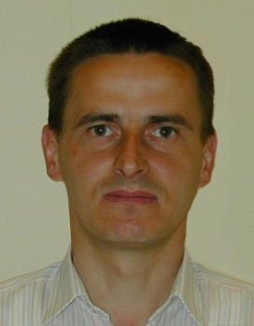
Research at Universities
What is a university teacher doing?
He/she is teaching
(4 - 12 weekly hours each term)
He/she is doing administrative work
(study curriculum, ...)
What is he/she doing during the breaks?
He/she is going on vacation
And then he/she is doing research

Slide 9
Research Groups
Institute subdivided in several research groups
Joint research interests
ICGA: rvr, vis-group, ads
Members of a research group
University teachers
Research associates, PhD students
Master students, interested students
Carrying out research projects

Slide 10
Research Projects (1)
Single projects – joint projects
Processing in several phases (milestones)
In each phase defined
Desired goals and results
Actions
Evaluation
Duration

Slide 11
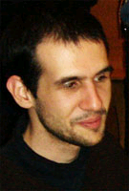
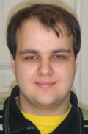
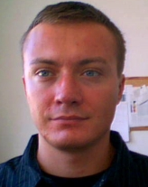
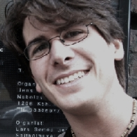
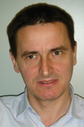
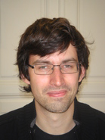
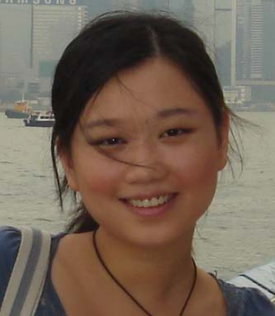
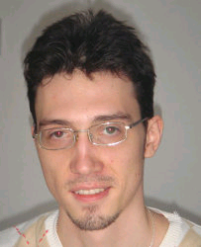
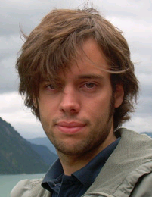
Vis-Group and Funding and Projects
Virtual Reality and Visualization Research Center
University of Bergen
Norway
Upper Austria University of Applied Sciences
Austrian Academy of Sciences
General Hospital
Vienna

Slide 12
Research Projekt - Milestones
Project start
State-of-the-art survey
Formulation of ideas and goals
Implementation, realization
Testing, evaluation
Publishing (write a scientific paper)
Project end with debriefing

Slide 13
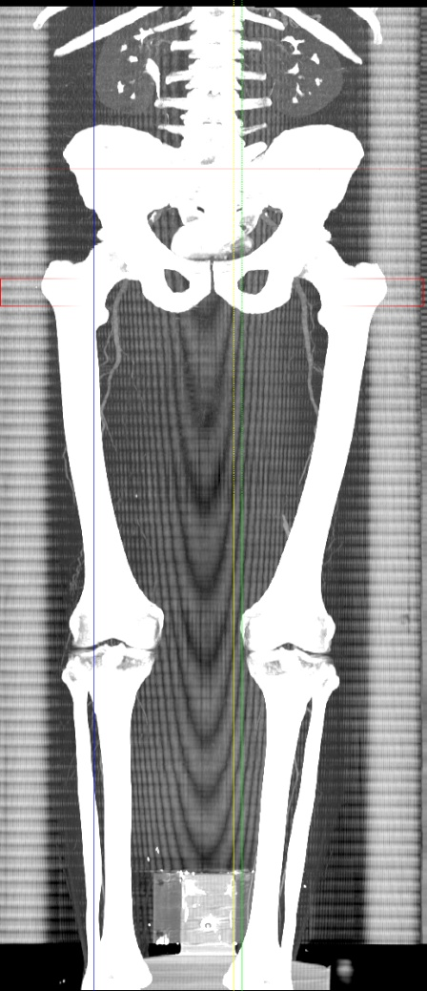
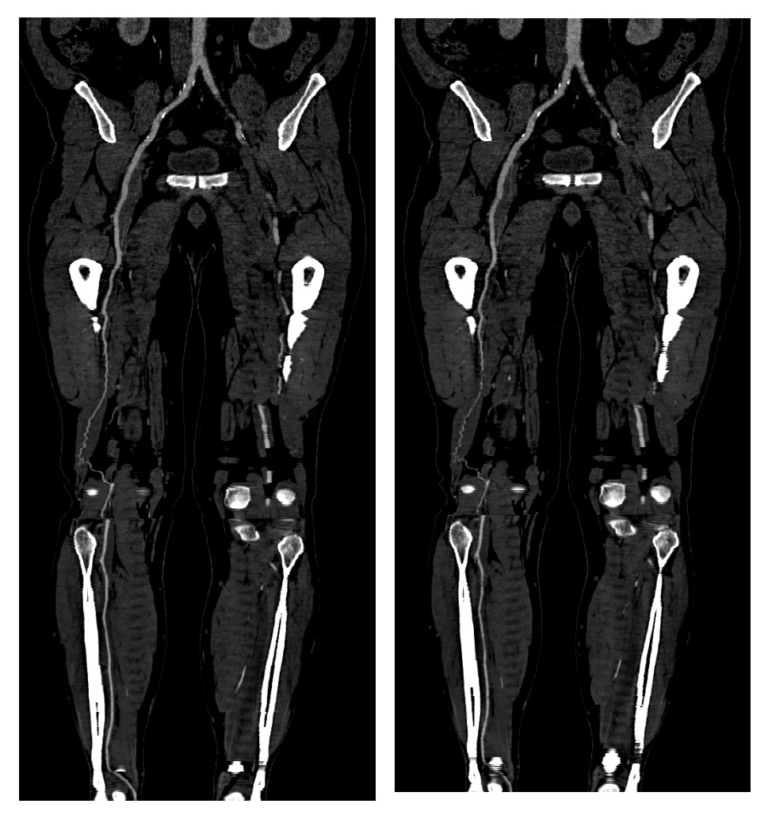
Reserch Project - Example
CT – angiography

Slide 14
Research Results
Master theses
PhD theses
Publications
at conferences
in scientific journals
Software prototypes
Patents, licenses
Spin-off companies

Slide 15
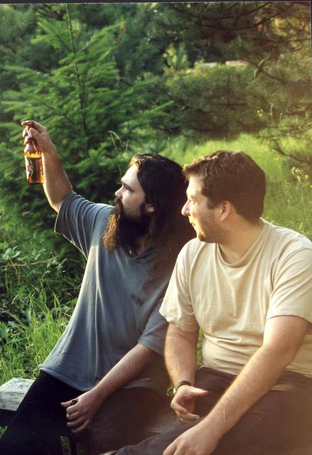
Research Groups (1)
Internal Communication
Individual meetings
Organisational meeting
Scientific meeting
Colloquy cycle
Yearly closed meetings
Social interaction

Slide 16
Research Groups (2)
External Communication
Colloquy cycle, guest lecturer
Guest researcher
External research stays
Conference attendance
Publications (papers, posters)
scientific
popular science
Trade fairs

Slide 17
Publications - Conferences
Organized by scientific associations
Local organizers
Conference chair, program committee
Call-for-papers
Submission of scientific papers (technical reports)
Peer reviewing
Conference attendance, giving a talk
Article published in conference proceedings

Slide 18
Publications - Journals
Published by commercial publisher or scientific association
Editor-in-chief, editorial board
Submission of scientific papers (technical reports)
Peer reviewing
Major revision with second review cycle
Article published in journal
Duration: half a year and longer

Slide 19
Scientific Associations
Advancement of scientific area, members
Ethical guidelines
Publishing of journals
Organization of scientific events
Examples of scientific associations
OCG (http://www.ocg.at/)
GI (http://www.gi-ev.de/),
Eurographics (http://www.eg.org/)
IEEE (http://www.ieee.org/)
ACM (http://www.acm.org/)

Slide 20
Journals on Academic Establishment
Austrian university journal
German university journal

Slide 21
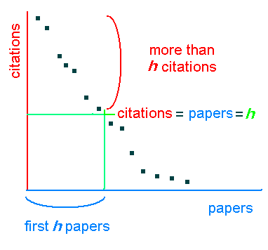
Research Activities - Evaluation
#Publications
#Patents
#Talks
Acquired research fundings
#PhD students, #Master students
Member in scientific associations
Member in program committees
Member in editorial boards
#citations
Science Citation Index
http://citeseer.ist.psu.edu/
http://scholar.google.com/
http://www.scopus.com/scopus/home.url
http://www.vs.inf.ethz.ch/publ/slides/Citation-Index-Unsinn.pdf
http://en.wikipedia.org/wiki/H-index

Slide 22
Research Funding
University, science funds, company funding
Science funds
FWF – basic research fund (http://www.fwf.ac.at/)
FFG – applied research fund (http://www.ffg.at/)
EU-programme
7. framework programme (FP7)

Slide 23
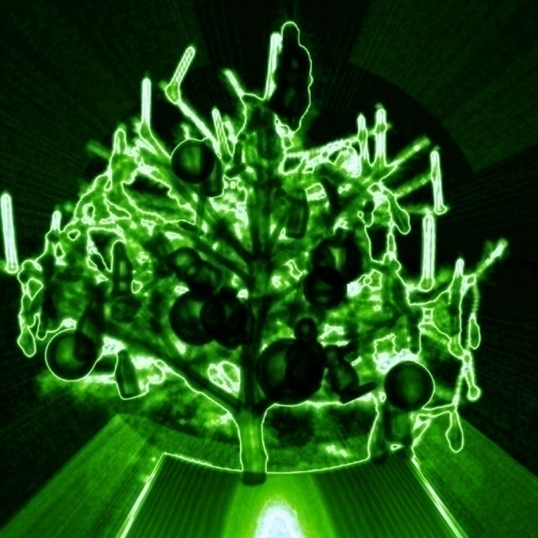
Study and Research
Unity of teaching and research
Scientific topics dealt with in
Seminars
Programming assignments
Master theses
PhD theses
Research is fascinating
Join in nibbling!

