Slide 1
volumeshop 101
Stefan Bruckner
Institute of Computer Graphics and Algorithms
Vienna University of Technology

Slide 2
Outline
What is VolumeShop?
Basic Overview
Setting up VolumeShop Projects
Programming in VolumeShop
The Future of VolumeShop

Slide 3
What is VolumeShop? (1)
VolumeShop is not …
… an extensive general-purpose visualization class library
→ try VTK, VisIt, ..
… a medical image processing and visualization toolkit
→ try MeVisLab, Amira, …
… a scene-graph API and rendering framework
→ try OpenInventor, Orge, …

Slide 4
What is VolumeShop? (2)
What does it do then?
VolumeShop is a prototyping platform for visualization research
Goal is to provide maximum flexibility to the developer
Provide easy-to-use facilities for common cumbersome tasks
Give developers the freedom of choice not to use them at all
Ease the transition from research prototypes to actual applications

Slide 5
Overview
graphical front-end, project setup, property management, …
VolumeShop application
base classes, serialization, resource management, plugin mechanism, …
VolumeShop core
import, export, compositing, interaction, rendering, scripting, …
VolumeShop plugins

Slide 6
Object Manager (1)
Object manager singleton for dynamic object creation/destruction/access
Classes of managed object types are registered at startup
All instances are identified by a unique object name

Slide 7
Object Manager (2)
Dynamic instantiation of VolumeShop objects using the object manager
// registration of RendererPlugin (derived vom Renderer)
VolumeShop::Get().registerType<RendererPlugin>();
// parameterless constructor creates unmanaged object
new RendererPlugin();
// object name in constructor creates managed object
new RendererPlugin(“MyRenderer”);
// creation via object manager using base class // (creates instance of derived class)
VolumeShop::Get().createObject<Renderer>(“MyRenderer”);
// Creation using the registered object type name // (creates instance of derived class)
VolumeShop::Get().createObject(“Renderer”,”MyRenderer”);

Slide 8
Object Manager (3)
The object manager’s degree of control can be influenced by object flags specified at creation
Accessible: the object is available through the object manager under its unique name
Destroyable: the object manager may destroy the object
Serializable: the object manager will serialize the object in the project file

Slide 9
Object Manager (4)
For static setups, all this is hidden by serialization from/to project files
Explicit use for advanced functionality (e.g., instantiate plugins from other plugins)
Application layer registers derived classes to provide additional GUI elements for the individual plugin types

Slide 10
Serialization (1)
The state of all objects is stored in/retrieved from a format-independent Archive object
A Serializer is responsible for actual reading/writing
Currently only one implementation (declarative XML-syntax files)
Multiple fragments (partial states) can be loaded from different files

Slide 11
Serialization (2)
Example of saving/loading using Archive and Serializer
// saving current state to “test.xml”
Archive myArchive;
myArchive.store(); // fill archive with current state
Serializer mySerializer(“test.xml”);
mySerializer.save(myArchive); // save archive to disk
// loading state from file “test.xml”
Archive myArchive;
Serializer mySerializer(“test.xml”);
mySerializer.load(myArchive); // load from disk into archive
myArchive.retrieve(); // restore state from archive

Slide 12
Plugins (1)
VolumeShop plugins are functionally independent components
Dynamically loaded modules which provide a certain functionality
The only dependency is the VolumeShop core module
Plugin interface designed to be useable outside the VolumeShop framework

Slide 13
Plugins (2)
Loaded plugins can be suspended & resumed at runtime
Upon resume, the plugin restores its previous state
Build system uses suspend/resume as pre-/post-build events
No need to close the application when recompiling a plugin
> volumeshop /suspend:plugin_renderer_volumesimple.dll
> volumeshop /resume:plugin_renderer_volumesimple.dll

Slide 14
Containers
VolumeShop containers are the „home“ of plugins
A container can host one or several plugin types
Provides all the necessary resources required by its plugins
Every plugin instance must be added to a container to operate

Slide 15
Properties (1)
A plugin stores its settings in a set of named properties
Should be able to reconstruct its complete state from property values
Properties represent a simple interface to manipulate the plugin’s functionality
Framework takes care of property manipulation, loading, and saving

Slide 16
Properties (2)
Variant class allows easy creation of complex data structures
GetPlugin().GetProperty(“Test0”) = // boolean property false;
GetPlugin().GetProperty(“Test1”) = // integer (full range)
12;
GetPlugin().GetProperty(“Test2”) = // integer in the range [0,255] Variant::TypeInteger(12,0,255);
GetPlugin().GetProperty(“Test3”) = // color value Color(255,0,0);
GetPlugin().GetProperty(“Test4”) = // option list of strings Variant::TypeOption(), “One”, “Two”, “Three”;
GetPlugin().GetProperty(“Test5”) = // mixed-type option list Variant::TypeOption(), “One”, 2, 3.0f;
GetPlugin().GetProperty(“Test6”) = // filenames with filter “*.xml” Variant::TypeFilename(“”,”*.xml”);

Slide 17
Properties – Linking
Basic mechanism for building more complex functionality from individual plugins
Changes in one property will be forwarded to linked properties and vice versa
Links can be specified in the GUI or programmatically
// Link property “MyProperty” to property “LinkedProperty”
PropertyContainer::Link myLink(pTargetObject,”LinkedProperty”);
GetPlugin().SetPropertyLink(“MyProperty”,myLink);

Slide 18
Properties – Observers (1)
Observers enable tracking of changes to properties (and other objects)
Convenience class ModifiedObserver allows binding of notifications to member functions
Can be used to receive change notifications from multiple objects of different types

Slide 19
Properties – Observers (2)
Example of observer usage
// usually a class member
ModifiedObsever myObserver;
// typically in plugin constructur
// connect observer to member function
myObserver.connect(this,&MyPlugin::changed);
// add observer to objects we want to track
GetPlugin().GetProperty(“MyProperty1”).addObsever(&myObserver);
GetPlugin().GetProperty(“MyProperty2”).addObsever(&myObserver);
// notification handler
void changed(const Variant & object, const Observable::Event & event)
{
// handle changes, e.g., trigger re-render
GetPlugin().update();
}

Slide 20
Viewers
Containers for renderer-, interactor-, and compositor-plugins
Responsible for providing a valid OpenGL-context to their plugins
Track update requests of their plugins and handle redrawing
Take care of translating input events and forwarding them to the plugins
One or multiple viewers comprise a viewport in the user interface

Slide 21
Renderer-Plugins
Very simple interface, structured similar to GLUT
display() – do the rendering
reshape() – handle size changes
idle() – idle time processing
cursor() – pointer position has changed
button() – press/release events
...

Slide 22
Interactor-Plugins
Interface essentially the same as for renderers, difference is mainly semantic
Responsible for providing common interaction functionality
Can also generate graphical output (e.g., overlays)
Examples: orthographic & perspective camera, viewpoint manipulation, ...

Slide 23
Compositor-Plugins
Responsible for combining the output of multiple renderers/interactors
Default compositor is simple layered rendering to OpenGL framebuffer
Exchange of compositors is transparent to renderers/interactors
Enable more complex things (e.g. stereo rendering) without change of rendering code

Slide 24
Resources
Represent source data (e.g., images, volumes, triangle meshes, point clouds, …)
Resources are containers for importer/exporter plugins
Efficient interface for traversal (iterators) and modification (manipulators)
Generic classes, support for different data types and multivariate data
Simple customizable facility for upload to the graphics hardware

Slide 25
Resources – Copy-on-Write
Data associated with a resource instance is internally shared and reference counted
When you assign resources (e.g., as return value from a function), only pointers are passed around
When the data of an instance with reference count > 1 is written, the data is copied and the copied version is modified

Slide 26
Resources – Texture Management
ResourceTexture is responsible for keeping concurrent versions of resource data in texture memory
Volume<float,4> *pVolume = new Volume<float,4>();
// bind whole volume to 3D texture
VolumeTexture3D & tex3D = ResourceTexture::Get<VolumeTexture3D>(pVolume);
tex3D.bind();
// bind slice of volume to 2D texture
VolumeTexture2D & tex2D = ResourceTexture::Get<VolumeTexture2D>(pVolume);
tex2D.SetSlicePosition(16);
tex2D.bind();

Slide 27
Importer- and Exporter-Plugins (1)
Responsible for loading/storing data into/from resources from hardisk, network, …
Resource acts as container, multiple importer/exporter plugins can be added
Importers/exporters allow queries for capabilities before instantiation
Existing plugins for common data formats (raw, dat, dicom, jpg, png, tiff, obj, ply, …)

Slide 28
Importer- and Exporter-Plugins (2)
for (ImporterPlugin::Iterator i("plugin_importer*.dll"); !i.IsAtEnd(); ++i)
{
std::string strResourceHint = ImporterPlugin::GetPluginInformation
(*i,"FileResourceHint",strDataFilename);
if (pResource->GetObjectTypeName() == strResourceHint)
{
ImporterPlugin *pImporter = VolumeShop::createObject<ImporterPlugin>
("MyImporter");
pImporter->SetFilename(*i);
pResource->add(pImporter);
if (pImporter->IsInitialized())
{
pImporter->GetProperty("Filename") = strDataFilename;
bool bSuccess = pResource->load(pImporter);
delete pImporter;
if (bSuccess)
break;
}
}
}

Slide 29
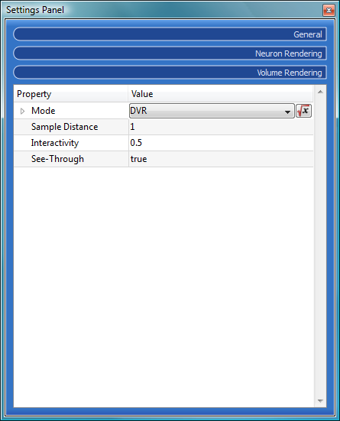
Environments
Provide a simple means for grouping properties
Allow generation of an inferface suitable for end-users

Slide 30
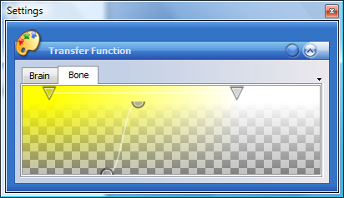
Editor-Plugins
Editors are specialized GUI widgets for certain tasks (e.g. transfer function editor)
Communicate via properties just like all other plugins
Facility to implement custom editors for multiple windowing toolkits

Slide 31
Tutorial 1: Setting up a Project (1)
VolumeShop projects store the complete application state
Viewer and plugin configuration, property values and links, etc.
When working on a prototype, first step is usually to create a basic project setup
Setup is then refined as new functionality is being developed

Slide 32
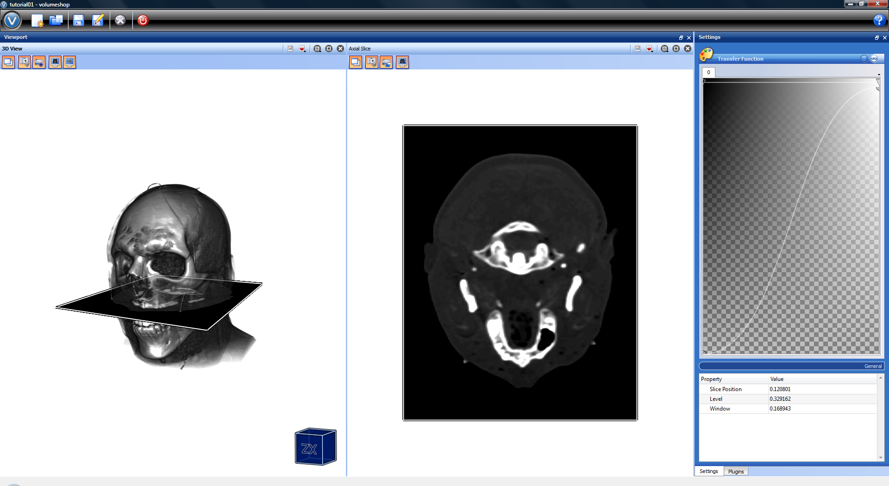
Tutorial 1: Setting up a Project (2)
tutorial01.xml

Slide 33
Tutorial 2: A Simple Renderer Plugin (1)
Step 1: Render a sphere using OpenGL
Nothing fancy here, looks pretty much like regular C++/OpenGL code
RendererTutorial.h – plugin_renderer_tutorial.glsl

Slide 34
Tutorial 2: A Simple Renderer Plugin (2)
Step 2: Expose plugin interface as properties
Add properties for projection transformation, viewing transformation and sphere color
Listen for property modifications and trigger re-render accordingly
Retrieve property values and set OpenGL state
RendererTutorial.h – plugin_renderer_tutorial.glsl

Slide 35
Tutorial 2: A Simple Renderer Plugin (3)
Step 3: Integrate resources and textures
Add a handle property to access external resource
For rendering, bind image resource as 2D texture
RendererTutorial.h – plugin_renderer_tutorial.glsl

Slide 36
Tutorial 2: A Simple Renderer Plugin (4)
Step 4: Using GLSL shaders
Add shader object, takes care of file loading, compiling and linking
Add observer to allow live shader modifications
When rendering, simply bind shader to activate it
RendererTutorial.h – plugin_renderer_tutorial.glsl

Slide 37
Tutorial 2: A Simple Renderer Plugin (5)
Step 5: Let‘s make it a bit fancy
Add a displacement map and use it modify vertex positions
Modify lighting computations in fragment shader to fix normals
Control amount of displacement with additional property
RendererTutorial.h – plugin_renderer_tutorial.glsl

Slide 38
Tutorial 2: A Simple Renderer Plugin (6)
Step 6: Add some more coolness
Add animation by simply modifying the displacement property for each frame
Enable/disable animation using additional property
RendererTutorial.h – plugin_renderer_tutorial.glsl

Slide 39
Command-Line Parameters
Make VolumeShop the default application for various file types
Generate project setup, use placeholder for parameters
Simple parameter substitution via the command line
Can also load multiple project fragments (modular project setups)
> volumeshop <project> [ -$(<name1>)=<value1> -$(<name2>)=<value2> … ]
command.xml

Slide 40
Scripting (1)
Expose VolumeShop object model to interpreted scripting language (e.g., Ruby, Python, Lua, ...)
Programmatically manipulate properties at runtime
Recompute property values when other properties have changed („triggers“)
Sample implementation for Squirrel (see http://squirrel-lang.org/)
scripting.xml

Slide 41
Scripting (2)
Squirel is a pretty neat language, it features ...
... a C/C++-like syntax
... classes & inheritance
... dynamic typing
... delegation (dynamic binding)
... coroutines (cooperative threads)
and much more
Current host implementation is still very basic (only manipulation of properties) and needs some work

Slide 42
Needed Improvements (1)
Documentation ...
... like source code documentation
More documentation ...
... like a developer‘s guide
Even more documentation ...
... like example project setups, online tutorials, etc.

Slide 43
Needed Improvements (2)
Plugin wizard for Visual Studio
Project wizards for common things
Cross-platform support & build system
Online plugin library
Auto-update mechanism

Slide 44
Needed Improvements (3)
Maintenance of importers/exporters
Better integrated data browser
Improved scripting support
Core needs to be made thread-safe
Out-of-core support for large data
Graph-view for property links
QGraphicsView-based GUI (?)

Slide 45
Thank you for your attention!
http://www.volumeshop.org
Notes:
more images

