Slide 1
Visibility Computations for Real-Time Rendering in General 3D Environments
Oliver Mattausch
Institute of Computer Graphics and Algorithms
Vienna University of Technology

Slide 2
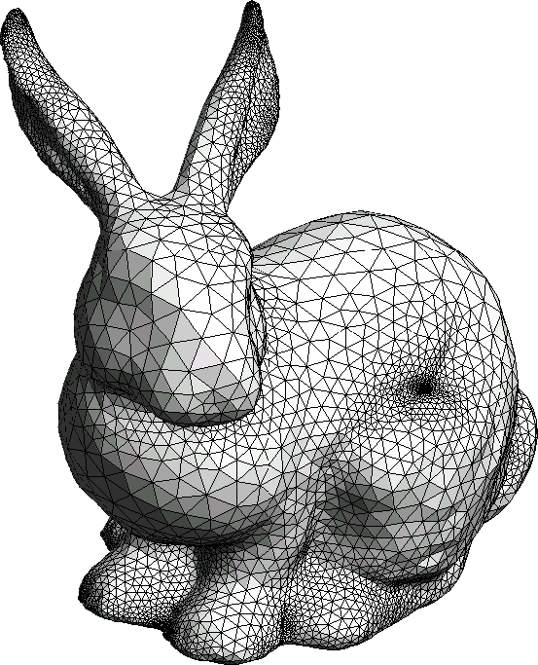
3D Rendering Pipeline
Input: 3D model
Transformations (model + camera)
Lighting
Geometry
Projection
Clipping
Window-viewport transformations
Rasterization

Slide 3

Real-Time Rendering
Interactive manipulation
> 60 frames per second (FPS)
→ < 0.02 s to compute image!
(+ simulation, physics, AI)
[Crysis: 2007]

Slide 4
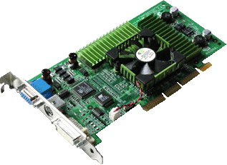
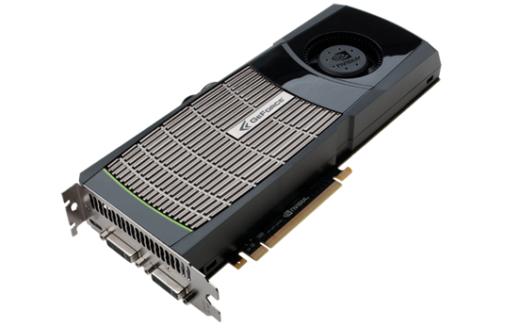
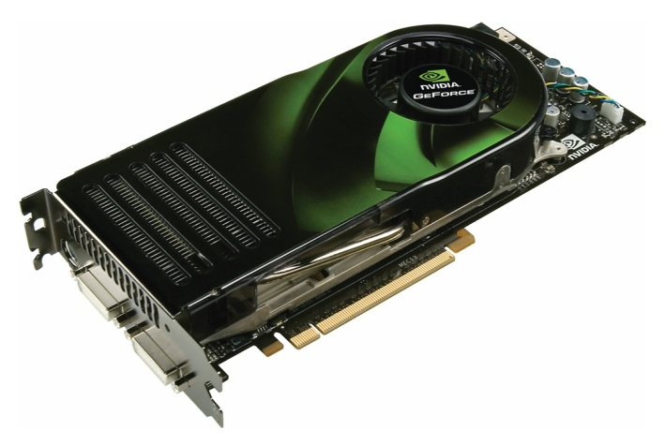
Real-Time Rendering
Graphics Processing Unit (GPU) Power:
2001
2006
2010
76 GFlops
518 GFlops
1.345 GFlops

Slide 5
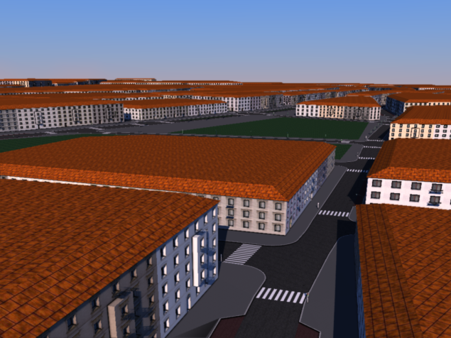
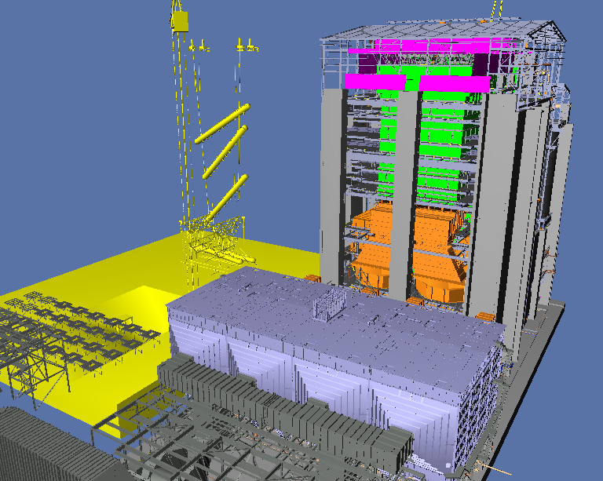
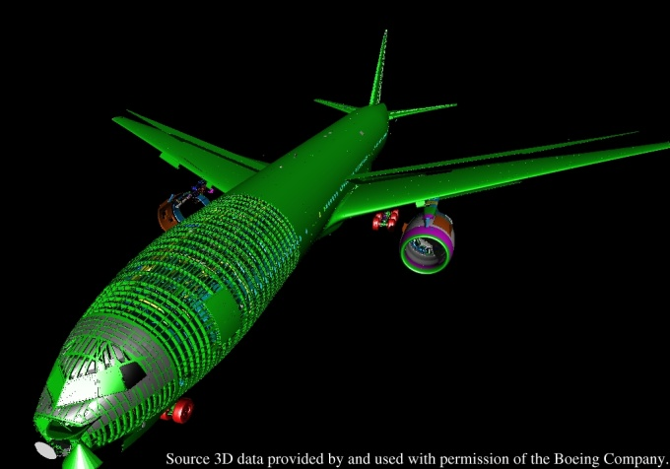
Real-Time Rendering
Scene complexity:
Vienna
Powerplant
Boeing
~1M triangles
~12M triangles
~300M triangles

Slide 6
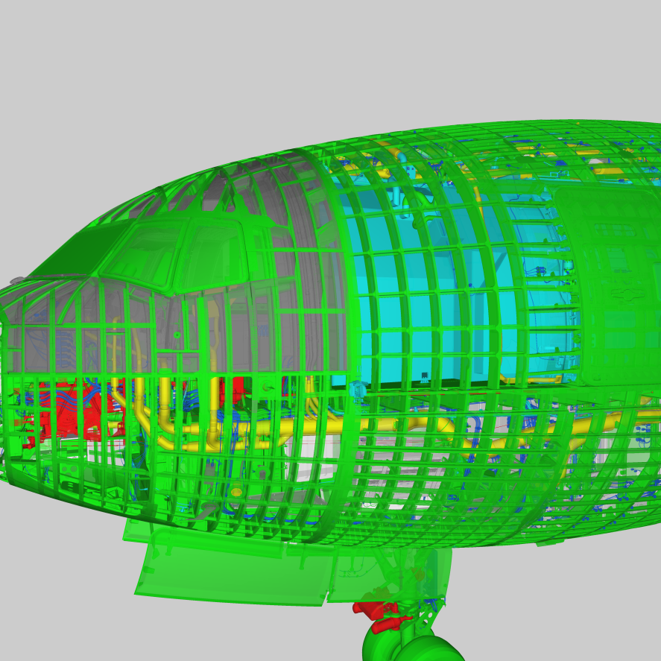
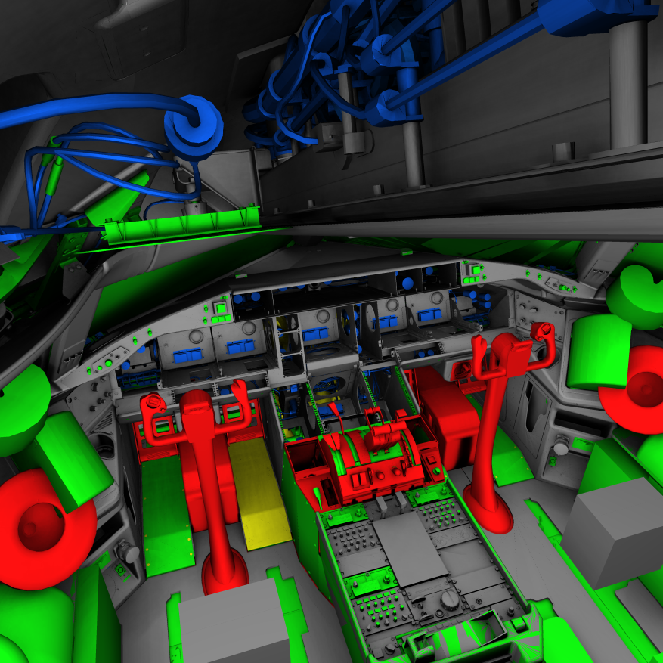
Real-Time Rendering: Boeing Model
Complex interior parts →
Rendering everything in detail is overkill!

Slide 7
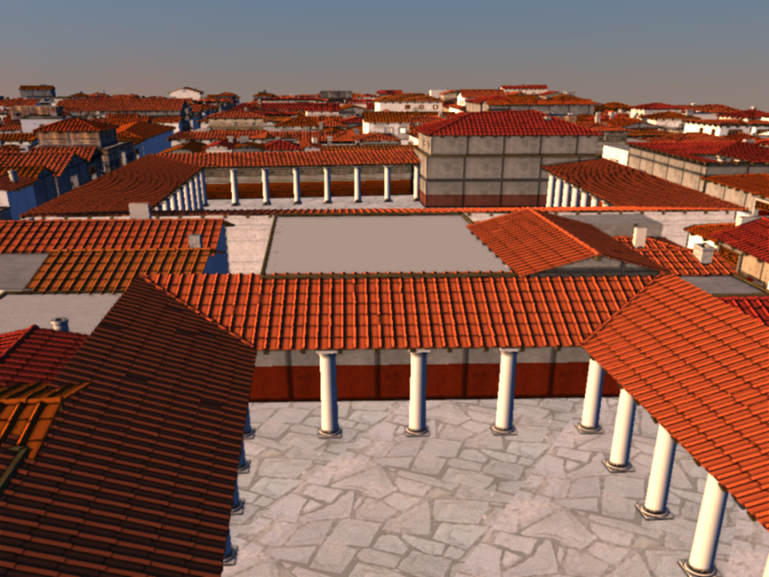
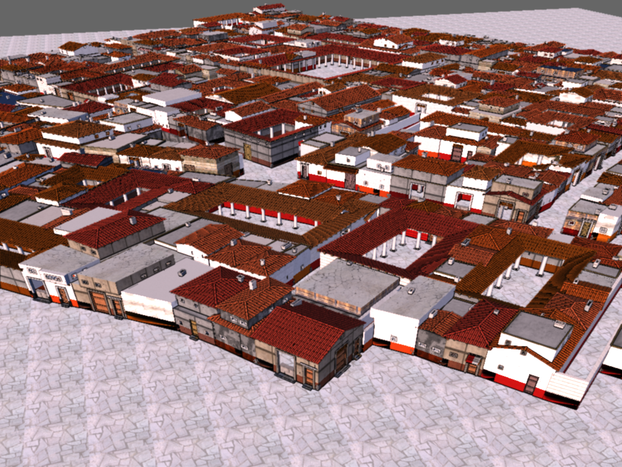
Real-Time Rendering
New acquisition / modeling techniques
Brute force rendering not sufficient
Need acceleration techniques
  Complexity: O(n) → O(log(n))
Procedural model of Pompeii (40M triangles)

Slide 8
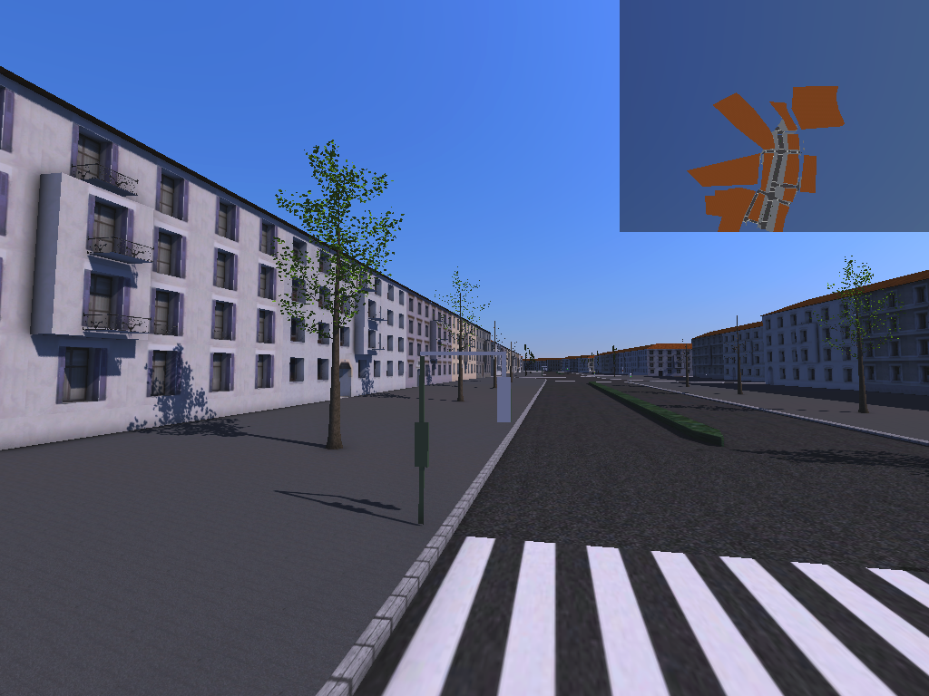
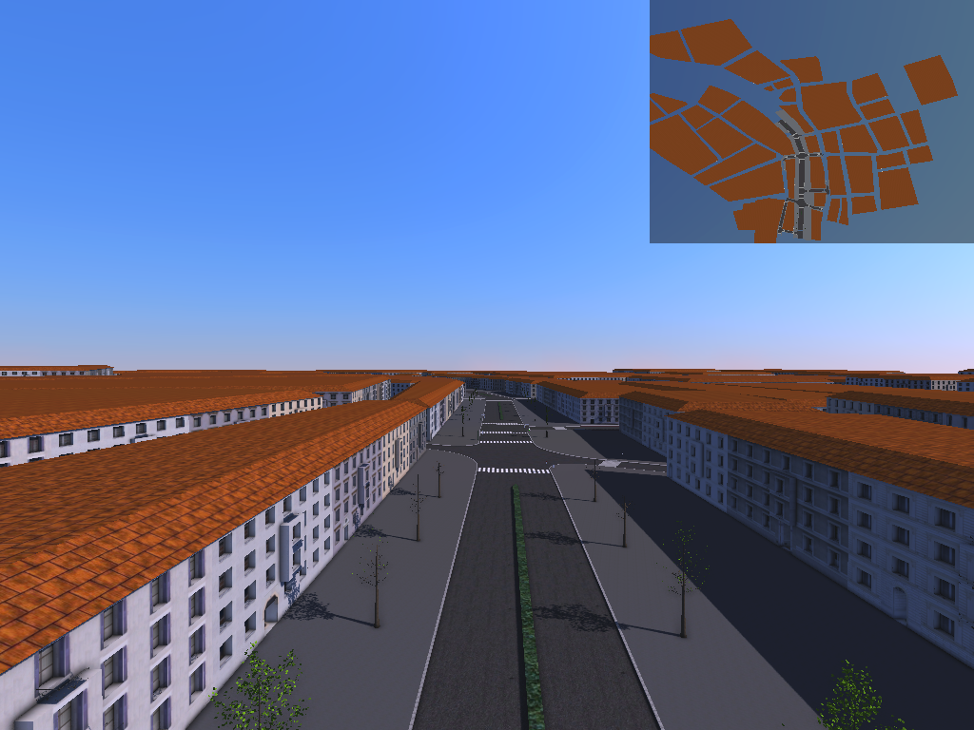
Visibility Culling
Only send visible primitives to graphics card
Output sensitivity: Render time depends on output
(not scene complexity!)
Limitations: Cannot do much if too much visible
Buildings
sent to GPU
Low view point
High view point

Slide 9
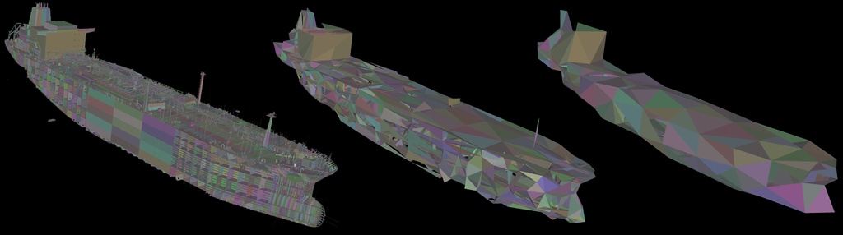
Visibility Culling
Often used in combination with
Level-of-detail (LOD)
Hierarchical LOD [Erikson et al.]

Slide 10
Visibility Culling: Paradigms
Preprocessing
Online occlusion culling

Slide 11
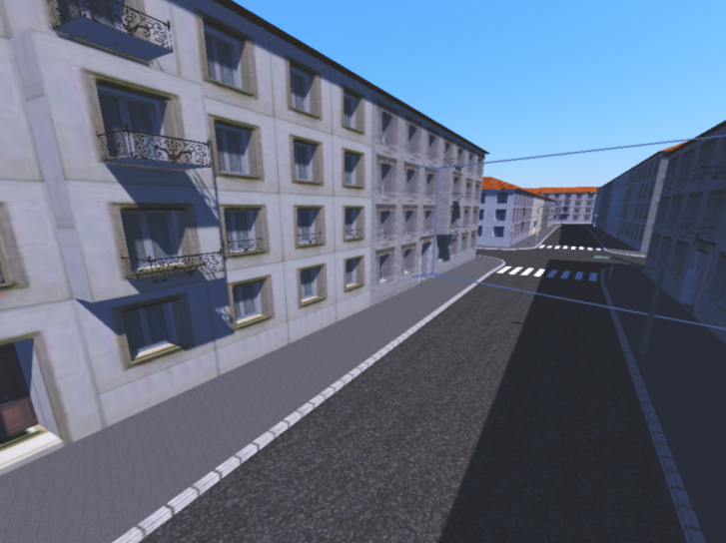
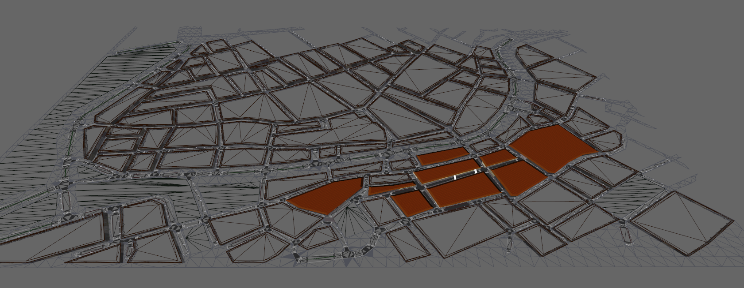
Visibility Preprocessing
Partition object space into objects
Partition view space into view cells
Compute potentially visible set
(PVS) of each view cell
View cell
PVS

Slide 12
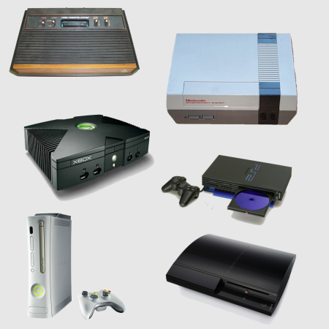
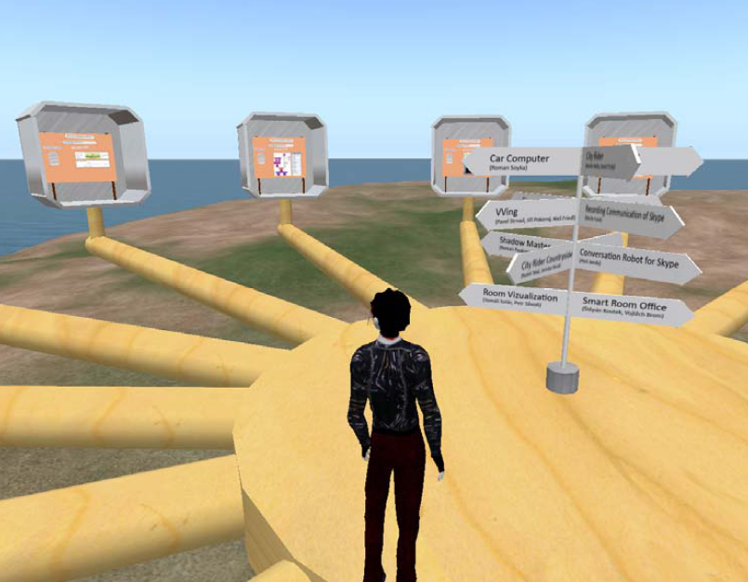
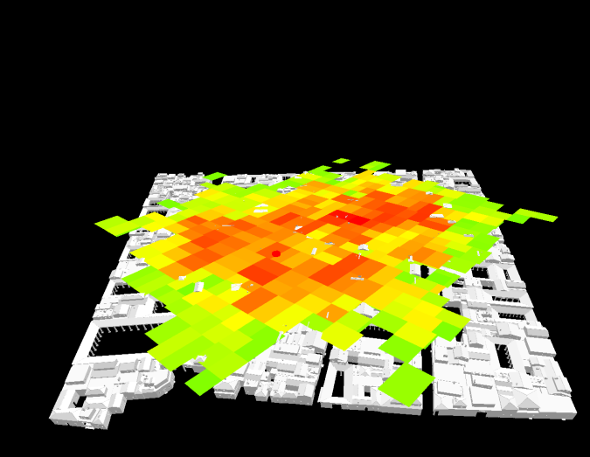
Visibility Preprocessing - Applications
Rendering
Game consoles
Data streaming
Virtual worlds
Visibility Analysis
Level design
[Bittner et al. 2009]

Slide 13
Online Occlusion Culling
Occlusion query: query visibility from view point
Spatial hierarchy for O(log(n))
Occlusion query: Typical usage
Visible?
Query bounding box
Render complex geometry

Slide 14
Online Occlusion Culling
Hardware occlusion queries
  Supported by GPU → fast
  Returns number of visible pixels
  Problem: still significant overhead
  Wait time until query result available

Slide 15
Preprocessing VS Online Culling
Preprocessing | Online culling
+ No online overhead | - Query overhead
+ Easy integration | - Hard to integrate
- Hard to implement | + Use GPU features
- Preprocessing times | + No preprocessing
- No dynamic scenes | + Dynamic scenes
- Robustness | + Image-based
+ Applications

Slide 16
Visibility Computations
Essential operations in 3D rendering
Qualitative visibility
  What is visible? (binary)
Quantitative visibility
  How much is visible?

Slide 17
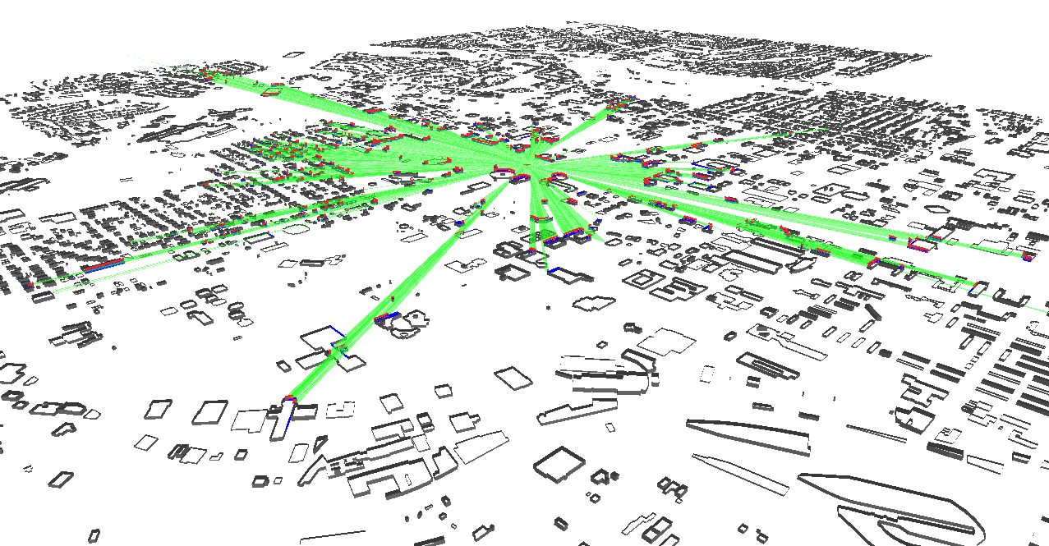

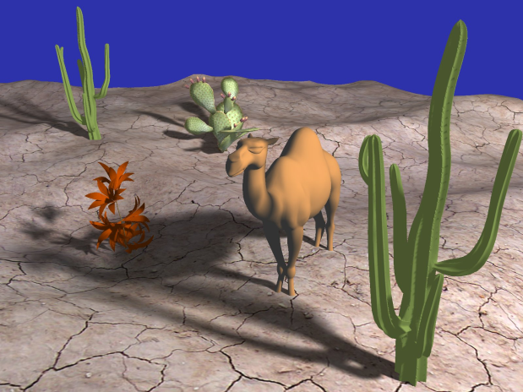

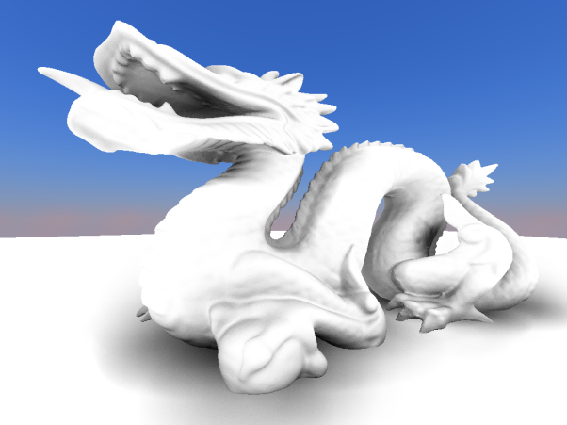
Qualitative VS Quantitative Visibility
Qualitative visibility
  Visibility culling
  Hard shadows
Quantitative visibility
  Soft shadows
  Global illumination
  Ambient occlusion

Slide 18
Lighting Computations
Rendering equation:
The bottleneck are the visibility computations!
Transport operator
(Ray casting)

Slide 19
Overview: Our Contributions
Visibility culling (qualitative visibility)
  Two algorithms for scene preprocessing
  CHC++: Coherent hierarchical culling revisited
Quantitative visibility for realistic lighting
  High-quality screen-space ambient occlusion using temporal coherence

Slide 20
Overview: Our Contributions
Visibility culling (qualitative visibility)
  Two algorithms for scene preprocessing
  CHC++: Coherent hierarchical culling revisited
Quantitative visibility for realistic lighting
  High-quality screen-space ambient occlusion using temporal coherence

Slide 21
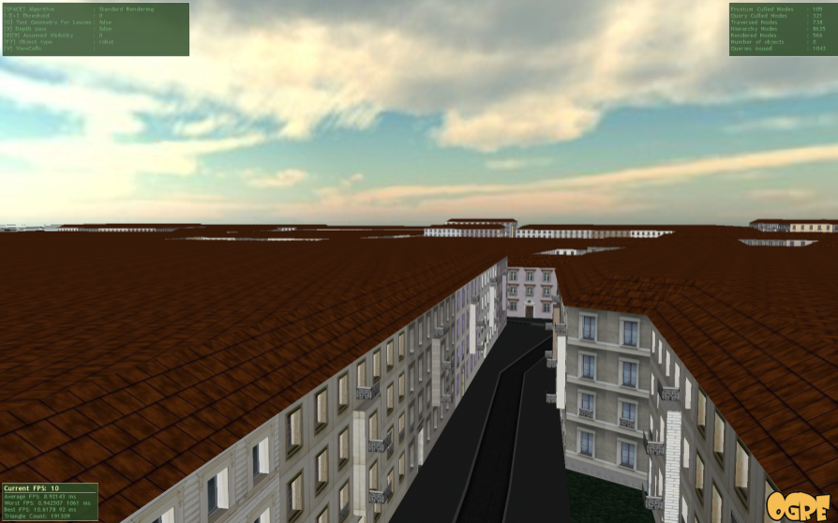
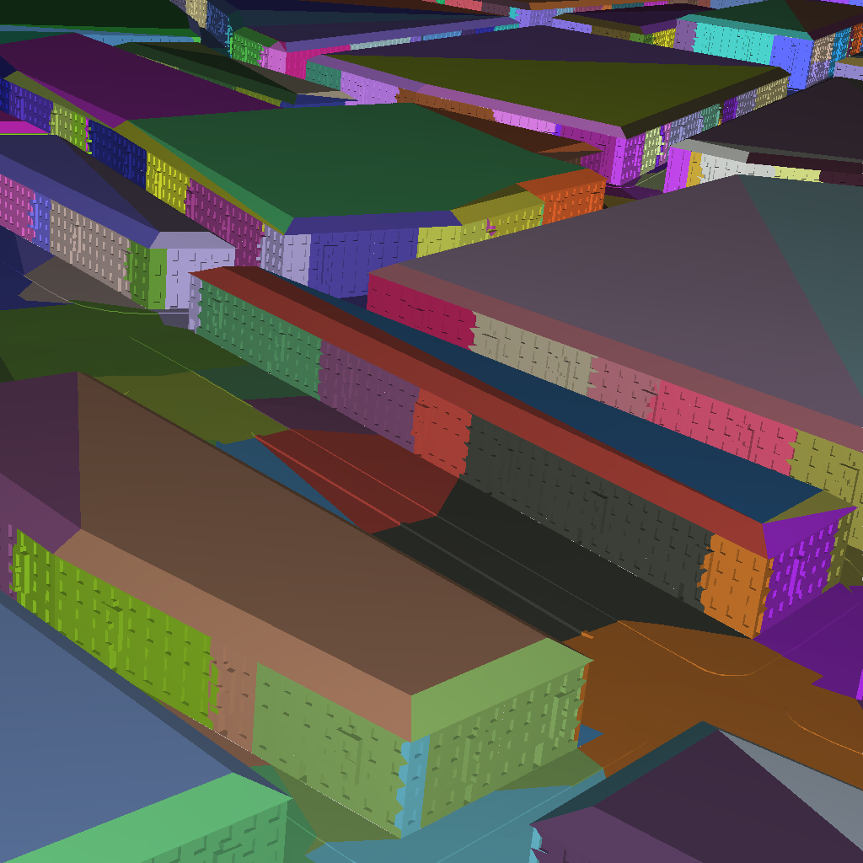

Algorithms for
Scene Preprocessing

Slide 22
Visibility Preprocessing
Partition object space into objects
Partition view space into view cells
Compute potentially visible set
(PVS) of each view cell
This is
what we are
optimizing
This is what most algorithms are about
View cell
PVS

Slide 23
Object / View Space Subdivision
City scene
Object space
subdivision
View space
subdivision

Slide 24
Scene Preprocessing
Two proposed algorithms
Common steps
  Coarse visibility sampling
  Subdivision driven by render time heuristics

Slide 25
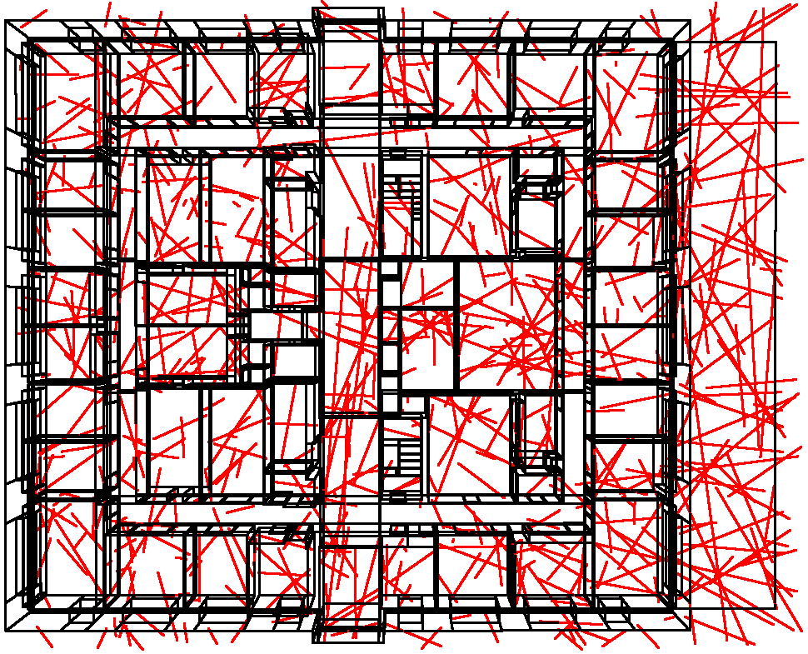
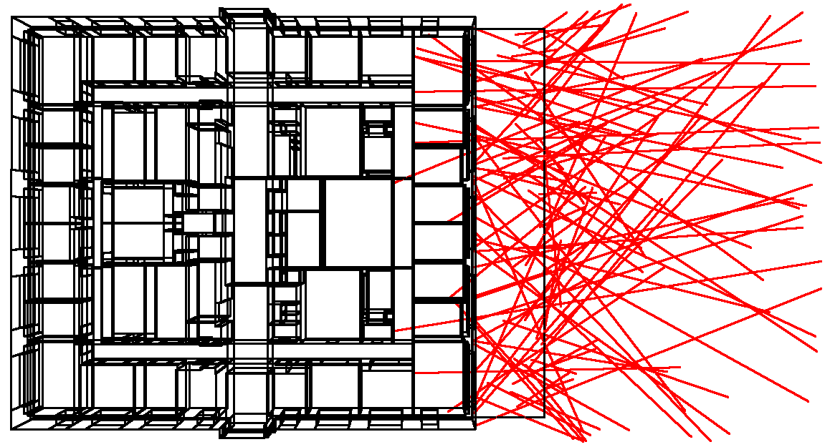
Visibility Sampling
Fast stochastic sampling
Casts rays from potential view points
Coarse estimate of visibility (some million samples)
View space =
scene bounding box
View space =
distant region

Slide 26

Visibility Sampling
Compute maximal free segments
invalid
valid
valid
Visibility samples

Slide 27
Render time heuristics
Main idea: minimize expected rendering time
c = expected rendering time (cost to minimize)
S = set of view cells
p = probability of view point inside a view cell
(~volume of view cell)
r = render time estimate [Wimmer03]

Slide 28
Scene preprocessing: Scenario 1
City scene
That‘s what
we are
optimizing
Already given
Object space
subdivision
View space
subdivision

Slide 29
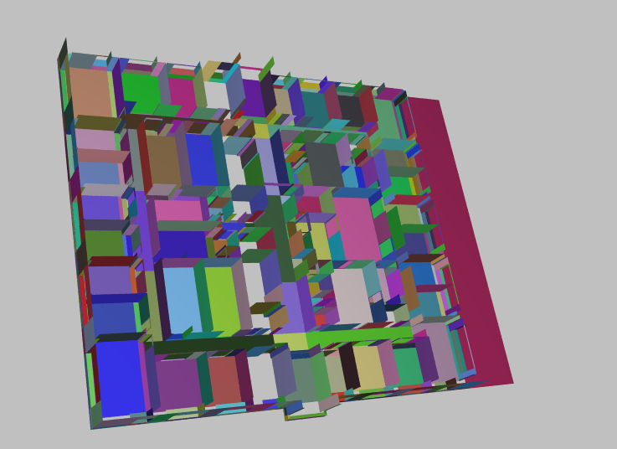
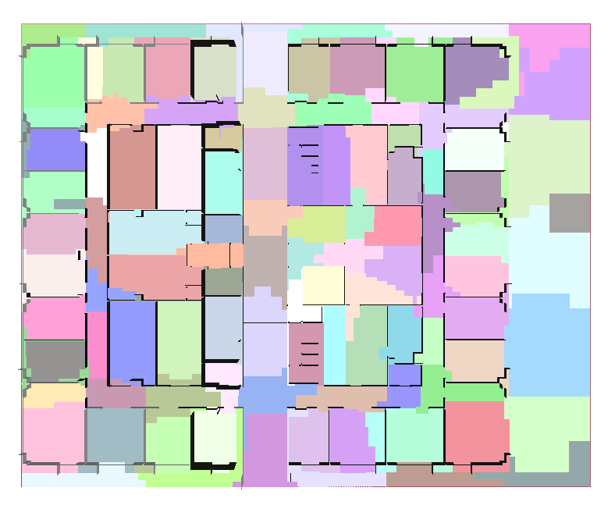
Adaptive visibility-driven view cell construction
Symposium on Rendering 2006
[Oliver Mattausch, Jiří Bittner, Michael Wimmer]

Slide 30
Algorithm 1: View cell construction
Create good view cells for general 3D scenes
What are good view cells?
  Low render cost c(S)
  Low memory consumption
  (view cell geometry, PVSs)

Slide 31
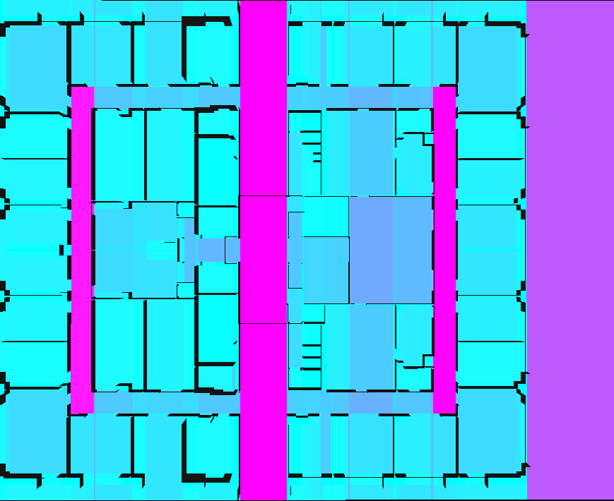
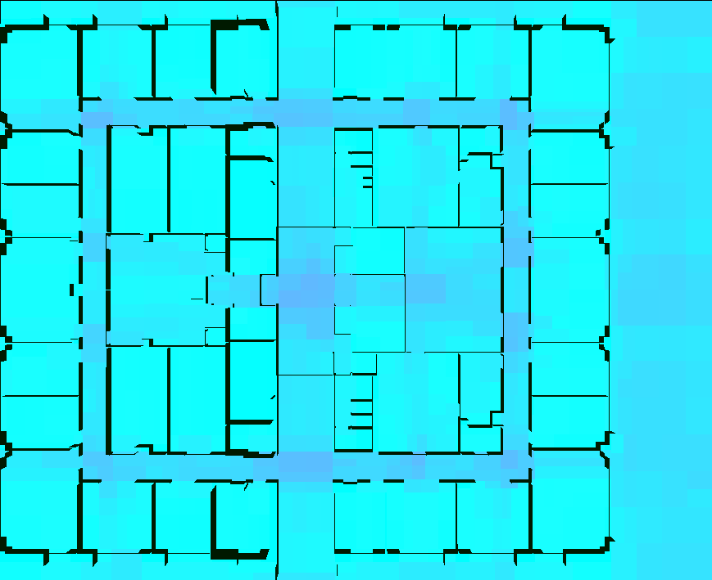

Example 1: Floor plan of 3D building
BSP [Teller 92]
Our method
Render time
Low
High

Slide 32
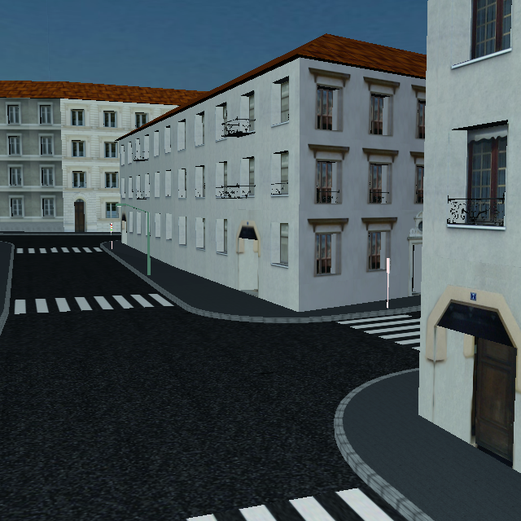
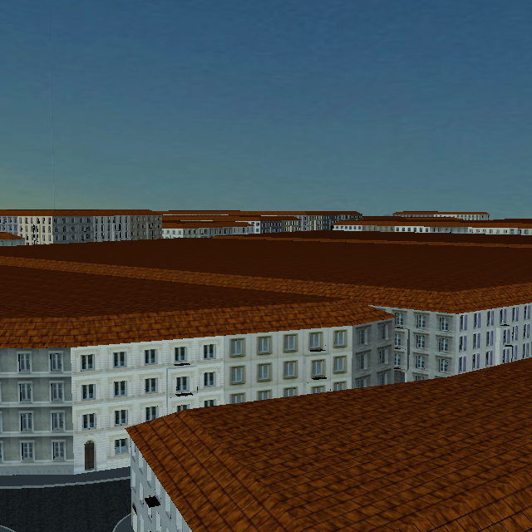
Example 2: City Scene
On the ground:
A few buildings visible
Above the roofs:
Many buildings visible
→ View points should belong to separate view cells

Slide 33
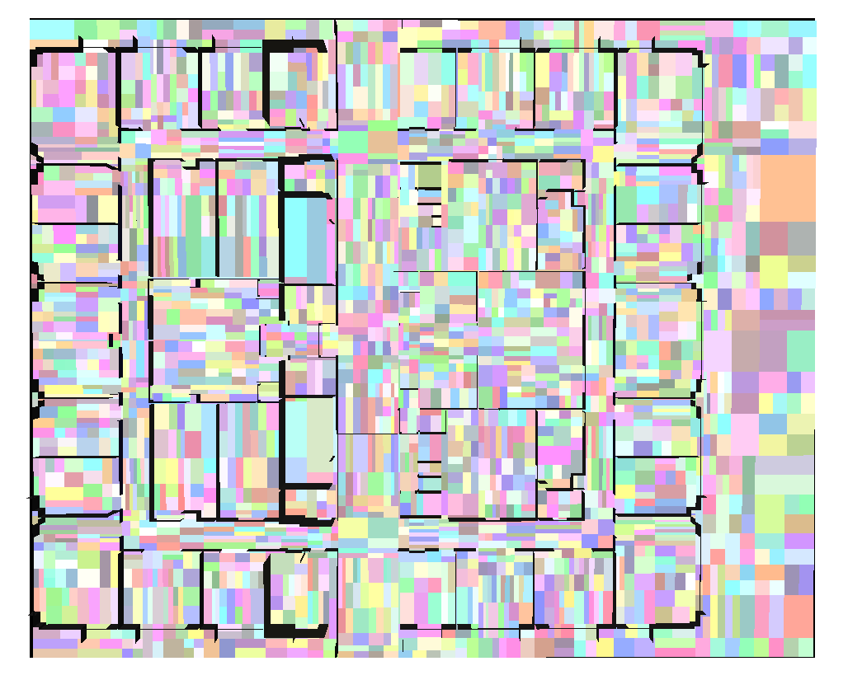
View Cell Construction
Three steps
  Visibility sampling
  View space subdivision
  View space merging
⇨
⇨
1.
2.
3.

Slide 34
View Space Subdivision: Properties
Apply globally best split (with respect to c(s))
  Subdivision is progressive
Intuitive global termination criteria
  Memory limit
  Minimal render cost decrease

Slide 35
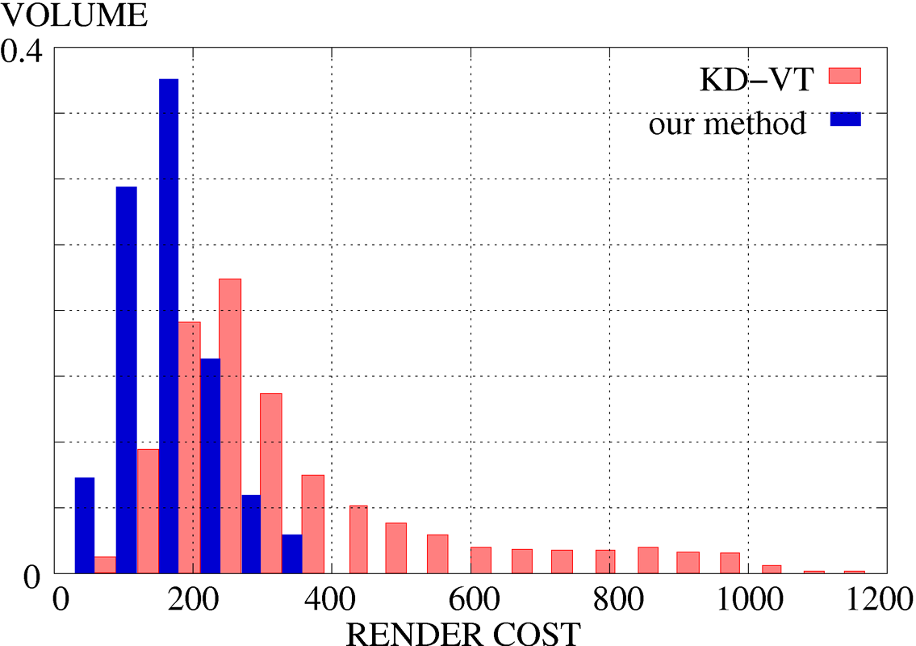
Results: Render Cost Histogram
Vienna (~11000 objects, 1M polygons)

Slide 36
Scene Preprocessing: Scenario 2
City scene
That‘s what
we are
optimizing
That‘s what
we are
optimizing
Not given
a priori
Object space
subdivision
View space
subdivision

Slide 37
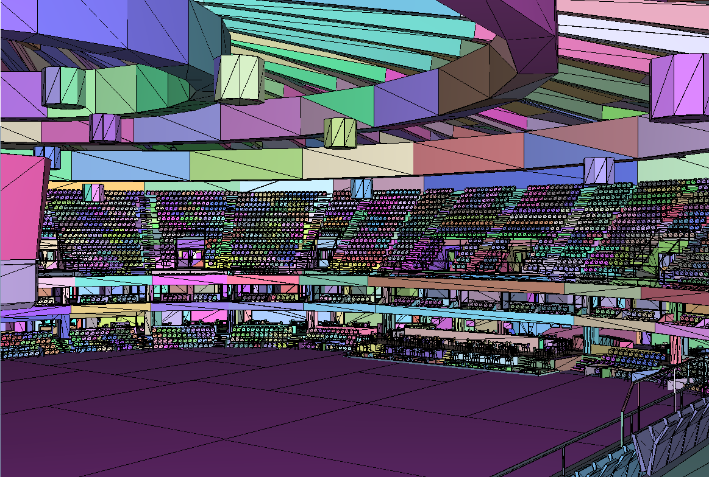
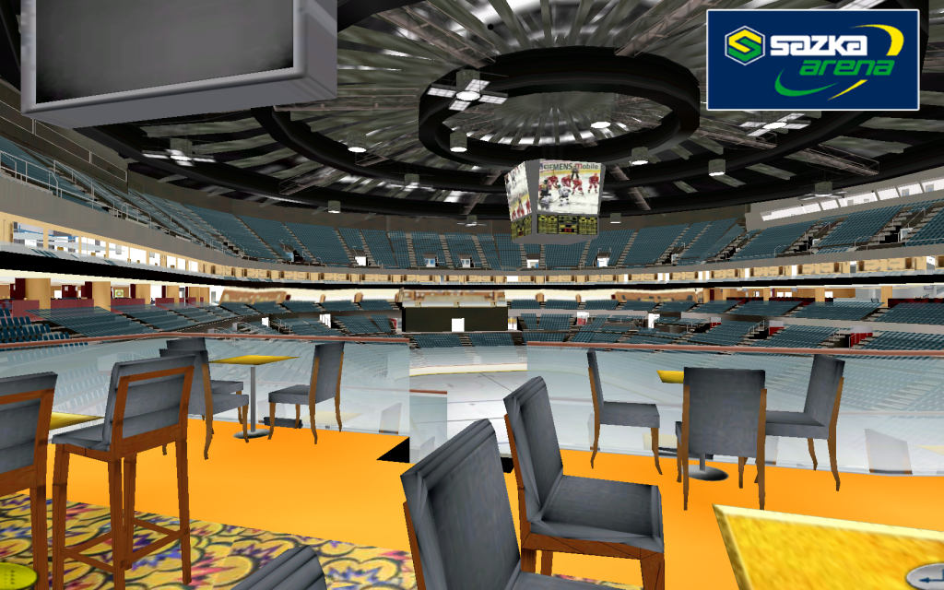
Optimized subdivisions for preprocessed visibility
Graphics Interface 2007
[Oliver Mattausch, Jiří Bittner, Michael Wimmer, Peter Wonka]

Slide 38
Motivation
Previous approaches
  First object space subdivision
  Then view space subdivision
Object space subdivision
  Can be too shallow / too deep
  View space subdivision cannot fix this!
Our approach
  Interleave view and object space splits

Slide 39

Interleaved Subdivisions
Related to knapsack problem
Items: Candidates for next split (view or object)
Benefit: Render time decrease (c(S))
Cost: Memory cost increase
Limit: Memory budget
Oliver Mattausch
39

Slide 40
Interleaved Subdivisions
Priority queue of candidates for a split
Priority p = dR / dM
  dR = render time decrease
  dM = memory cost increase
Apply next best split:
View space
Object space
Render cost
Object space split
View space split
Limit
Memory

Slide 41
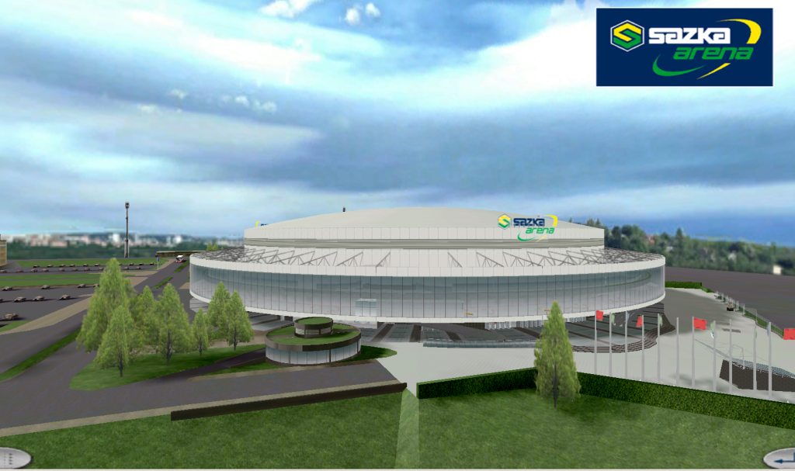
Results Arena: Interleaved subdivisions
Oliver Mattausch
41
1.5M triangles
Compared to previous approach
  First view space, then object space
  Varying numbers of objects
Speedup of 2.72 – 4.45

Slide 42
Overview: Our Contributions
Visibility culling (qualitative visibility)
  Two algorithms for scene preprocessing
  CHC++: Coherent hierarchical culling revisited
Quantitative visibility for realistic lighting
  High-quality screen-space ambient occlusion using temporal coherence

Slide 43

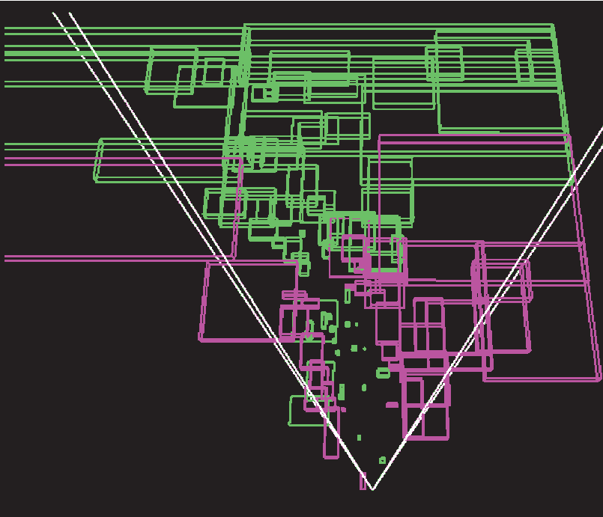
CHC++:
Coherent Hierarchical Culling Revisited
Eurographics 2008
[Oliver Mattausch, Jiří Bittner, Michael Wimmer]

Slide 44
CHC++: Fast occlusion culling algorithm
Notes:
Chc++ several times better than previous work, always better than vfc

Slide 45
Naive method: Hierarchical Stop & Wait
For each node: Issue hardware occlusion query
  Visible → traverse subtree
  Invisible → cull subtree
Problem: Query latency
  CPU stalls
  GPU starvation
Cull
Render
Render
Hierarchical culling

Slide 46
Previous Work
Coherent Hierarchical Culling (CHC) [Bittner04]
Near Optimal Hierarchical Culling (NOHC) [Guthe06]
Notes:
Always use term „near optimal algorithm“

Slide 47
Coherent Hierarchical Culling (CHC)
Use temporal coherence
  Assume node stays (in)visible
For previously visible nodes
  Don‘t wait for query result
Issue
query
Use result in next frame
Result
available?
render geometry immediately

Slide 48
Coherent Hierarchical Culling (CHC)
Manage query queue
While result not available
  Continue traversal / rendering
Keep CPU and GPU busy

Slide 49
Problems of CHC
Too many queries
Query cost
Sometimes slower than view frustum culling
Many houses visible →
Bad view point for CHC
Notes:
Note that state changes are costly
Vfc problem prevents wide spread use

Slide 50
Improved algorithm: CHC ++
Reduction of query cost
  Query batching
Reduction of query number
  Multiqueries
Keeps conceptual simplicity of CHC
Notes:
Go through once, then click
Multiqueries: reduce queries for previously invisible nodes

Slide 51
Query Batching: Cost of Queries
Switch between render / query mode
→ Need GPU state change
Can be big overhead on modern GPUs!
CHC induces one state change per query
Notes:
Depth write on / off quite costly

Slide 52
Query Batching: Previously invisible nodes
Idea: Store query candidates in separate queue
  Collect n nodes
  Switch to query mode
  Query all nodes
Query
State
change
State
change
Query
Render
nodes
Query
Query
Query
Candidate queue
Query queue
Notes:
Reduce number of state changes by 1/n

Slide 53
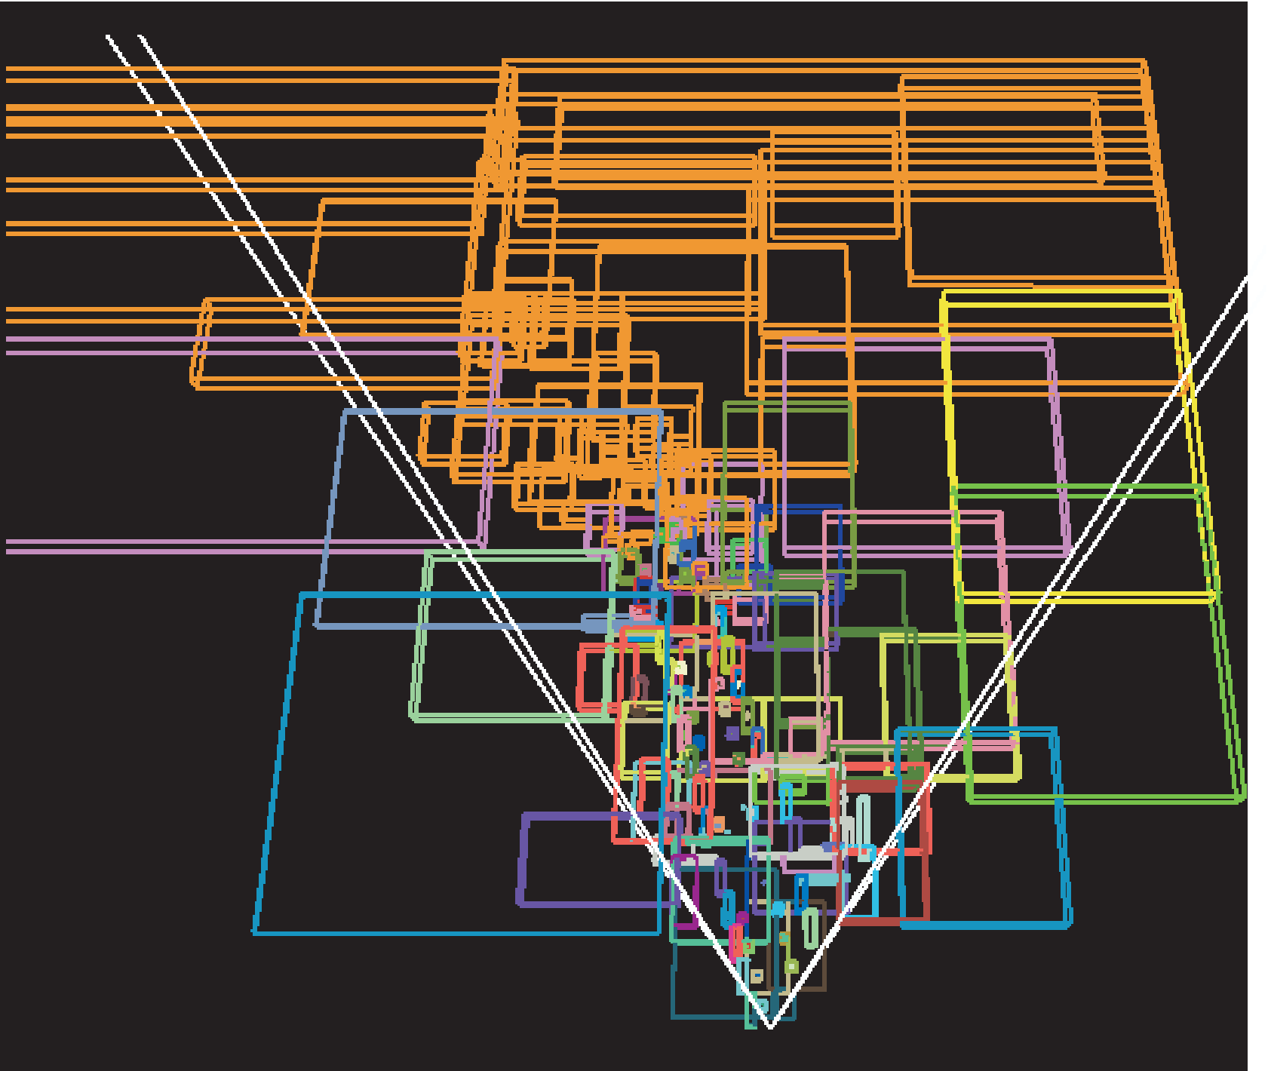
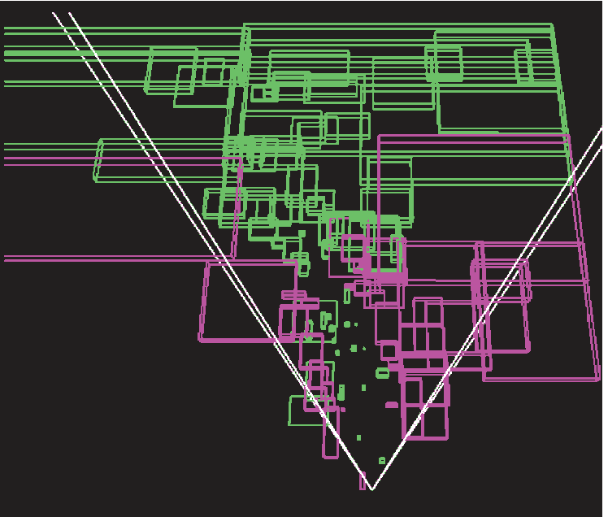
Query Batching: Visualization
Each color represents a state change
CHC: ~100 state changes
CHC++: 2 state changes
(Max. batch size: 50)

Slide 54
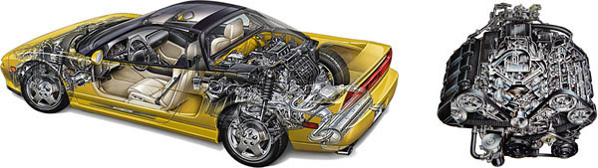
Multiqueries: Number of Queries
Node invisible for long time
  Likely to stay invisible
  E.g., car engine blocks in a parking lot
Cover many nodes with single query

Slide 55

Multiqueries: Number of Queries
Test q nodes by single (multi)query
  Invisible → saved (q – 1) queries
  Visible
    Must test individually - wasted one query!
4 more
individual
queries
Multiquery
passed
Multiquery
failed

Slide 56
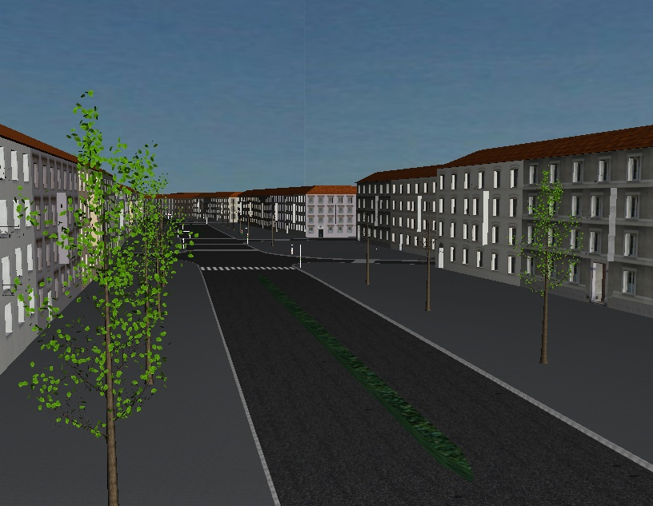
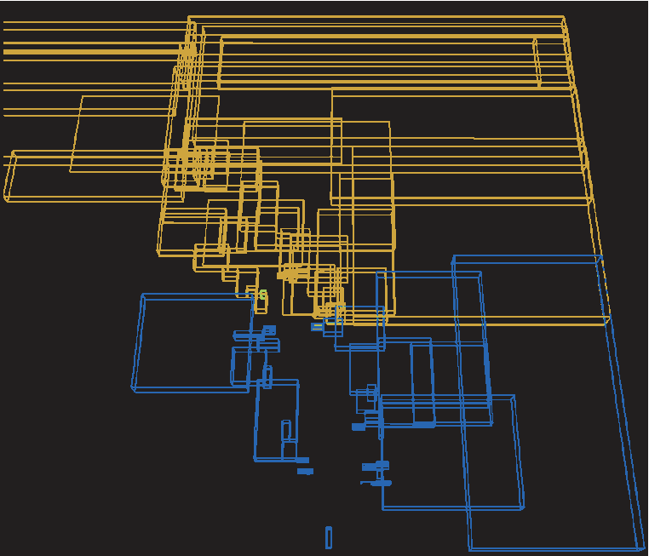
Multiqueries: Greedy Algorithm
Use probability that node stays invisible
Find optimal query size with cost / benefit model
This view is covered with 3 multiqueries
Notes:
Sorted by probability to stay invisible

Slide 57
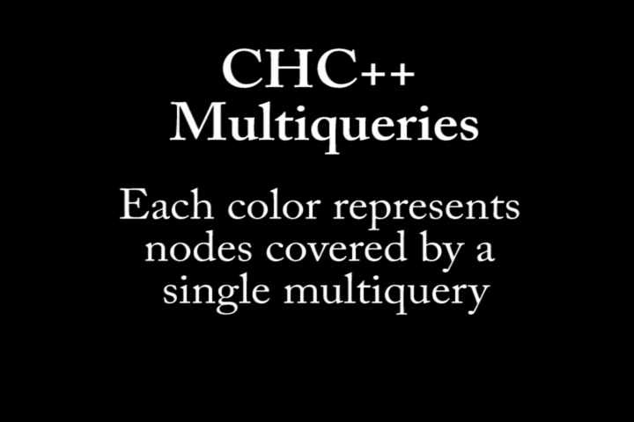
Multiqueries: Vienna (1M triangles)
Notes:
Show movie in continous loop

Slide 58
Queues in CHC++
New in CHC++
New in CHC++
traversal queue
i-queue
(invisible nodes)
v-queue
(visible nodes)
Multiquery
query queue
Notes:
New: i-queue and v-queue

Slide 59
Results: Powerplant (12M triangles)

Slide 60
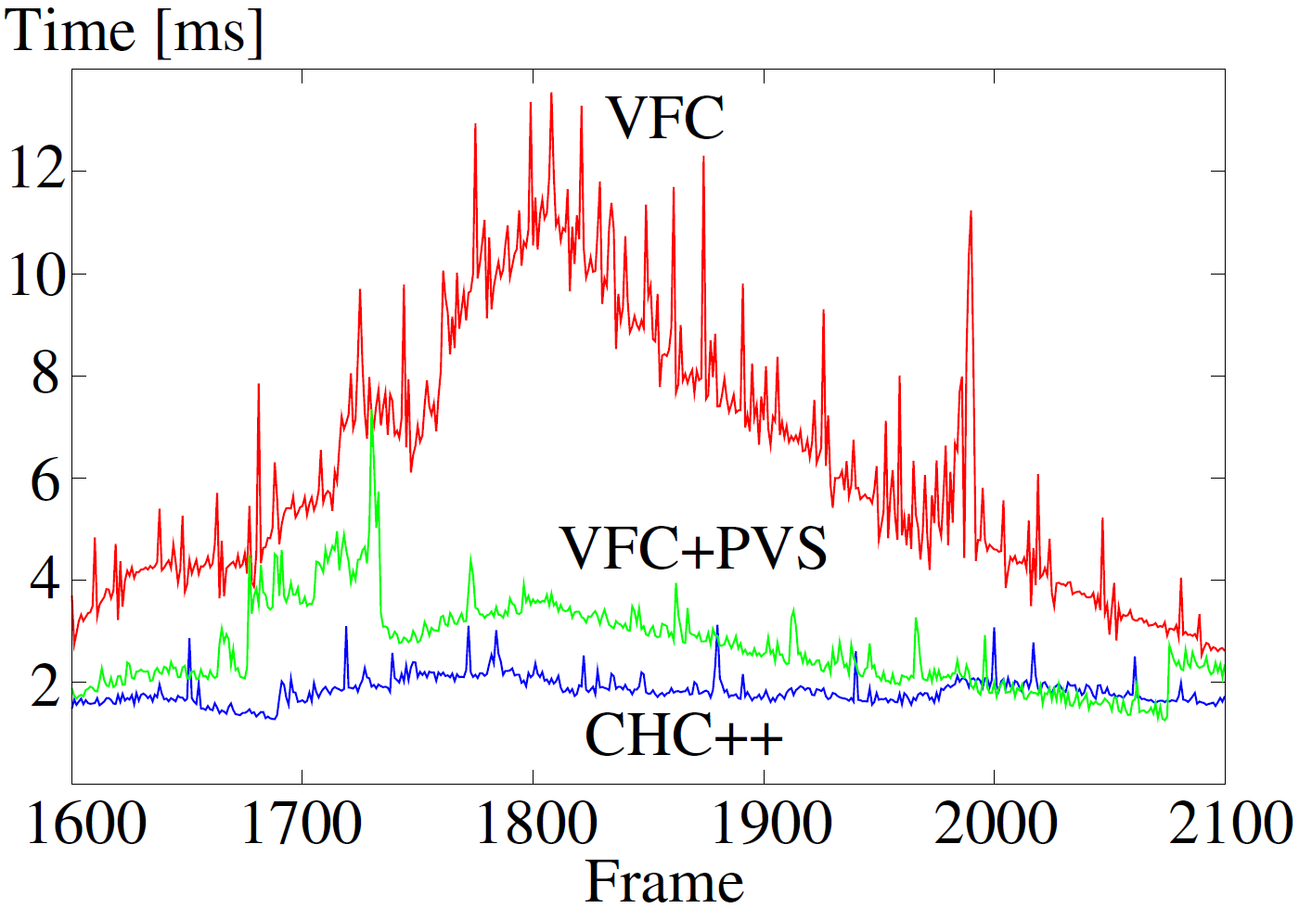
Results: Powerplant (12M triangles)

Slide 61
Overview: Our Contributions
Visibility culling (qualitative visibility)
  Two algorithms for scene preprocessing
  CHC++: Coherent hierarchical culling revisited
Quantitative visibility for realistic lighting
  High-quality screen-space ambient occlusion using temporal coherence

Slide 62
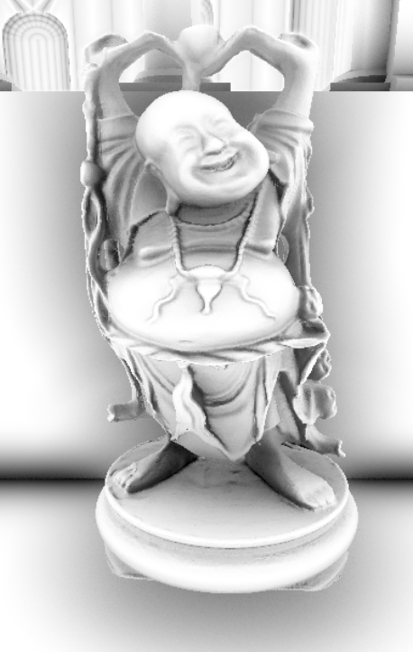


High Quality Screen-Space Ambient Occlusion
Using Temporal Coherence
Computer Graphics Forum
(Accepted with minor revisions)
[Oliver Mattausch, Michael Wimmer, Daniel Scherzer, Alexander Kusternig]

Slide 63
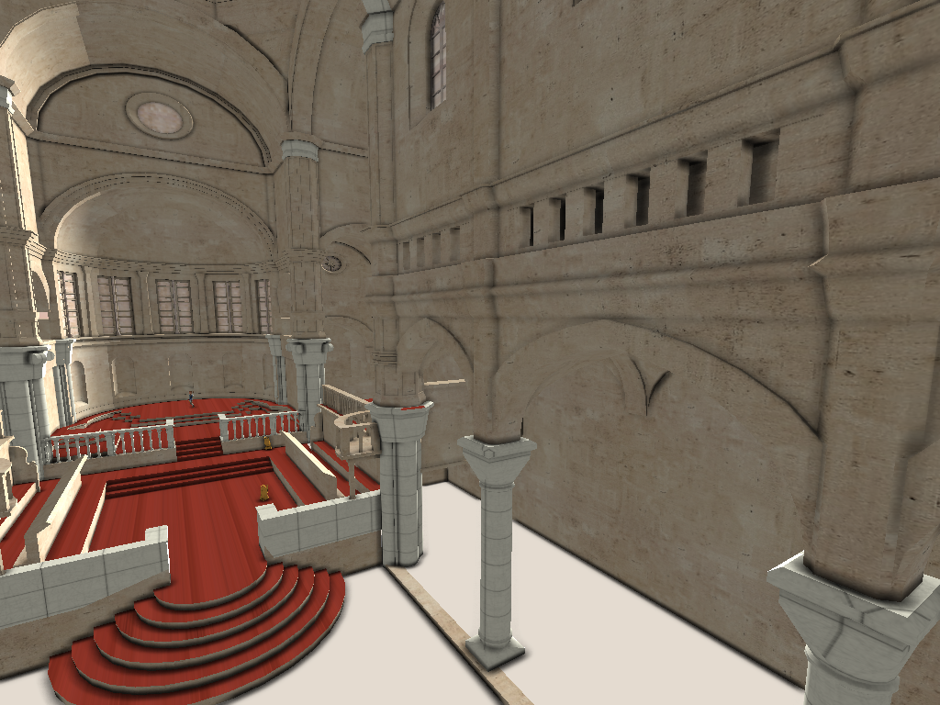
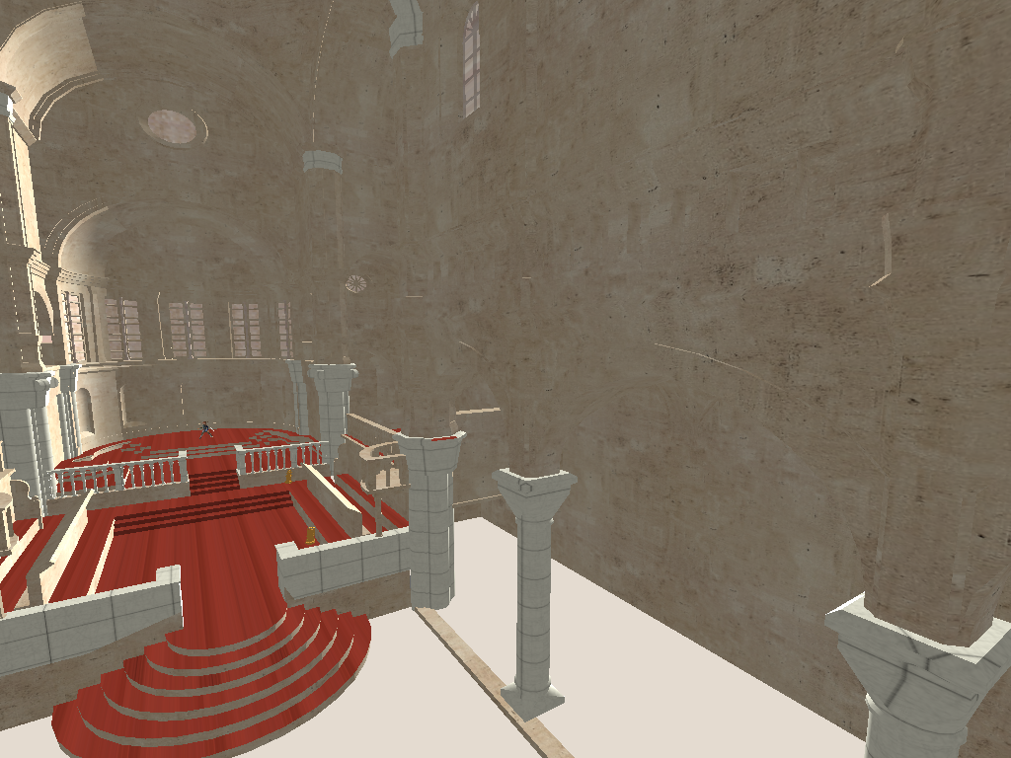
Ambient Occlusion
Cheap approximation of global illumination
% of hemisphere that is blocked
Integrate visibility function V (0 or 1)

Slide 64
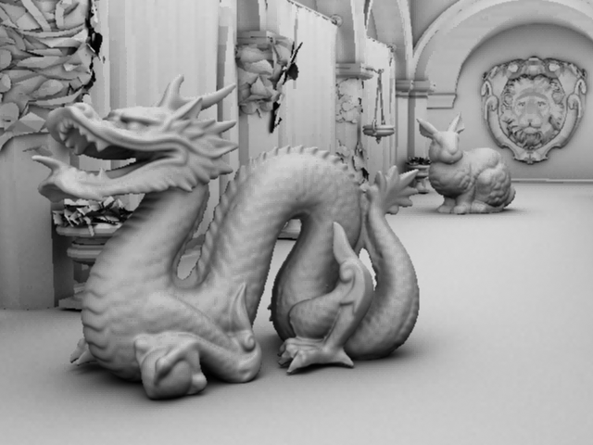
Screen-Space Ambient Occlusion (SSAO)
Rasterize scene
Use (depth) output as discrete scene approximation
Output sensitive → fits to our goals!
Lost information

Slide 65
SSAO: Method of Crytek
Cast 8 – 32 spherical samples
Farther away than surface → direction occluded
Evaluate % of occluded samples
P

Slide 66
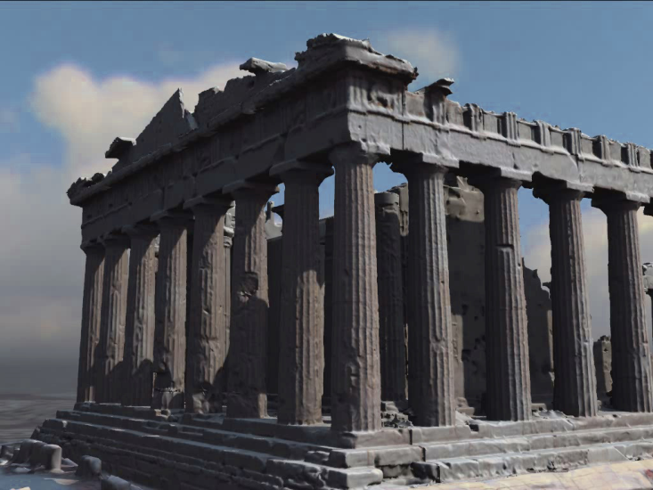


Temporal Coherence
Most pixels stay coherent
Reuse these pixels (green)
GPU friendly operation
  Reprojection
Animation
Moving view point

Slide 67
Temporal Reprojection
Reproject pixels into old frame
Reuse stored information
Distribute costly calculation over time
(accumulate samples)
Frame t
Frame t-1

Slide 68


Our Algorithm: TSSAO
Combine SSAO + temporal reprojection (TSSAO)
Happy Buddha
(~1M triangles)
23 FPS
45 FPS
Screen Space Ambient Occlusion (SSAO)
Our method (TSSAO)

Slide 69


Detecting invalid old pixels
When is old pixel invalid?
  Disocclusion (sufficient for static scenes)
  Change in the neighborhood (dynamic scenes)
Our
invalidation
scheme
No invalidation
Translational
movement

Slide 70
Invalidation: Detect changes
Only relative changes important
Cast invalidation samples
Reproject samples into frame t-1
Compare old to new length
L_{old}
CV
P_{t}
P_{t-1}
L_{new}
Frame _{t-1}
Frame _{t}

Slide 71


Invalidation: Optimizations
Reuse SSAO samples for invalidation
Only check upper hemisphere
Visualization of recently invalidated pixels
in dynamic scenes (red = current frame)

Slide 72


Adaptive Convergence-Aware Filter
Filter only undersampled pixels
Depending on number of accumulated samples
  Filter size
  Sample weight
Our filter
No filter

Slide 73
Optimization: Adaptive Sample Generation
If pixel undersampled
  Use more samples (e.g., 32)
Else
  Use minimum amount of samples (e.g., 8)

Slide 74
Results: Happy Buddha (~1M triangles)
SSAO
23 FPS
TSSAO
45 FPS
Reference
2.5 FPS

Slide 75



Results: Dragon (~1.1M triangles)
SSAO
32 Samples
TSSAO
8 – 32 Samples
Reference
480 Samples

Slide 76
Results: Videos
Movements
Vienna walkthrough

Slide 77

Results: Movements

Slide 78
Results: Walkthrough Vienna

Slide 79
Visibility Computations: Conclusions
Important operations in 3D computer graphics
  Visibility culling (qualitative visibility)
  Realistic lighting (quantitative visibility)
Proposed 4 algorithms in the fields of
  Visibility preprocessing
  Online culling
  Ambient occlusion

Slide 80

Visibility Computations: Conclusions
Use scene preprocessing algorithms with
  Adaptive Global Visibility Sampling (AGVS)
  [Siggraph 2009: Bittner, Mattausch, Wonka, Havran, Wimmer]

Slide 81
Visibility Computations: Conclusions
CHC++ successfully ported on major consoles [Stefan Reinalter]
  Playstation
  Xbox
  Wii (occlusion queries reimplemented!)
Calibration tool for parameter settings

Slide 82

Visibility Computations: Conclusions
Output-sensitive real-time rendering framework
All algorithms can be used together
  Preprocessing for static scene
  Online culling for dynamic objects
  Ambient occlusion for realistic lighting

Slide 83
Discussion
Thank you for your attention!

