Slide 1
Michael Birsak and Michael Hanzl
Institute of Computer Graphics and Algorithms
Vienna University of Technology

Slide 2
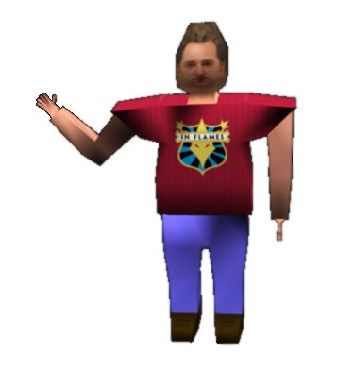
Outline
Motivation
Related work
Game description
Implementation
Performance
Demo
Future Work
Conclusions

Slide 3
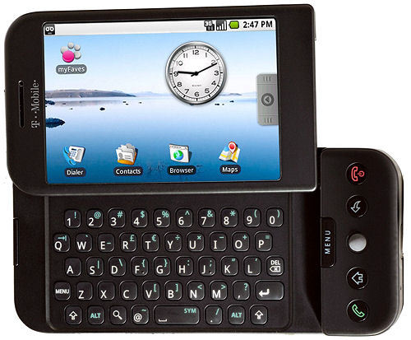
Motivation
Develop and release a 3D game
Google Android
OpenGL ES
Experiment with Android
NOT a computer graphics demo!!!

Slide 4
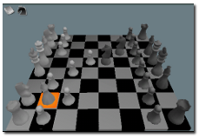
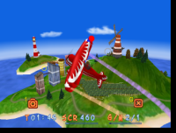
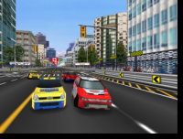
Related Work
Many 2D games (tiles)
Basically no 3D game in Spring 2009
Now: Some 3D games available
Android Knight (3D Chess game)
Games from OmniGSoft:
Super-G Stunt
Snow Rally City Stage
…

Slide 5
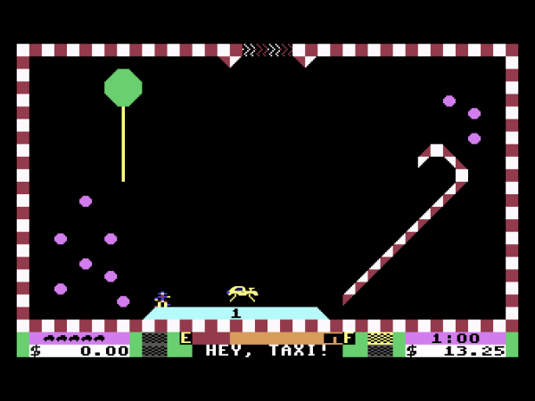
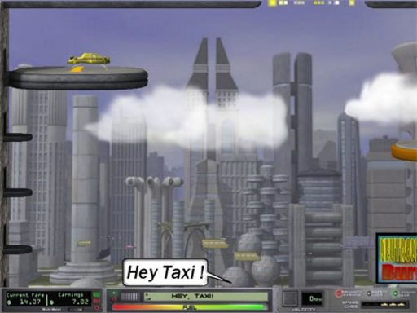
Idea
Space Taxi for Commodore 64 (1984)
Space Taxi 2 (2004)
Some inofficial versions

Slide 6
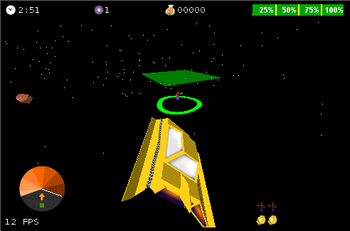
Game Overview
3D, but discrete height levels
7 levels + 7 bonus levels
3 lives & power
Transport passengers in 3 minutes
Score
Highscore

Slide 7
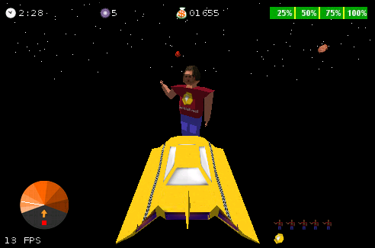
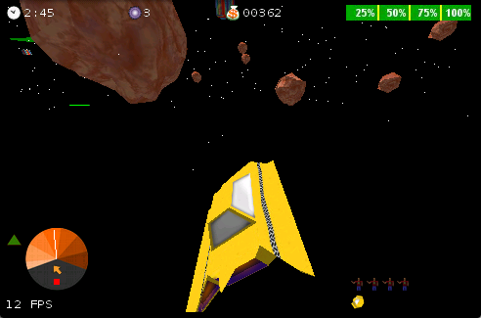
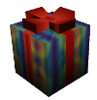
Game Objects
Transporter
Passenger
Terrorist
Asteroid
Geyser Bullet
Packet
Banana

Slide 8
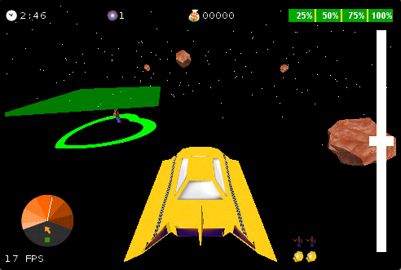
Controlling
Devices have different input units
Accelerometer
Calibration
How to ascend or descend?
Slider
Height depends on the velocity

Slide 9
Implementation Overview
Collision Detection
View Frustum Culling
Modelloader (obj)
LOD
Effects
Random level generation
Own models & images & sounds
Settings
Local & Online Highscore

Slide 10
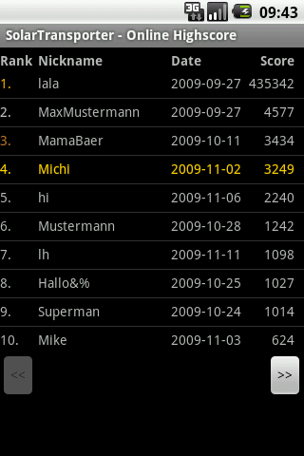
Highscore Features
Online Highscore
Local Highscore
Compete against other users
Only one entry per user
Registration required
Search for your own result
Compare your own results
Delete all entries
View highscore on your Android device
Detailed overview of the highscore entries
Overview of your result after insert
Correct handling of time zones
Correct handling of ties

Slide 11
Highscore Implementation
Local Highscore
SQLite
Online Highscore
Insert / Login / Register: HTTP Post (HTTPS!)
Retrieve Data: HTTP / XML
Web-Server: PHP / MySQL
Client
Server
HTTP Post
Response
Android device
Webserver

Slide 12
Highscore Security
Avoid SQL-Injections
Check and constrain the user input
PHP escape function
Password → SHA-512 Hash
Secure connection (HTTPS)
Check the highscore
Special „password“
Check constraints: s-pt:22-pt:48-pt:17-pt:10-le:1-ti:28- b-b-le:1001-pk-pp-d-d-d

Slide 13
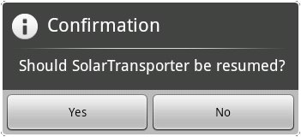
Lifecycle
Activities could be interrupted
Activity not killed
Activity killed
Screen orientation change
Less memory
Save / restore state
Do not block the main thread!
Avoid injuries!!!

Slide 14
Performance Issues
Geometry
Rasterizer
Creating objects expensive
Garbage Collector (~100 - 300ms)
Object Oriented Design
Function calls: local, via interface, JNI
Loading and parsing ASCII files is slow

Slide 15
Performance Solution
Reuse your objects → Object Pool
Try to avoid garbage
Concatenated Strings / Java built-in methods!
Invoke Garbage Collector manually
Decrease the number of polygons to render
Use the draw_texture extension
Use Java Object Serialization for model loading
Write code that is fast
Reference: Chris Pruett: Writing Real Time Games For Android, Google IO 09, May 2009

Slide 16
Performance
G1: 20 - 30 FPS
Emulator: 10 - 20 FPS (Dual Core 2x3Ghz)
Models: 18 - 508 / 372 triangles

Slide 17
Demo

Slide 18
Skills and Benefits
Controlling the game is not easy!
Measuring distances
Spatial imagination
Find strategies very quickly
Balance between speed and score
Trust in luck
Work under stress

Slide 19
Future work
Save the game
Highscore search
Objects
Planets / suns
Spaceships (enemies)
Effects
Lens Flare

Slide 20
Conclusions: Android
Permanent further development
License: „Free“
Easy to write applications, but…
Great tools, examples, community, guidelines
OpenGL ES support not perfect
Different hardware (currently ~11 smartphones)
Different display resolutions
Different input units
Performance
Emulator ǂ Real Device

Slide 21
The END
Thank you for your attention
Special thanks to Peter Rautek & the institute
Are there any questions?

