Slide 1
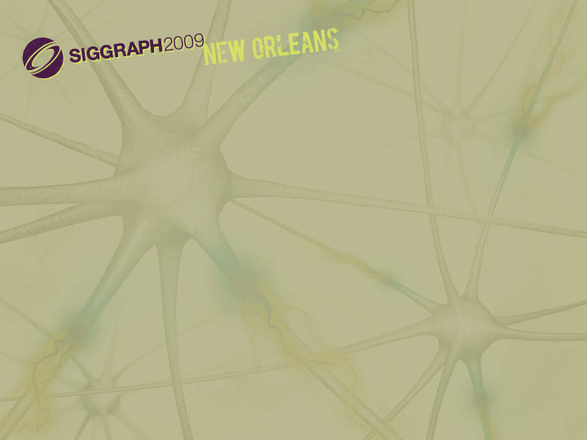

Adaptive Global Visibility Sampling
Jiří Bittner¹, Oliver Mattausch², Peter Wonka³, Vlastimil Havran¹, Michael Wimmer²
¹Czech Technical University in Prague
²Vienna University of Technology
³Arizona State University

Slide 2
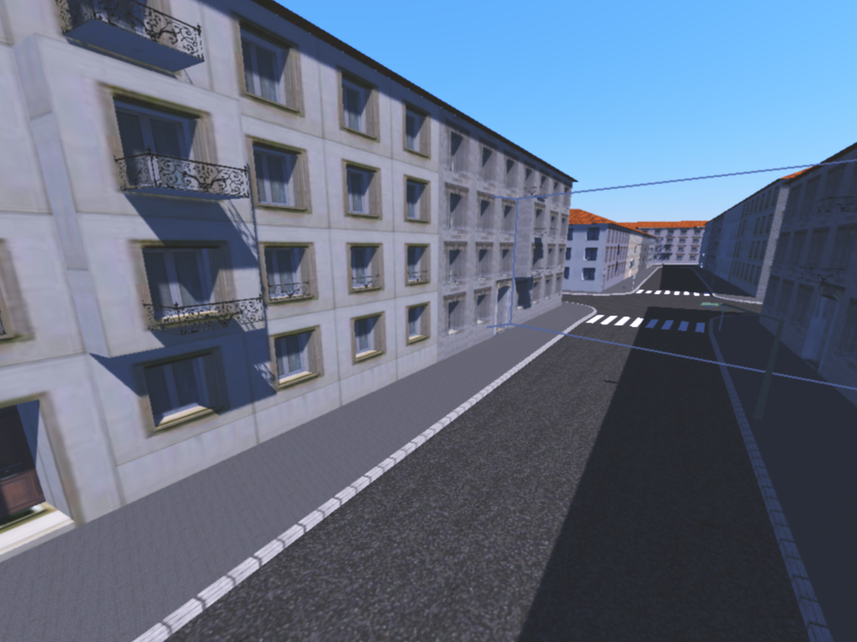
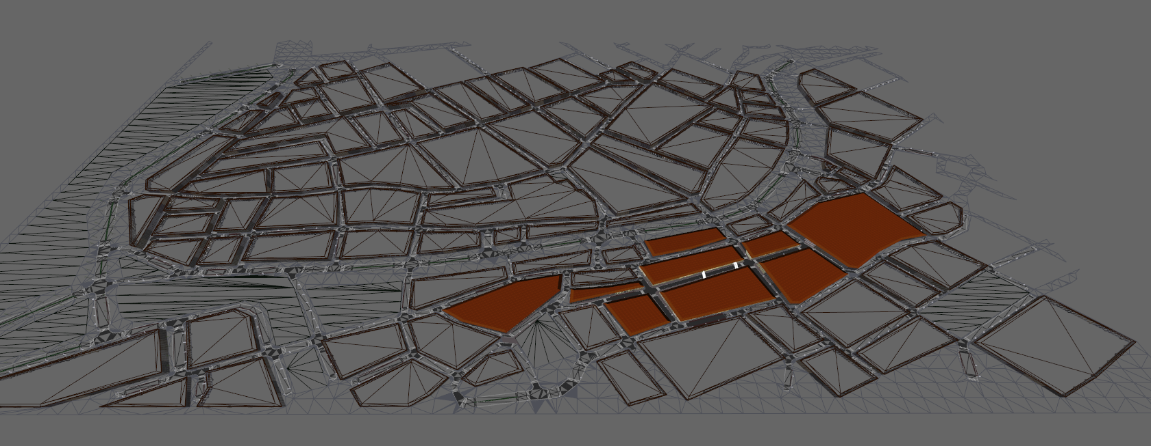
Motivation – Potentially Visible Sets
View cell
Potentially Visible Set (PVS)

Slide 3
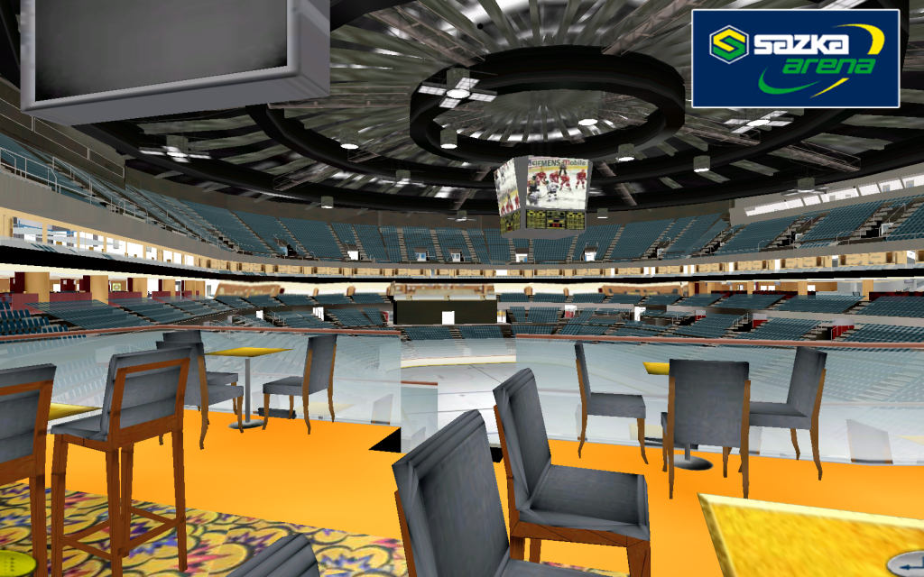
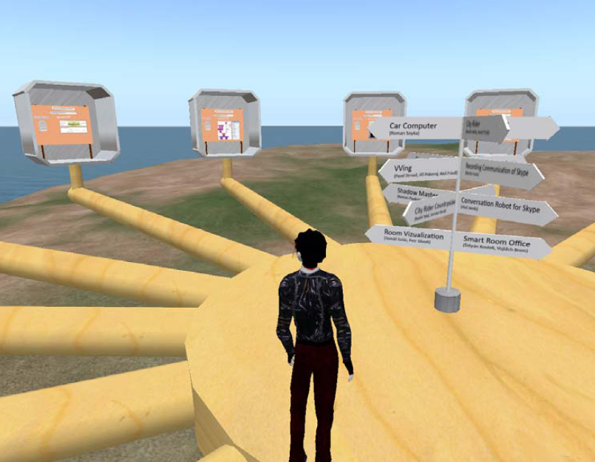
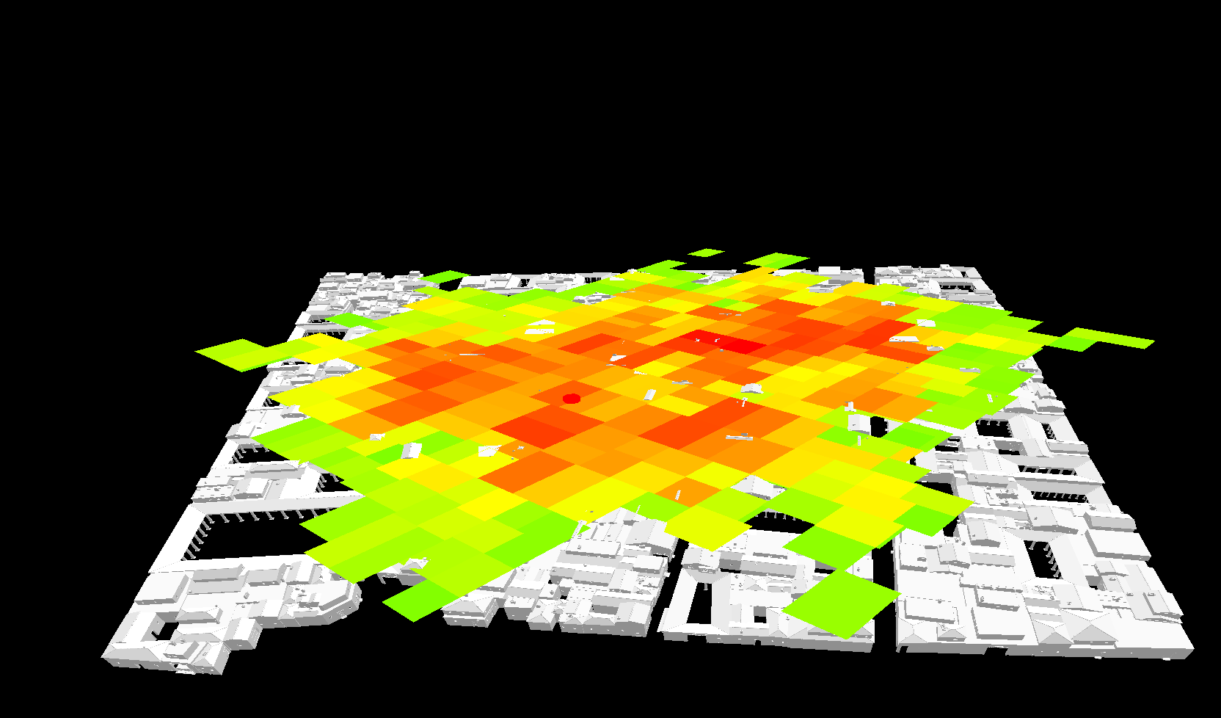
Motivation – PVS Applications
Rendering
Game consoles
Data streaming
Virtual worlds
Visibility Analysis
Level design

Slide 4
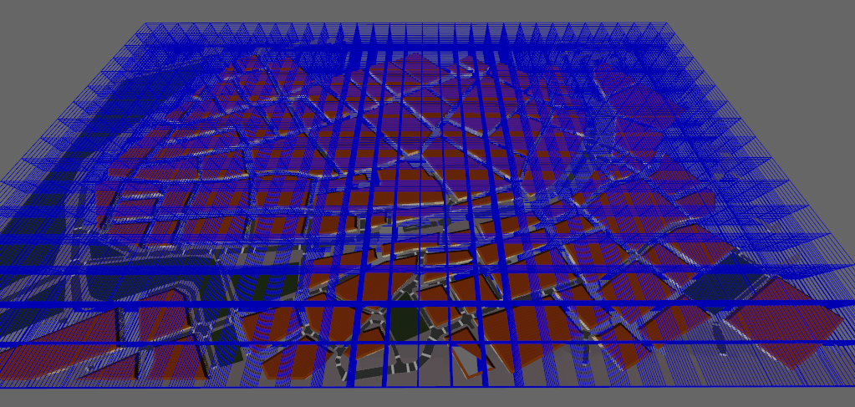
Motivation – Global Visibility
PVS for 10,000 view cells: > 1 day
PVS for 1 view cell: ~ 10 sec

Slide 5
PVS Computation Methods
PVS size
Conservative
PVS ⊇ PVS_{E}
[Durand00] [Wonka00]
[Koltun01] [Leyvand03], …
Exact
PVS ≡ PVS_{E}
[Nirenstein02] [Bittner03]
[Haumont05]
Aggressive
PVS ⊆ PVS_{E}
[Airey90] [Nirenstein04] [Wonka06], …

Slide 6
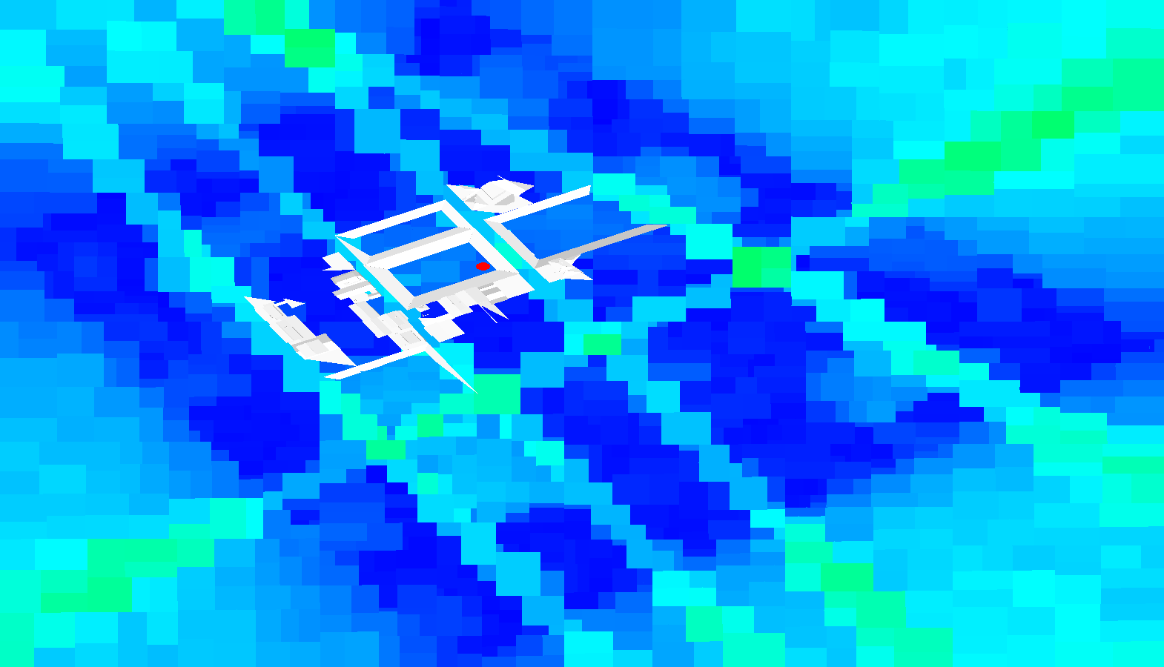
Yet Another PVS Computation Method?
∑
PVS size
> 20x faster
  Conservative
Interaction with global visibility
Conservative
New applications
  Too large PVSs
Ideal
Hotspot #12
  Exact
  Not robust
Exact
  Our method
Tune a bit more …
  Costly
Tune parameters…
Aggressive
We want to get here!
  [Wonka et al. SIGGRAPH 2006]
~1 minute
Time

Slide 7
Global Visibility Sampling
for each view cell
Compute PVS
while !terminate
Compute vis. sample
Add to all PVSs
Classical from-region visibility
Global visibility sampling
  Uses visibility coherence
  And is progressive
`

Slide 8
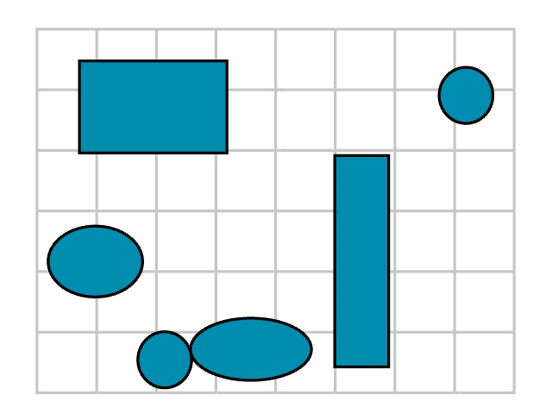
Visibility Samples

Slide 9
Adaptive Global Visibility Sampling
while !terminate
Compute visibility sample
Add to all PVSs
How to sample efficiently?
Different sample distributions
  Stationary
  Adaptive
Mix distribution according to their performance

Slide 10
Stationary Sample Distributions
Two point
  point + point
Point-direction
  point + direction
Object-direction
  surface point + direction
Each distribution good for particular scene configuration

Slide 11
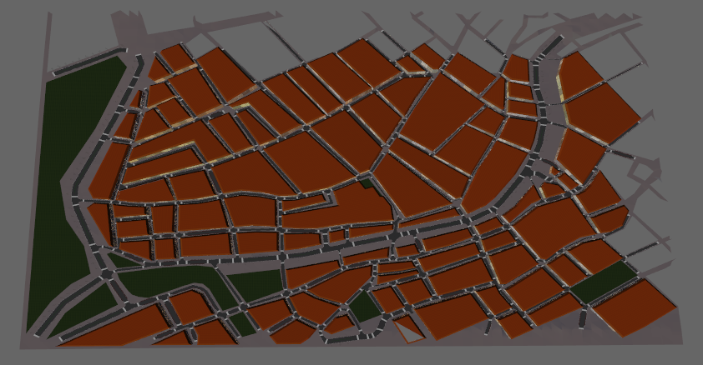
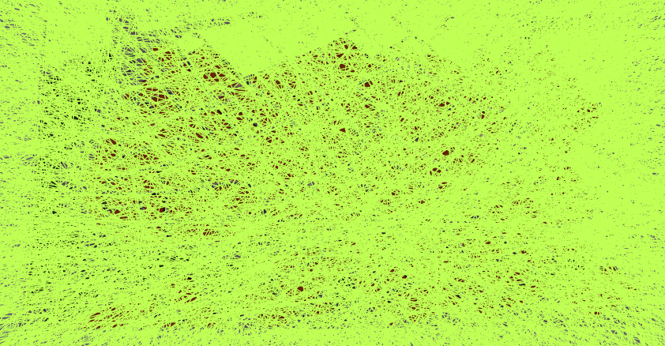
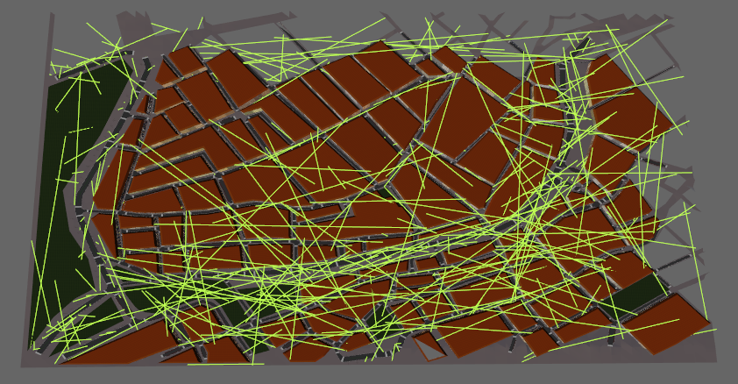
Adaptive Sample Distribution
Stationary distributions
Adaptive sampling
  Assume visibility coherence
  Sample neighborhood of good samples by mutations
  Many bad samples
  (no new PVS entries)
  A few good samples
  (new PVS entries)

Slide 12
Mutation Based Sampling
What is a “good” sample?
  Sample with contribution to at least one view cell!
Store good samples in mutation queue

Slide 13
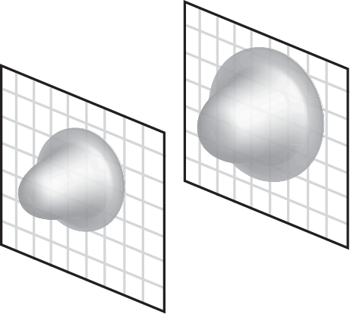
Mutation Based Sampling
Two-point mutation
  Mutate both end points of a sample
  Use 2D Gaussian in tangent plane

Slide 14
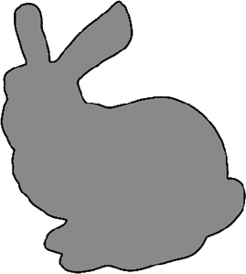
Mutation Based Sampling – cont.
Silhouette mutation
  Mutate termination point
  Find silhouette ray
Reverse mutation
  Mutate origin
  Applied if depth discontinuity detected

Slide 15
Mixing Sample Distributions
Mix distributions adaptively
Contribution of a sample
… new PVS entries for view cell v
… view cells pierced by the sample
0
1
0
0
0
`
2
1
1
0
0
0
0

Slide 16
Mixing Sample Distributions
Mix distributions adaptively
Contribution of a sample
… new PVS entries for view cell v
… view cells pierced by the sample
0
1
0
0
0
`
+
2
1
+
1
0
0
0
0

Slide 17
Mixing Sample Distributions – cont.
Performance (weight) of distribution D
Distribution selected randomly according to w(D)
t(s) … time to process the sample

Slide 18
Terminating the Computation
ΔPVS / sample < threshold
pixel error < threshold
Cheap pixel error estimation
  Error seen by randomly positioned camera
  Uses contributions of point-direction samples

Slide 19
Putting it Together
Terminate?
y
Done
n
Select distribution
Draw sample
Cast bidirectional rays
Update PVSs
Hit?
y
Contribution?
n
n
y
Store as mutation candidate
Update distribution weights

Slide 20
Visibility Filtering
V
Minimize visibility errors
in early stages
Quick preview
Extend visible objects
Filter kernel width depends on
  Distance
  Sampling density
Errors vs. PVS overestimation

Slide 21
Dynamic Updates
Interactive editing
Update only affected scene parts
Delete object
  Remove from all PVSs
  Mutations find new objects
Insert object
  Create shadow volumes
  Remove shadowed objects
  Mutations reinsert PVS entries
V

Slide 22
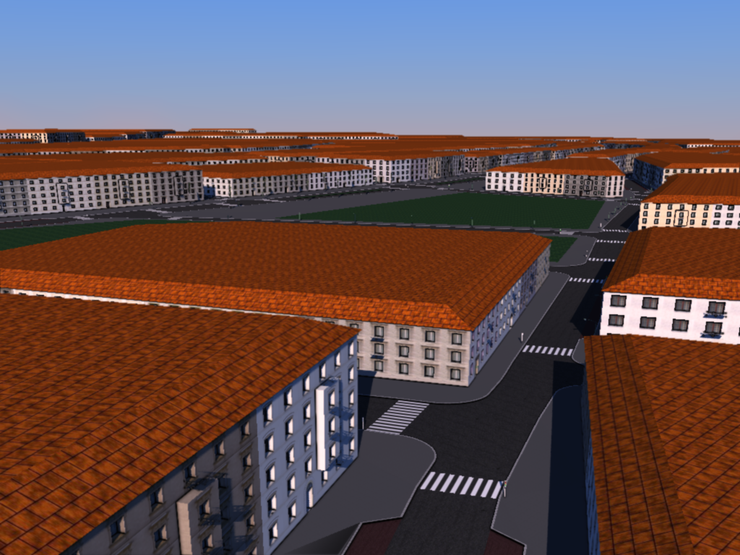
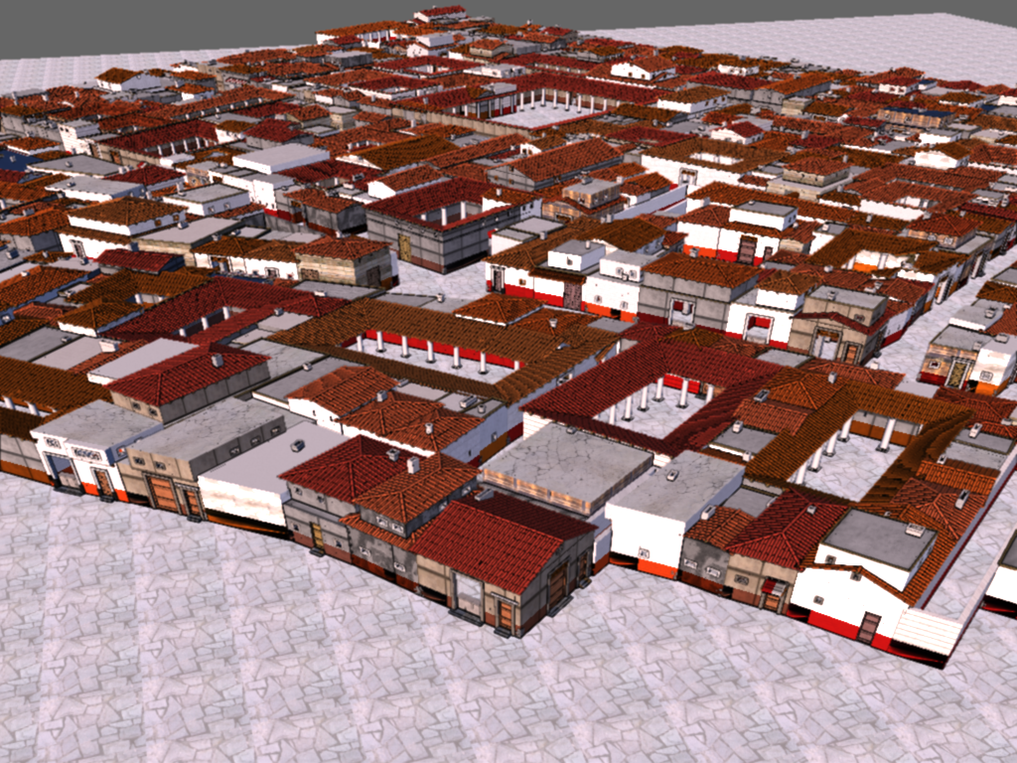
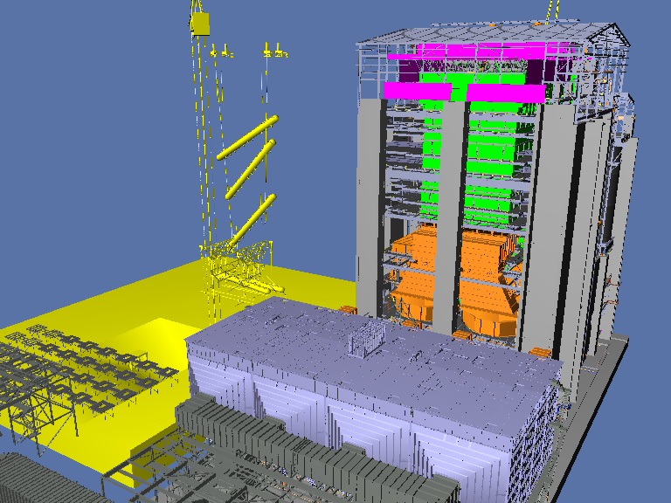
Results
5 test scenes
8,192 view cells each
2 x Xeon E5440 2.83GHz quad-core CPU, 32GB RAM
Custom BVH-based ray tracer 0.1M-1M rays/s
Scene | Vienna | Arena | Pompeii | Powerplant | Boeing 777
Triangles | 3,609,675 | 4,528,160 | 5,646,041 | 12,748,510 | 337,000,000
Objects | 6,156 | 7,804 | 12,228 | 10,150 | 130,000

Slide 23
Results – Evaluated Methods
AGVS … Adaptive Global Visibility Sampling
REF … Uniform random sampling (point-direction)
GPU-REF … GPU implementation (occlusion queries)

Slide 24
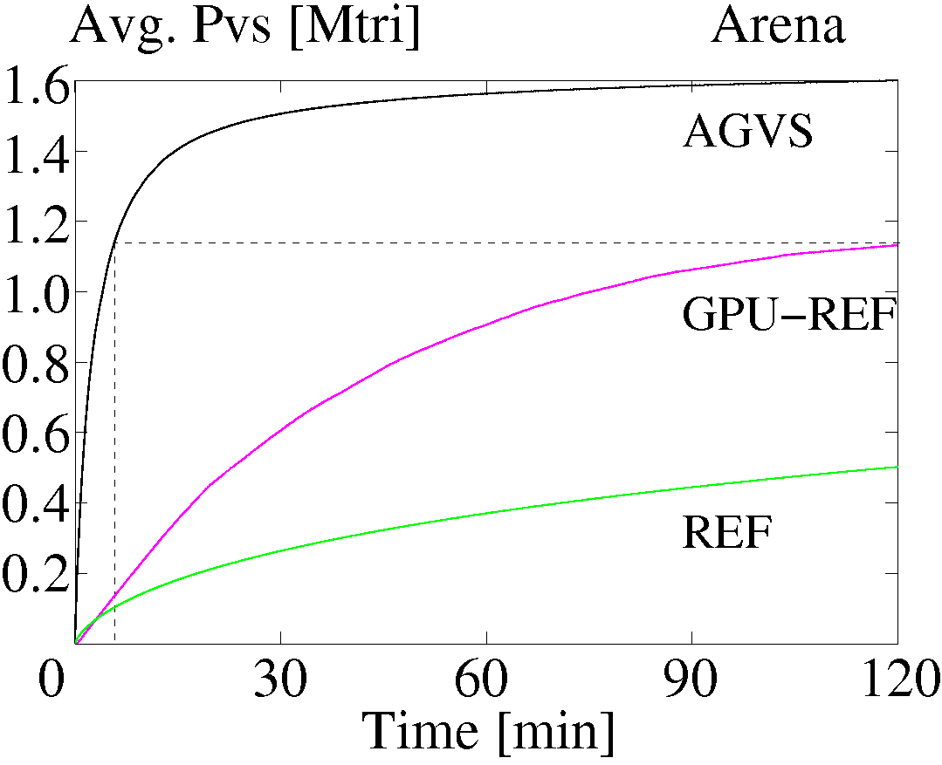
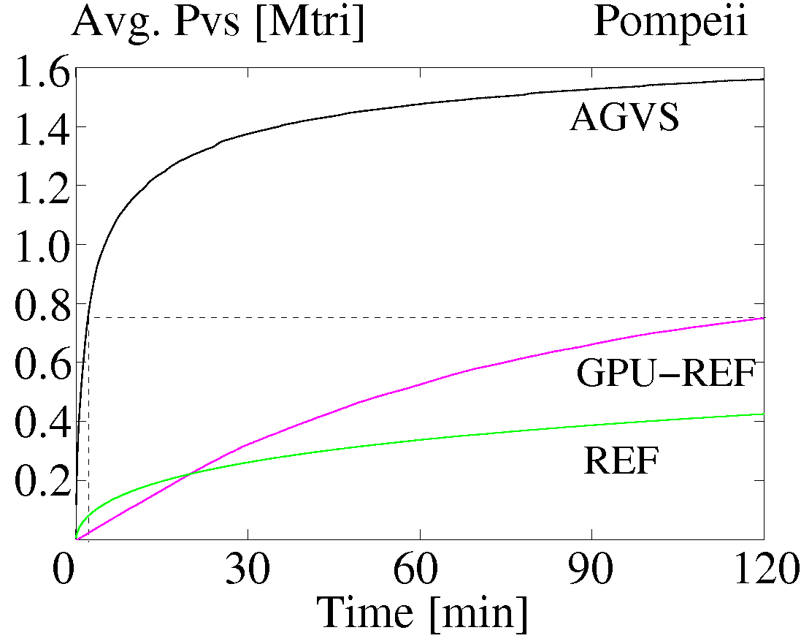
Results – Average PVS size
speedup ~18
speedup ~43
6.6
120
2.8
120
Notes:
1.3953 => 1.4 = 1.23 sec ca 1.5 min
0,6976744186046511627906976744186

Slide 25
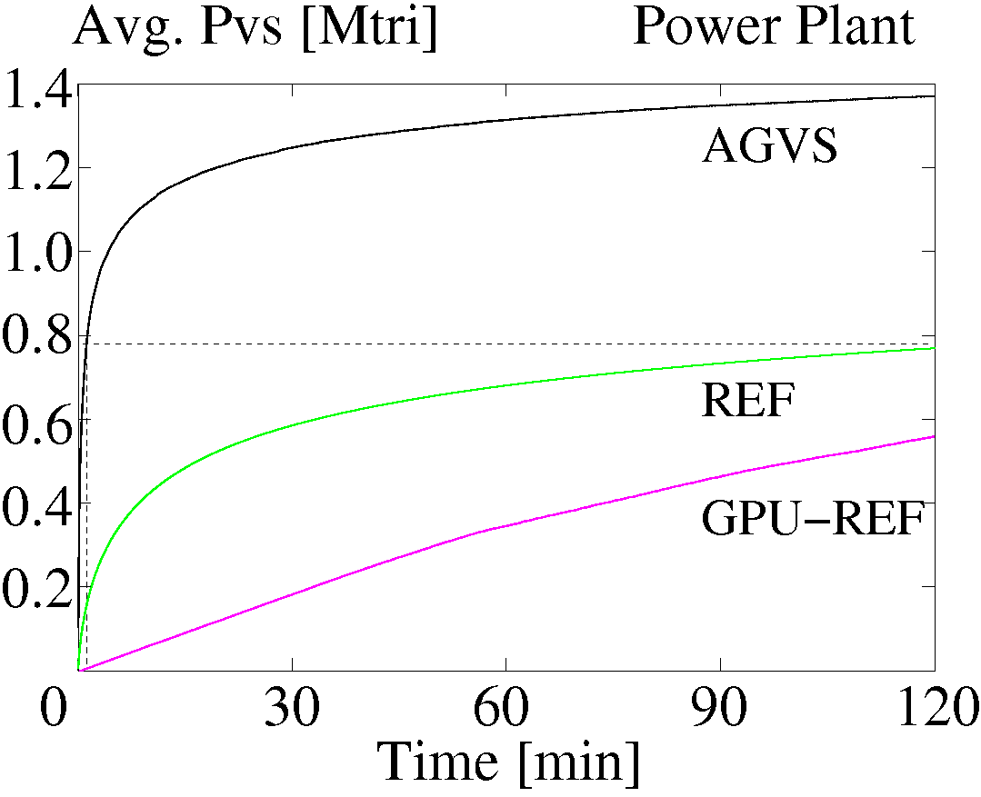
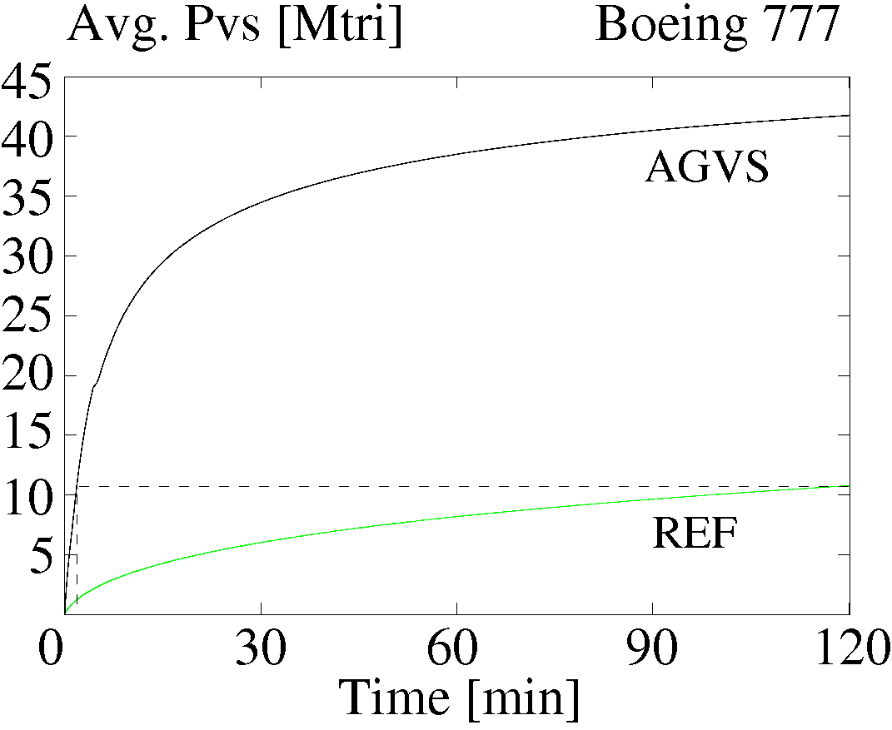
Results – PVS size
speedup ~85
speedup ~60
1.4
120
2.0
120

Slide 26
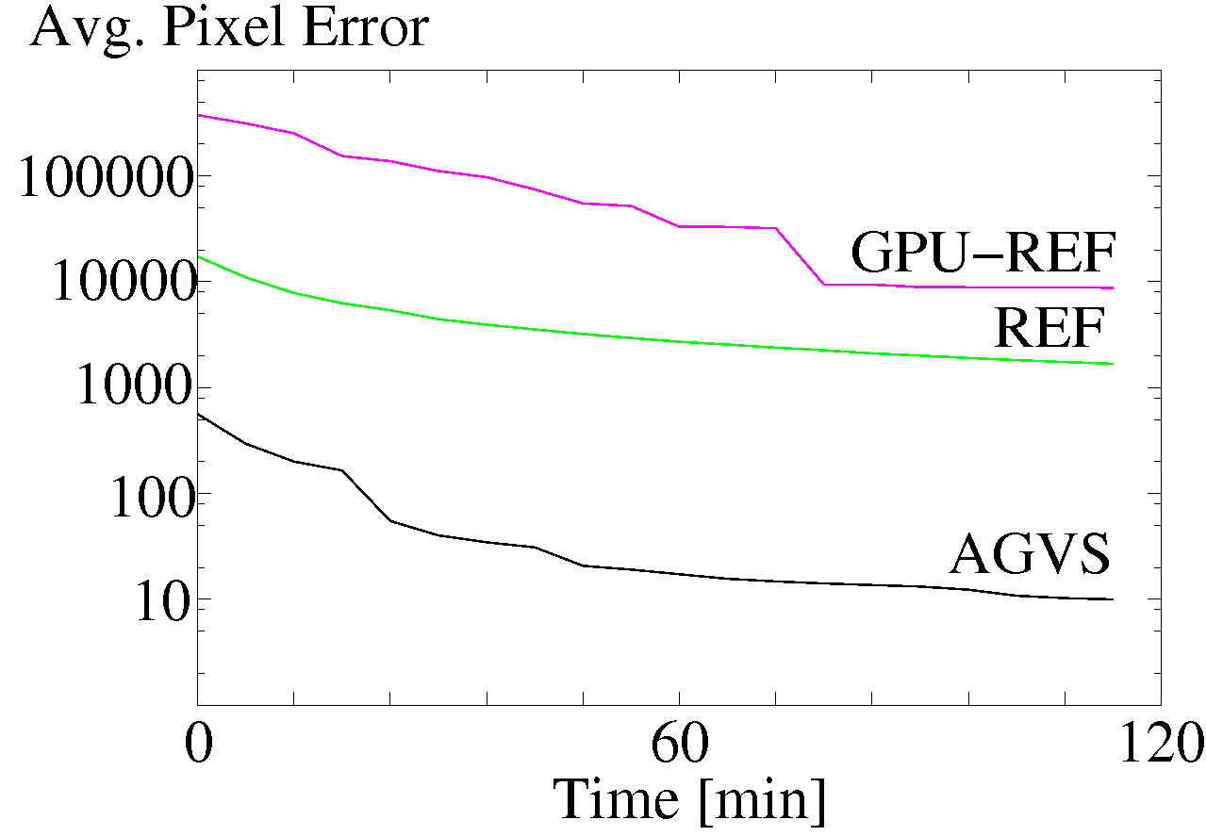
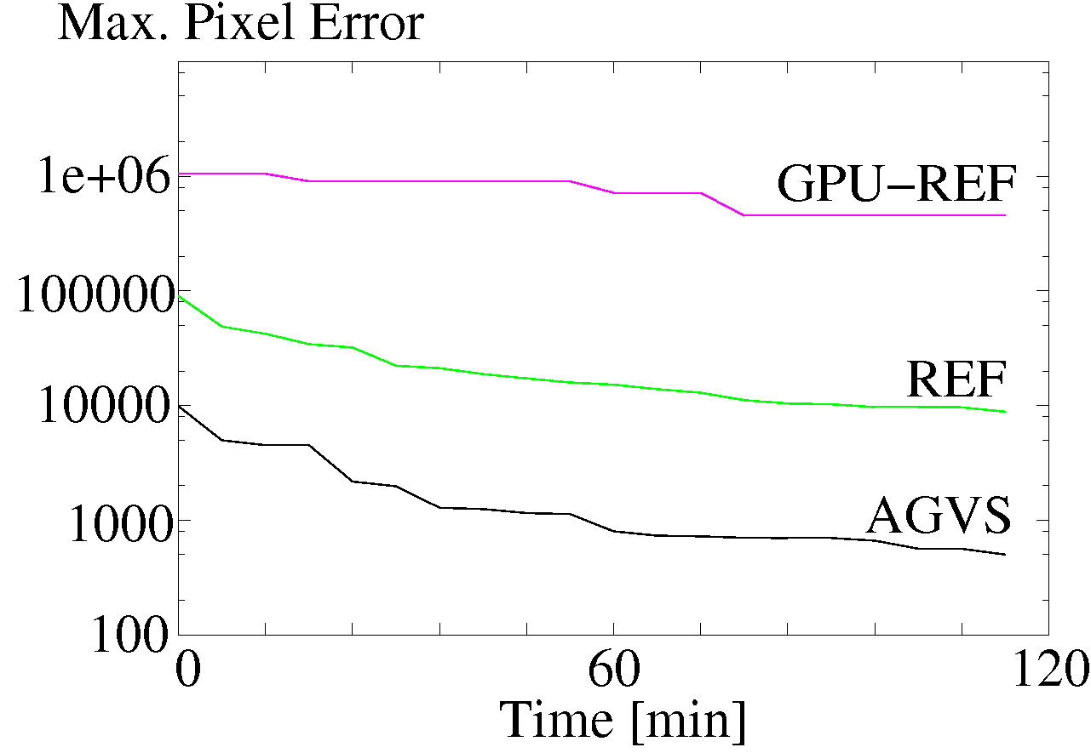
Results – Pixel Error Measurement
Walkthrough in Vienna
Resolution 1000 x 1000
After 2 hours: avg. ~10 pixels, max. ~500 pixels

Slide 27
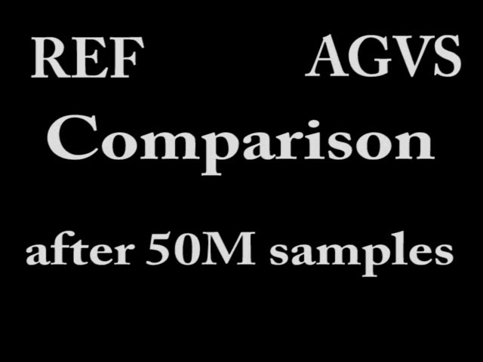
Results - Visibility Error Visualization

Slide 28
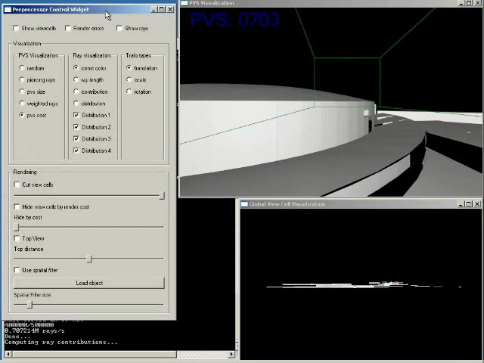
Results – Render Cost Analysis Application

Slide 29
Conclusion
New PVS computation method
  Progressively refines global visibility solution
  Adaptive sampling
Benefits
  Speed
  Ease of use (interaction, termination)
Quick preview of global visibility
  Render cost analysis, game level design
High quality PVS computation
  Games, online multi-user virtual worlds

Slide 30
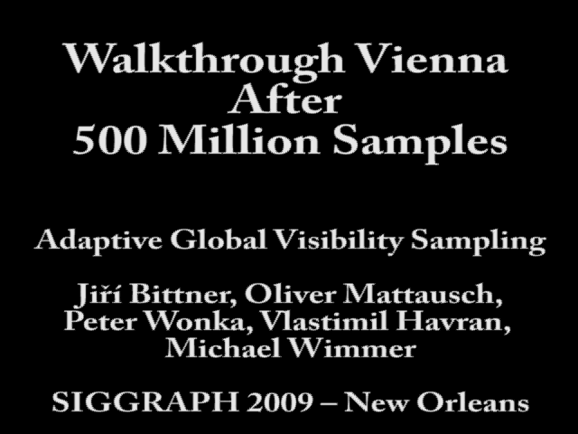
Thank you!
Acknowledgments
Data: Digital Media Production, Boeing comp.
Funding: Austrian Science Fund (FWF) (P21130-N13), Ministry of Education, Youth and Sports of the Czech Republic (LC-06008, MSM 6840770014, Kontakt 2009/6), NSF.

Slide 31
Details – Comparison with GVS
Walkthrough of 33 view cells
GVS
  ~62 hours for 8,192 view cells
  avg. pixel error 5.4, max. pixel error 424
AGVS
  17 minutes, avg 104, max 4519
  2 hours, avg 10, max. 501

Slide 32
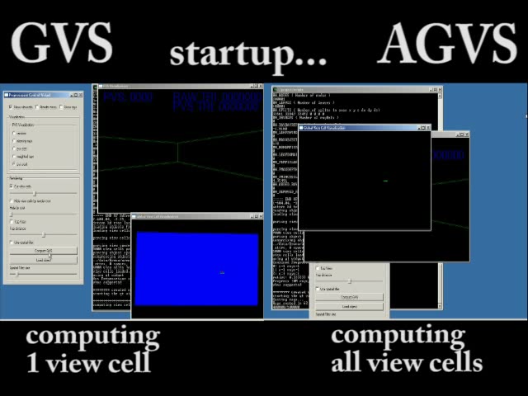
Results – Comparison with GVS

Slide 33
Details – Comparison with Online Culling

Slide 34
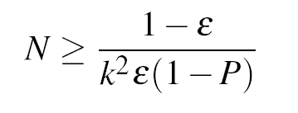
Details - Termination Criteria

Slide 35

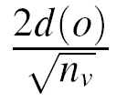
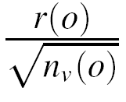
Details – Visibility Filter

Slide 36
Details - Mutation Sample Buffer
Recent entries
…
…
1
17
17
17
17
17
17
17
17
1
3
2
17
0
2
17
3
Queue of mutation candidates
Every entry has a mutation count
Equalize mutation counts
Size: 0.5M - 2M rays

Slide 37
Details – Distribution Mixture

