Slide 1
How to do a Successful PhD (in Visualization)
Eduard Gröller
Institute of Computer Graphics and Algorithms
Vienna University of Technology

Slide 2


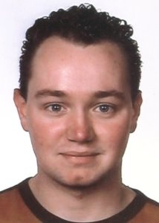
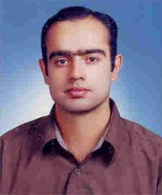
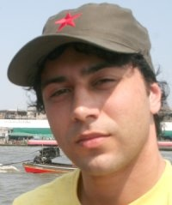

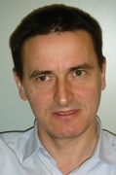


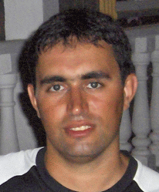
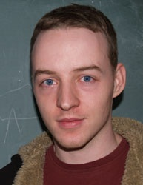

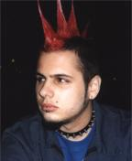
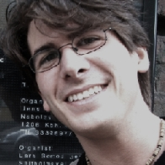
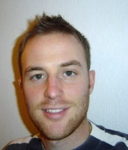


The vis-group
Virtual Reality und Visualisierung Forschungs-gmbh
Österreichische
Akademie der
Wissenschaften
GWI Research
AKH Wien
University of Bergen
Norway
PHILIPS
Medical Systems
Projects: www.cg.tuwien.ac.at/research/vis
Upper Austria University of Applied Sciences

Slide 3
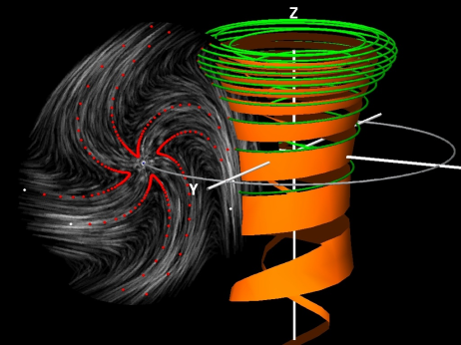
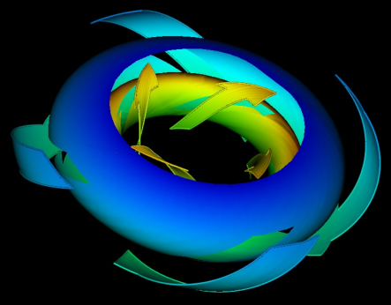
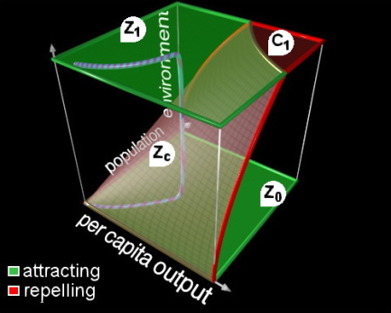
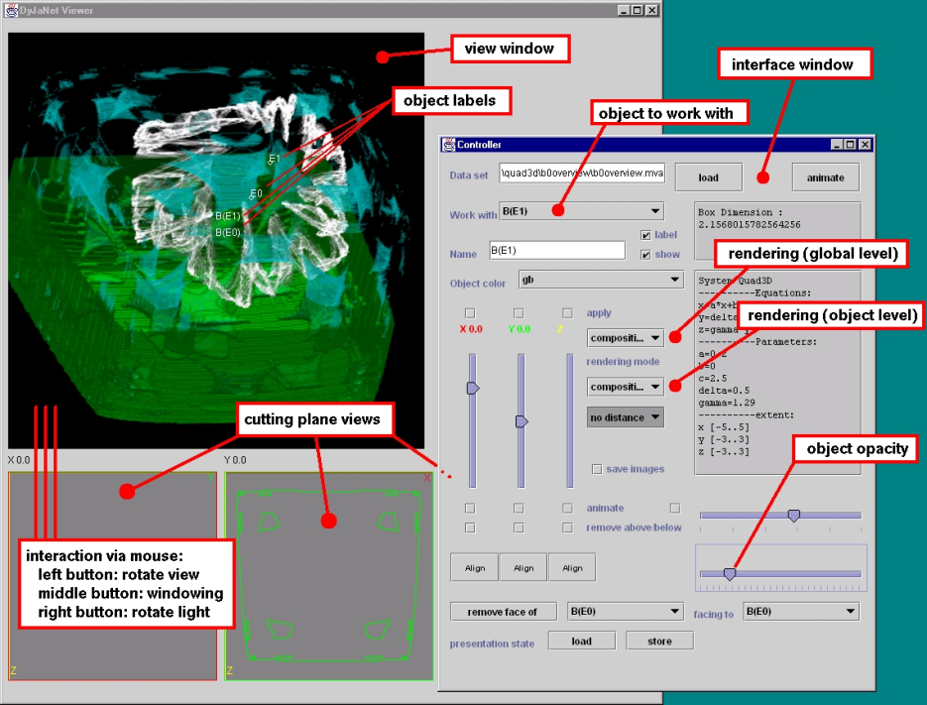
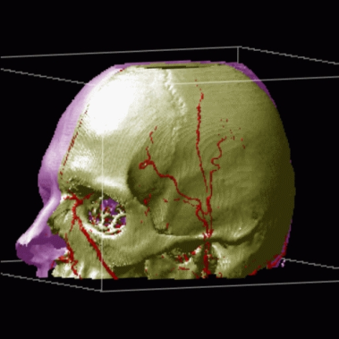
Previous PhD Projects (1)
Visualization of complex dynamical systems (1993-1999)
[Löffelmann]
[Wegenkittl]
BandViz – Visualization over the Internet (FWF; 1998-2001)
[Mroz]

Slide 4
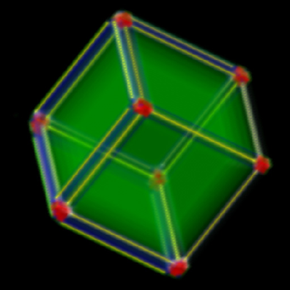
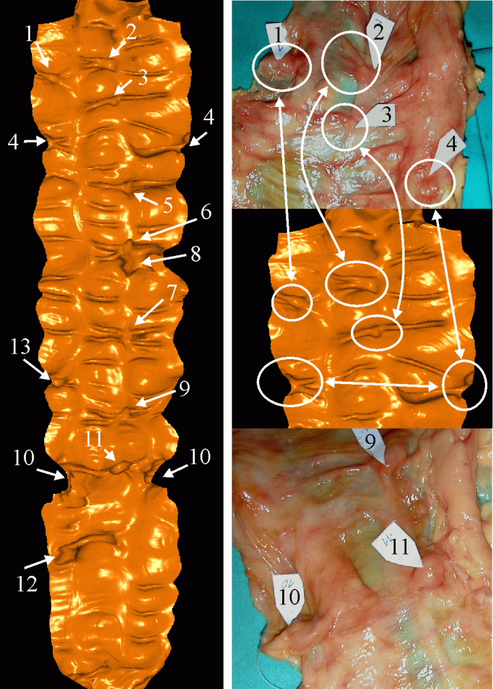
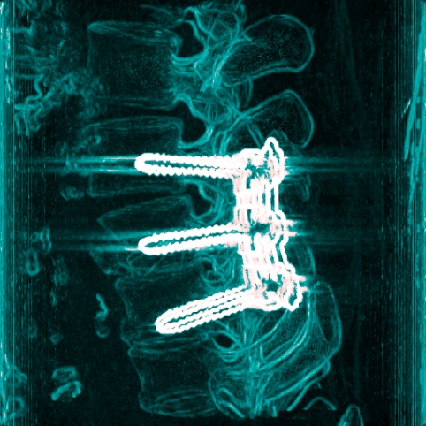
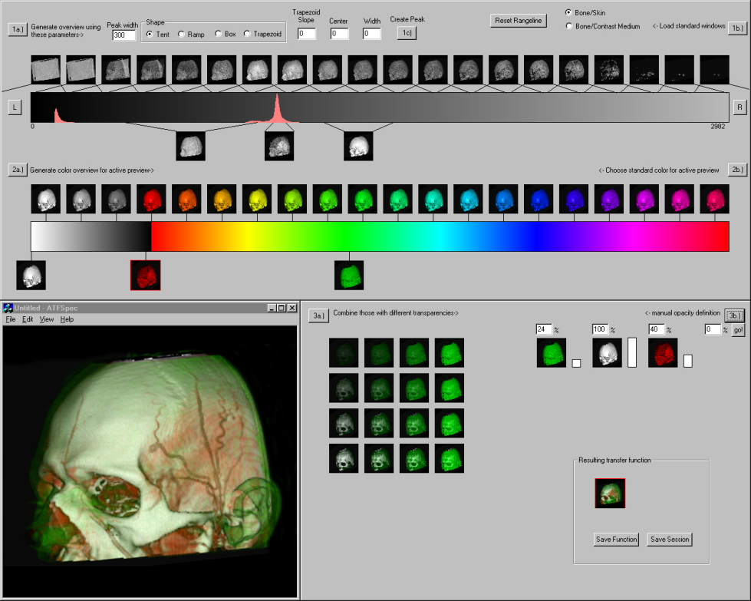
Previous PhD Projects (2)
VisMed - Advanced Volume Visualization Techniques (Tiani, FFF; 1998-2001)
Derivatives and Eigensystems for Volume-Data Analysis and Visualization [Hladuvka]
Interactive Volume-Rendering Tech. for Medical Data Visualization [Csebfalvi]
Usability Issues in Medical Volume Visualization [König]
Visualization Techniques for Virtual Endoscopy [Vilanova]

Slide 5
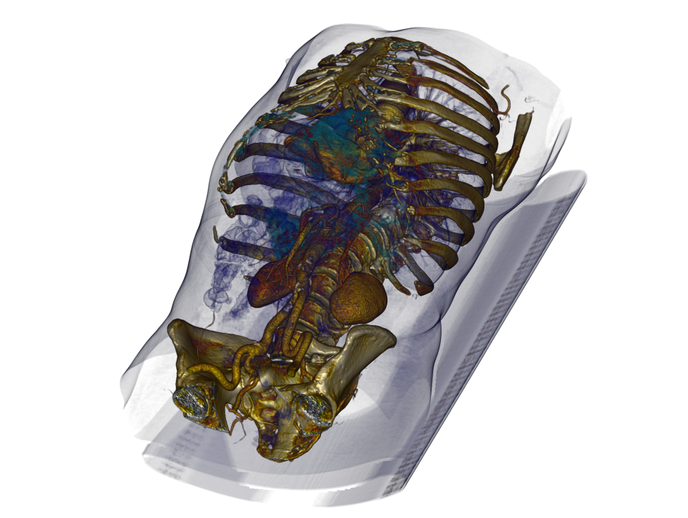
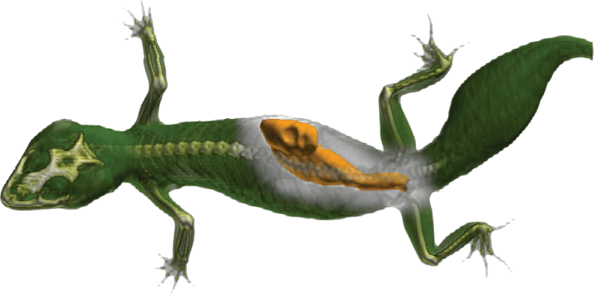
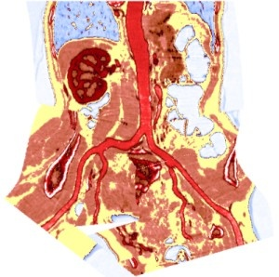
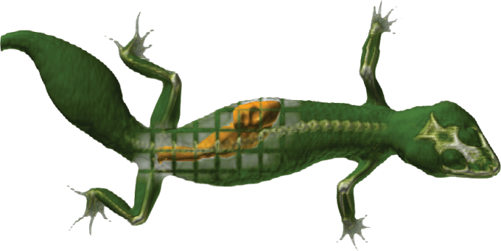
Previous PhD Projects (3)
Adapt - Advanced Diagnosis, Analysis and Planning Tools (in Medicine) (Tiani, FFG; 2002-2005)
Importance-Driven Expressive Visualization [Viola]
Curved Planar Reformation for Vessel Visualization [Kanitsar]
Real-Time Mono- and Multi-Volume Rendering of Large Medical Datasets on Standard PC Hardware [Grimm]

Slide 6
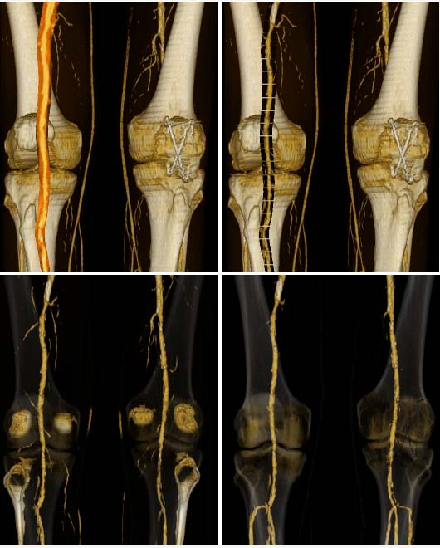
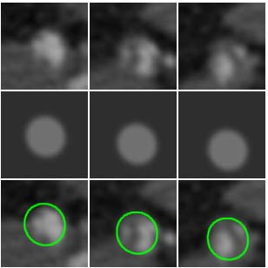
Previous PhD Projects (4)
AngioVis I+II: (Clinical) Visualization Tools for Peripheral CT-Angiography (FWF, AKH, OeAW, Stanford) (2002-2004, 2006-2009)
Processing and Visualization of Peripheral CT-Angiography Datasets [Straka]
3D Modelling and Reconstruction of Peripheral Vascular Structure [La Cruz]

Slide 7
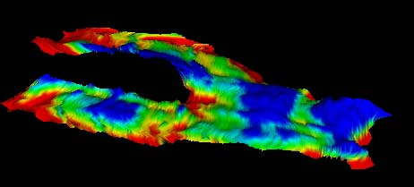
Previous PhD Projects (5)
COMRADE – Colonoscopic and Orthopedic MR Analysis, Design and Evaluation (Philips; 2003-2008)
Medical Visualization for Orthopedic Applications [Mlejnek]

Slide 8
Previous PhD Projects (6)
Exvisation - Expressive Visualization for Illustration (FWF; 2005-2008)
Interactive Illustrative Volume Visualization
[Bruckner]

Slide 9
Before You Get Started
Why to do a PhD?
  Money
  Reputation
  Job opportunities
  Scientific curiosity
How to get a PhD?
  Find a good topic
  Find a good supervisor
  Use a good research method
  Give lots of good talks
  Write lots of good papers
  Write a good thesis
[Peter Eades]

Slide 10
How to do Research?
"If we knew what it was we were doing,
it would not be called research, would it?"
[Albert Einstein]
Doing a PhD is a
  highly unstructured process
  underspecified task
Structuring
  Divide and conquer
  Anchor your work in a local research group
  Get connected in international reseach community

Slide 11
Divide and Conquer
Subdivide your three-year PhD endeavour
  State-of-the-art (6 months)
  4-5 research subprojects (6 months each)
  Write-up thesis, wrap-up results (6 months)
For each subproject define
  Problem
  Goal
  Approach
  Outcome
  Cost
Define Milestones

Slide 12
  Get Connected
To steal ideas from one person is plagiarism – to steal from many is research
[Steven Wright]
Regular meetings with advisor
Expose your ideas early on to your local peers
Attend scientific meetings from early on
  Local conferences
  International conferences
Attend talks, tutorials
Try to give many talks
Use every opportunity to talk to your (international) colleagues

Slide 13

Reflection and Transparency
Internally, externally
Everything is peer based
  Peer reviewing
  Peer learning
  Supervisor learns as much as you do
Be sincere to yourself and to others
Evaluation is key [Peter Eades]
  Effectiveness
  Efficiency
  Elegance
α = β
γ = δ
N
H
L
β
I_{R}
α
γ
δ
V
R
T
I_{T}
Transparency
  Clearly know what you are doing
  Clearly communicate to others
Reflection
  By yourself
  Get feedback from others

Slide 14
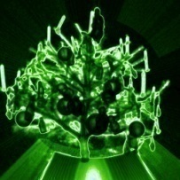
Failure is the Key to your Success ??
Failure is
If you can look into the seeds of time,
And say which grain will grow and which will not, Speak then to me …
[William Shakespeare]
The landscape of the known is convoluted
In hindsight everything looks straightforward and simple
The path to scientific discovery is tangled
Learn from errors (from your own, from others)
If you cannot fail you cannot succeed
And sometimes you fail because it is your fault !!!

Slide 15
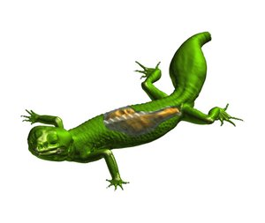
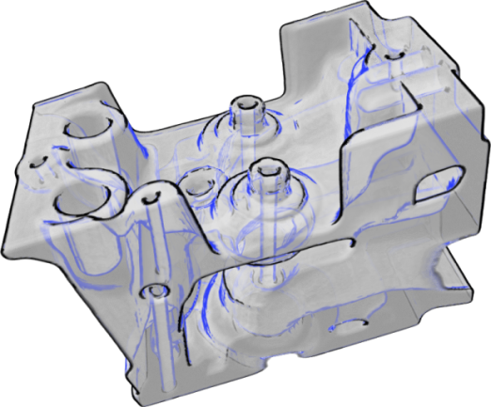
Three Failure Stories from the vis-group
Project proposal on dynamical systems
Depth-of-Field for Volume Rendering
Semantic layers for Illustrative Vol. Rend.
„In my opinion this work is a significant step backwards“
[anonymous reviewer]
I have not failed.
I've just found 10,000 ways that won't work.
Thomas A. Edison

Slide 16

The Most Valuable Resource for your PhD?
Stay focused and dedicated
Act as problem solver
The result not the amount of work counts
Solutions: trivial – complicated – simple
Cost/benefit curve
It‘s you
benefit
Genius is one percent inspiration and ninety-nine percent perspiration.
cost
[Thomas A. Edison]

Slide 17
The Pareto Principle (80-20 rule)
With 20% effort you achieve 80% of a goal
The Pareto principle is a blessing
  Structured reading of papers
  Keep a record of your research activities and ideas
The Pareto principle is a curse
  Sometimes you have to care for the smallest details (110% is barely enough)
Make everything as simple as possible, but not simpler.
[Albert Einstein]

Slide 18
Learn to Write Good Scientific Papers
  Your papers have to tell a story
    Something to tell
    Somebody to address
  Hierarchical top down approach
    Define section headings first
  Illustrative figures
    Overview figure (as pictorial table of content)
    Figures by themselves should tell the story
  Paper writing as a collaborative effort
  Review papers from others

Slide 19
PhD Student – PhD Advisor
What is a good PhD student ?
  Curiosity and playful thinking
  Know your tools
  Analytic reasoning, abstracting
  Creativity
  Learning on the job
  Stay focused and dedicated
What is a good PhD advisor ?
  Interested in your research work
  Scientifically well connected
  Provides continuous support, stimulating environment
  Supports the runners-if (self-runners, runners-if, never-runners)
First class people hire first class people,
second class people hire third class people,
and third class people hire fifth class people.

Slide 20
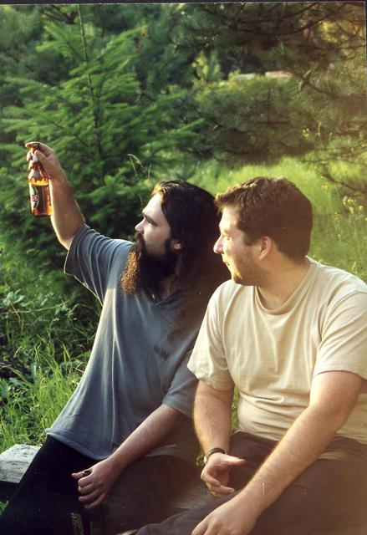

Vis-group Specifics
Group has distinct identity
Tight professional interaction
  Weekly meetings in the group
  Regular meetings with supervisor
  Yearly closed meeting
  Joint deadline frenzies
Tight social interaction
  Joint lunches
  Going for a fast beer
  Rejection parties
Senior PhD students act as role models
International composition

Slide 21
The End is Near
Interesting Links
  Silvia Miksch (http://www.ifs.tuwien.ac.at/%7Esilvia/research-tips/)
  Peter Eades (http://www.cs.usyd.edu.au/~peter/howtogetphdusyd.pps)
Solve relvant problems and enjoy your work
I never did a day's work in my life.
It was all fun.
[Thomas A. Edison]

Slide 22
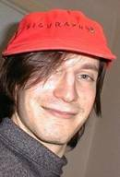
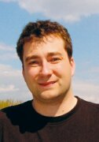
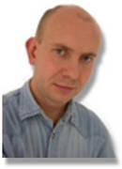
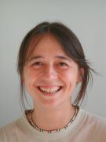
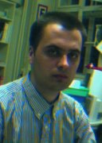
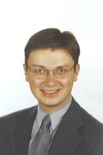
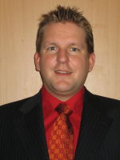
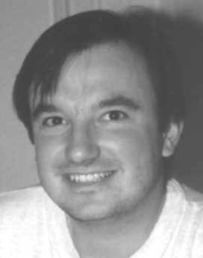
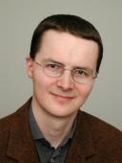
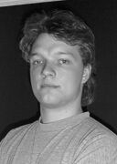
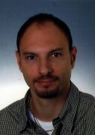
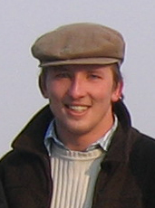
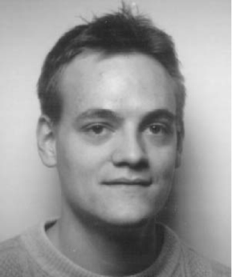
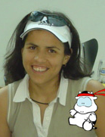

Good Luck for your PhD !!!
People from the vis-group that overcame

