Slide 1
Seminar aus Computergraphik 186.175, WS 2017/18, 2.0h (3 ECTS)
Stefan Ohrhallinger
Institute of Computer Graphics and Algorithms (E186)
Vienna University of Technology
http://www.cg.tuwien.ac.at/staff/StefanOhrhallinger.html

Slide 2
Important!
Register to course in TISS: to get news & updates
These slides will on the website after this meeting
Official registration: by submitting the literature list
Topics are presented and assigned here today

Slide 3
Seminar Goals
Practice selecting, reading and understanding
Search and select papers relevant to your topic
Summarize them as a state-of-the-art report
Prepare a talk about your topic in the seminar
This permits in-depth familiarization with the topic

Slide 4
Tasks
Submit a literature list (chosen with supervisor)
Attendance of 3 lectures
Meetings with supervisor: paper selection, discussion of papers, preparing talk slides
Alternative: evaluate and compare algorithms
Final talk in seminar

Slide 5
Literature List
Analyze recent papers (select with supervisor)
Study secondary literature to understand topic
How to find relevant papers:
SIGGRAPH Proceedings
Google Scholar: find the right key words
Survey papers, often-referenced papers
Submits a list of 10+ papers per email to supervisor & me → official registration

Slide 6
State-of-the-Art Report (STAR)
8 pages per student, preferably in english
Format in the style of a scientific paper
Use LaTeX template on course website
LaTeX tools and guides also on the website
Submit the draft in PDF format, per email to supervisor+organizer

Slide 7
Scientific Review
You will get a draft of another student to review
Typical conference review form (Eurographics)
This helps author to improve the manuscript
Guides on review writing on course website
You will receive 2 reviews (student, supervisor)
Improve final report according to reviews

Slide 8
Seminar Talk
Prepare slides in advance, using template
Each student talks for 15 minutes, english pref.
5 minutes discussion after each talk
Focus is on overview/comparison of methods
Present so that other students will understand it
Active discussion is mandatory and is graded
Submitted slides are presented on seminar PC

Slide 9
Grading
Lecture attendance 5%
Review: 20%
Seminar slides+talk: 30%, discussion 5%
Final report: 40%
Late submission: 15% off per day, max. 1 week

Slide 10
Important Dates
25.10. 23:59 Submit literature list (per email)
10.11. 14:00 – 16:00 Lecture Prof. Wimmer
23.11. 13:00 – 15:00 Lecture Prof. Gröller
29.11. 13:00 – 15:00 Lecture Prof. Purgathofer
04.12. 23:59 Submit report draft
18.12. 23:59 Submit review
24.01. 23:59 Submit slides
25.01. 09:00 – 13:00 Seminar talks
25.01. 23:59 Submit final report

Slide 11
Topic Presentation
Now 18 topics will be presented
After the presentation, please mark down at least 3 in order of preference (1, 2, 3, …)
I will try to make a fair assignment of topics

Slide 12
1 Light Painting for Lighting Design
Solve the Inverse Lighting Problem for 3D Scenes
Light Painting
Sketch Based Lighting
Lin, Wen‐Chieh, et al. "Interactive lighting design with hierarchical light representation." Computer Graphics Forum. Vol. 32. No. 4. Blackwell Publishing Ltd, 2013.
Katharina Krösl
Notes:
Talking points:
In Lighting Design for architectual scenes, games, or animated movies, a lighting designer or artist drafts a lighting concept for a 3D scene.
Computer-assisted lighting design aims to find a lighting configuration that best approximates the illumination effect specified by designers.
There are different approaches on how to solve the inverse lighting problem, like Light Painting or Sketch Based Lighting.
Research and survey the state of the art for such lighting design techniques.

Slide 13
2 Real-time Global Illumination
Radiosity
Raytracing
Quality versus Speed
GPU methods
Crassin, Cyril, et al. "CloudLight: A System for Amortizing Indirect Lighting in Real-Time Rendering." Journal of Computer Graphics Techniques Vol 4.4 (2015).
Katharina Krösl
Notes:
Talking points:
Global illumination in computer graphics has always been a challenging problem.
A number of global-illumination approaches are based on radiosity; raytracing; or hybrid methods like instant radiosity.
The objective of these methods is to render in real time or at least at interactive frame rates; under the constraint of image quality and speed.
Most enhanced adaptive photon tracing methods increase rendering time and memory consumption.
However, many progressive photon-tracing methods have reached interactive frame rates on the GPU.
Research and survey the state-of-the-art in real-time Global Illumination.

Slide 14
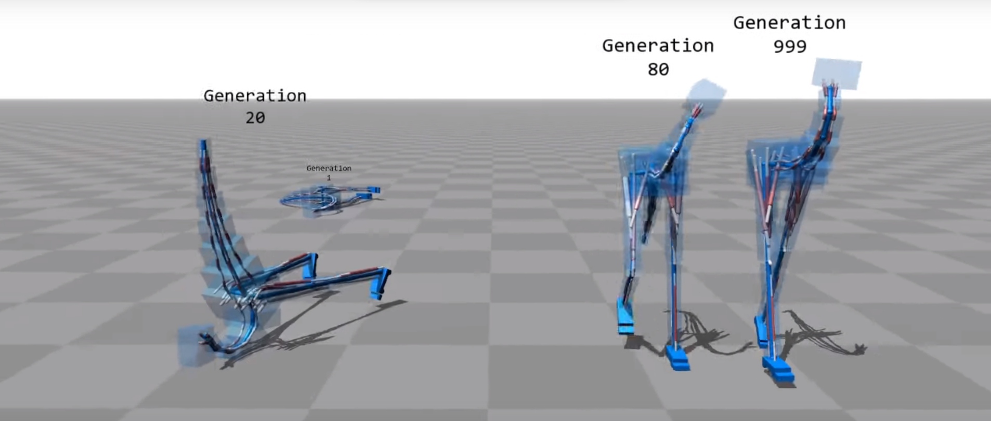
3 Reinforcement Learning in Graphics
Reinforcement learning is an amazing tool for optimizing the behavior of an agent in an enviroment. It is capable of playing computer games at a high level and also has applications in computer graphics. Check this out.
Károly Zsolnai-Fehér

Slide 15
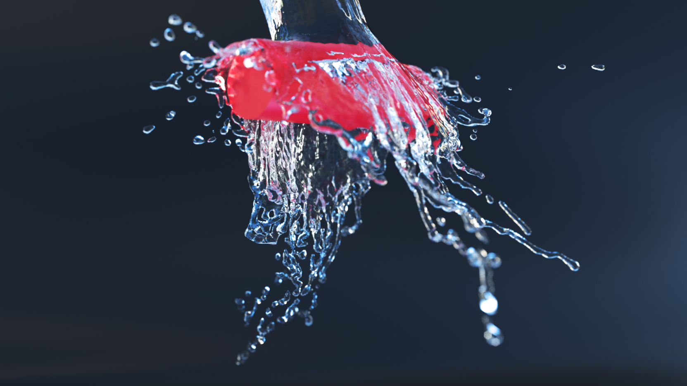
4 Neural Networks in Graphics
Neural networks are universal function approximators that are used to solve difficult problems in image and speech recognition, image synthesis, and many more. Check this out and see for yourself!
Károly Zsolnai-Fehér

Slide 16
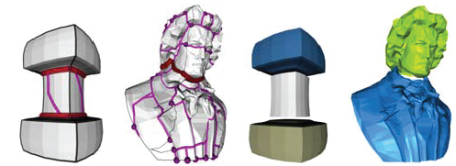
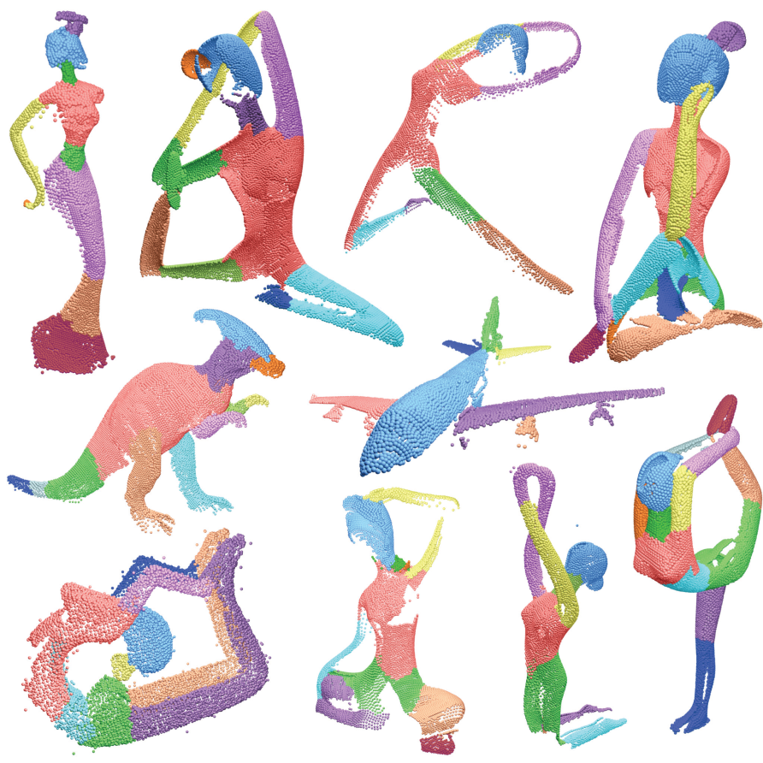
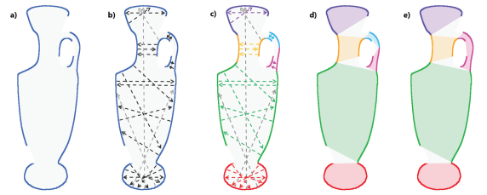
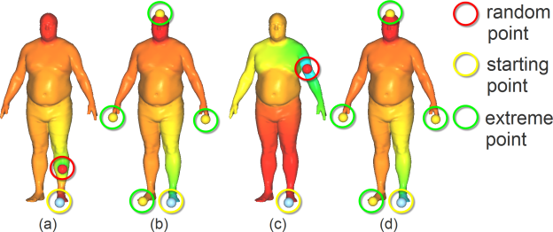
5 Shape Segmentation
Conduct a survey of shape segmentation methods.
Pocket cuts [Lien et al 2007]
Lines of sight [Kaick et al 2014]
Concavity aware fields [Au et al 2012]
Mohamed Radwan

Slide 17
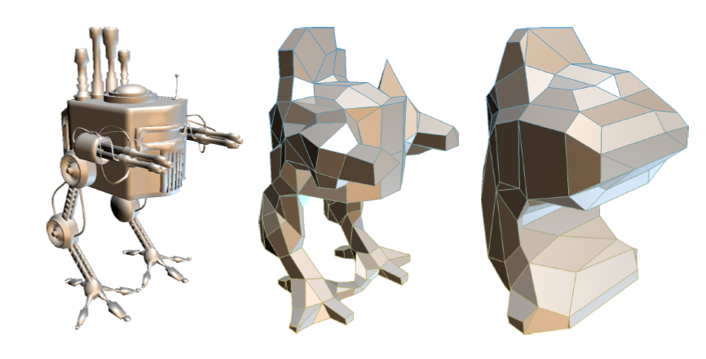
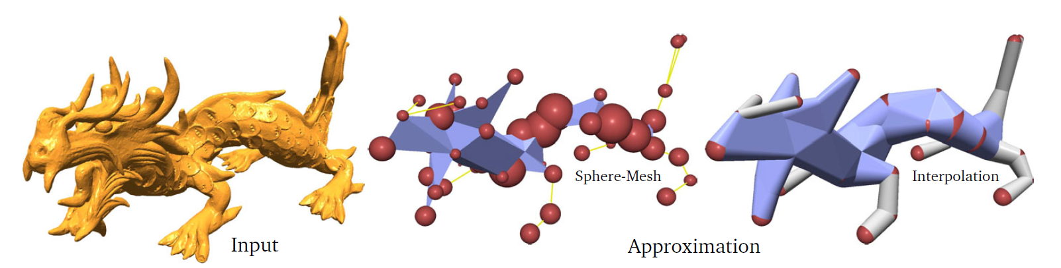
6 Shape Approximation
Mesh simplification
MAT, CSG
Bounding volumes
Sphere meshes
Bounding proxies
Bounding proxies. Calderon et al 2017.
Mohamed Radwan
Notes:
Talking points:
How to approximate a geometric data set with a simpler set of geometric primitives? Conduct a survey.
Simplification = older approach. mesh decimation algorithms
MAT = approximation with medial axis
CSG = (constructive solid geometry) representation by a tree of basic shapes and set operators
Bounding volumes = spheres, axis aligned BBs, ..etc. Detailed primitives bounded by larger ones.
Sphere meshes = recent approach. combines bounding spheres (via MAT) and simplification
Bounding proxies = recent approach focuses on “bounding”

Slide 18
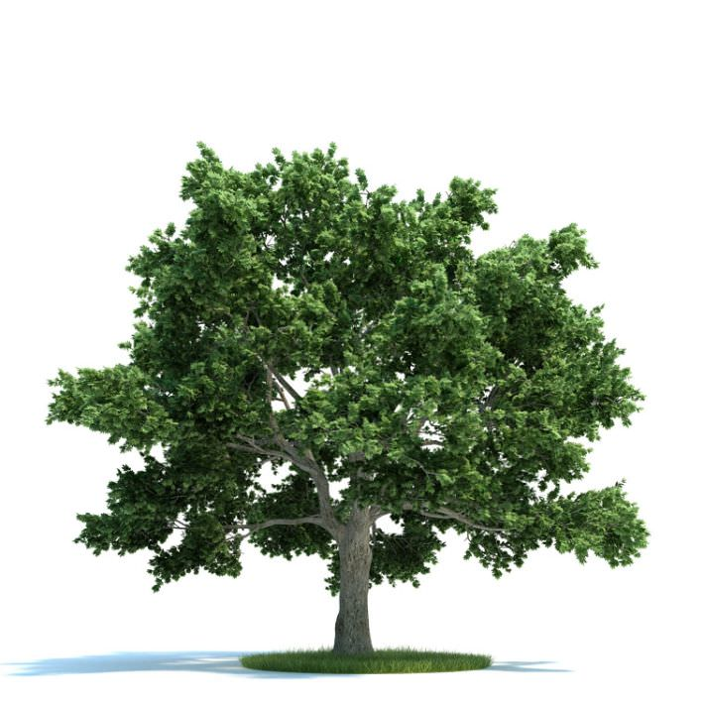

7 3D Model Compression
Detailed 3D models require a lot of space
Investigate 3D model compression techniques and their advantages (disk usage, load times, ...)
Markus Schütz
Notes:
Model compression is especially relevant for streaming assets over the web to browser based 3D-Applications.
Users have limited bandwidth and it‘s important to reduce load times.

Slide 19


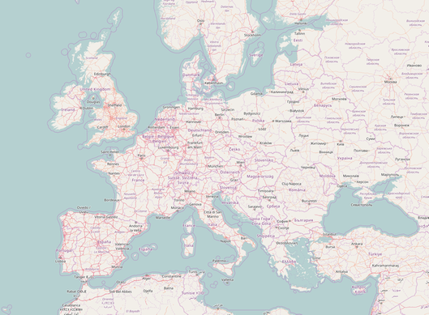
8 Level of Detail
Some models are too large to be loaded and rendered as a whole
LOD structures allow you to load and render only the essential parts of a model (or map)
Markus Schütz
Notes:
Level of Detail techniques and out-of-core rendering are increasingly important to deal with high-resolution and large-scale scans or game levels.
Google Maps is a 2-dimensional example for LOD
Google Earth is a 3-dimensional example

Slide 20
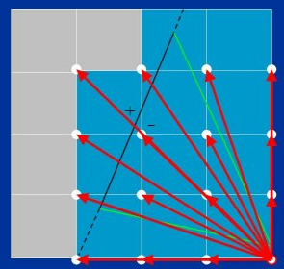
9 Hardware Algorithms for Rendering
Investigate how GPUs perform rasterization
  Tile-Based Rasterization
  Efficient Memory Patterns
Bernhard Steiner
Notes:
Talking points:
Modern graphics hardware provides a large set of algorithms for fast and efficient rasterization. Conduct a survey on recent advances in this area, including tiled rasterization and methods for memory friendly traversal.

Slide 21
10 Bending Active Structures
Survey about Bending
Active Structures
Design Methods
Form Finding
Bernhard Steiner
Notes:
Talking points:
Bending active structures are structures that keep their shape because they are under active stress. Designing and simulating such objects is a field where computer graphics can support architects and civil engineers. Investigate state-of-the-art methods in designing bending active surfaces and finding bending active structures for a given target shape.

Slide 22

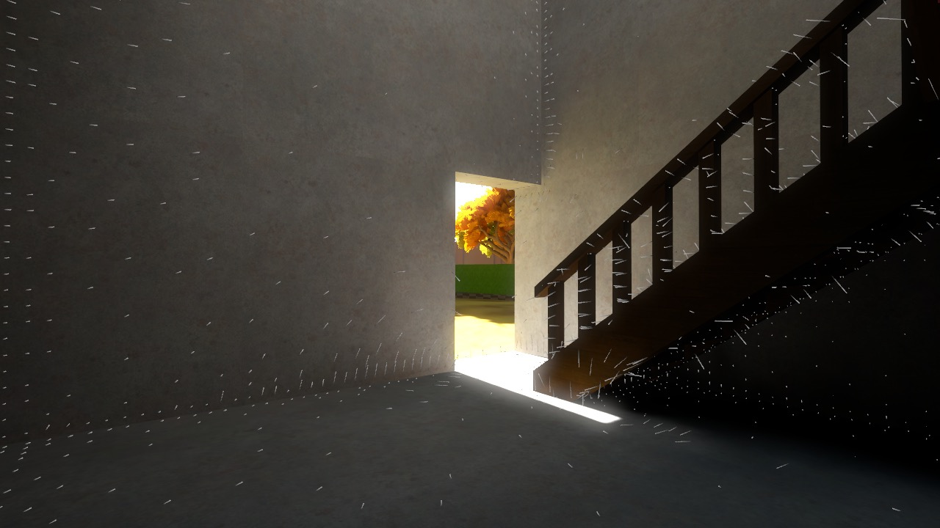
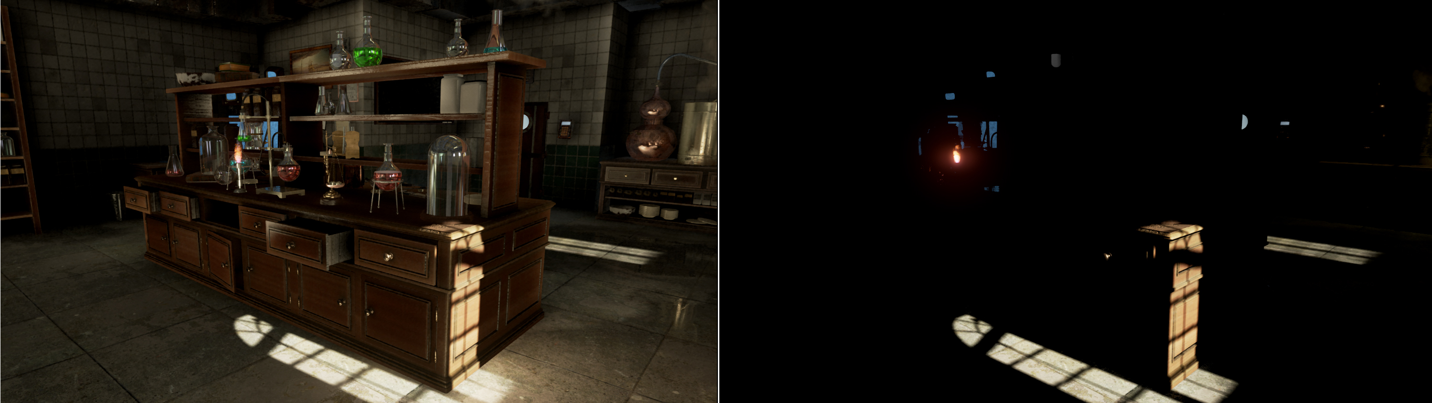

11 A Brief History of RT Global Illumination
provide an chronological overview of real-time global illumination techniques
Enlighten On
Enlighten Off
Hiroyuki Sakai

Slide 23
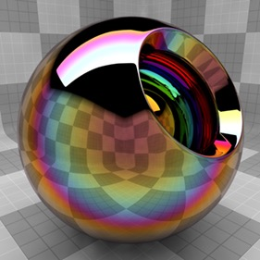
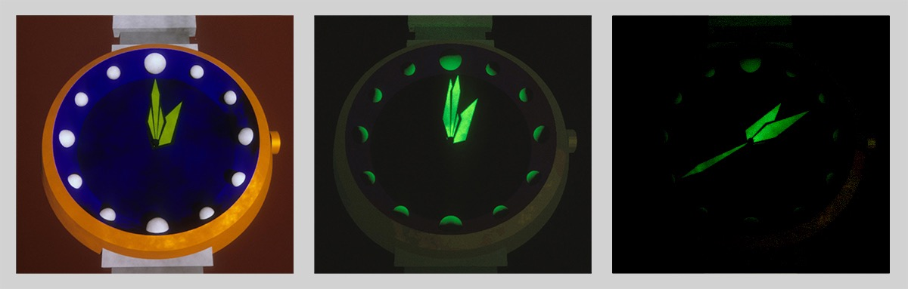
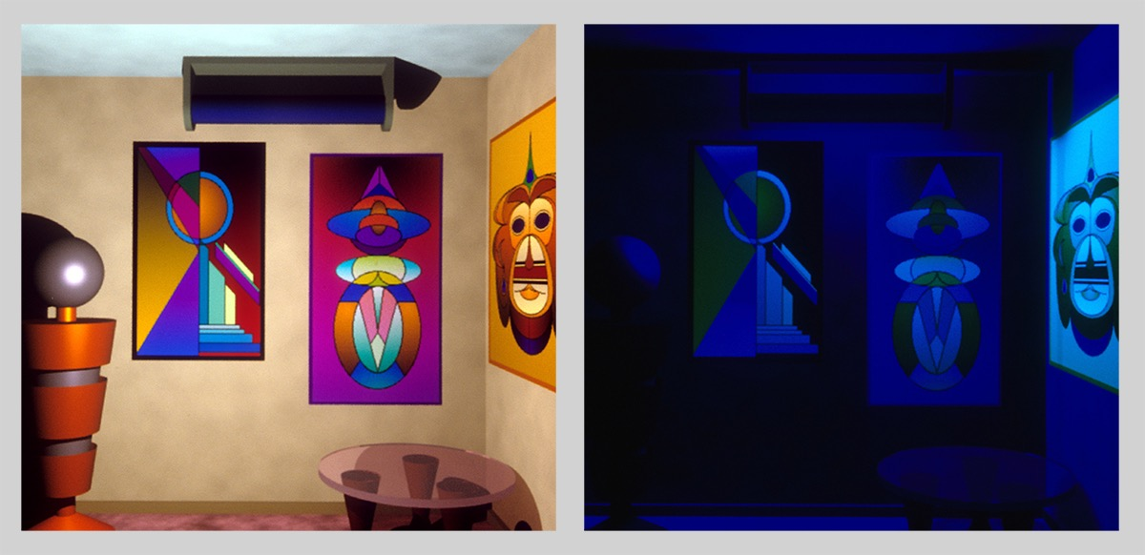
12 Physically Based Rendering Effects
provide an overview of techniques that can render specialized effects such as phosphorescence, fluorescence, chromatic abberation, lens flare, etc.
Hiroyuki Sakai

Slide 24
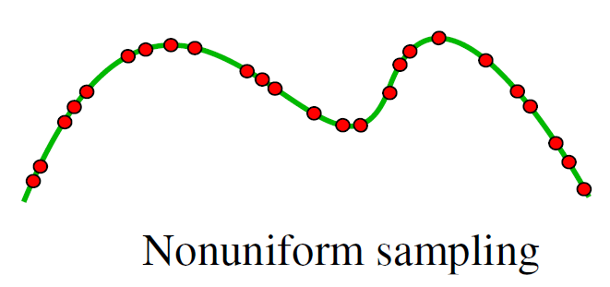
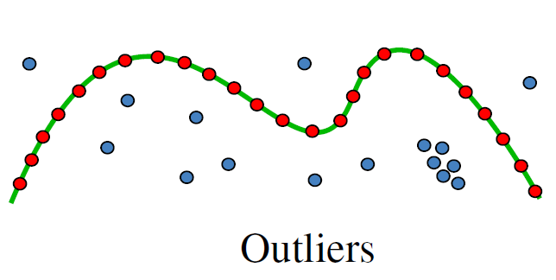
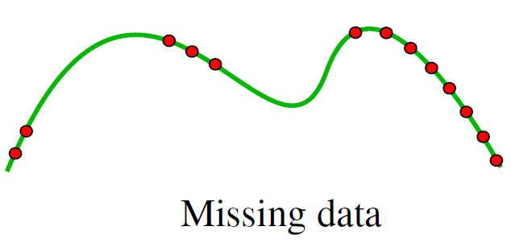
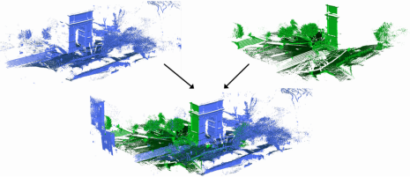
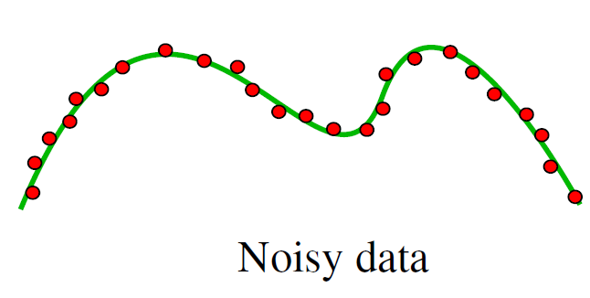
13 Point Cloud Registration
Merge laser scans
Match overlapping areas
Problem: sampling artifacts
Philipp Erler
Notes:
Talking points:
e.g. laser scan around house
Need multiple scans to cover all sides
Register overlapping areas
Right: typical artifacts of laser scans
Bottom; when the registration is done correctly
error should be minimal
difficulties e.g. through noise
should be fast (parallelizable for GPGPU)
several algorithms are available:
Iterative Closest Point (point-point vs point-plane)
Squared distance approximation (on demand vs d2Tree)
4-Points Congruent Sets (Keypoint-Based or not)
Robust point matching
Sorting the Correspondence Space
PCL Registration API
References:
"Registration of Point Cloud Data from a Geometric Optimization Perspective" by Mitra
"MARKERLESS POINT CLOUD REGISTRATION WITH KEYPOINT-BASED 4-POINTS CONGRUENT SETS" by Theiler
"New algorithms for 2D and 3D point matching: pose estimation and correspondence" by Golda
"Chapter 6: Sorting the Correspondence Space" by Assalih
Image sources:
"A Benchmark for Surface Reconstruction" by Berger et al.
https://www.ethz.ch/content/specialinterest/baug/institute-igp/photogrammetry-and-remote-sensing/en/research/completed_projects/automatic_registration_of_point_clouds.html

Slide 25
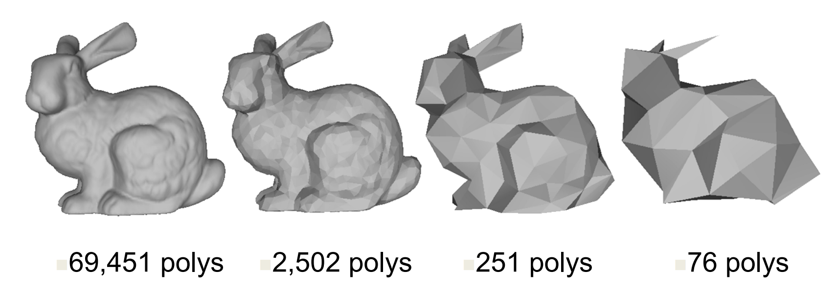
14 Level-of-Detail Systems for Meshes
Render only the necessary
Increase performance
Popping Artifacts
Philipp Erler
Notes:
Talking points:
We always need to increase the performance, especially in VR. Therefore, we render only as accurate as necessary. Can be defined by covered pixels on the screen and angle to camera.
LoD is e.g. geometric simplification and simpler shaders. Most interested in geometric simplification. Optimize visual quality for a given number of vertices. See images.
Discrete steps of LoD often used in games -> causes popping artifacts but is rather simple
More interested in continuous LoD (without popping) -> e.g. interpolate between LoDs, may require special data structures.
References:
Hoppe, H. Progressive meshes. Computer Graphics (SIGGRAPH’96 Proceedings) (1996), 99–108.
Hoppe, H. View-dependent refinement of progressive meshes. Computer Graphics (SIGGRAPH ’97 Proceedings) (1997), 189–198.
Hoppe, H. „Efficient Implementation of Progressive Meshes“ Technical Report MSR-TR-98-02, Microsoft Research, 1998 (also in SIGGRAPH '98 Course Notes 21 ).
Image source:
https://www.cs.purdue.edu/homes/aliaga/cs535-10/lec-lod.pdf

Slide 26
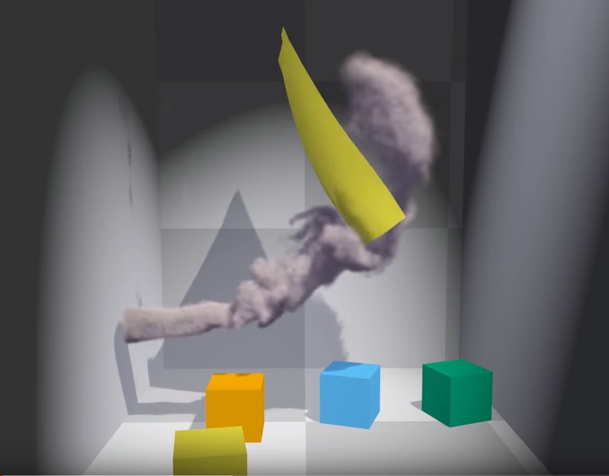
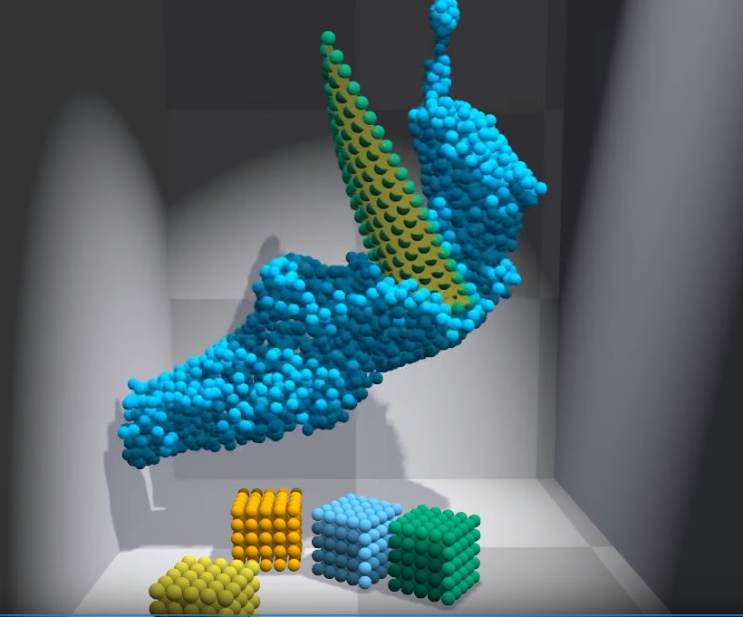
15 Position-Based Simulation Methods
Position-Based Dynamics
Set of particles connected
by constraints
Stable two-way interaction
of all object types
  Cloth
  Deformables
  Liquids
  Gases
  Rigid Bodies
Johannes Unterguggenberger
Notes:
Talking points:
Everything is a set of particles connected by constraints
Constraint types:
- Distance (clothing)
- Shape (rigids, plastics)
- Density (fluids)
- Volume (inflatables)
- Contact (non-penetration)
References:
Müller et al. 2006, Position Based Dynamics
Macklin and Müller 2013, Position Based Fluids
Bender, Müller, and Macklin 2017, A Survey on Position Based Dynamics

Slide 27
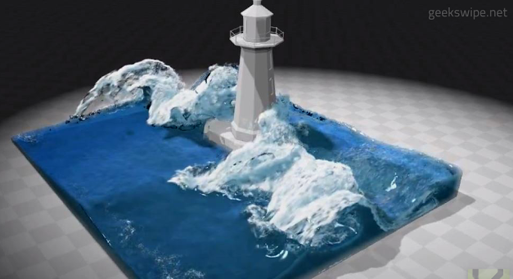
16 Real-Time Fluid Simulation
State of the art report about real-time fluid simulation techniques
  Position-Based Fluids
  Fluid-Implicit-Particle methods
  Data-Driven Fluid Simulations
  ...
Johannes Unterguggenberger
Notes:
Talking points:
Position-Based Fluids, based on Position Based Dynamics, used in Nvidia Flex
Fluid-Implicit-Particle methods; simulates on both, grid and particles; used in Nvidia Cataclysm
Data-driven fluid simulations, Machine Learning, PHYSICSFORESTS.com
References:
Macklin and Müller 2013, Position Based Fluids
Bridson 2008, Fluid Simulation for Computer Graphics
Ladický et al. 2015, Data-Driven Fluid Simulations using Regression Forests

Slide 28
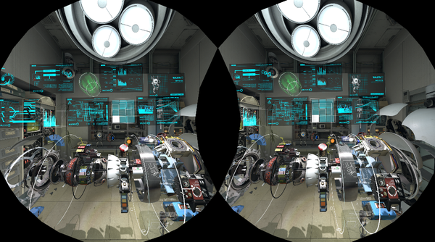
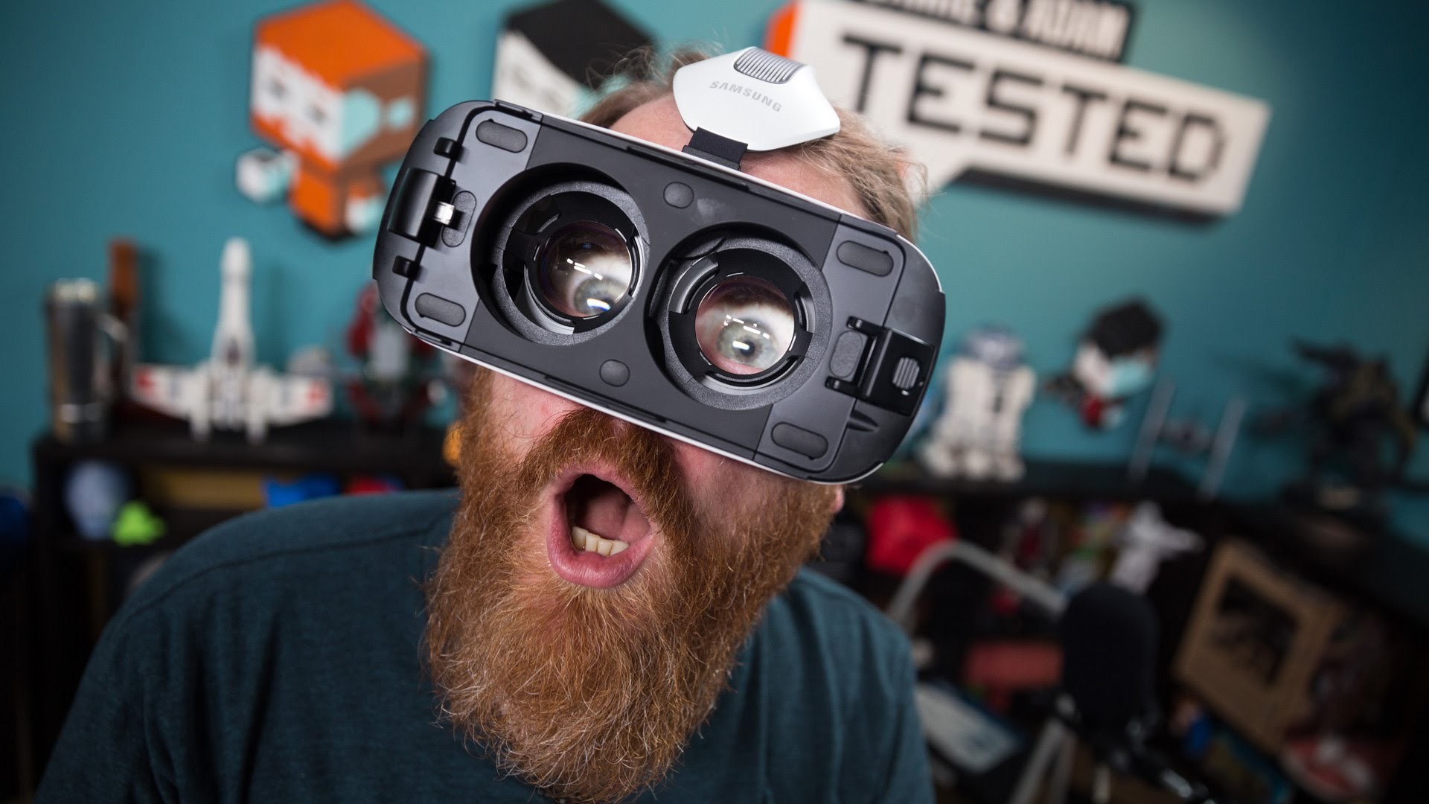
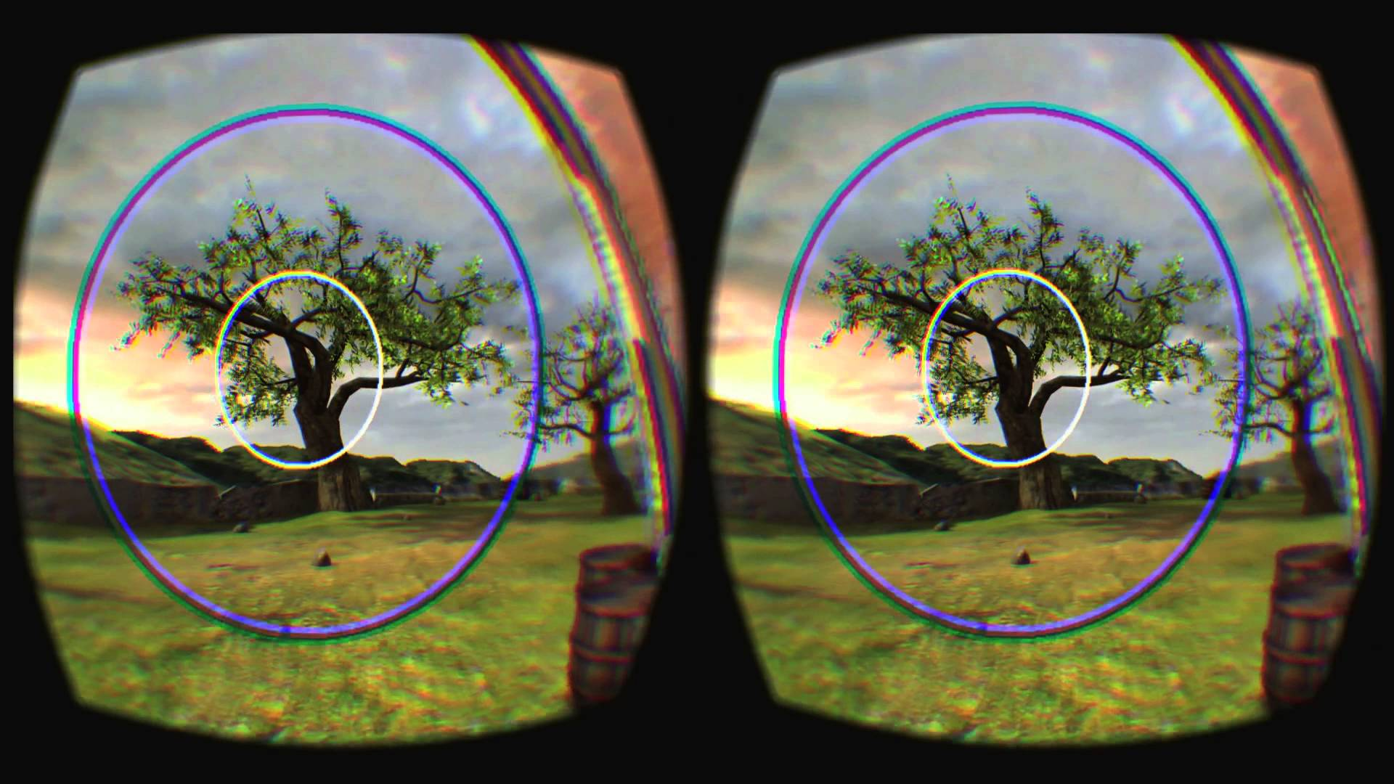
17 VR Rendering
Conduct a survey on
recent advances
in rendering for VR.
Christian Freude
Notes:
With the advent of new affordable consumer VR Headsets, like the Oculus and Vive, VR is becoming more and more popular.
VR Rendering poses additional challenges and constraints on performance and rendering quality, so more and more methods are developed to address this aspects.

Slide 29
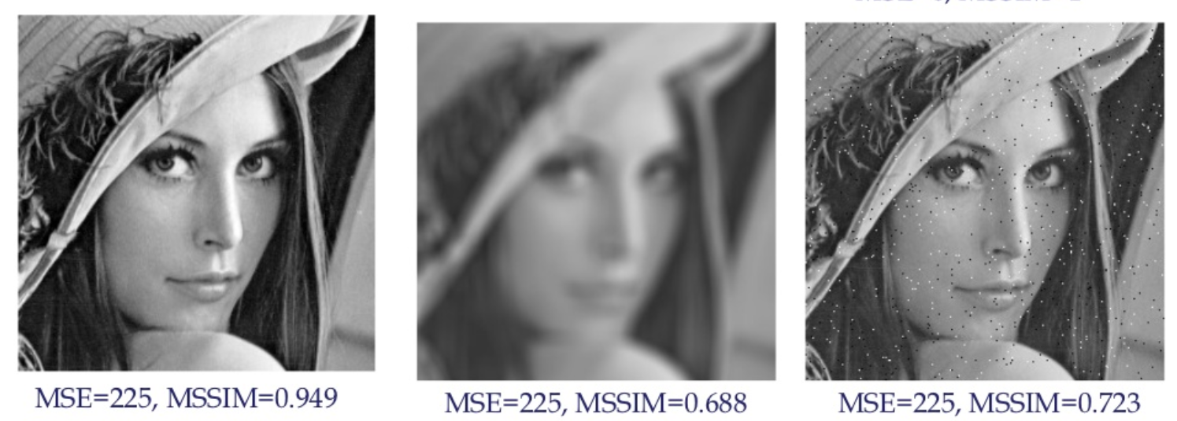
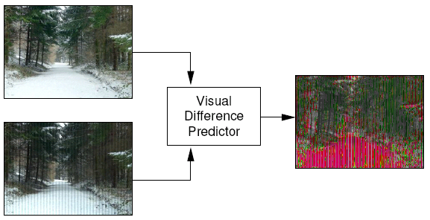
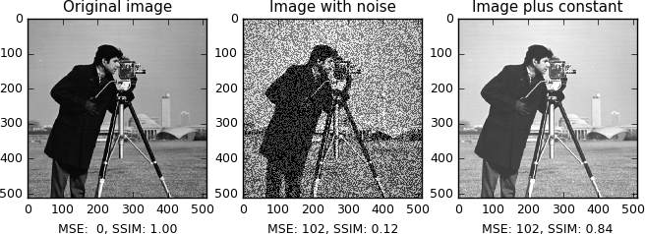
18 Image Quality Metrics
Conduct a survey on
image comparison
and quality metrics.
Christian Freude
Notes:
Image comparison is a very common task in many scientific fields, and suitable metrics are necessary.
Since the Mean-Squared-Error is often not suitable, different, sometimes also perceptual, approaches have been developed,
that better represent the visual differences perceived by a human observer.

Slide 30
Topic Assignment
Please mark at least 3 topics in order of preference (1, 2, 3, …), with your name, email and student number
Hand in the sheet
Then I will assign the topics on the spot

Slide 31
Questions?
Get in contact with your supervisor ASAP
Discuss literature list with your supervisor
Submit the list (to both me and supervisor) per email by 25.10.

