Slide 1
Seminar aus Computergraphik 186.175, WS 2016/17, 2.0h (3 ECTS)
Stefan Ohrhallinger
Institute of Computer Graphics and Algorithms (E186)
Vienna University of Technology
http://www.cg.tuwien.ac.at/staff/StefanOhrhallinger.html

Slide 2
Important!
Register to course in TISS: to get news & updates
These slides will on the website after this meeting
Official registration: by submitting the literature list
Topics are presented and assigned here today

Slide 3
Seminar Goals
Practice selecting, reading and understanding
Search and select papers relevant to your topic
Summarize them as a state-of-the-art report
Prepare a talk about your topic in the seminar
This permits in-depth familiarization with the topic

Slide 4
Tasks
Submit a literature list (chosen with supervisor)
Attendance of 3 lectures
Meetings with supervisor: paper selection, discussion of papers, preparing talk slides
Write a report draft
Review a colleague’s paper
Alternative: evaluate and compare algorithms
Final talk in seminar

Slide 5
Literature List
Analyze recent papers (select with supervisor)
Study secondary literature to understand topic
How to find relevant papers:
SIGGRAPH Proceedings
Google Scholar: find the right key words
Survey papers, often-referenced papers
Submits a list of 10+ papers per email to supervisor & me → official registration

Slide 6
State-of-the-Art Report (STAR)
8 pages per student, preferably in english
Format in the style of a scientific paper
Use LaTeX template on course website
LaTeX tools and guides also on the website
Submit the draft in PDF format, per email to supervisor+organizer

Slide 7
Scientific Review
You will get a draft of another student to review
Typical conference review form (Eurographics)
This helps author to improve the manuscript
Guides on review writing on course website
You will receive 2 reviews (student, supervisor)
Improve final report according to reviews

Slide 8
Seminar Talk
Prepare slides in advance, using template
Each student talks for 15 minutes, english pref.
5 minutes discussion after each talk
Focus is on overview/comparison of methods
Present so that other students will understand it
Active discussion is mandatory and is graded
Submitted slides are presented on seminar PC

Slide 9
Grading
Lecture attendance 5%
Review: 20%
Seminar slides+talk: 30%, discussion 5%
Final report: 40%
Late submission: 15% off per day, max. 1 week

Slide 10
Important Dates
26.10. 23:59 Submit literature list (email to me)
13.10. 15:00 – 17:00 Lecture Prof. Wimmer
09.11. 13:00 – 15:00 Lecture Prof. Gröller
30.11. 13:00 – 15:00 Lecture Prof. Purgathofer
07.12. 23:59 Submit report draft
21.12. 23:59 Submit review
22.01. 23:59 Submit slides (per email)
23.01. 10:00 – 18:00 Seminar talks
23.01. 23:59 Submit final report

Slide 11
Topic Presentation
Now 18 topics will be presented
After the presentation, please mark down at least 3 in order of preference (1, 2, 3, …)
I will try to make a fair assignment of topics

Slide 12
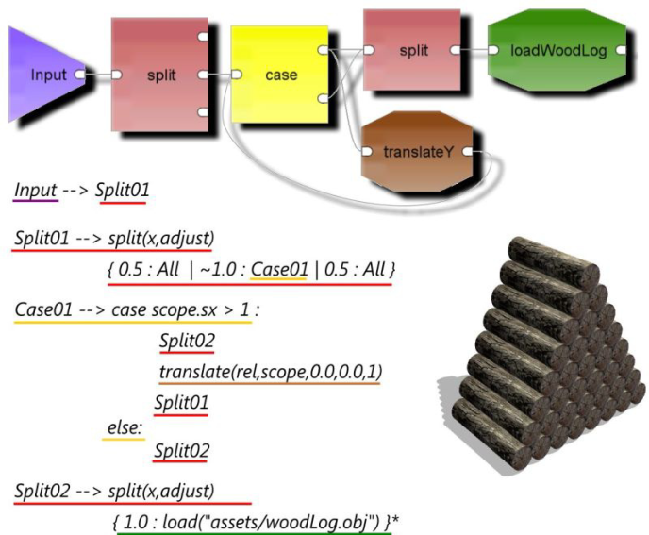
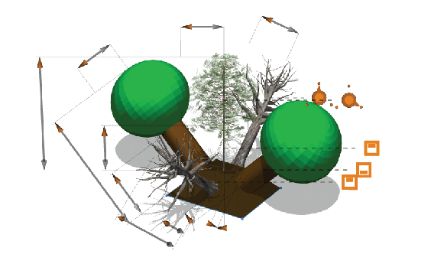
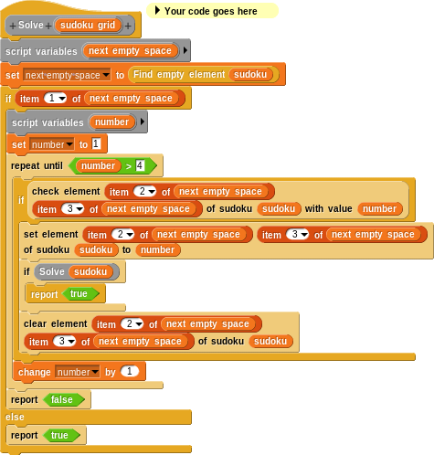
1 Visual Interfaces for Procedural Models
Grammar-based modeling = programing.
How to change it?
Handles
Node editors
VPLs
Martin Ilcik
Notes:
Talking points:
Procedural modeling means writing of scripts and code. Of course that is the main obstacle for artists. Analyze existing methods that substitute programming by visual editing. By critical analysis of the STAR, try to develop an own suggestion for a non-programming interface.
Handles = Parametric models can be manipulated by handles. Spatial placement and alignment of the handles is not trivial.
Node editors = Visualize the modeling flow, however they often loose features like non-determinism and Turing completeness.
VPLs = Visual programming languages of all kinds.
Very good understanding of the theory around formal grammars and programming languages required.
References:
Lipp et al. 2008 Interactive Visual Editing of Grammars for Procedural Architecture
Resnick et al. 2009 Scratch: programming for all
Myers and Baniassad 2009 Silhouette: visual language for meaningful shape
Silva et al. 2013 Node-based Shape Grammar Representation and Editing
Kelly et al. 2015 Interactive Dimensioning of Parametric Models

Slide 13
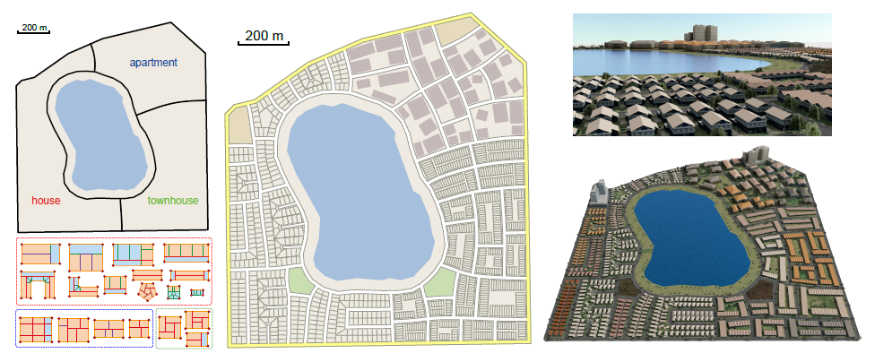
2 Layouts Generation for Cities
Multi-scale
Constraints
Optimization
Martin Ilcik
Notes:
Talking points:
Procedural generation of cities involves heavy layout operations on different scales: districts, streets, blocks, parcels, etc. The main constraint is always the boundary polygon. Further constraints involve the number, shapes and topology of regions of the partition. Further attributes and relations can be defined to asses the quality of a generated solution. We mostly end up solving a non-convex optimization problem with many constraints. The student should map the existing methods and their interfaces, provide a comparison and look for potential improvements.
Parish and Müller 2001: Procedural modeling of cities
Lechner et al 2006: Procedural modeling of urban land use
Groenewegen et al. 2009: Procedural City Layout Generation Based on Urban Land Use Models
Lipp et al. 2011: Interactive Modeling of City Layouts using Layers of Procedural Content
Vanegas et al. 2012: Procedural Generation of Parcels in Urban Modeling
Yang et al. 2013 Urban Pattern: Layout Design by Hierarchical Domain Splitting
Schwarz and Müller 2015: Advanced modeling of architecture

Slide 14
3 Physically Based Shading for Games
Investigate physically based illumination models for games
  Microfacet BRDFs
  Image-based lighting
Bernhard Steiner
Notes:
Talking points:
On the way to realistic looking games, choosing the best illumination model is crucial. Nowadays most game engines use physically based microfacet brdfs. In this paper the current state of the art in using these models
should be reviewed together with image based lighting approaches to allow for reflective surfaces.

Slide 15
4 Design of structurally sound buildings
Conduct a survey of
recent advances in
Structural optimization for buildings/bridges etc.
Modelling of plausible buildings
Bernhard Steiner
Notes:
Talking points:
Constructing not only good looking but also structural plausible 3d buildings is a great challenge in computational modelling.
Review approaches that deal with structural optimization of existing buildings or with the generation of new ones.

Slide 16
5 Light Painting for Lighting Design
Solve the Inverse Lighting Problem for 3D Scenes
Light Painting
Sketch Based Lighting
Lin, Wen‐Chieh, et al. "Interactive lighting design with hierarchical light representation." Computer Graphics Forum. Vol. 32. No. 4. Blackwell Publishing Ltd, 2013.
Katharina Krösl
Notes:
Talking points:
In Lighting Design for architectual scenes, games, or animated movies, a lighting designer or artist drafts a lighting concept for a 3D scene.
Computer-assisted lighting design aims to find a lighting configuration that best approximates the illumination effect specified by designers.
There are different approaches on how to solve the inverse lighting problem, like Light Painting or Sketch Based Lighting.
Research and survey the state of the art for such lighting design techniques.

Slide 17
6 Real-time Global Illumination
Radiosity
Raytracing
Quality versus Speed
GPU methods
Crassin, Cyril, et al. "CloudLight: A System for Amortizing Indirect Lighting in Real-Time Rendering." Journal of Computer Graphics Techniques Vol 4.4 (2015).
Katharina Krösl
Notes:
Talking points:
Global illumination in computer graphics has always been a challenging problem.
A number of global-illumination approaches are based on radiosity; raytracing; or hybrid methods like instant radiosity.
The objective of these methods is to render in real time or at least at interactive frame rates; under the constraint of image quality and speed.
Most enhanced adaptive photon tracing methods increase rendering time and memory consumption.
However, many progressive photon-tracing methods have reached interactive frame rates on the GPU.
Research and survey the state-of-the-art in real-time Global Illumination.

Slide 18
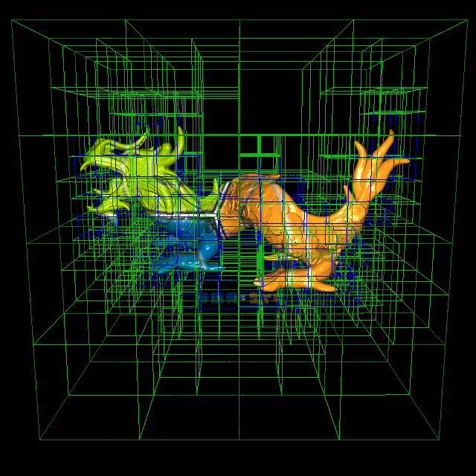
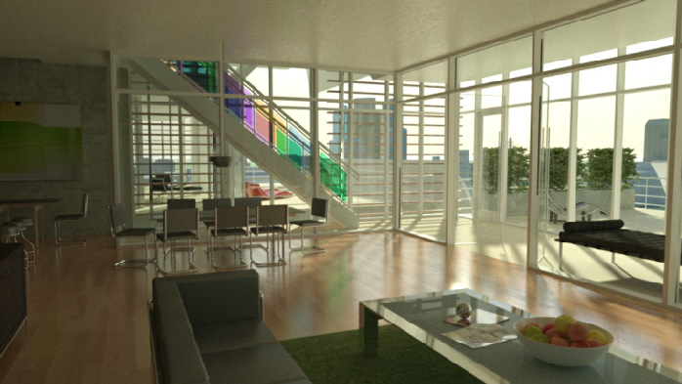
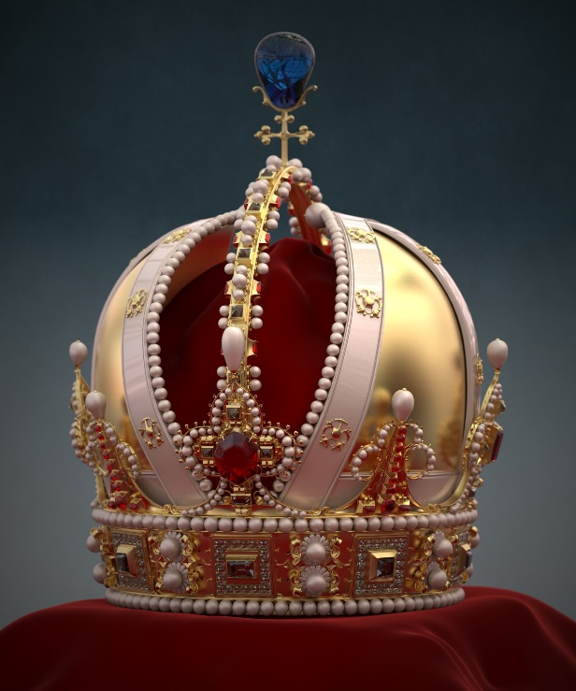
7 Acceleration of Ray Tracing
Conduct a survey of recent advances in the acceleration of ray tracing
Christian Freude
Notes:
Talking points:
To render photorealistic images it is usually necessary to simulate a vast amount of light rays
and their interaction with the materials and surfaces of a virtual scene.
In order to render such images in a reasonable amount of time
it is necessary to accelerate the computations by using efficient algorithms,
special data structures or advanced hardware.

Slide 19
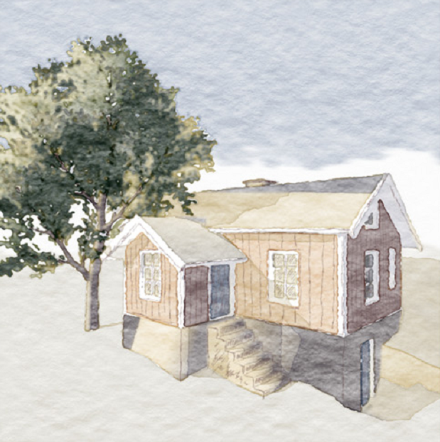
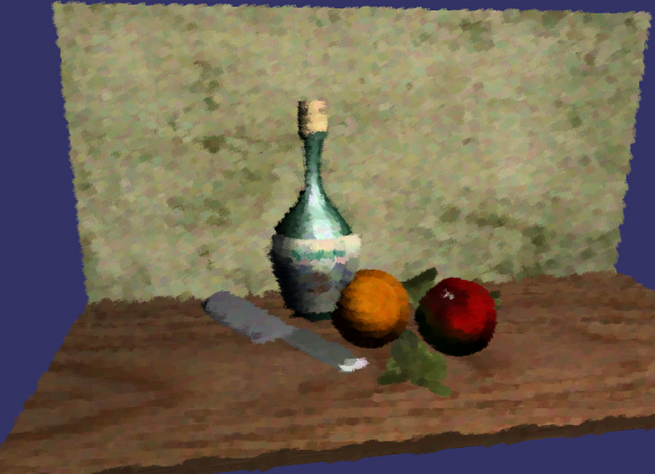
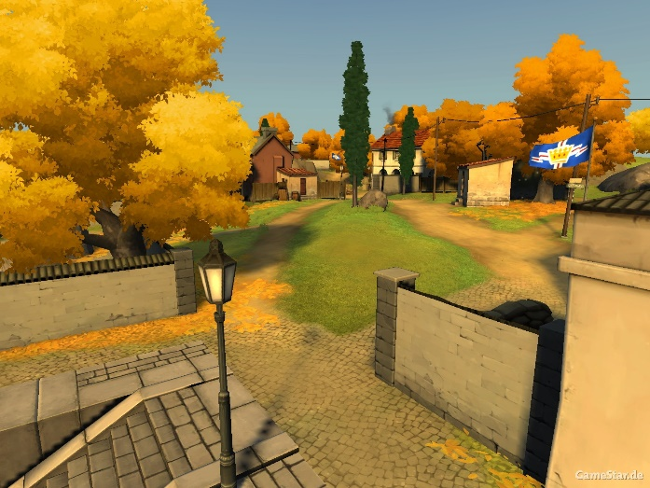
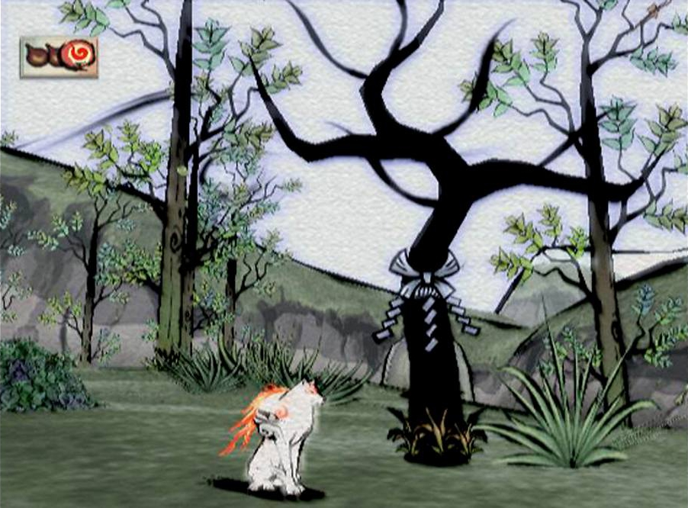
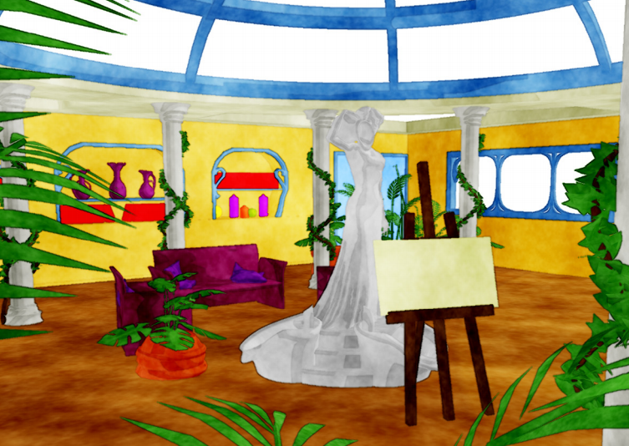
8 NPR in Real Time
Conduct a survey of recent advances in real-time non-photorealistic rendering
Christian Freude
Notes:
Talking points:
In computer graphics it is often the goal to render realistic looking images,
and in recent years even real-time renderings are approaching photorealism.
So with this goal nearly reached, it often becomes desirable to explore the potential of
non-photorealistic rendering, e.g. the reproduction of a particular artistic style.

Slide 20

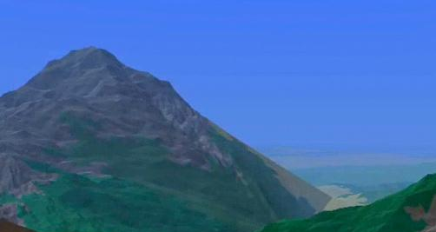
9 Fractal Image Compression
Fractal Geometry
State-of-the-art methods to improve speed
Comparison with other image compression techniques
Jeremy Forsythe
Notes:
Talking points:
Fractals have an important property of self-similarity, exactly as we can find in nature’s clouds, asteroids and plants.
These ideas suggest potential uses in the pursuit of teaching computers how to ‘see’ the world around us.
This topic is offered to look at the state-of-the-art fractal geometry techniques and how we can overcome hardware limitations to pursue real-world applications.

Slide 21
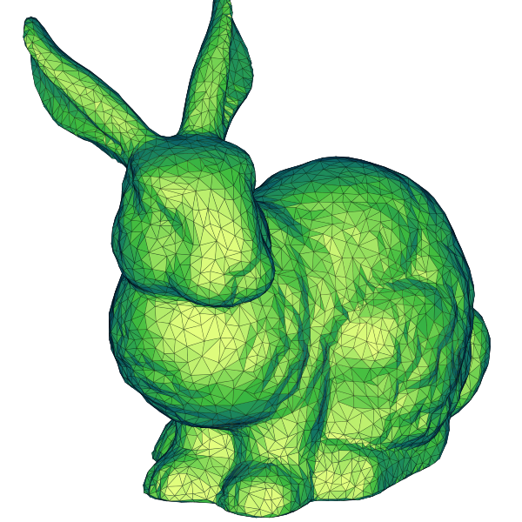
10 Surface Reconstruction
Compare state-of-the-art algorithms
Evaluate pros and cons of different approaches
Will improve knowledge in:
  Computational Geometry
  Computer Graphics!
Jeremy Forsythe
Notes:
Talking points:
The problem of reconstructing surfaces computationally using real-world data is well studied, however there are a variety of different approaches.
Advances in surface reconstruction techniques can be compared using the latest benchmark which includes 3 key quality measures.
(Mean distance, Hausdorff distance, Mean angle deviation...)
We aim to use this data to determine the current state-of-the-art.

Slide 22
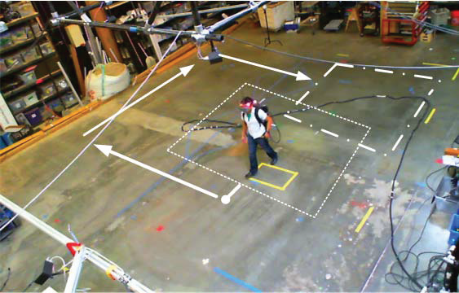
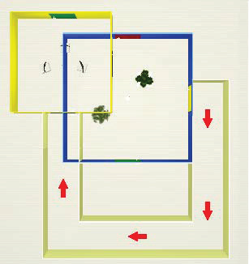
11 Walking in Virtual Environments
How virtual spaces are formed with respect to real space
Effects on human perception
Mohamed Radwan
Notes:
Talking points:
Current trend in computer graphics is the evolution from the generations of images to the generation of reality.
You can see it as the future of 3D printing.

Slide 23
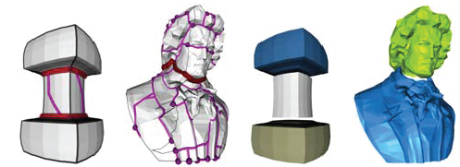
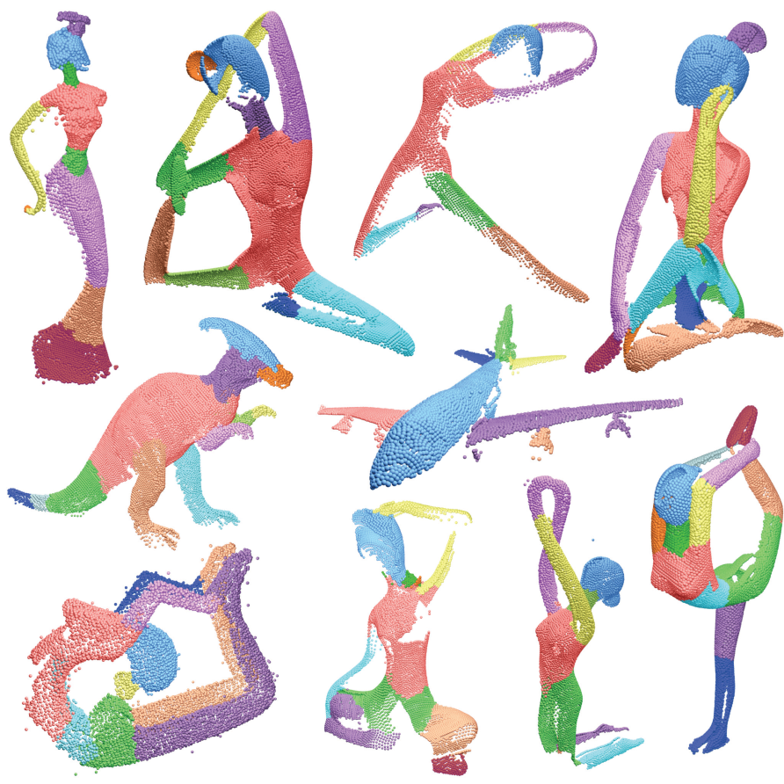
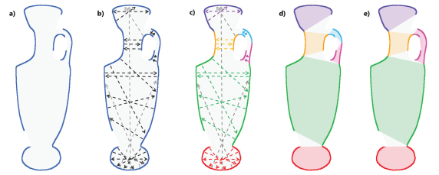
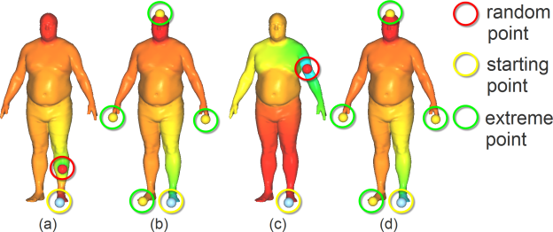
12 Convex Decomposition
Conduct a survey of convex decomposition methods.
Pocket cuts [Lien et al 2007]
Lines of sight [Kaick et al 2014]
Concavity aware fields [Au et al 2012]
Mohamed Radwan

Slide 24
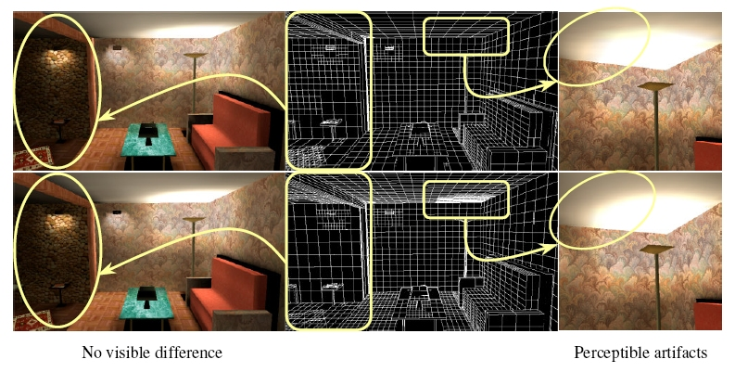
13 Perceptual Methods in Global Illumination
Write a state-of-the-art report about methods that exploit perceptual aspects for rendering global illumination
Hiroyuki Sakai

Slide 25
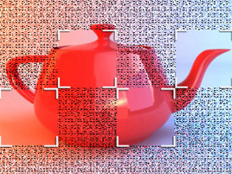
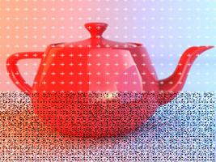
14 The State of the Art in GPU Ray Tracing
Write an overview of current GPU ray tracing solutions
Consider advantages and disadvantages compared to CPU methods
Hiroyuki Sakai

Slide 26
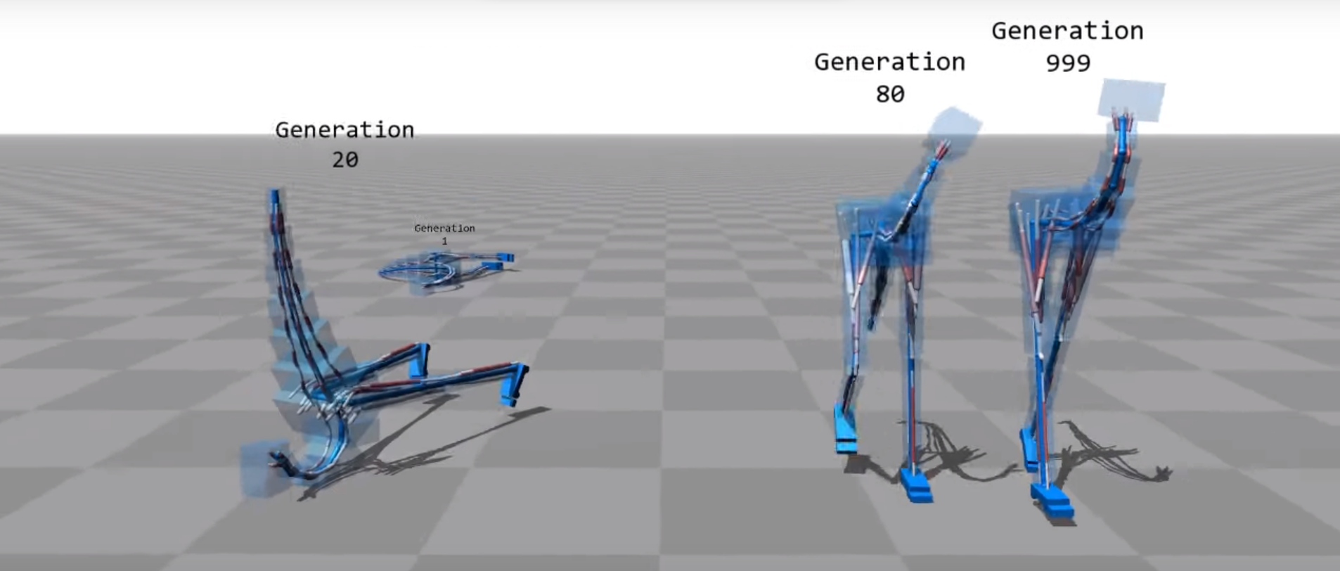
15 Reinforcement Learning in Graphics
Reinforcement learning is an amazing tool for optimizing the behavior of an agent in an enviroment. It is capable of playing computer games at a high level and also has applications in computer graphics. Check this out.
Károly Zsolnai-Fehér

Slide 27
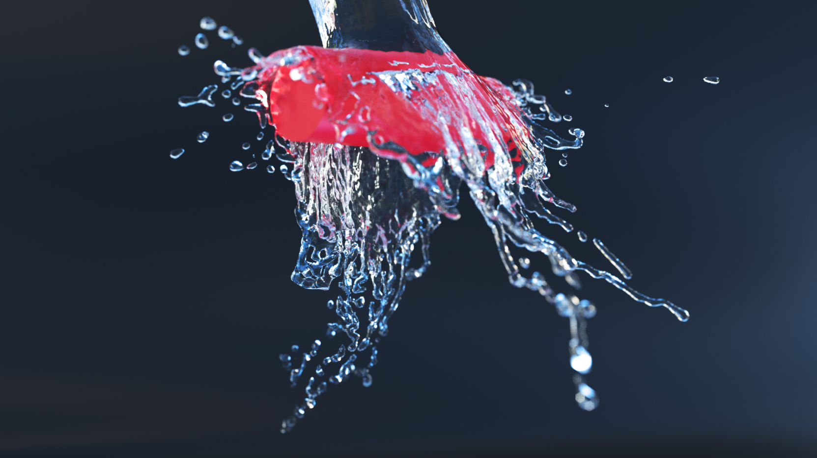
16 Neural Networks in Graphics
Neural networks are universal function approximators that are used to solve difficult problems in image and speech recognition, image synthesis, and many more. Check this out and see for yourself!
Károly Zsolnai-Fehér

Slide 28
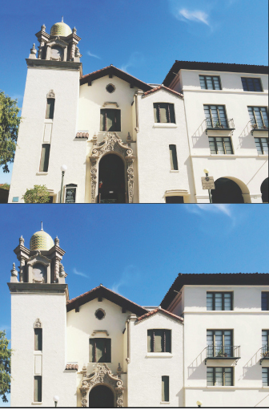
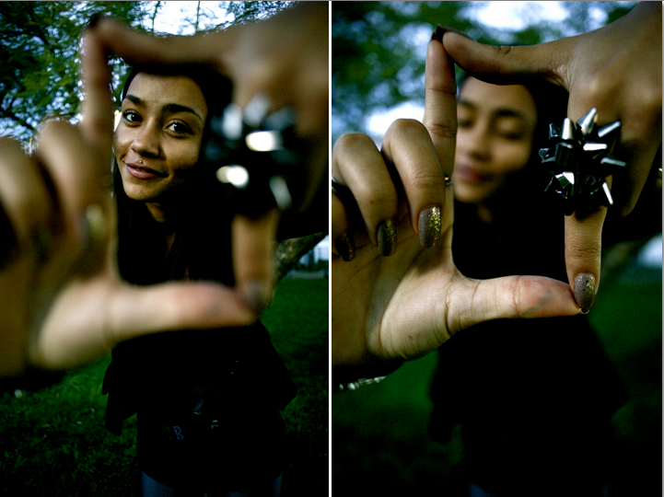
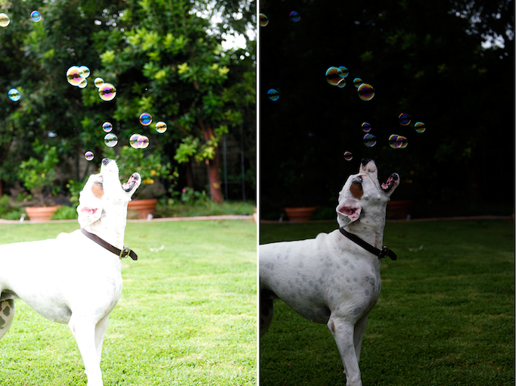
17 Improve Photos using Depth
Smartphones can soon take RGBD images.
Can depth segmentation correct these errors?
depth-of-field perspective overexposure
Stefan Ohrhallinger

Slide 29
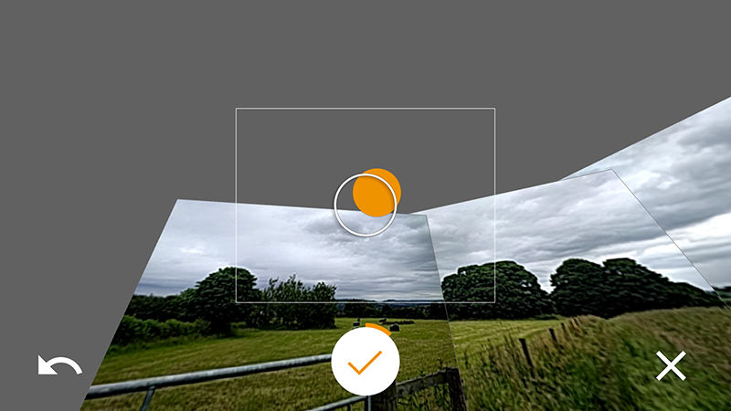
18 Non-Spherical Virtual Tours
360°-photos are nowadays easy to generate.
How about more complex scenes, using depth?
Stefan Ohrhallinger

Slide 30
Topic Assignment
Please mark at least 3 topics in order of preference (1, 2, 3, …), with your name
Hand in the sheet
Then I will assign the topics on the spot

Slide 31
Questions?
Get in contact with your supervisor ASAP
Discuss literature list with your supervisor
Submit the list (to me and supervisor) per email by 26.10.

