Slide 1
186.175 Seminar aus Computergraphik 186.046 Seminar aus Visualisierung SS 2018
Organizer: Hsiang-Yun Wu and Peter Mindek
Teaching staff: Manuela Waldner, Renata Raidou, Tobias Klein, Haichao Miao, David Kouřil, Christoph Heinzl, Ivan Viola, and Eduard Gröller
Institute of Visual Computing&Human-Centered Technology
TU Wien, Austria

Slide 2
Seminar
Get an idea how scientific work is carried out (in CG)
Practice to review literature and get familiar with a particular scientific topic
Selecting, reading and understanding
Summarizing and explaining (orally and written)
Comparing and discussing
Write a review on a paper
Practice to give a talk

Slide 3
Seminar
Select a topic

Slide 4
Topic
Students can work alone or in groups of 2
State-of-the-Art
TUWEL: https://tuwel.tuwien.ac.at/course/view.php?id=13424
wu@cg.tuwien.ac.at
Important!!
Register your topic on TU WEL
Registration start: 6th March 2018, 22:00 (Today!!)
Registration due to:
23th March 2018, 23:59
First come first serve

Slide 5
Seminar
Select a topic
Submit list of literature
It is better that you confirm the list with your supervisor
Expected 5 papers

Slide 6
Literature List
List of papers related to the topic
Seminar subscription
23.03.2018: List of literature submission deadline

Slide 7
Seminar
Select a topic
Submit list of literature
Attend 3 lectures
All three lectures will be held in ICGA seminar room

Slide 8
Attend 3 Lectures
10.04.2018 15:00 - 16:30 (s.t.)
Wie schreibt man eine wissenschaftliche Arbeit
Professor Wimmer
25.04.2018 15:00 - 16:30 (s.t.)
Forschung und wie sie funktioniert
Professor Gröller
15.05.2018 16:30 - 17:30 (s.t.)
Wie halte ich einen Vortrag
Professor Purgathofer

Slide 9
Seminar
Select a topic
Submit list of literature
Attend 3 lectures
Write report (draft version)

Slide 10
Report
State-of-the-Art report
Final report: 8 pages (16 pages / group)
In English
Regular meetings with supervisor
Format as for a scientific paper
LaTeX (Template on the wepage)
22.04.2018: Draft report submission deadline

Slide 11
Seminar
Select a topic
Submit list of literature
Attend 3 lectures
Write report (draft version)
Write review

Slide 12
Review
Review paper of other student (or group of students)
Fill out review form (will be sent by e-mail)
25.04.2018: Receive a review form and a report from another student.
18.05.2018: Review submission deadline

Slide 13
Seminar
Select a topic
Submit list of literature
Attend 3 lectures
Write report (draft version)
Write review
Refine report

Slide 14
Seminar
Select a topic
Submit list of literature
Attend 3 lectures
Write report (draft version)
Write review
Refine report
Give a talk

Slide 15
Talk
Use institute’s PowerPoint template for presentations (template is on the webpage)
20 + 5 minutes
In English
Active discussion participation
07.06.2018: Presentation submission deadline
14.06.2018, 9:00 s.t. – 18:00: Talks
Will be held in ICGA seminar room Seminar room 183/2 (HA 04 03) [new institute number 193/1] (Favoritenstr. 9-11 / 4.floor).

Slide 16
Seminar
Select a topic
Submit list of literature
Attend 3 lectures
Write report (draft version)
Write review
Refine report
Give a talk
Submit final version

Slide 17
Report
State-of-the-Art report
8 pages (15-16 pages if working in a group)
In English
Format reports in the style of a scientific paper
Use LaTeX (template is on the webpage)
24.06.2018: Final report submission deadline

Slide 18
Grading
It is necessary to attend the 3 lectures to get a positive grade!
Grading criteria:
40% written report
30% presentation
20% review
5% attendance during the presentations
5% active discussion after the presentations

Slide 19
Anyway…

Slide 20
Report Grading
Grading criteria:
Structure, figures,...
Language
Content
References
Points will be deducted for:
Delayed submission
Page number below 8 (16)
Plagiarism check!

Slide 21
Plagiarism
“plagiarism involves the use of another person's work without full and clear referencing and acknowledgement” http://www.usq.edu.au/library/referencing/what-is-plagiarism

Slide 22
Presentation Grading
Grading Criteria
Content Expertise
Didactic / Preparation
Presentation Technique
Overtime

Slide 23
All the information is here:
https://cg.tuwien.ac.at/courses/SeminarAusCG/
All the questions go here:
wu@cg.tuwien.ac.at

Slide 24
Topics 2018

Slide 25
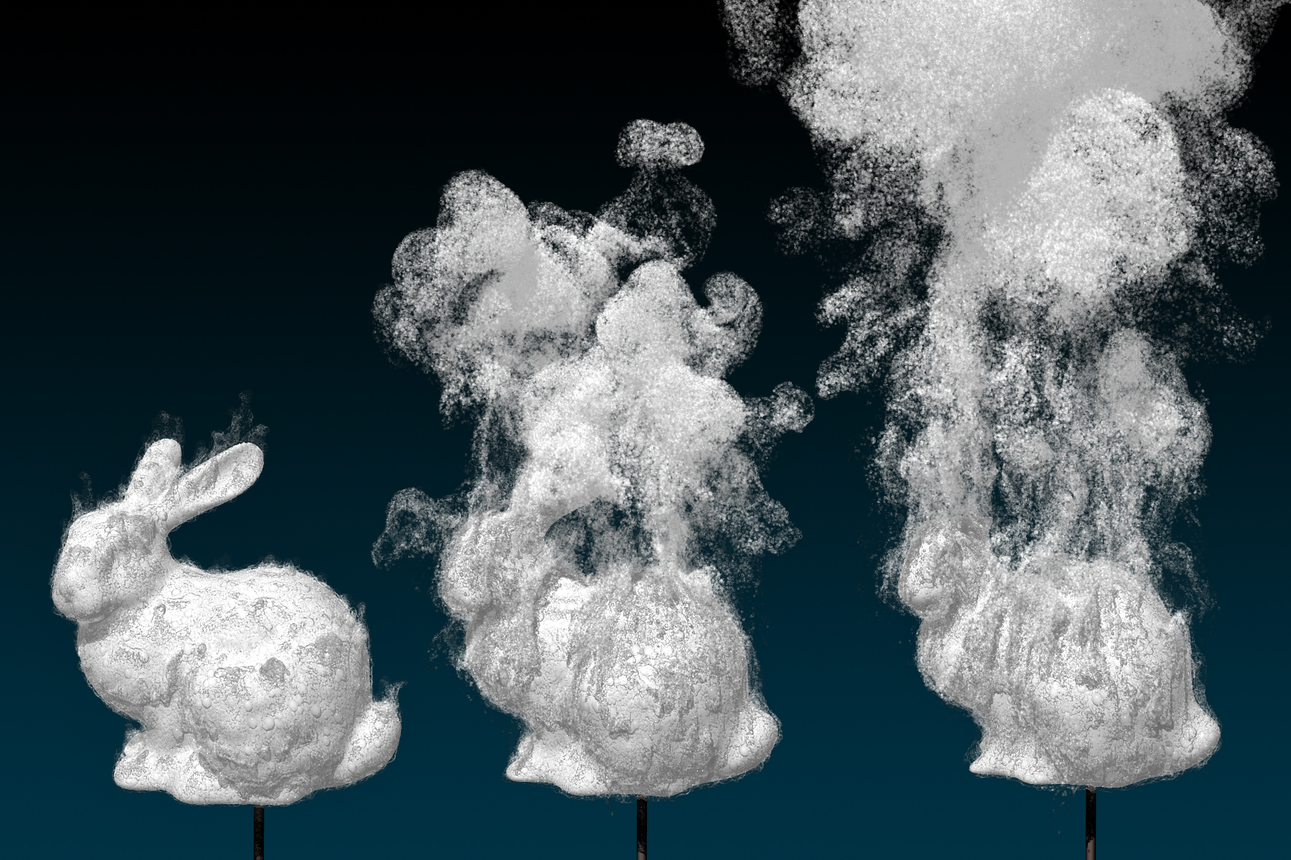
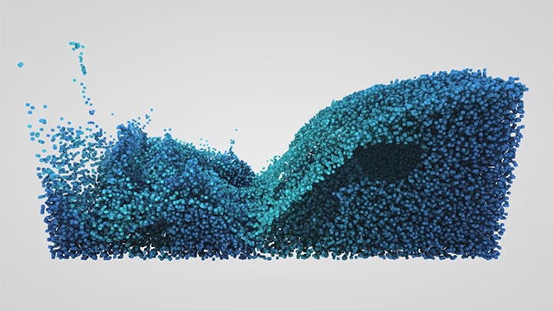
(1) Real-Time Methods for Fluids Simulation
Research what methods can be used to achieve realistic look and behavior of fluids like water or smoke.
Find out which of these methods are used in publicly available physics libraries like nvidia FleX

Slide 26
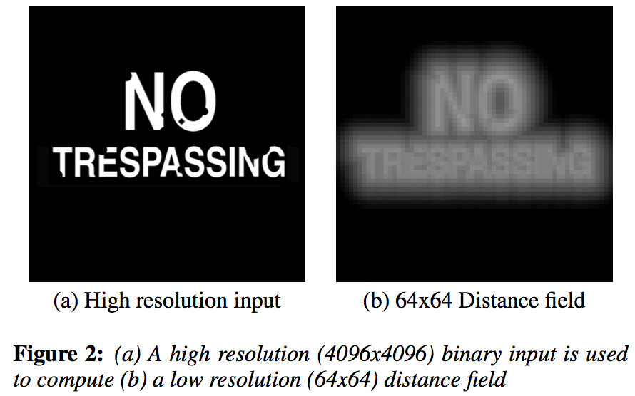
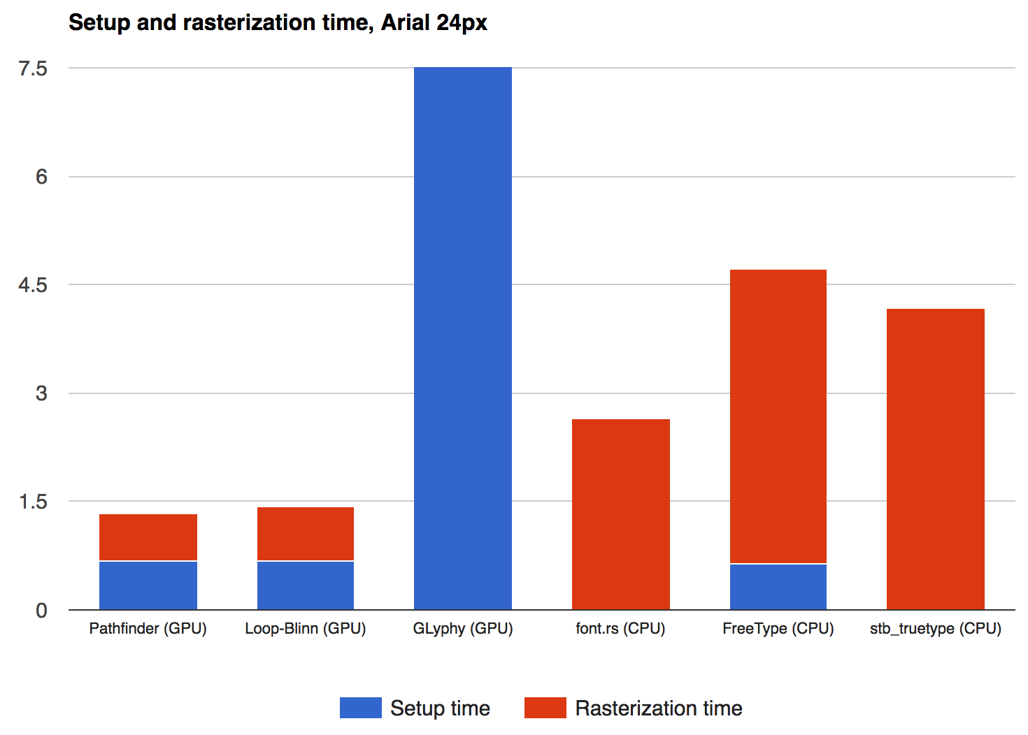
(2) State of the Art of Text Rendering
Research and summarize different methods of real-time rendering of text
Focus on advantages and disadvantages of each method

Slide 27
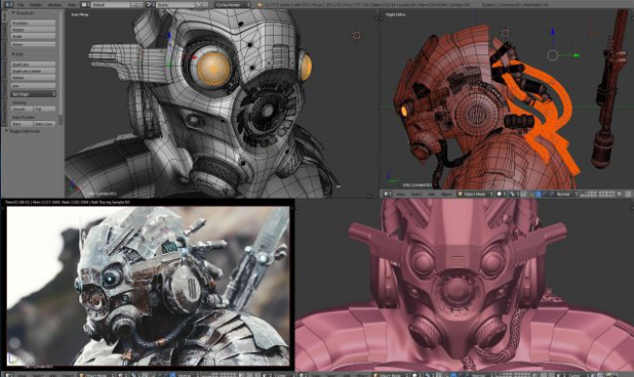
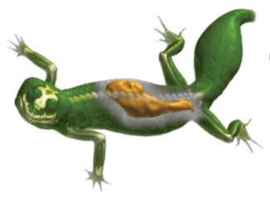
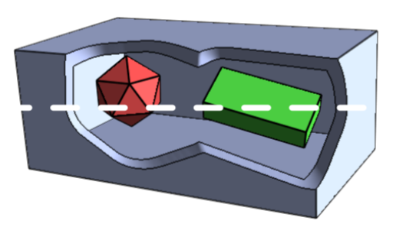
(3) Occlusion Management in 3D Environments
Problem of occlusion of objects in 3D environments
Different methods and strategies to manage occlusion
Multiple views, transparency, explosion, cutaway view etc.
Multiple views
[blender.org]
Importance-driven
transparency
[Viola et al. 2004]
Adaptive cutaway view
[Viola et al. 2004]
Notes:
In 3D scenes, objects are occluded, which impact the user efficiency in solving visual tasks. A wide range of methods and strategies have been developed to manage the occlusion. A popular approach, often employed by modeling software is to use additional views that display from different angles and showing different properties of the same objects and juxtapose these views. To suppress unimportant information the surface can be made transparent to reveal automatically the underlying information, based on the object importance. A technique often used in illustration are cutaway views. The adaptive cutaway views technique interactively render polygonal scenes to reveal the occluded objects inside.
References:
Niklas Elmqvist and Philippas Tsigas. 2008. A taxonomy of 3D occlusion management for visualization. IEEE TVCG 14 (2008), 1095–1109.
Ivan Viola, Armin Kanitsar, Meister Eduard Gröller, "Importance-Driven Volume Rendering", in proceedings of IEEE Visualization 2004, pages 139-145.
Michael Burns and Adam Finkelstein. Adaptive Cutaways for Comprehensible Rendering of Polygonal Scenes. ACM Transactions on Graphics (Proc. SIGGRAPH ASIA) 27(5):124:1--124:9, December 2008.

Slide 28
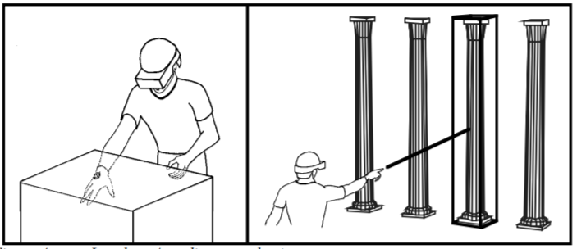
(4) 3D User Interfaces – Interaction Techniques
Human-computer in a 3D spatial context
2D or 3D input device
Interaction is 3D
Interactions: navigation, selection and manipulation
Local vs. distance selection
[Mine 1995]
Pen & tablet interaction metaphor
[Bowman 1998]
Notes:
A 3D User Interface involves the direct interaction in a 3D spatial context between human and computer. The user’s tasks are to carry out using a either a 2D or 3D input device. A mouse would be a 2D input device and the position-tracked head-mounted display (e.g. HTC Vive, Oculus Rift) would be an example for 3D input devices, where the device input are directly transformed into the (virtual) 3D space.
Basic 3D interaction are the basis to achieve tasks, such as the navigation and travelling in the 3D space. The selection describes the specification on the objects that are then manipulated. Special techniques that are designed for 3D interfaces, which has to be explored by the student.
References:
Mine, M. (1995). Virtual Environment Interaction Techniques (Technical Report TR95- 018): UNC Chapel Hill CS Dept.
D. Bowman. Interaction techniques for immersive virtual environments: Design. In Proceedings of the Human-Computer Interaction Consortium (HCIC) Conference, 1998.
Schmalsteig, D., Encarnacao, L., & Szalzvari, Z. (1999). Using Transparent Props For Interaction with The Virtual Table. Proceedings of the ACM Symposium on Interactive 3D Graphics, 147-154.
Bowman, Doug A., Kruijff, Ernst, LaViola, Joseph J. and Poupyrev, Ivan (2005): 3D User Interfaces: Theory and Practice. Addison-Wesley Professional

Slide 29
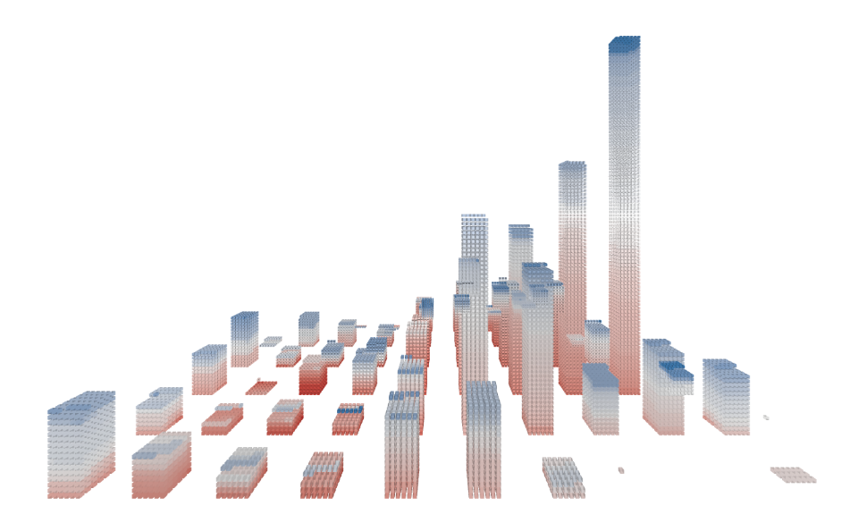
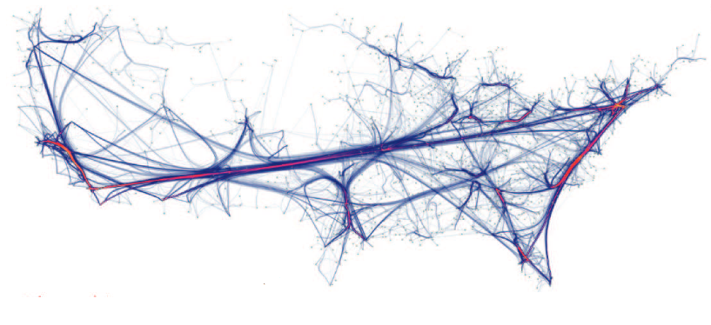
(5) GPU-Accelerated Information Visualization
Explore InfoVis toolkits and techniques using GPU processing or rendering
Shaders for fast rendering
GPGPU for efficient data processing
Notes:
GPU-based rendering is quite common for scientific visualization, where the underlying data has some 2D or 3D spatial structure. For information visualization, which deals with abstract data, GPU acceleration is not so common. Yet, there are some information visualization toolkits and prototype implementations that use GPU shaders for faster rendering or GPGPU techniques for efficient data processing. In this seminar report, existing approaches to utilize the GPU for visualization and pre-processing of abstract data should be researched and categorized.

Slide 30
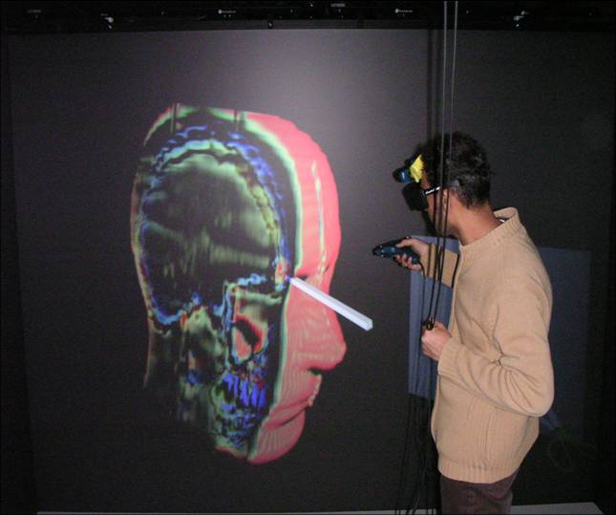
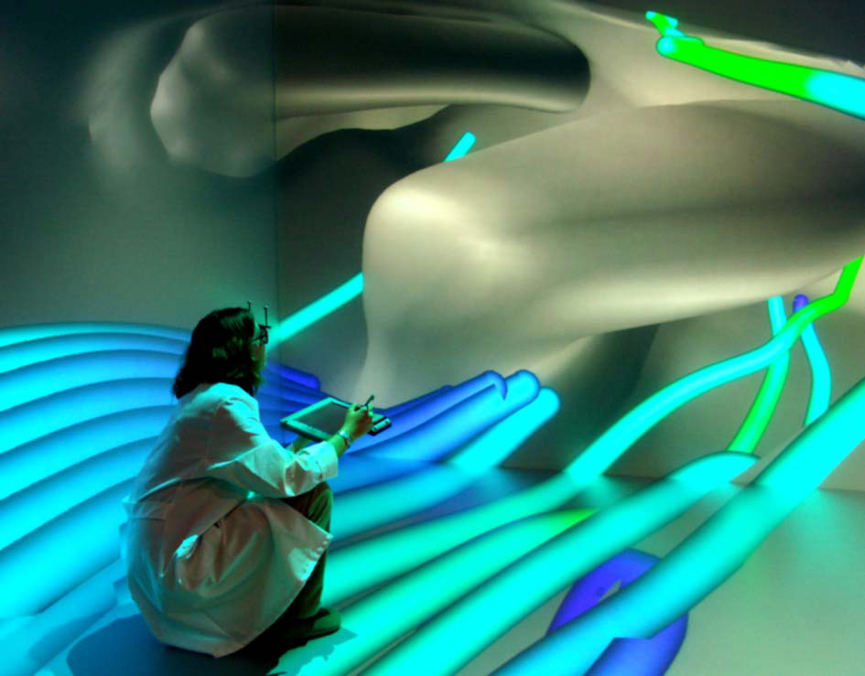
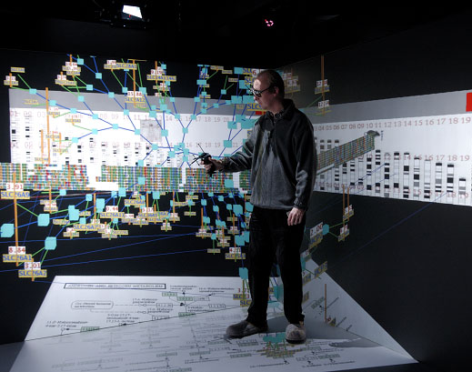
(6) Virtual Reality Visualizations
Explore applications, chances, and challenges when using virtual reality for visualizing spatial and abstract data
Reading University
RWTH Aachen
Barco
Medical Visualization
Flow Visualization
Information Visualization
Notes:
With new powerful and affordable virtual reality hardware, a lot of applications are being adapted for virtual environments. VR visualizations – in particular in the scientific visualization domain – have been developed for a long time, and now again gain popularity. In the course of this seminar work, useful application domains for VR visualizations should be explored, as well as the benefits and problems when visualizing data within a virtual environment. A special focus of the work should lie on the necessary modifcations required to adopt visualizations to VR (e.g., 3D navigation, rendering, interative exploration techniques).

Slide 31
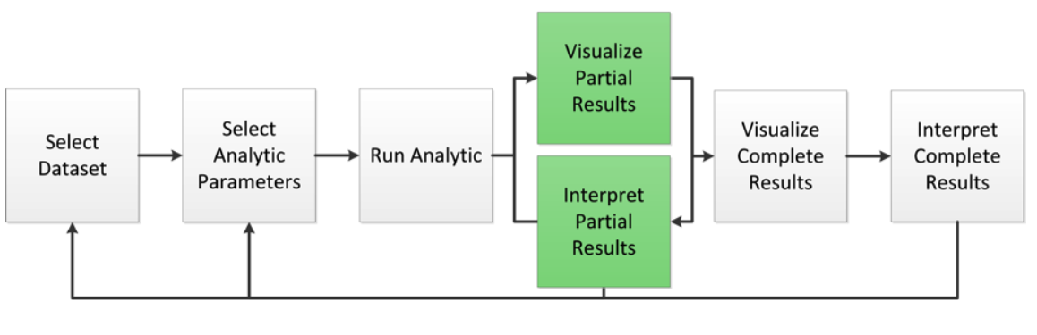
(7) Progressive Visual Analytics
VA
PVA
[Stolper et al. 2014]
Notes:
Visual Analytics strategies can be a very promising basis for a number of applications, supporting users to explore and analyze their data. Yet, the results of the incorporated dimensionality reduction techniques may be not entirely understood, or it may not be feasible to achieve results on-the-fly. The latter implies that the users might be required to wait until the completion of the employed algorithm, every time that they need to redefine it, which is not always optimal for the analysis workflow. To this end, the field of Progressive Visual Analytics, where partial results of an algorithm can be produced and interactively explored and analyzed, may be beneficial. In this project, we are interested in a study on recent work on the field of PVA, and on their fields of application.

Slide 32
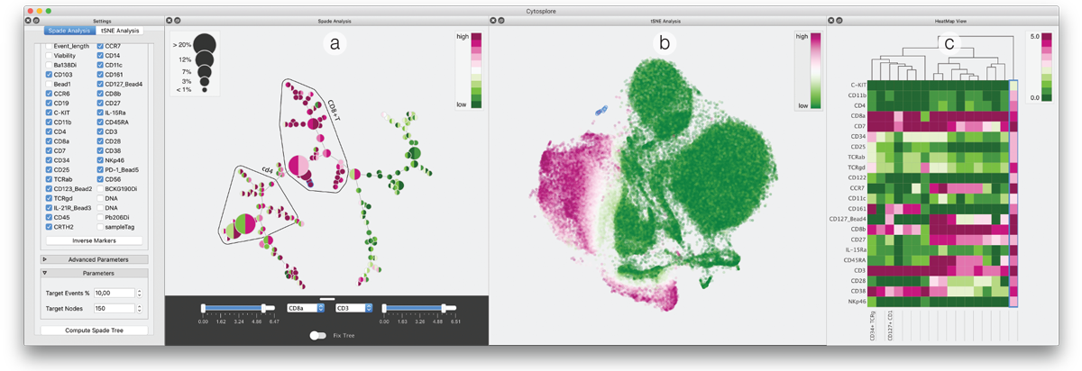
(8) Visual Analytics for (Bio-)Medical Applications
[Hoellt et al. 2014]
Notes:
The amount of information coming from (bio-)medical data is increasing drastically. These large data sets are obtained from hospitals, medical practices or laboratories and can be used to explore the underlying information, to discover unknown knowledge about patients and to confirm or generate new hypotheses. Knowledge discovery systems, provided from the field of Visual Analytics, can support experts to make further decisions, explore the data or to predict future events. The field of Visual Analytics combines Visualization with other disciplines, such as data mining, statistics and pattern recognition in highly interactive environments to support users to integrate domain knowledge into the knowledge discovery process. In this project, we are interested in a study on recent work performed in Visual Analytics for Bio-/Medical applications.

Slide 33
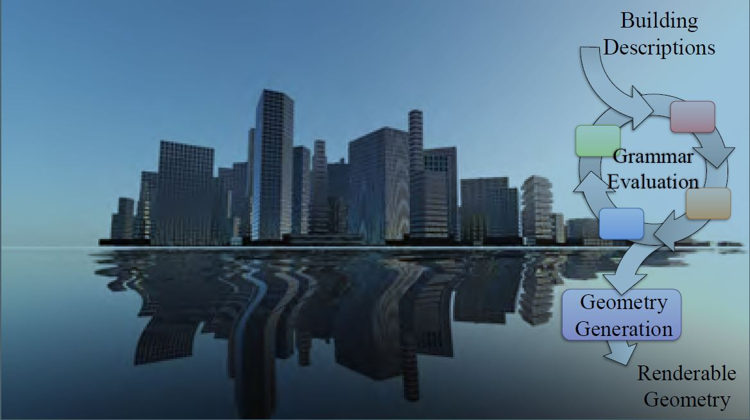
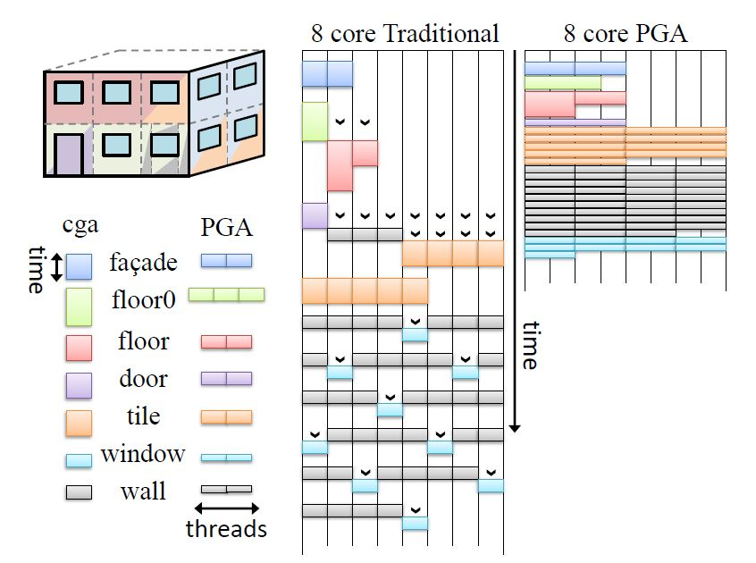
(9) Procedural Modeling on the GPU
Real-time content generation
Efficient GPU scheduling
Notes:
Procedural Modeling reduces the manual effort of creating models and facilitates the generation of large-scale virtual worlds.
However, creating these models on the CPU may take minutes or hours. By utilizing the parallel power of the GPU, large procedural models can be generated in real-time.
The modeling step quite often leads to irregular workloads that can slow down the performance,
which is why sophisticated scheduling methods are developed to fully utilize the potential of the GPU.

Slide 34
(10) DSLs in Visualization
DSL = Domain-specific language
How to incorporate domain knowledge in a language
Notes:
Domain-specific languages (DSLs) offer increased expressiveness compared to general purpose programming languages and higher flexibility compared to graphical user interfaces at low computational overhead.
By abstracting the details of the computer soft- and hardware, the user can focus on the relevant (i.e., domain-specific) problems.
A well-chosen Domain-specifc language improves the productivity for developers and the communication with domain experts.
It makes it easier to understand a complicated block of code, thus improving the productivity of those working with it.
It can also make it easier to communicate with domain experts, by providing a common text that acts as both executable software and a description that domain experts can read to understand how their ideas are represented in a system.

Slide 35
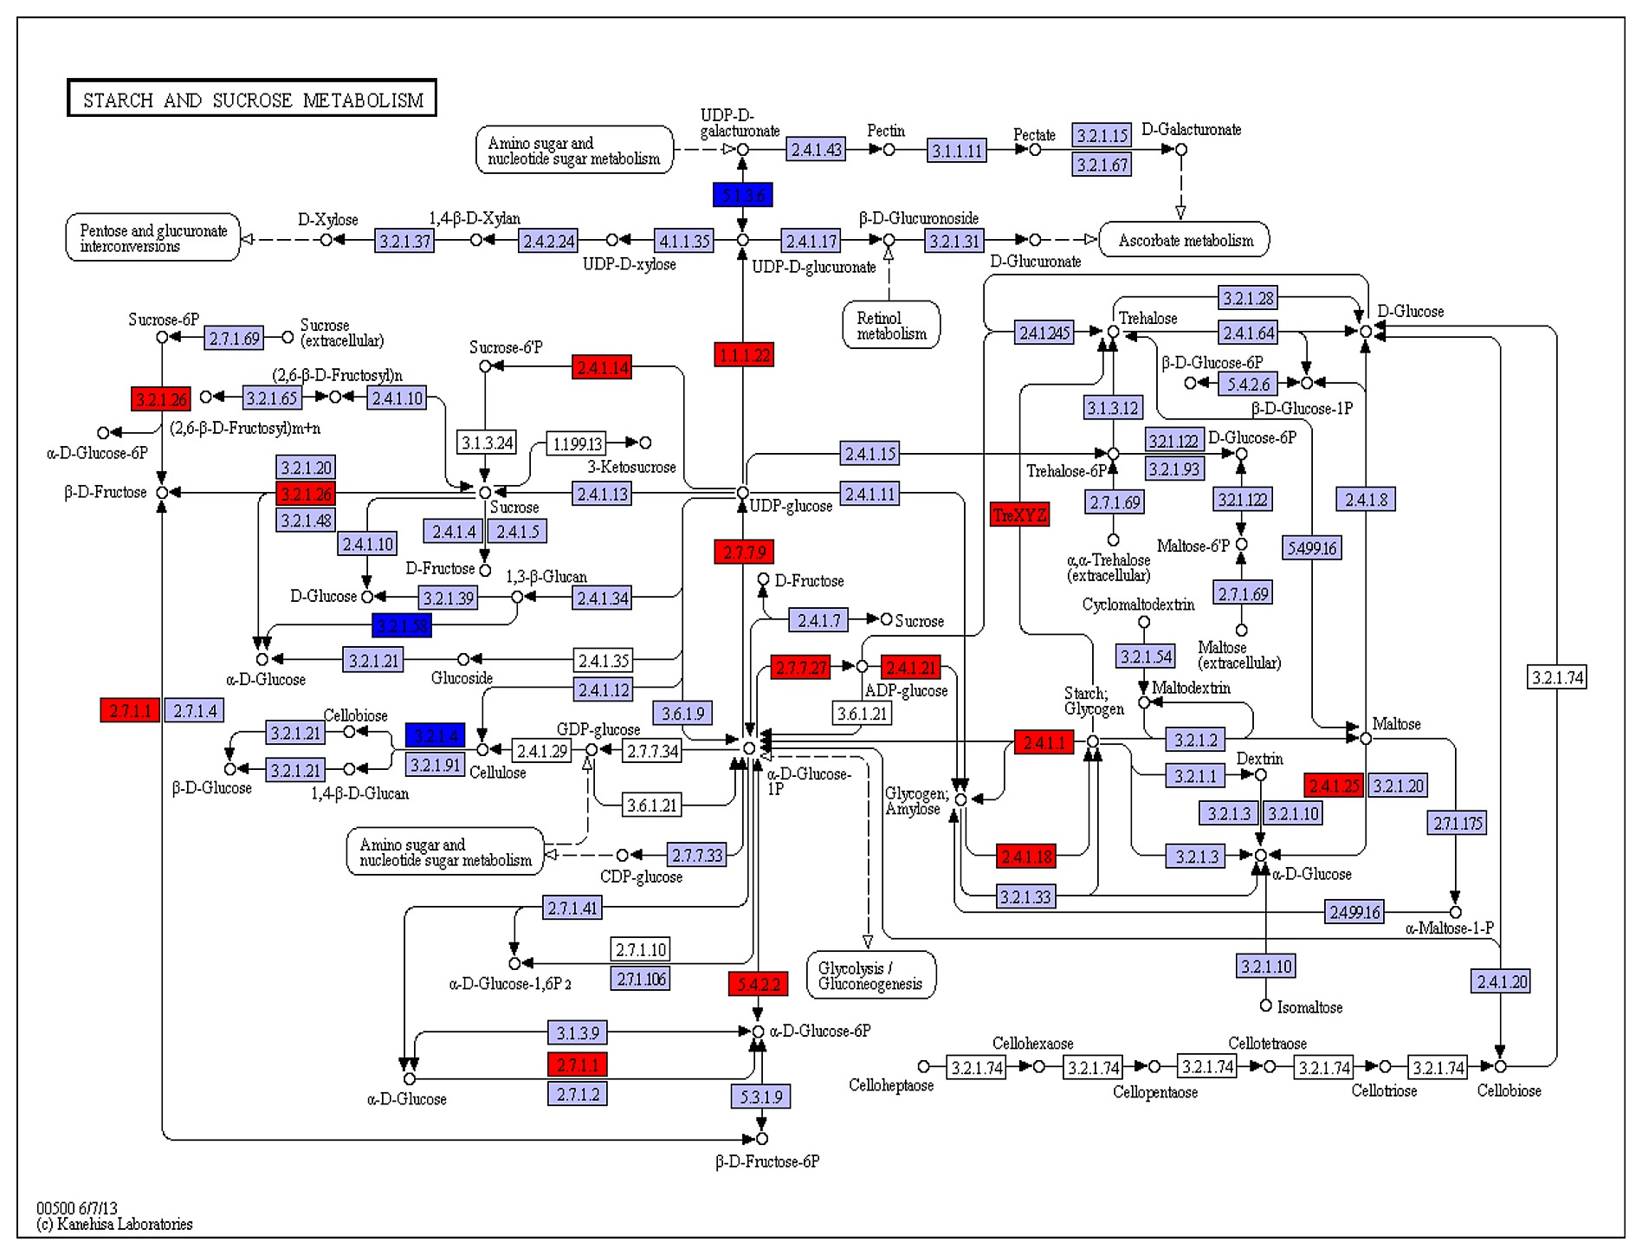
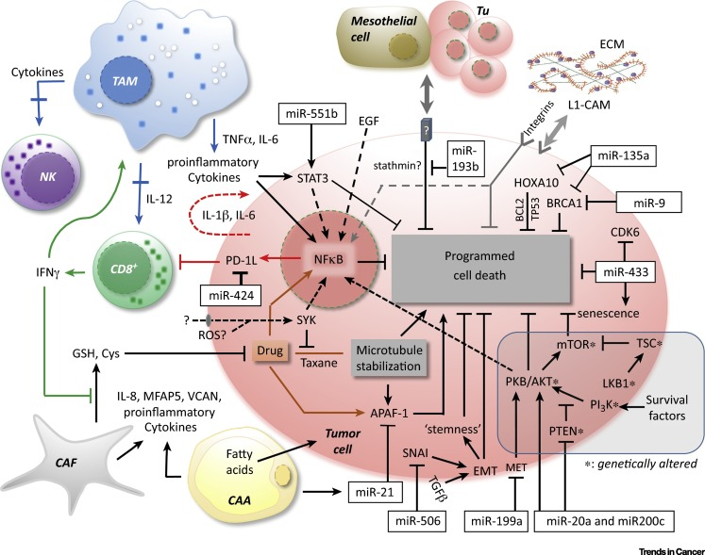
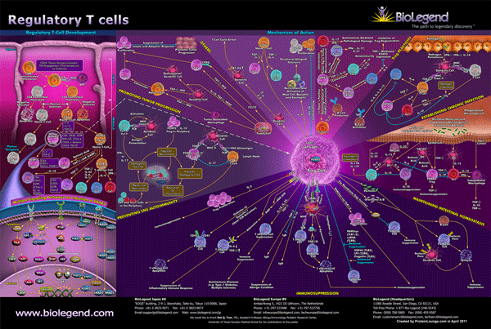
(11) Network Visualization for Biological Pathways
Title: Network Visualization for Biological Pathways
Challenge:
Layout simplification and arrangement
Scalability, complexity, and usability
35
Notes:
Networks are well-known representations for describing a relationship of entities between data samples. Thus, it is also intuitive to use networks as a base for visually describing biological interactions. In this seminar, network visualization techniques should be categorized and organized as a meaningful taxonomy.

Slide 36
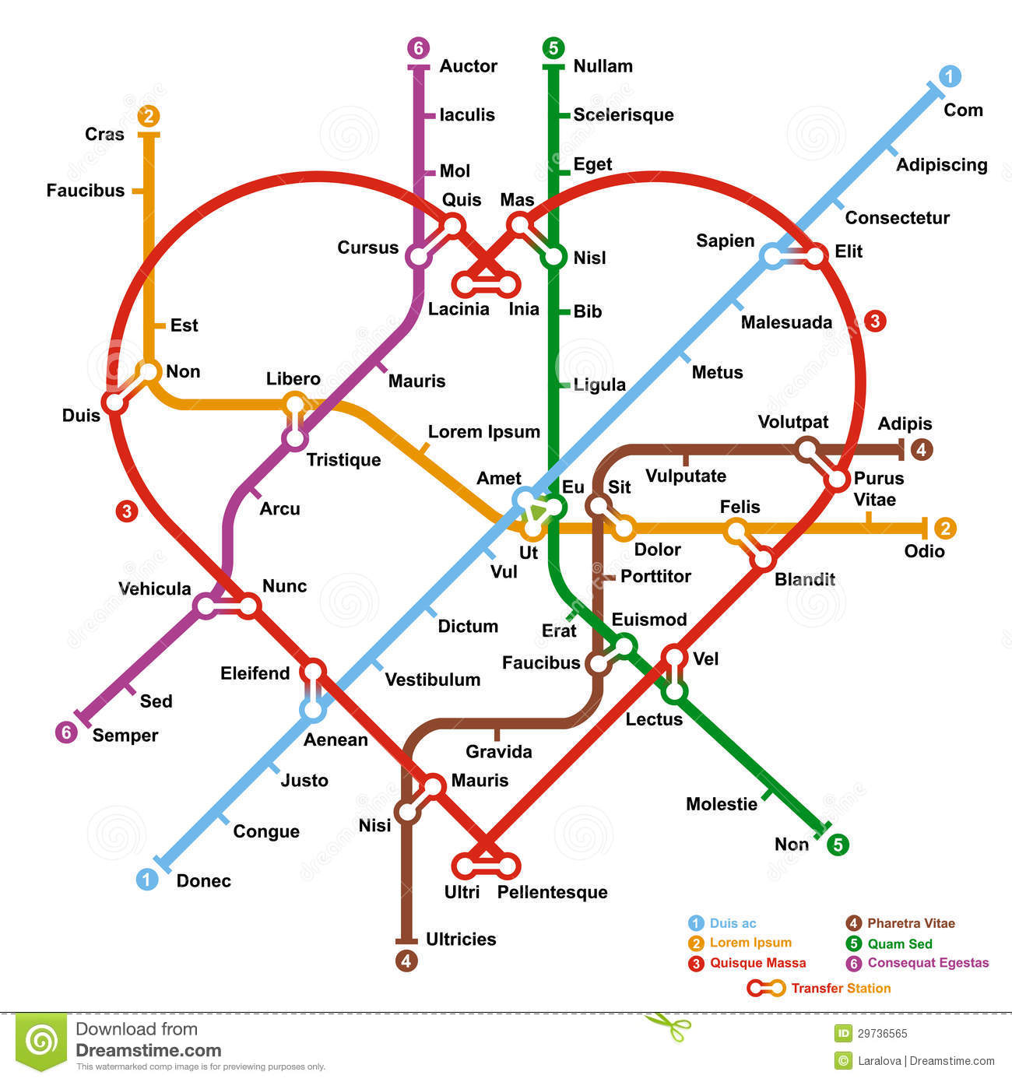
(12) Schematic Map Representation and its Complexity
Title: Schematic Map Representation and its Complexity
Challenge:
Shape simplification, including polygon, hexagon, … etc.
Computational time and recognizability
36
Notes:
Schematic map representation becomes an interesting topic because it can be not only used for understanding geospatial information but also for fun design purpose. This representation encourages users to identify and further remember geospatial information effectively and thus can serve as a base for the hand-drawn design. In this topic, map schematization approaches should be categorized and organized as a meaningful taxonomy.

Slide 37
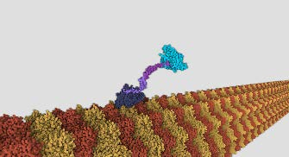
(13) Level of detail in computer animation
Title: Level of detail in computer animation
Related work: http://www.animlife.com/publications/vriphys08.pdf Modeling Hair Using Level-of-Detail Representations http://ieeexplore.ieee.org/stamp/stamp.jsp?arnumber=1199302 https://www.cg.tuwien.ac.at/research/publications/2017/JAHRMANN-2017-RRTG/JAHRMANN-2017-RRTG-draft.pdf http://gamma.cs.unc.edu/research/crowds/ http://onlinelibrary.wiley.com/doi/10.1111/1467-8659.00156/pdf
37
Notes:
Geometric level-of detail is quite known concept. Mesh simplification, topological simplification etc. But how about levels of detail on a procedure? What methods do exist in computer graphics?

Slide 38
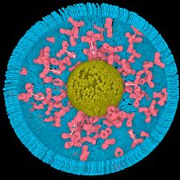
(14) Procedural modeling based on user interaction statistics
Title: Procedural modeling based on user interaction statistics
Related work: http://onlinelibrary.wiley.com/doi/10.1111/cgf.13107/full https://www.cg.tuwien.ac.at/research/publications/2017/Mitterhofer_2017/ https://www.cg.tuwien.ac.at/research/publications/2017/Wihann_2017/ http://www.cellpack.org/
38
Notes:
procedural modeling based on user interaction statistics Instead of of doing the procedural modeling based on rules, the system is capturing the transformations of some object representatives in the scene and according to these positional and spatial statistics, the information is further projected on other members of the same object type.

Slide 39
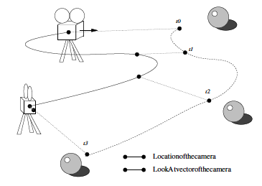
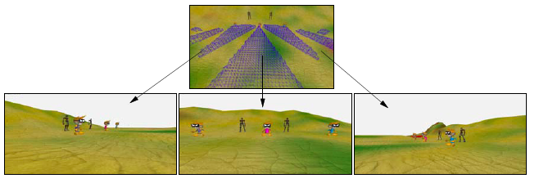
(15) Automatic camera control
Title: Automatic camera control
Related work:
https://pdfs.semanticscholar.org/b6d3/21e69773e4cebe9d6e144503baa799d9b00f.pdf
39
Notes:
attached state of the art report from several years back. the idea is to make another star of camera control after the year 2006

Slide 40
(16) A periodic tiling for computer graphics
Title: A periodic tiling for computer graphics
Related work:
https://www.cg.tuwien.ac.at/research/publications/2015/Sippl_Sebastian_EFG/
40
Notes:
- wang tiles, wang cubes, are there other known aperiodic tiling patterns that have been used in CG? - work of Kurt Hofstaedter: https://www.cg.tuwien.ac.at/research/publications/2015/Sippl_Sebastian_EFG/

Slide 41
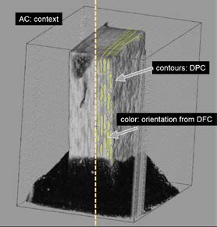
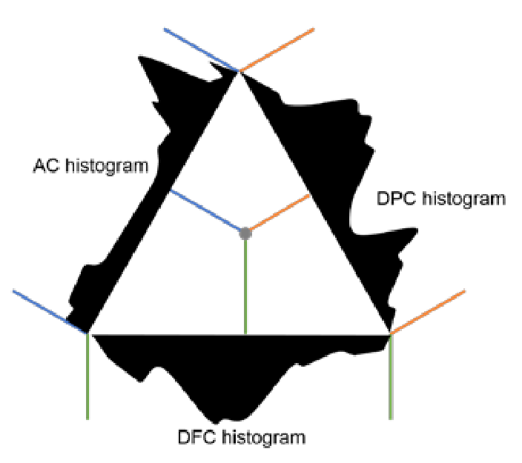
(17) Barycentric Coordinates Widget for Histograms and Transfer Functions
Multi-channel 3D volume rendering
Multi-channel 3D volume rendering
Multi-channel 3D volume rendering: absorption contrast (AC) image serves as a basis, providing spatial context, features are enhances with differential phase contrast (DFC) and darkfield contrast (DFC) modalities: contours, fibers and fiber bundles direction is visually conveyed (glyphs, tensor imaging).
Custom widgets for histograms and transfer functions: triangle 3D transfer function widget. Barycentric coordinates are used to specify and construct 3D transfer function.

Slide 42
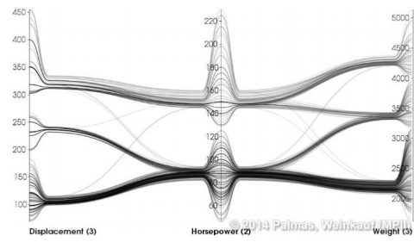
(18) Edge Bundling Method for Parallel Coordinates
Parallel Coordinates View
Parallel Coordinates View with Edge Bundling
Parallel coordinates is a data visualization technique designed for multivariate data. To display the data for an n-dimensional space, the technique utilizes n-parallel lines, usually vertical. Each point of the data is represented as a polyline running though the lines. The problem using parallel coordinates on big data is that many polylines are overlapping each other and result in visual clutter, which makes the parallel coordinates hard to read.
One modification of parallel coordinates is edge bundling. This method merges similar polylines into bundles, which makes the parallel coordinates look much clearer without losing displayed information.

Slide 43
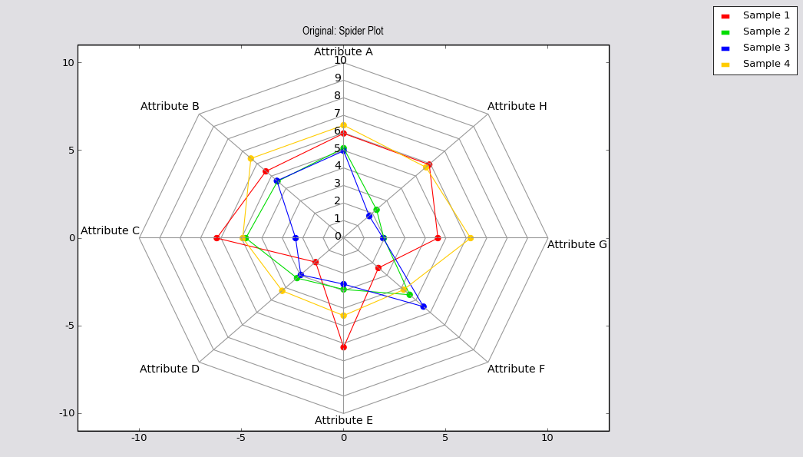
(19) Spider Plot Widget
Many analysis tasks require analyzing multi‐variate datasets. For example, when analyzing the fiber distribution in a fiber‐reinforced polymer, material scientists are interested in properties such as size, shape diameter and direction of each fiber.
Spider plots can provide a useful overview of a specific combination of such properties, and are useful for comparing two or more objects regarding their properties.

Slide 44
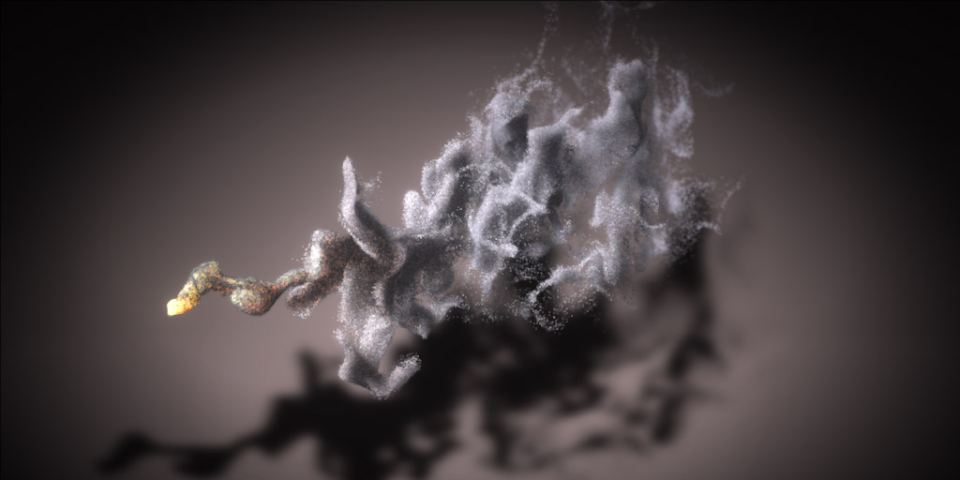
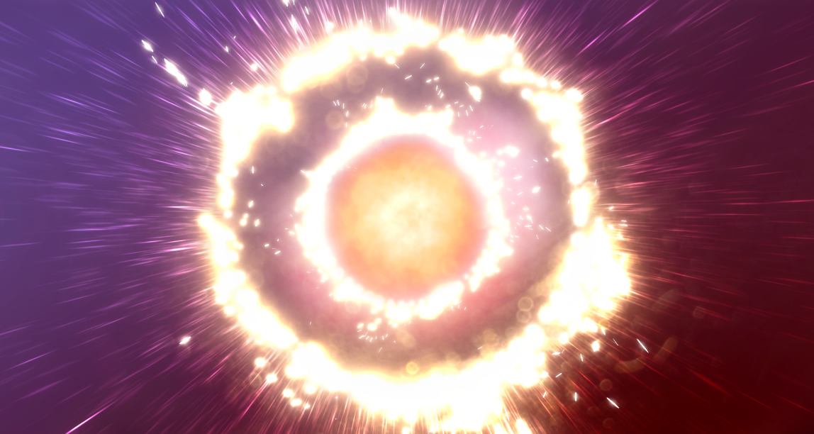
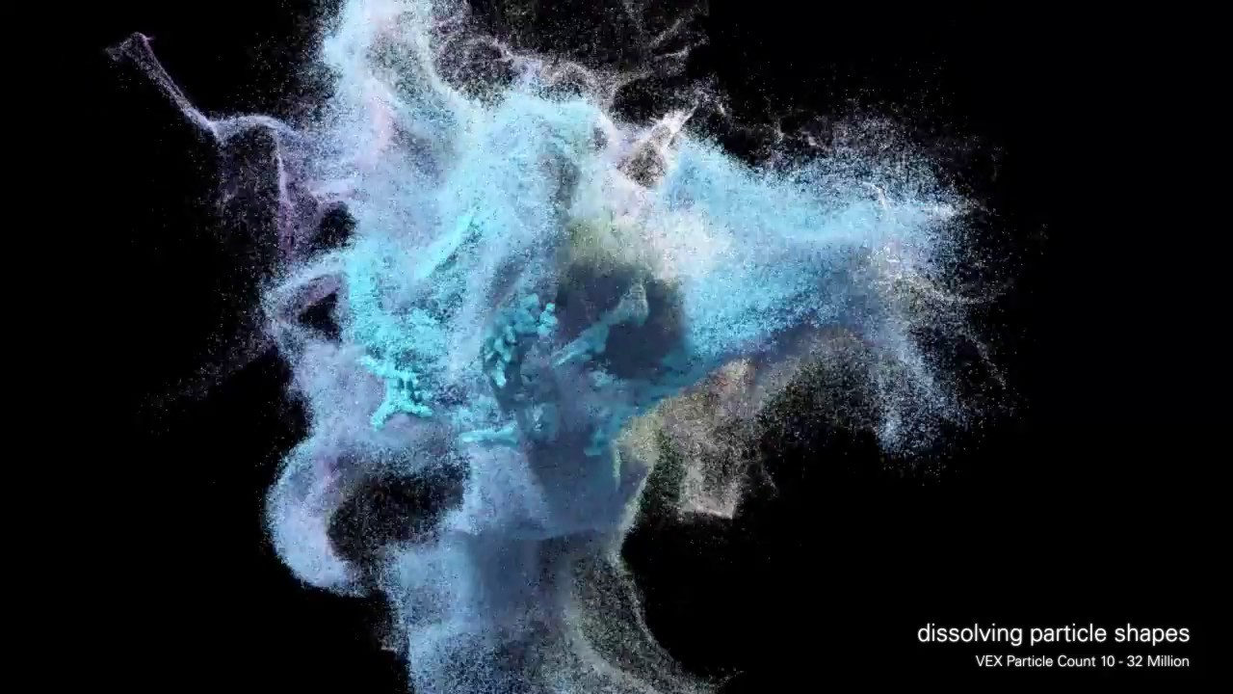
(20) Modern Particle Systems
Notes:
Particle systems are used in today’s movies and videogames to create large variety of effects. Current GPUs allow the particle systems to handle tens of millions of particles in real time, which can be exploited to create interesting visuals. In this topic, you will explore the inner workings data structures, and acceleration algorithms of the contemporary particle systems.

Slide 45
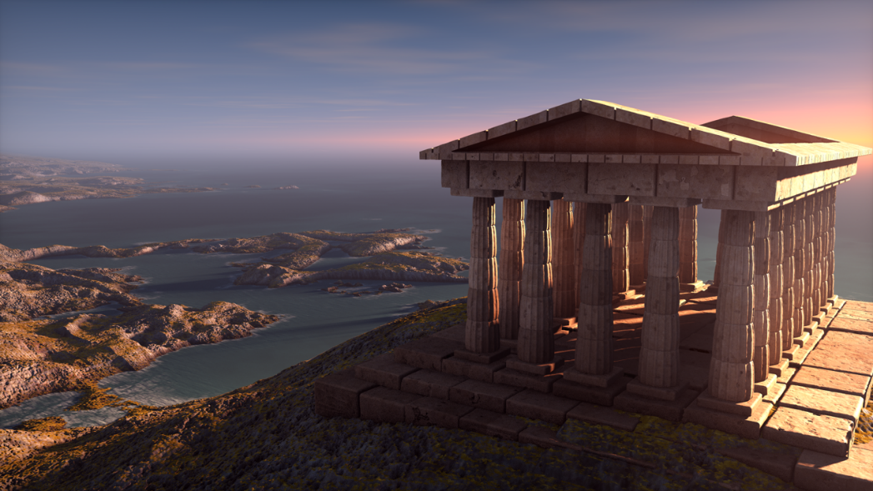
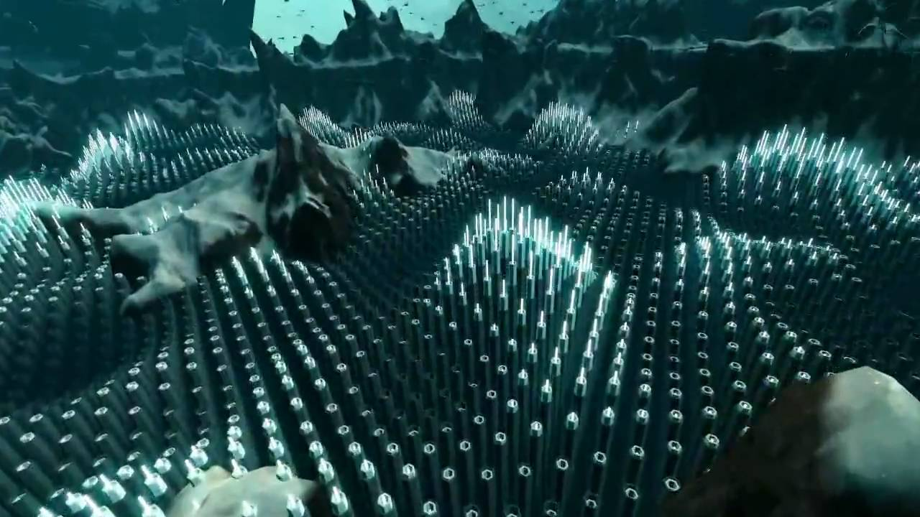
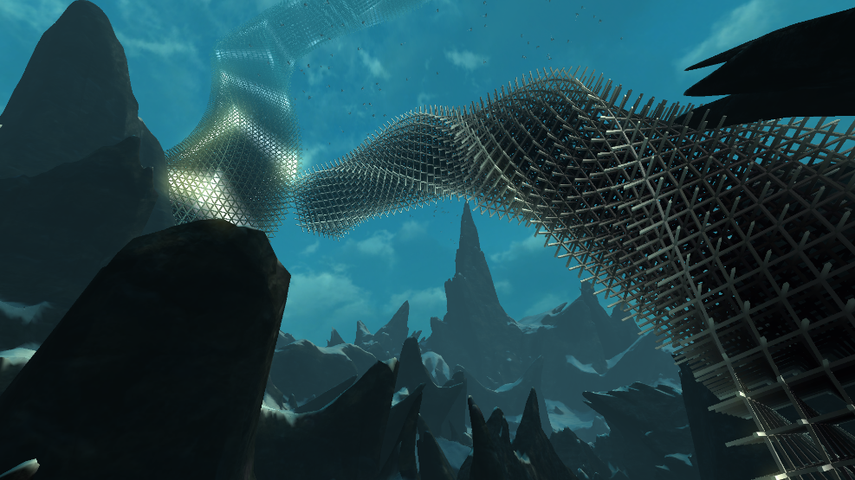
(21) Special Effects in Computer Graphics
Notes:
In this topic, you will explore the cool stuff that computer graphics can be used for. Volumetric effects, instancing, deferred lighting schemes, you name it. All the things that can be used to create breathtaking virtual worlds.

Slide 46
Topics 2018
Real-Time Methods for Fluids Simulation
State of the Art of Text Rendering
Occlusion Management in 3D Environments
3D User Interfaces – Interaction Techniques
GPU-Accelerated Information Visualization
Virtual Reality Visualizations
Progressive Visual Analytics
Visual Analytics for (Bio-)Medical Applications
Procedural Modeling on the GPU
DSLs in Visualization
Network Visualization for Biological Pathways
Schematic Map Representation and its Complexity
Level of detail in computer animation
Procedural modeling based on user interaction statistics
Automatic camera control
A periodic tiling for computer graphics
Barycentric Coordinates Widget for Histograms and Transfer Functions
Edge Bundling Method for Parallel Coordinates
Spider Plot Widget
Modern Particle Systems
Special Effects in Computer Graphics
Important!!
Register your topic on TU WEL
Registration start: 6th March 2018, 22:00 (Today!!)
Registration due to:
23th March 2018, 23:59

Slide 47
Not finished yet…

Slide 48
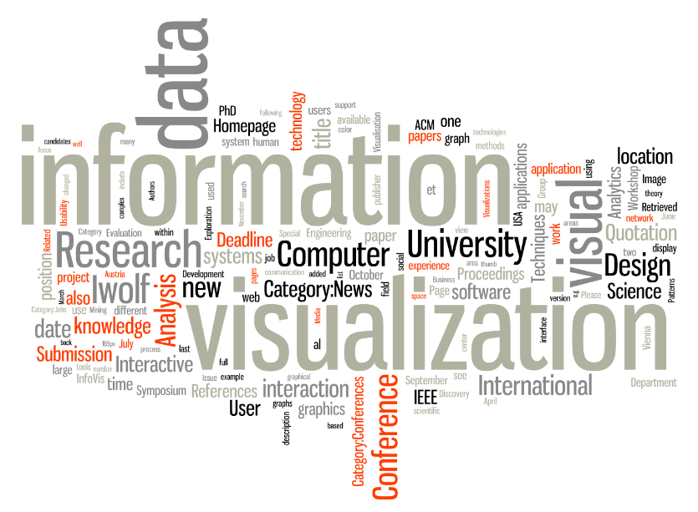
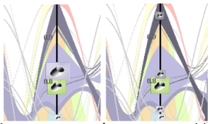
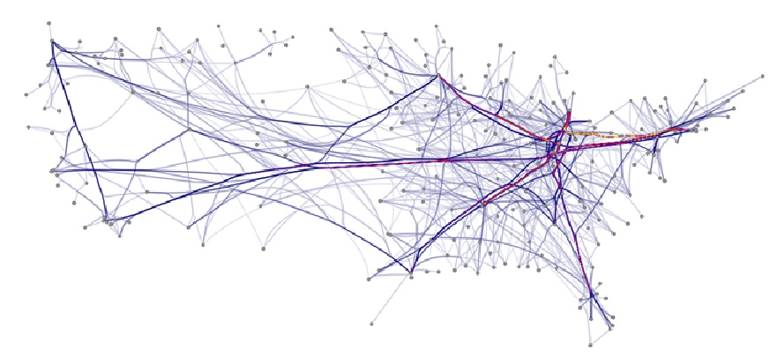
Informationsvisualisierung VO: 186.141 – UE: 186.143 https://www.cg.tuwien.ac.at/courses/InfoVis/
Multivariate data visualization, interactive visual analysis of complex data, visualization of high-dimensional data, visual analysis of multivariate network data…
Institute of Visual Computing and Human-Centered Technology, TU Wien, Austria

Slide 49
Graph Drawing Algorithms VU 192.053 · Tuesday 9–11
Are you interested in network visualization?
Graph drawing is the algorithmic core of network visualization. In this course you learn about
graph layout aesthetics and their optimization
fundamental layout algorithms for different types of graphs (trees, planar, non-planar, . . .)
practical aspects as well as theoretical properties and computational limitations
Topics in this course combine the areas of algorithms, visualization, and graph theory.
Registration in TISS is open, First lecture on March 13

Slide 50
Thank you.
Projects: https://www.cg.tuwien.ac.at/courses/projekte/
wu@cg.tuwien.ac.at

