Slide 1
Stockmarket Loser
Markus Lipp
Institute of Computer Graphics and Algorithms
Vienna University of Technology

Slide 2
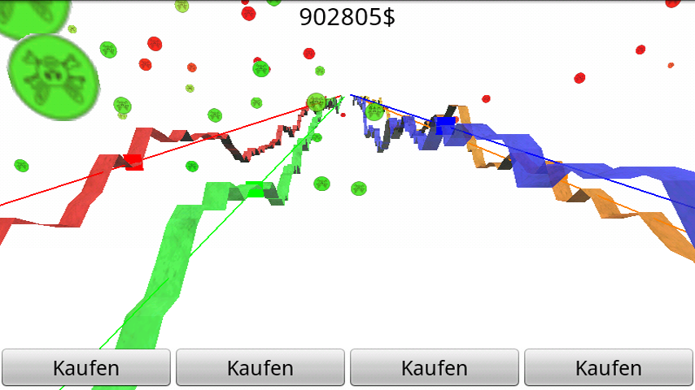
Gameplay
Lose money on the stock market
Buy high, sell low

Slide 3
Gameplay Video

Slide 4
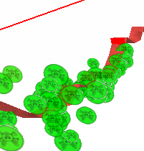
Features
Accurate economy crisis simulation
Directly connects to Wall Street
Investors are already using it!
Visual effects improve playability
Particle system
Transparency
Textures on graphs
NO background

Slide 5
Thank you!
Questions?

