Slide 1

Augmented Reality for Mobile Devices
Level 55
Michael Probst
Johannes Unterguggenberger

Slide 2
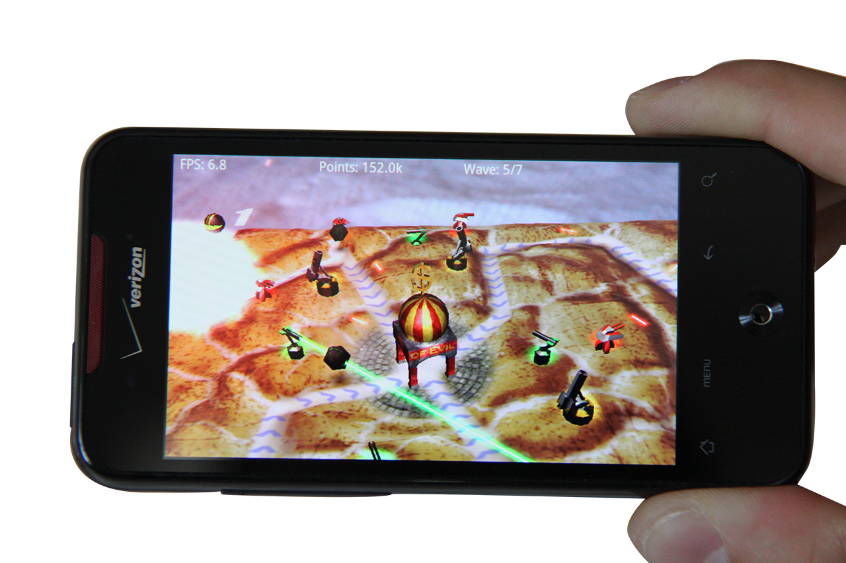
Overview
Towerdefense
3 Towers
3 Enemies
7 Waves

Slide 3
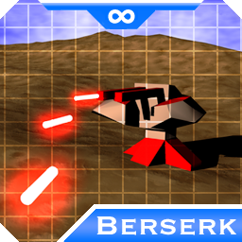
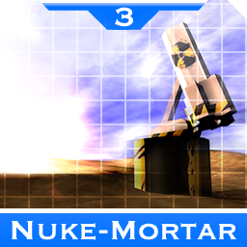
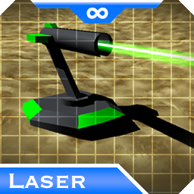
Towers
Berserk
Laser
Nuke-Mörser

Slide 4
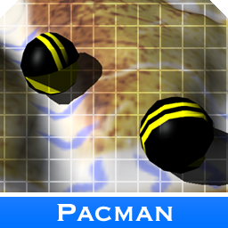
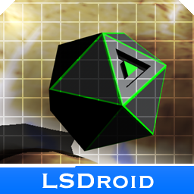

Enemies
PacMan
LSDroid
Peanut-Boss

Slide 5
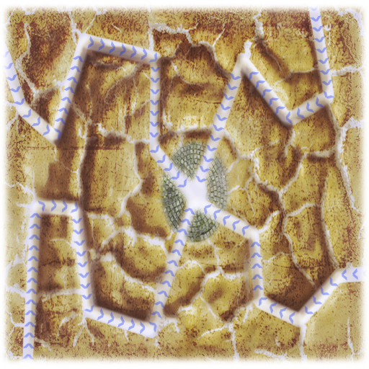
Gameplay
7 Waves
Random path-ordering
Tactical tower-placement
Building towers => ++money
Killing enemies => --money

Slide 6
Technical stuff
Per-pixel lighting too expensive
Post processing with FBOs too expensive
Per-vertex lighting
Billboards (e.g. Nuke)
Volumetric Lines

Slide 7
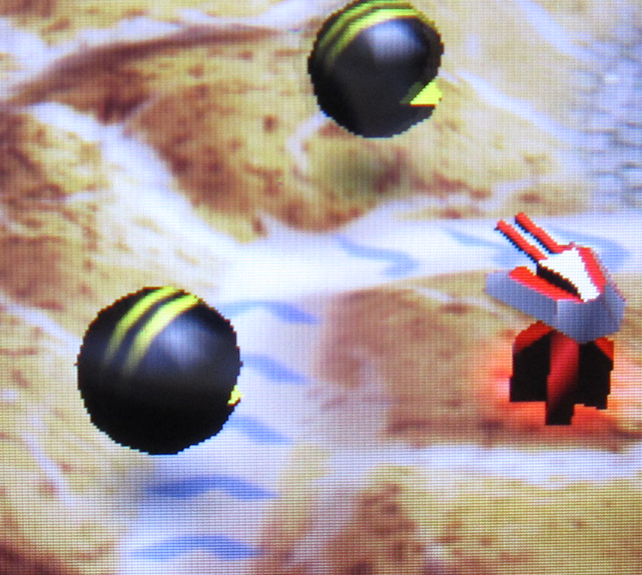
Per-vertex lighting
Enemies
Towers

Slide 8
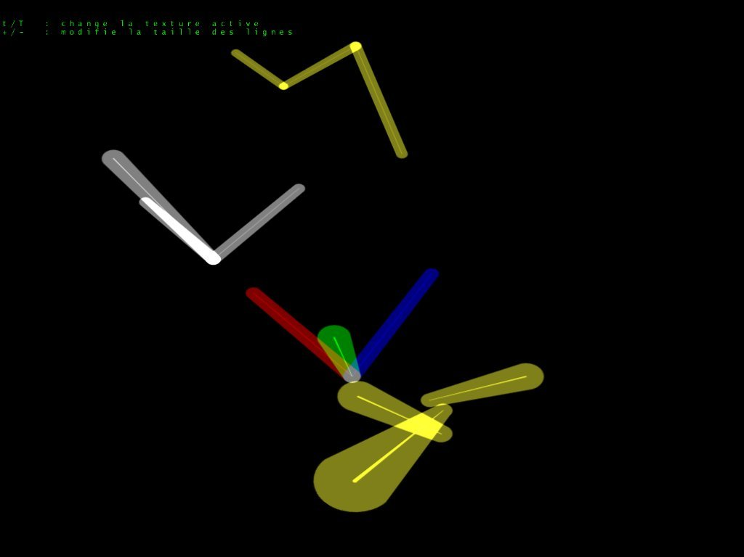
Volumetric lines
Berserk shots
Laser-beams

Slide 9


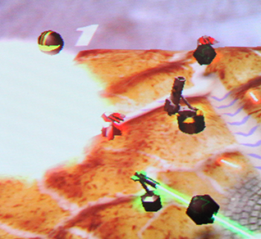
Nuke
2 Billboards

Slide 10
Questions?
Thank You!
Questions?

