Slide 1
Augmented Reality on Mobile Devices
Level 13 – Faust Terrado

Slide 2
Story
Earned huge fortune in a not honest way
Need to balance your Karma helping people
Buy objects and give them to people
Each person needs just one concrete thing
Give them exactly what they need

Slide 3
How to play
Colored cubes moving on the board
Each pair of cubes have one color
One cube of the pair represents a person and the other the object it needs
Pick the two cubes with the same color consecutively to lose money
If you pick two different colored cubes you win money
The difficulty increments with the time (more pairs on screen and moving faster)

Slide 4
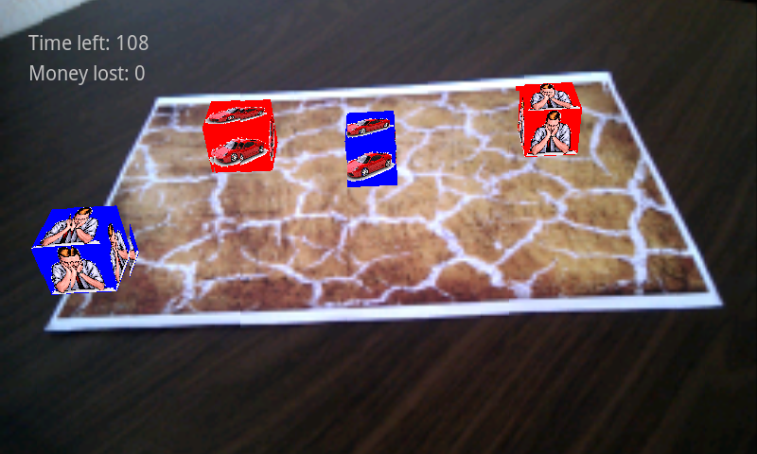
How to play

Slide 5
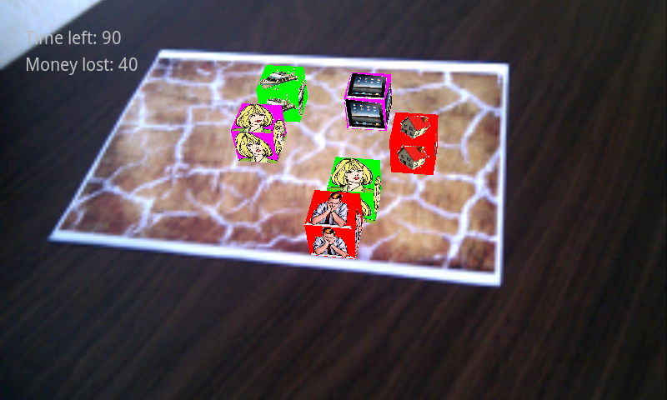
How to play

Slide 6
Missing features
Replace cubes for animated models
Collision Detection between models
More kinds of movement (jumps…)
Make it visually acceptable
Detective
…

