Slide 1
Information-based Transfer Functions for Multimodal Visualization
Martin Haidacher¹, Stefan Bruckner¹, Armin Kanitsar², and M. Eduard Gröller¹
¹ Institute of Computer Graphics and Algorithms
Vienna University of Technology
² AGFA HealthCare
Vienna, Austria
Notes:
Welcome to my talk about Information-based Transfer Functions for Multimodal Visualization. My name is Martin Haidacher and I’m from the Institute of Computer Graphics and Algorithms from the Vienna University of Technology. This work was done together with Stefan Bruckner, Armin Kanitsar and Eduard Gröller.

Slide 2
Multimodal Visualization
Modality 1
Modality 2
Diagnosis
More modalities enhance diagnosis process
Tissues visible in one modality and not in the other
Different combinations:
anatomical-anatomical
functional-anatomical
Notes:
At the beginning I want to start with a basic instruction in multimodal visualization and I want to explain for which purpose our new approach is useful. Multimodal visualization is the visualization of more than one data set from different modalities. These different modalities can enhance the diagnosis process. Some parts which are necessary for a diagnosis might be visible in one modality and not in the other one and vice versa. Therefore, it is possible to see all necessary parts for a diagnosis in the combination of different modalities.
Typical combinations of modalities are anatomical with anatomical modalities. Such modalities show the anatomy of the body such as CT or MRI. The different techniques are enable to enhance different parts of the body. Another common combination is the combination of functional with anatomical modalities. Functional modalities show processes inside the body. In combination with anatomical modalities the location of these processes inside the body is easier to locate.

Slide 3
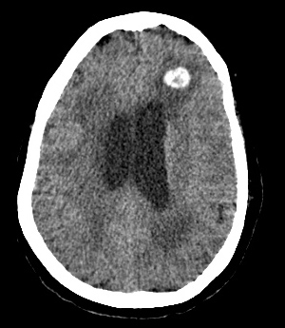
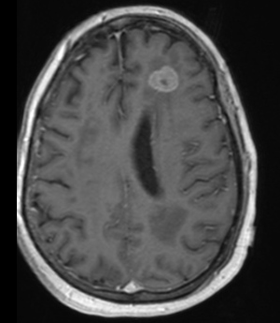
Multimodal Visualization: Issues
2D
Side-by-side view:
Mental blending of images
Needs experience
CT
MRI
Notes:
A typical method for multimodal visualization is the inspection of the different modalities in a 2D side-by-side view. Here in this example you can see such a simple visualization. On the left side a slice of a CT modality can be seen and on the right side the corresponding slice from an MRI modality is shown. Radiologists are able to mentally blend these two images together to get corresponding points from one slice in the other one. The problem with this method is that it needs quite a lot of experience.

Slide 4
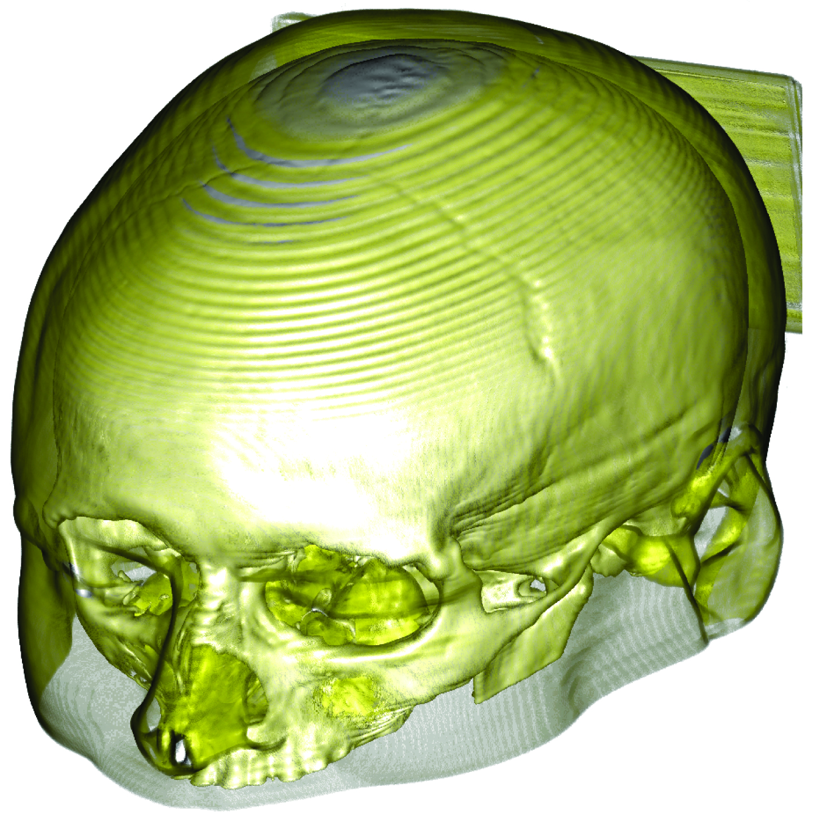
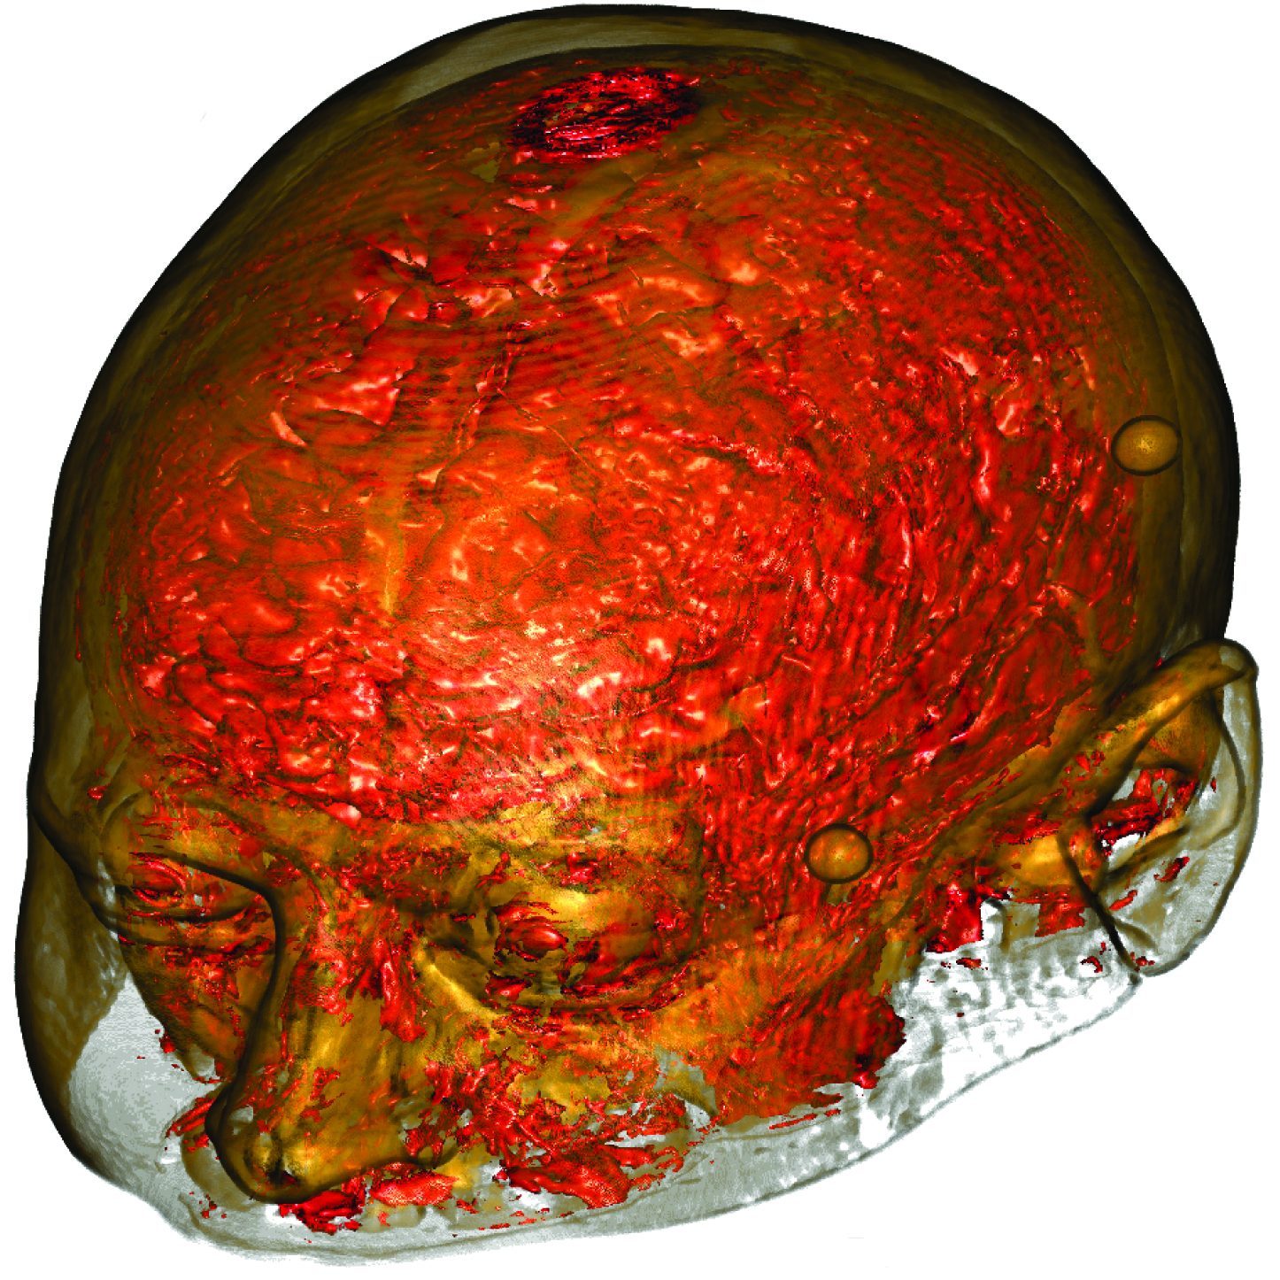
Multimodal Visualization: Issues
3D
Side-by-side view:
Mental blending is not practicable
Fusion of both volumes
CT
MRI
Notes:
For 3D the visualization is more complicated. As shown with the example of a CT and MRI data set it is also possible in 3D to provide a side-by-side view. But the problem here is that the mental blending does not work with 3D images, because it is hard to estimate the depth value of a point in one data set to get the corresponding point in the other data set. Therefore another visualization technique is needed which fuse together both volumes. As result only one volume is visible which should contain the information from both modalities.

Slide 5
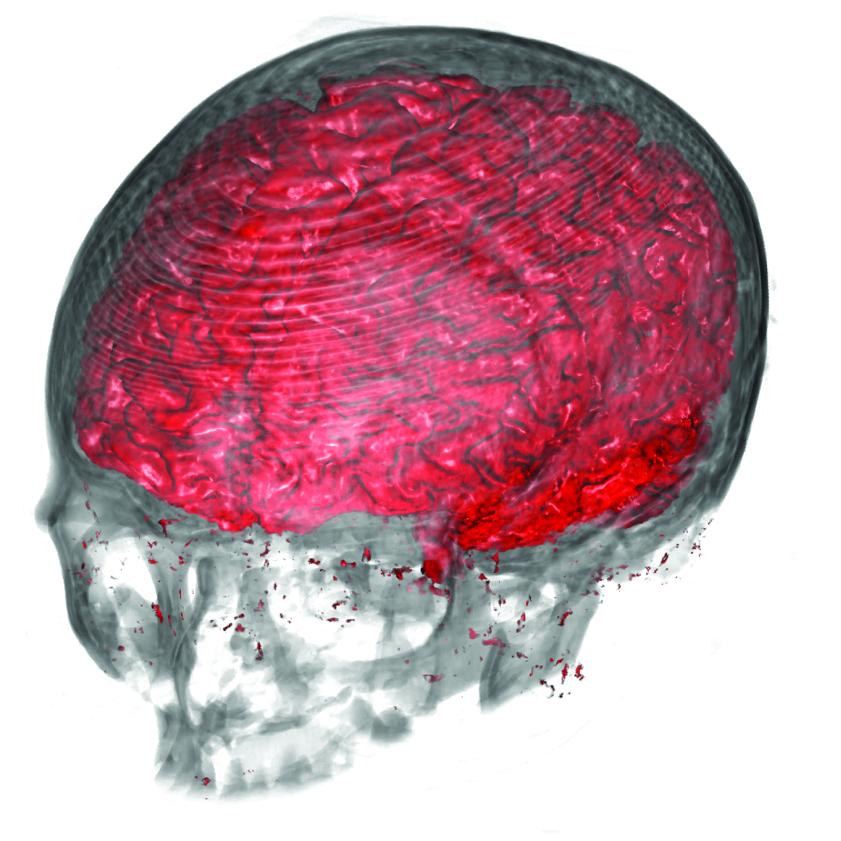
Goal of our Approach
Fusion which lose as less information as possible
Good separation of different tissues
Notes:
The goal of our approach is to apply such a fusion with a minimum loss of information through this process. Some loss of information can not be avoided because two scalar fields can not be merged to one scalar field without any loss of information. Additional to the first goal with our method it should also be possible to separate different tissues from each other. For these two modalities as shown on the slide we want to get a fused volume as this one. In this case we are interested in the brain and its location in relation to the skull.

Slide 6
Information in Volume Visualization
Information theory of Shannon:
More frequent signals → less information
Less frequent signals → more information
Information in volume visualization
More frequent intensities → less information
Large constant regions, e.g. air
Less frequent intensities → more information
Small features, e.g. transitions between tissues
Notes:
Before I will go into detail of the new approach I want briefly explain what information means for volume visualization. The information theory was introduced by Shannon. It says that more frequently signals contain less information. On the other way around less frequently signals contain more information. In volume visualization this theory can be interpreted in the following way: more frequently intensities contain less information. Such intensities occur at large constant regions such as air. In contrast to that less frequently intensities contain more information. Such intensities can occur at small features or transitions between tissues. In general large constant regions contain less information as small regions.

Slide 7
Information in Volume Visualization
Information content: probabilities of intensities are estimated
Single histogram: probabilities of one data set
Dual histogram: probabilities of pair of values
Notes:
To quantify this information content for certain intensity values the probabilities of their occurrence are needed. For that reason the histogram can be used. The normalization with the total number of points will result in a well defined probability density function. To get the probability of the occurrence of a single value in one modality the single histogram of this modality is used. To get the joint probability for the occurrence of a pair of values the dual histogram is used. Here on the slide a dual histogram of a CT and MRI data set is shown.
If we have a combination of values as shown by the red lines we would get a rather high probability of occurrence of these two values together. In the dual histogram this higher probability can be seen by the darker color. In contrast to that the combination of these two values would end up in a lower probability.
With that we have the basic for the infomtion-based part of the new approach.

Slide 8
Overview of our System
Notes:
This diagram shows an overview over all necessary steps for the definition of the transfer function space and the final classification in this transfer function space with our new approach. As input we get two values from two different modalities and as output we get a single color and opacity. The bluish nodes are the processing steps. In the next slides I want to explain each of these processing steps in more detail.

Slide 9
Information-based Data Fusion
Notes:
I want to start with the information-based data fusion.

Slide 10
Information-based Data Fusion
Reduction of dimensionality by fusion
Fusion of data with minimum loss of information
Information content:
Fusion factor:
Notes:
The goal of this processing step is to reduce the dimensionality by fusion of the two values. The fusion should be done in a way to lose as less of information as possible. Shannon defined the information content by the shown equation on the slide. It is a negative logarithmic function of the probability that a value will occur. For a combination of values from both data sets this information content can be calculated for both values. Out of these information content values a fusion factor gamma can be calculated. This gamma value is close to 0 when the second value contains less information than the first value and it is close to 1 when the first value contains less information than the second one.

Slide 11
Information-based Data Fusion
Fusion:
Notes:
This fusion factor can then directly be used to fuse all values. The fusion of the value is done as shown in the upper equation. The lower equation explains the fusion of the gradients.
The benefit of this fusion is that it is an automatic process with which as less as possible information is lost. If a value has a high information content in one modality then the fused value is close to this value. Therefore points with high information content remain at approximately the same position in the new fused transfer function space as they would be in the individual 2D transfer function space with the intensity and gradient magnitude as the two dimensions.
The 2D histograms on the slide show the result of the fusion of a CT data set and an MRI data set. The individual 2D histograms are shown on the left. The top one comes from CT and the lower one from MRI. On the right the 2D fused histogram is shown. In this histogram still some similarities to the two individual histograms can be seen as for example some of the arcs from the CT data set. This similarity makes it easier for a user to find a transfer function if the user is already used to the 2D transfer function space in single modality visualization.

Slide 12
Mutual Information Retrieval
Notes:
For the data fusion we used a quantity, gamma, which is calculated as combination of the individual information content values of an intensity in both modalities. In the next step we will now also consider the information which is contained in the combined occurrence of both values together. This mutual information is then later used as additional parameter for a better separation of different tissues in the new transfer function space.

Slide 13
Mutual Information Retrieval
Quantity for information, contained in the combination of values
Point-wise mutual information:
Normalized and inverted:
δ…1, combination contains more information
δ…0, combination contains less information
Notes:
This additional quantity should express how much information contains a combination of two values. For this reason the point-wise mutual information can be used. As shown in this equation also the joint probability of the occurrence of both values is included in this equation. The point-wise mutual information is 0 when a pair of values occurs exactly as frequently as one would expect by chance. This is the case when the joint probability is statistically independent and a product of both individual probabilities. The PMI is higher than 0 when the combination of values occur more often then one would expect by chance. If the PMI is lower than 0 then the combination of points occurs less frequently as one would expect. This case contain also more information than a PMI higher than 0 in the context of Shannon’s information theory. To make that useful for the transfer function space we normalize the PMI to a value between 0 and 1 and invert it. We call the new variable delta. If delta is close to one then the combination of points contain more information. For a value close to 0 it is the other way around.

Slide 14
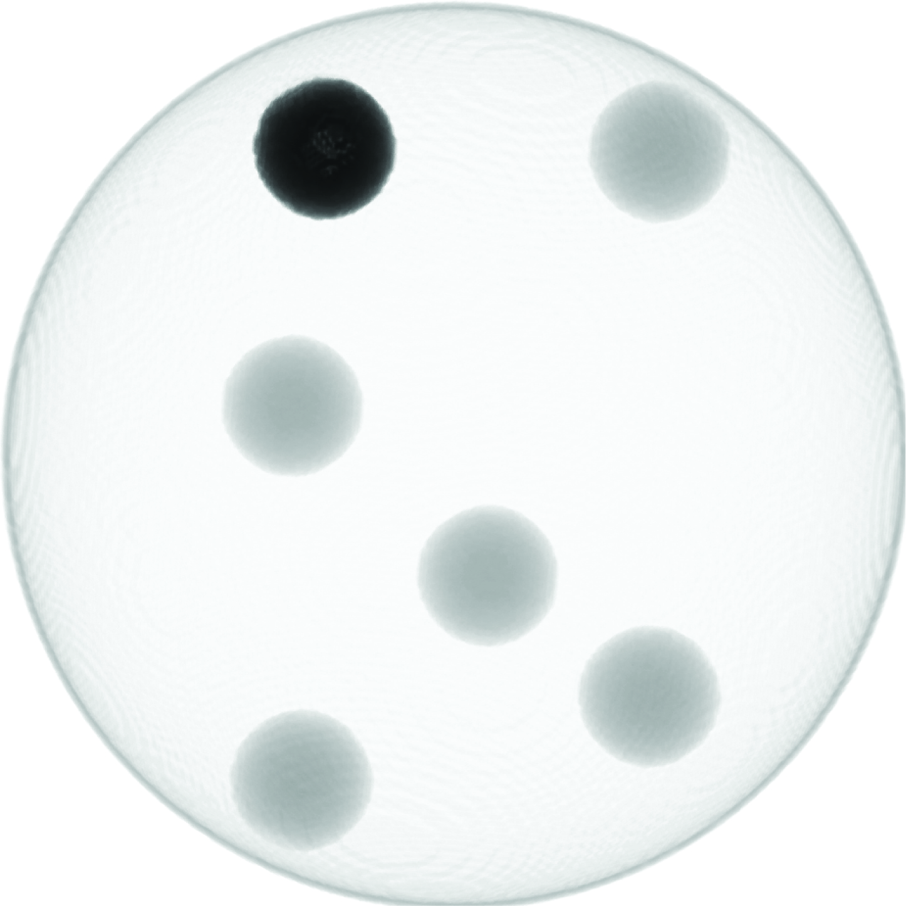
Mutual Information Retrieval
δ-Response:
Notes:
This example shows the delta response for two data sets. The second data set on the left bottom contains one sphere less than the other one above. The intensity values for the large and the small spheres is different in both data sets. The calculation of delta results in the image on the right. The region where only in one data set contains a sphere has the highest delta value because this combination of values occurs less frequently as the other combinations.

Slide 15
Information-based TF Classification
Notes:
Now we have a fused value, a fused gradient magnitude and an additional quantity, delta, for the mutual information. This values should now be used to define the new transfer function space in which the classification with color and opacity values can be done.

Slide 16
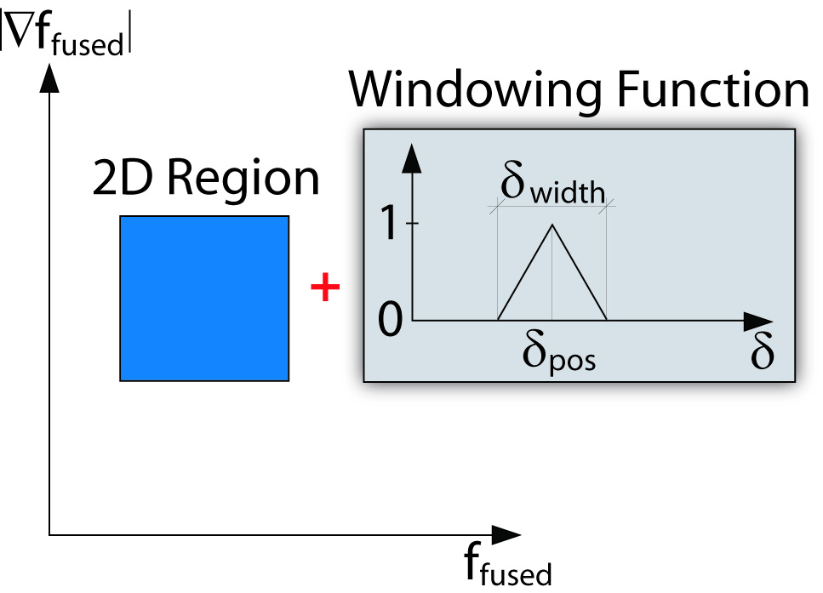
Information-based TF Classification
Simplification of transfer function space
Windowing function modifies opacity
Simplification
2D Transfer Function +
1D Windowing Function
3D Transfer Function
Notes:
The three values would normally define a 3D transfer function space as shown on the left. The problem with such a transfer function space is the degree of freedom for the definition of a transfer function space. Therefore it is better to simplify the transfer function space into a 2D transfer function space with the fused value and fused gradient magnitude as the 2 dimensions. To integrate the delta value in this transfer function space for each region an additional 1D transfer function is defined. This additional transfer function is defined by a simple windowing function and is just used to modify the opacity as defined by the 2D region. The color is not modified by this windowing function.

Slide 17
Implementation
Notes:
Now I have explained all necessary steps for the creation of the information-based transfer function space. Before I show you some results I will briefly explain the implementation of the approach. The diagram shows all steps which have to be computed for each sample point during the raycasting. The bluish nodes are lookups and the reddish nodes are calculations. All necessary tables for the lookups can be calculated before the rendering and therefore a real-time frame rate can be reached. The parameters for the windowing function are stored in a separate lookup table because they lookup table for the 2D transfer function is already used for the color and opacity. As input we get always two values from the two different modalities and as output we get a single color and opacity value.

Slide 18
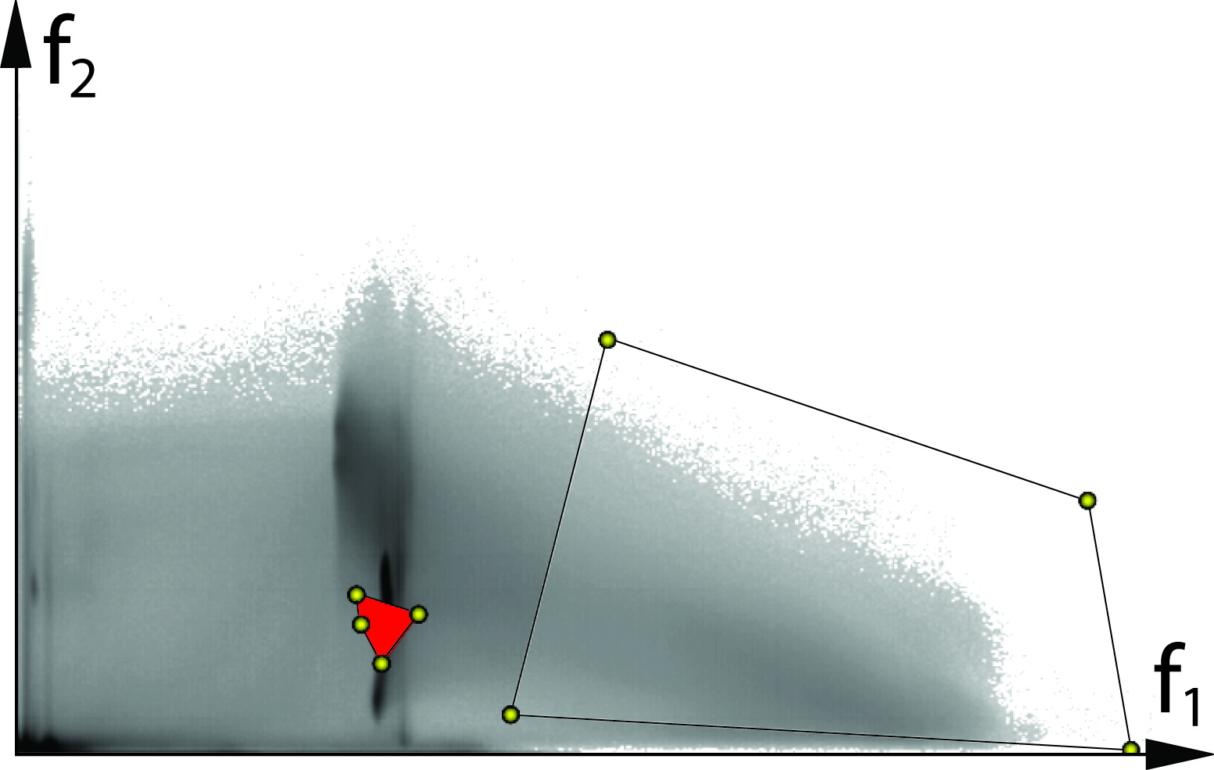
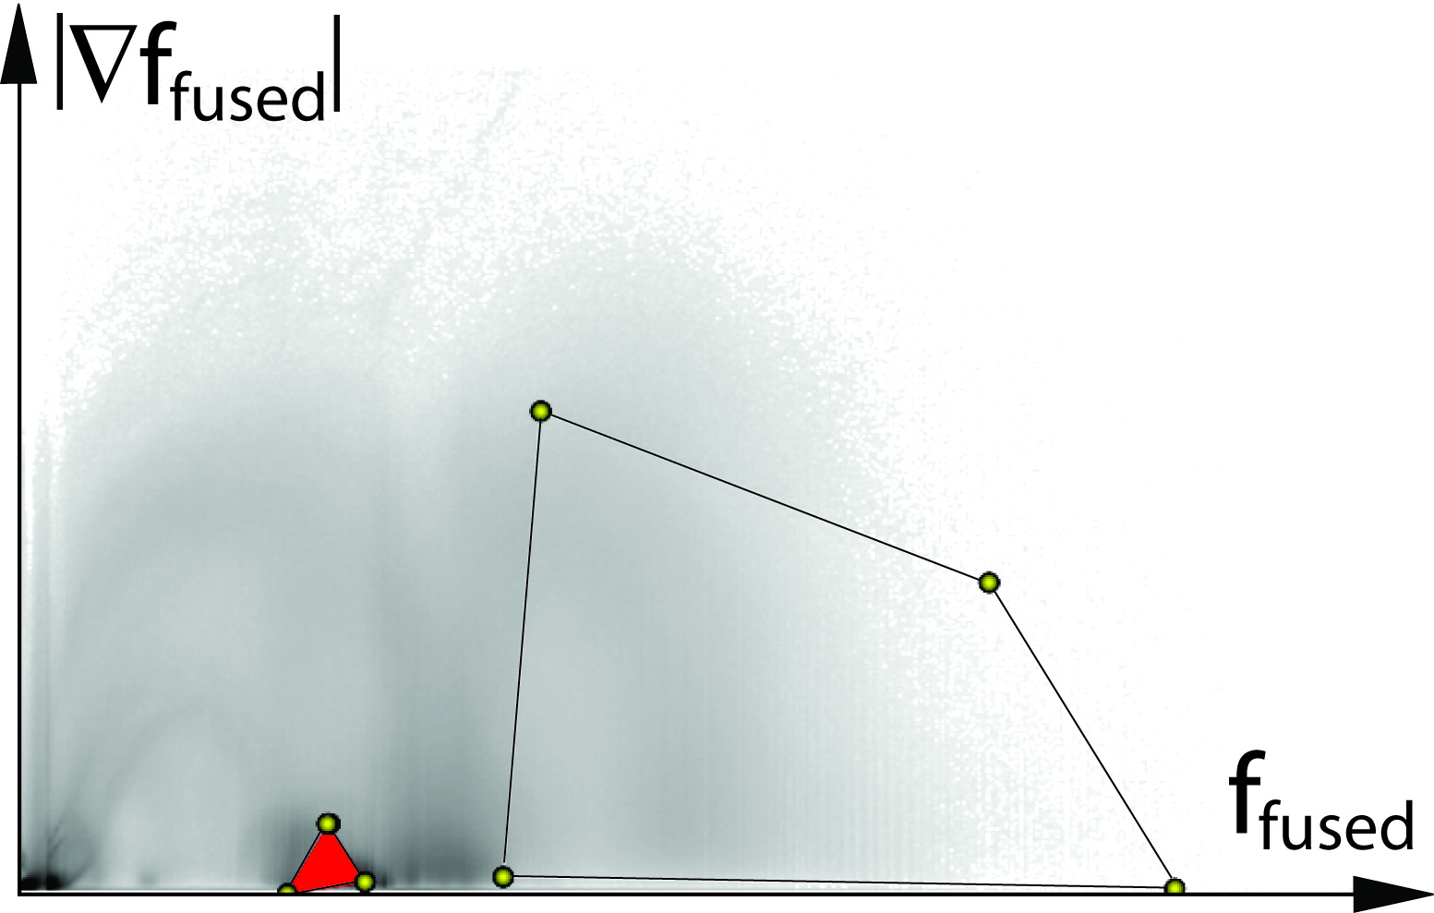
Results
Dual
Fused
Notes:
Finally I want to show you some results which were produced by our method. Here on this slide you see a comparison of our transfer function space on the right with the dual histogram on the left.
The dual histogram space is often used to define a transfer function for multimodal visualization. The drawbacks in comparison to our method are the missing similarity to known transfer function spaces from single modality visualization and that only the intensity values are considered for the transfer function assignment. With our approach also the gradient magnitude is used and therefore tissues are better to separate from each other.
For the examples on the slide a user had the task to find a transfer function which shows the brain and the bones of the head together. The regions in the different histograms show the final settings for the transfer functions. With the new method the user were able to separate the brain much better in comparison to the dual histogram space where also a lot of artifacts are classified together with the brain.

Slide 19
Results
Without Windowing Func.
With Windowing Func.
Notes:
The result before has just shown the region in the fused transfer function space. This result shows the additional influence of the windowing function for the delta value. On the left no windowing function is used. For the result on the right the windowing function is adjusted to separate the brain. With this adjustment most of the artifacts can be removed in a very simple way.

Slide 20
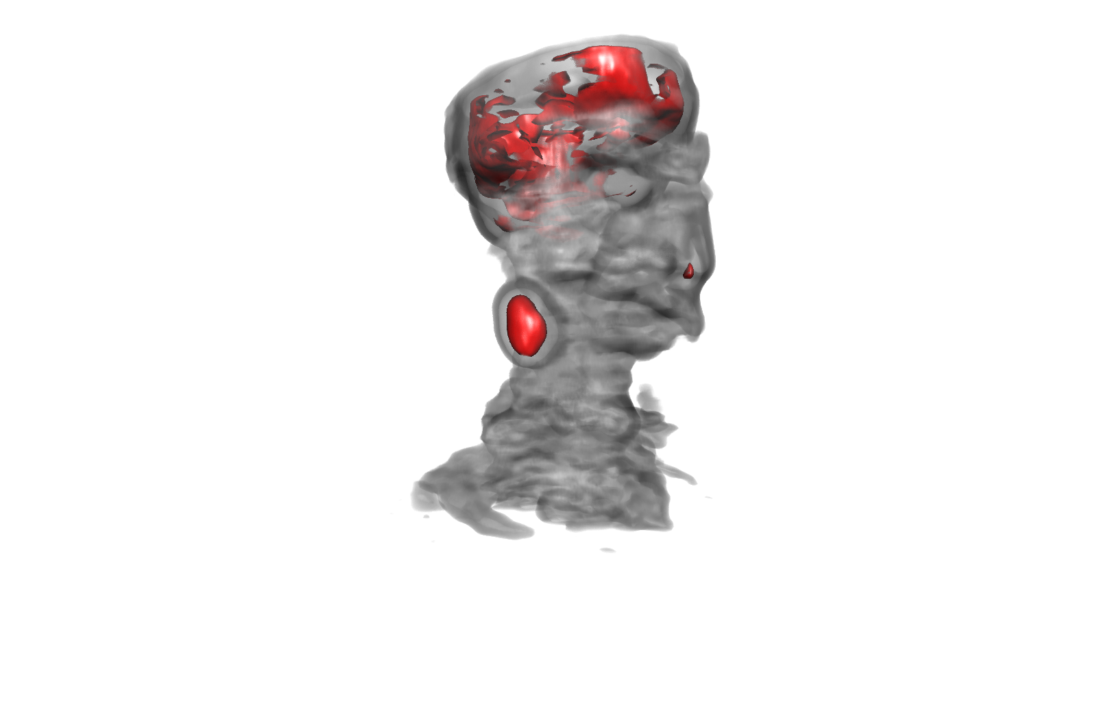
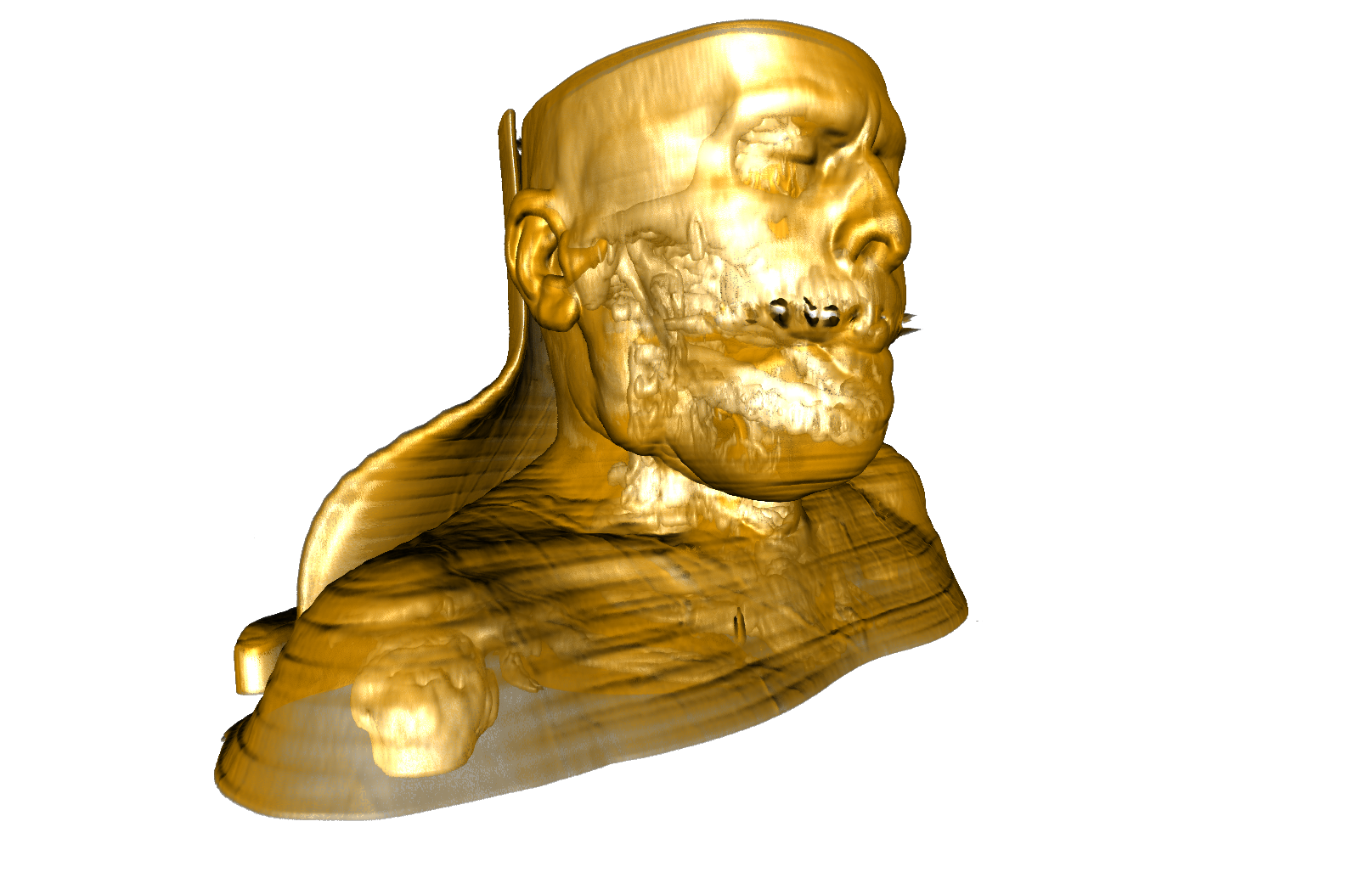
Results
CT
PET
Notes:
This result shows the combination of a function with an anatomical modality. As functional modality a PET scan was used and as anatomical modality a CT scan was used. The two images show the result when both modalities are visualized individually. For the PET data set it is hard to locate the region of high activity in relation to the anatomy. By the fusion of both data sets with our method we get this result. Now the regions of high activity can be easily located in relation to the anatomy. This visualization can be helpful for the operation planning for the tumor in the neck.

Slide 21
Results
CT + MRI
Notes:
As a final result I want to show another combination of a CT and MRI scan. In this example a tumor is located inside the brain. To highlight such a small region the mutual information value delta is very helpful because this value is higher for this region because the combination of intensity values in the tumor region is quite rare in the brain and therefore the delta value is higher. So the windowing function can be used to locate such a region and separate it from the rest of the brain.

Slide 22
Conclusion
New transfer function space for multimodal visualization based on information content
Fused transfer function space is more intuitive compared to dual histogram
Similarity to individual transfer function spaces
Additional mutual information for better separation of different tissues
AGFA applied for a patent
More user studies has to be done with radiologists
Notes:
Finally I want to wrap up everything in a short conclusion. In this talk I have shown a new transfer function space for multimodal visualization based on the information content. The benefit of the fused transfer function space is that it is more intuitive compared to the dual histogram because it is similar to the individual 2D transfer function space of both modalities. Additionally a quantity for opposite information was introduced which can be used to better separate different tissues.
The method has already been applied for a patent by AGFA. At the moment we are integrating the method in their system to do more user studies with radiologists.

Slide 23
The End
Thank you for your attention!
Notes:
This brings me to the end of my talk. I thank you for your attention and would be happy to answer your questions.

