Slide 1
186.162 Seminar (mit Bachelorarbeit) 186.175 Seminar aus Computergraphik WS 2008
Organizers: Muddassir Malik, M. Eduard Gröller
Teaching staff: Erald Vuçini, Peter Rautek, Peter Kohlman, Martin Haidacher, Maurice Termeer
Institute of Computer Graphics and Algorithms
Vienna University of Technology

Slide 2
Seminar
Mission statement "Write a scientific state of the art report"
Tasks
Literature list
Written report
GMA lecture of Prof. Werner Purgathofer
Talk
Active discussion participation

Slide 3
Written Reports
8 (186.175) or 15 (186.162) pages per student
Preferably in English
Format reports in the style of a scientific paper
Use LaTeX
Some reports from the previous year available
Students can work in groups of two

Slide 4
Talk
Use Institute’s PowerPoint template for presentations
20 + 5 minutes talk
In English
Active discussion participation is mandatory and will be graded

Slide 5
Important Dates
List of literature due on:
21st October, 2008
GMA lecture on:
24th Nov, 2008. 17:00 – 18:30, FH Hörsaal 6
Written reports due on:
6th December, 2008
Presentations on:
18th December, 2008 from 9:00 to 18:00 in the Seminar room of ICGA
Notes:
24th Nov, 2008. 17:00-18:30, FH Hörsaal 6

Slide 6
Topics
3D Programming for Everyone
Compressed Sensing
Evaluation of Open Source Software for Medical Visualization
PACS-Picture Archiving and Communication System
Plasma Rendering
Scanning Technologies
Tomorrow's Digital Photography
Tomorrow's Photoshop Effects
Volume Rendering
Multi-resolution Volume Rendering
Volume Rendering of Unstructured Point Sets
Volume Visualization on Mobile Devices

Slide 7
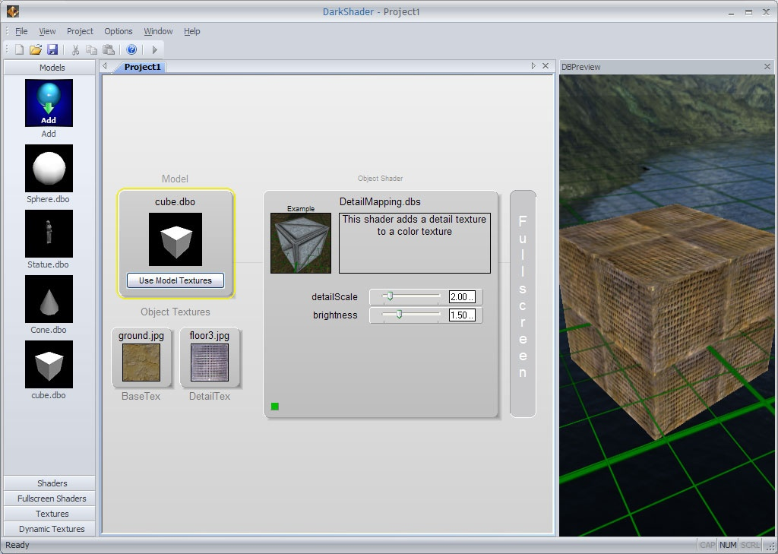
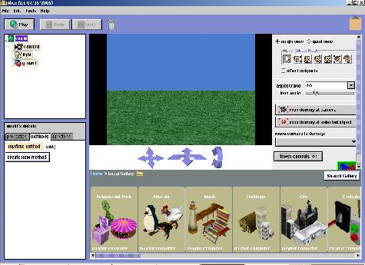
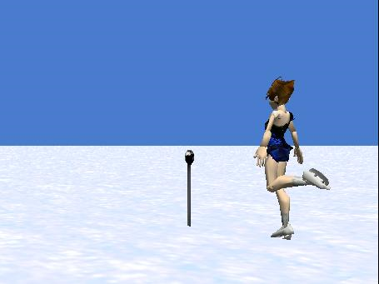
3D Programming for Everyone
Alice
3D Gamemaker, DarkBASIC Professional
3D Rad

Slide 8
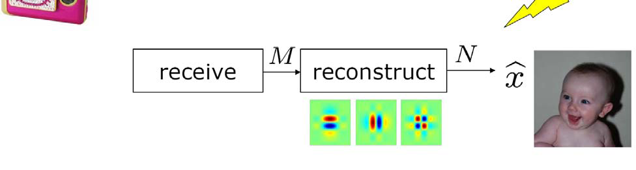
Compressed Sensing
Role of transform coding in data acquisition
condenses the signal directly into a compressed representation
Skips the stage of taking samples

Slide 9
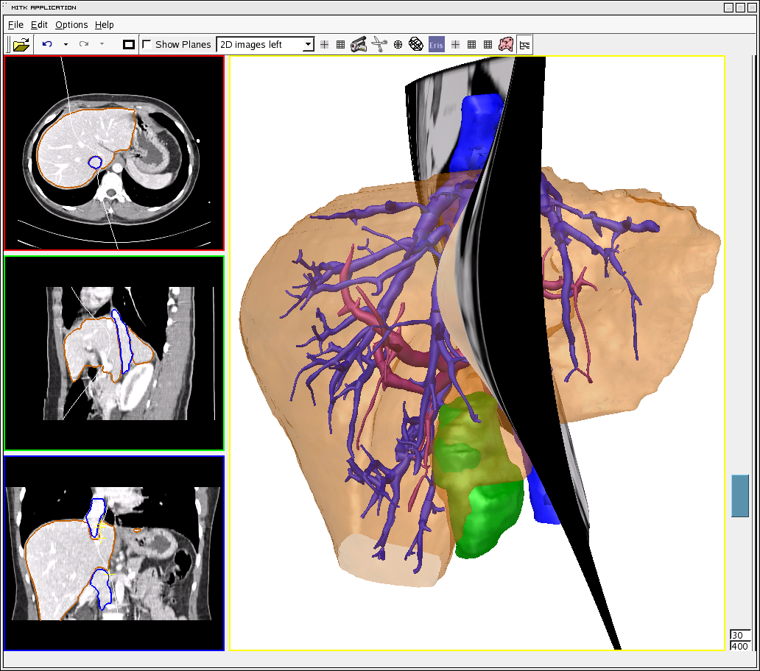
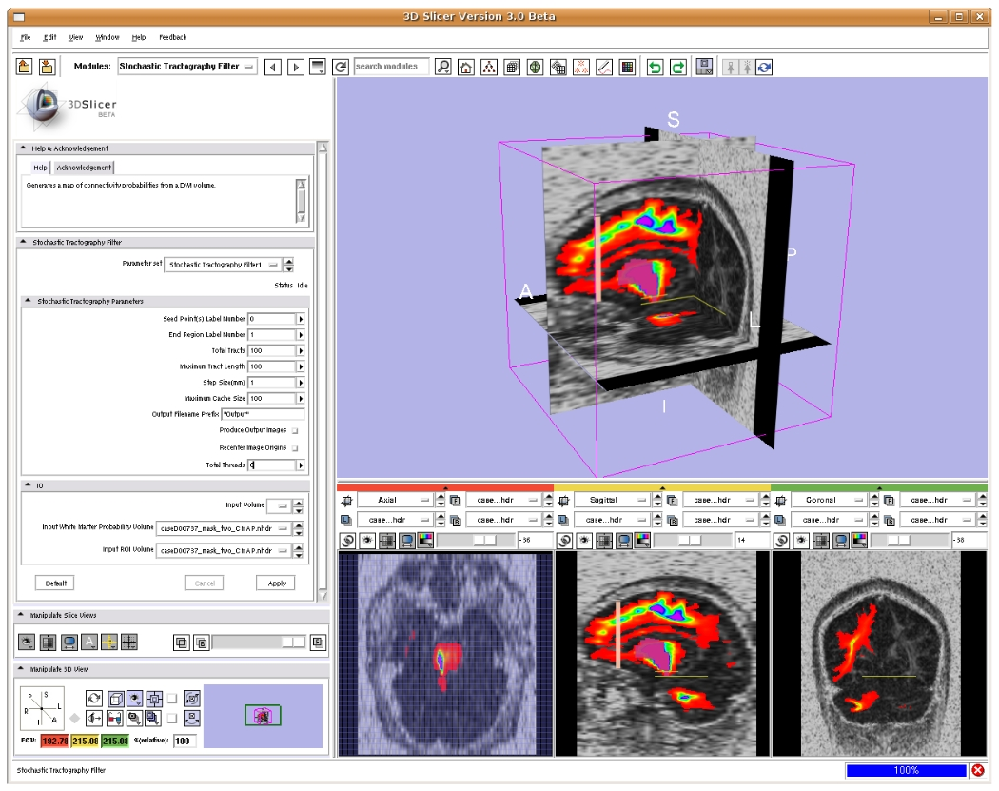
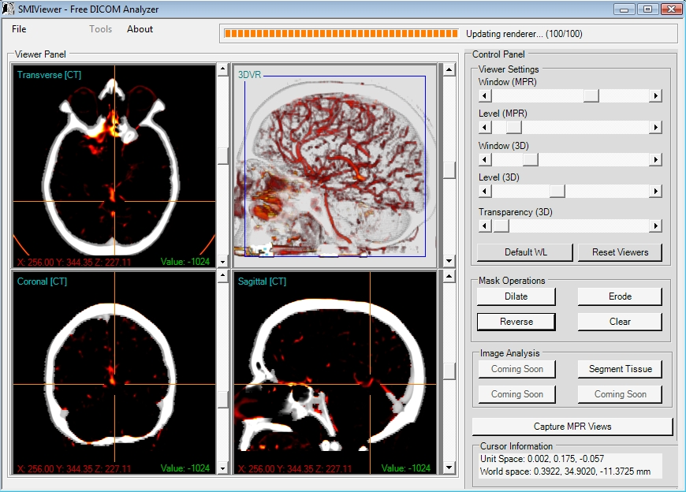
Evaluation of Open Source Software for Medical Visualization
Commercial and open source software
Evaluating visualization and interaction capabilities, as well as extensibility

Slide 10
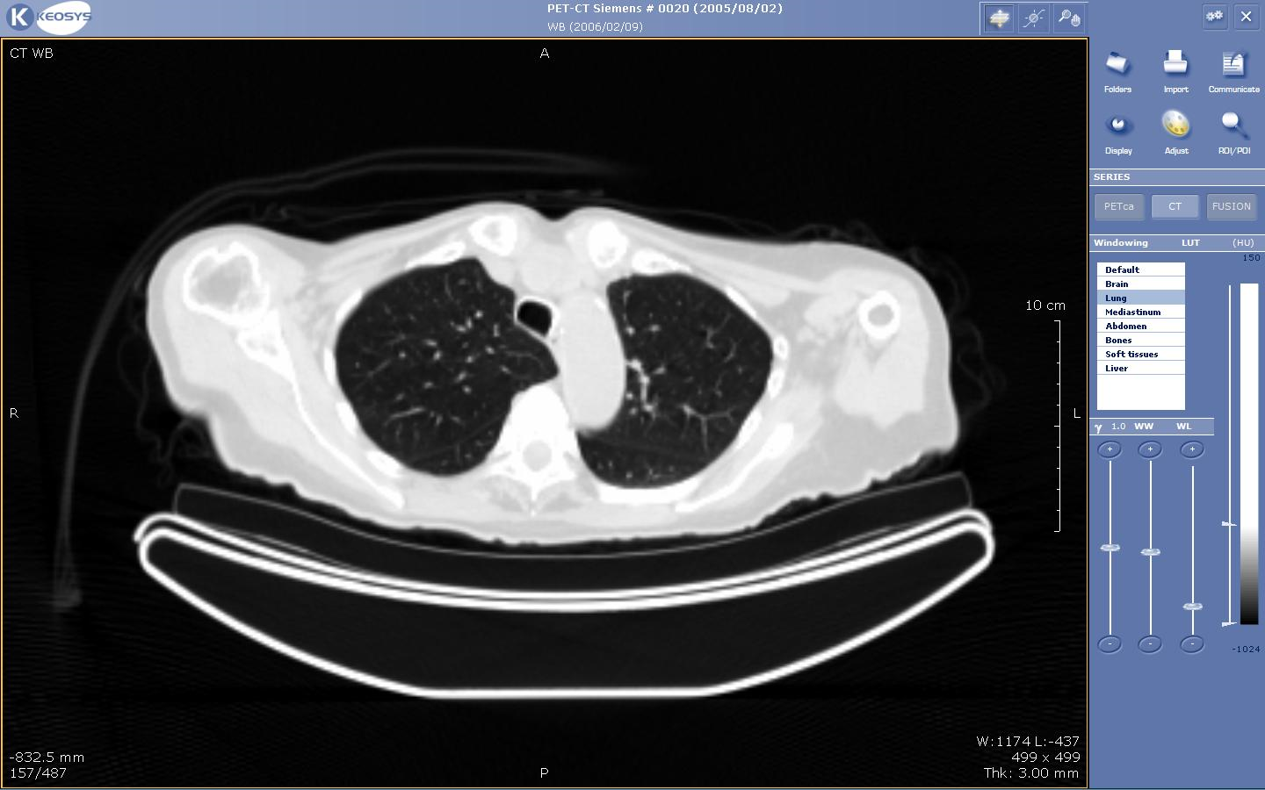
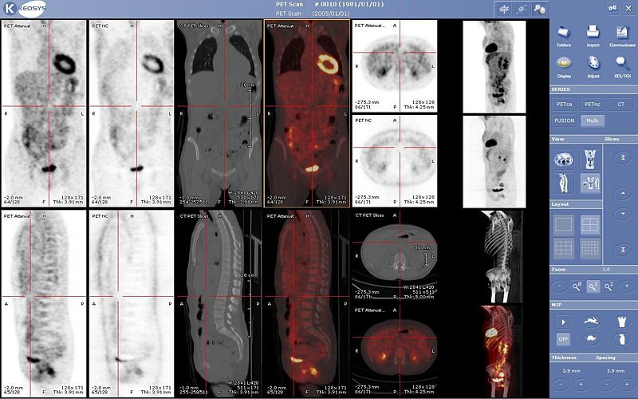
PACS - Picture Archiving and Communication Systems
Used for the entire medical process
A number of tools for preprocessing the data
Survey on functionality and comparison of PACS

Slide 11
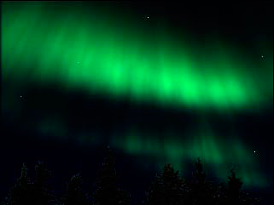
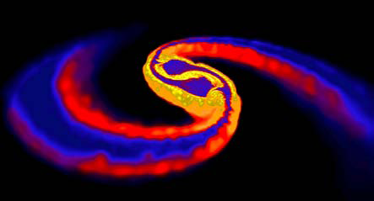
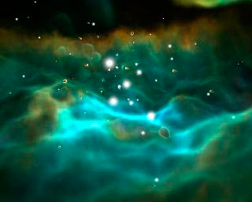
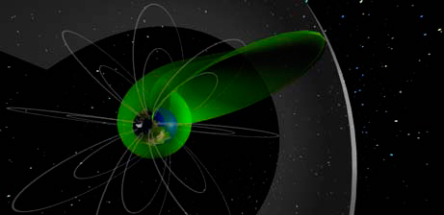
Plasma Rendering
Plasmas are ubiquitous in the Universe
Neutron Collision, Aurora, Magnetic Field, Lighting, Solar Storms, Black Holes

Slide 12
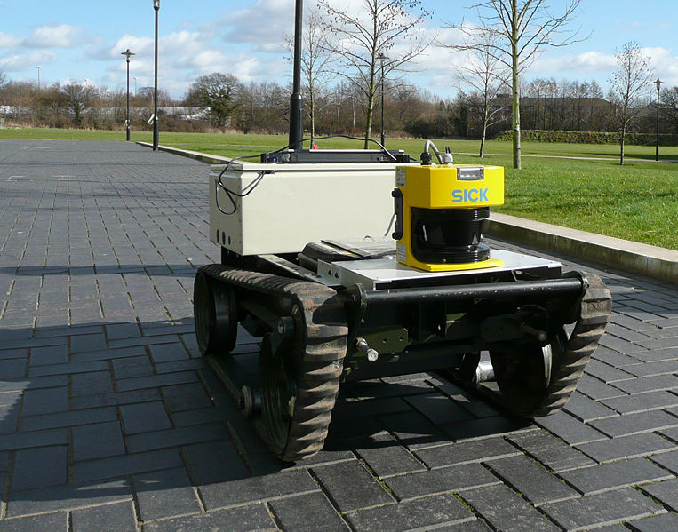
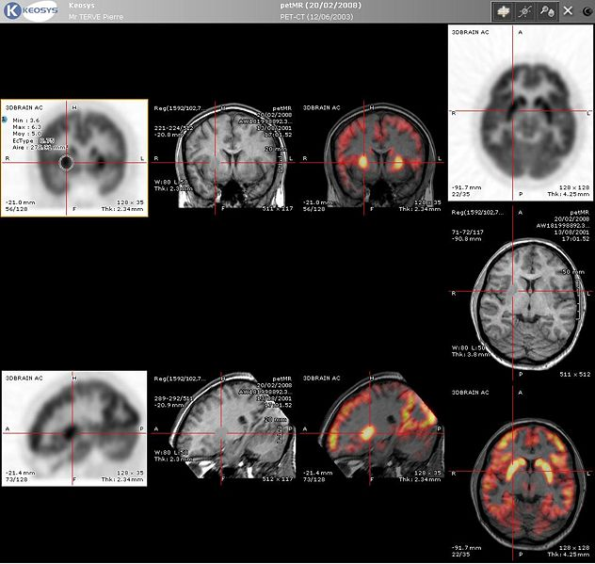
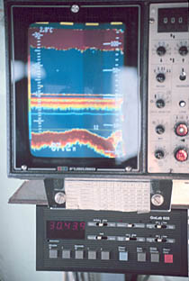
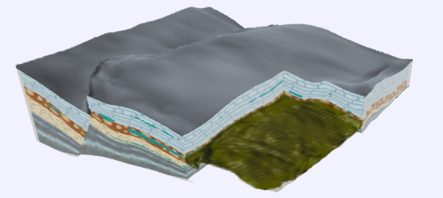
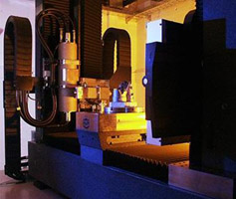
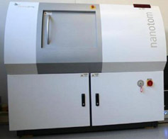
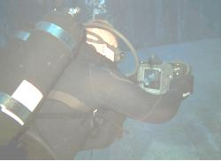
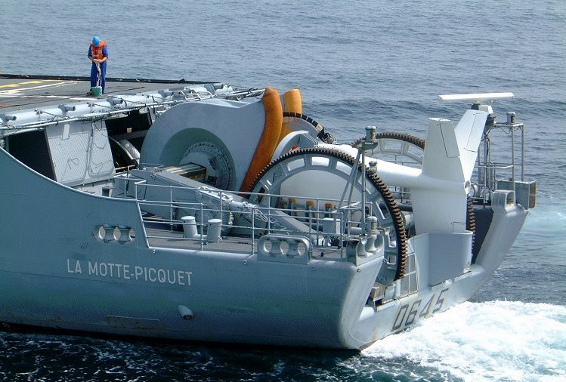
Scanning Technologies
Various options, different advantages
CT, MRI, PET, Sonar, Time-of-flight 3D laser scanner, Lidar

Slide 13
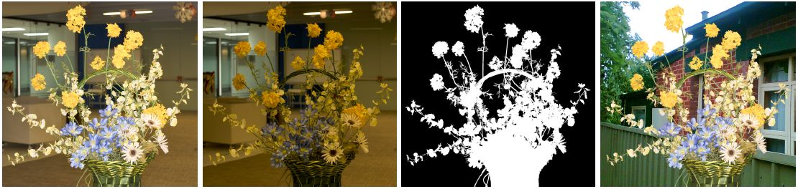
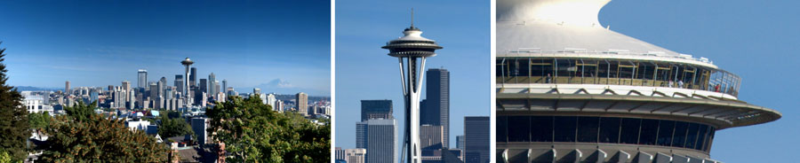
Tomorrow's Digital Photography
High tech cameras available for low budget consumers
New features for next generation cameras

Slide 14
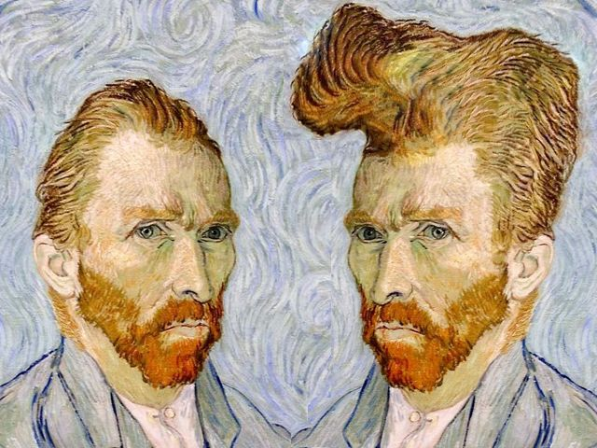
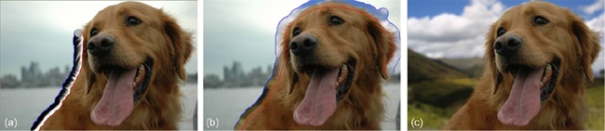
Tomorrow's Photoshop Effects
Photoshop
Wide range of standard features
More advanced features are being added
Next generation effects for photoshop

Slide 15
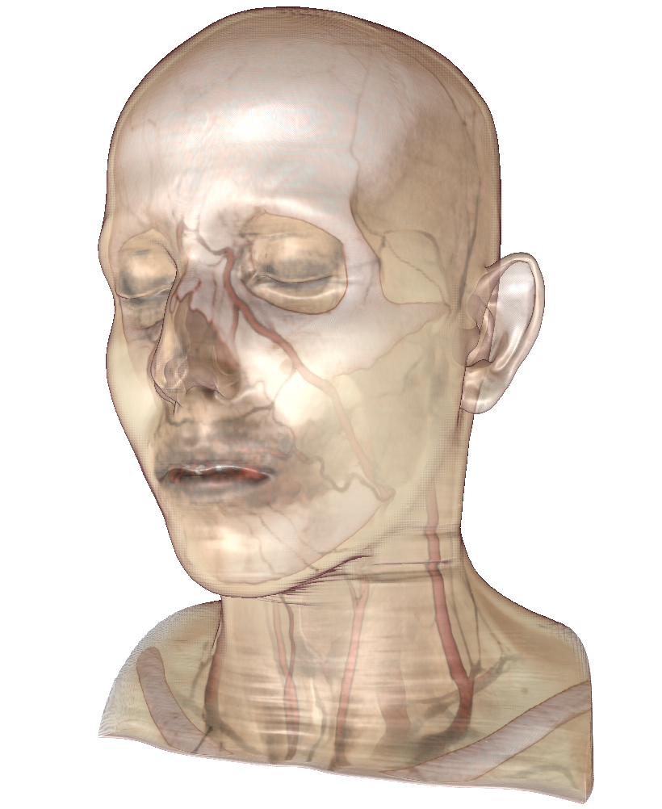
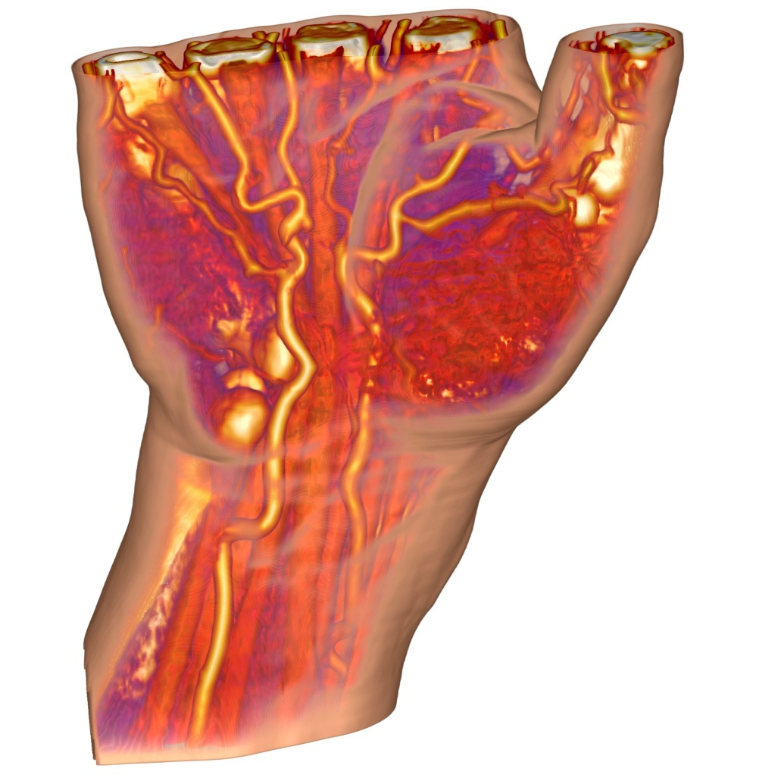
Volume Rendering
Direct visualization of 3D scalar field
Mapping intensity values to visual properties

Slide 16
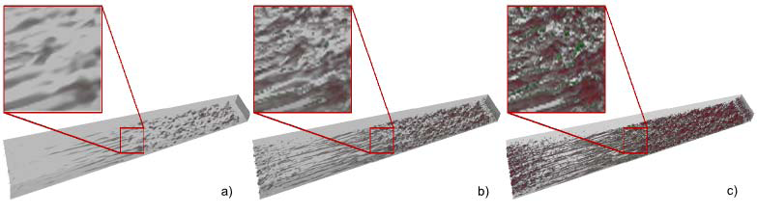
Multi-resolution Volume Rendering
Resolution exceeding displaying capability
Non-Uniform representation required
Multi-resolution rendering for Non-Uniform datasets

Slide 17
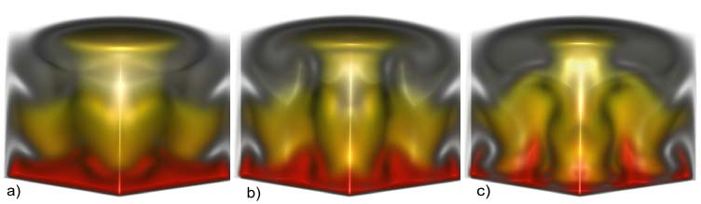
Volume Rendering of Unstructured Point-Sets
Unstructured volume data arises from
structural dynamics, fluid mechanics , thermodynamics, shock physics

Slide 18
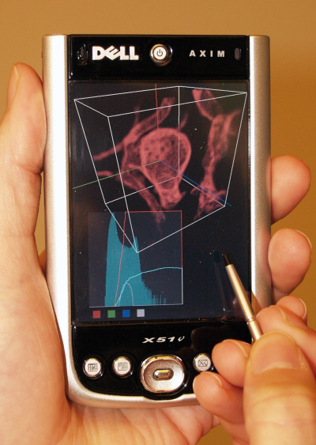
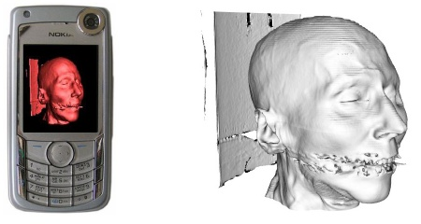
Volume Visualization on Mobile Devices
Limitations like:
small screen space
hardware restrictions
available interaction methods.
Evaluate the current state of the art

Slide 19
A very short introduction to LaTeX
LaTeX

Slide 20
A very short introduction to LaTeX
„Programming“ a text document
Similarities to HTML
No WYSIWYG
Most convenient to use a LaTeX distribution and a LaTeX IDE (integrated development environment)
Notes:
What You See Is What You Get

Slide 21
A very short introduction to LaTeX
First install a LaTeX Distribution
MiKTeX
Then a LaTeX IDE
TeXnicCenter
Texmaker
LEd

Slide 22
A very short introduction to LaTeX
MiKTeX
"Basic MiKTeX" Installer
Adds the MiKTeX \bin directory to the PATH

Slide 23
A very short introduction to LaTeX
Extract the archive acmsiggraph.zip
Open a command line window
Go to the directory where template.tex is
On command line type: epstopdf sample.eps
In LaTeX IDE open template.tex
Change all sample.eps to sample.pdf
Produce PDF document
In TeXnicCenter open template.tex
Select LaTeX=>PS output profile
Produce a PS document
Convert PS to PDF using Adobe Distiller

Slide 24
A very short introduction to LaTeX
Work with 2 files:
A .tex file for the text
A .bib file for the bibliography which is used by the citations command \cite

Slide 25
Seminar
Questions?
http://www.cg.tuwien.ac.at/courses/Seminar/index.html
mmm@cg.tuwien.ac.at

