Slide 1
Volume Rendering
Leonid I. Dimitrov and Miloš Šrámek
Austrian Academy of Sciences
Notes:
Frequently, presenters must deliver material of a technical nature to an audience unfamiliar with the topic or vocabulary. The material may be complex or heavy with detail. To present technical material effectively, use the following guidelines from Dale Carnegie Training®.
Consider the amount of time available and prepare to organize your material. Narrow your topic. Divide your presentation into clear segments. Follow a logical progression. Maintain your focus throughout. Close the presentation with a summary, repetition of the key steps, or a logical conclusion.
Keep your audience in mind at all times. For example, be sure data is clear and information is relevant. Keep the level of detail and vocabulary appropriate for the audience. Use visuals to support key points or steps. Keep alert to the needs of your listeners, and you will have a more receptive audience.

Slide 2
Overview
Volume visualization
Volume viewing
Volume visualization by mapping
  Transfer functions & segmentation
Direct volume rendering
  DVR techniques, compositing
DVR algorithms
  Splatting, ray casting, isosurfacing

Slide 3
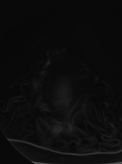
Volume Data
A spatial sequence of 2D images – slices
Produced by
  3D scanners (tomographs)
    Different physical background
    Different and complementary properties
  Simulation

Slide 4
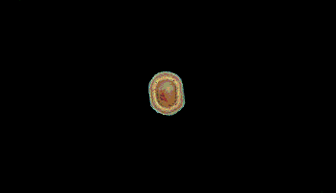
Volume Data
A spatial sequence of 2D images – slices
Produced by
  3D scanners (tomographs)
    Different physical background
    Different and complementary properties
  Simulation

Slide 5
Volume Visualization
Visually perceivable data presentation
Understanding, not photorealism
Simple volume viewing
  Straightforward presentation of measured data
Mapping techniques
  Measured densities are mapped to visual attributes (transparency, color)
Measured Data
Rendering
Images
Measured Data
Mapping
Measured Data
Rendering
Images
Derived Data

Slide 6
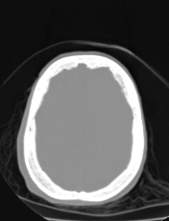
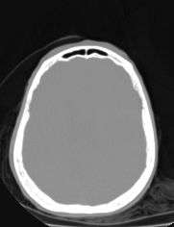
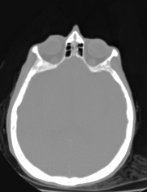
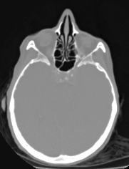
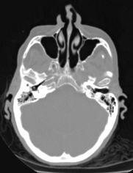
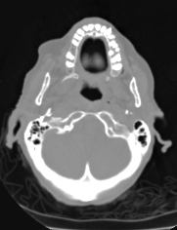
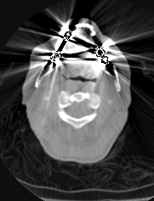
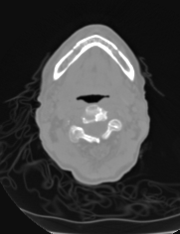
Volume Viewing (1)
Slice-by-slice viewing

Slide 7
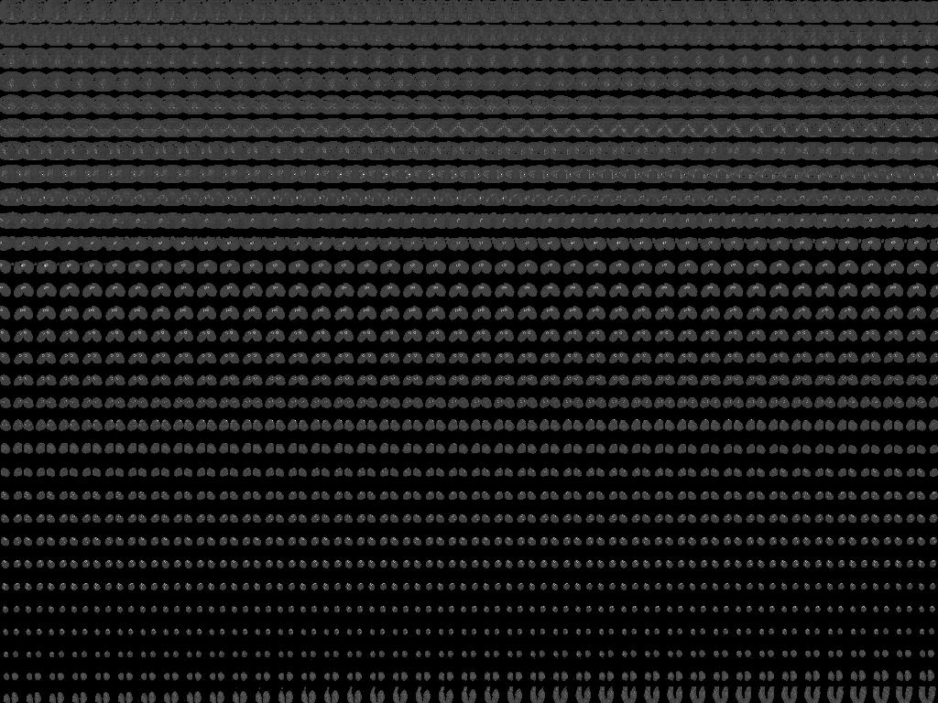
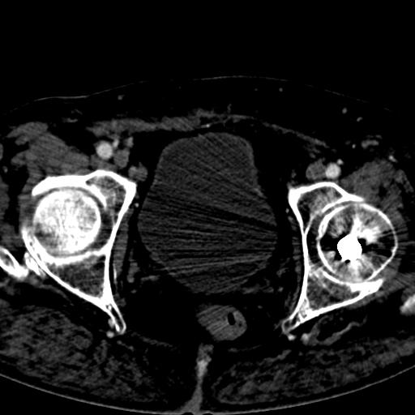

Slide 8
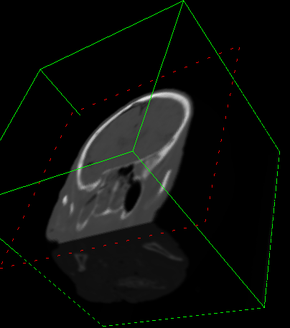
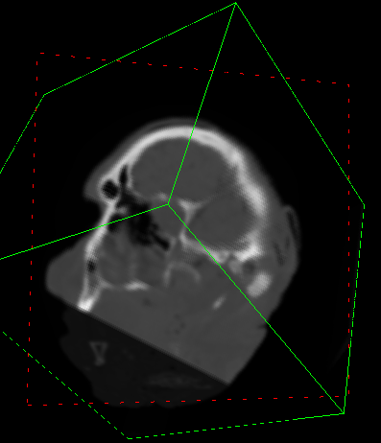
Volume Viewing (2)
Multiplanar reconstruction
  Definition of new cutplanes
Axis aligned
Oblique

Slide 9
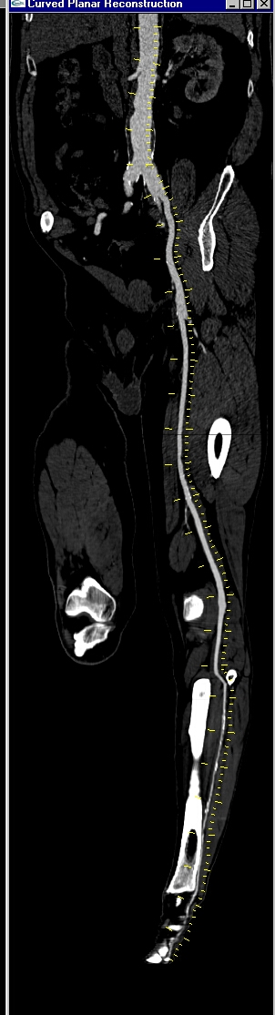
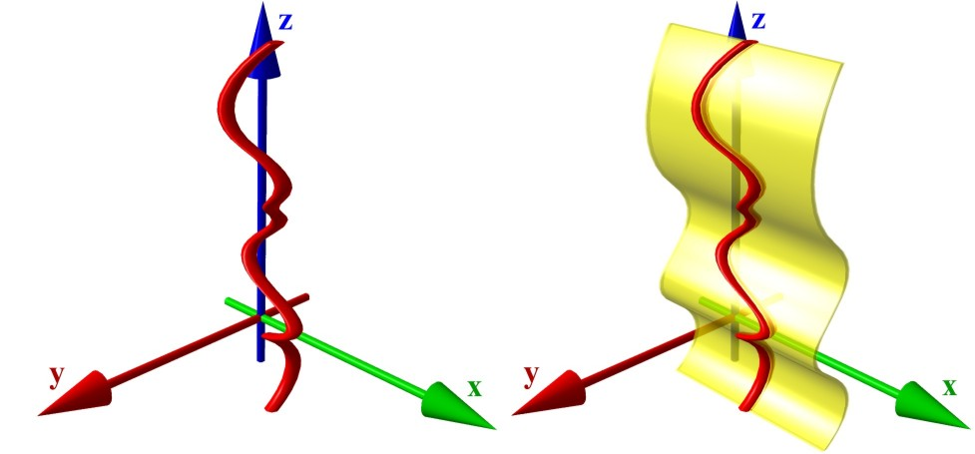
Volume Viewing (3)
Curved planar reconstruction
  Volume cutting along a line
Kanitsar 2002

Slide 10
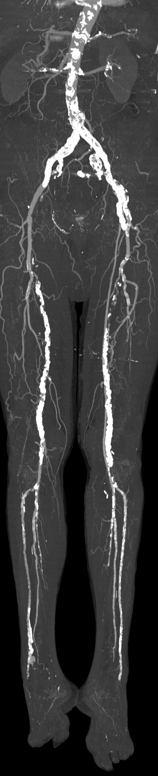
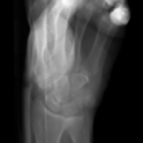
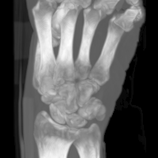
Volume Viewing (4&5)
Reprojection
  Add all values along a viewing ray
  Simulation of X-ray projection
Maximum intensity projection
  Register the brightest value along a viewing ray
  Suitable for thin structures

Slide 11
Overview
Volume visualization
Volume viewing
Volume visualization by mapping
  Transfer functions & segmentation
Direct volume rendering
  DVR techniques, compositing
DVR algorithms
  Splatting, ray casting, isosurfacing

Slide 12
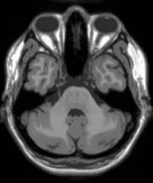
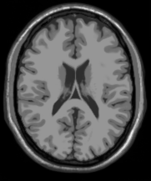
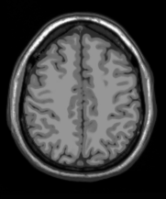
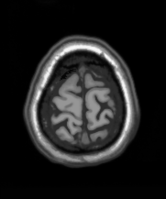
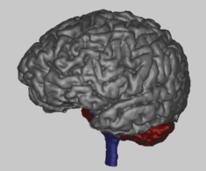
Volume Visualization by Mapping
Data Acquisition
CT, MRI, USG, PET, SPECT
Mapping
Visual attributes
Rendering
Surface & Volume Techniques

Slide 13
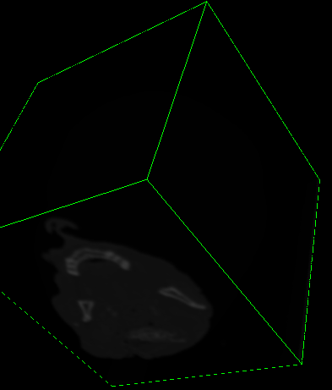
Why Do We Need Mapping?
No visual representation readily exists for 3D data
Area of interest is occluded by the black background
We need something to make the background transparent

Slide 14
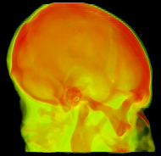
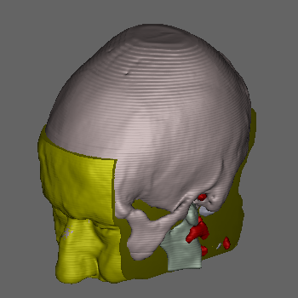

Mapping
Mapping: Assignment of visual attributes to data:
  transparency, color, reflectance, surface strength...
“Area of interest” specification achieved:
Density-based
classification
Space-based
segmentation
Combined

Slide 15
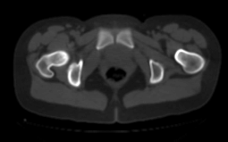
Mapping by Density Classification
Assumptions:
  Areas of interest can be identified solely by density value
  Neighbors in histogram are neighbors in space
air
muscles
Histogram
of tissues
# of voxels
fat
bones
Density
# of voxels
Data
histogram
Density
CT scan of a human pelvis

Slide 16
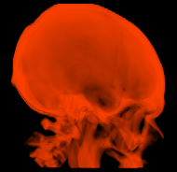
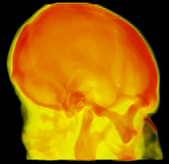
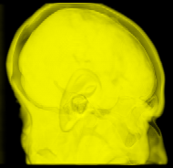
Density Classification by Transfer Functions
Bone only
R,G,B,α
Density
Bone & soft
Soft only
R,G,B,α
R,G,B,α
Density
Density

Slide 17
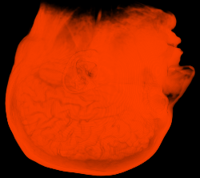
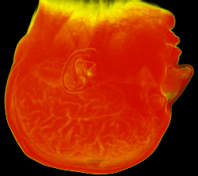
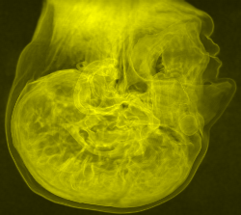
Transfer Functions with General Data
MRI Data:
The histogram/position model not fulfilled
No TF can separate the tissues
Additional info required
R,G,B,α
Density
R,G,B,α
R,G,B,α
Density
Density

Slide 18
Mapping: Summary
Transfer function based:
  Color & transparency assigned to voxels
  Semitransparent volumes
  Display of volumes
Segmentation-based
  Unambiguous object definition
  Color & transparency assigned to objects
  Display of surfaces
(
not used for classification of rendering techniques
)

Slide 19
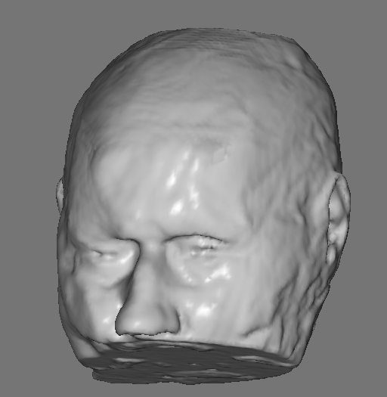
Classification of Rendering Techniques (1)
Based on the basic rendering primitive
Surface rendering
Basic primitive: 2D patches (polygons)
Extra data structure: a surface model
Decoupling of the model and the data
Rendered by standard CG approaches
Triangulation by the
Marching Cubes technique,
approx. 200000 polygons

Slide 20
Classification of Rendering Techniques (2)
Volume rendering
Basic primitive: the voxel itself
Rendering directly from volume data:
Two flavors:
  TF based: Direct volume rendering (DVR)
    Semitransparent data, all volume samples potentially contribute to the image
  Segmentation (object) based: Isosurfacing
    Hard surfaces, only visible surfaces are displayed

Slide 21
DVR vs. Isosurfacing
Isosurfacing is a limit case of DVRs with special TF and parameter setting
Isosurfacing
DVR

Slide 22
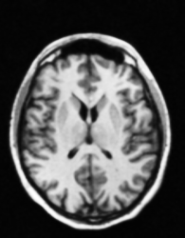
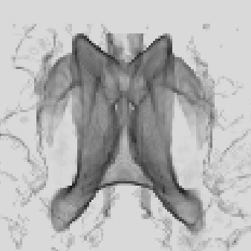
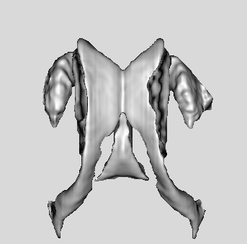
When to Prefer DVR?
Low data contrast, weak edges, thin objects
MRI head data:
Ventricles &
deep brain
structures
DVR
Isosurfacing

Slide 23
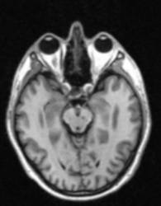

When to Prefer Isosurfacing?
Numerous & complex objects, TFs make no sense
MRI data
DVR
Object labels
Isosurfacing with cutplanes

Slide 24
Overview
Volume visualization
Volume viewing
Volume visualization by mapping
  Transfer functions & segmentation
Direct volume rendering
  DVR techniques, compositing
DVR algorithms
  Splatting, ray casting, isosurfacing

Slide 25

DVR Basics
Simplified light interaction with semi-transparent material
Light attenuation and emission along a ray
No shadows, no reflections
Numerical evaluation:
  Per-segment compositing by Porter&Duff's operators
    Front-to-back order
    Back-to-front order
I(t): Light intensity at the point t
ρ(t): Optical density (attenuation)
ρ(t)I(t): Light attenuation at t
k(t): Chromacity
k(t)ρ(t):Light emission rate at t

Slide 26
DVR Techniques (1)
Free/adjustable parameters:
Transfer functions:
Edge accentuation:
Shading:
...

Slide 27
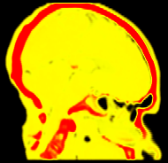
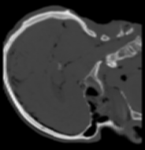
ρ(d), k(d): Transfer Functions
Chromacity k(d)
slice
ρ(d), k(d)
rendition
Density d

Slide 28
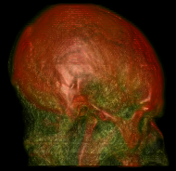
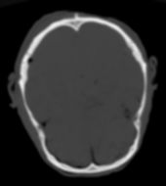
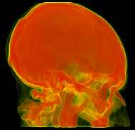
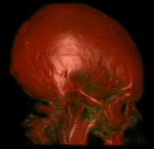
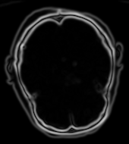
DVR Techniques (2)
No edge enhancement
Unshaded
Shaded
Edge enhancement

Slide 29
Rendering by Compositing
Interaction of light with matter results in absorption
  Beer-Lambert law:
Evaluation along a projection ray

Slide 30
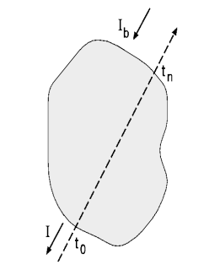
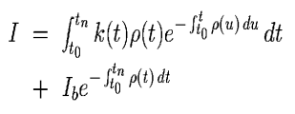
Volume Rendering Integral
Integral form of the Beer's law
Object transparency

Slide 31

Per Segment Evaluation of the VRI (1)
Opacity: amount of stopped light:
  opacity = 1 – transparency
Segment opacity:
  The amount of light stopped along a segment

Slide 32


Per Segment Evaluation of the VRI (2)
Break ray in segments, compute β and C
Front-to-back compositing
Back-to-front compositing
'under' operator
'over' operator
I – accumulated color
C- sample color
β- accumulated opacity
α- sample opacity

Slide 33
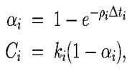
Approximations
Approximation of ρ and k by a constant:
Chromacity premultiplied by opacity
Scaling required with real data

Slide 34
Overview
Volume visualization
Volume viewing
Volume visualization by mapping
  Transfer functions & segmentation
Direct volume rendering
  DVR techniques, compositing
DVR algorithms
  Splatting, ray casting, isosurfacing

Slide 35
DVR Algorithms
Object-order algorithms (splatting)
  Projection of samples from volume to image
  Compositing in image plane
Image-order algorithms
  Ray casting based
  Sequence of samples along the ray
  Compositing along the ray

Slide 36
3D Discrete Space
3D grid point (sample):
P = [x, y, z], x, y, z ∈ Z
Value at sample P: density
Voxel:
  Voronoi neighborhood of P
  NN interpolation
Cell:
  8 samples
  higher order interpolation

Slide 37
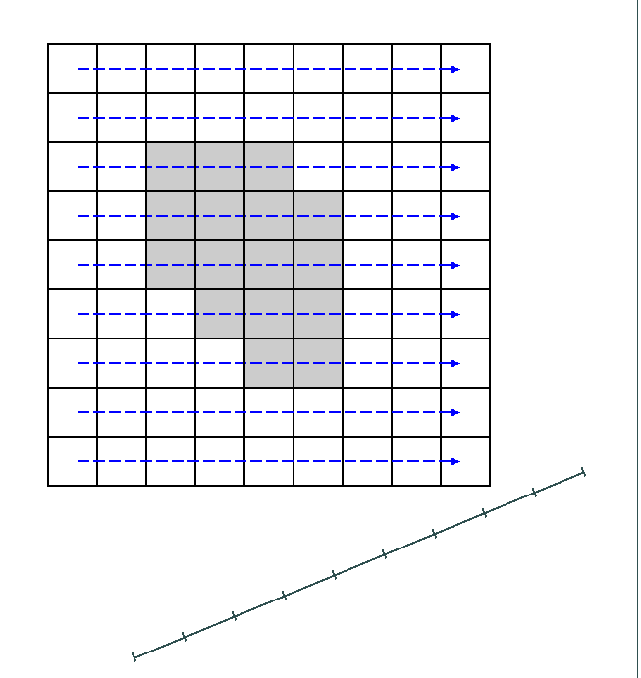
Object-Order VR: Splatting
Samples/voxels are projected (splatted) onto the viewing plane
Back-to-front of front-to-back order
One sample projects onto several pixels
Object Space - volume
Image

Slide 38
Splatting Footprint (Westover)
Sample represented as a cloud of particles
High resolution footprint table: computed only once
BTF, FTB compositing

Slide 39
Footprint table

Slide 40



Splatting artifacts (1)
Traversal order depends on viewing angles
The most parallel scanline to image is chosen
Popping artifacts:
scanline 2
scanline 1
[Mueller 1998]
image 2
image 1
rot=45°
rot=45.1°

Slide 41


Splatting artifacts (2)
image aligned
sheet-buffer
Image aligned sheet-buffer
No popping
[Mueller 1998]
rot=45°
rot=45.1°
image

Slide 42



HW Acceleration by Texture Mapping
Do the costly part by hardware
2D Textures
  compositing only
  volume aligned slices
  three copies of the volume required
3D Textures
  interpolation & compositing
  image aligned slices
Shading possible in fragment programs

Slide 43

Image Order VR by Ray-Casting (1)

Slide 44
Image Order VR by Ray-Casting (2)
Shoot rays from each pixel
Define a sequence of samples
Accumulate color and opacity along each ray
CPU and GPU implementations possible
Acceleration required:
  Adaptive sampling, empty space skipping, hierarchical subdivision, early termination

Slide 45
Isosurfacing Basics
Interpolation domain:
  Original densities
  Segmentation labels
Algorithms:
  (First hit) ray tracing
  Ray/surface intersections by numerical root finding
CPU and GPU implementa- tions possible
Acceleration required
Surface

Slide 46


Isosurfacing
Isosurface definition by interpolation & thresholding
Interpolation domain:
  Original densities
  Segmentation labels
Interpolation surface
within a single cell
(trilinear interpolation)
Triangulation by the MC
algorithm

Slide 47

Ray Casting Advantages
Simplicity and flexibility
Combination of techniques possible:
  DVR, isosurfacing, MIP, CPR, cutplanes
  per object definition of techniques and parameters

Slide 48


Ray Casting Advantages
Simplicity and flexibility
Combination of techniques possible:
  DVR, isosurfacing, MIP, CPR, cutplanes
  per object definition of techniques and parameters

Slide 49

Ray Casting Advantages
Simplicity and flexibility
Combination of techniques possible:
  DVR, isosurfacing, MIP, CPR, cutplanes
  per object definition of techniques and parameters

Slide 50
Conclusion
We have plentiful volume rendering techniques
We do not have enough memory
The computers are not fast enough
The doctors still prefer slice-by-slice viewing (but getting better recently...)

Slide 51
Thank you!
milos.sramek@oeaw.ac.at

